Slide 1






Slide 2
Clinico pathological conference
Presented by Surgical unit 2
Under supervision of Prof. Dr. M. Hassan Abbas
Presided by:
Dr. Iqra Hameed
(Postgraduate Trainee-General Surgery)
Aima Siddiqui
Noor ul ain Ashfaq
Usama Naseer

Slide 3

HISTORY

Slide 4
Biodata
  Amir Yaqoob, 26 year old
  Married, Muslim, Male
  Resident of Rahim Yar Khan
  presented to OPD, on 27th April 2024
Presenting complain
  Hearing loss since 3 years of age.
  Swelling in front of the neck – 07 years

Slide 5
History of presenting illness
My patient was in ususal state of health then at age of 7 month he started developing hearing loss which was gradual in onset and bilateral. He completely lost hearing at the age of 3 years. There was no history of trauma, URTI, noise exposure and antibiotics intake. There was delayed language development. There was no remission and no aggravating and relieving factors.

Slide 6
  Thyroid swelling was gradual in onset, painless, progressive in nature with no aggravating or relieving factors.
  There was history of weight gain, cold intolerance and constipation for 2 years.
  No palpitations, anxiety, tremors, diarrhea, weight loss, heat intolerance, sweating of palms, increase in appetite, or insomnia.
  No fatigue, dyspnea, depression, ankle swelling, hair loss, loss of concentration and loss of appetite.
  No hoarseness of voice, stridor, shortness of breath or any dysphagia.

Slide 7
Systemic history
´Central Nervous System: There were no complains of headache, vomiting, unconsciousness, neck stiffness, seizures, visual symptoms, ear discharge, earache, soar throat or any nasal discharge.
´Gastro Intestinal System: There was history of constipation for 2 years. There was no nausea, vomiting, abdominal pain, heart burn dysphagia, diarrhea, hematemesis, malena or jaundice.
´Respiratory System: There was no cough, sputum, hemoptysis, wheeze, chest pain.

Slide 8
´Cardiovascular System: There was no exertional dyspnea, orthopnea, paroxysmal nocturnal dyspnea, peripheral or central cyanosis of any kind.
´Genitourinary System: There was no dysuria, hematuria, pyuria, burning micturition or poly/oliguria.
´Endocrine System: There was history of weight gain and cold intolerance. There was no history of fatigue, dyspnea, depression, alopecia, ankle swelling, palpitations, anxiety, tremors, sweating of palms, insomnia and weight loss.
There was also no history of polyuria, polydipsia, polyphagia

Slide 9
Past medical and past surgical history
There was no history of previous ear surgery and any significant previous illness such as meningitis.
Family history
There was no family history of any thyroid pathology and deafness.
No history of diabetes, hypertension, tuberculosis, asthma or any other disease.

Slide 10
Personal history
The patient was not addicted to anything and had normal sleep and impaired bowel habits. He was known smoker for 4 years, 4-6 cigarettes per day.
socioeconomic history
The patient belonged to lower middle class and has cemented house and drinks tap water.

Slide 11
drug history
Patient had been on thyroxin 150ug per day for 2 months as prescribed by out door patient department.
No history of radioiodine therapy, lithium, aminoglycosides intake or other ototoxic drugs.
Also no history of any other recreational drugs or alcohol intake
allergy history
There were no known allergies

Slide 12
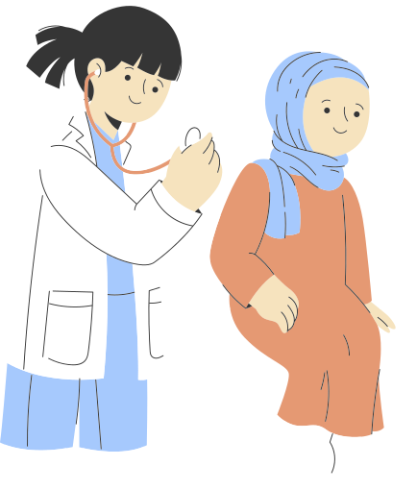
Examination

Slide 13
´A young, obese male , well oriented with time, place and person cooperative during the examination having IV cannula on the right hand with following vitals;
  ´Pulse Rate 75 bpm
  ´Blood Pressure 110/80 mmHg
  ´Temperature 97.1 F
  ´Respiratory Rate 15 bpm

Slide 14
general physical examination
´There was no koilonychia, leukonychia, osler nodes, janeway lesions, duptyrens contracture, heberdens nodes, palmer erythema or tremors.
´There were no palpable lymph nodes.
´Orodental hygiene was good.
´There was no periorbital puffiness or any kind of rash or parotid swelling.
´There was no lid lag, lid retraction or exophthalmos.
´There was also no pedal or sacral edema.

Slide 15
Local examination
Inspection
´There was a swelling in front of neck
10*15 cm in size
Nodular surface
Extending from adam`s apple to 1.5 cm above supra sternal notch
well defined margins
Moveable with swallowing but not with tongue protrusion
Overlying and surrounding skin is normal
No prominent veins
No scar marks
No pulsations or discharge.

Slide 16
Palpation
´Temperature of swelling was comparable to the surrounding.
Non tender.
´No trachea shift.
´Size was 10*15cm
nodular surface
firm in consistency
well defined margins.
Overlying skin was mobile swelling was itself moveable over deep structures.
No signs of retrosternal extension on tracheal compression

Slide 17
percussion
There was no retrosternal extension.
Auscultation
There was no audible bruit.
lymph node examination
No cervical lymph nodes were not palpable.

Slide 18
Systemic Examination
Cardiovascular Examination
The apex was located in 5 th Intercostal space just medial to mid-clavicular line and is normal in character and volume. S1 and S2 were audible with no added sounds.
GIT Examination: Unremarkable.
Central Nervous System: Positive Woltman`s sign ( delayed relaxation phase of deep tendon reflex)
Respiratory System Examination:
There was normal vesicular breathing. There were no visible pulsations, scar marks, or striae.
The chest movements were symmetrical with no tracheal shift.
Percussion note was normally resonant throughout the chest.
There were no added sounds.

Slide 19
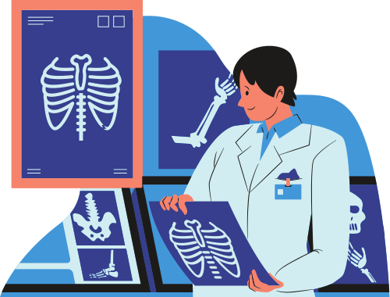
investigations

Slide 20
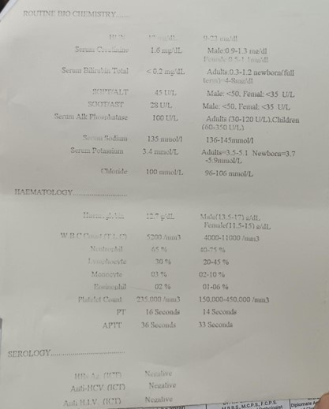
biochemical tests
Baselines were done along with;
  TSH,
  T3 and T4,
  Serum thyroglobulin

Slide 21
thyroid profile ( 2 months ago )
  Serum Total T4 --------------------------2.76 ug/dL (4.6-11 ug/dL)
  Serum Total T3 --------------------------55.85 ng/dL (70-204 ng/dL)
  Serum TSH ---------------------------------6.4 uIU/mL (0.4-4.5 uIU/mL)
pre operative
  Serum Total T4 --------------------------4.9 ug/dL (4.6-11 ug/dL)
  Serum Total T3 --------------------------110.62 ng/dL (70-204 ng/dL)
  Serum TSH ---------------------------------3.6 uIU/mL (0.4-4.5 uIU/mL)
  Serum Calcium = 10.4 mg/dl
  Serum Magnesium = 2.0 mg/dl

Slide 22
radiological
  ECG: Shows normal sinus rhythm
  Thoracic inlet X ray: No retrosternal extension
  Indirect laryngoscopy: Both vocal cords were mobile.
  CT Scan: Mondini Deformity ( Choclear hypoplasia & enlarged VA )
  Pure Tone Audiometry (PTA): Showed moderate to profound bilateral sensorineural hearing loss.
  ´FNAC: The FNAC report showed no malignant cells.
´

Slide 23
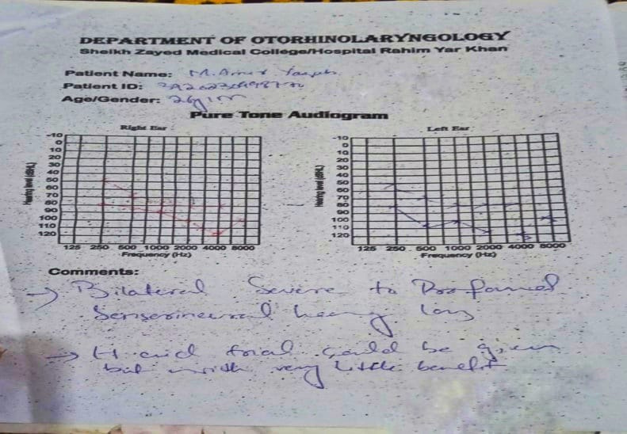

Slide 24
differential diagnosis
  Pendred Syndrome
  Congenital hypothyroidism with hearing impairment

Slide 25
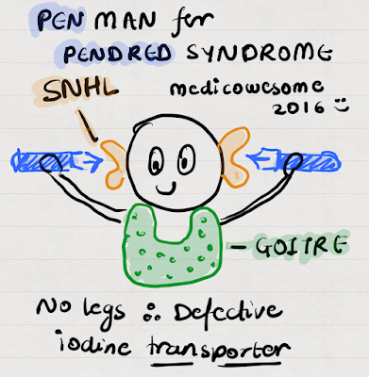
Pendred
Syndrome

Slide 26
introduction
´Autosomal recessive disorder
Characterized by;
  sensorineural hearing impairment
  presence of goiter
  partial defect in iodide organification
Goiter development and development of hypothyroidism are variable and depend on nutritional iodide intake.

Slide 27
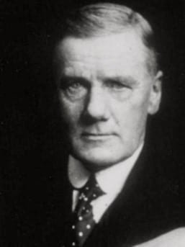
history
  In 1896, VAUGHAN PENDRED first described pendred syndrome as a combination of congenital deafness and goiter.
  Although this disease was described more than 100 years ago, it remain unknown to most clinical physicians and its diagnosis is certainly missed.

Slide 28
epidemology
  7.5-10 in 100000
  It accounts for approximately 10% cases of hereditary deafness.
  Most common cause of syndromic deafness

Slide 29
genetics
  Pendred syndrome is caused by biallelic mutations in the SLC26A4 gene, which encodes pendrin, a transporter of chloride, bicarbonate and iodide.
  This pendrin gene is located at Chromosome 7.
  Upto now, more than 100 different mutation have been identified in PDS gene.
  In many families, consanguinity is present.

Slide 30
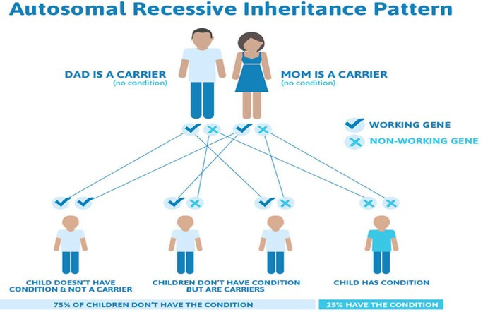

Slide 31
presence of pendrin
Located on 4 places in body:
  Inner Ear :
In cochlea and vestibule
Important for endolymphatic resorption, acid base balance and proper function of inner ear
  Thyroid gland
On thyrocyte apical membrane
Important for organification as it act as Cl-/I- exchanger

Slide 32
  Kidneys
At or near the apical membrane of type B and non A non B intercalated cells of CCD.
Important for BP regulation and flhid balance
  Bronchial Epithelium
At the apical membrane of bronchial epithelial cells
Regulate airway surface liquid thickness, helps in innate defense mechanism

Slide 33
steps of thyroid hormone synthesis
  Oxidation of iodide ion
  Organification
  Coupling
  Processed thyroglobulin endocytosis

Slide 34
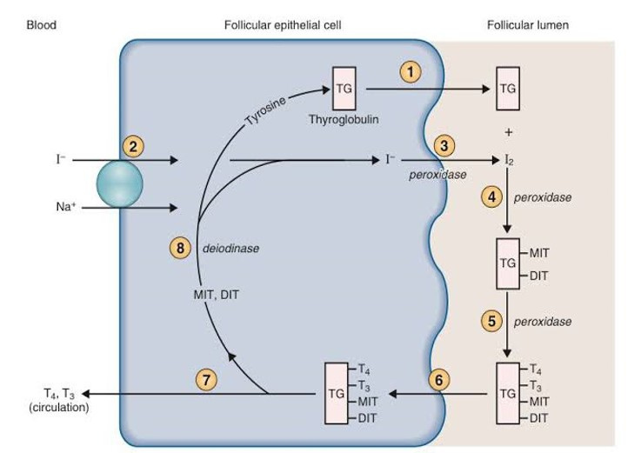

Slide 35
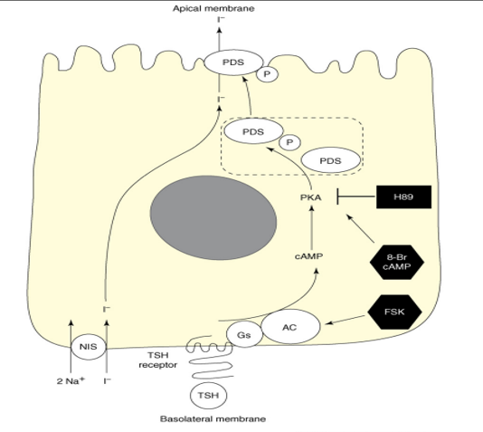
role of pendrin in thyriod hormone synthesis

Slide 36
´Several findings suggested that pendrin could be involved in mediating iodide transport into the follicular lumen and correspond to one of these channels.
  First, biallelic SLC26A4 mutations
  Second, experiments in Xenopus oocytes demonstrated that pendrin transports iodide and chloride.
  Third, pendrin is localized at the apical membrane of thyrocytes.
Experimental data supporting a role of pendrin in apical iodide efflux have been obtained in heterologous cell systems.

Slide 37
clinical features
´The following are symptoms of Pendred's syndrome:
  sensorineural hearing loss of varying severity and onset;
  goiter - an increase in the volume of the thyroid gland;
  impaired vestibular function causes vertigo and balance problems

Slide 38
  Goiter develops usually during childhood, but there is substantial intrafamilial and regional variation, and nutritional iodide intake appears to be a significant modifier of the thyroid phenotype.
  Under conditions of high iodide intake, thyroid enlargement may be very mild or absent, and hence these patients are often simply categorized as having (familial non-syndromic enlarged vestibular aqueduct ) EVA.
  Children who are born with Pendred syndrome may begin to lose their hearing at birth or by the time they are three years old. Usually, their hearing will worsen over time. The loss of hearing often happens suddenly, although some individuals will later regain some hearing.

Slide 39
investigtions
  Biochemical tests
TSH, T4, Thyroid antibodies and Serum Thyroglobulin
  Imaging
CT Scan and MRI
  Temporal bone imaging ( CT, MRI ); Shows Mondini deformity
It is detected on thin cut CT of temporal bone. The choclea is hypoplastic and has 1.5 choclear turn intead of expected 2.75 turns and VESTIBULAR AQUEDUCT is enlarged with mid point width exceeding 1.5mm.
  Perchlorate Discharge Test: (a test that determines whether iodide is normally organified into thyroglobulin, permits the determination whether EVA patients might have Pendred syndrome.)
  Molecular Diagnosis: Rare

Slide 40
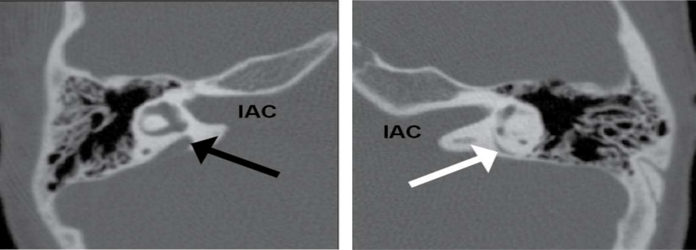
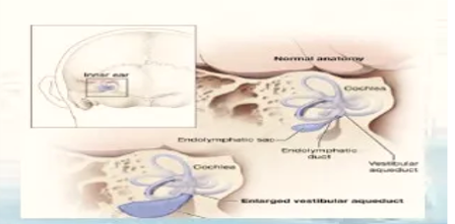

Slide 41
malignant potential
  Patient with dyshormogenetics goiters may undergo malignant transformation probably by prolonged stimulation of thyrotrophin.
  In PDS, the incidence of thyroid CA is 1%.
  Most common thyroid CA arising from PDS are;
1. Follicular CA
2. Follicular Variant of Papillary Thyroid CA

Slide 42
diagnostic criteria
Mutation in both alleles of SLC26A4/ PDS gene in a person with hearing impairment & Thyroid pathology

Slide 43
management
There is no specific treatment for Pendred syndrome and supportive therapies are typically aimed with multidisciplinary approach;
  Pediatricians
  Endocrinologist
  Geneticist
  Pediactrics audiologist
  ENT specialist
  Neuro-radiologists

Slide 44
  Patients with Pendred syndrome may need hearing aids, therapy or thyroid supplements.
  Children with Pendred syndrome should start early treatment to gain communication skills.
  Most people with Pendred syndrome will have hearing loss significant enough to be considered eligible for a cochlear implant.
  ´People with Pendred syndrome who develop a goiter need to have it checked regularly.
  The type of goiter found in Pendred syndrome is unusual because even though it grows in size, it still continues to make normal amounts of thyroid hormone. Such a goiter often is called a euthyroid goiter.

Slide 45
medical management
Thyroxine supplements to treat hypothyroidism

Slide 46
surgical management
Indications for surgery
  Often on cosmetic grounds.
  For pressure symptoms and discomfort
  Patients anxiety to get the swelling removed.
  Retrosternal extension with actual or incipient tracheal compression assessed by CT scanning of thoracic inlet and functional obstruction assessed by volume air loop studies and peak flow measurements.
  Presence of dominant area of enlargement , which may be neoplastic.
  Recurrent bleeds into the degenerative areas.

Slide 47
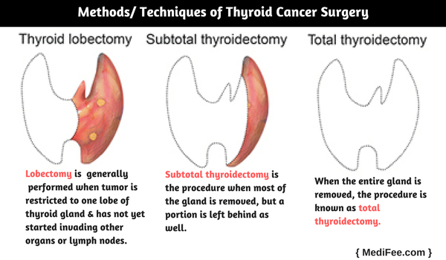
surgical options
  Hemithyroidectomy
  Total Thyroidectomy
  Subtotal thyroidectomy

Slide 48
preoperative investigations
  Thyroid Function Tests.
  Thyroid Antibodies
  Baseline Serum Calcium levels
  X-ray thoracic inlet
  X-ray cervical spine
  Indirect laryngoscopy
  ´Isotope Scan
  Ultrasound guided fine needle aspiration cytology (FNAC)

Slide 49
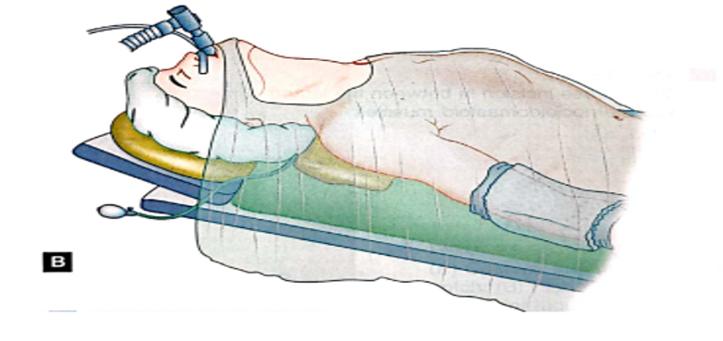
Anesthesia
General Anesthesia with Endotracheal Tube
position of patient

Slide 50
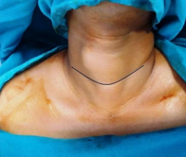
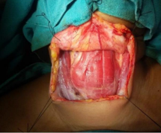
steps of total thyroidectomy
´Step 1: Skin crease incision
Step 2: Raising of flaps

Slide 51
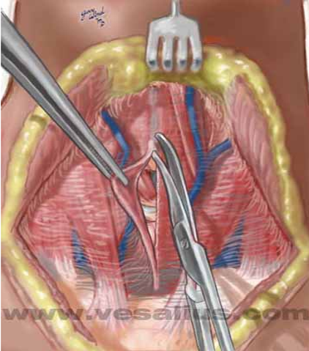
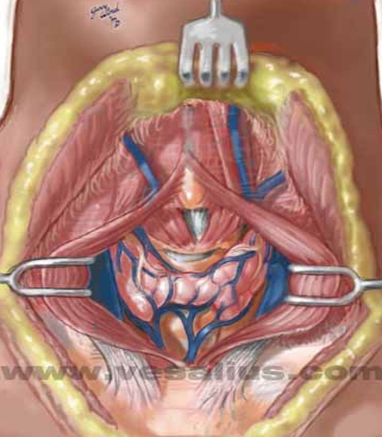
´Step 3: Exposure of Thyroid

Slide 52
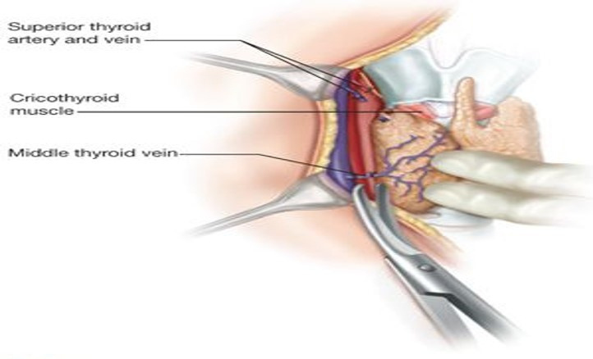
´Step 4: Mobilization of thyroid lobe and ligation of middle thyroid vein

Slide 53
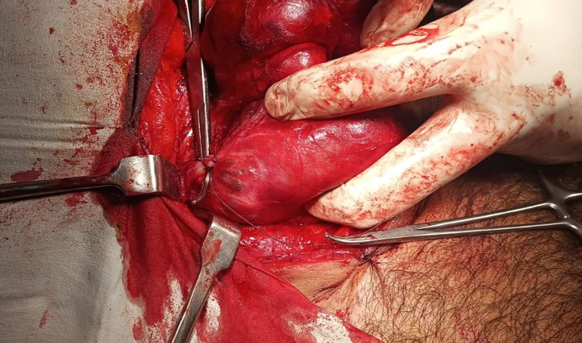
Step 5: Mobilization of superior pole and ligation of superior thyroid vessels

Slide 54
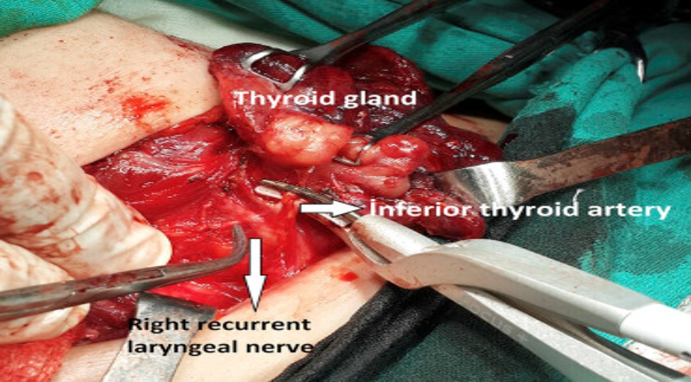
´Step 6: Identification of recurrent laryngeal nerve and inferior thyroid artery

Slide 55
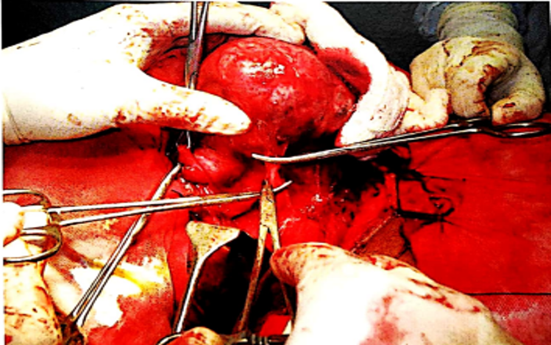
´Step 7: Identification of parathyroid glands & removal of thyroid

Slide 56
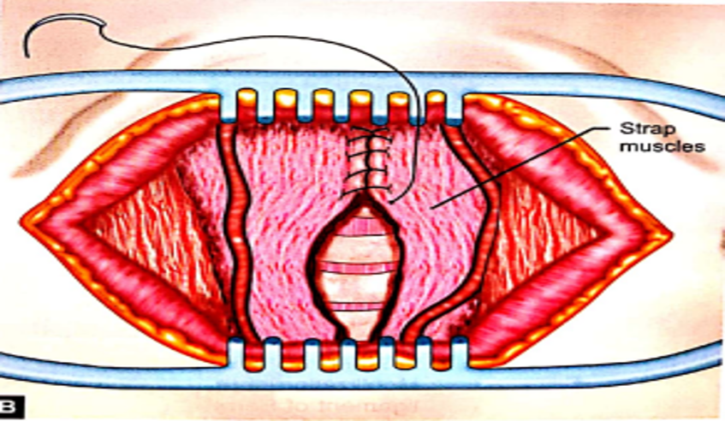
´Step 8: Closure

Slide 57
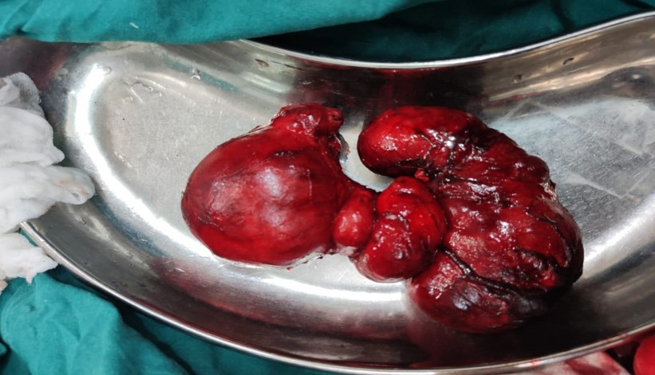

Slide 58
surveillance
  Repeat audiometryevery 3 to 6 months intially if hearing loss is progressive, then semiannually or annually.
  Baseline Ultrasound examination of thyroid with periodic physical examination and/or ultrasonography to moniter volumetric changes; thyroid function tests every 2 to 3 years.

Slide 59
precautions
  ´To reduce the likelihood of hearing loss progression, children and adults with Pendred syndrome should avoid contact sports that might lead to head injury.
  ´wear head protection when engaged in activities such as bicycle riding and skiing that might lead to head injury.
  ´Avoid situations that can lead to barotrauma (extreme, rapid changes in pressure), such as scuba diving or hyperbaric oxygen treatment.

Slide 60
genetic counselling
  At conception, each sib of an affected individual ha a 25% chance of being affected, a 50% chance of being an asymptomatic carrier and a 25% chance of being unaffected and not a carrier.
  When the family specific pathogenic variants are known, carrier testing for at risk family members, prenatal testing for pregrancies at increased risk, and pre-implantationgenetic testing are possible.

Slide 61
summary
  Autosomal recessive disorder.
  Defect in Tyrosine Iodination.
  Gene mutations affect Pendrin-molecule involved in chloride-iodine transport.
  Severe to profound SNHL & MNG in childhood.
  Associated with EVA.
  Treatment by thyroid supplementation and thyroidectomy.

Slide 62
any question?

Slide 63


