Slide 1
MALNUTRITION
Dr sidra iqbal
P2 pgr

Slide 2
Malnutrition
Cellular imbalance b/w supply of nutrients and energy and body demands required for growth development and body functions is called malnutrition
It can be
under-nutrition
over-nutrition
or deficiency of particular nutrients

Slide 3


Slide 4
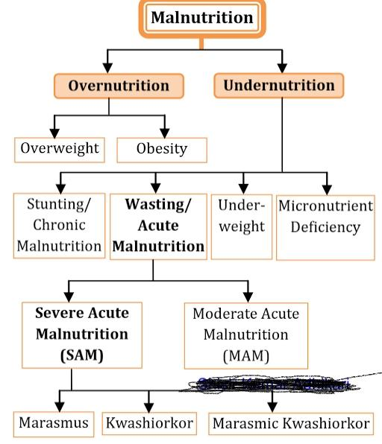

Slide 5
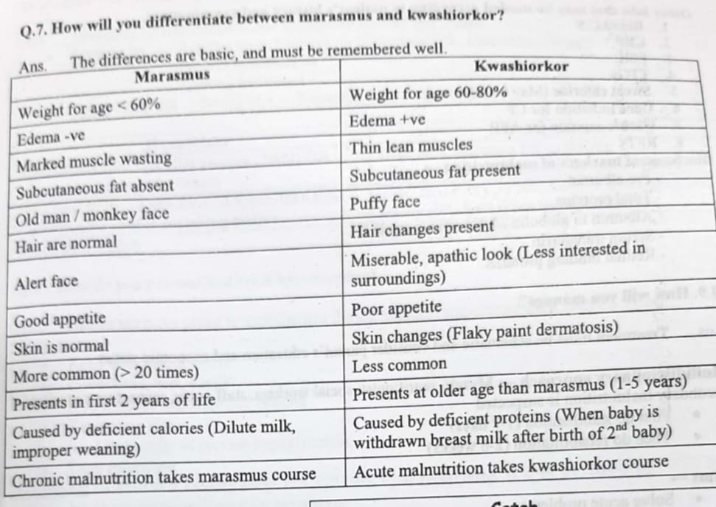

Slide 6
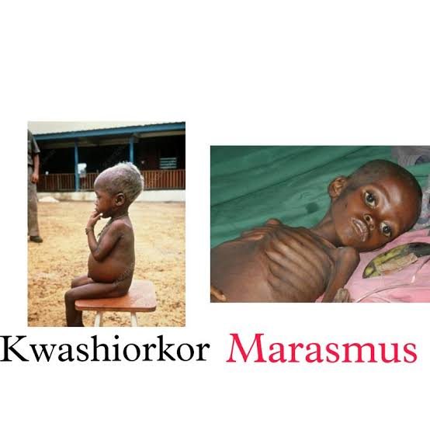

Slide 7
Causes
Primary (lack of food)
Failure of lactation
Ignorance of weaning/ improper weaning
Poverty
Un-educated mother
Lack of immunization
Lack of family planning (3 children of < 5 years of age )
Secondary causes ( food is available, but body cannot use because of illness)

Slide 8
How does body respond to under- nutrition
Reductive adaptation
Liver makes glucose less readily-------hypoglycemia
Heat production is less _---- hypothermia
Kidneys unable to excrete Na and water _ volume overload
Heart becomes weaker _ dec cardiac output _ vol overload
Gut motility is reduced _ bacterial overgrowth and mucosal damage
Gut enzymes are reduced – malabsorption and diarrhea
Red cells are decreased so iron released_ more glucose and amino acids needed to convert iron to ferritin – iron promotes pathogen overgrowth

Slide 9
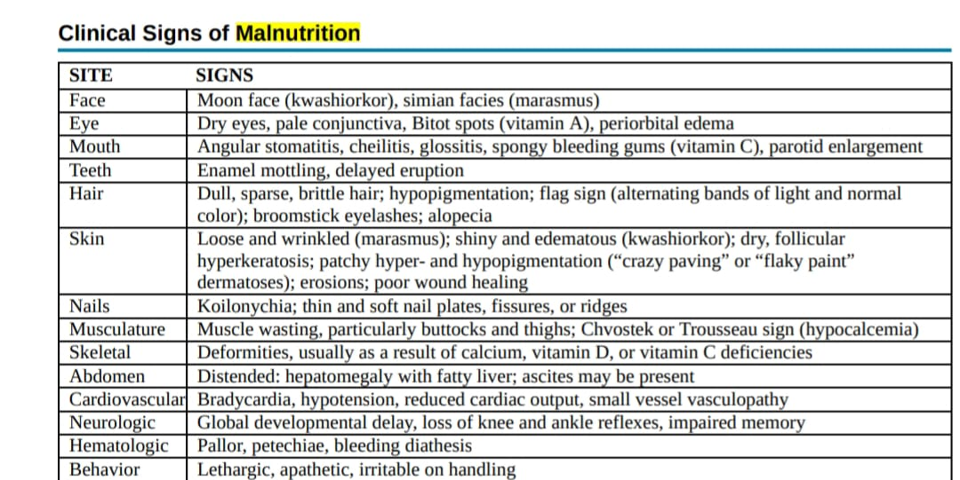

Slide 10
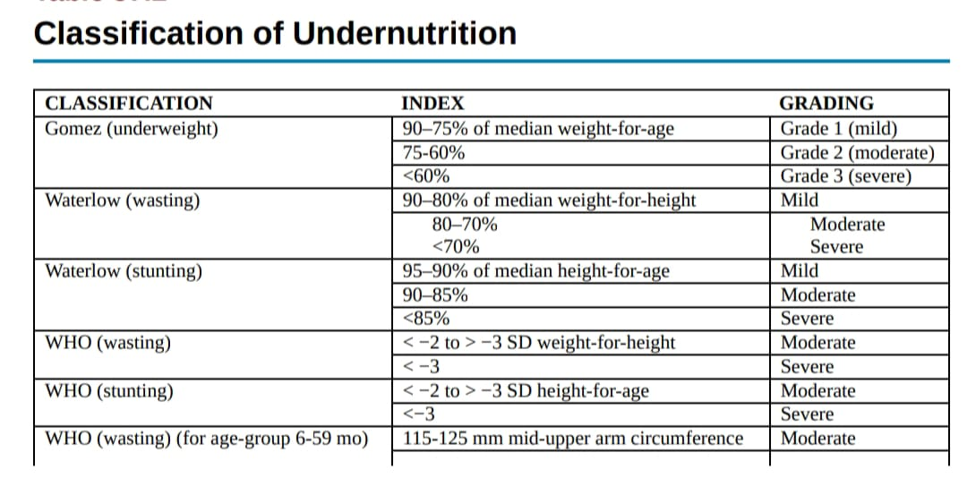

Slide 11
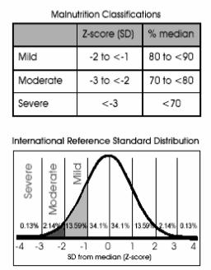

Slide 12
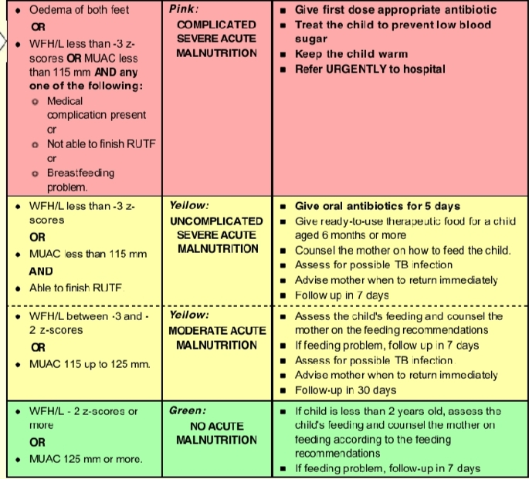

Slide 13
Severe Acute Malnutrition
It is defined as
Weight for height <-3SD
OR MUAC < 11.5cm
OR bilateral pedal edema

Slide 14
Admission criteria
Oedema +,++,+++
Weight for height less than -3SD with any of the following complication
Anorexia
Vomits everything
Hypothermia <35.5c
Severe Pneumonia,Dehydration,anemia
Not alert(very weak,lethargic,unconcious ,fits or convulsios
Condition requiring Iv infusion or NG tube feeding

Slide 15
WHO recommends 10 investigations
BLOOD
Cbc
Mp slide
Serum electrolytes
Blood sugar levels
Serum albumin
Hiv screening
Others
CXR,urine C/E,C/S,stool C/E,Mantoux test
Others…blood C/S,CRP,ESR,TTGs,gene mutation for CF ,RFTs

Slide 16
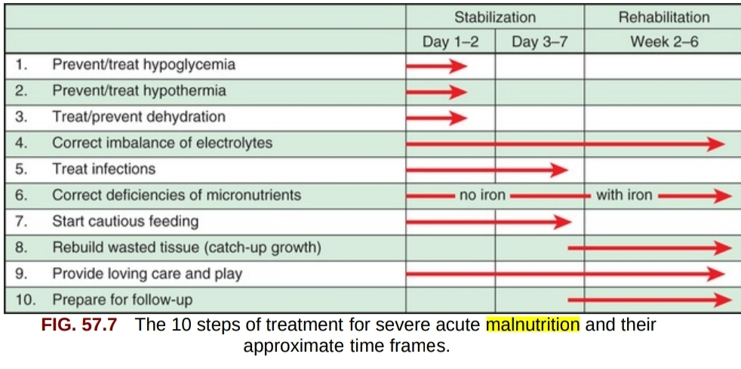
How will you manage it?

Slide 17
Stabilization phase(1-7) days
Rehabilitation phase(2-6)weeks
AIMS
Solve acute problems
Nutritional rehabilitation
Education of Mother
Psychosocial support
Regular follow up

Slide 18
1-How will you manage hypoglycemia?
Prevented by
Regular feed – 3 hrly day and night (2 hrly if sick)
Prevent hypothermia
Treat infection ( they compete for glucose )
Treat
when BSL <54mg/dl ( 3mmol/l)

Slide 19
Treat
IF CONSCIOUS | IF UNCONSCIOUS
Immediately feed OR 10% glucose( 50ml) OR 1tsp sugar under tongue | Give 10% glucose IV at 5ml/kg
Then feed every 30 min for 1st 2 hrs , then feed 2 hrly ( NG feed if not taking orally) | Then feed every 30 min for 1st 2 hrs , then feed 2 hrly ( NG feed if not taking orally)
Check BSR 2hrly | Check BSR 2hrly
Keep warm, start broad spectrum antibiotics | Keep warm, start broad spectrum antibiotics

Slide 20
2-How will you prevent and treat hypothermia?
Prevented by
Keep body warm and dry
Cover head, feet and hands
Avoid undue exposure and bathing( if very ill )
Feed frequently
Treat infections
Keep room warm

Slide 21
Treatment
when axillary temp < 35 C/ 95F , rectal <35.5C(95.9F)
All above mentioned care for prevention
Feed immediately , change wet diapers
Kangaroo care/ skin to skin contact with mother
Place heater/ lamp nearby
Check temp 1hrly or every 30 min if heater is placed
Stop rewarming when axillary temp rises to 36C( 96.8F) or rectal temp rises to 36.5( 97.7F)

Slide 22
3-How to prevent and treat dehydration?
Prevention
RESOMAL after every loose motion
Feed regularly
Treatment
Avoid IV fluids unless in shock
Give 5ml/kg resomal every 30min in 1st 2 hrs (orally or NG)
Then 5-10ml/kg in every alternative hrs for upto 10hrs

Slide 23
 | OLD WHO ORS | WHO low osmolarity ORS | ReSoMal
SODIUM | 90 | 75 | 45
POTASSIUM | 20 | 20 | 40
GLUCOSE | 119 | 75 | 125

Slide 24
How to prepare Resomal?
Boiled and cooled water 2litres
WHO ORS packet one
Sugar 50 grams
Mineral mix 20 ml for 1 litre,40ml for 2 litres , KCL can be given instead of mineral mix ,

Slide 25
Stop active rehydration when
Signs of overload appears
PR> 25/min above baseline
RR> 5/min above baseline
Engorged jugular veins / edema develops
Signs of rehydration appears
Less thirsty , less lethargy , less sunken eyes
skin pinch less slow
Mouth become moist
Passing urine
Pulse and RR decrease

Slide 26
4-How will you manage shock in SAM?
Assume shock if_ patient is unconscious, cold peripheries, CRT > 3sec and rapid pulse
Give O2 inhalation
Check vitals every 10min to assess for improvements
choice of fluid in order of preference is
R/L with 5% D/W
N/2 with 5% D/W
darrow’s solution with 5% D/W
Give 10% D/W at 5ml/kg bolus
Give IV fluids at 15ml/kg over 1hr-

Slide 27
If improving ( PR, RR falls)
Give same IV fluids for 1more hr at 15ml/hr
Then start oral rehydration/ feeds i.e resomal and F-75 in alternate hour
If no improvement ( assume septic shock)
Start maintenance fluid 4ml/kg/hr
5-Arrange and transfuse blood ( 10ml/kg whole blood or 5-7ml/kg PCV)
Transfuse over 3hrs
1mg/kg furosemide at the start of transfusion

Slide 28
6-How will you treat infections?
General prevention – avoid over crowding, frequent hand washing, cover skin lesion and nappy changes, avoid steroids
No complications
Oral amoxicillin at 25mg/kg/dose BD for 5 days
Oral co-trimoxazole 2.5ml BD < 6kg 5ml BD > 6kg
If complications ( lethargy, shock, hypoglycemia, UTI)
Inj gentamycin 7.5mg/kg IV OD (7days) plus
Inj ampicillin 50mg/kg/dose IV 6hrly ( 2days)
Then replace inj ampicillin with oral amoxicillin TDS (5days)
Add oral flagyl 7.5mg/kg/dose TDS (7 days) if diarrhea

Slide 29
5-How will you correct electrolyte imbalance ?
Give extra K ( 4mmol/kg/day) and extra Mg (0.6mm0l/kg/day) for 2 weeks
K and Mg are already added in F-75 and F-100 formula feed
Na is already in excess due to intracellular shift,,,,So always avoid sodium diet or hypertonic fluids
Always avoid diuretics for edema in a patients with malnutrition

Slide 30
7-HOW WILL you replenish micronutrients?
All micronutrients should be given for at least 2 Weeks
Give Folic acid 5mg on day 1,1mg daily thereafter
Zinc 2mg/kg/d
Copper 0.3mg/kg/d
Combine mineral vitamin mix
Vit A
Upto 6 months 50,000IU(grey capsule)
6 months to 1year 100,000(blue capsule)
More than 1year 200,000IU(red capsule)

Slide 31


Slide 32
8-How to start feed in Malnourished child?
Give 8-12 small feeds of F 75 provide 130ml/kg/d,100kcal/kg/d,,and 1-1.5g protein /kg/d
If gross edema ,reduce volume to 100ml/kg/d
WITH FEED TAKE CARE OF FOLLOWING
Maintain intake chart
Daily weight
Monitor of left over milk
If not taking re offer ,if taking <80%,give by Ng tube
Continue breastfeeding

Slide 33
Shift to F100 when
1-Appetite return to normal
Edema subsides
Start 130ml/kg/d for first 2 days then inc gradually by 10ml/kg/d till some feed remains unconsumed
Build up feed upto 200-220ml/kg/d
One solid feed can be added after 3 days
Upto 3solids feeds can be added after 3weeks

Slide 34
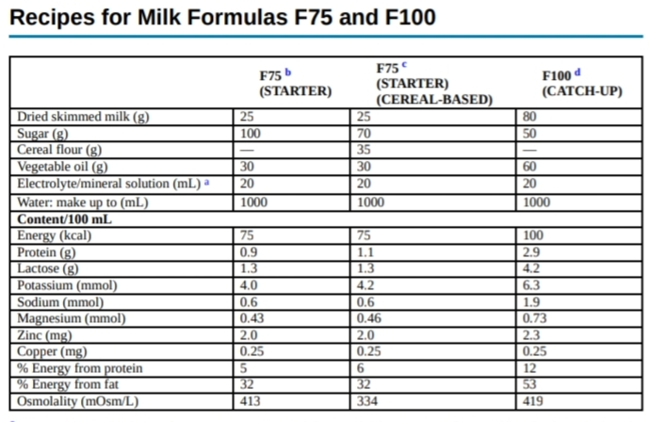

Slide 35
F-75 1litre
Milk=300ml
Water=600ml
Sugar=100g
Olive oil=20ml
Inj kcl=20ml
F-1oo 1litre
Milk pack=800ml
Water =80ml
Sugar =75g
Olive oil =20ml
Inj kcl =20ml

Slide 36
What is re-feeding syndrome
Patient is fasting so insulin levels are decresed
Sudden administration of CHO diet causes inc in insulin release
There is intracellular shifting of electrolytes like
HYPOPHOSPHATEMIA Respiratory failure,cardiac failure,,CNS impairment
HYPOKALEMIA Arrthymia,paralysis,constipation
HYPOMAGNESEMIA Arrhtmias,weakness,dirrhoea
THIAMINE Beriberi
Prevention ,,,,1)continue feeding according to guideline
Frequent electrolyte monitoring

Slide 37
How do you monitor weight gain once your patient rehabilitation has started?
Daily weight should be measured
>10g/kg/d(Good) Praise staff and mother
5-10g/kg/d(moderate) Evaluate for infection and intake
<5g/kg/d(severe) Complete reevaluation
FAILURE TO RESPOND CRITERIA
BY day 4 Failure to lose edema/Gain appetite
By day 10 Edema still present /inadequate weight gain (<5g/kg/d)

Slide 38
What are the criteria to discharge baby?
CHILD:
W/H reaches -1SD(on z scoring)
Gaining weight
Good appetite
Micronutrient and electrolyte replacement done
Antibiotic course completed(Free of infection)
Vaccinated(Age appropriate)
MOTHER;
Is able to look after child
Can give treatment for ARI and Dirrhea

Slide 39
Followup
1st week,2nd weeks ,1month,3months,6months then 6 monthly till 3 years
Assess the
weight,
height
MUAC,
vaccination and development

Slide 40


