Slide 1

BY GYNAE-1
CPC PRESENTATION
Dr. Ahsan Khalil Dr. Arooj Younis

Slide 2








Slide 3
CASE HISTORY

Slide 4


INTRODUCTION
Name : Mrs Farzana Wife of : M Amir Age : 38 years Married for : 8 years
Profession : Housewife Education : Matriculation Gravida : 4
Para : 3
Abortion : 0

Slide 5



PATIENT’S
LMP : 26th of October 2023 EDD : 1st August 2024 Duration of Pregnancy : 35+6 weeks by dates.

Slide 6
PRESENTING COMPLAINT
Admitted through Emergency on 2nd July 2024 with the complaint of vaginal bleeding.

Slide 7
HISTORY OF PRESENTING ILLNESS

Slide 8

My patient had one episode of bleeding for first time in pregnancy, bleeding was not associated with abdominal pain and trauma. It was mild in amount and socking one pad since yesterday night.

Slide 9


FIRST TRIMESTER
My patient conceived spontaneously in regular menstrual cycle and was not practicing any method of contraceptives.
Patient confirmed her pregnancy at home by UPT. Booked throughout first trimester. She did her first antenatal visit at 2nd month of gestation to GP when she was told about single intrauterine pregnancy. Her bp and lab investigations were done and were normal according to the patient.

Slide 10


FIRST TRIMESTER
She took one tablet of folic acid per day regularly.
Her first trimester remain uneventful with no complaint of vomiting, vaginal discharge, bleeding, lower abdomen pain, increased frequency of micturation, burning micturation, fever and flu like rash.

Slide 11


SECOND TRIMESTER
She started feeling fetal movements at 5th month of pregnancy on antenatal checkup from nearby doctor.
Her blood pressure was checked that was within normal range ; no blood, OGTT, or urine test were sent.
Her anomaly scan was not done.

Slide 12


SECOND TRIMESTER
Patient took oral supplements in form of iron and calcium tablets that she had taken with good compliance. There is no history of headache, blurring of vision, epigastric pain, pallor, easy fatigability, shortness of breath, PV bleeding and discharge.
According to patient her abdominal growth is going well according to dates and keep on feeling adequate fetal movements on regular antenatal visits.

Slide 13


THIRD TRIMESTER
On 8th month of pregnancy her ultrasound was done and patient was reassured for viability and normal placentation. Her blood pressure was checked that was raised, her blood & urine tests were sent that were in normal range according to patient.
Patient was prescribed oral supplements and was guided about diet to decrease salt intake and do regular exercise.

Slide 14
THIRD TRIMESTER
She got tetanus prophylaxis at 7th and 8th month of gestation.
She was diagnosed as a patient of pregnancy induced hypertension at 9th month of gestation. So tab Aldomat 250mg twice a day prescribed on which her bp was controlled.
Lab investigations were normal

Slide 15


THIRD TRIMESTER
Grey scale ultra sound was done and she was diagnosed as a case of major degree placenta previa. Patient was counselled about her high risk pregnancy and arrangement of atleast 10 units of blood and need for hysterectomy in the case of severe bleeding.
FKCC & CTG was done two times a day.
For fetal lung maturation, steroid cover in form of injection dexamethason 2 doses of 12 mg , 12 hours apart was given.

Slide 16
PAST OBSTRETIC HISTORY

Slide 17

She is having three kids ; one son & two daughters, all alive and healthy, breastfeed and vaccinated.
All her children were delivered by c- section in tertiary care hospital.
All her pregnancies were superwised and uneventful with no history of hypertension, diabetes, APH, PPH, wound sepsis and post partum depression.

Slide 18
PAST GYNAECOLOGICAL HISTORY

Slide 19
Patient is having regular menstrual cycle 5/30, no history of heavy menstrual bleeding, dysmenorrhoea, post coital bleeding and intermenstural bleeding.
Pap smear was never done.

Slide 20
PAST MEDICAL & SURGICAL
HISTORY

Slide 21
History of blood transfusion after every C-section but there is no history of transfusion induced reactions.
And there is no other significant past medical history.
In surgical history, There is history of past 3 c-sections.

Slide 22
PERSONAL HISTORY

Slide 23
Patient is having normal appetite, sleep pattern and bowel habits.
There is no history of smoking or any other drug addiction.

Slide 24
FAMILY HISTORY

Slide 25


Her mother is hypertensive and father is known case of ischemic heart disease.

Slide 26
SOCIOECONOMIC HISTORY

Slide 27
She belongs to a middle class family.
Her husband works in a factory with monthly wage of 50,000.
Sanitary conditions are good. Patient is having good support at home.

Slide 28
DRUG ALLERGY

Slide 29

There is no history of any drug allergy.

Slide 30
GENERAL PHYSICAL EXAMINATION

Slide 31
A middle aged over weight lady sitting comfortably on bed, well oriented in person, place & time, having IV canula on right hand, having Body Mass Index (BMI) of 32kg/mm2.
with blood pressure : 140/90 Pulse : 98 bpm.
Temperature : 98.6 F Respiratory rate : 18 bpm

Slide 32
No pallor, with no jaundice, clubbing, cyanosis & koilonychia.
Lower abdominal wall edema present. No visible veins, pulsations but stria gravidarum and scar marks are visible. Thyroid was not enlarged.
Hernial orfices were intact. Accessible lymph nodes were not palpable.

Slide 33


CARDIOVASCULAR EXAMINATION
Precordium normal.
Apex beat in 5th intercostal space 1cm medial to the midclavicular line.
Normal S1 and S2 with no added sounds.

Slide 34
RESPIRATORY EXAMINATION
Chest shape was normal, moving equally on both sides with respiration.
Normal vesicular breathing with no added sounds.

Slide 35
ABDOMINAL EXAMINATION
Symmetrically protruded abdomen with centrally inverted umbilicus.
Visible stria gravidarum.
No Prominent veins & pulsations. Scar marks present.
Hernial orifices are intact.

Slide 36


PALPATION
SFH = 36 cm = 36 week
LIE = Longitudinal / Cephalic P/P = 5/5
No Palpable contractions
AUSCULTATION
FHR = 120-135/minute

Slide 37
Fetal back is on left sife with estimated fetal weight 2.5kg.
Amount of liquor seems to be normal. P/S on per peculum examination vulva and vagina and cervix were normal.
There was mild pv bleeding

Slide 38
INVESTIGATIONS

Slide 39
BASELINE INVESTIGATIONS MIDSTREAM URINE MICROSCOPY & BIOCHEMISTRY
RANDOM BLOOD SUGAR SCREENING FOR HEPATITIS LFTS & RFTS ULTRASONOGRAPHY
CTG

Slide 40
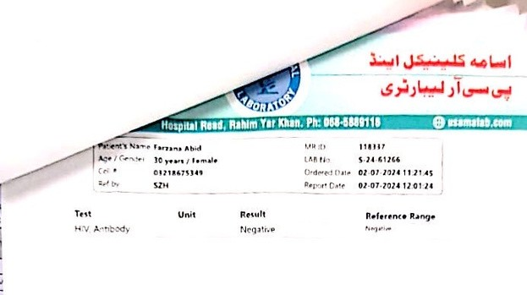
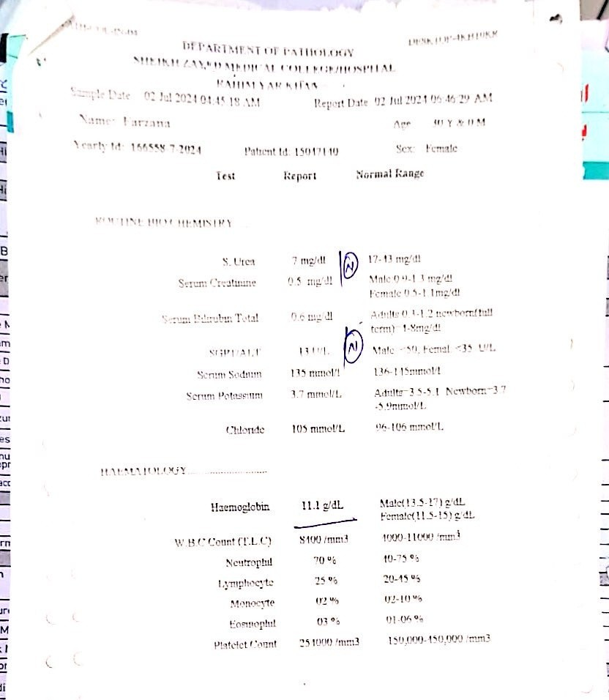
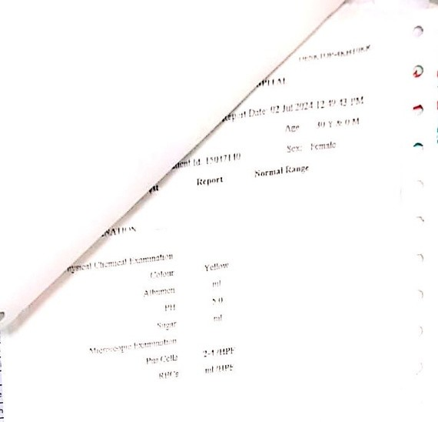

Slide 41

Ultrasound
Single alive intrauterine cephalic pregnancy with Bi parietal diameter and femur length of 36 weeks, liquor adequate, placenta was major degree previa with multiple lacunae and bladder interface interrupted.
Loss of hypo echoic placental myometrial differentiation.

Slide 42
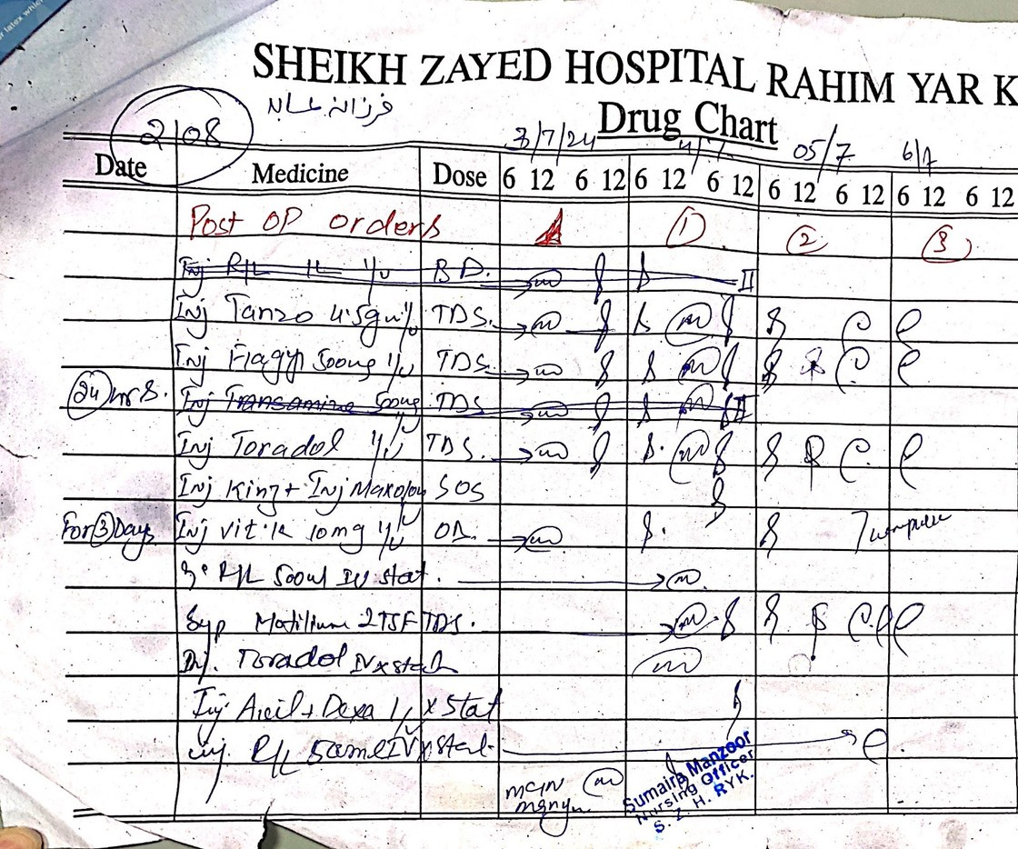

Slide 43
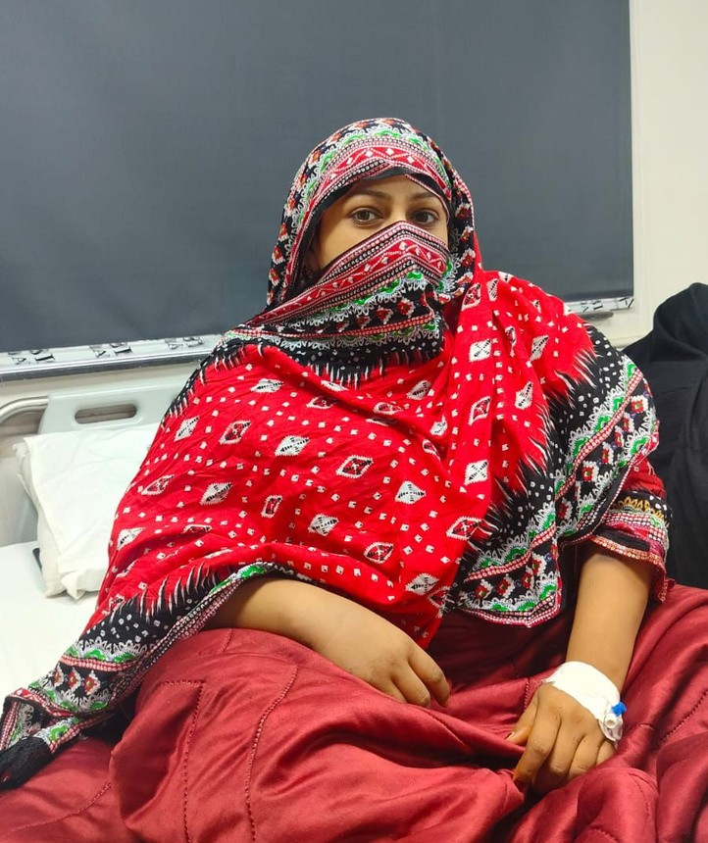
PATIENT

Slide 44
MANAGEMENT

Slide 45
THANK YOU
if you’ve any querry, you can ask.

