Slide 1
THE ART AND SCIENCE OF WHIPPLE RESECTION
Dr. Usama Rehman
Department of Pathology
Sheikh Zayed Medical/Hospital

Slide 2
OBJECTIVES
Introduction
Anatomy
Grossing
Fixation & grossing
Pathological staging criteria
Microscopy ± Stains (IHC).
Reporting

Slide 3
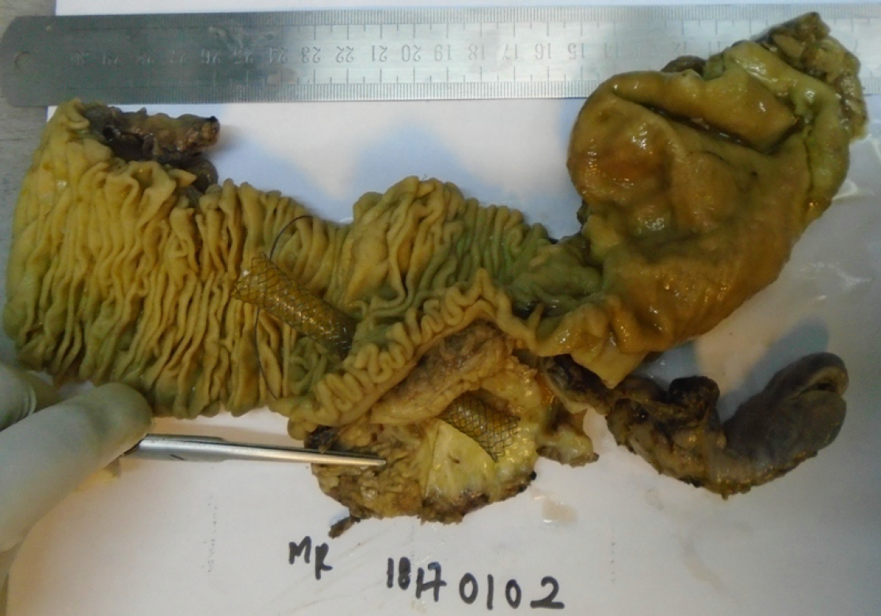

Slide 4

IS THIS A NEW SPECIMEN FOR PATHOLOGISTS?
1898: Codivilla performed the first reported pancreaticoduodenectomy for carcinoma of the pancreas and removed parts of the pancreas, duodenum, distal stomach and distal bile duct
1940: The first recorded one-stage procedure for complete excision of the head of the pancreas and the entire duodenum by Allen Whipple (Columbia-Presbyterian Medical Center in New York).
Its been around for 83 years!!

Slide 5
Why this apprehension among young pathologists?
1. Lack of adequate exposure to Whipple during postgraduate training. In fact some trainees may not have seen one in their entire course
2. Complicated anatomy.
3. Lack of understanding of ‘concept’ of pathological staging among pathologists.
‘Pathological staging’ is the single most important purpose of grossing any oncology specimen which makes grossing ‘meaningful’.

Slide 6
4. No one to teach.
As consultants we often avoid handling the specimen and leave it to postgraduates – Unsupervised grossing is equivalent to butchering.
Without consultant’s complete involvement Whipple cannot be satisfactorily grossed and reported!!

Slide 7
Indications for Whipple
To treat tumours of the:
  Duodenal ampulla
  Head of the pancreas
  Common bile duct
  Duodenum near the pancreas and
Also some cases of pancreatitis with or without a definitive cause.
Always correlate with radiological findings

Slide 8
Components of Whipple Specimen
Essential components:
  Duodenum + Head of Pancreas + Common Bile duct.
Additional components:
  Distal stomach, Jejunum and Gallbladder

Slide 9
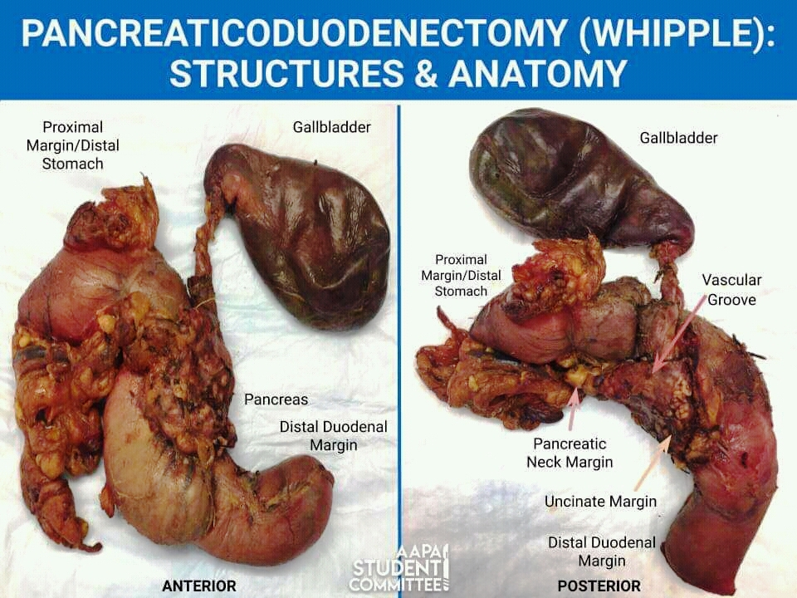
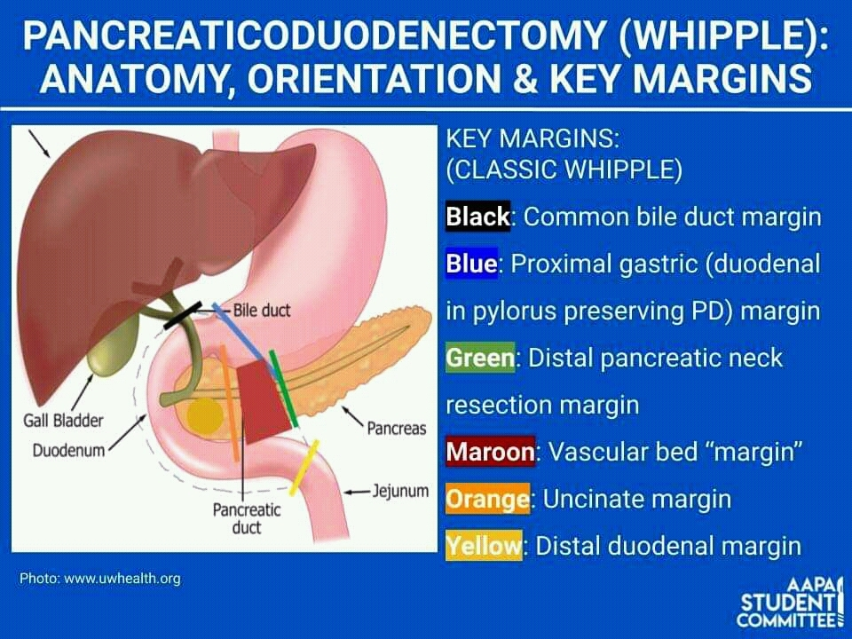

Slide 10
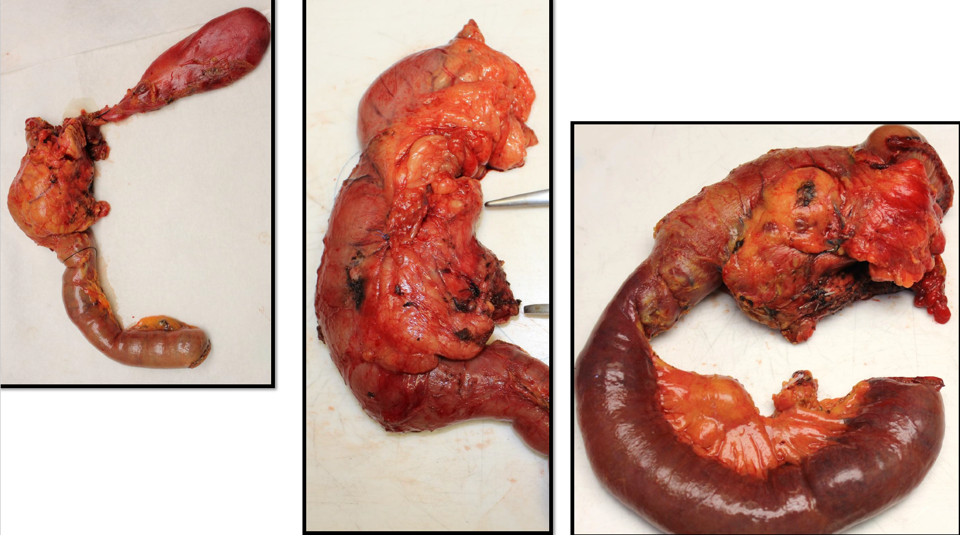

Slide 11
What am I supposed to investigate?
➢ Status of surgical margins:
➢Positive surgical margin is associated with very poor prognosis and may be given adjuvant CTRT.
➢Median survival rate of patients with positive margin is the same or worse than that of patients with unresectable tumors
➢ Site of origin and extent of tumour
➢ Status of lymph nodes:
➢One of the most important independent prognostic factors of survival.
➢Guidelines recommend examination of at least 12 lymph nodes for accurate staging as pN0
Always remember to pathologically stage the tumour.

Slide 12
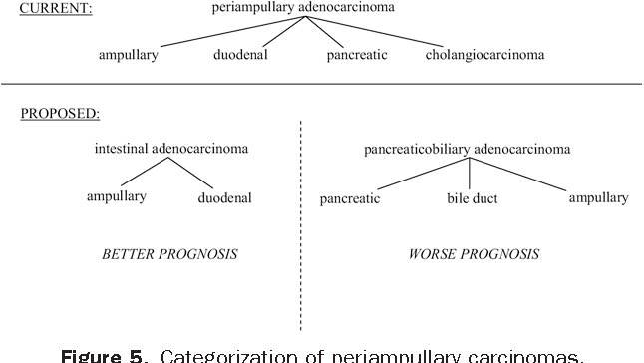

Slide 13
Donot touch if you don’t know the anatomy!

Slide 14
First step – Orient the specimen

Slide 15
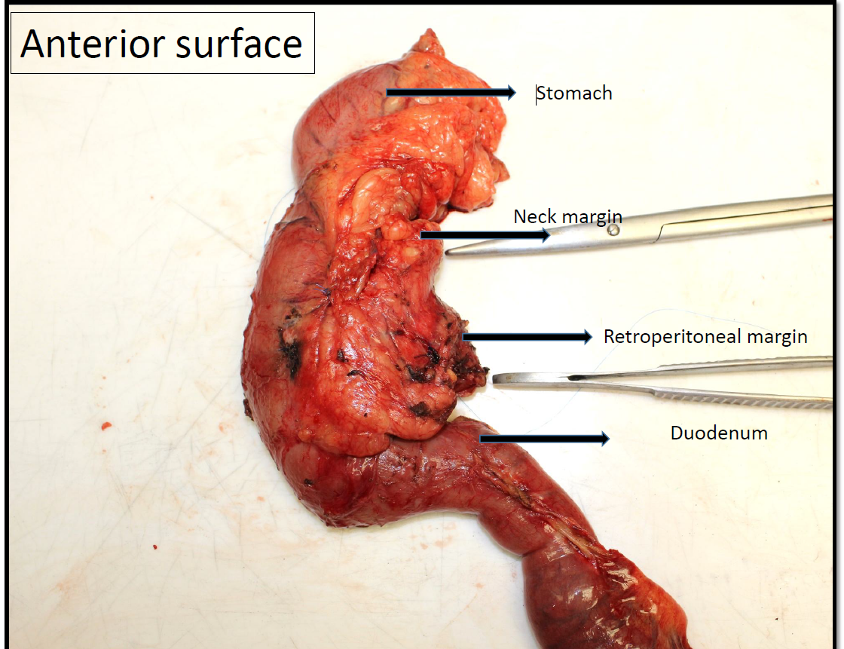
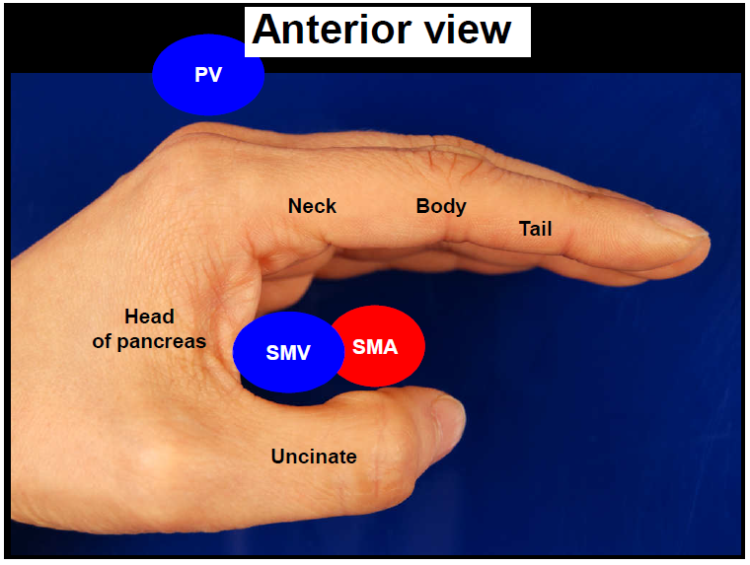

Slide 16
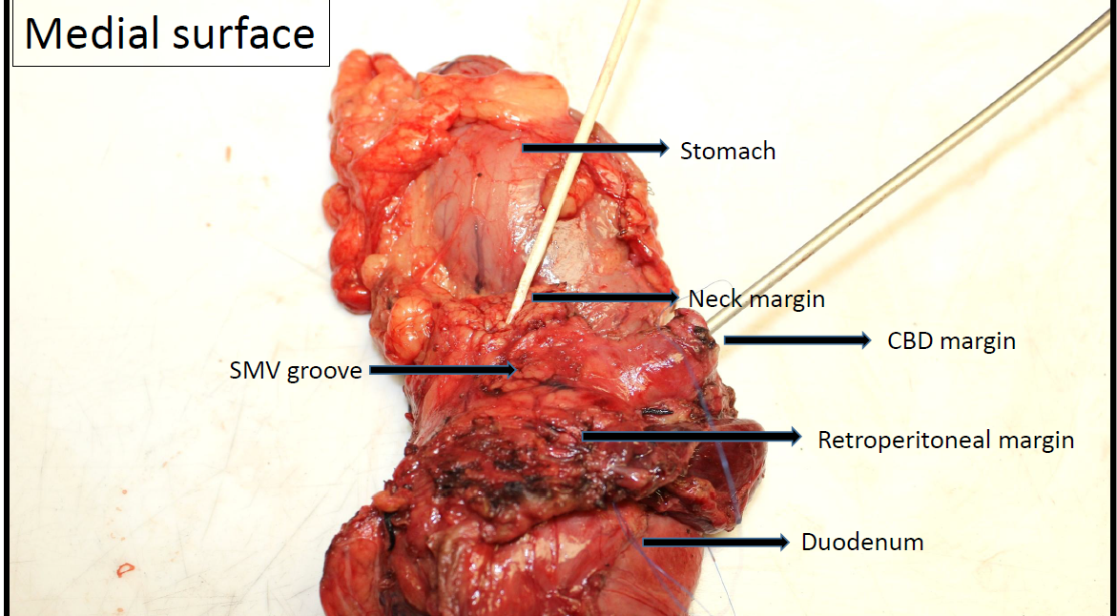
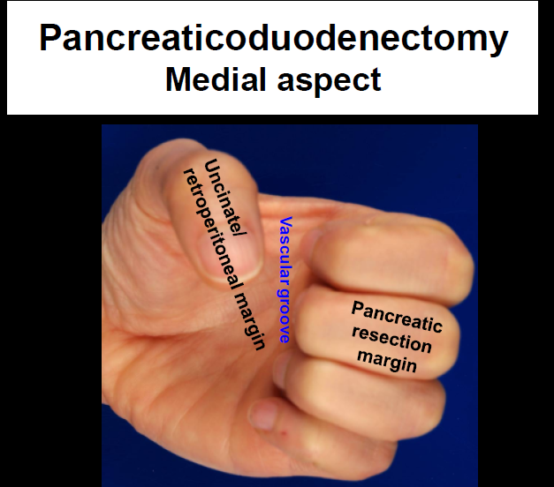

Slide 17
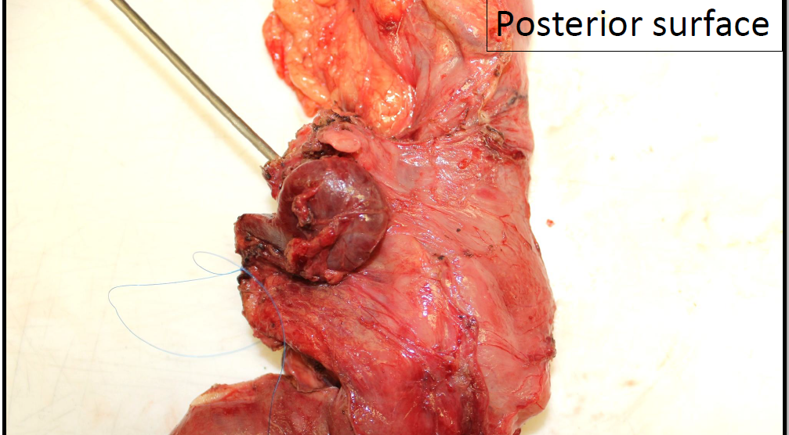

Slide 18
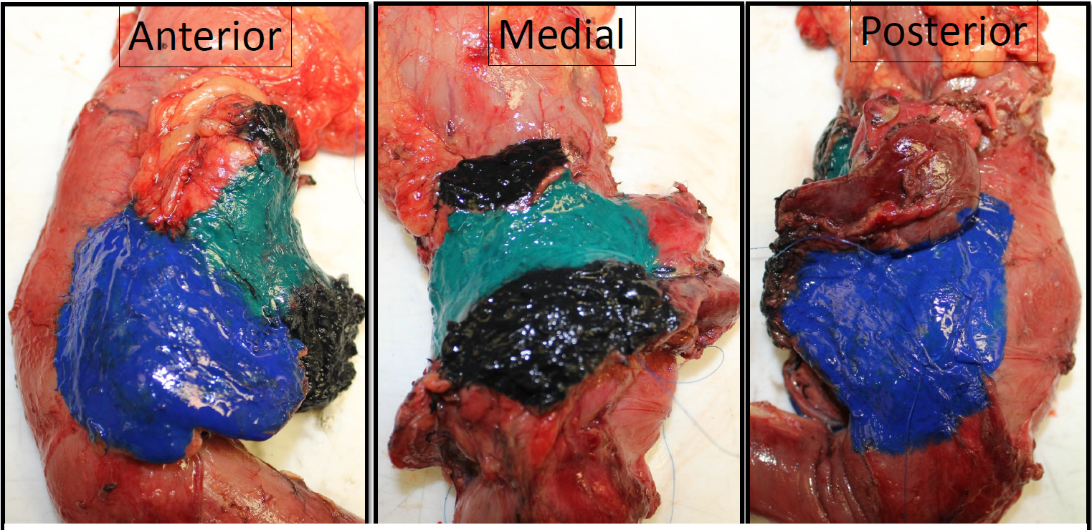

Slide 19
Second step - Remove surgical margins
Essential margins:
Common bile duct
Pancreatic resection/neck margin
Retroperitoneal/uncinate
Stomach/duodenum margin
All shaved margins.
Retroperitoneal margin should preferentially be taken radially.

Slide 20
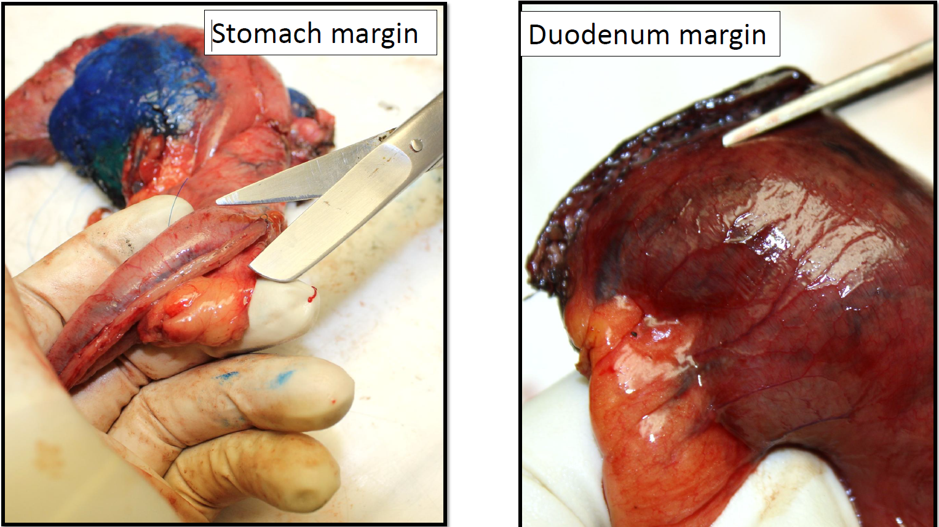

Slide 21
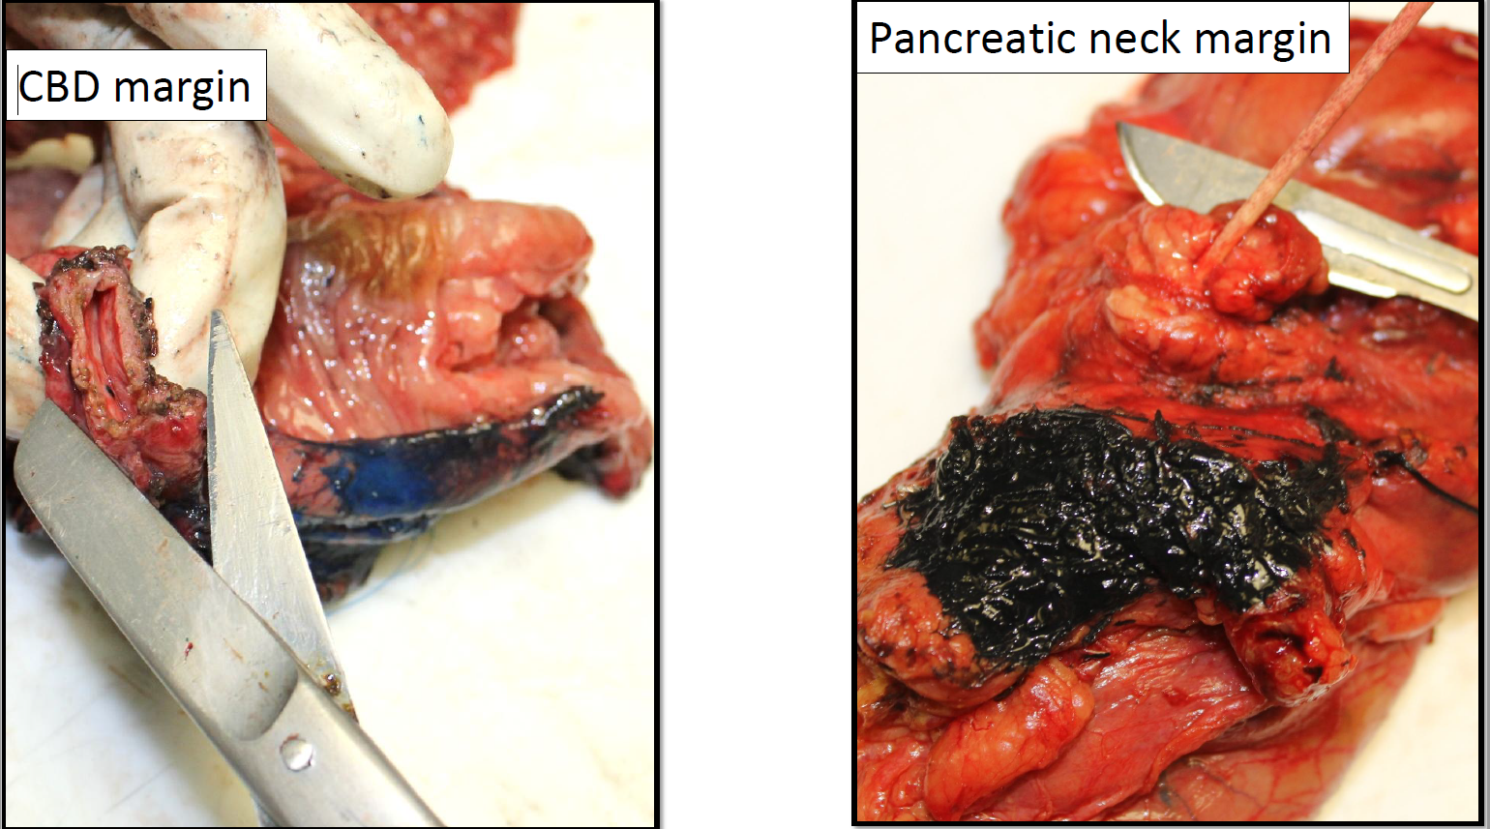

Slide 22
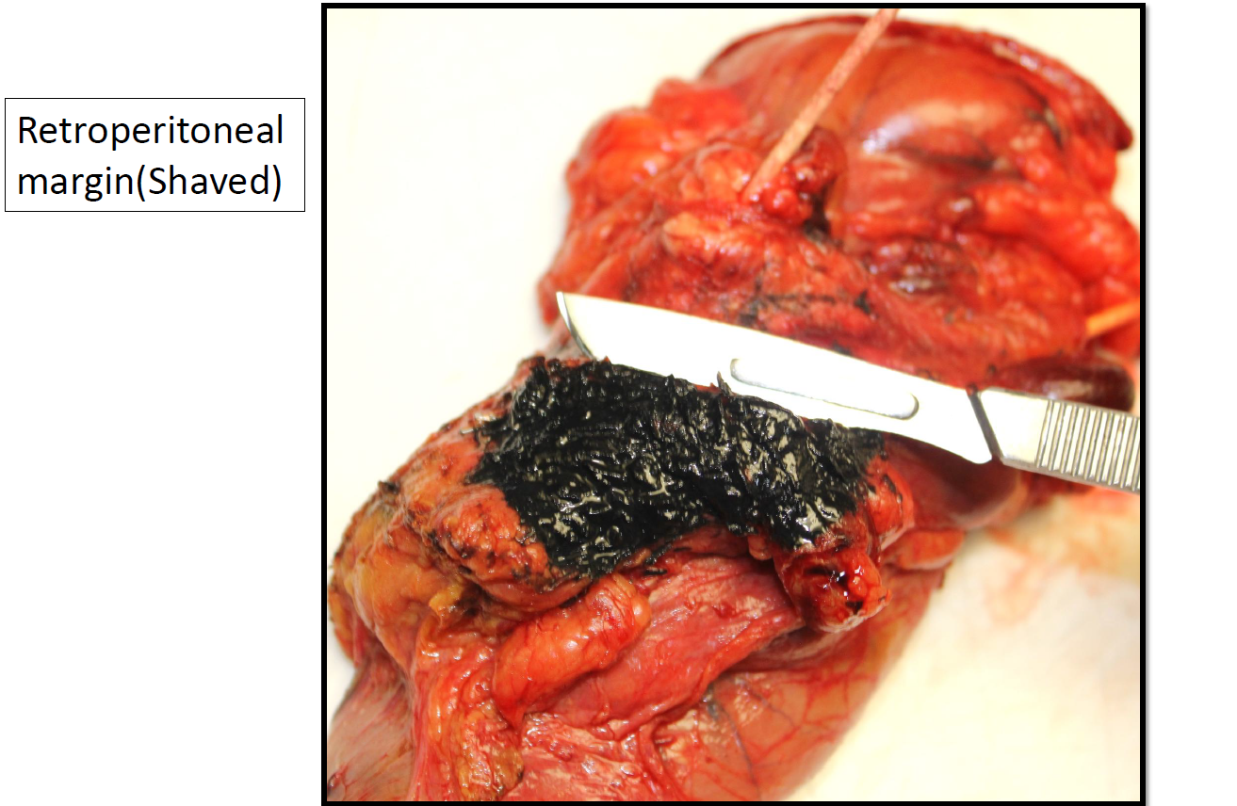

Slide 23
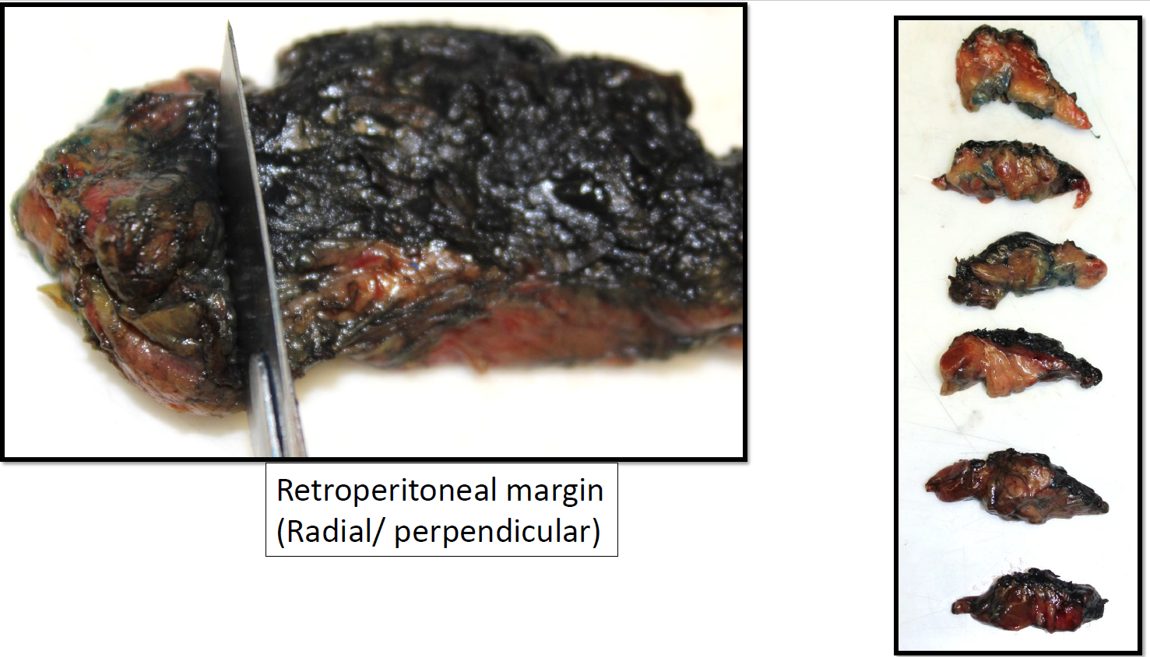

Slide 24



Slide 25
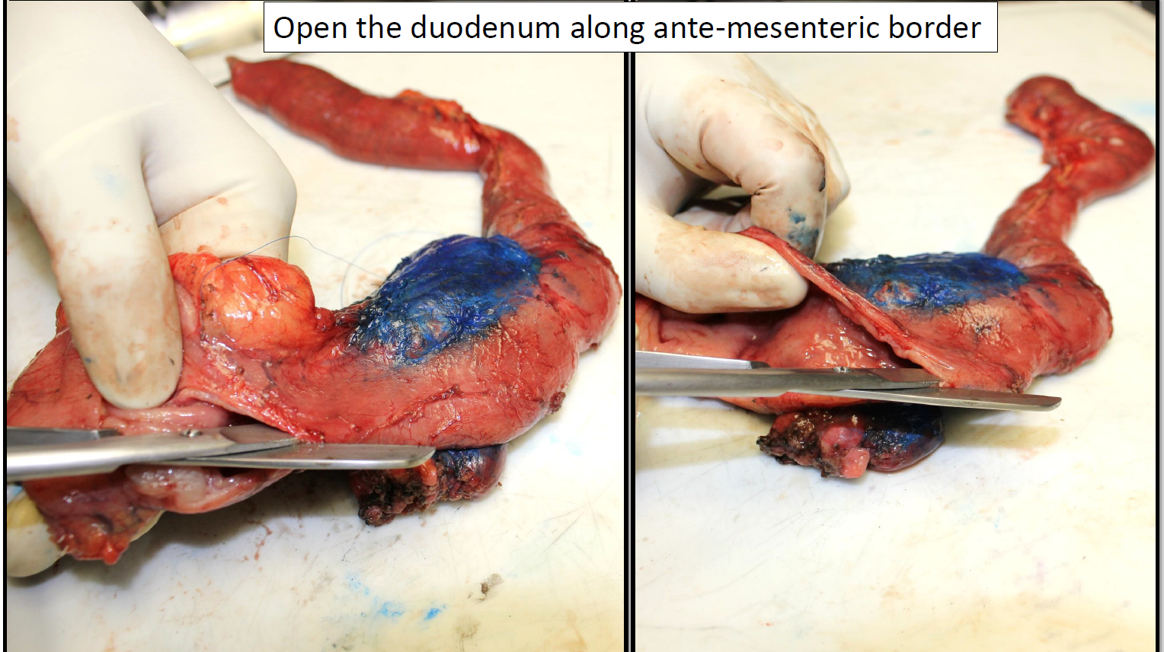

Slide 26
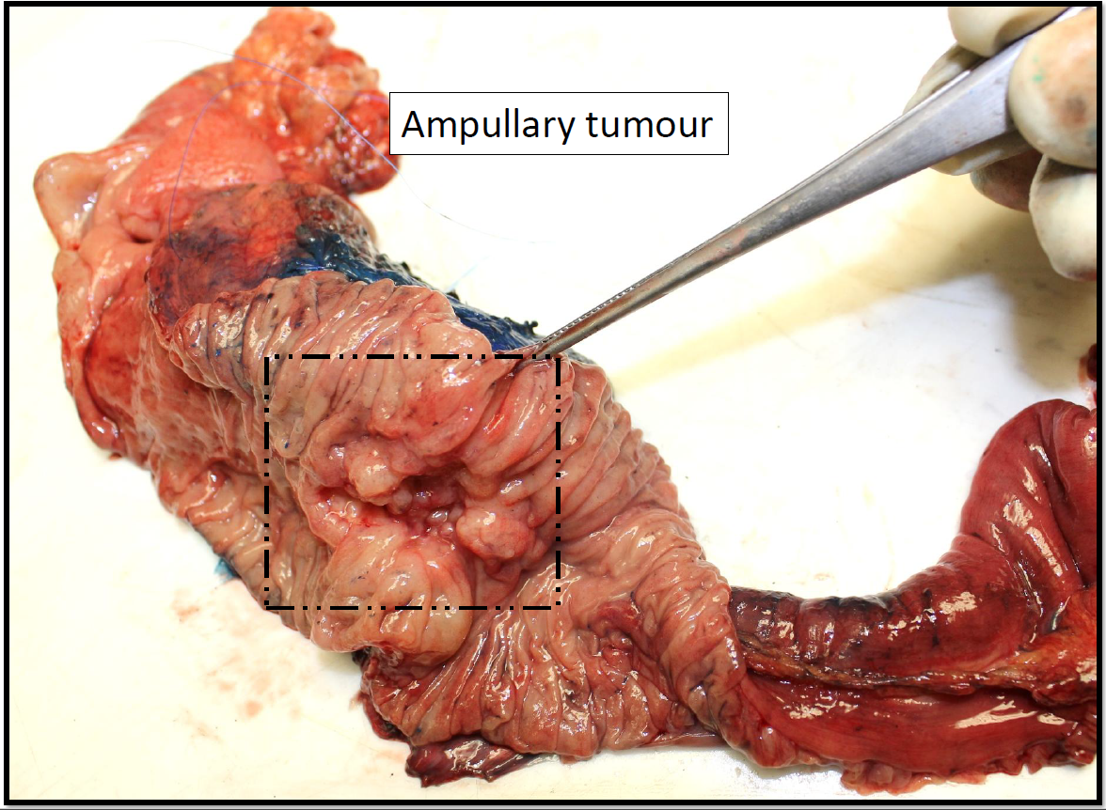

Slide 27
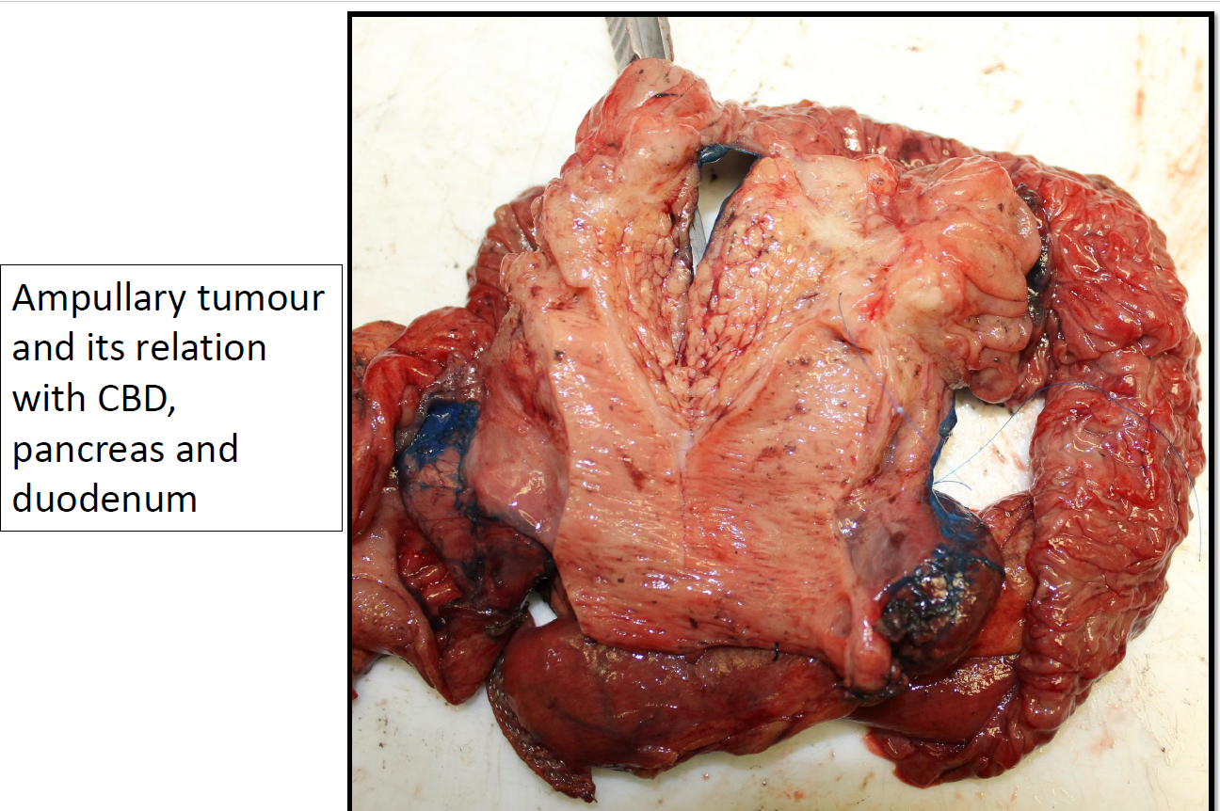

Slide 28
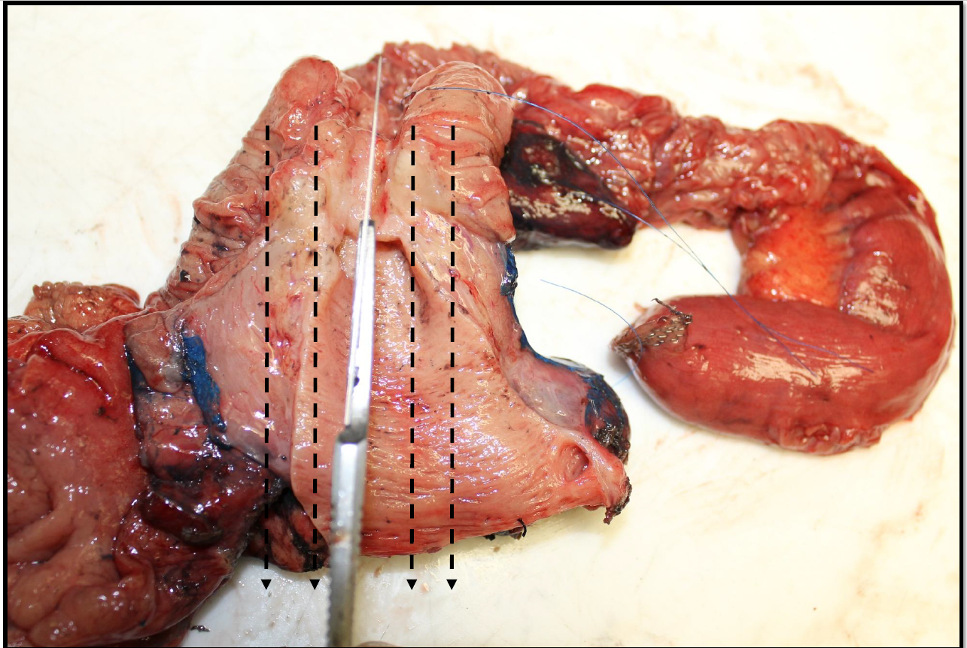

Slide 29
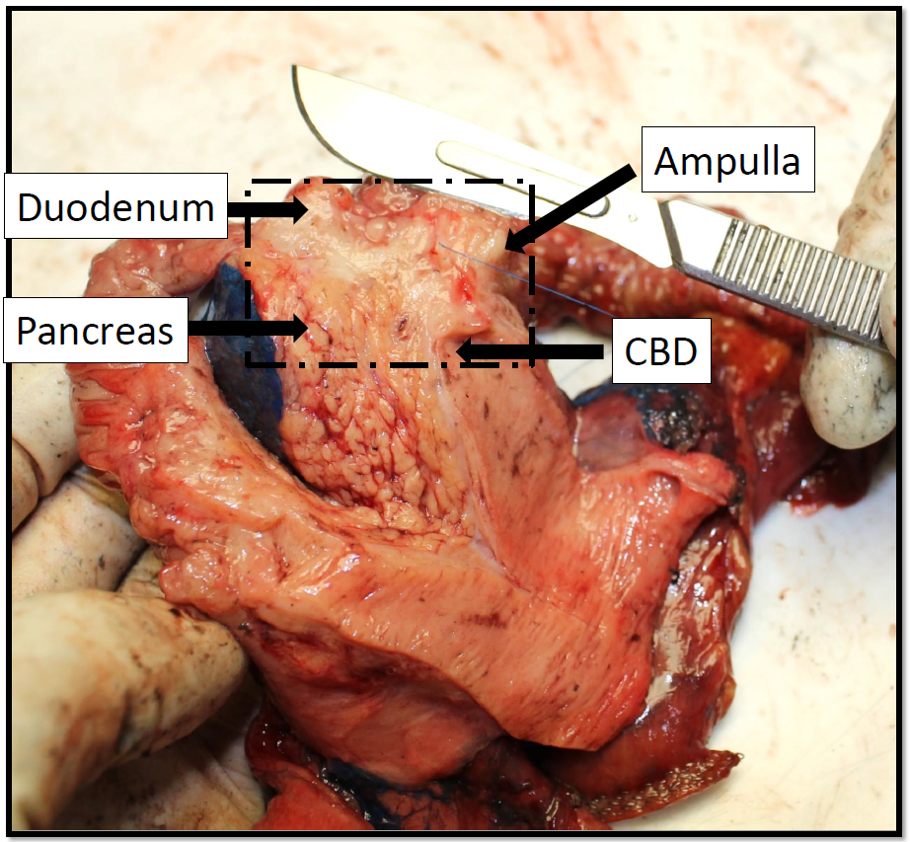

Slide 30
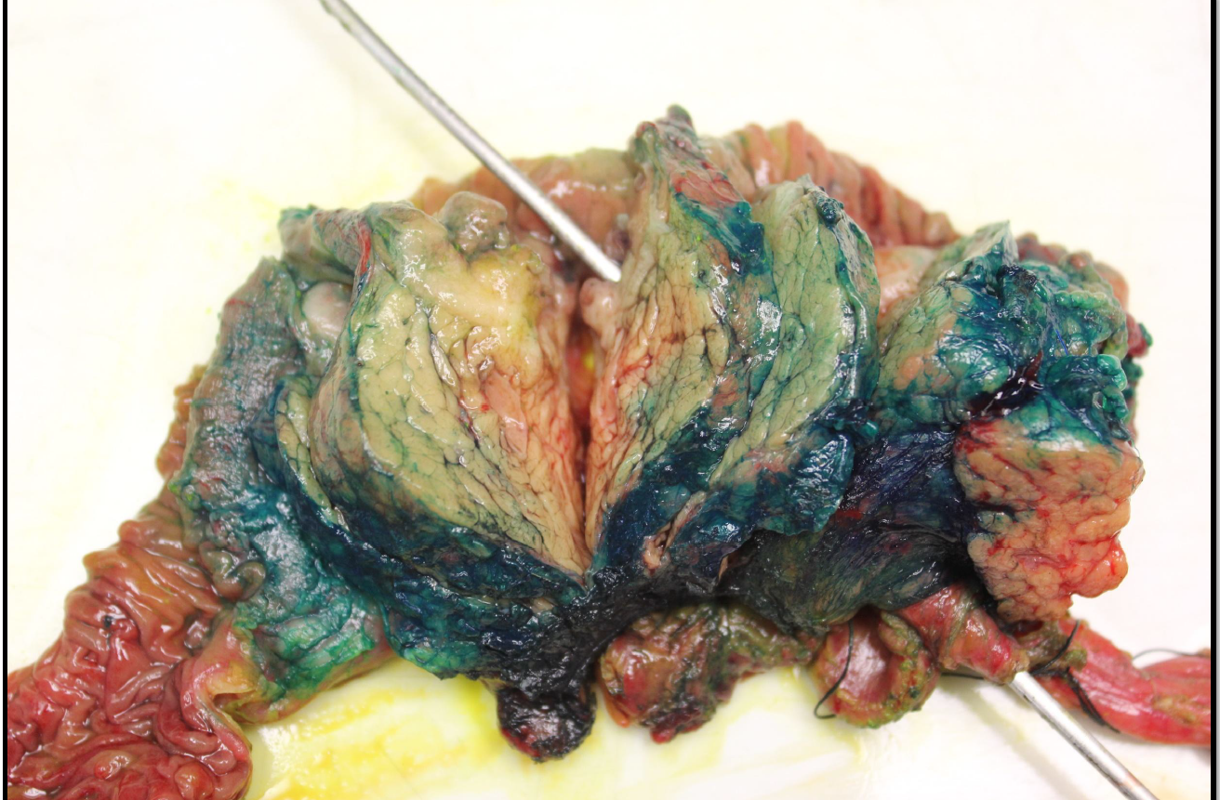

Slide 31
Lymph nodes are not easily visible from outside as peripancreatic fat can be thin and covered with serosa.
Search for lymph nodes in every single ‘cm’ of adipose tissue.
Don’t forget to search in the pancreato-duodenal groove.
Search diligently – You will be surprised by the yield.

Slide 32
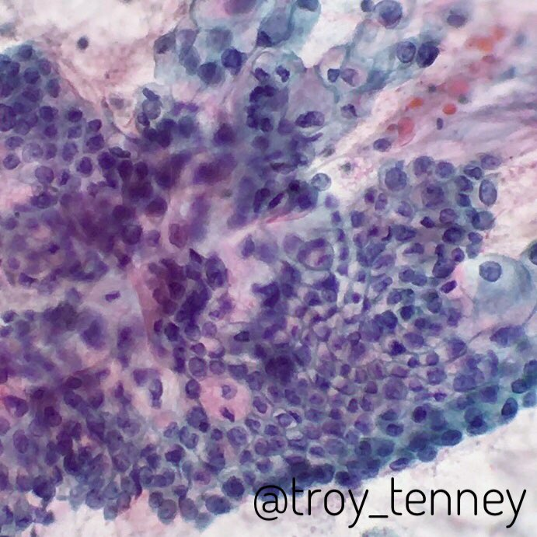
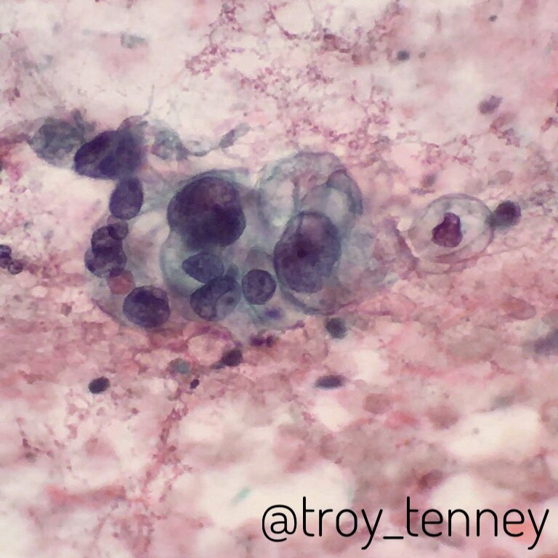

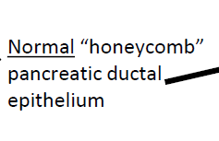

Slide 33
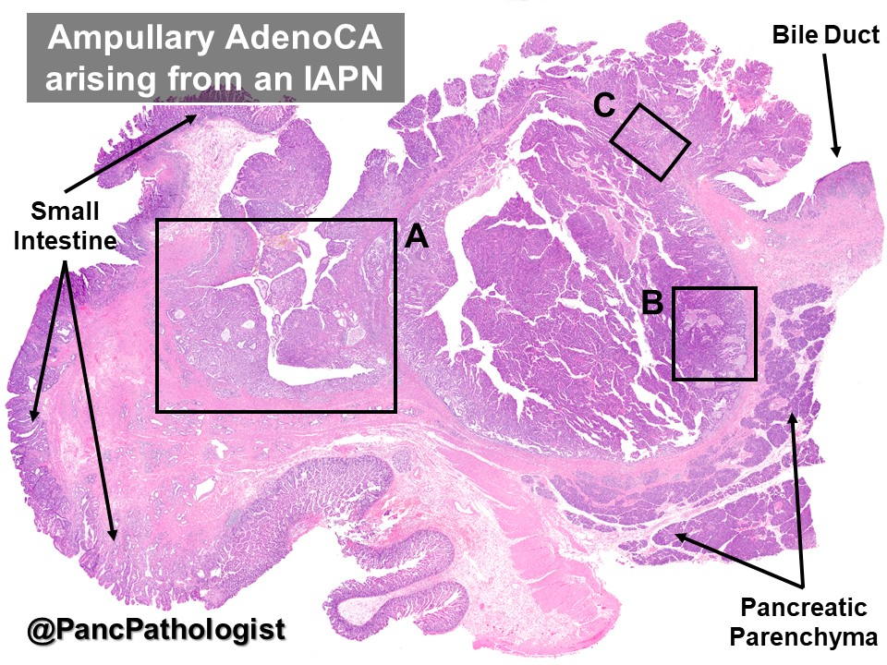

Slide 34
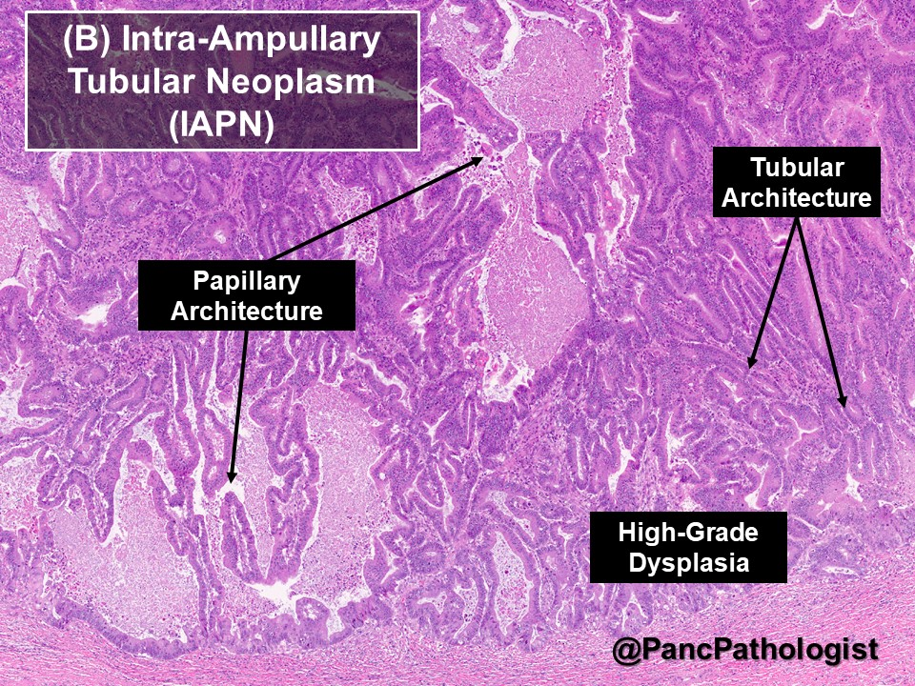

Slide 35
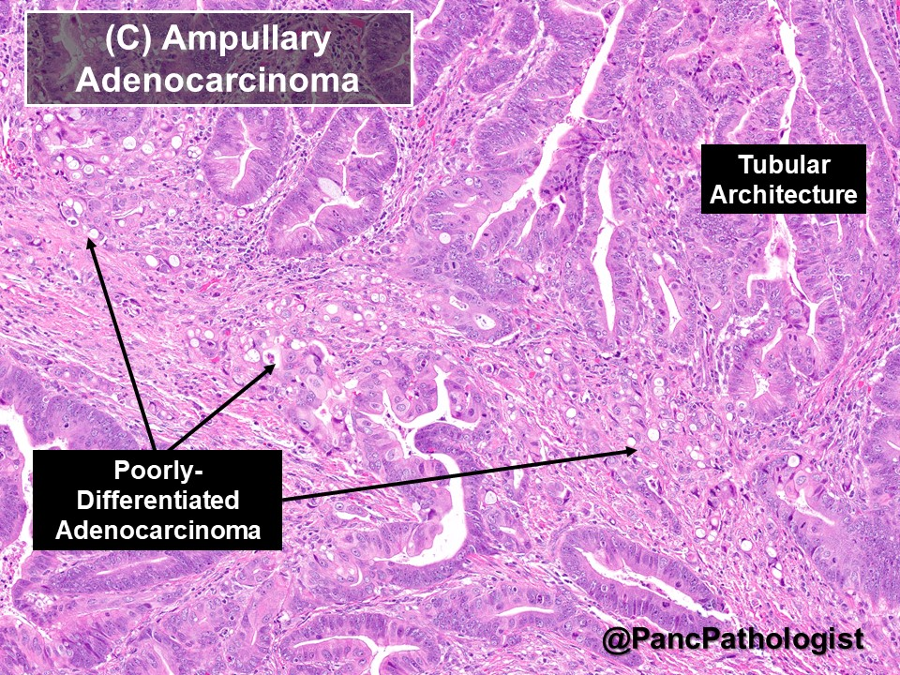

Slide 36
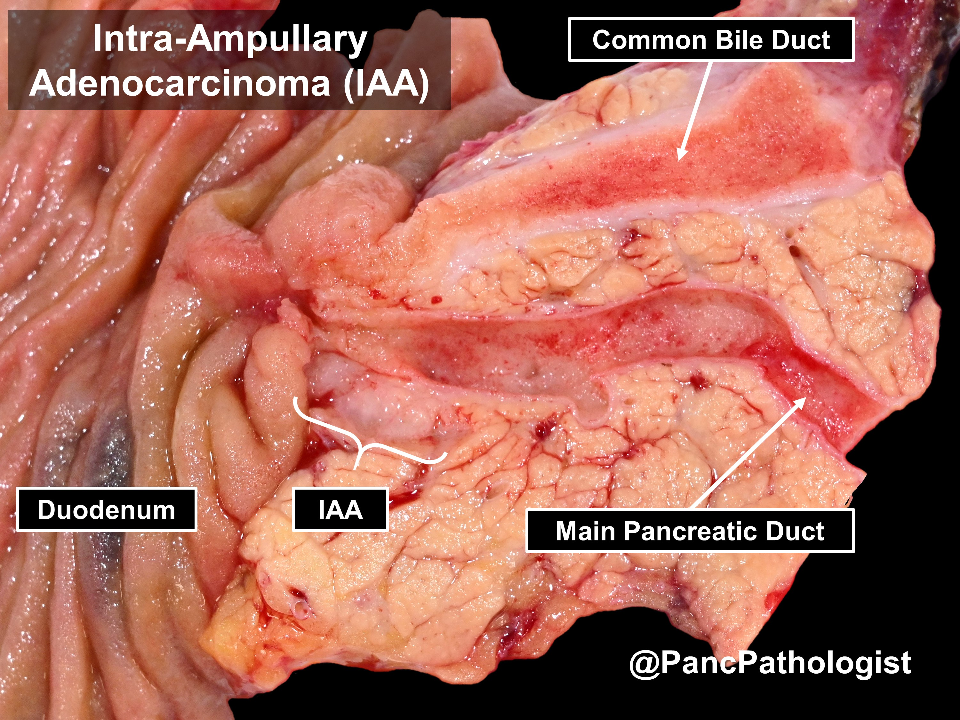

Slide 37
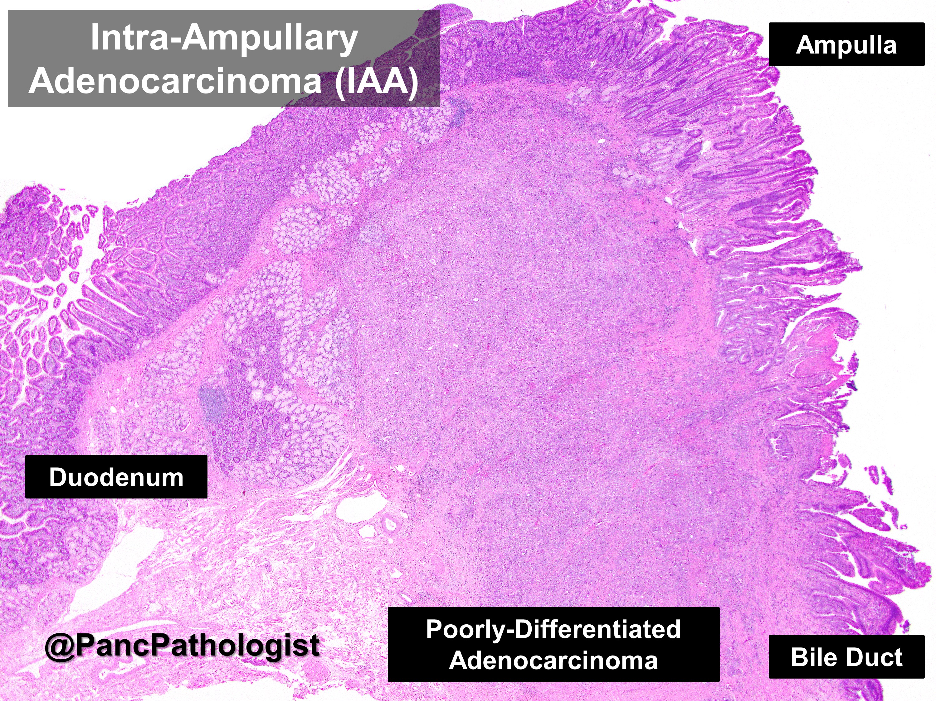

Slide 38
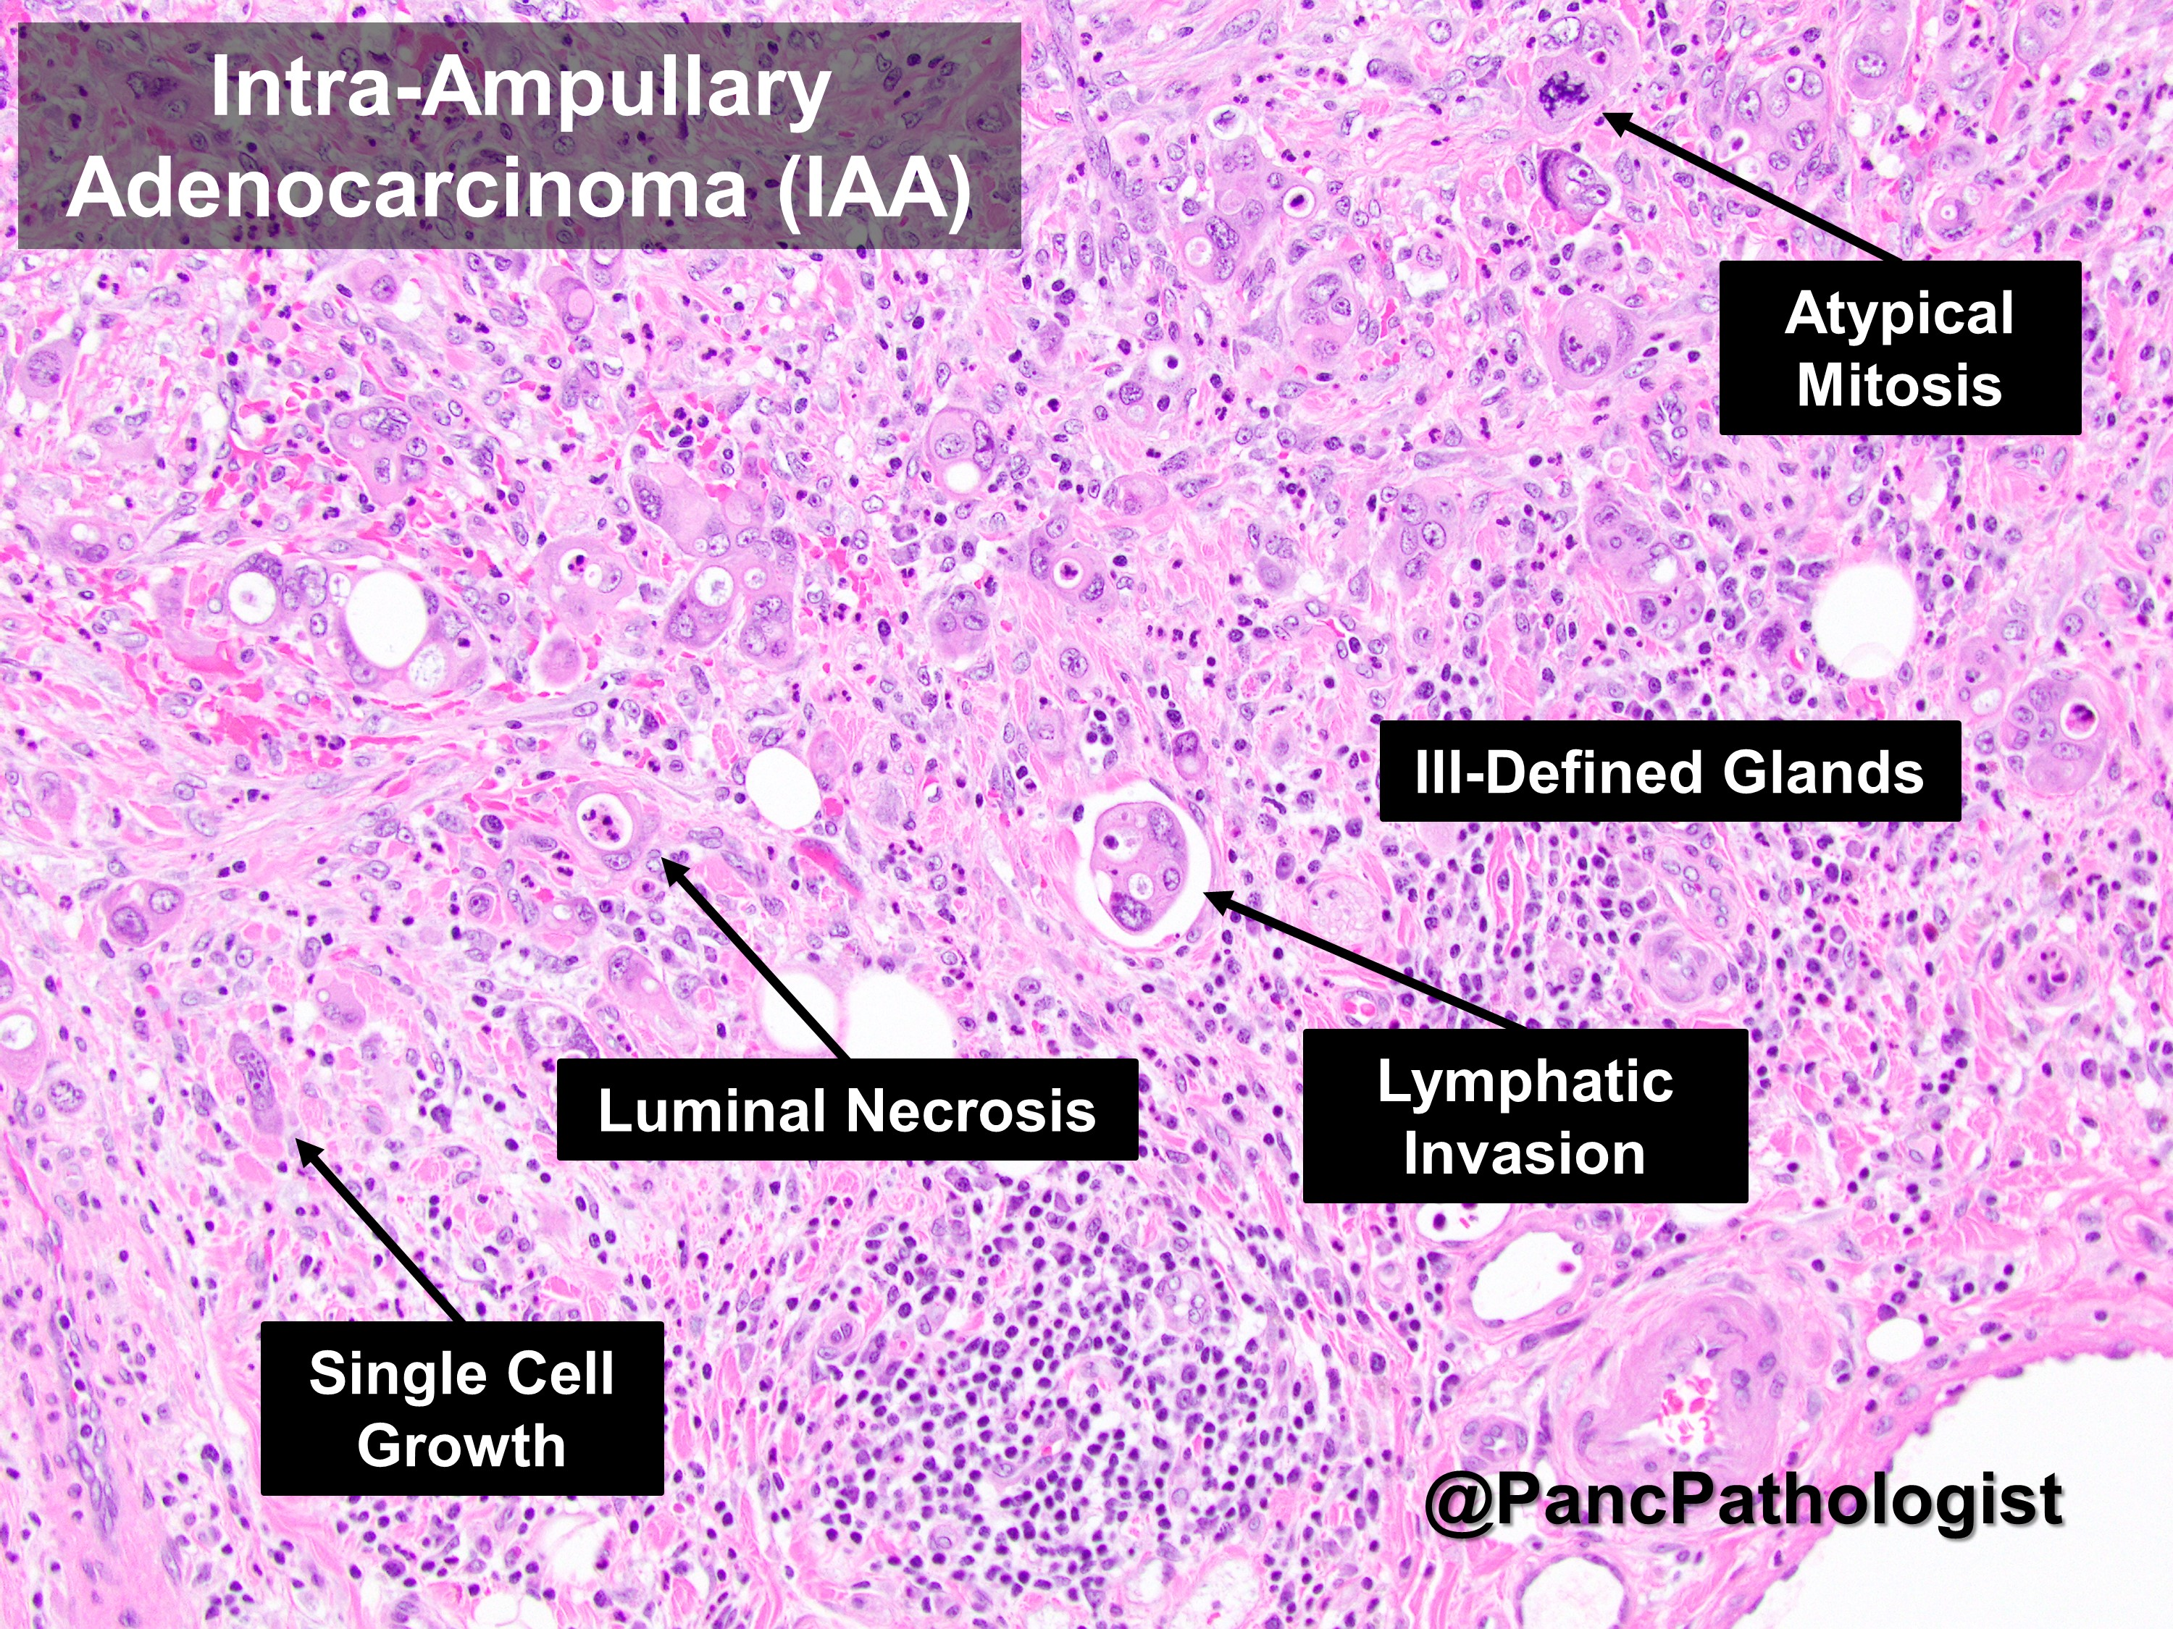

Slide 39
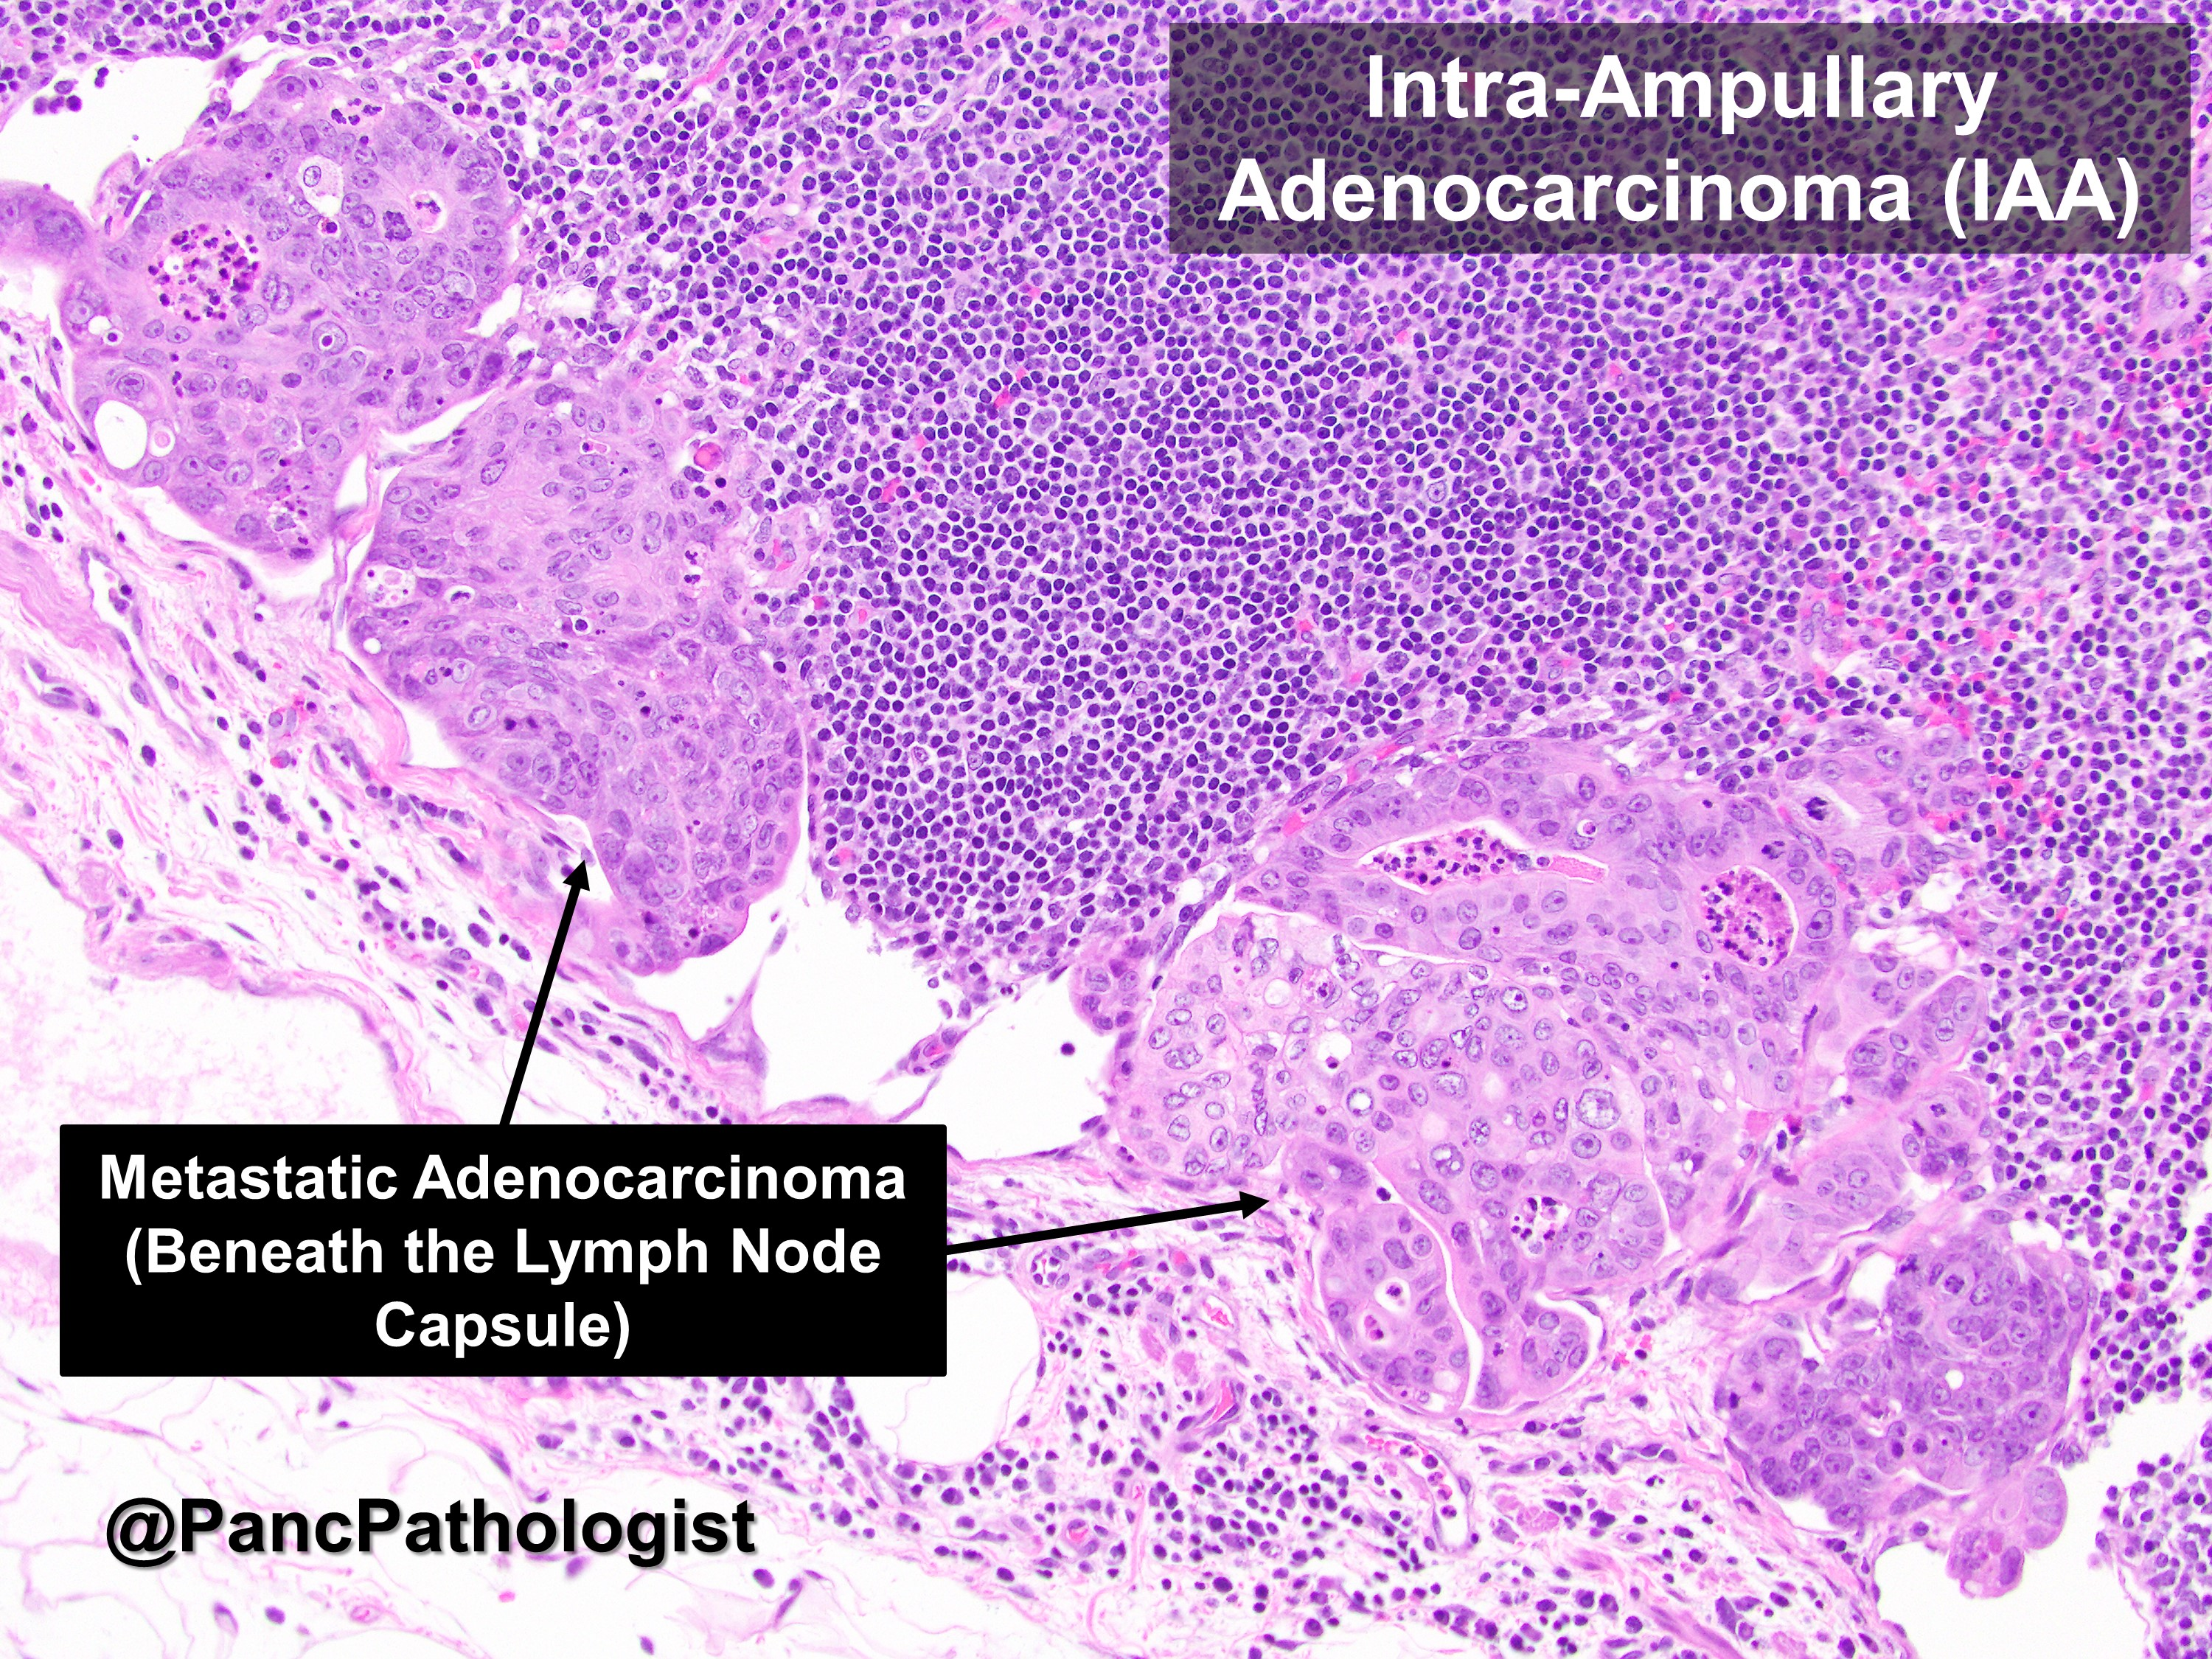

Slide 40
Pathological Staging
Ampullary tumors:
•Primary Tumor (pT)
  •___ pTX: Cannot be assessed
  •___ pT0: No evidence of primary tumor
  •___ pTis: Carcinoma in situ
  •___ pT1: Tumor limited to ampulla of Vater or sphincter of Oddi
  •___ pT2: Tumor invades duodenal wall
  •___ pT3: Tumor invades pancreas
  •___ pT4: Tumor invades peripancreatic soft tissues or other adjacent organs or structures
Regional Lymph Nodes (pN)
  •___ pN0: No regional lymph node metastasis
  •___ pN1: Regional lymph node metastasis
  •___ pN2: Metastasis in 04 or more regional lymph nodes.

Slide 41
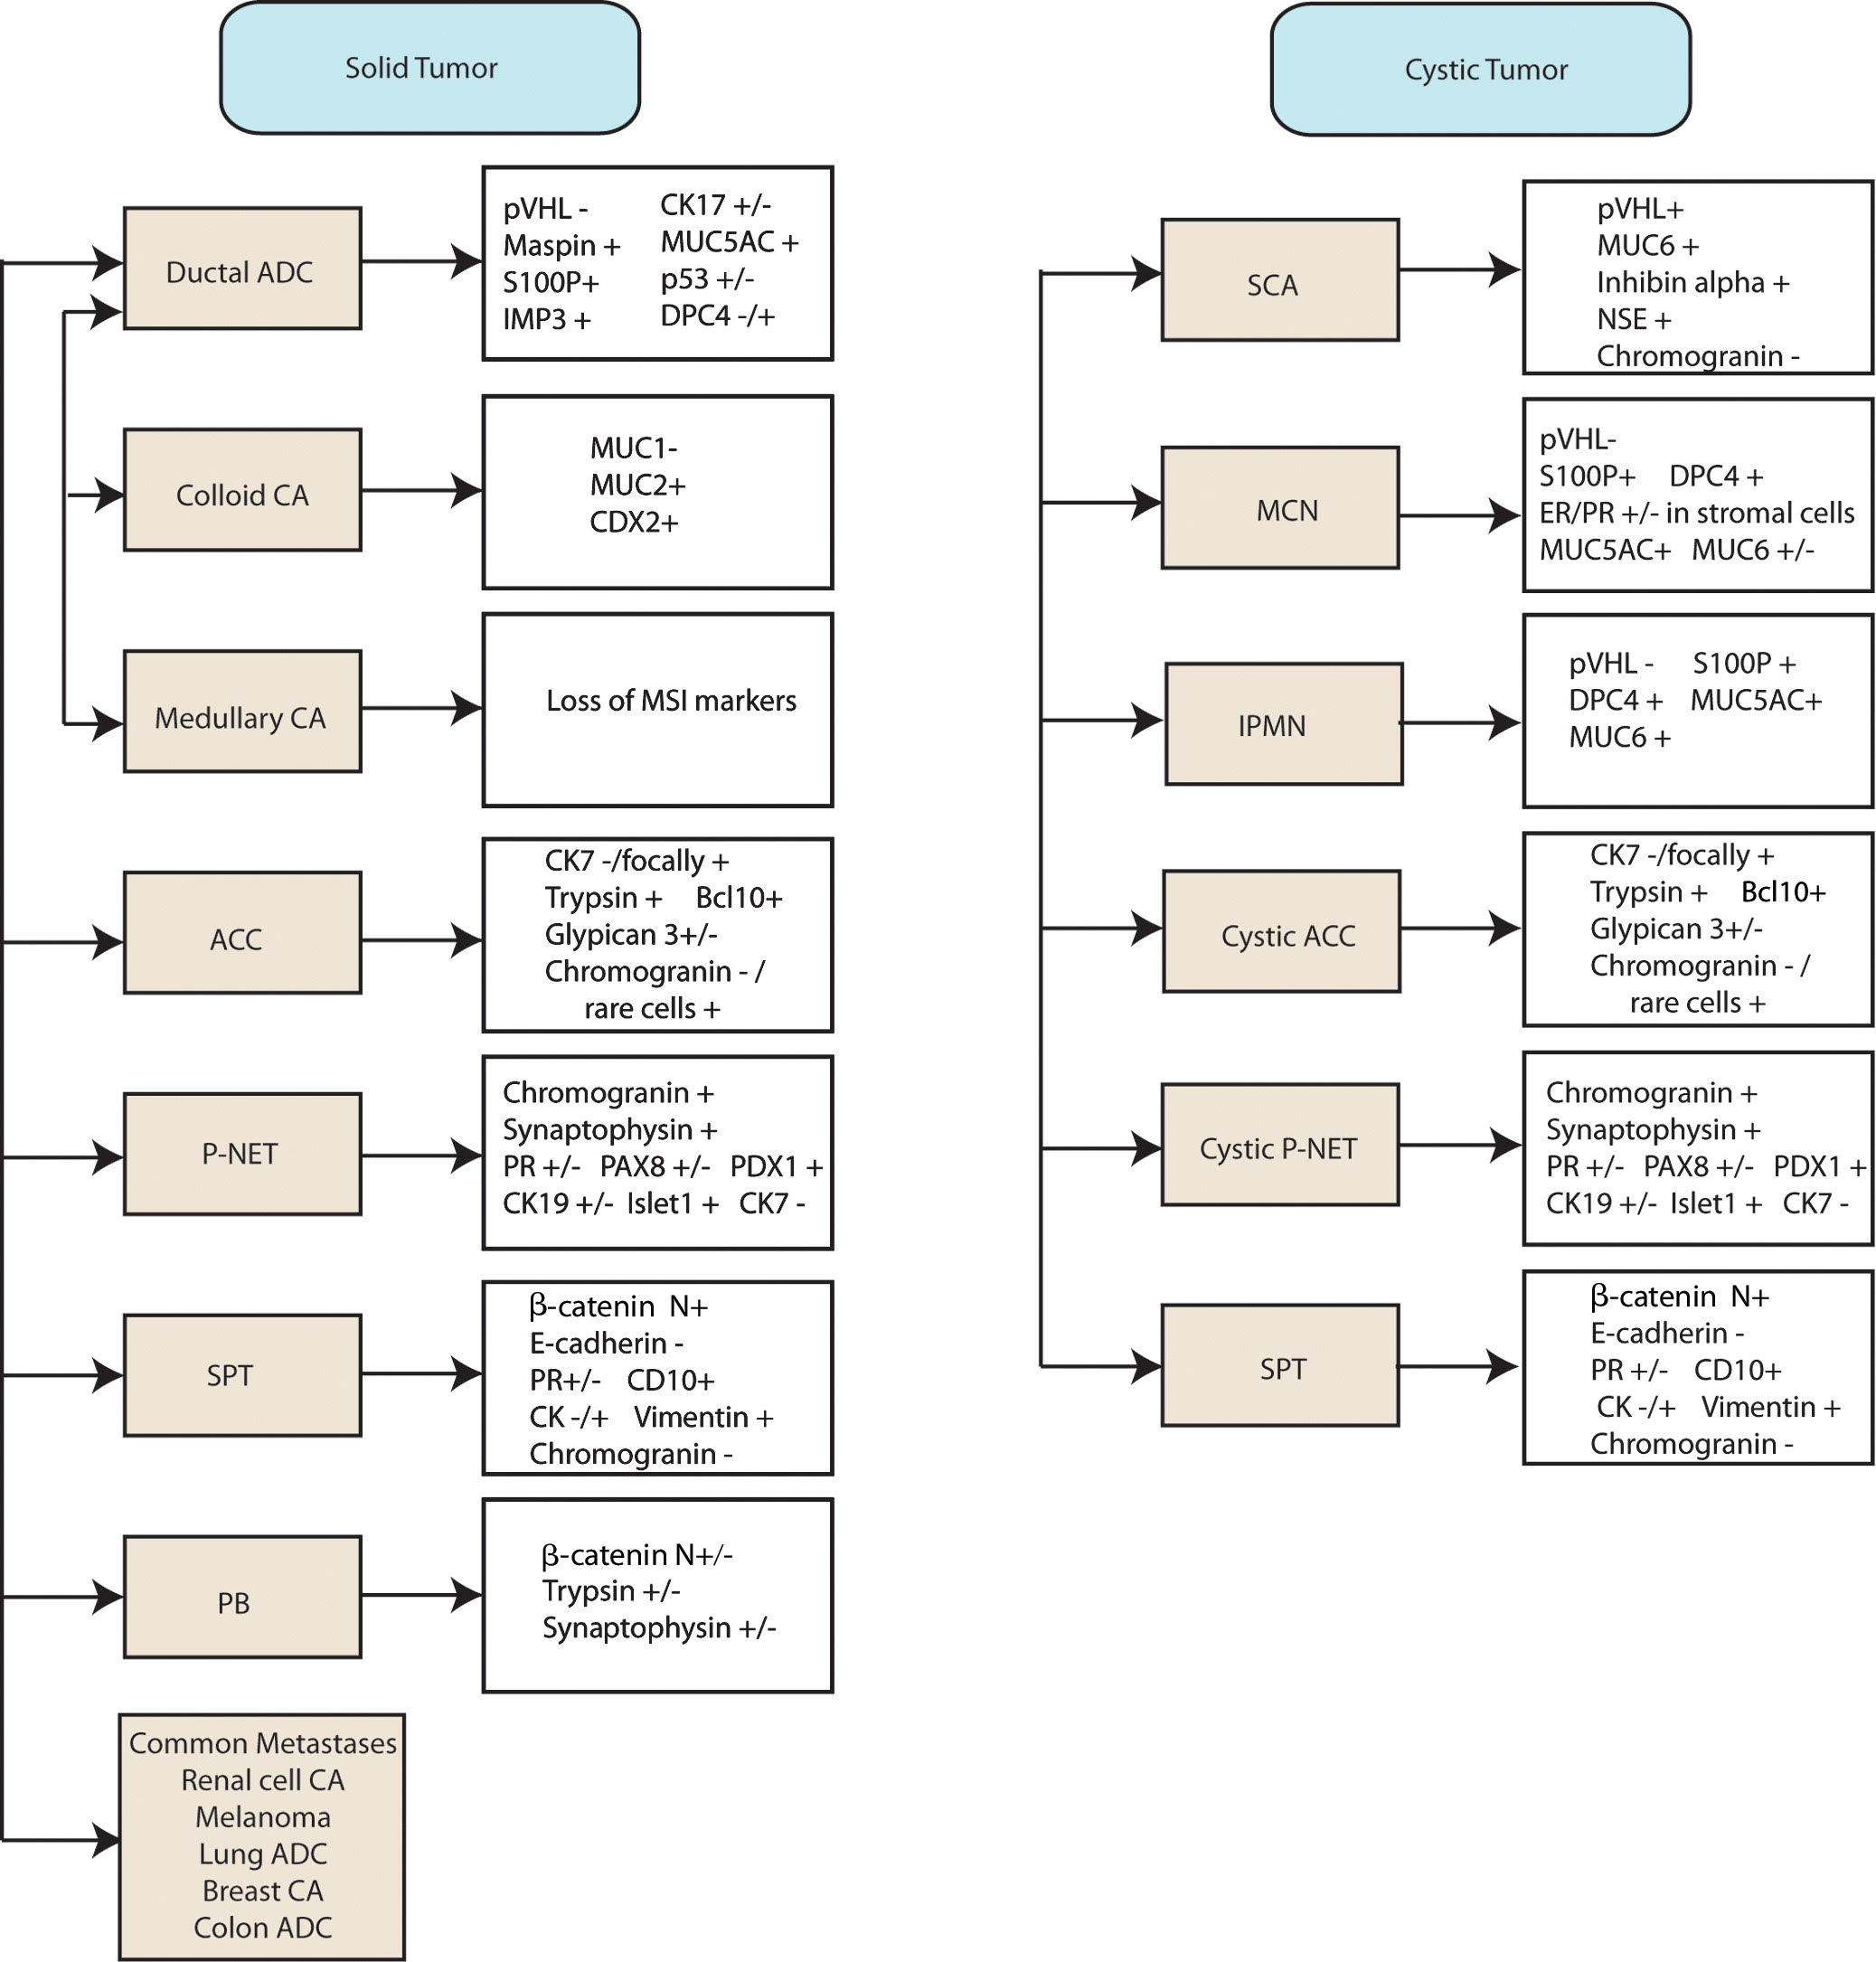

Slide 42
REPORT FORMAT
GALLBLADDER, COMMON BILE DUCT, HEAD OF PANCREAS, UNCINATE PROCESS & DUODENUM, WHIPPLE RESECTION:
PERIAMPULLALLARY ADENOCARCINOMA.
HISTOLOGIC GRADE: G2; MODERATELY DIFFERENTIATED.
TUMOR SIZE: 38 mm.
MARGINS: ALL MARGINS ARE FREE OF TUMOR.
LYMPHOVASCULAR INVASION: SEEN.
PERINEURAL INVASION: SEEN.
02 OUT OF 17 LYMPH NODES ARE INVOLVED BY METASTATIC CARCINOMA.
PATHOLOGIC STAGE: pT3a, N1.

Slide 43
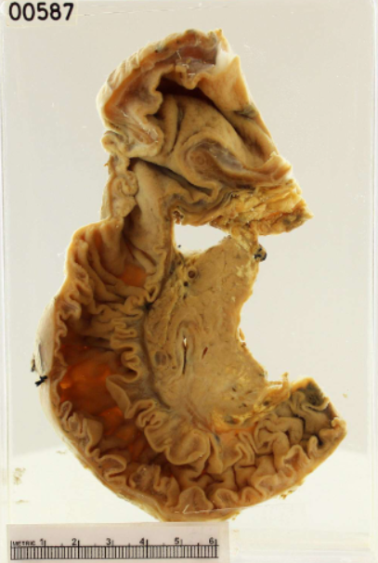
take hOme message….
Be brave and grab the opportunity to gross any Whipple you come across.
Be honest to the specimen…. For us specimen is ‘the patient’!!
Check the radiology.
Know your anatomy.
Check the staging.
Take help whenever in doubt.

