Slide 1
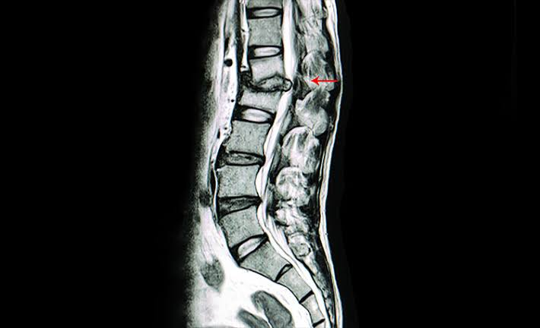
POTT’S DISEASE
By dr Aliza aslam
Pgr medical unit 2

Slide 2
DEFINITION
Potts disease is also called as Pott’s spine /Spinal TB/Tuberculosis Spondylitis.
Spinal tuberculosis is a destructive form of tuberculosis.
It is generally secondary.
The causative organism is Mycobacterium tuberculosis.
It spreads via the lymphatic and hematogenous systems.
It is associated with debilitating disease,AIDS , drug addict , alcoholism
Most common – Lower thoracic and upper lumbar , hip , knee .
Adult –the most common site is Thoracolumbar. Child – the most common site is Cervical .

Slide 3
TYPES

Slide 4
PARADISCAL (most common) -Involves adjacent margins of two consecutive vertebrae with reduced intervening disc space
CENTRAL- Involves central portion of a vertebra, proximal and distal disc spaces are intact.
ANTERIOR-Begins as destructive lesion in one of the anterior margins of the vertebral body, minimally involving the disc spaces.
Posterior elements –Involves posterior arch, usually without involvement of body.

Slide 5
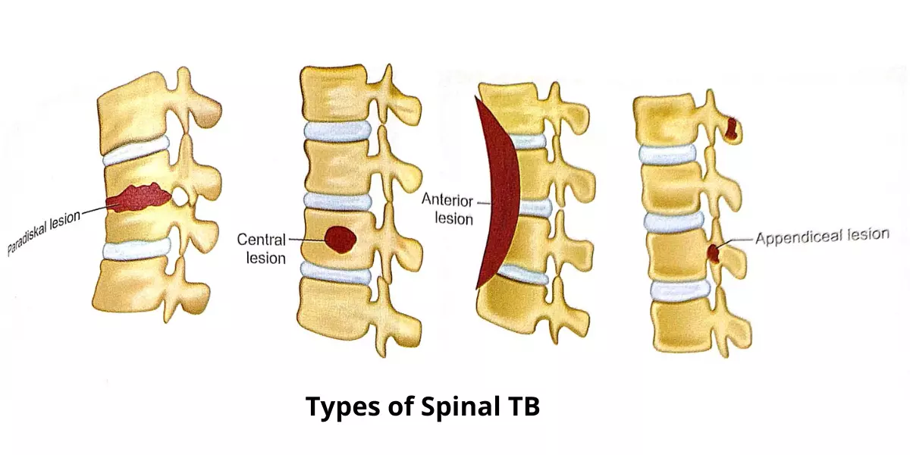

Slide 6
PATHOPHYSIOLOGY

Slide 7


BACILLI REACHES FINEST BRONCHIOLES AND INFLAMMATORY REACTION OCCURS
BACILLI ENTERS LYMPHATIC AND BLOOD STREAM AND REACHES DIFFERENT PARTS OF THE BODY
BACILLI REACHES THORACOLUMBAR SPINE
BACTERIA LODGES IN THE CONTAGIOUS AREA BETWEEN ADJ. VERTEBRAE
GRANULOMATOUS INFLAMMATION RESULTING IN EROSION OF THE MARGIN OF THESE VERTEBRAE
NUTRITION TO IV DISC STOPS LEADING DISC DEGENERATION AND COMPLETE DESTRUCTION
COLLAPSE OF VERTEBRAE

Slide 8
GRADES
1 –No motor symptoms or neurological deficits are
seen.
2 -The walk is clumsy.
3 - Not able to walk, partial loss of sensation
4 - Sphincter disturbances.

Slide 9
CLINICAL FEATURES
ACTIVE STAGE
PAIN (Back pain)
STIFFNESS –A very early symptom, Decreased range of motion
COLD ABSCESS - swelling cold abscess' or problems secondary to its compression effects on nearby viscera
PARAPLEGIA- the inability to voluntarily move the lower parts of the body (if neglected in early stages)
DEFORMITY/Kyphosis /Gibbus /kyphus
OTHER SYMPTOMS- Fever, Weight loss, Night sweats, Malaise

Slide 10
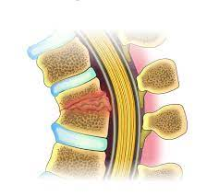
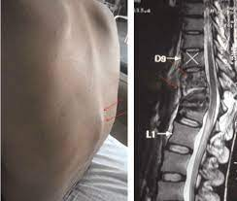
INTERNAL GIBBUS
Pathagnomic feature of potts’s spine .
Angulation of the diseased spine leads to the formation of the bony ridge on anterior wall of spinal canal

Slide 11
LAB FINDINGS
ESR- Elevated ESR : >100 mm/h .
Mantoux test or Tuberculin skin test (purified protein derivative [PPD]) results are positive in 84–95% of patients with Pott disease who are not infected with HIV.
ELISA: Anti-TB antibody
Lymphocyte increased

Slide 12
IMAGING
RADIOLOGY:
X-ray-specify 1st investigation to be done .
Chest X-ray, X-ray of the abdomen
KUB- if psoas abscess suspected
Computed tomography (CT) (100% sensitivity): earlier stage
Magnetic resonance imaging (MRI) – Investigation of Choice . MRI is the most useful modality in diagnosing spinal TB. MRI best detects the extent of soft tissue enhancement, the location of the abscess and spinal canal compromise.
Biopsy – Best diagnostic procedure.

Slide 13
MANAGEMENT
The mainstay of treatment for spinal TB is chemotherapy for antitubercular treatment.
Based on their presentation:
    Uncomplicated spinal TB is a medical disease.
    Complicated TB spine patients need surgical intervention in addition to chemotherapy.
The treatment protocol is formulated based on the presence or absence of neurological involvement.

Slide 14
In the case of neurological involvement usually, pharmacotherapy is preferred over surgery.
The anti-tubercular medications employed in pharmacotherapy are Isoniazid, Rifampicin, Ethambutol, and Pyrazinamide.
Surgery done during the active course of the disease is much safer with a faster and better response.
WHO recommends 9 months of treatment for Bone and joint TB.

Slide 15
SURGICAL MANAGEMENT
Anterior decompression spinal fusion (ADSF)
Anterior radical focal debridement
Debridement of the infected material without stabilization.
Debridement with stabilization of the spine (spinal reconstruction)
KYPHOSIS CORRECTION
LAMINECTOMY-

Slide 16


