Slide 1


Slide 2
CLINICOPATHOLOGIC CONFERENCE
Presented by
Tuba Riaz (264)
Ali Zubair (408)
Nabiha Arshad (452)

Slide 3

HISTORY
BIODATA
Ghulam murtaza
45 year Male
Muslim
Labour
Resident of chak 123
Presented to OPD on 15-7-24

Slide 4
PRESENTING COMPLAIN
Yellow discoloration of eyes with itching for 1 Month
Abdominal pain for 5 days
HOPI
Patient notice yellow discoloration of Eyes 1 month back
Gradual in onset
Progressively increasing
Associated with smelly clay colored stool, not containing any blood or mucus
Dark colored urine
No Aggravating or relieving factor

Slide 5
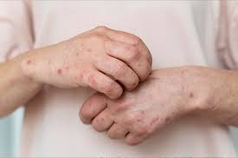
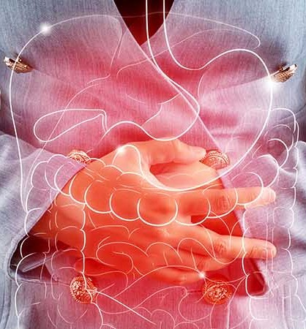
Generalized itching started 10 days after yellow discoloration of eyes
Gradual in onset
Variable, more marked at night
Stinging in character
Sever in nature as it disturb the sleep of patient
Not relieved by anti histamine
Not associated with any skin rash
epigastric pain 5 days back
Sudden in onset
Severe
Crushing In character
Non radiating
No Aggravating factor
Relived by pain killer

Slide 6
SYSTEMIC REVIEW
GENERAL REVIEW:
Weight loss 5-7 kg in 1 month
No Fever
Decreased appetite, bowel and bladder activity
CNS REVIEW:
No headache, weakness,fits,loss of consciousness
RESPIRATORY REVIEW:
  No SOB, cough, sputum

Slide 7
CVS REVIEW:
No chest pain, palpitations, orthopnea, PND
GIT REVIEW:
Clay colored stool
No malaise, abdominal distention, nausea, vomiting
UROGENITAL REVIEW:
Dark colored urine
No pyuria, hematuria, Burning micturition
MUSCULOSKELETAL REVIEW:
leg pain
No rashes, swelling, redness, backache

Slide 8
PAST MEDICAL AND SURGICAL HISTORY
Tooth extraction 2Y back
No Hepatitis, D.M, Hypertension, hospital admission, blood transfusion
FAMILY HISTORY
History of CA pancreas of brother
PERSONAL HISTORY
Poor sleep
Addicted to Naswar for 20 Y
SOCIO-ECONOMIC HISTORY
Cemented house comprises of 1 room shared by 5 people
Good sanitation
Drink tap water

Slide 9
DIFFERENTIAL DIAGNOSIS
Choledocholithiasis
CA Pancreas
Peri Ampullary Tumor
Chlangiocarcinoma
EXAMINATION
I Examined Middle aged man, looking emaciated with average height, well oriented with time, place and person, having IV cannula on right hand
Vitals:
B.P 100/70 | Pulse 106/min
Temp A/F | RR 18/min

Slide 10
G.P.E
Brittle nails, no clubbing, cyanosis, koilonychia
Yellow discoloration of palms, muscle wasting of hands
Yellow discoloration of eyes, pallor not appreciable
No skin rashes, pedal edema
No enlargement of lymph nodes
GIT EXAMINATION
INSPECTION:
Abdomen is scaphoid, symmetrical, umbilicus central and inverted, no striae, no scar marks, no visible pulsations
PALPITATION:
Abdomen is soft and non tender.
Mass of 3×3 cm was palpable in R.H.C , mass was globular in shape, firm in consistency with smooth surface, Margins are not sharp, not move with respiration.
Liver, spleen and Gallbladder are not palpable

Slide 11
PERCUSSION:
Tympanitic note in abdomen
No fluid thrill and shifting dullness
AUSCULTATION:
Bowel sounds are audible
No hepatic, splenic, aortic bruit is audible
PER RECTAL EXAMINATION:
Anal tone and sphincter was normal.
No mass , fissure or haemorrhoids present
Soft fecal matter present in rectum.

Slide 12
CNS EXAMINATION
Higher mental function: Normal GCS 15/15.
Well ortiented with time , place and person
Motor system: Intact
Sensory system: Intact
SOMI: negative
CVS EXAMINATION
Inspection: There was no striae ,scar mark ,visible pulsations ,
chest deformity
Palpation: Apex beat was localized at 4th intercostal space,1cm medial to mid-clavicular line.There was no palpable heave & thrill.
Auscultation: S1 and S2 were normal. There were no added sounds.

Slide 13
RESPIRATORY EXAMINATION
Inspection: Respiration was abdomino-thoracic. Chest movements were normal. There was no striae, scar mark or any chest deformity
Palpation: There was no tenderness, crepitus, vocal fremitus. Trachea was central.
Percussion: Upper border of liver at 4th intercostal space
Auscultation: Normal Vesicular breathing and there were no added sounds
INVESTIGATION

Slide 14
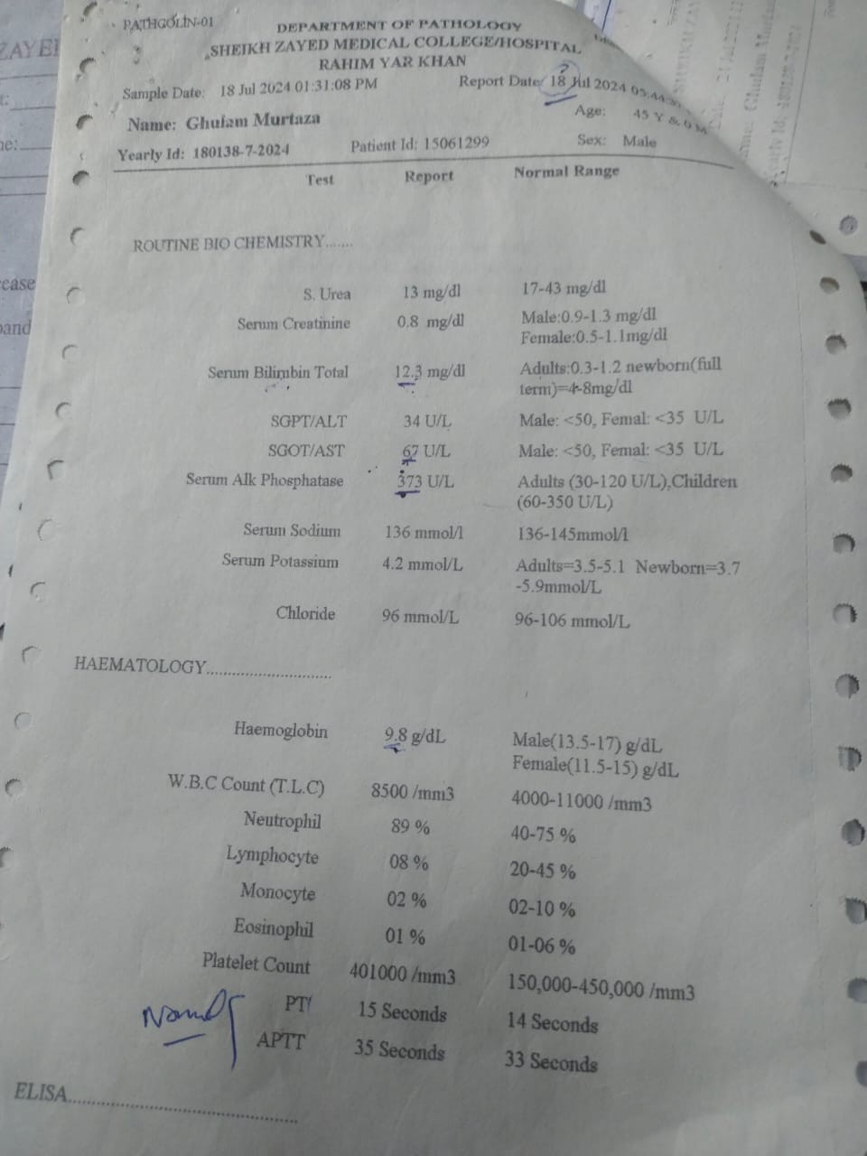
CBC
25
Hb 9.8 g/dl
Neutrophils 89 %
ROUTINE BIOCHEMISTRY
Total bilirubin 12.3 mg/dl
Alkaline Phosphatase 373 U/L
Bleeding Time Normal
VIRAL MARKERS
Negative for Hep B and C

Slide 15
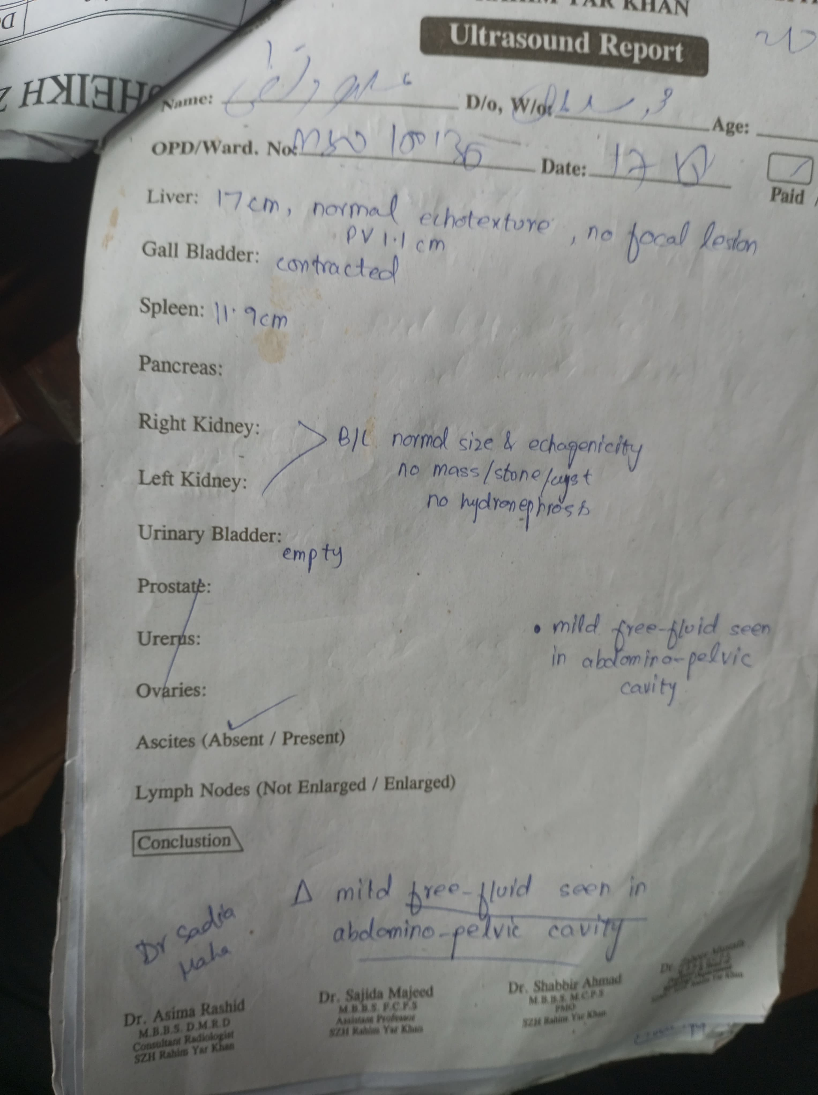
TUMOR MARKER
CA 19-9
4.52 U/ml (Normal range)
28
ULTRASOUND
Gall bladder contracted
Liver 17 cm with normal texture
Mild free fluid in abdomino-pelvic cavity

Slide 16
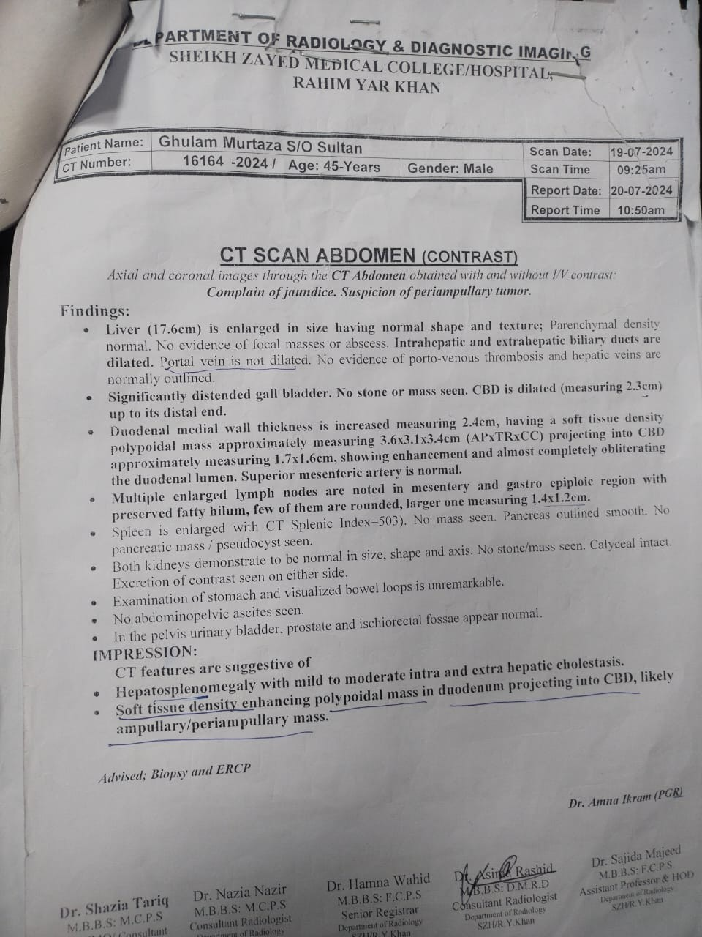
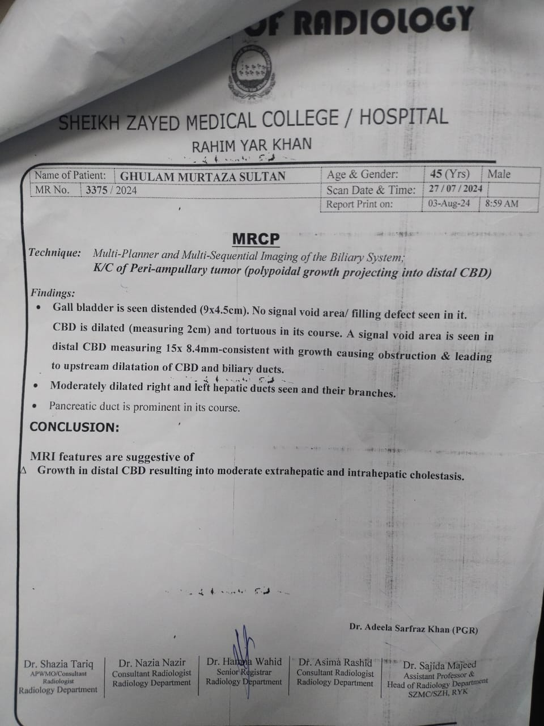
CT SCAN
29
Polypoidal mass of 3.6×3.1×3.4 projecting into CBD measuring
1.7*1.6cm showing enhancement and almost completely obliterating duodenal lumen
Hepatosplenomegaly
Intra and extra hepatic cholestasis
30
MRCP
Growth in Distal CBD resulting into
extra and intra hepatic cholestasis

Slide 17
PERIAMPULLIARY TUMOR (HEAD OF PANCREAS)
MANAGEMENT

Slide 18
PRE OPERATIVE MANAGEMENT
Vitamin K
Prophylactic Antibiotics
IV fluids to maintain renal perfusion
  Echo
  ECG
SURGICAL MANAGEMENT
Whipple Procedure

Slide 19
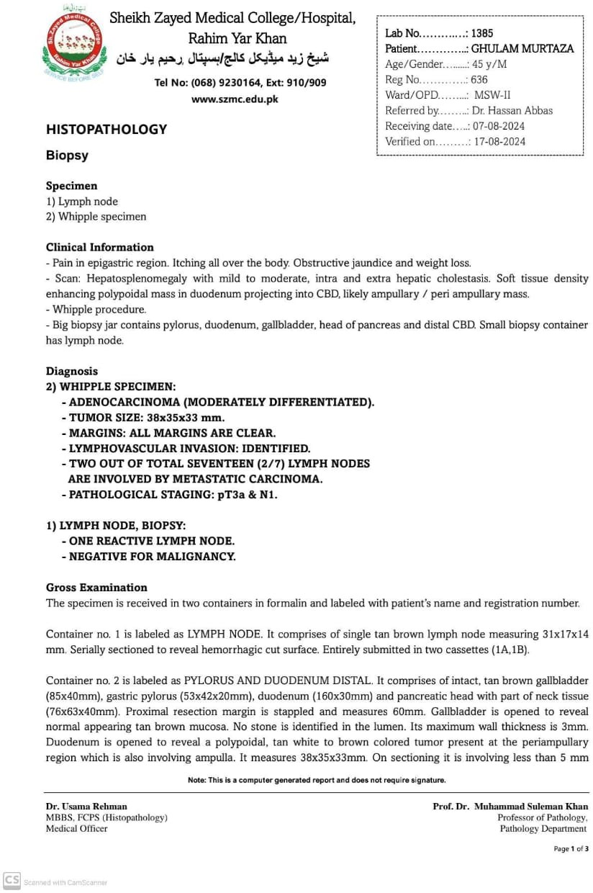
35
BIOPSY
Whipple Specimen:
ADENOCARCINOMA (MODERATELY DIFFERENTIATED)
TUMOR SIZE: 38×35×33 mm
MARGINS: ALL MARGINS ARE CLEAR
LYMPHOVASCULAR INVASION:
IDENTIFIED
TWO OUT OF TOTAL SEVENTEEN (2/7) LYMPH NODES ARE INVOLVED BY METASTATIC CARCINOMA
THANK YOU

Slide 20
OBSTRUCTIVE JAUNDICE
Presented By: Dr. Saba Asad (PGR) UKSO: Dr. M. Nauman Ashraf (Senior Registrar)
Surgery Unit II

Slide 21

JAUNDICE
Jaundice is a medical condition characterized by the yellowing of the skin, mucous membranes, and sclera due to an increased level of bilirubin in the blood.
Jaundice can be classified into three main types based on the underlying cause of the increased bilirubin levels.

Slide 22
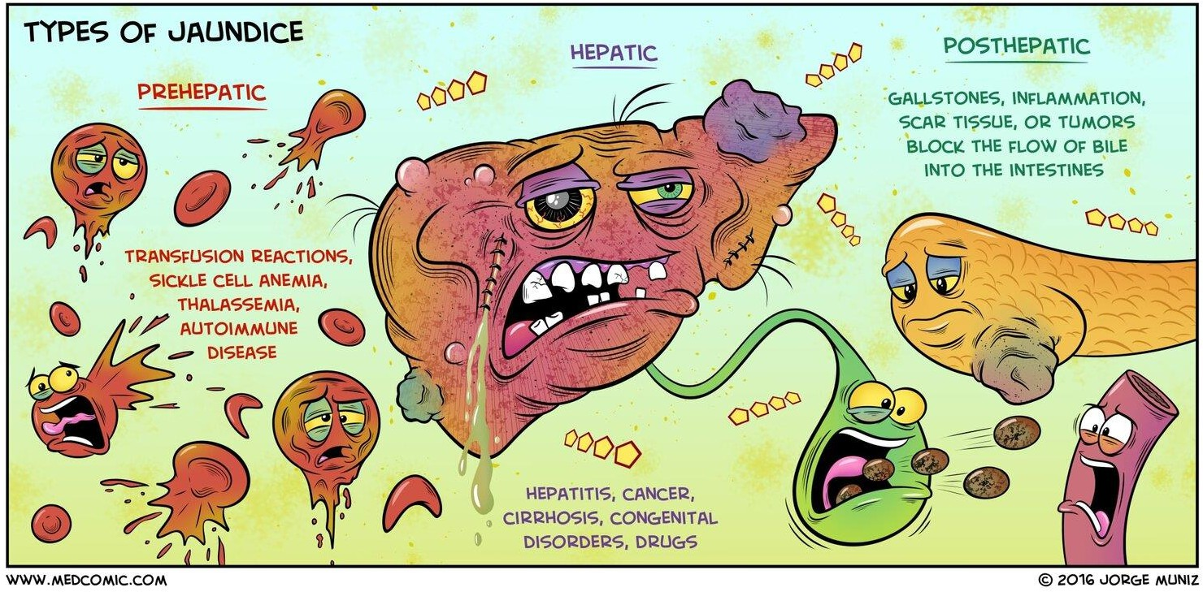

Slide 23
Obstructive Jaundice
Cause
This type of jaundice occurs due to an obstruction in the bile ducts, which prevents bile (and bilirubin) from being excreted into the intestines. The bilirubin then backs up into the bloodstream.
Common Conditions
Choledocholithiasis
Gall Stones (Mirizzi Syndrome)
Pancreatic cancer (especially involving the head of the pancreas) Ampullary/Periampullary Tumours
Bile duct strictures
Bile Duct tumours (e.g., Biliary Atresia, cholangiocarcinoma) Parasites (e.g., Clonorchis sinensis, Ascaris lumbricoides

Slide 24
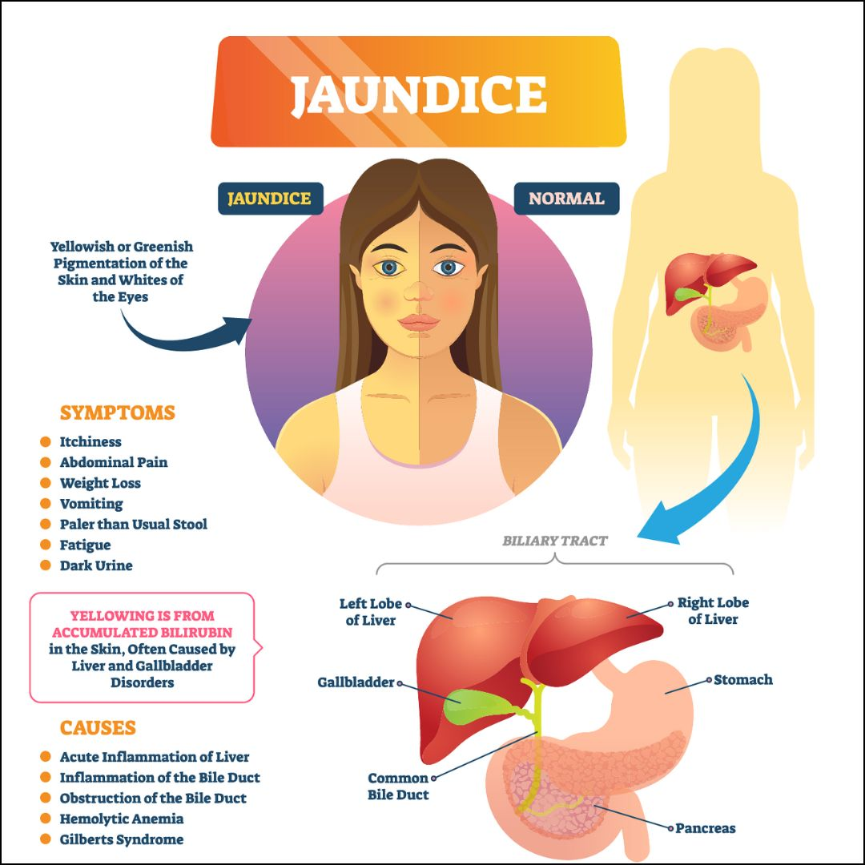

Slide 25
Investigation
CBC: Raised Leukocyte ( Increase immature neutrophils in patients with cholangitis)
LFTS:
  Total Serum Bilirubin increased
  Conjugated Bilirubin increased
  Unconjugated Bilirubin Normal
  ALP raised
  ALT & AST Normal or Increased
Stool and Urine Examination:
  Urine urobilinogen decreased
  Dark colored urine (Bilirubinuria)
  Clay colored stool (absent Stercobilin)

Slide 26
Investigation(cont..)
Ultrasonography:
  Possibly GB or CBD calculi
  CBD Diameter
  Presence of intrahepatic Billiary Dilatation
  GB masses, liver metastasis
CT & MRI:
  To delineate the anatomy of lesions and surrounding structures
  Staging of hepatic and gall bladder malignancy

Slide 27
Investigation(cont..)
ERCP (Invasive)
  Diagnostic:
    For Billiary tree anatomy and cause of obstruction
    Brushing for Cytology
  Therapeutic:
    Stone Extraction
    Sphincterotomy
    Billiary Stent
MRCP(Non Invasive)
  Used for only diagnostic Purposes

Slide 28
Pre-Operative Management
of Obstructive Jaundice
Correct metabolic abnormalities
Improve general conditions of Patient
Measure to reduce the complications associated with prolonged or severe cholestasis
  Prevention of infective complications
  Correction of coagulation disorders
  Prevention of Renal failure
  Prevention of hepatic Encaphalopathy

Slide 29

Prevention of Infective Complications
Use of IV prophylactic antibiotics ( cephalosporin, aminoglycosides and pipracillin) in
All jaundiced patients
Patients with rigors and pyrexia
Patients undergoing emergency biliary procedures/Operations
Elderly patients
Patient with CBD stones even if not jaundiced
Patients Undergoing secondary Biliary interventions

Slide 30
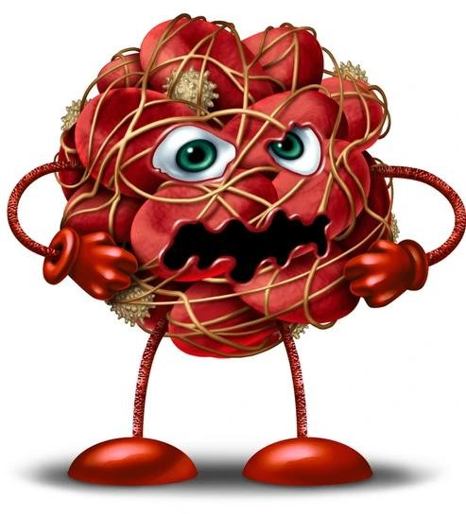
Correction of Disorders of
Coagulation
Prolonged prothrombin time in patients of severe hepatic disease due to deficiency of vitamin k dependent factors
Rx: vitamin k injection
FFPs Transfusion
DIC – Due to circulating endotoxin
Rx: Monitoring of fibrinogens, FDPs Platelets count
FFPs, heparin

Slide 31
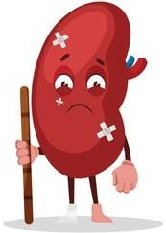
Prevention of Renal failure
Endotoxenemia results in GFR reduction
Rx:
Adequate hydration( IV fluids 5%dextrose saline 12- 24 hours before surgery
Diuretics (Osmotic and loop diuretic at time of induction of anesthesia)
Hourly UOP monitoring

Slide 32

Prevention of Hepatic
Encephalopathy
Liver failure in patients with complete Bile duct obstruction, chronic hepatocellular disease.
If jaundice is severe or impending signs of liver failure:
Insertion of plastic endoprosthesis
Endoscopic Sphincterotomy in peri- ampullary cancer
Promethazine or chlorpromazine for sedation

Slide 33
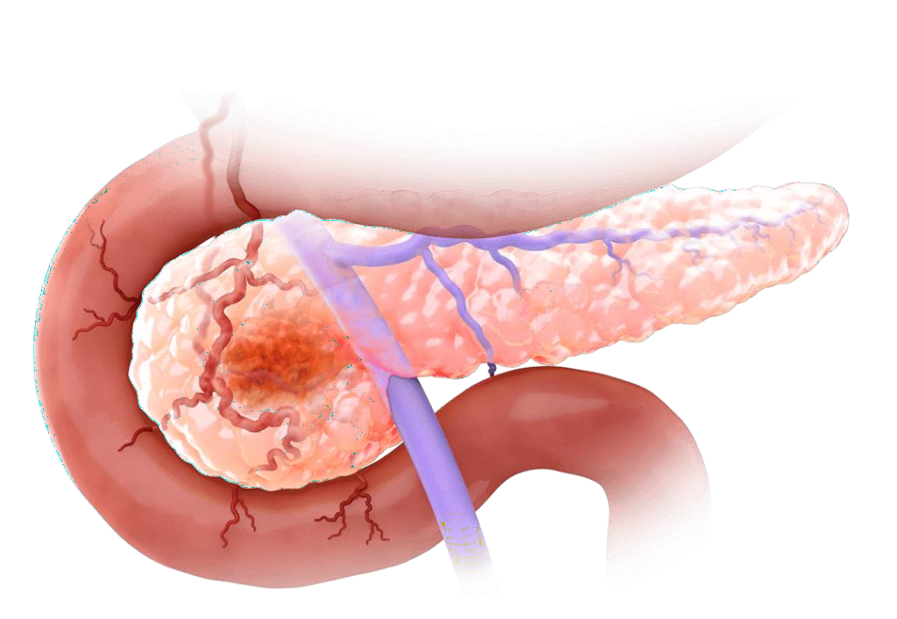
Periampullary Tumors

Slide 34
Introduction
Most duodenum tumors originate in peri ampullary region and commonly in pre existing villous adenoms.
Direct involvement leads to obstructive jaundice.
Histologically, it is most common adenocarcinoma.
Metastasis are common to regional lymph nodes and liver.

Slide 35
Introduction(cont..)
At presentation, about 70% of patients have resectable disease with an expected 5-year survival rate of approximately 20%.
Poor prognostic features include regional lymph node metastases, transmural involvement and perineural invasion.
Patients with FAP, which is due to a mutation in the APC gene on chromosome 5, are predisposed to periampullary cancer.

Slide 36
Clinical Features
Patients present with anaemia due to ulceration of the tumour or obstruction
Painless jaundice with nausea and epigastric discomfort
Pruritus
Dark urine, pale stool with steatorrhea
Anorexia with weight loss
Back pain (Retroperitoneal infiltration)

Slide 37
Examination
Jaundice
Palpable liver
Palpable gall bladder( courvoisers Law)
Signs of intra abdominal malignancy- Palpable mass, ascites, supraclavicular nodes and tumors deposits in pelvis

Slide 38
Investigations
Blood Tests
Ultrasound
Contrast Enhanced CT
  Resectability
  Staging
MRA & MRI
ERCP & Biliary Stunting
  Diagnostic and Therapeutic

Slide 39
Endoscopic US
  If CT fails to demonstrate Tumor
  If Tissue dx is required prior to surgery
  If vascular invasion needs to be confirm
  If separating Pseudo cyst from cystic tumor
Tumor Marker
  CA 19-9 ( not specific and sensitive)
Diagnostic laparoscopy

Slide 40
Surgical treatment Options
Pylorus Preserving pancreatico duodenectomy
Whipple’s Procedure

Slide 41
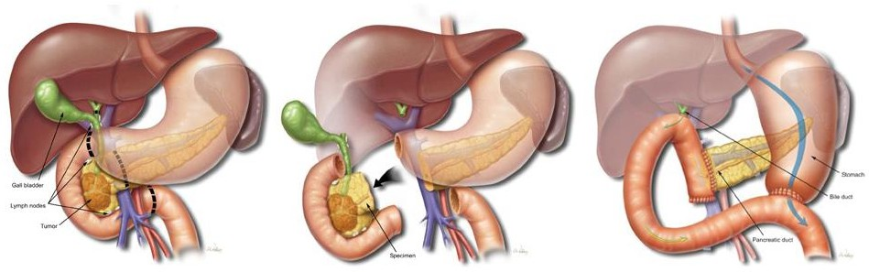
WHIPPLE PROCEDURE

Slide 42
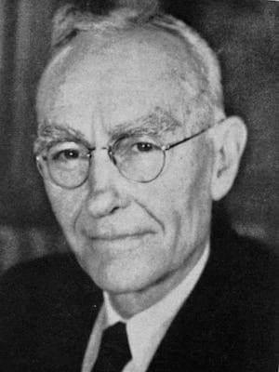
Introduction
Pancreaticoduodenectomy involves removal of the pancreatic head, duodenum, gallbladder, and bile duct with or without removal of the gastric antrum.
Alessandro Codivilla performed the first pancreatico duodenectomy in 1898.
Whipple performed the first anatomic one- stage pancreaticoduodenectomy for a tumor of the head of e pancreas in 1940

Slide 43
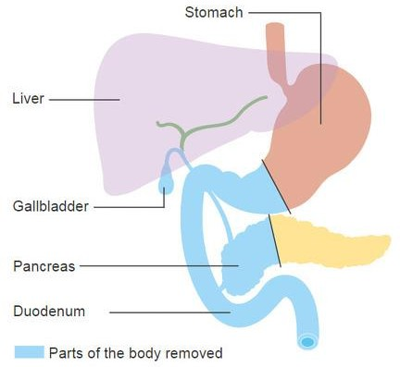
Anatomy Involved
Pancreas (head)
Duodenum
Proximal Jejunum
Common bile duct
Gallbladder
Possible part of the stomach (pylorus-preserving or not)

Slide 44

Indications
Pancreatic head cancer
Ampullary carcinoma
Distal cholangiocarcinoma
Duodenal cancer
FAP
Selective cases of chronic pancreatitis
Trauma to Pancreatic or Duodenal region

Slide 45
Contraindications
If SMA , Hepatic Artery, and Portal Vein becomes involved.
Presence of Ascites , nodal and peritoneal metastasis
If tumor greater than 4cm
Liver and lung metastasis

Slide 46
Patient Preparation
Clear liquid diet on the day prior to surgery.
An endotracheal tube, nasogastric tube, urinary catheter, and appropriate monitoring lines are placed.
Prophylactic subcutaneous heparin (5,000 units) to prevent deep venous thrombosis.
Prophylactic antibiotics are administered within 30 minutes of the incision.
The operation is performed in the supine position

Slide 47
Surgical Procedure
Exploration and Assesment
Laparotomy to access abdominal cavity.
Resection
Removal of the pancreatic head, duodenum, part of the bile duct, gallbladder, and sometimes part of the stomach
Reconstruction
Pancreaticojejejunostomy (connecting the pancreas to the jejunum) | Choledochojejunostomy (connecting the bile duct to the jejunum) | Gastrojejunostomy (connecting the stomach to the jejunum)

Slide 48
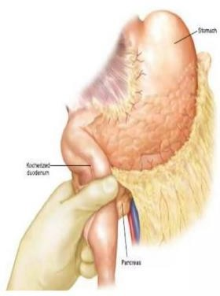
Resection steps
A midline incision
Thorough exploration for occult metastasis
The duodenum is widely kocherized by releasing it from the retroperitoneum
This allows for palpation of tumor and its relationship to SMA

Slide 49
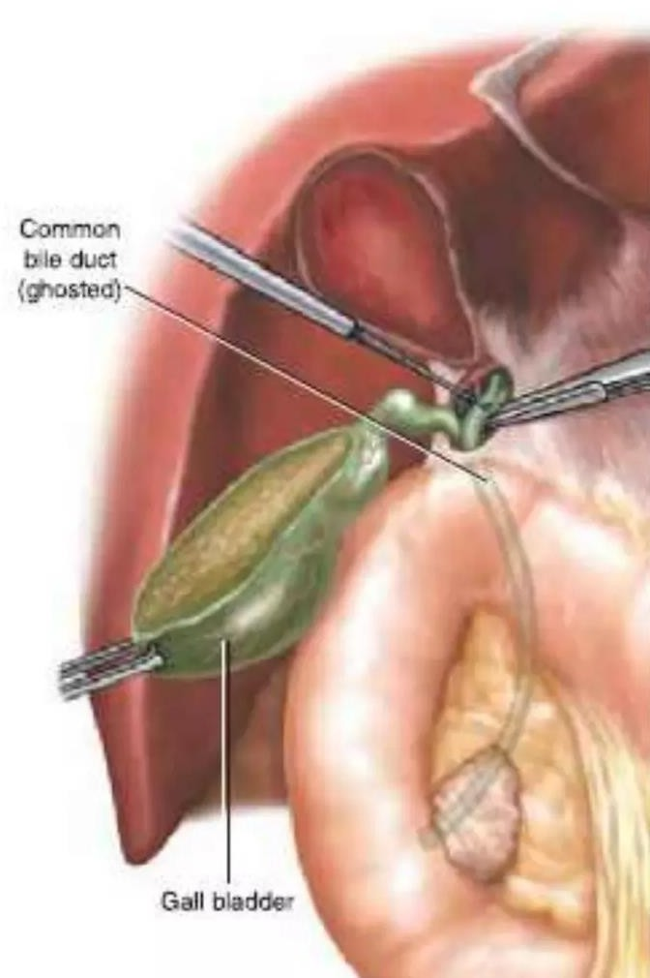
The gallbladder is resected via the "dome down" technique
The gastrohepatic ligament is partially divided
Further dissection within the hepatoduodenal ligament allows for identification of the proper hepatic artery and its branches
The common hepatic duct is divided
A bulldog vascular clamp is placed on the proximal common hepatic duct to limit bile spillage
The gastrodudenal artery (GDA) is identified and ligated

Slide 50
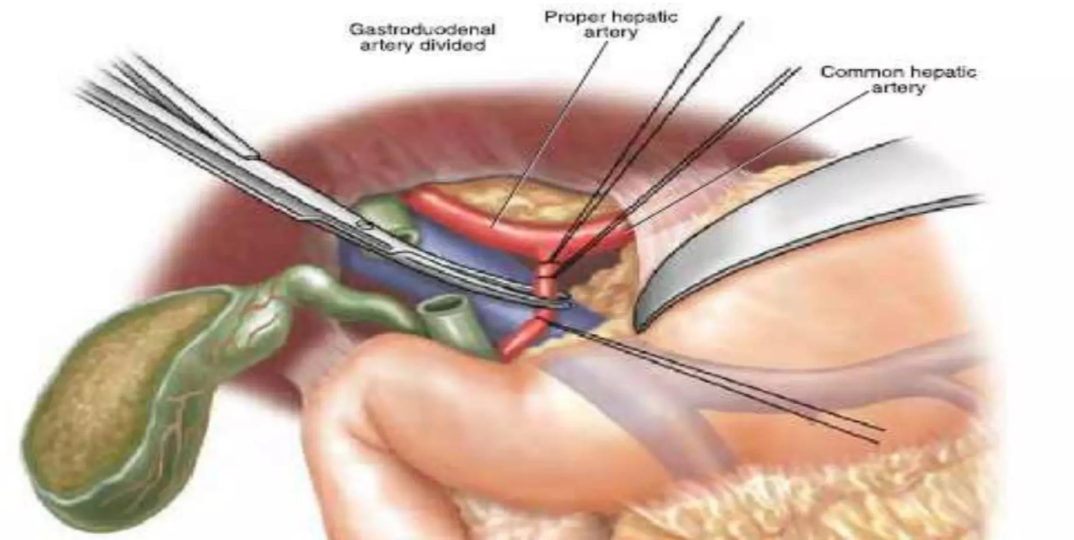

Slide 51
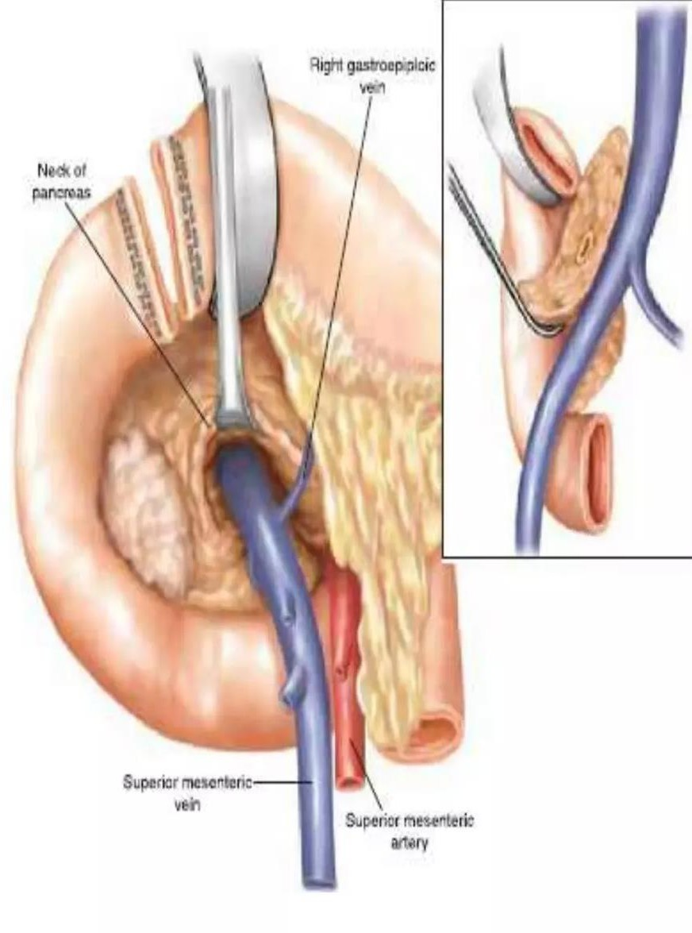
The pancreatic head and uncinate process are further mobilized and the right gastroepiploic artery and vein are ligated.
Creation of the tunnel posterior to the pancreatic neck, in the avascular vertical plane of the SMV-PV axis.
A Penrose drain is passed through this tunnel, to elevate the pancreatic neck is then divided with electrocautery over the Penrose drain

Slide 52
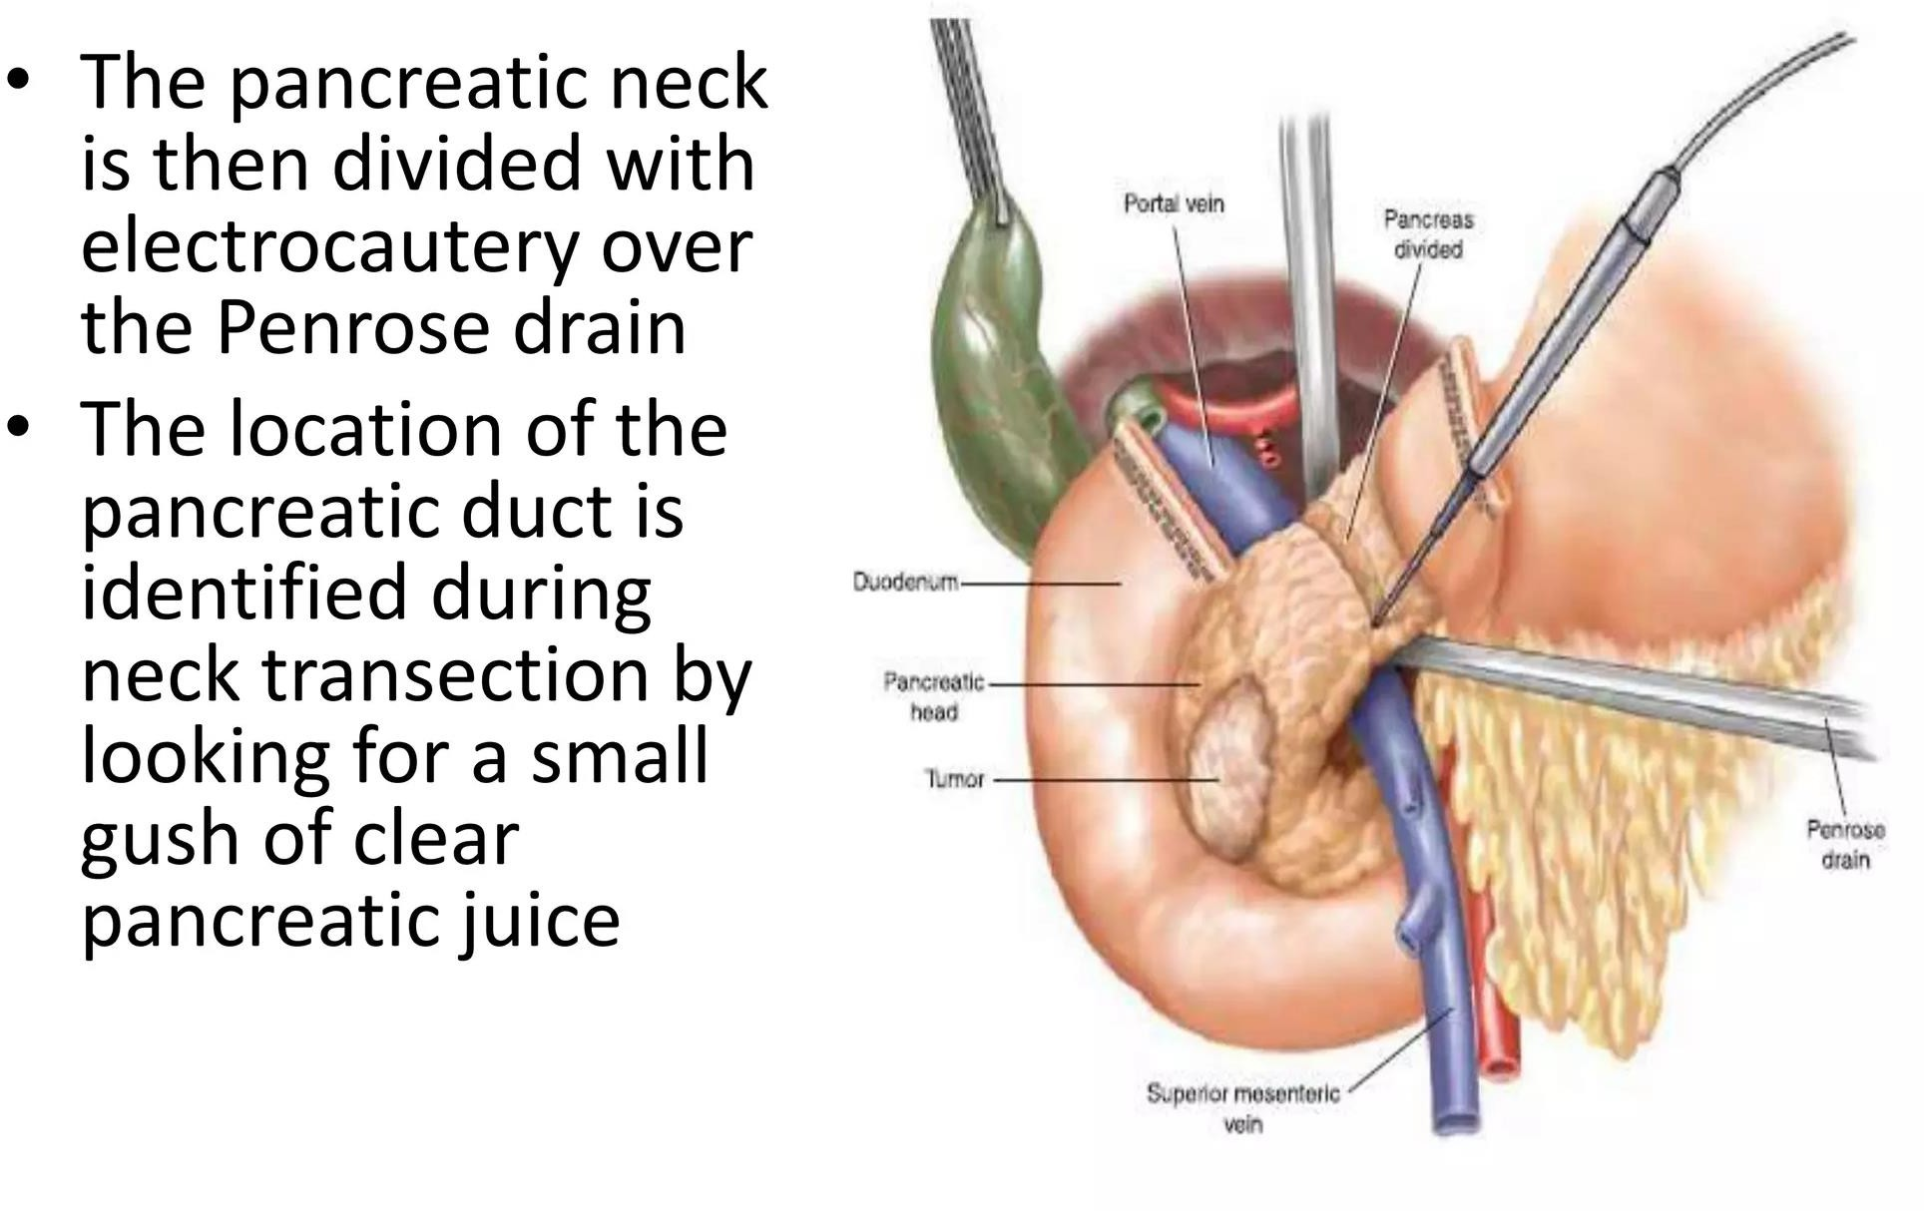

Slide 53
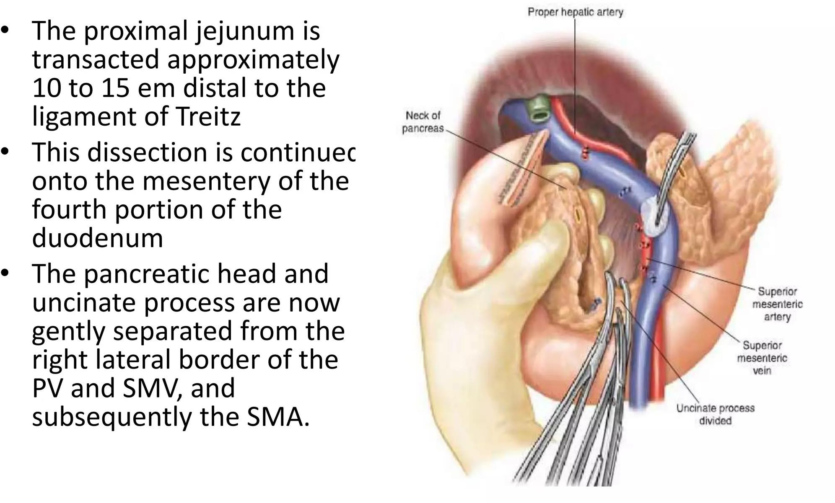

Slide 54
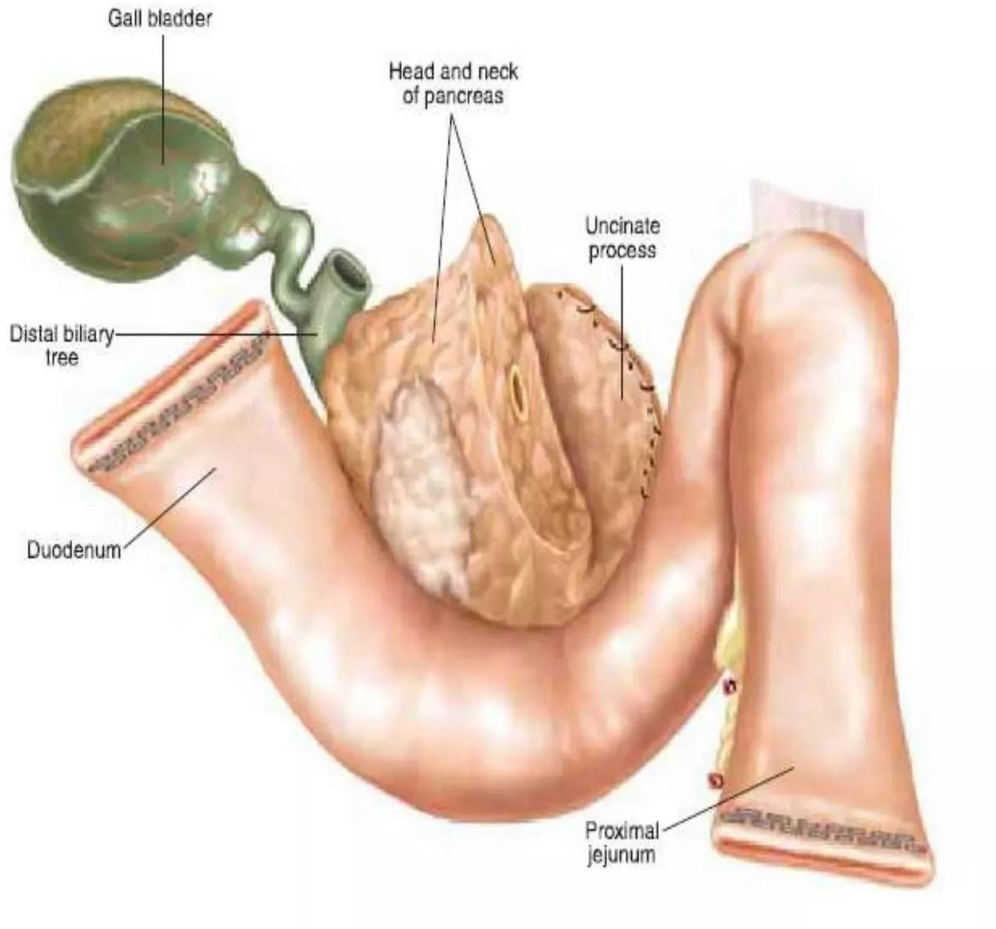
The specimen is then removed
The specimen is marked (by suture and marking pen) to identify the bile duct, pancreatic neck, and retroperitoneal soft-tissue margins and is sent for intra- operative frozen section analysis of the margins and pathologic examination of the tumor
The peritoneal defect at the ligament of treitz is closed with interrupted 3-0 silk sutures to prevent internal herniation Technique.

Slide 55
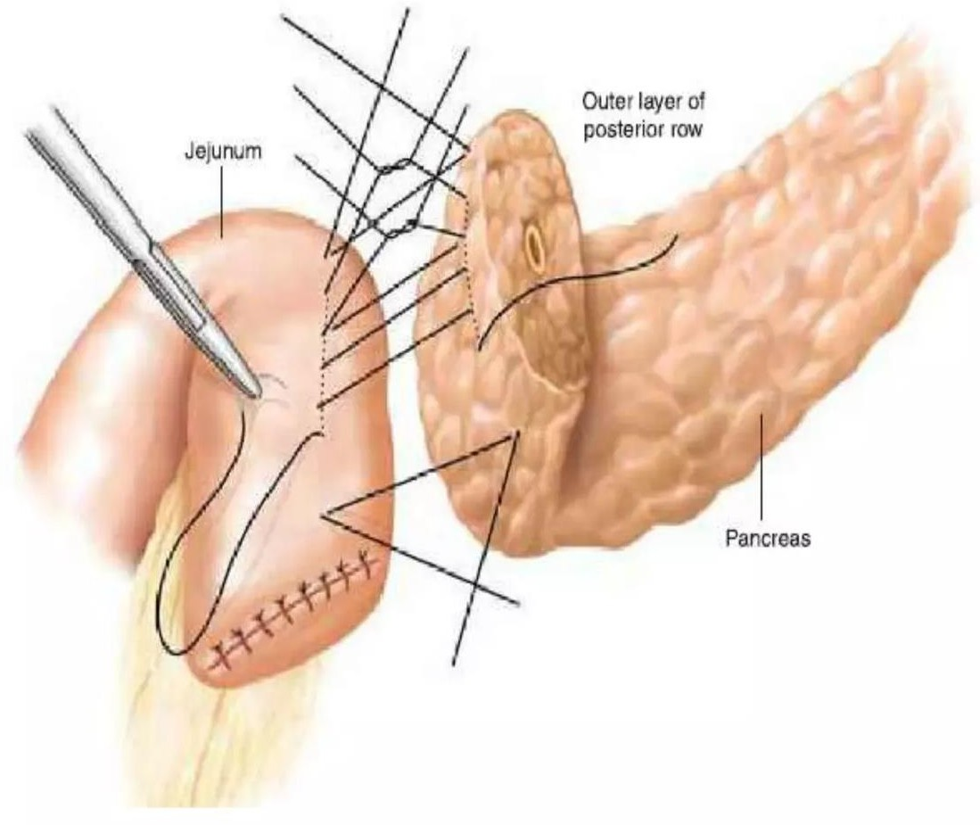
Reconstruction Phase
(Pancreaticojejunostomy)
A defect is made in the transverse mesocolon to the right of the middle colic vessels, through which the proximal jejunal limb is delivered
The pancreatic remnant is mobilized for a distance of 2 cm ventrally off the splenic vein, to facilitate creation of the invaginated pancreaticojejunostomy
The end-to-side invaginated pancreaticojejunostomy is performed

Slide 56
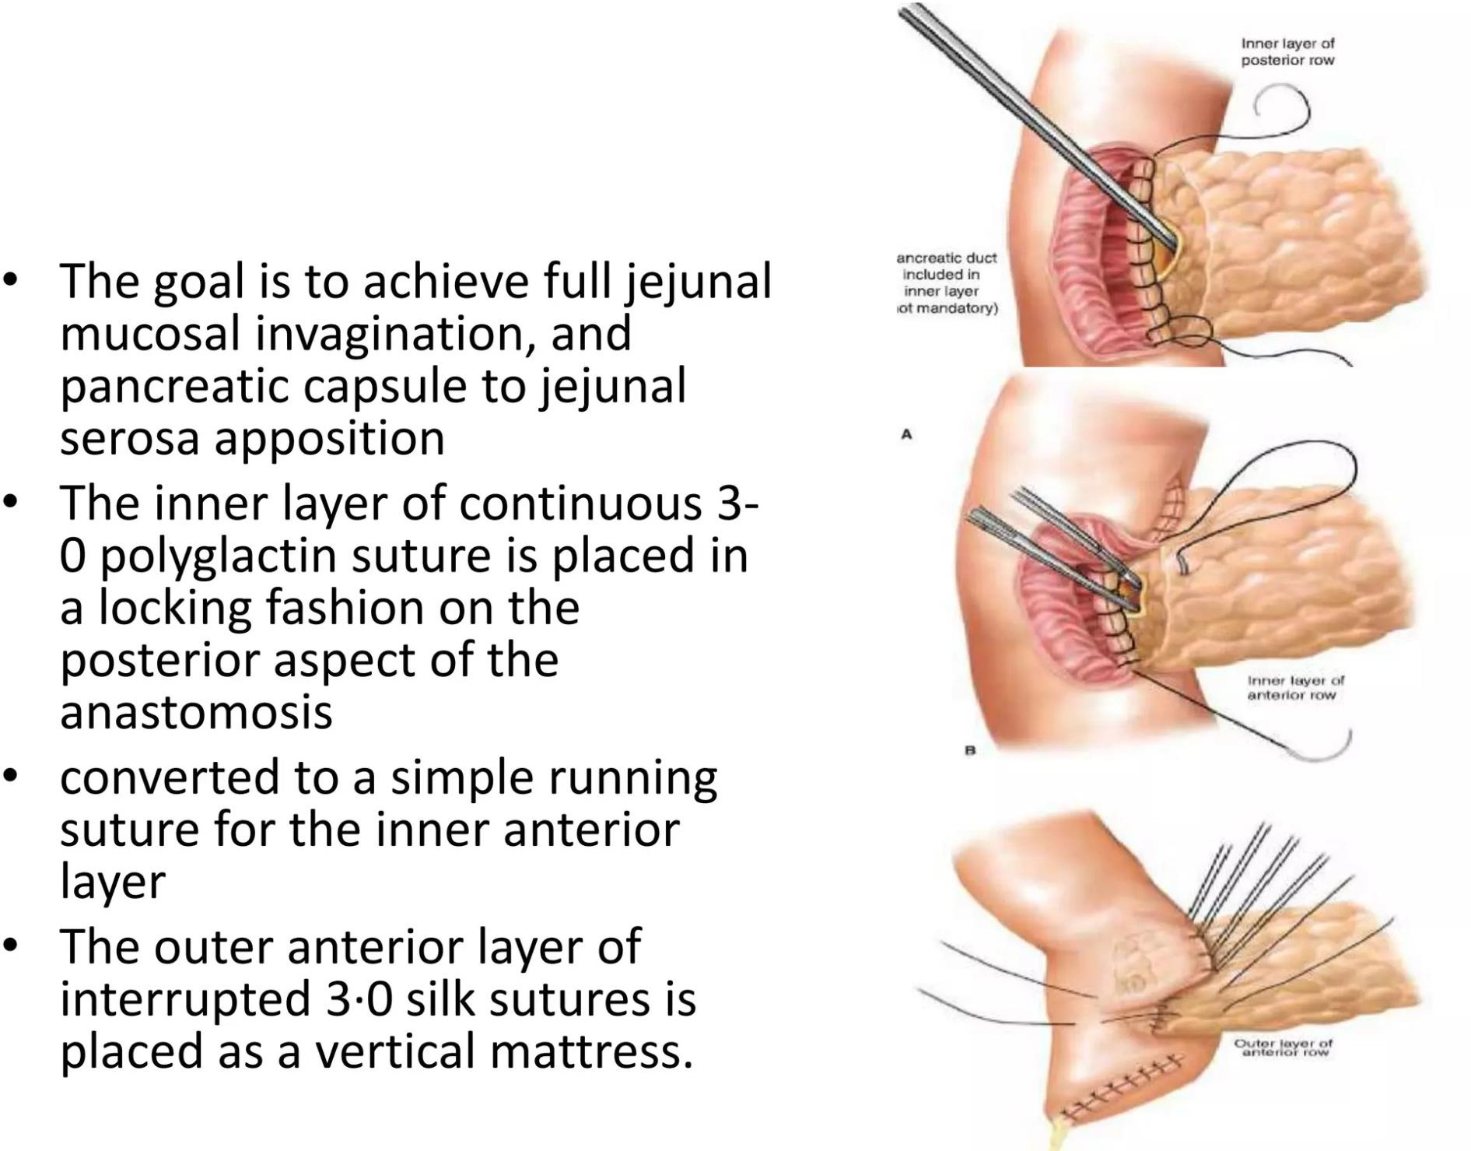

Slide 57
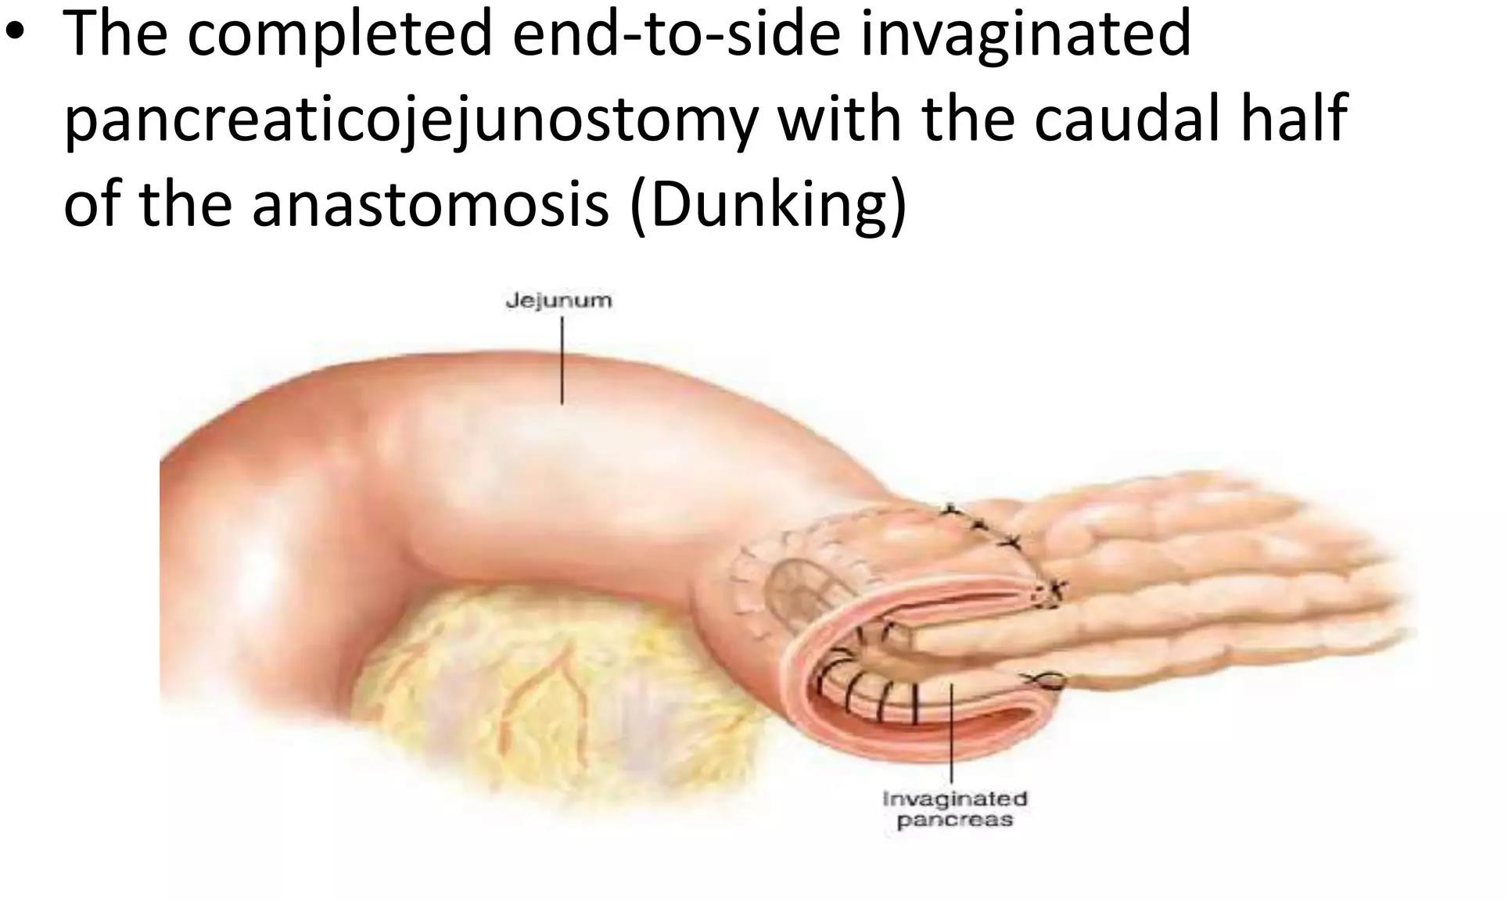

Slide 58
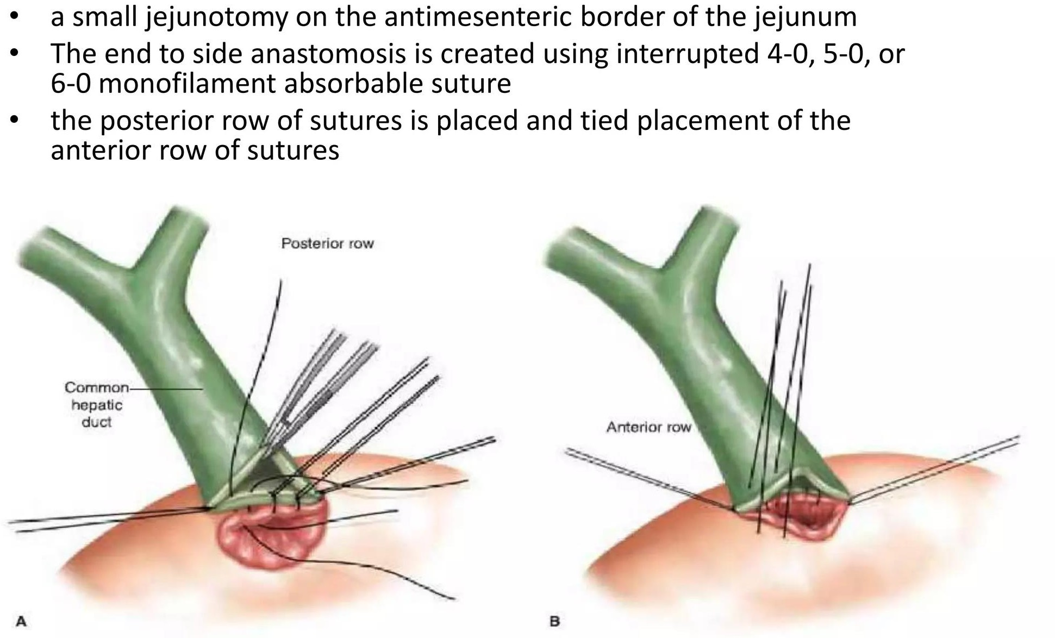
Hepaticojejunostomy

Slide 59
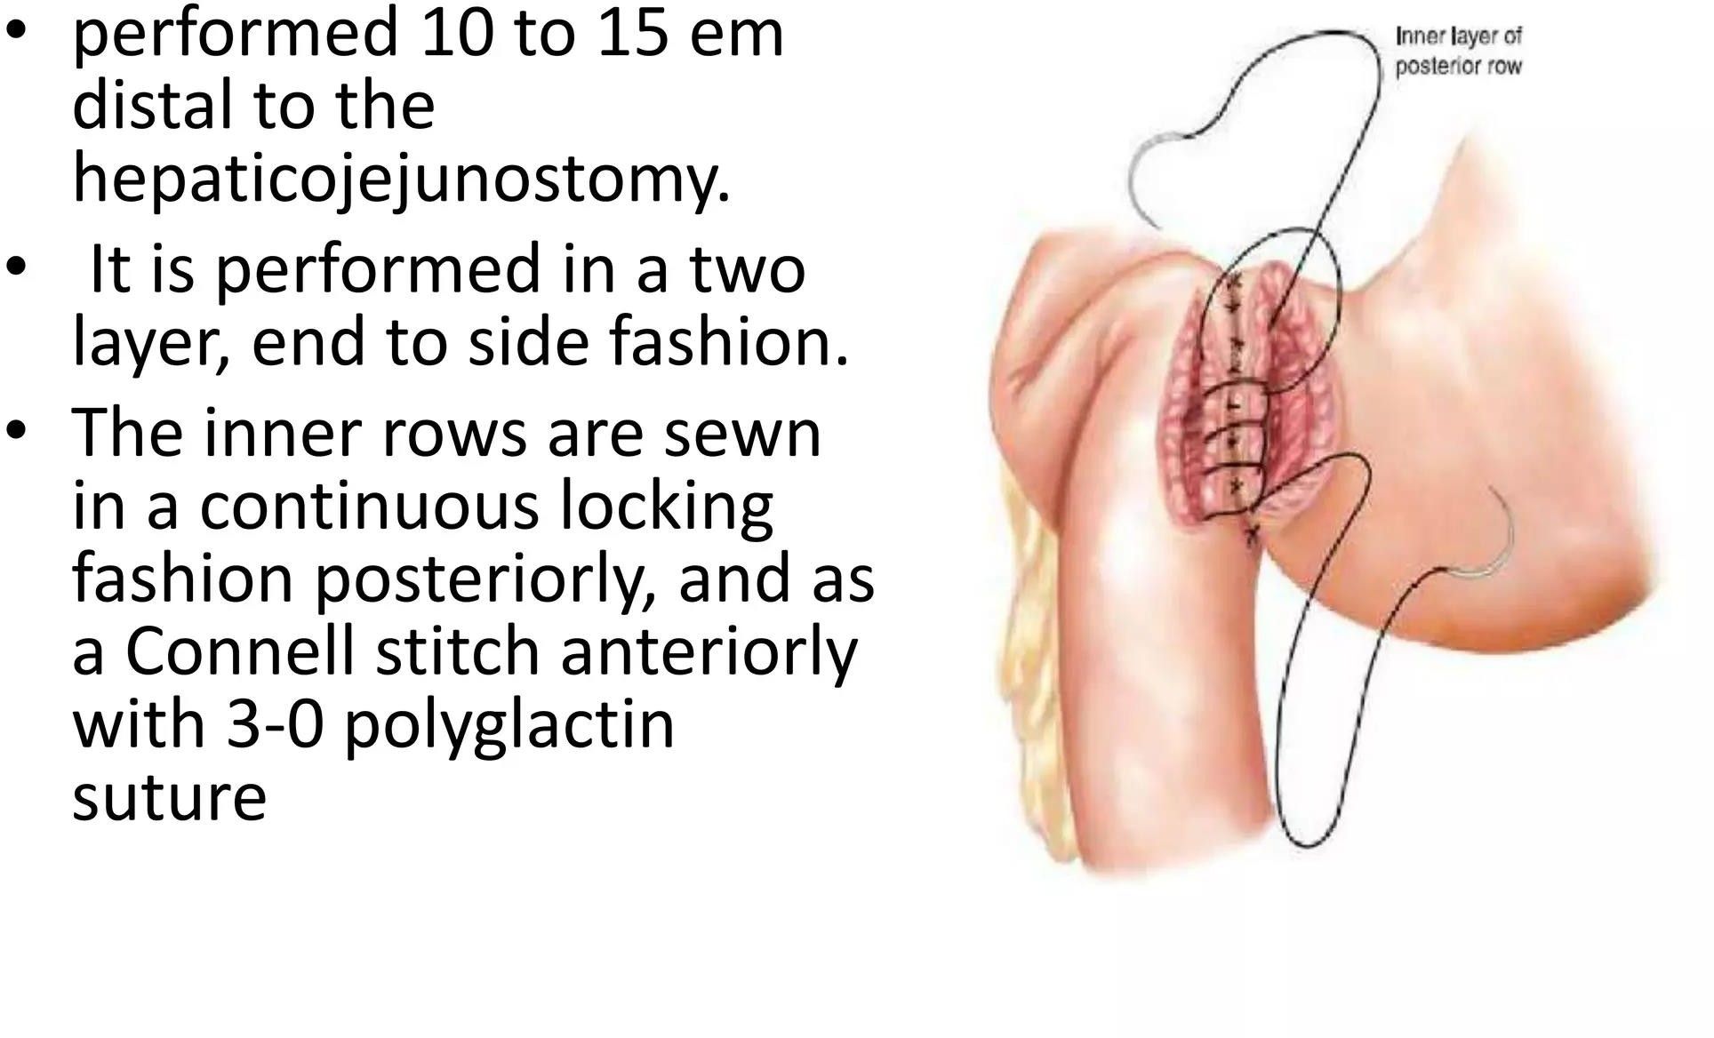
Gastrojejunostomy

Slide 60
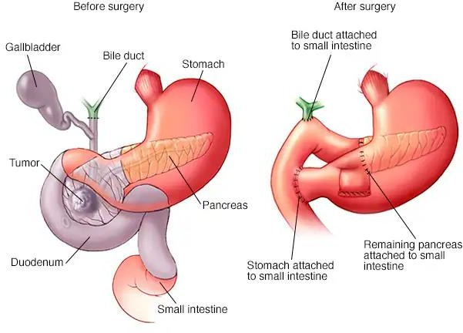

Slide 61
Drain position and closure
Right sided drain is placed in subhepatic space and posterior to right upper RUQ and posterior to jejunal loops
The left sided drain is placed through gastrocolic ligaments and few centimeter cephalad to PJ

Slide 62
Postoperative management
Patients are routinely placed in ICU.
ERAS protocol is followed for evidence based practice. Analgesia –Mid-thoracic epidurals are recommended post op nausea and vomiting – Metoclopramide
Post op glycemic control

Slide 63
Post op fluid management
0.9% saline leads to
  Renal edema
  Reduced renal flow velocity
  Reduced Renal cortical tissue perfusion
  Overall increase in post op complication when compared with balanced crystalloids
To avoid fluid overload vasopressor should be considered ,For intra and post operative mangement of epidural induced hypotension

Slide 64
Complications
Haemmorhage
Pancreatic Fistula
Bile Leak
Chylous Ascites
Pneumonia
Myocardial Infarction
Wound Infection
Delayed Gastric Emptying

Slide 65
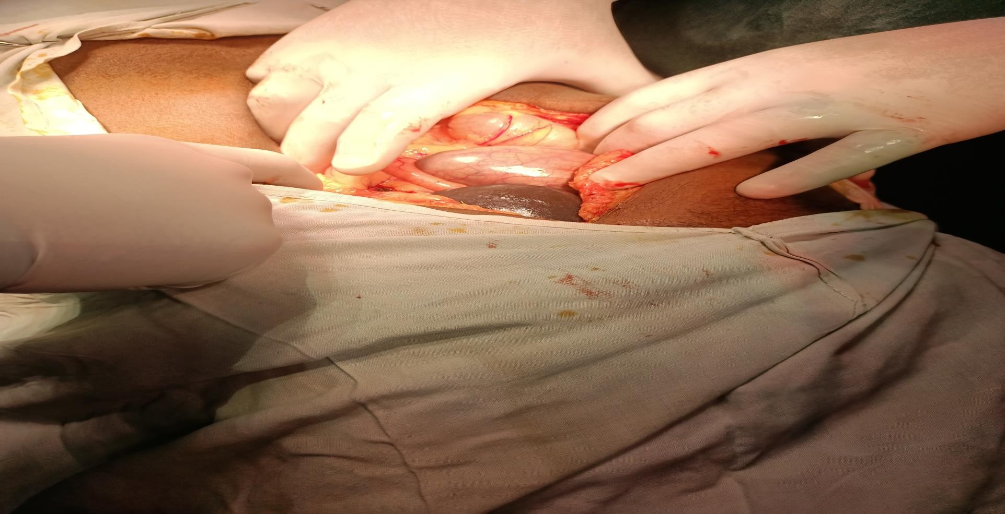
EXPLORATIN AND ASESSMENT

Slide 66
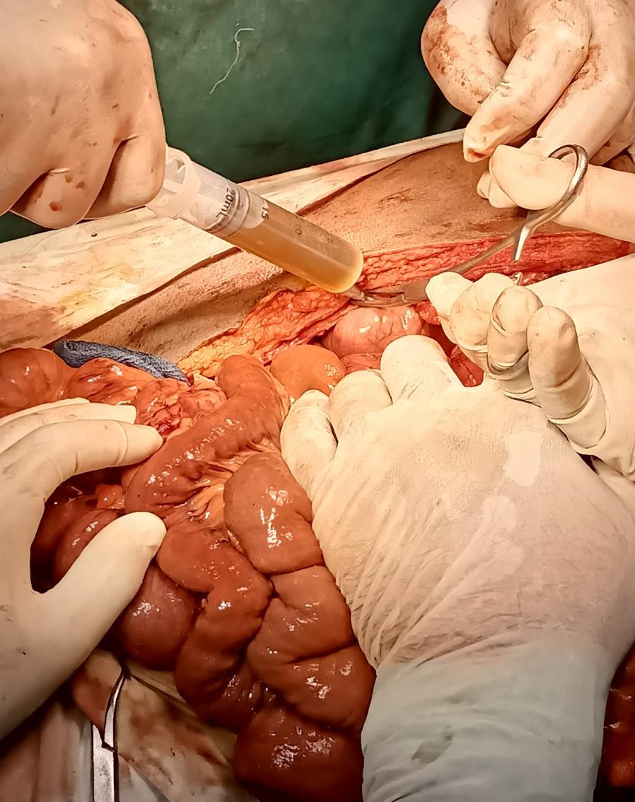
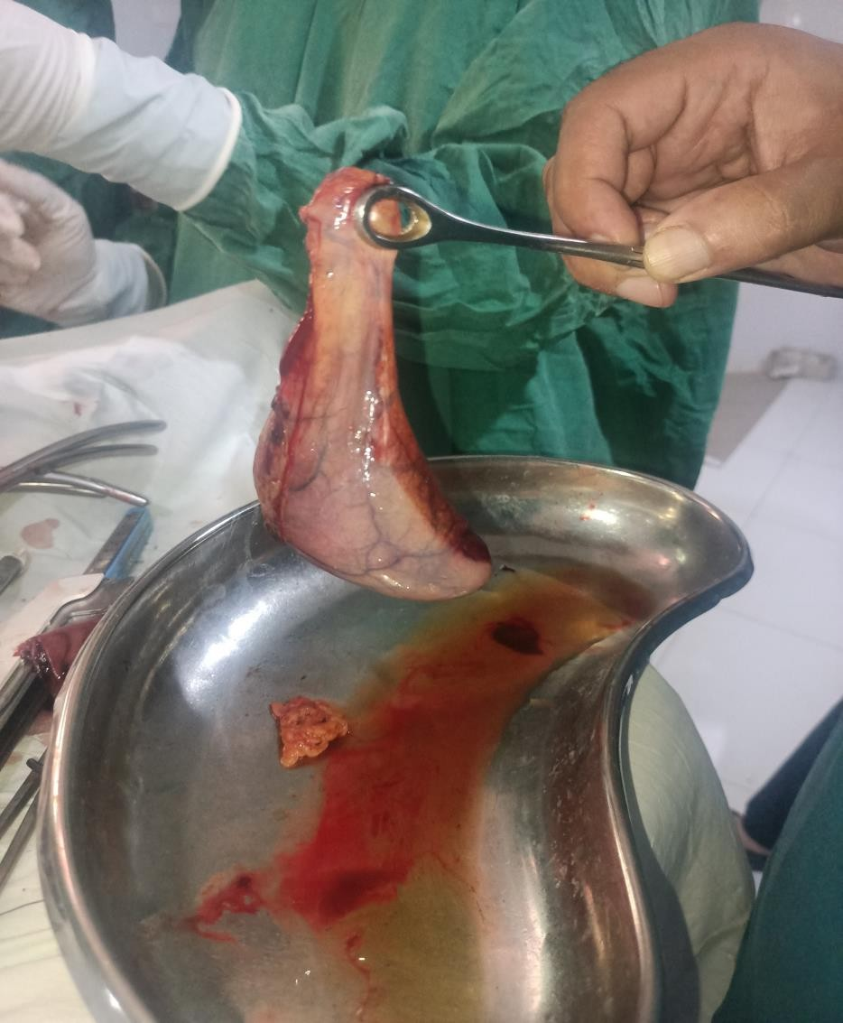
RESECTION

Slide 67
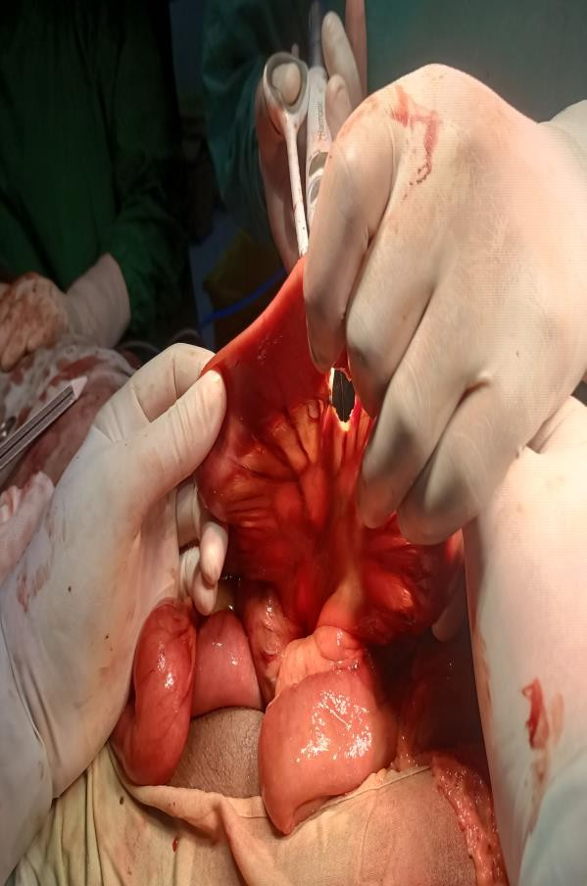
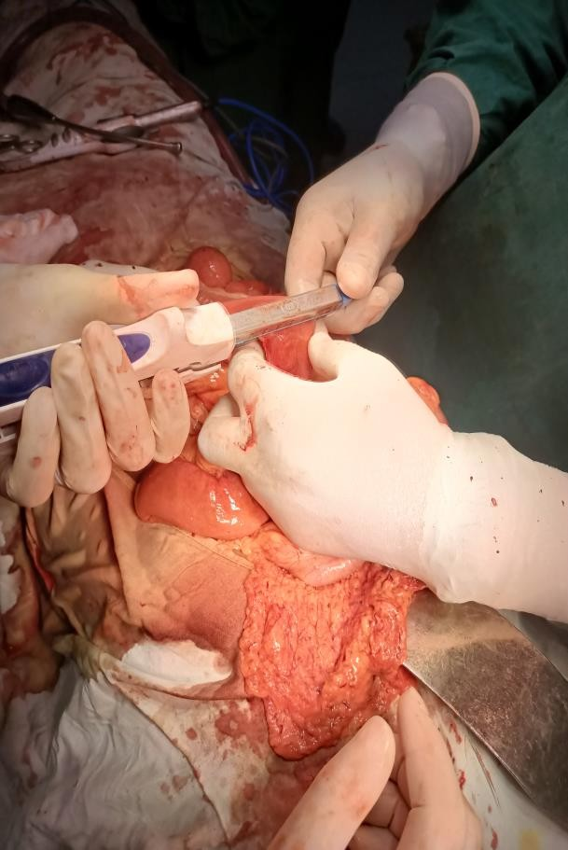
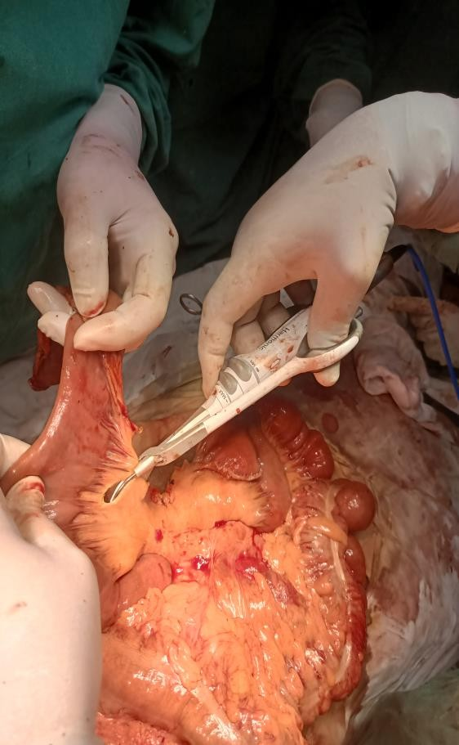
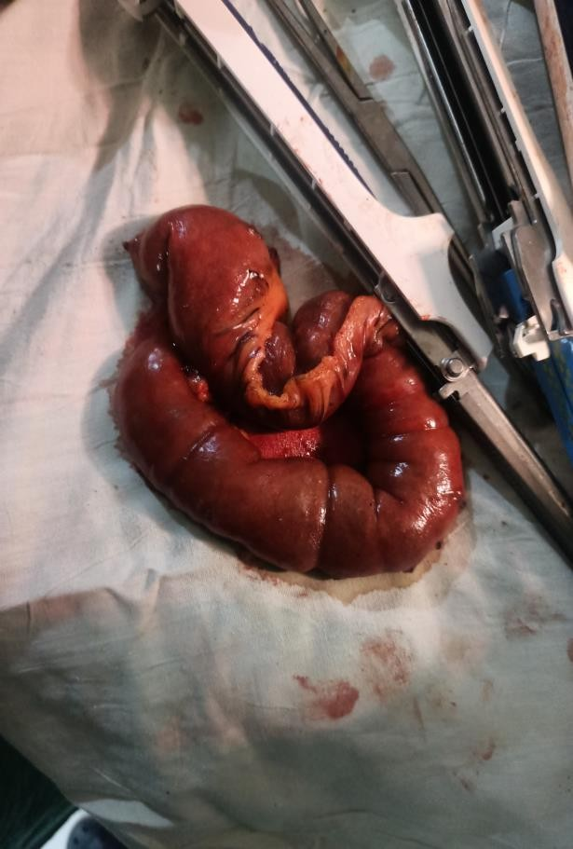
RESECTION

Slide 68
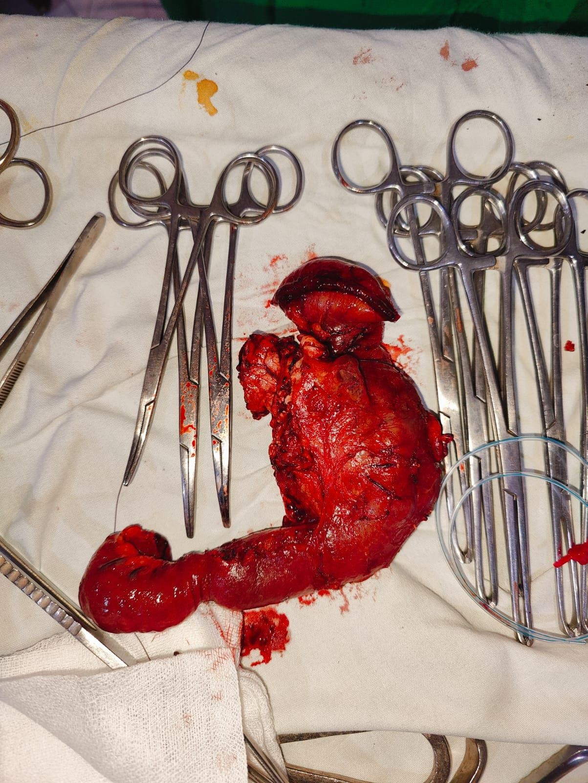

Slide 69
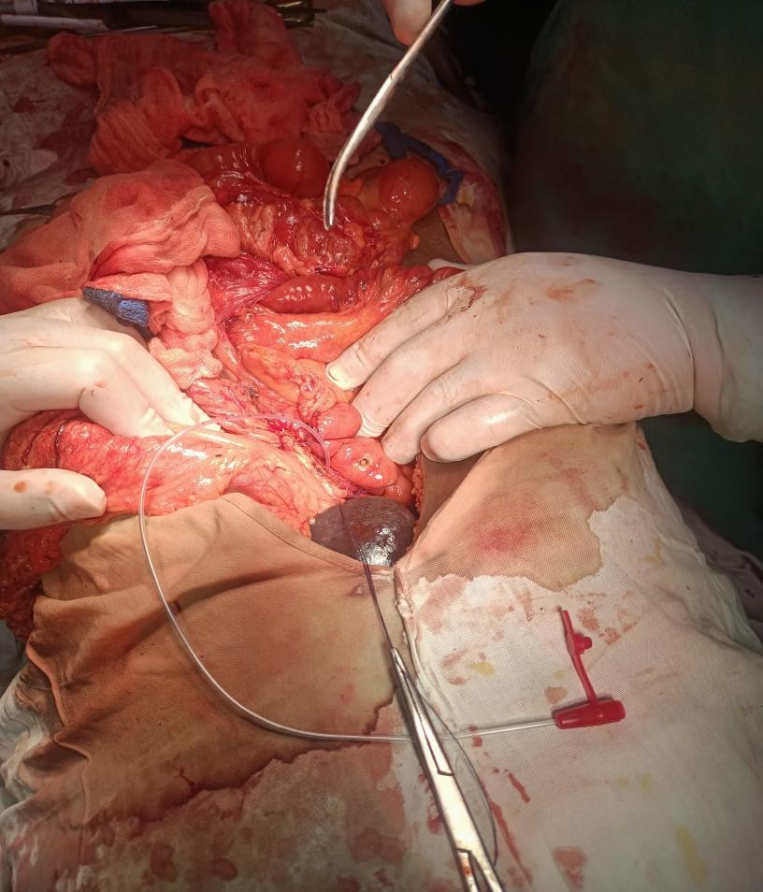
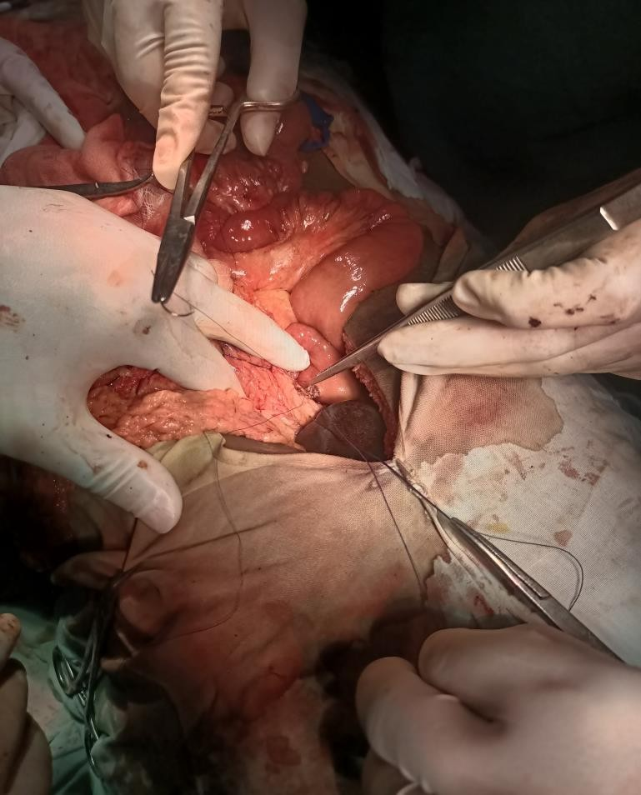
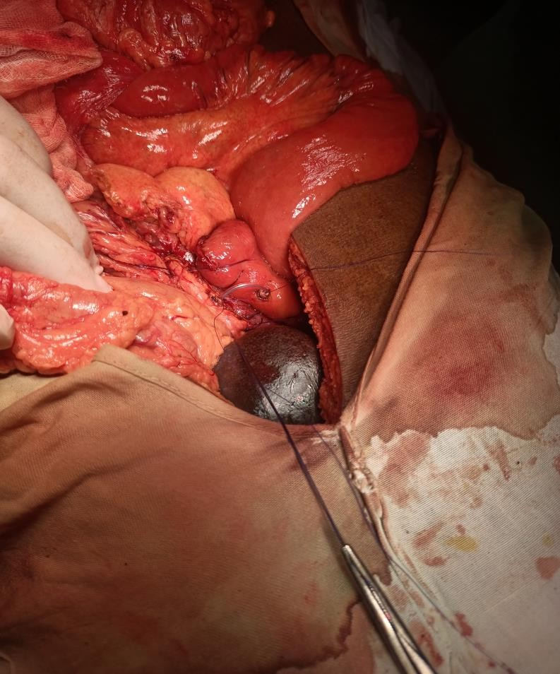
RECONSTRUCTION

Slide 70
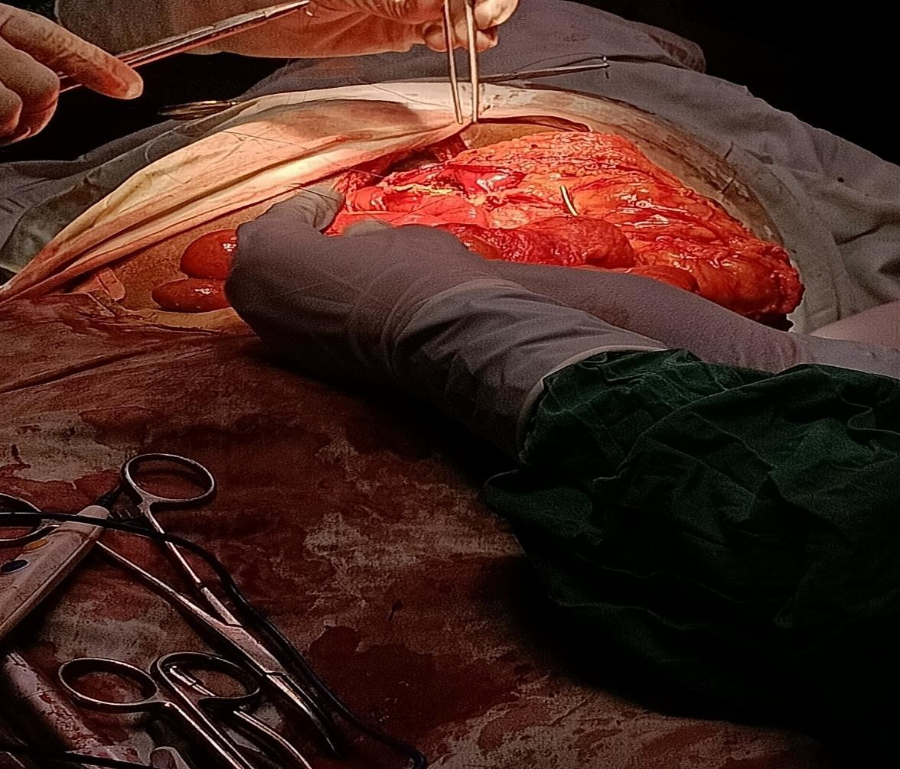
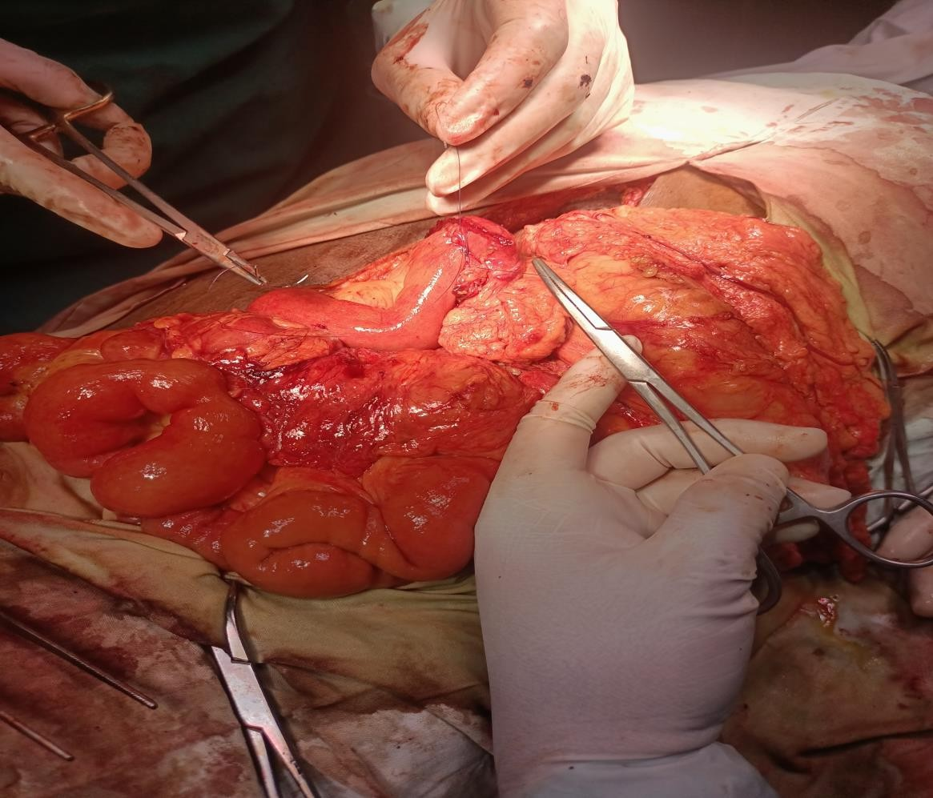

Slide 71
Take home message
Pancreatic resection is now an accepted form of therapy for a large spectrum of pancreatic diseases both benign and malignant.
These improvements in overall outcome are a result of surgical technique,patient selection,peri operative care and diagnostic imaging.
The management of patients with pancreatic diseases is best done with multispeciality approach with the surgeon in central and coordinating role.

Slide 72


Slide 73


