Slide 1
DIABETES IN PREGNANCY
CLINICAL SCENARIOS
DR. SUMBLA RAFIQUE
SENIOR REGISTRAR OBSTETRICS AND GYNAECOLOGY DEPARTMENT UNIT II
SHEIKH ZAYED MEDICAL COLLEGE AND HOSPITAL
RAHIM YAR KHAN

Slide 2

A BABY THAT NEVER LIVED……

Slide 3
CASE 1
Mrs. Naseem, 39 years of age,G5P3A1 with Prev 3 C-Sections, known diabetic for the last 5 years, taking insulin with poor compliance. She presented in outpatient department with deranged blood sugar levels and a scan showing miscarriage of 13 weeks. Her HbA1c done in the prior month was 11%. She has 2 alive issues and history of PrePROM in her last pregnancy due to Polyhydramnios leading to preterm delivery and ENND.
Q. What do you think is the cause of Miscarriage in this Patient?
Uncontrolled diabetes leading to miscarriage
Gestational diabetes with complications
Miscarriage due to unknown reasons

Slide 4

UNCONTOLLED DIABETIES LEADING TO MISCARRIAGE

Slide 5
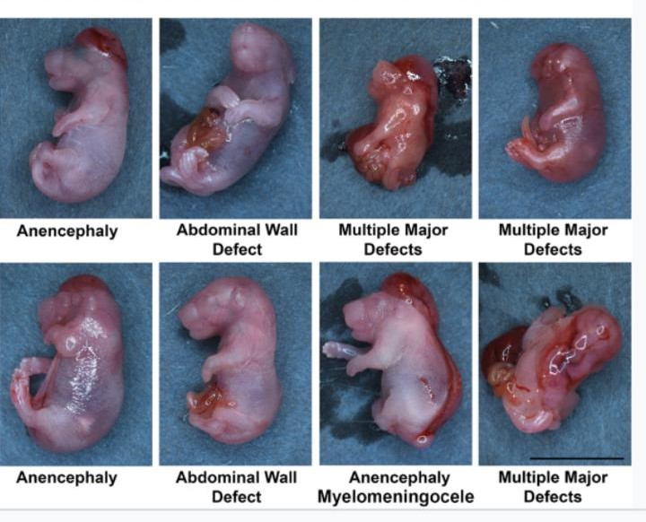
DIABETIES RELATED MISCARRIAGES

Slide 6
CASE 2
Mrs. Naheed, age 29 years primigravida with BMI 31 kg/m2 at 32 weeks of gestation by dating scan presented to you with pain in abdomen. She has EPIGASTRIC DISCOMFORT and her SFH is 36 weeks. Her scan shows single intrauterine pregnancy with EXCESSIVE LIQUOR and fetal biometry corresponding to 36 WEEKS. Her random BS was 219mg/dl. Her booking blood sugar level was 80mg/dl. Q. What is the Diagnosis?
Gestational diabetes with complications.
Type 1 diabetes mellitus
Complications due to increased maternal weight

Slide 7
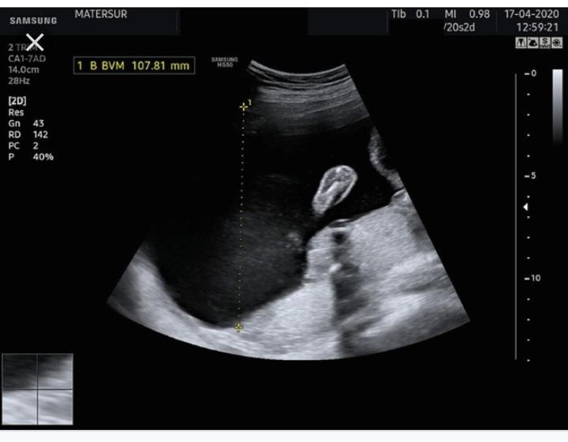
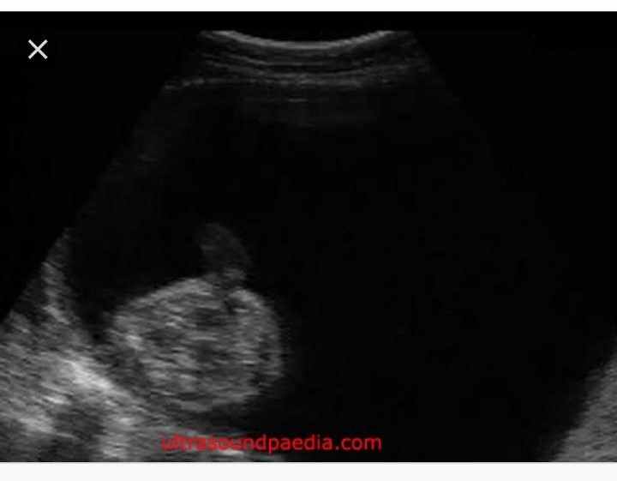
POLYHYDROAMNIOS

Slide 8
CASE 3
Mrs. Abida age 34 Years P2 with Prev SVDs and one alive issue. Her BMI is 39kg/m2. She had Shoulder Dystocia in her last pregnancy and fetal weight was 4.5kgs (MACROSOMIA). She reports GDM in her last pregnancy. Her 1st pregnancy was INTRAUTERINE FETAL DEMISE at 9 months due to some cardiac anomaly. Her mother was DIABETIC. She is very concerned and has come for Pre-pregnancy counselling.
Q. What will you advise?
Folic acid 5mg
Weight reduction through exercise and diet, Pre-pregnancy optimization of maternal risk factors
Early booking and regular antenatal visits in pregnancy
All of the above

Slide 9

BMI 39

Slide 10
Case 4
Mrs. Shaheen,G2P1 Prev SVD with history of GOOD SIZED BABY in previous pregnancy. She is at 15 weeks of gestation. She has a BMI of 28kg/m2.Her father is diabetic and mother died of ischemic heart disease. She is very concerned that she might have hidden diabetes.
Q. what diagnostic test you will offer in pregnancy for gestational diabetes based on her risk factors ?
ORAL GLUCOSE TOLERANCE TEST
HbA1c
Urine for glycosuria
Fasting blood glucose

Slide 11
ORAL GLUCOSE TOLERANCE TEST…
DIAGNOSTIC TEST
SCREENING TEST

Slide 12
Case 5
Mrs. Shabana G3P2 at 34 weeks of pregnancy has come to your clinic with ABSENT FETAL MOVEMENTS for 2 days. She was booked at primary healthcare and was advised blood glucose monitoring as she had increased AFI OF 38 on scan along with MACROSOMIA. Her blood sugar levels were deranged and she was diagnosed as INTRAUTERINE FETAL DEMISE. She is admitted for delivery.
Q. What postnatal tests would be offered to this patient?
FASTING BLOOD GLUCOSE after 6 weeks
HbA1c after 6 weeks
Oral Glucose tolerance test after 6 weeks

Slide 13



