Slide 1
CLINICOPATHOLOGICAL CONFERENCE
GYNAE UNIT 1
Dr. Suhaira Aziz
Dr. Nimra Riaz

Slide 2
Medical illnesses in pregnancy
Rheumatic heart disease

Slide 3
CASE HISTORY

Slide 4
BIODATA
Patient Name : Parveen
W/O : Shoaib Iqbal
Age : 22 years
Profession : Housewife
Resident: Mastan Shah
Married For : 3 years
G2 P1( previous one C-section )

Slide 5
LCB : 1 year back
LMP : 12-01-2024
EDD : 19-10-24
DOP : 34 weeks + 2 days

Slide 6
PRESENTING COMPLAINT
Presented to labour room on 09-09-24
With lower abdominal pain for 3 days

Slide 7
HISTORY OF PRESENTING ILLNESS
My patient is a known case of Rheumatic Heart Disease for 2 years and was in usual state of health 3 days back when she started having lower abdominal pain which was sudden in onset , of mild intensity, intermittent, with the duration of 5 minutes followed by pain free interval of 30 minutes.
Started from back and radiated towards lower abdomen
Aggravated by movements
Not associated with dysuria, fever, increased frequency of micturition, PV leaking, bleeding and discharge
No vomiting , body swelling , shortness of breath as well

Slide 8
Present obstetric history
It was an unplanned pregnancy and was not practicing any method of contraception.
Confirmed by UPT and dating scan (done in 3rd month of gestation)

Slide 9
1st Trimester
Experienced nausea and vomiting, relieved spontaneously at the end of trimester.
No history of fever flu rash cough PV bleeding discharge and burning micturition.
No history of folic acid intake or hospitalisation.
She started taking medicines of her ongoing cardiac condition after consultation in 2nd month of pregnancy which included : digoxin, furosemide, beta blocker and warfarin.
These were continued through out the pregnancy.

Slide 10
2nd trimester
First fetal movement felt at 5th month.
She took her regular antenatal checkup from the nearby doctor where her blood pressure was checked which was in normal range. Blood and urine tests were sent that were in normal range as well.
Anomaly scan was not done.
Positive history of shortness of breath after exertion or climbing 2-3 stairs.
Easy fatigability after 10 to 15 minutes of daily activity.
She was not taking any supplements.
No history of fever flu rash cough PV bleeding leaking discharge and abdominal pain

Slide 11
3rd trimester
Her abdominal growth was not satisfactory according to duration of pregnancy , But she kept perceiving fetal movements and experienced pain lower abdomen for which she presented in labor room and got admitted.
Diagnosed with asymmetrical IUGR after ultrasonography
Her labs were sent that were reassuring.
Blood pressure and cardiac evaluations conducted
Fetal monitoring performed (CTG and FKCC)
Counselled regarding cesarean section and contraceptive methods

Slide 12
Previous obstetric history
Patient is G2P1 with previous one C-section.
Her previous pregnancy was unplanned and spontaneous and she was diagnosed with RHD in 6th month of pregnancy after which she remained in consultation with cardiologist.
4 FFPs and 1 pack of fresh blood were transfused in the 7th month.
Delivered her male baby which was small for gestational age at 8th month of pregnancy by C-section in SZMH and it was an early neonatal death.

Slide 13
Menstrual history
Menarche : 13 years
Regular cycle ; 3/28 days
2 pads soaked per day , No clots
No dysmenorrhoea, dyspareunia, intermenstrual bleeding
No history of contraceptive use
PAP test was not done

Slide 14
Systemic history
CVS: Exertional dyspnoea +ve for 2 years, no tachycardia, orthopnoea and pedal oedema.
RESPIRATORY SYSTEM: No wheezing, cough, chest pain
CNS: No history of headache, seizures, tremors , blurring of vision
GIT: No history of abdominal pain and distention, melena, dyspepsia, dysphagia
UROGENITAL: No dysuria, pyuria, increased frequency of micturition or burning micturition
MUSCULOSKELETAL: No history of bone pain, joint pain and swelling

Slide 15
Personal history
No history of smoking or drug abuse
Sleep, appetite and bowel habits are unchanged
No history of drug allergy
No history of any chronic disease like DM, TB , HTN , Hep B , Hep C

Slide 16
Family history
No family history of DM, HTN, cardiac disease.
No history of twin gestation and congenital anomaly.

Slide 17
Socioeconomic history
Husband is a labourer.
Monthly income : less than 15,000 PKR.
She lives in an uncemented house.
Hygienic conditions are satisfactory.

Slide 18
Examination

Slide 19
General physical examination
22 years old Parveen Bibi lying comfortably on bed with IV line on right hand , well oriented in time, place, and person with BMI of 21.1 kg/m2 having following vitals:
Pulse : 98 regular per minute
BP : 110 / 70 mmHg
RR : 22 bpm
Temperature: 98° F
SpO2 : 98 %

Slide 20
No pallor , jaundice , clubbing, cyanosis and koilonychia
Thyroid was not enlarged
Accessible lymph nodes were not palpable
No sacral and pedal edema

Slide 21
Abdominal examination
Abdomen was moving with respiration.
No visible pulsations .
Umbilicus seems to be central
Scar mark present on lower abdomen.
Hernial orifices were intact.
Symphisio-fundal height : 32 weeks
Fetus’ lie was longitudinal with cephalic presentation and was 5/5 palpable
FHR : 130-145 BPM
Fetal weight was approximated to be 2kg

Slide 22
CVS examination
Precordium normal.
No visible pulsations, prominent veins or scar marks.
Apex beat palpable in 4th ICS 1cm lateral to midclavicular line.
S1 and S2 heard with added sounds.
Murmur was heard at lower border of sternum near apex.

Slide 23
Respiratory examiNation
Normal chest shape moving equally on both sides with respiration
Bilateral crepitation were heard in lower lung zone.

Slide 24
Other examinations
CNS EXAMINATION:
She was well oriented with time place and person
GCS : 15/15.
BREAST EXAMINATION:
Bilateral breast were normal and symmetrical looking

Slide 25
CASE SUMMARY
A 22 years old female G2P1 previous one C-section at 34 weeks according to dates
Presented to labor room with Lower abdominal pain for 3 days that was settled with analgesia
History is suggestive of her abdominal growth not growing well with the duration of pregnancy
On workup she was told that baby’s growth is not good
Known case of RHD
Compliant with medications and in regular checkup with cardiologist
Murmurs heard in precordium region
Per abdominal examination:
Liquor seemed to be inadequate. SFH was 32 weeks lie was longitudinal cephalic and 5/5 palpable

Slide 26
Investigations

Slide 27
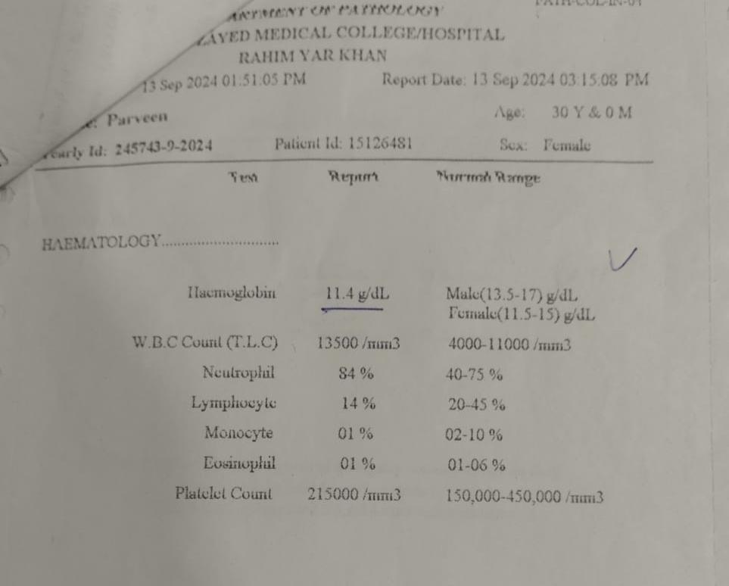
Baseline investigations
BLOOD GROUP: O
Rh FACTOR: +ve
CBC
Hb : 11.1 g/dL
TLC : 12700 /mm3
Platelets: 253000

Slide 28
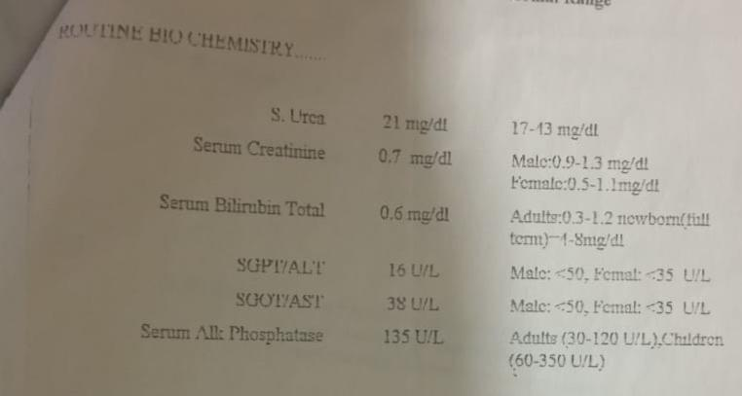
VIRAL SEROLOGY
HbsAg neg
Anti HCV neg
Anti HIV neg
LFTs , RFTs were in normal range

Slide 29
CLOTTING PROFILE (3rd TRIMESTER )
DATE | INR | PT | APTT
13-09-24 | 1.1 | --- | ---
15-09-24 | 1.0 | 15 sec | 35 sec

Slide 30
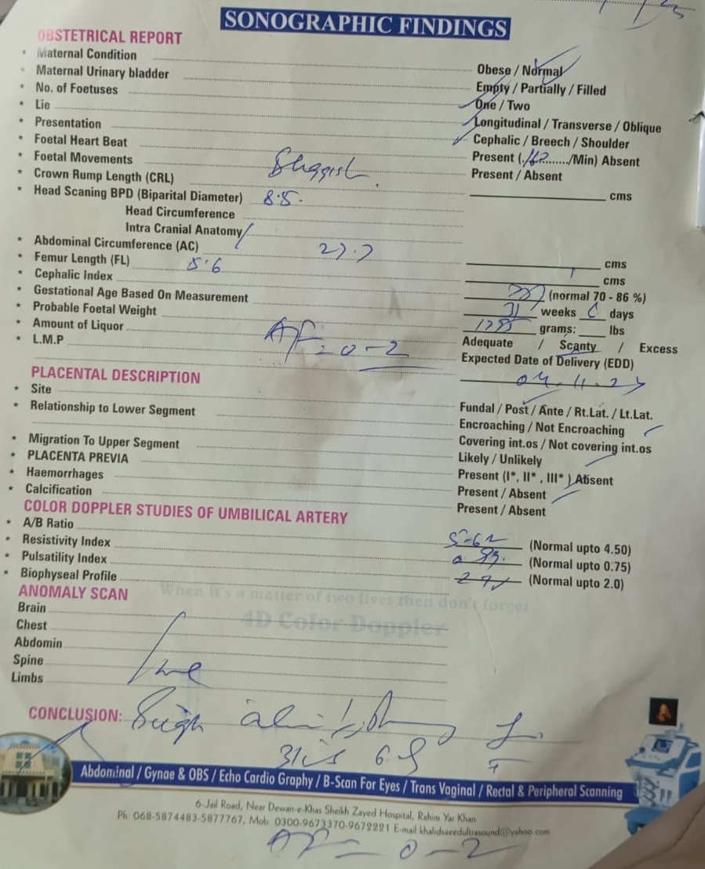
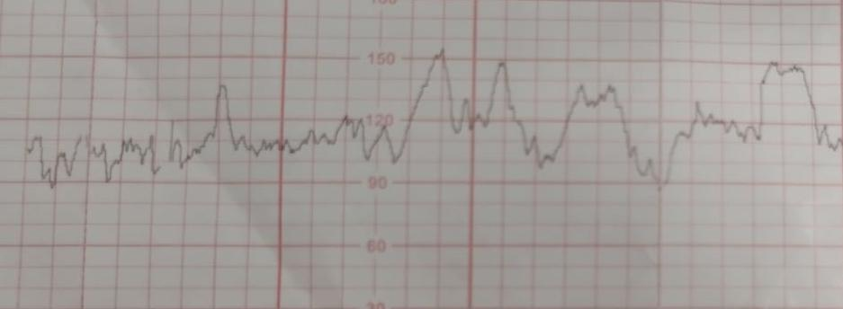
REGARDING PREGNANCY
USG done at 34 weeks
Sluggish fetal movements and oligohydroamnios with AFI of 0-2.
Doppler USG of umbilical artery
Asymmetrical IUGR
Placental insufficiency
CTG(done twice daily in 3rd trimester)
Reactive with multiple accelerations

Slide 31
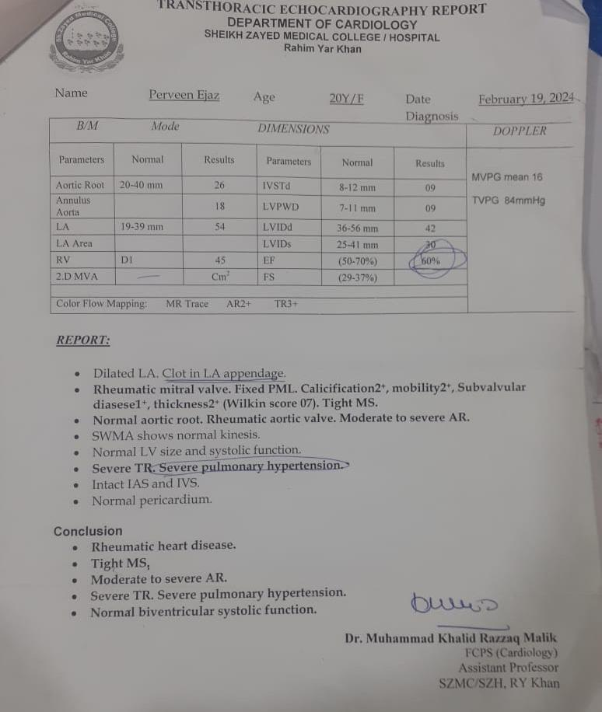
Regarding Medical illness
Echo cardiography in 3rd trimester
Revealed
Severe mitral stenosis (0.6cm2)
Moderate aortic regurgitation
Moderate left ventricular systolic dysfunction
Dilated right sided chamber
Severe pulmonary HTN
Severe tricuspid regurgitation
Ejection Fraction = 60%
(3 valves involved)

Slide 32


