Slide 1


Slide 2
Clinicopathological Conference (CPC)
OBSTETRICS & GYNAECOLOGY UNIT II
DIABETES IN PREGNANCY

Slide 3

Diabetes in pregnancy
Dr.Noman Hameed Kamboh(final year)
Dr.Mateen Ansari (final year)
Dr.Sana Abduljabbar(PGR GU-2)
Dr.Faiza Sattar(PGR GU-2)

Slide 4
Biodata
Mrs. Najma w/o Munir
35 years of age
House Wife with no Formal Education
Resident of Khanpur
Admitted on 06/09/2024
Through OPD

Slide 5
Biodata
MF:6 years
G3P2A0 with previous all SVDs no alive issues.
LMP:15/01/2024
EDD:22/10/24
DOP:32 weeks

Slide 6

Presenting complain
Patient came for antenatal checkup and was found to have high blood sugar level(BSR) hence admitted.

Slide 7
History of present pregnancy
She conceived spontaneously .
Pregnancy was confirmed by urine pregnancy test

Slide 8

1st Trimester
She was unbooked.
No hx of excessive nausea and vomiting ,fever,flue and rash.
No hx of folic acid intake.
No hx of vaginal bleeding and discharge.
Dating scan was not done.

Slide 9

2nd trimester
Quickening felt at 5th month.
Patient took her first visit at 6th month of gestation at SZMC RYK OPD .
Based on her prior bad obstetric history, OGTT done which was deranged
She was diagnosed as Gestational Diabetes Mellitus and admitted in antenatal ward
for monitoring and control of BSR Levels
WHEN HER BSR LEVELS NORMALIZED.
SHE WAS DISCHARGED AFTER 2 WEEKS
(tab metformin was started along with life style modification ).

Slide 10
Anomaly scan was normal .
Blood pressure was normal .Urine dipstick for proteins was negative.
No hx of vaginal bleeding or abnormal watery discharge.

Slide 11
3rd Trimester
Patient was perceiving good fetal movements.
Growth scan was normal .
No hx of vaginal bleeding or any abnormal watery discharge
No hx of raised blood pressure.
No hx of burning micturition ,constipation , epigastric pain .
Blood sugar levels were raised ,patient was admitted at 32 Weeks for management of increased blood sugar levels

Slide 12
Obstetrical history
She is a G3P2 previous SVDs at hospital.
First baby boy intrauterine death at term.
No History of antenatal visits.
Delivered through SVD at home.
Second baby girl was good size and it was a difficult delivery, SVD,at Hospital.
Early neonatal death due to some respiratory problem.

Slide 13
Gynaecological history
Age of menarche : 14 years .
Menstrual cycle: regular 7/28 days with normal flow.
Not associated with Dysmennorhea.
Intermenstrual bleeding and post coital bleeding.
No contraceptive method was practiced.
PAP Smear was never taken.

Slide 14
Family history
Her mother was diabetic.
No family hx of:
Hypertension
Asthma
tuberculosis
and ischemic heart disease

Slide 15

Medical history
No history of Diabetes Mellitus, Hypertension, Ischemic Heart Disease, Asthma and Tuberculosis.

Slide 16
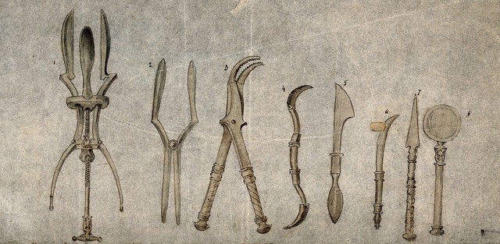
Surgical history
No Significant Surgical History
ThePhoto by PhotoAuthor is licensed under CCYYSA.

Slide 17

Personal history
She has normal sleep pattern and
She has normal bowel and bladder habit.
She has no history of smoking and any other addiction.

Slide 18

Socioeconomic history
Her husband is factory worker and earns 75000/month.
She lives in a rented house with 3 rooms shared among 6 family members.
She is satisfied with her living condition.

Slide 19

General physical examination
Mrs Najma of 35 years G3p2A0 conscious, alert, cooperative well oriented in time place and person having following vitals
Pulse 88bpm of regular Rythm,
Blood pressure:110/70 mmHg
Respiratory Rate:17/min
Temp: 98.6F

Slide 20
General physical examination
Height 150cm
Weight: 78kg
BMI: 30 kg/m2
No Pallor , Jaundice, cyanosis, edema
No accessible lymph nodes were palpable.
Thyroid examination : Thyroid was not enlarged
Breast examination :b/l breasts were symmetrical with normal nipple areola complex
Spine examination :normal

Slide 21
Systemic examination
Respiratory system NVB ,no added sounds
Cardiovascular system
S1+S2+0
Central nervous system
No focal neurological deficit

Slide 22
Obstetric examination
Inspection
Abdomen is protuberant with central everted umblicus and striae gravidarum .
On superficial palpation abdomen was soft and non tender in all quadrants
No scars, dilated veins or abnormal pulsations . hernial orifices were intact.
Palpation

Slide 23
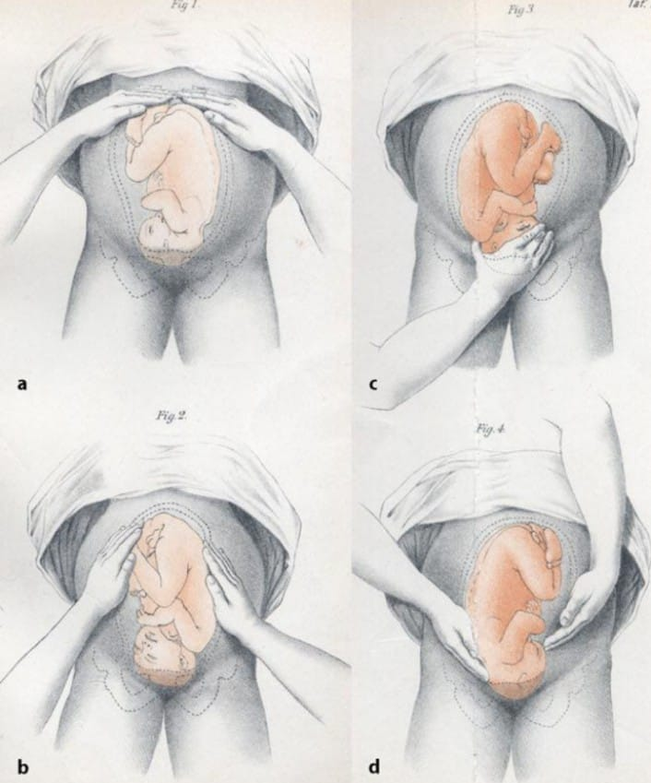

Slide 24
Per Abdomenal Examination
Symphysio fundal height:34 weeks of pregnancy
Lie :Longitudinal
Liquor seems to be adequate
Cephalic presentation
fetal heart rate of 145bpm

Slide 25

Auscultation
FHR: 145bpm

Slide 26

INVESTIGATIONS
Baseline Labs

Slide 27
INVESTIGATION
Blood group and Rh factor B +ve
CBC
Hb 11.3g/dl(12-14)
TLC 10000/mm3
Platelets 154000/mm3
Time random blood sugar 192mg/dl

Slide 28
investigations
LFTS:
Serum Bilirubin ------ 0.4mg/dl
ALT/SGPT ------ 19 IU/L
RFTS:
Blood Urea ------ 16mg/dl
Serum Creatinine ------ 0.5mg/dl

Slide 29
Urine Complete
Examination
Physical chemical examination:
Color --------Yellow
Albumin------ Nil
PH------ 5.0
Sugar----- +2
Microscopic Examination:
Pus Cells: 2-3/HPF
RBCs: Nil

Slide 30


Slide 31
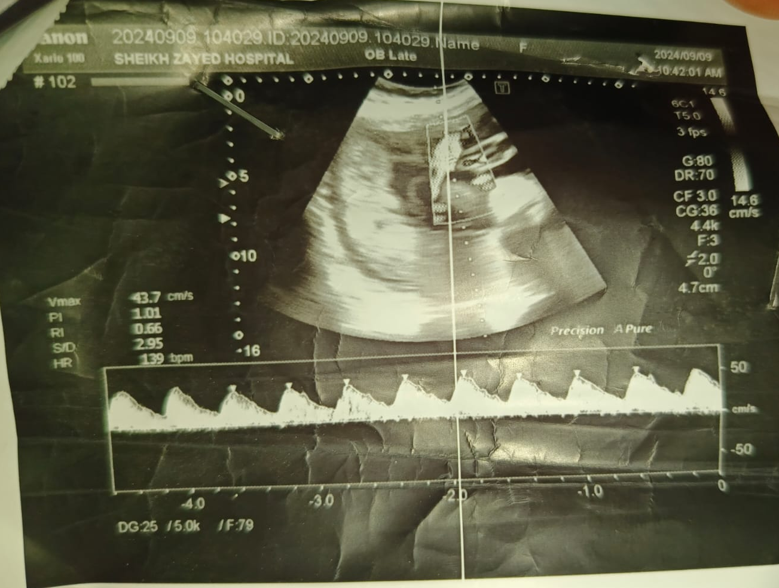
ultrasound
Single Alive Intrauterine Pregnancy of about 34 weeks
AFI: 20

Slide 32
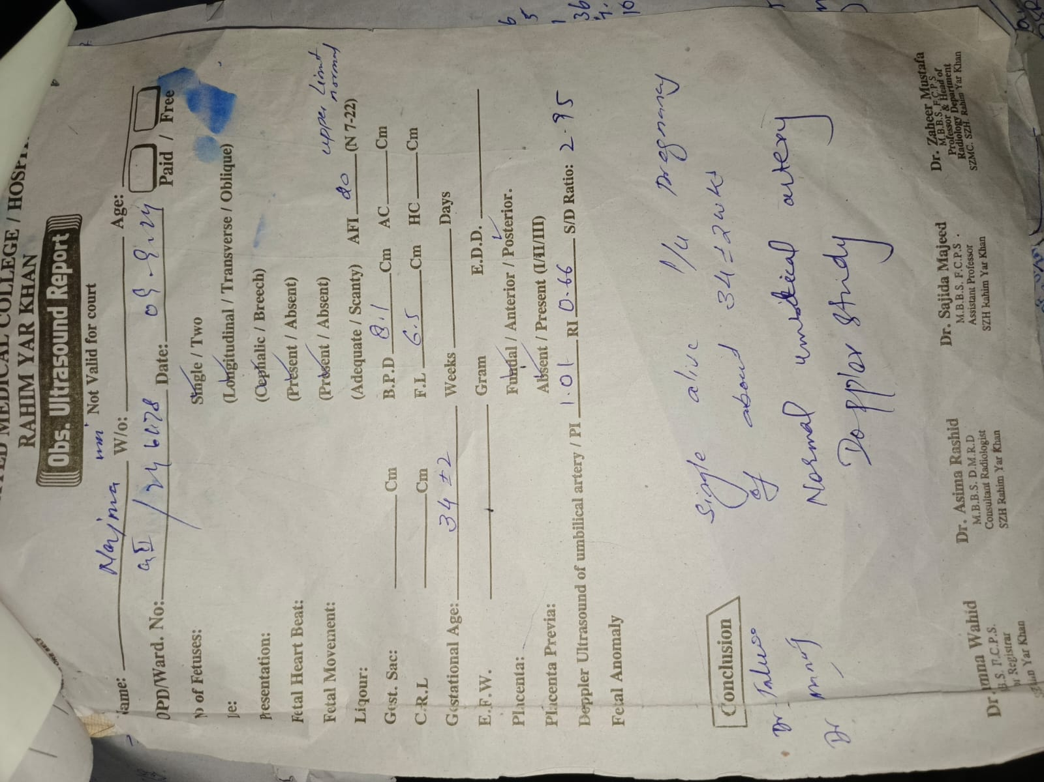

Slide 33
Case summary
A 35 years old G3P2A0 previous SVDS having no live issue presented to us with uncontrolled BSR levels at 32 weeks of gestation . She had a positive family history of diabetes mellitus . her BMI was 30 kg/m2, glycosuria +2,AFI=20.
History suggests the diagnosis of Gestational Diabetes Mellitus

Slide 34
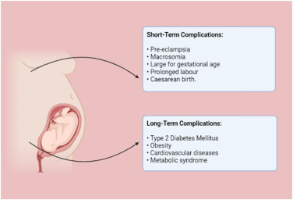
Aim of hospital admission
Our aim of management is to control her Blood sugar levels,to prevent complications and to reduce fetomaternal risks associated with gestational diabetes malleitus thus to prolong the pregnancy as close to term as possible.

Slide 35


Slide 36

Management
Hospital admission
Counselling regarding diagnosis of GDM and Associated Fetomaternal Risks and Complications.

Slide 37
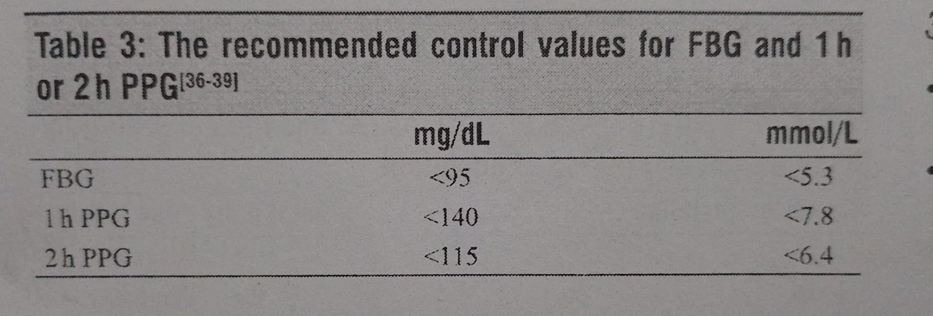
Management
Blood Sugar Levels Monitoring (7 levels)
Tab. Metformin 500mg TDS
Inj. Insulin Regular 18 units TDS
NPH 14 units Hs

Slide 38
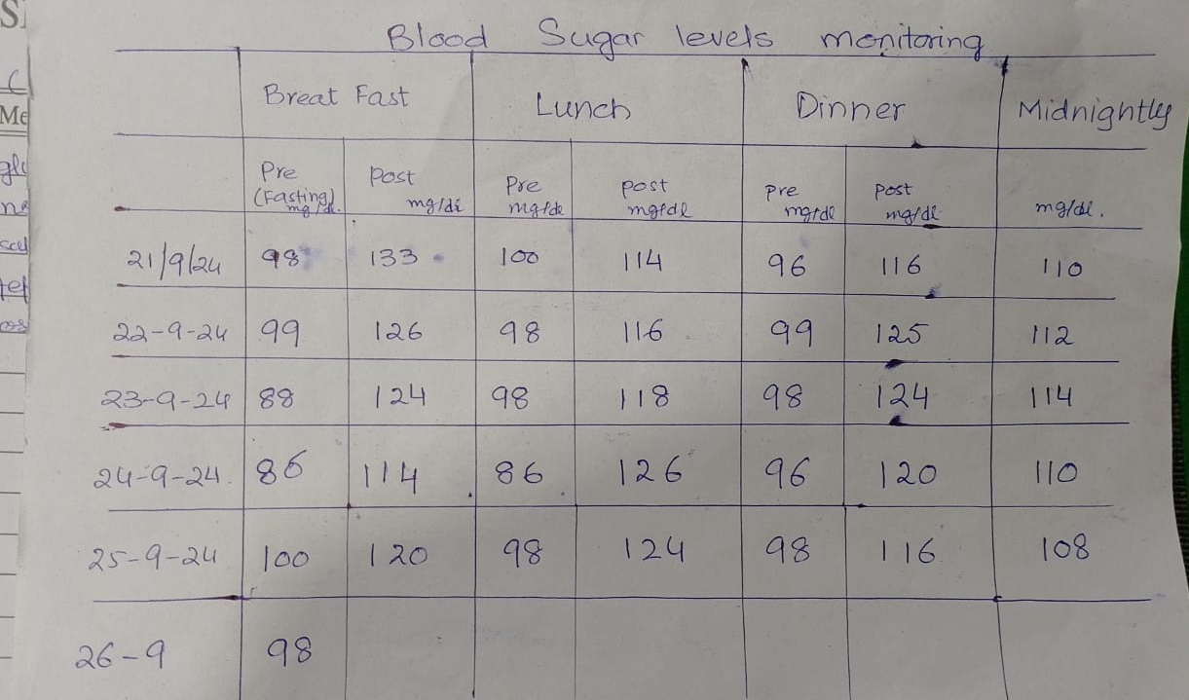
Blood Sugar Levels

Slide 39
Counselling Regarding LifeStyle Modification
Exercise
Walk
Diet of Low Glycemic Index

Slide 40
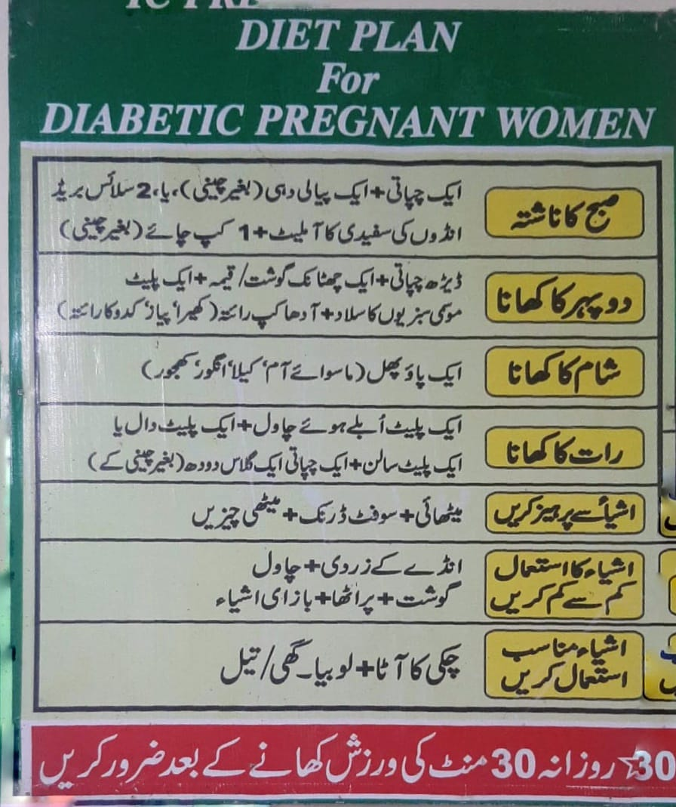

Slide 41

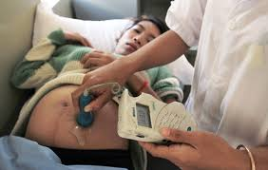
Fetomaternal monitoring
CTG
Growth scan-4 weekly

Slide 42
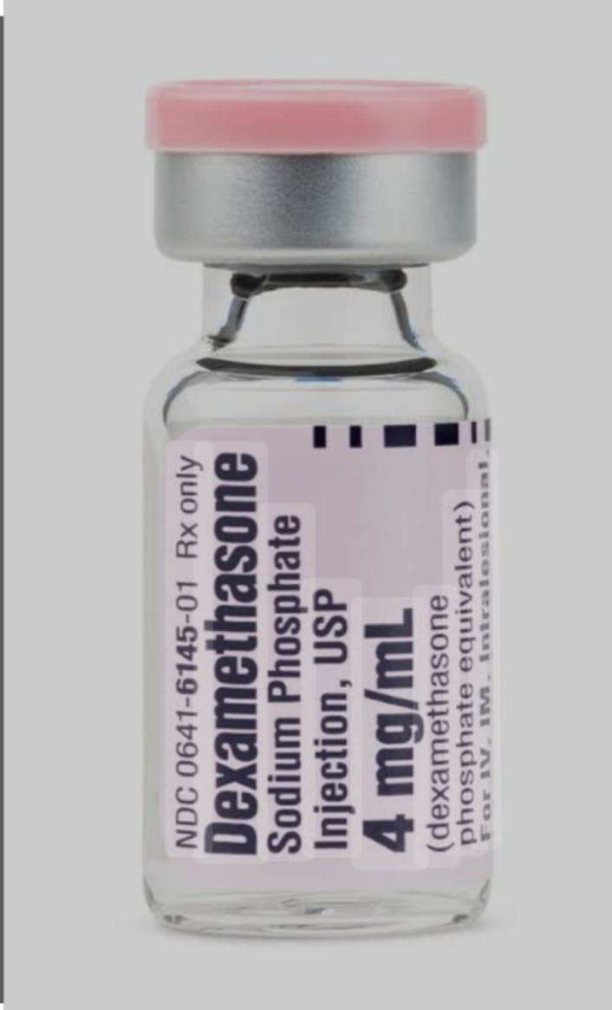
Steroid cover with sliding scale insuline
Inj. Dexa 6mg/12 hours apart in 4 doses with insulin according to sliding scale
Blood Sugar Level 4 hourly

Slide 43

Time and mode of delivery
Counselling with Patient
Delivery is Planned at 38 completed weeks

Slide 44


Slide 45
Diabetes in pregnancy
Pregestational diabetes
Gestational diabetes
Glucose intolerance or diabetes occurring or first recognized in pregnancy.
Type1 diabetes
Type2 diabetes

Slide 46

Gestational Diabetes mellitus

Slide 47
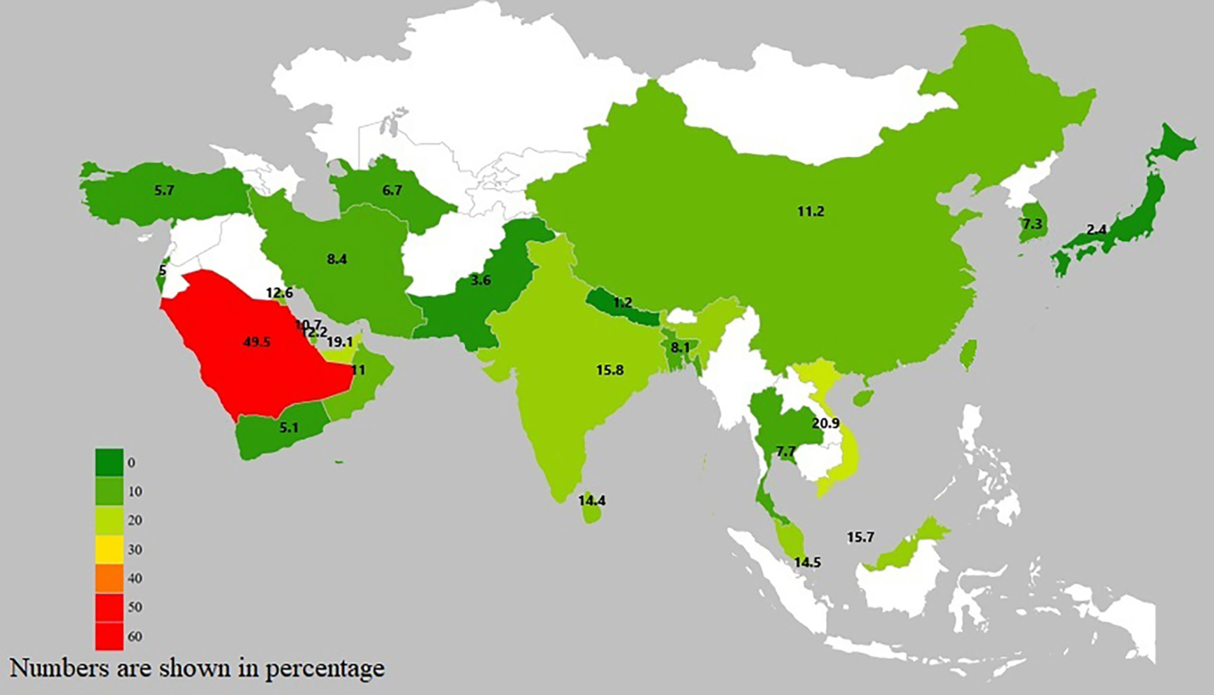
Prevalance of GDM
IDF in 2019 estimated that 15.8 % women are affected by GDM (1 in 6 birth )
In Southeast Asia 26.6%
South Asia(Pakistan,India,Bangladesh) 1-5%

Slide 48
Risk factors of Gestational Diabetes mellitus
BMI>30kg/m2
Previous macrosomic baby weighing 4.5 kg or more
Previous Gestational diabetes
Family hx of diabetes(first degree relative)
Ethnicity with high prevalence of diabetes

Slide 49
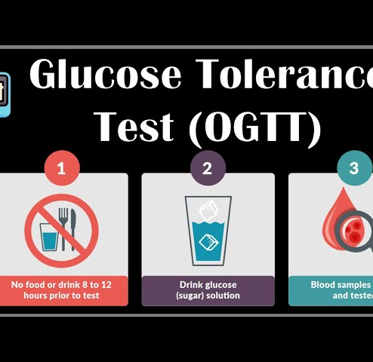
Screening and diagnosis
After booking
At 24-28weeks (if initially normal)

Slide 50
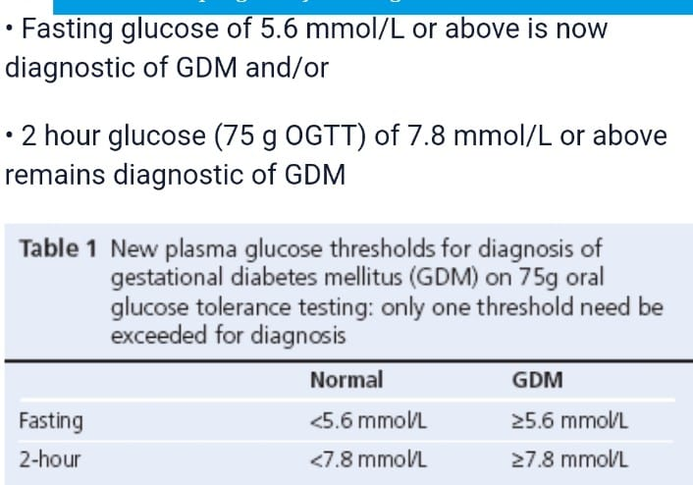
Oral Glucose Tolerance Test

Slide 51
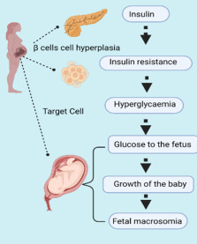
Pathophyiology

Slide 52
complications
Maternal
Adult life
Fetal & neonatal
Macrosomia
ARDs
Still birth
Birth injuries
perinatal mortality
Hypoglycemia in neonate
Severe hyperglycemia
Poly hydramnios
Pre eclampsia
Infection
Operative delivery
DM type 2
Obesity

Slide 53
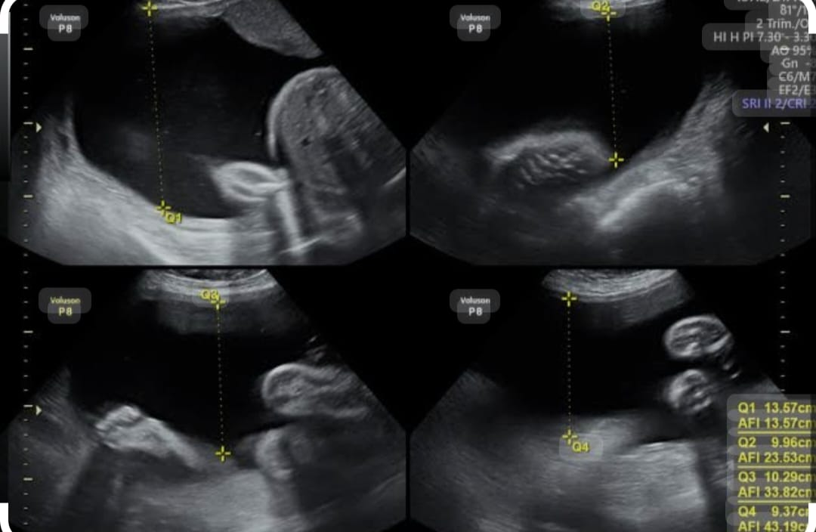
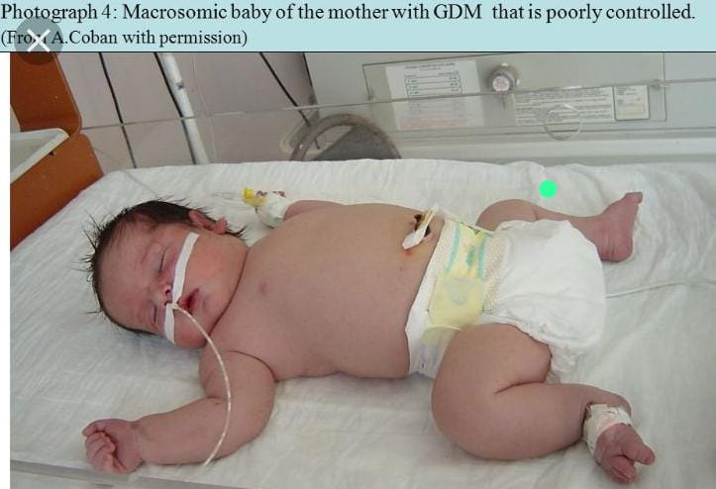
complications
Macrosomia

Slide 54

Management of GDM

Slide 55
Management of GDM
Multidisciplinary approach
Good Glycemic control
Blood sugar levels (7levels)
Lifestyle modification
Dietary councellig/diet chart
Exercise/walk

Slide 56

Multidisciplinary approach

Slide 57
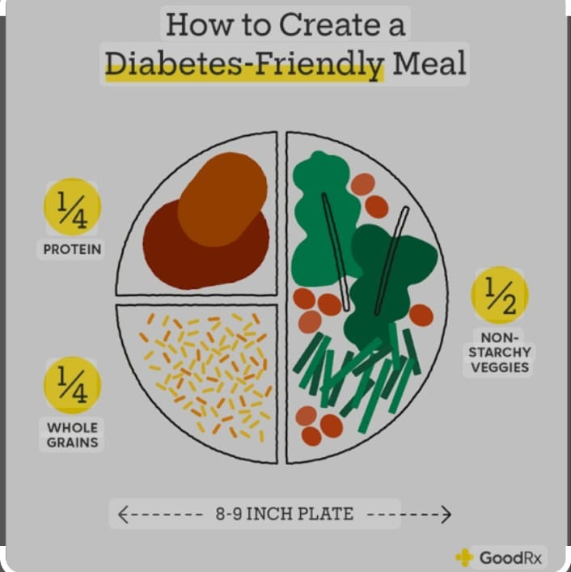

Good glycemic control

Slide 58

Recommended calories in GDM
Manage calories 25-35 kcal/kg
Women with obesity and GDM 1500-1800kcal/day
Less than 1500kcal/day for women with GDM is not safe
Diet chart should include complex carbohydrates
3 meal
3 snacks
1 snack at bedtime
Replace food of high glycemic index with low glycemic index food
Artificial sweetener are not recommended in pregnancy

Slide 59
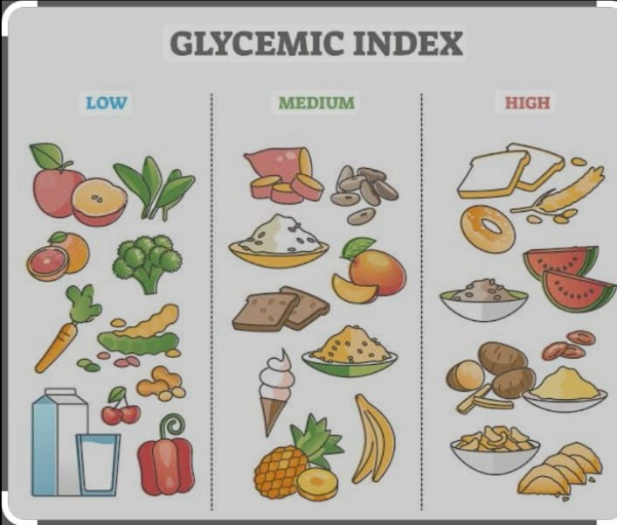

Slide 60

Pharmacological treatment
Oral:Tab Metformin
Injectable: inj Insulin (reg,NPH)
Target for daily capillary glucose level;
Fasting<5.3mmol/l(94mg/dl)
1hour<7.8mmol/l (140mg/dl)

Slide 61
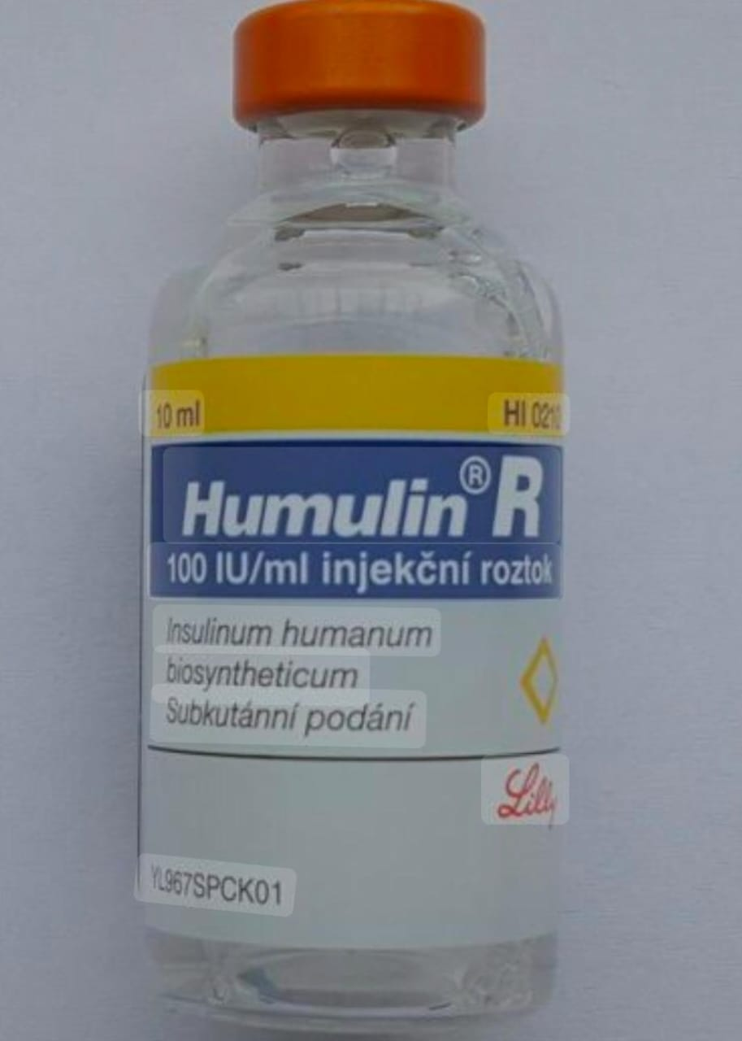

Insulin

Slide 62
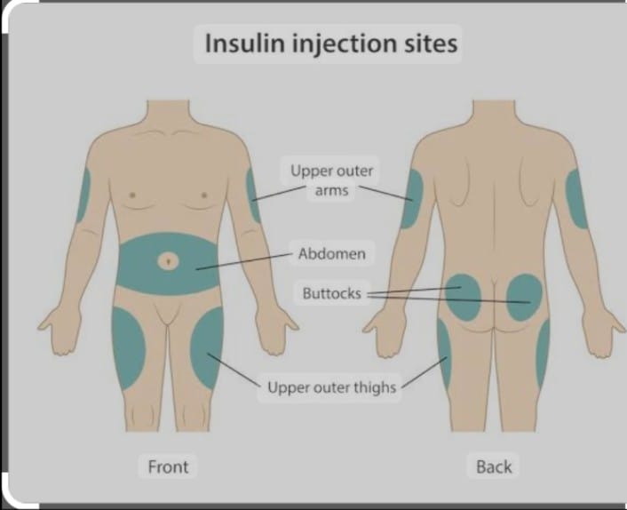
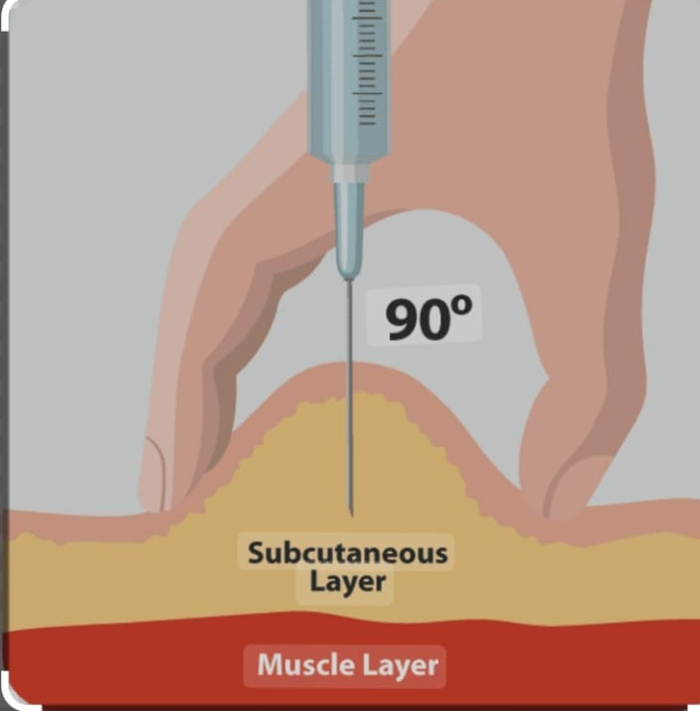

Slide 63

Fetal monitoring
growth scan(4 weekly)

Slide 64

Intrapartum care
Monitor Blood glucose levels hourly
Control of blood glucose during labour
Try to maintain target levels 4-7 mmol/L
Give insulin according to sliding scale / infusion pump
Target levels :
4-7mmol/L(72-126mg/dl)
Inj insulin according to sliding scale

Slide 65
Delivery : uncomplicated GDM:40weeks
complicated GDM:38-39weeks
Mode of delivery:
according to obstetrical indications

Slide 66
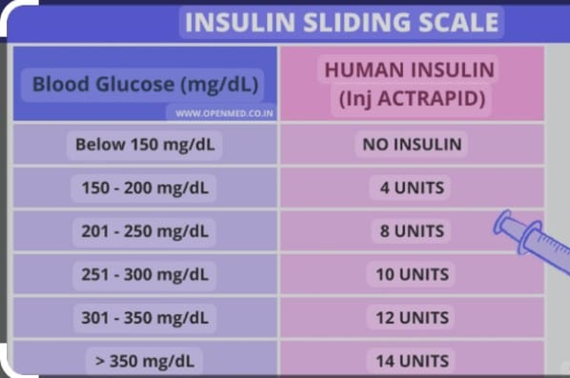
Sliding scale

Slide 67
Postnatal care:
monitor blood sugar levels in order to detect women with undiagnosed prexisting diabetes
(target :4-6mmol/l)
Contraception;
Future risk:
Recurrence 50%
Type 2 DM 15-50%
Follow up;
Fasting blood glucose offered 6-13 weeks postnatally ,if normal annually OGTT will be done.

Slide 68
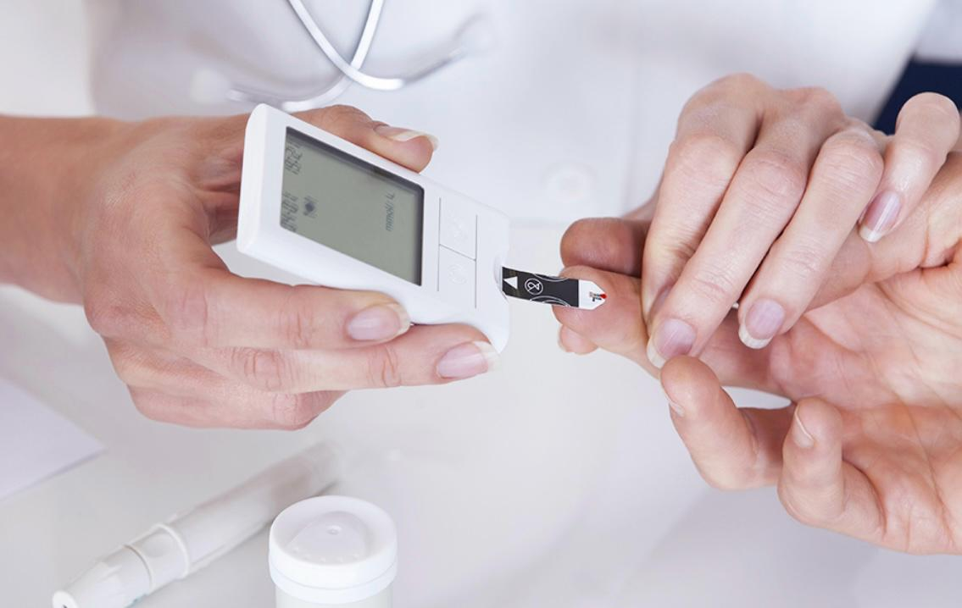
Management of diabetic patient in pregnancy

Slide 69
Management of known diabetic in Pregnancy
Preconceptional councelling
Antenatal management
Intrapartum management
Neonatal care
Postnatal management

Slide 70
Preconception counselling in Diabetics
BMI:<27kg/m2
Role of diet ,exercise to reduce weight
High dose Folic acid:5mg/day until 12 weeks
Optimize glycemic control(HbA1c<6.5%)
Use of contraception until optimization of BS levels.
Assessment diabetic Nephropathy, retinopathy in known diabetics.
Stop ACE inhibitors, ARbs ,statins as soon as pregnancy is confirmed.

Slide 71
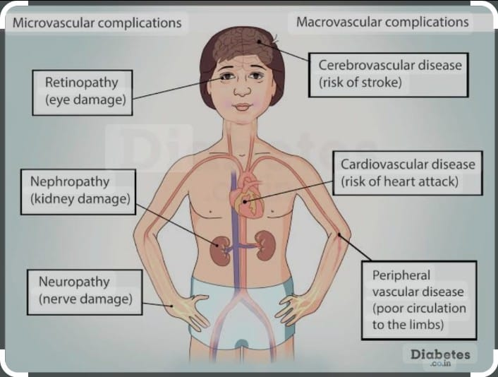

Slide 72
Antenatal management

Slide 73
First trimester
Combined multidiciplinary approach
Dating scan(6-8weeks)
Assesment and optimization of blood sugar levels
Advice on hypoglycemia prevention

Slide 74
Second trimester
Optimization of glycemic control
Screening for diabetic micrvascular and macrovascular complications
Surviellance for medical obs complications, including hypertension
Anomaly scan at 18 to 22 weeks
Assesment of fetal growth

Slide 75
Third trimester
As pregnancy progress insuline requirement increases, dose of insuline should be adjusted.
Assesment of fetal growth at 28,32 and 36 weeks of gestation
Timing and mode of delivery should be discussed at 36weeks of gestation

Slide 76
Postpartum care
With delivery of placenta insulin requirement decrease
Target insulin 5-9mmol/L
Address hypoglycemia
Exclusive breast feeding
Advice contraception

Slide 77

Neonatal care
Monitoring of blood sugar every 2 to 4 hours
Watch for respiratory distress and cardiac decompensation
Cord care
Encourage early &frequent breast feeding

Slide 78

h

