Slide 1


Slide 2
CPC
PAEDIATRICS MEDICINE
By our worthy
Principal Prof.saleem leghari sb

Slide 3
HISTORY
Hassaan Karim
Roll No. 325
Final Year
MBBS

Slide 4
Biodata
Amir
S/o Abdul Jabbar
12 years old boy
Resident of Chak 11/P RYK
Admitted via OPD, on 27/08/2024

Slide 5
Presenting complaints
Fever 7days
Weakness of lower limbs 3 days

Slide 6
History of presenting illness
My patient was in usual state of health 7 days back when he developed fever which was
Sudden in onset
Low grade
Intermittent
With no diurnal variation
Not associated with rigor and chills
There was no association of fever with sore throat, ear discharge, burning micturition, loose motion, vomiting
He consulted local doctors for fever and fever was relieved with oral medication.

Slide 7
Weakness of lower limbs
My patient slept well at night but in the morning he was unable to get up from bed
He started developing weakness of lower limbs which was:
Sudden in onset
Progressively increasing over the days involving both upper limb
Weakness remains same during the whole day
There is no history of urinary or fecal incontinence, backache, neck pain, difficulty in swallowing, speaking, or breathing difficulty
There is no history of tingling , numbness, loss of consciousness, fits, visual symptoms
No history of recent IM injection, trauma to spine

Slide 8
Systemic History
GIT
There is no history of nausea, vomiting, hematemesis, loose motion, melena, bleeding PR
Cardiorespiratory
No history of:
chest pain , cough, sputum, wheezing, hemoptysis, palpitations and pedal edema

Slide 9
Genitourinary
No history of oliguria ,hematuria, flank pain and burning maturation
Musculoskeletal
No history of joint pain, swelling, morning stiffness.
Endocrine
No history of polyuria, increased thirst, heat or cold intolerance

Slide 10
Past history
No history of any chronic illness or any hospital admission in the past
No surgery has been done.

Slide 11
Birth history
Prenatal
Natal
Postnatal
All are insignificant except immunization history
Patient has not been vaccinated according to EPI schedule

Slide 12
Family History
Age of mother is 40 and of father is 45 years
Consanguineous marriage
He has 8 siblings
All are alive and healthy
No history of IHD, DM, HTN, Asthma, TB, Polio or same illness

Slide 13
Personal History
He has normal bowel and bladder habits
Sleep and appetite is good
Normal social behavior
No schooling history

Slide 14
Socioeconomic History
He lives in uncemmented house having 4 rooms with 15 family members
No kitchen or bathroom in home
Poor sanitation condition
Pets in the same house
His father is laborer by occupation earning Rs.16000/month
Poor socioeconomic status

Slide 15
EXAMINATION
Danyal Ahmad
Roll No. 294
Final Year
MBBS

Slide 16
Examination
General Physical Examination
12 Years old boy, named Amir Jabbar, lying on the bed ,pale and sick looking, with normal height and body built, well oriented in time and place, IV line on the right arm with the Vitals of;
Pulse: 88/min
Respiratory Rate: 24/min
Temperature: 98.5 F
Blood Pressure: 110/70 mmHg
The Anthropometric measures are;
Weight: 31Kg
Height: 150cm

Slide 17
GPE Findings
Pallor
Poor oral hygiene
No palmar erythema,sweating,clubbing,cyanosis and splinter hemorrhages
No jaundice,proptosis,rash,
No Thyroid enlargement
No lymph nodes are palpable.
No feet and sacral edema

Slide 18
Central Nervous System
Higher Mental Functions
Patient is alert and conscious, well oriented in place and time,
Short term and long term memory intact
No hallucinations and grasp reflexes
Cranial Verves
All the cranial nerves are intact

Slide 19
Motor System
Inspection
Patient is lying on the bed with nonspecific posture
Bulk is equal and bilaterally symmetrical in all the limbs
No deformity, contractures and fasciculations.

Slide 20
Palpation
Temperature is normal and equal in all the limbs.
No tenderness.
Hypotonia in upper and lower limbs.
Power 2/5 in lower limbs.
Power 3/5 in upper limbs.
Superficial reflexes diminished.
Deep tendon reflexes are absent in upper and lower limbs.
Planters are static.
No involuntary movements.

Slide 21
Sensory System
Primary and cortical sensations are intact.
Cerebellar Signs
No nystagmus,intentional tremors and pendular knee jerk.
Rest of the signs could not be assessed because of the weakness.
Signs of meningeal irritation
Neck stiffness and Brudzunski’s sign are negative

Slide 22
Respiratory System
Inspection
Respiratory Rate 24/minute.
Normal chest expansion, thoracoabdominal type of respiration.
Movements equal on both sides.
No prominent veins, pulsations and scar mark.
Palpation
Trachea central ,chest expansion is 3cm.
Vocal fremitus normal on both sides of the lower chest .
No tenderness, and palpable sounds.

Slide 23
Percussion
Percussion note resonant and equal on both sides.
Auscultation
Vesicular breathing of normal intensity.
Vocal resonance normal and equal on both sides of the lower chest
No added sounds are audible.

Slide 24
Cardio vascular System
Pulse: 88/minute ,regular, normal volume & character, no radio radial and radio femoral delay.
BP: 110/70 mmHg
Neck veins: Not prominent
Examination of Precordium
Inspection
No chest deformity, scar mark, visible pulsations and prominent veins

Slide 25
PALPATION
Apex beat palpable in left 5th intercostal space medial to the midclavicular line, normal character
No left parasternal heave, palpable heart sounds and thrill
Auscultation
Normal first and second heart sounds
No added sounds and murmurs.

Slide 26
Gastrointestinal System
Inspection
Abdomen is flat, moving with respiration, type of respiration is thoracoabdominal.
umbilicus centrally located & inverted
No prominent veins,pulsations,striae and scar mark
Hernia orifices are intact
Male pattern distribution of pubic hairs with intact genitalia

Slide 27
Palpation
Soft, nontender.
No visceromegaly.
Percussion
Upper border of liver in right 5th intercostal space
No shifting dullness.
Auscultation
Bowel sounds 6/minute
Normal intensity
No hepatic,spleenic,aortic and renal bruit audible

Slide 28
Investigations
Ashan Khan
Roll No. 345
Final Year
MBBS

Slide 29
General Investigations:
Complete Blood Count
 | Result | Normal range
Hemoglobin (Hb) | 12.8 g/dl | 14-18 g/dl
TLC | 12,900/Cmm | 4000-11,000 /Cmm
Neutrophils | 63% | 40-75 %
Lymphocytes | 32% | 20-50%
Eosinophils | 03% | 1-6 %
Monocytes | 02% | 2-10%
Platelets | 263,000 | 150,000-400,000
ESR | 27 mm/1st hr | 1-10 mm/1st hr

Slide 30
Clinical Chemistry
Liver Profile
 | Result | Normal range
Serum Bilirubin (total) | 0.5 mg/dl | 0.3-1.2 mg/dl
S.G.P.T/ ALT | 18 U/L | <50U/L
S.G.O.T/ AST | 27 U/L | <50U/L
Alkaline Phosphatase | 213U/L | 60-350U/L

Slide 31
Renal Profile
 | Result | Normal range
Blood urea | 39 mg/dl | 17-43 mg/dl
Serum Creatinine | 0.5 mg/dl | 0.67-1.17 mg/dl

Slide 32
Electrolytes
 | Result | Normal range
Sodium ( Na+) | 139 mmol/L | 135-155 mmol/L
Potassium ( K+) | 3.9 mmol/L | 3.5-5.5 mmol/L
Calcium (Ca++ ) | 10.1 mg/dl | 8.8-10.6 mg/dl

Slide 33
Serology
C-Reactive Protein Test is Negative.

Slide 34
Specific Examination
CSF Examination
Physical Examination
Chemical Examination
Quantity | 1.5 ml
Color | Opaque
Proteins | 76 mg % | 50 mg %
Glucose | 42 mg % | 40 mg %

Slide 35
CSF Examination
Microscopic Examination
RBCs ( Cmm ) | 3/ Cmm
WBCs ( Cmm ) | ----
Neutrophils (%) | Nil
Lymphocytes (%) | Nil
Malignant Cells | zero

Slide 36
Nerve Conduction Studies + EMG
Motor Nerve Conduction Studies of peroneal nerve and
tibial nerve shows ;
Delayed DL’s
Reduced CMAP (Compound Muscle Action Potential)

Slide 37
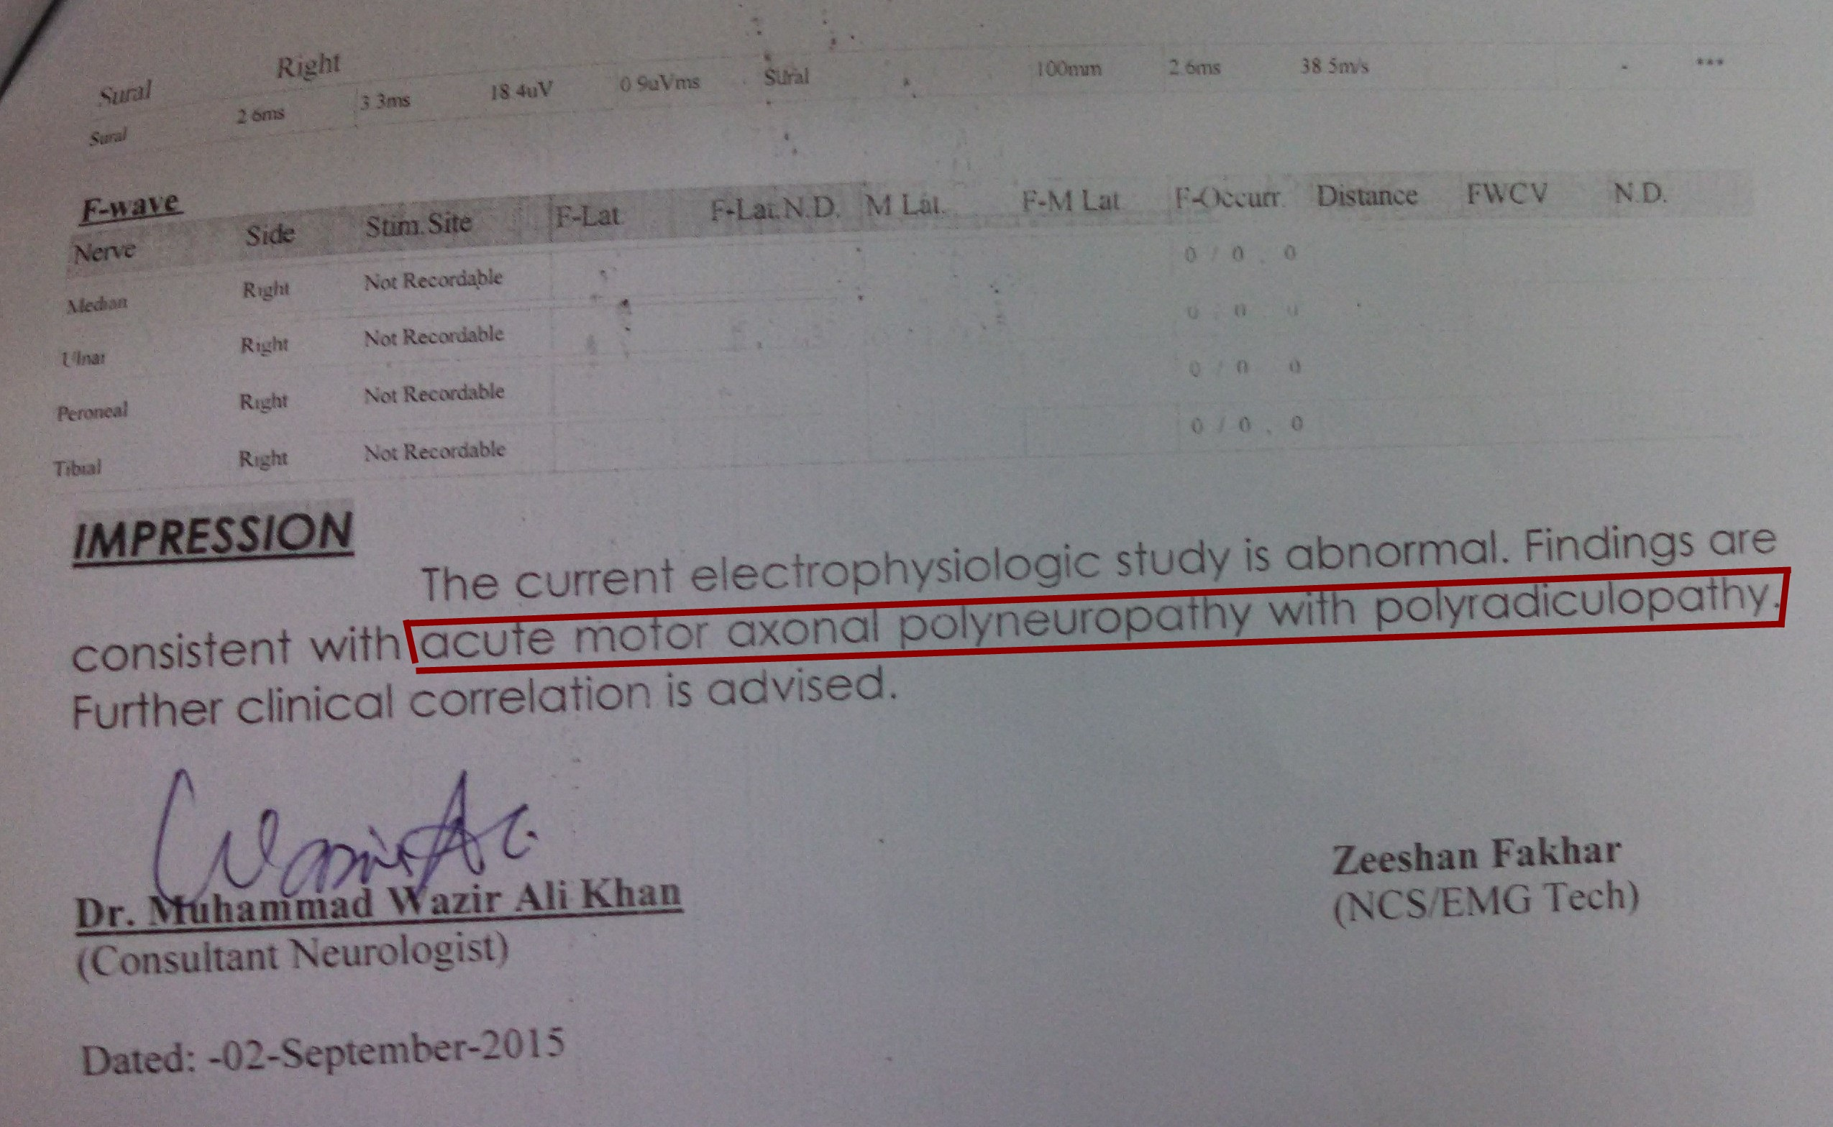

Slide 38
WHAT IS YOUR DIAGNOSIS?
WHAT DIFFERENTIAL WOULD YOU KEEP IN MIND?

Slide 39
This is a case of acute flaccid paralysis with important differentials
Guillian-Barre syndrome
Traumatic neuritis
Transverse myelitis
Poliomyelitis

Slide 40
ACUTE FLACCID PARALYISIS
DR SAIRA MAHMOOD
PGR
Pediatrics Medicine

Slide 41
DEFINITION
It is the acute onset of floppy weakness in a child less than 15 years
of age due to any cause

Slide 42
ACUTE ONSET
WEAKNESS OF ANY LIMB
SUDDEN
ACUTE FLACCID PARALYSIS
PREVIOUSLY HEALTHY

Slide 43
DIFFERENTIAL DIAGNOSIS OF AFP
Traumatic neuritis
Transverse myelitis
Guillian-Barre syndrome
Polio myelitis
And others including toxins, enterovirus, metabolic, drug induced

Slide 44
Guillain-Barre
Syndrome

Slide 45
DEFINITION
  G.B.S is an autoimmune disorder that is thought to be a post infectious polyneuropathy involving mainly motor but sometimes also sensory and autonomic nerves.

Slide 46
ETIOLOGY
Gastrointestinal infection ( C.Jejuni, H.Pylori )
Respiratory tract infection (M.pneumoniae)
Vaccination against;
Polio (oral)
Rabies
Influenza
Conjugate meningococcal vaccine
Lyme disease, cytomegalovirus, zika virus and most recently COVID-19

Slide 47
CLINICAL MANIFESTATIONS
Initial symptoms include numbness, paresthesia, followed by weakness. Radicular back pain and myalgias are common.
Weakness usually begins in lower extremities and progressively involves the trunk, upper limbs and finally the bulbar muscles.
Affected children are irritable, refusal to walk and later flaccid tetraplegia and paresthesia
In most cases weakness is essentially symmetric.
Maximal severity of weakness is reached by 4 weeks after onset

Slide 48
Bulbar involvement
Occurs in half of the cases.
Dysphagia
Facial weakness leading to increased risk of aspirations
Vocal cord paralysis causing hoarse voice
Respiratory insufficiency may occur in severe bulbar and respiratory muscle involvement.

Slide 49
Autonomic nervous system
Postural hypotension
Tachycardia or bradycardia and sometimes asystole
Tendon reflexes are usually lost early in the disease
Bowel and bladder involvement may occur in one-fifth of the cases.

Slide 50
Sub types
Acute inflammatory demyelinating polyneuropathy AIDP
Acute motor axonal neuropathy AMAN
Acute motor and sensory neuropathy AMSAN
Miller Fischer Syndrome
Uncommon GBS variant consisting of acute external ophthalmoplegia, ataxia, and areflexia.
Urinary incontinence is a complication in 20% of the cases, usually transient.

Slide 51
DIFFERENTIAL DIAGNOSIS
 | CLINICAL FINDINGS | CSF FINDINGS | EMG FINDINGS | OTHER SUPPORTIVE TEST
BRAIN ENCEPHALITIS | Drowsiness, seizures | pleocytosis | normal | MRI
Spinal cord Transversemyelitis | Sensory level, brisk reflexes | normal | normal | ABNORMAL SPINE MRI
ANTERIOR HORN CELL POLIO | Fever, flaccid paralysis | pleocytosis | Motor neuropathy | Virus detection
Peripheral nerves Metabolic or electrolyte | Predispoisng factors | normal | normal | Abnormal electrolytes
NMJ Myasthenia gravis | Fatigable weakness | normal | Repititive nerve stimulation for decremental response | Antibodies against acetylcholine receptor
Muscle Inflammatory myositis | Weakness with intact reflexes and sensation | normal | myopathic | Raised serum creatine kinase

Slide 52
DIAGNOSIS
CSF findings
Albumino-cytological dissociation
Proteins elevated twice the normal limit
Glucose level normal
No pleocytosis
Fewer than than 10 WBC/mm3
Bacterial cultures are negative
Viral cultures rarely isolate specific viruses
May not be apparent in first week

Slide 53
MRI
MRI of the spinal cord may be indicated to rule out other disorders
Thickening of cauda equine
Intrathecal nerve roots with gadolinium enhancements

Slide 54
Motor NCV/EMG
NCV greatly reduced and sensory nerve
conduction time is often slow.
EMG shows evidence of acute denervation of
muscle.
Serum CK
Mildly elevated/normal

Slide 55
TREATMENT
Patients in early stages of this acute disease should be admitted to hospital for observation because the ascending paralysis can rapidly involve the respiratory muscles during the next 24 hours

Slide 56
GENERAL TREATMENT
Admission
Supportive care
ABC maintenance
Good medical and nursing care
Tube feeding
Bowel and bladder care
Frequent change of posture
Vital monitioring

Slide 57
SPECIFIC TREATMENT
Respiratory support.
IVIG administration for , commonly recommended protocol is IVIG 0.4 g/kg/day for 5 days consecutively or 1g/kg/day for 2 days
Plasmapheresis
Combined administration of immunoglobulin and interferon is effective in some patients
The role of Steroids is controversial

Slide 58
PROGNOSIS
The clinical course is benign ,recovery begins in 2- 3 weeks. May take upto month
Tendon reflexes are usually the last functions to recover
Bulbar functions recover first
Lower extremities weakness resolving last
Three clinical features are predictive of poor outcome
1) Cranial nerve involvement
2) need for mechanical ventilation
3) Maximum disability at the time of presentation

Slide 59
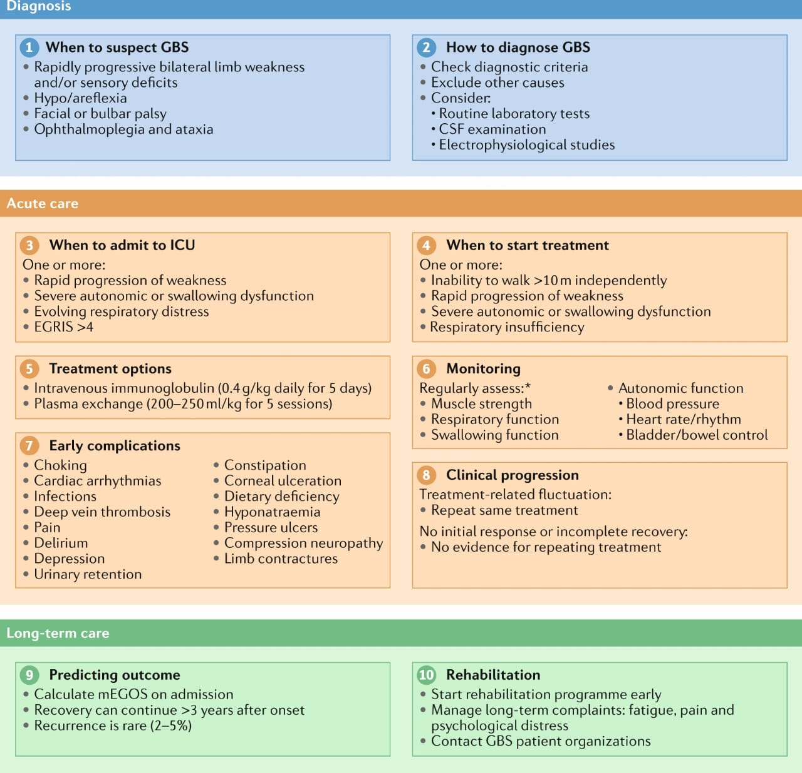

Slide 60
Q & A

Slide 61


