Slide 1





CLINICOPATHOLOGICAL CONFERENCE
Gynae Unit 1
Dr Suhaira Aziz
Dr Nimra Riaz

Slide 2

CARDIAC ILLNESSES IN PREGNANCY
Rheumatic Heart Disease

Slide 3

CASE HISTORY

Slide 4
Biodata
Patient Name : Parveen
W/O : Shoaib Iqbal
Age : 22 years
Profession : Housewife
Resident: Mastan Shah
Married For : 3 years
G2 P1( previous one C-section )

Slide 5
  LCB : 1 year back
  LMP : 12-01-2024
  EDD : 19-10-24
  DOP : 34 weeks + 2 days

Slide 6
Presenting Complaint
Presented to labour room on 09-09-24 with lower abdominal pain for 3 days

Slide 7
History Of Presenting Illness
  My patient is a known case of Rheumatic Heart Disease for 2 years and was in usual state of health 3 days back when she started having lower abdominal pain which was sudden in onset, of mild intensity, intermittent, with the duration of 5 minutes followed by pain free interval of 30 minutes.
  Started from back and radiated towards lower abdomen.
  Aggravated by movements.
  Not associated with dysuria, fever, increased frequency of micturition, PV leaking, bleeding and discharge.
  No vomiting , body swelling , shortness of breath as well.

Slide 8

Present Obstetric History
It was an unplanned pregnancy and she was not practicing any method of contraception.
Confirmed by UPT and dating scan (done in 3rd month of gestation)

Slide 9
1st Trimester
  Experienced nausea and vomiting, relieved spontaneously at the end of trimester.
  No history of fever flu rash cough PV bleeding discharge and burning micturition.
  No history of folic acid intake or hospitalisation.
  She started taking medicines of her ongoing cardiac condition after consultation in 2nd month of pregnancy which included : digoxin, furosemide, beta blocker and warfarin.
  These were continued through out the pregnancy.

Slide 10
2nd Trimester
  First fetal movement felt at 5th month.
  She took her regular antenatal checkup from the nearby doctor where her blood pressure was checked which was in normal range. Blood and urine tests were sent that were in normal range as well.
  Anomaly scan was not done.
  Positive history of shortness of breath after exertion or climbing 2-3 stairs.
  Easy fatigability after 10 to 15 minutes of daily activity.
  She was not taking any supplements.
  No history of fever flu rash cough PV bleeding leaking discharge and abdominal pain.

Slide 11
3rd Trimester
  Her abdominal growth was not satisfactory according to the duration of pregnancy, but she kept perceiving fetal movements and experienced pain lower abdomen for which she presented in labor room and got admitted.
  Diagnosed with asymmetrical IUGR after ultrasonography
  Her labs were sent that were reassuring.
  Blood pressure and cardiac evaluations conducted.
  Fetal monitoring performed (CTG and FKCC).
  Counselled regarding cesarean section and contraceptive methods.

Slide 12
Previous Obstetric History
  Patient is G2P1 with previous one C-section.
  Her previous pregnancy was unplanned and spontaneous and she was diagnosed with RHD in 6th month of pregnancy after which she remained in consultation with cardiologist.
  4 FFPs and 1 pack of fresh blood were transfused in the 7th month according to the patient.
  Delivered her male baby who was small for gestational age at 8th month of pregnancy by C-section in SZMH and it was an early neonatal death.

Slide 13
Menstrual History
  Menarche : 13 years
  Regular cycle ; 3/28 days
  2 pads soaked per day , No clots.
  No dysmenorrhoea, dyspareunia, intermenstrual bleeding.
  No history of contraceptive use.
  PAP test was not done.

Slide 14
Systemic History
CVS: Exertional dyspnoea +ve for 2 years, no tachycardia, orthopnoea and pedal oedema.
RESPIRATORY SYSTEM : No wheezing, cough, chest pain.
CNS : No history of headache, seizures, tremors, blurring of vision.
GIT: No history of abdominal pain and distention, melena, dyspepsia, dysphagia.

Slide 15

UROGENITAL: No dysuria, pyuria, increased frequency of micturition or burning micturition.
MUSCULOSKELETAL: No history of bone pain, joint pain and swelling.

Slide 16
Personal History
  No history of smoking or drug abuse.
  Sleep, Appetite and Bowel habits are unchanged.
  No history of drug allergy.
  No history of any chronic disease like DM, TB, HTN, Hep B , Hep C.

Slide 17
Family History
  No family history of DM, HTN, cardiac disease
  No history of twin gestation and congenital anomaly

Slide 18
Socioeconomic History
  Husband is a labourer.
  Monthly income : less than 15,000 PKR
  She lives in an uncemented house.
  Hygienic conditions are satisfactory

Slide 19

Examination

Slide 20

General Physical Examination
  22 years old Parveen Bibi lying comfortably on bed with IV line on right hand , well oriented in time, place, and person with BMI of 21.1 kg/m2 having following vitals:
  Pulse : 98 regular per minute
  BP : 110/70 mmHg
  RR : 22 bpm
  Temperature: 98°F
  SpO2 : 98 %

Slide 21
  No pallor , jaundice , clubbing, cyanosis and koilonychia .
  Thyroid was not enlarged .
  Accessible lymph nodes were not palpable.
  No sacral and pedal edema.

Slide 22
Abdominal Examination
  Abdomen was moving with respiration.
  No visible pulsations .
  Umbilicus seems to be central
  Scar mark present on lower abdomen.
  Hernial orifices were intact.
  Symphisio-fundal height : 32 weeks
  Fetus’ lie was longitudinal with cephalic presentation and was 5/5 palpable.
  FHR : 130-145 BPM
  Fetal weight was approximated to be 2kg

Slide 23
CVS Examination
  Precordium normal.
  No visible pulsations, prominent veins or scar marks.
  Apex beat palpable in 4th ICS 1cm lateral to midclavicular line.
  S1 and S2 heard with added sounds.
  Murmur was heard at lower border of sternum near apex.

Slide 24
Respiratory Examination
  Normal chest shape moving equally on both sides with respiration.
  Bilateral crepitation were heard in lower lung zone.

Slide 25
Other Examinations
CNS EXAMINATION:
She was well oriented with time place and person
GCS : 15/15.
BREAST EXAMINATION:
Bilateral breast were normal and symmetrical looking

Slide 26
CASE SUMMARY
  A 22 years old female G2P1 previous one C-section at 34 weeks according to dates.
  Presented to labor room with Lower abdominal pain for 3 days that was settled with analgesia.
  History is suggestive of her abdominal growth not growing well with the duration of pregnancy.
  On workup she was told that baby’s growth is not good.

Slide 27
  Known case of RHD
  Compliant with medications and in regular checkup with cardiologist
  Murmurs heard in precordium region
  Per abdominal examination:
  Liquor seemed to be inadequate. SFH was 32 weeks lie was longitudinal cephalic and 5/5 palpable

Slide 28

INVESTIGATIONS

Slide 29
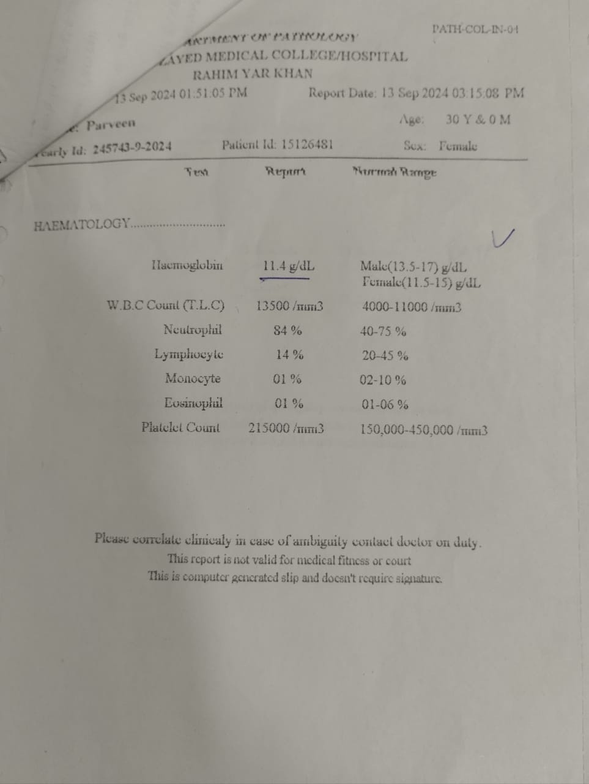
Baseline Investigations
BLOOD GROUP: O
Rh FACTOR: +ve
CBC
Hb : 11.1 g/dL
TLC : 12700 /mm3
Platelets: 253000

Slide 30
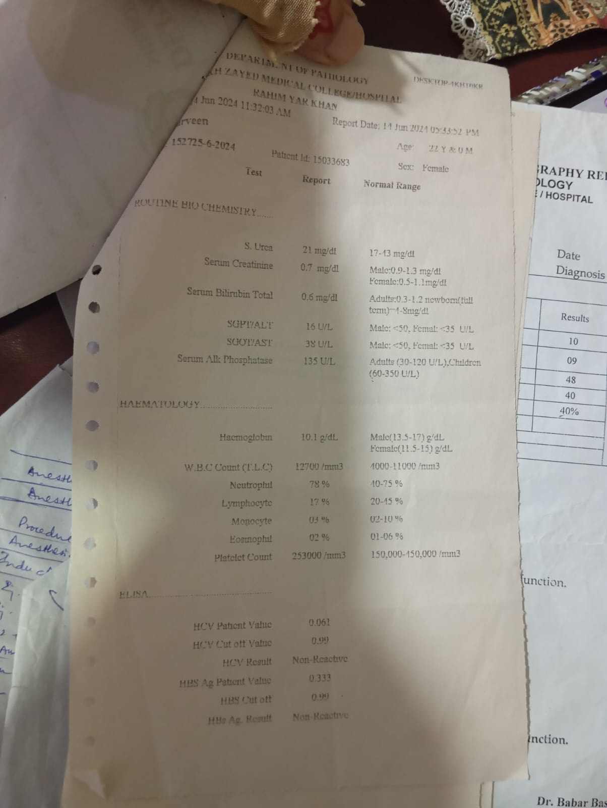
VIRAL SEROLOGY
HbsAg neg
Anti HCV neg
Anti HIV neg
LFTs and RFTs
Normal range

Slide 31
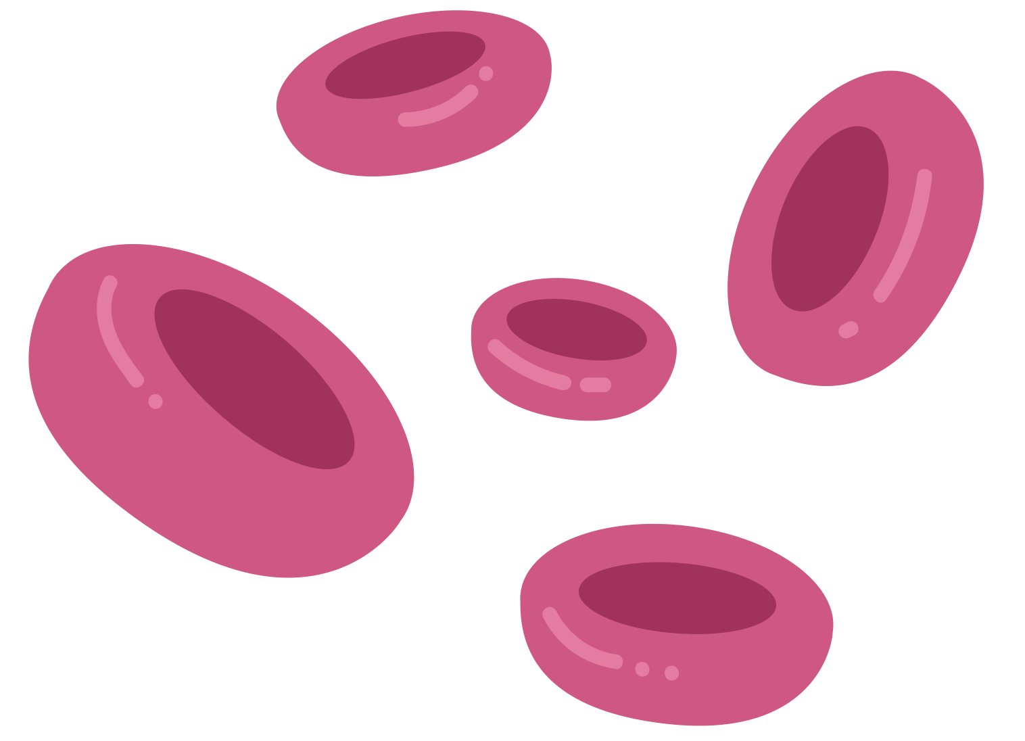
CLOTTING PROFILE (last trimester )
﻿DATE | 13-09-24 | 15-09-24
INR | 1.1 | 1.0
PT | -- | 15 sec
APTT | -- | 35 sec

Slide 32
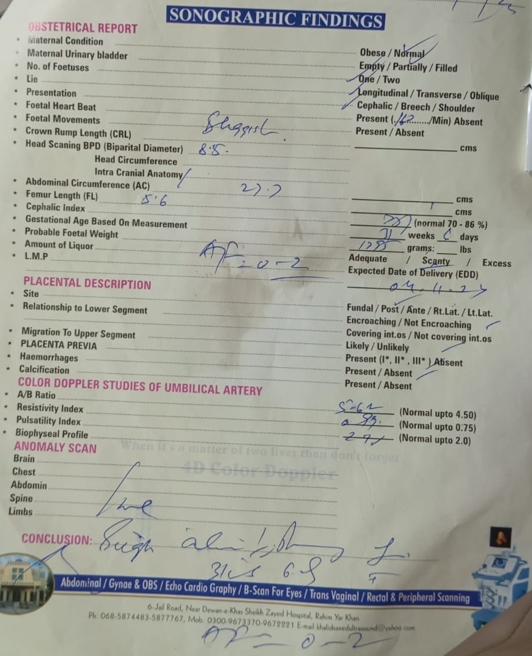
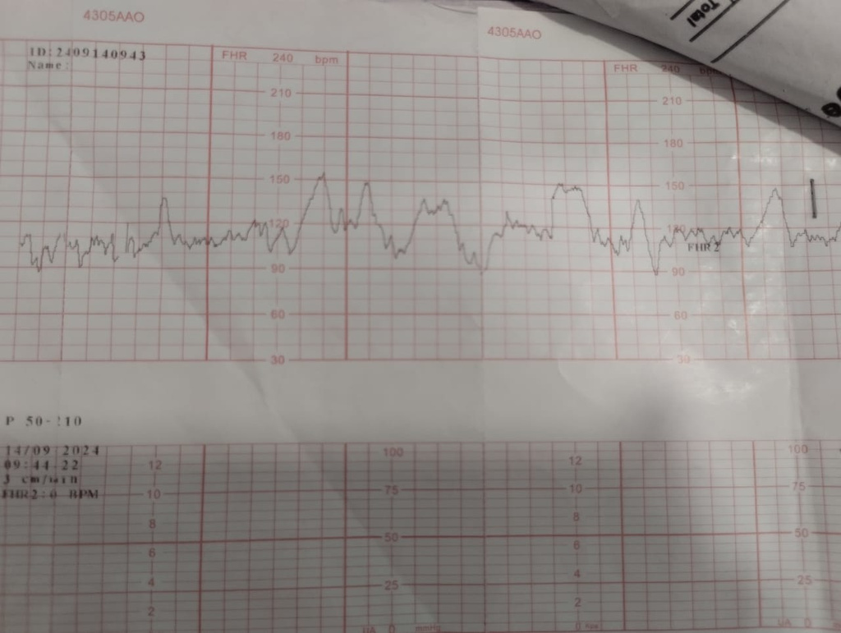
Regarding Pregnancy
USG done at 34 weeks
Sluggish fetal movements .
Oligohydraoamnios with AFI of 0-2.
Doppler USG of umbilical artery
Asymmetrical IUGR.
Placental insufficiency.
CTG (done twice daily in 3rd trimester)
Reactive with multiple accelerations

Slide 33
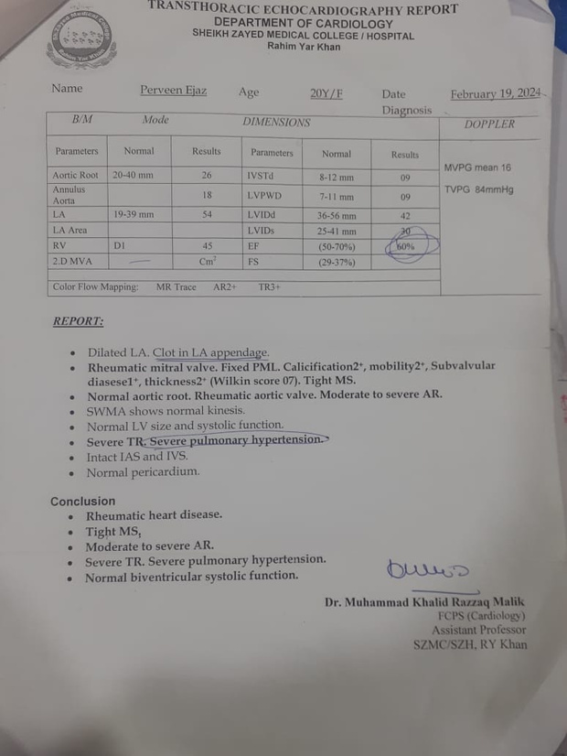
Regarding Medical illness
Echo cardiography in 3rd trimester
Revealed
  Severe mitral stenosis (0.6cm2)
  Moderate aortic regurgitation
  Moderate left ventricular systolic dysfunction
  Dilated right sided chamber
  Severe pulmonary HTN
  Severe tricuspid regurgitation
  Ejection Fraction = 60%
(3 valves involved)

Slide 34


