Slide 1
Autoimmune Hepatitis
Final year Presenters :
Rohama Qubra
Danyal Ahmad
Sajjad Ahmad

Slide 2

Table of Contents:
01
02
03
04
05
History
Examination
Investigations
Summary
Case Discussion

Slide 3

HISTORY
Biodata:
Name - D/O | Muqadas D/O M.Tariq
Age | 7 yr/old
Gender | Female
Residency | Khanpur
Date of admission | 21-08-2024
Mode of admission | ER
Informant | Mother
Ward and bed no. | General ward-1 /bed no . 49
Registration no. | 218422

Slide 4
Presenting complaint
vomiting
For 6 days
Fever
For 7 days
Abdominal pain
For 6 days

Slide 5

HOPI
According to my patient’s attendent she is a known case of CLD,diagnosed 11 months ago.
Now she’s presented with the complaint of Fever for 7 days, that was sudden in onset, high grade and continous. Not associated with rigors, chills ,night sweats .
No aggravating or relieving factors.

Slide 6

She’s been complaining of vomiting for 6 days, that’s non-projectiles, 5-6 episodes per day, yellow in color, having food content, odorless and around 1 cup in amount. There is blood in vomitus, that is red in color and small in amount.
Having abdominal pain for 6 days ,that was mild, generalized and non radiating.
As she is a known case of CLD, She’s having yellowish discoloration of eyes and abdominal distension for 11 months which increased progressively,
There is also a history of joint pain, hair loss and lethargy .
There is no History of Blood transfusion and Drug intake.

Slide 7






Systemic Inquiry:
Gastrointestinal tract:
vomiting+, Abdominal pain+, Hematemesis +,Nausea-, Chronic Diarrhea-, Constipation-,Melena -
Central nervous system:
Altered level of consciousness+(on the day of admission) loss of vision-,blurring- ,headache -,Nausea-,slurring of speech-,abnormal body movements-
Cardiovascular system:
Tachycardia-, palpitations-, bradycardia-, night sweats-, arrythmias-
Urogenital tract:
Dark colored urine, urogenital tract irritation -, burning during micturition-,pyuria-, hematuria-, oliguria-, Polyuria-, Frothy urine-
Locomotor System:
Joint pain+, muscle pain-
Respiratory System:
SOB+, cough-, sputum-, wheeze-, crepts-
Cold or heat intolerence-,polyuria-, polydipsia-
Endocrine system:

Slide 8


Previous Treatment history
Previously she’s been taking medications for CLD,that didn’t seem to improve, For which she was referred to SZH,RYK for further investigations and treatment.

Slide 9

Past History
Past Medical History:
She is a known case CLD .
Hep B/C –ve
Asthma –ve
TB –ve
HTN -ve
Past surgical History:
Insignificant

Slide 10

Birth History
Antenatal
Natal
Postnatal
Full term gestation
Hospital delivery
SVD
Conducted by doctors
With normal APGAR
No resuscitation needed
First feed given half an hour after birth
Breast milk was given
Urine and stool passed
No jaundice
No diarrhea
No fits
No vomiting
No fever
No history of illness
No infections
Drugs: ca2+,iron and folic acid supplements
Vaccinated for TT
No Trauma
No radiation exposure

Slide 11
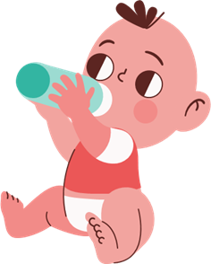
Feeding History
Breast Feeding | Artificial Feeding | Weaning | Current Diet
5-6 hrs after birth | Cow milk with no dilution | Started at the age of 7 months | Roti Rice salan
5-6 times/day | 1-2 times per day | Roti Rice | 2-3 meals/day
Till 1 year of age | Total amount per day was two 500ml feeding bottles | 2-3 times/day | Appetite decreased during Illness
} Adult diet

Slide 12
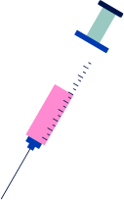
Immunization History
BCG ✔️
OPV ✔️
Penta 1 ❌
Penta 2 ❌
Penta 3 ❌
MMR ❌
Hepatitis ❌
Influenza ❌
Typhoid ❌
DT ❌
Pneumococcal ❌

Slide 13



Developmental history:
Gross motor
Fine motor & vision
Hearing and speech
Social Behavior
Neck holding
(3 months)
Sitting w/o support
(9 months)
Standing
(12 months)
Walk (1 year)
Pincer grip
(10 months)
Follow light beam
(2 months)
Talking (12 months)
Combining words
(18 months)
Social smile (1 month)
Stranger Anxiety
(9 months)

Slide 14

Family History
Age of mother is 35 and father is 38 years
Consanguineous Marriage
Six children together
No history of Jaundice in mother during pregnancy
No history of liver diseases ,Hep B/C , Asthma, HTN, TB, DM, infectious disease
No deaths in family

Slide 15

Socioeconomic History
Parents are uneducated
Father is a laborer
Monthly income: 28k
Poor socioeconomic status, having a
Non-cemented house, with 2 rooms and
3 families living in it.

Slide 16



Environmental History
Rural area
Non-sanitary conditions
Consuming Tap water
Having access to fresh air and sunlight

Slide 17

Personal History
Behavior: Lethargic and Irritable
Uninterested in physical activities
Not school going
Appetite has decreased recently
Weight loss (undocumented)

Slide 18
EXAMINATION

Slide 19
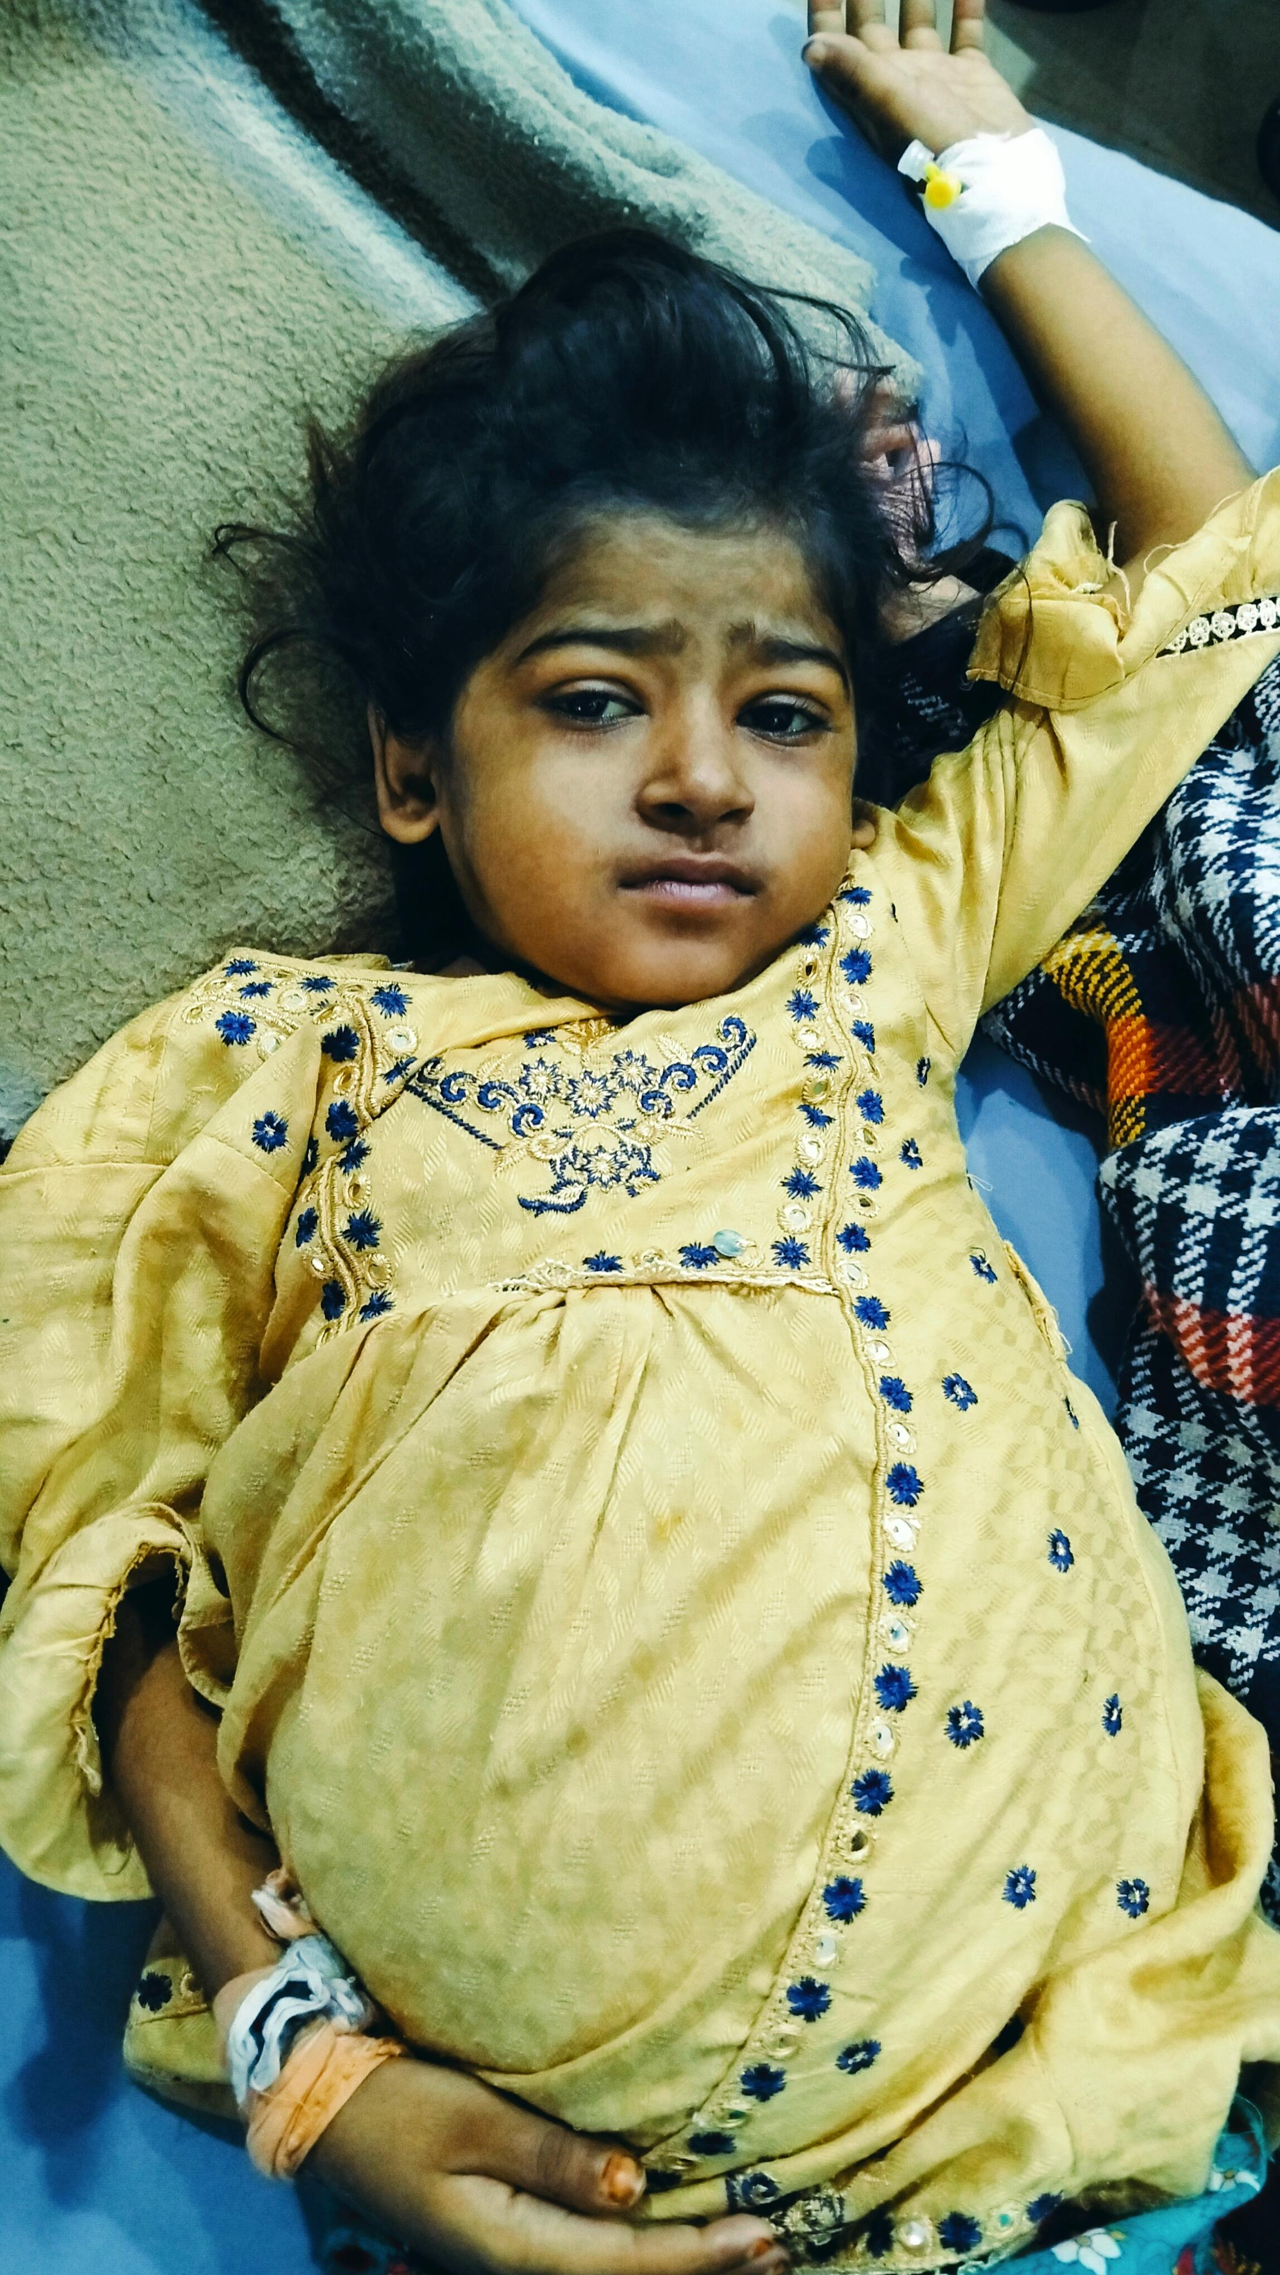
GENERAL PHYICAL EXAMINATION
7y old girl ill looking, malnourished lying on bed, conscious, irritable, seems to be oriented, IV line in her left hand. She has obvious abdominal distension and pallor, no dyspnea and dysmorphism.
VITALS
Pulse 88 bpm
BP 100/70 mmHg
RR 29 per min
Temp 98 F

Slide 20
Anthropometric Measurements
Weight 17.5 kg
Height 105 cm
There was clubbing
BCG scar was present
There was icterus and pallor in eyes
There was scalp eczema and hair were brittle and normal in color
There were few petechiae on abdomen and chest with largest one measuring 0.9*0.7cm
No ear discharge, oral ulcer and oral hygiene was good
No lymphadenopathy, edema, palmar erythema, osler nodes, wrist widening and enlarged thyroid.

Slide 21
ABDOMINAL EXAMINATION
Abdomen was distended, umbilicus was central and everted, moving with respiration.
No striae, scar marks, visible pulsation.
Abdomen was soft and non tender.
Liver was palpable 4cm below the right costal margin, upper border percussed in 5th ICS with total span of liver 11cm, firm in consistency, smooth surface, rounded borders. Liver is non tender and non pulsatile
No other viscera palpable
Hernial orifices were intact.
Percussion note was dull all over the abdomen and fluid thrill was positive
On auscultation, normal bowel sounds were heard and no bruit

Slide 22
Cardiovascular Examination
Precordium was normal in shape, no pulsations, scar marks or any deformity seen.
JVP was not raised
Apex beat was palpable at 5th ICS in midclavicular line.
No parasternal heave and epigastric thrill.
On auscultation, S1 + S2 with no added sounds were heard.
Pulse was 88 bpm, regular in rhythm, normal in volume and character.
No radio-radial or radio-femoral delay.

Slide 23
Respiratory Examination
Respiration was thoracoabdominal.
No scar marks, visible pulsation or any deformity.
Trachea was central.
Normal chest expansion and vocal fremitus was felt normally.
Percussion note was resonant and equal bilaterally.
On auscultation, normal vesicular breathing with no added sounds.
Vocal resonance was normal.

Slide 24
CNS Examination
Patient seems to be oriented and conscious.
GCS 15/15
Speech was normal.
Cranial nerves intact.
Sensory and motor system were intact.
Cerebellar signs were negative

Slide 25
Summary
7y old girl known case of CLD. Now, presented with fever for 7 days, vomiting and abdominal pain for 6 days. On Physical examination, there was clubbing, petechiae, pallor and icterus. On systemic examination, there was massive ascites, fluid thrill positive and hepatomegaly.

Slide 26
Investigations

Slide 27
LABS
CBC
LFTs
Viral markers
Coagulation Profile
Ultrasonography
Ceruloplasmin
Autoantibodies

Slide 28
CBC
 | Pt. Value | Normal Value
Hemoglobin | 9.8 g/dL | 11.5-15 g/dL
TLC | 9900/mm3 | 4000-11000 /mm3
Platelets | 55000/mm3 | 150000-450000 /mm3

Slide 29
LFTs
Sr. Bilirubin 20.1 mg/dL 0.3-1.2 mg/dL
SGPT/ALT 523 U/L <35 U/L
SGOT/AST 332 U/L <35 U/L
Sr. Alkaline Phosphatase 227 U/L 60-135 U/L
Sr. Albumin 2.0 g/dL 3.5-5.2 g/dL

Slide 30
Viral Markers
Anti HCV negative
HbsAg negative
HIV negative

Slide 31
Coagulation Profile
PT 35 sec 14 sec
aPPT 55 sec 33 sec

Slide 32
Ultrasonography
Liver Enlarged, Coarse Texture, 13cms, regular margins
Spleen 9.3*4.4 cm
Other findings normal
Conclusion:
  Hepatosplenomegaly
  Hepatic Parenchymal Disease

Slide 33
Esophagogastroduodenoscopy
Grade 1 esophageal varices were found

Slide 34

Autoantibodies
Sr. Ceruloplasmin 29 mg/dl 20-60
Sr. IgG 46.6 g/L 3.17-9.94
Anti-nuclear Antibodies Positive
Anti-smooth-muscle antibodies Negative
Anti-mitochondrial antibodies Negative
Serum LKM-1 IgG <1 U/mL

Slide 35
Differential Diagnosis
Chronic liver disease due to
Viral hepatitis
Autoimmune
Drug induced
Metabolic (Wilson’s disease, alpha 1 antitrypsin deficiency)

Slide 36
Diagnosis
Chronic liver disease due to autoimmune hepatitis type 1

Slide 37
Autoimmune Hepatitis
Dr. Daniyal
PGR paeds Unit-1

Slide 38
Autoimmune Hepatitis
Chronic hepatitis of unknown etiology
Can progress to cirrhosis
Characteristics include:
  Presence of autoimmune antibodies
  Evidence of hepatitis
  Elevation of serum globulins
  Unresolving hepatocellular inflammation and necrosis

Slide 39
Diagnosis
Diagnosis of exclusion
Rule out other causes of chronic liver diseases
  Wilson disease
  Chronic viral hepatitis
  Drug induced
  Non alcoholic fatty liver disease
  Immune cholangiopathies

Slide 40
Epidemiology
Frequency of AIH in north America 11%-22%
Accounts for 5.6% of liver transplants in US
Prevalence greatest among northern European white persons
Japanese have lower frequency
Incidence of AIH in Pakistan is 0.23 per 100000 children

Slide 41
Pathogenesis
Histopathological lesions composed of cytotoxic T cells and plasma cells
Circulating autoantibodies
Hyperglobulinemia
Other autoimmune disorders i.e. thyroiditis, diabetes mellitus, celiac disease
Histocompatibility haplotypes associations
Response to steroids and immunosuppression

Slide 42
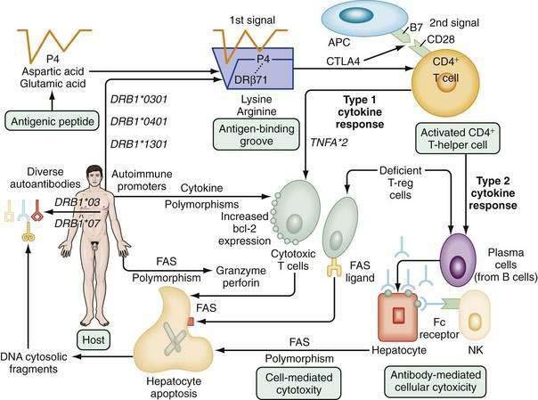
Pathogenesis

Slide 43
Pathogenesis
Exact pathogenesis is unknown
Cell mediated immune attack is directed against liver cells
Humoral immunity plays a role in extrahepatic manifestations i.e. arthritis, vasculitis and glomerulonephritis

Slide 44
Clinical Features
Fatigue 86%
Jaundice 77%
Upper abdominal discomfort 48%
Pruritis 36%
None 25-34%
Anorexia 30%
Myalgias 30%
Diarrhea 28%
Cushingoid Features 19%
Fever 18%

Slide 45
Clinical Features
Hepatomegaly 78%
Jaundice 69%
Spider Angiomata 58%
Concurrent immune disease <38%
Splenomegaly >32%
None <25%
Ascites 20%
Encephalopathy 14%

Slide 46
Lab Features
Labs
Elevated AST 100%
Hypergammaglobulinemia 92%
Inc. immunoglobulin G 91%
Hyperbilirubinemia 83%
ALP >2 folds 33%
Immunoserological Markers
SMA, ANA or anti-LKM1 100%
Atypical p-ANCA 92%(type 1 only)
Anti sialoglycoprotien receptor 82%
Anti actin 74%
Anti Liver cytosol 32%(type 2 only)
Anti Soluble Liver Antigen 11-17%

Slide 47
Associations
Hashimoto’s thyroiditis
Endocrine changes i.e., acne, hirsutism
Pulmonary changes i.e. pleurisy, transitory pulmonary infiltrates and collapse
Acute, recurrent and non-deforming polyarthritis of large joints
Mild anemia, AIHA.

Slide 48
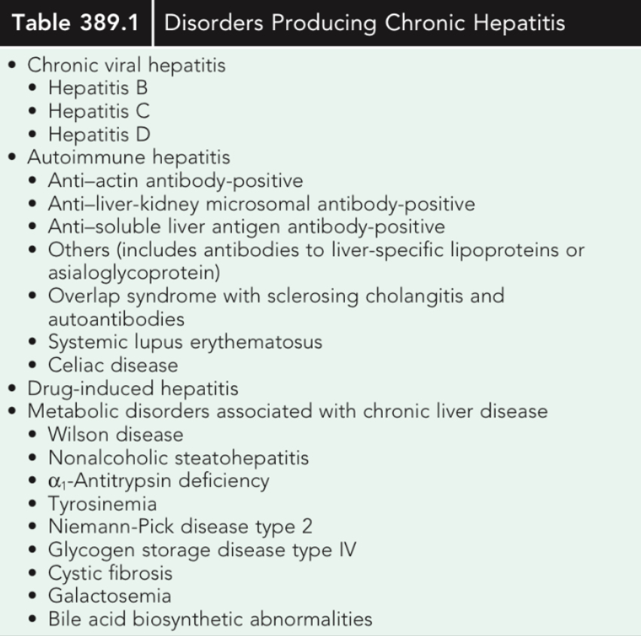

Slide 49
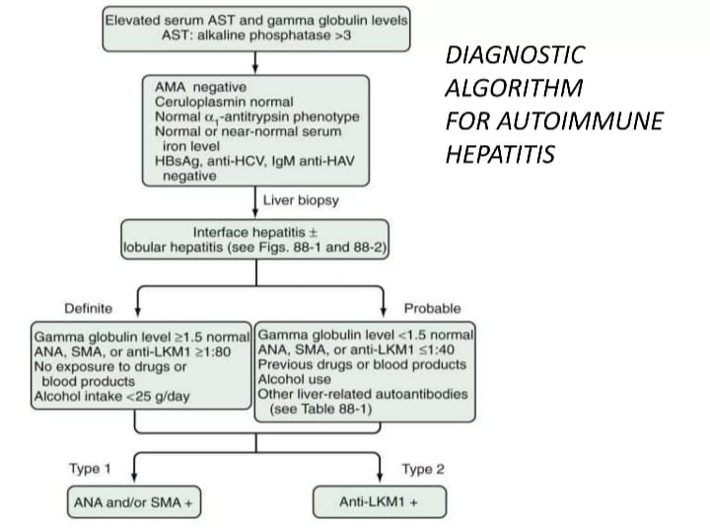

Slide 50
Classification
Two types of AIH
  Type 1
  Type 2

Slide 51
Type 1 AIH
Classically in young females
A NA or Anti-Smooth Muscle antibody positive
Titer usual ly > 1:100
10% will have an antibody to Soluble Liver antigens (SLA)
Other Antibodies: anti-DNA, p-ANCA, Anti­ mitochondria l, Anti-Actin (AAA), cytoskeletal
antibody, nuclear envelope proteins lamin A and C, plasma membrane sulfatides
Anti-actin antibodies have greater specificity

Slide 52
Type 1 AIH
Bimodal Age distribution (ages 10-20 and 45-70)
Female : ma le (3.6:1)
HLA DR3 or DR4 association
Associated with extrahepatic manifestations{ 38%):
  Autoimmune thyroiditis(12%), Graves disease( 6%), Chronic UC{6%).
  Less commonly with RA, pernicious anemia, systemic sclerosis, ITP, SLE, coombs positive hemolytic anemia, leucocytoclastic vasculitis ,erythema nodosum
40% present with acute onset of symptoms similar to toxic hepatitis or acute viral hepatitis

Slide 53
Type 2 AIH
Seen in children (2-14 years)
HLA DRB1 or DQB1 association.
Presence of anti-Liver/Kidney Microsome Antibodies (anti-LKM1) directed against cytochrome p450 2D6
Anti- Liver Cytosol Antibody (ALC-1)
Concurrent autoimmune disease like autoimmune thyroiditis, vitiligo and type 1 diabetes mellitus can be present.
Acute or fulminant possible

Slide 54
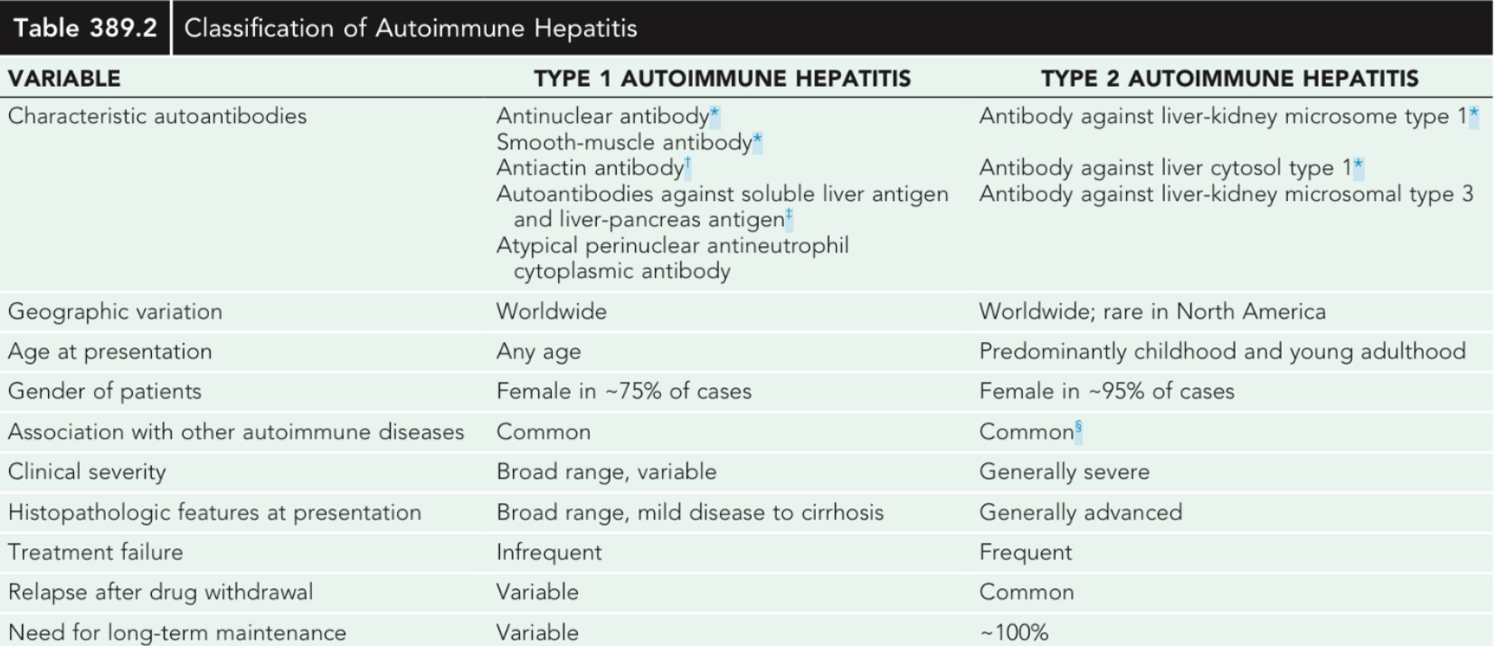
Types

Slide 55
Variant forms of AIH
AIH + Primary biliary cirrhosis
AIH + Primary sclerosing cholangitis
AIH + Cholestatic features
Autoantibody-Negative Autoimmune Hepatitis

Slide 56
AIH + PBC
Along with features of AIH, pt. also have antimitochondrial antibodies
Histological features of cholangitis and bile duct loss are present
Treatment with prednisone is done if alkaline phosphatase level is <2 × ULN
Treatment with prednisone and UDCA is done if ALP >2 × ULN

Slide 57
AIH + PSC
Along with features of AIH, pt. also have abnormal cholangiographic changes
Inflammatory bowel disease may be present
Antimitochondrial antibodies are absent
Histological features of cholangitis and cholestasis are present
Treatment with prednisone and UDCA

Slide 58
AIH + Cholestatic features
Along with features of AIH, pt. also have antinuclear antibodies or anti smooth muscle antibodies
No Inflammatory bowel disease may be present
Absence of Antimitochondrial antibodies and cholangiographic changes
Histological features of cholangitis and cholestasis are present
Treatment with prednisone and UDCA

Slide 59
Auto antibody Negative AIH
13% of chronic hepatitis of unknown cause satisfy the criteria for AIH but lack autoantibodies
Commonly called Cryptogenic chronic hepatitis
Age, female predominance, frequency of immunologic disease, histologic features and lab findings are similar with classic AIH
Associated with HLA-B8, DR-3
Respond to treatment with glucocorticoids

Slide 60
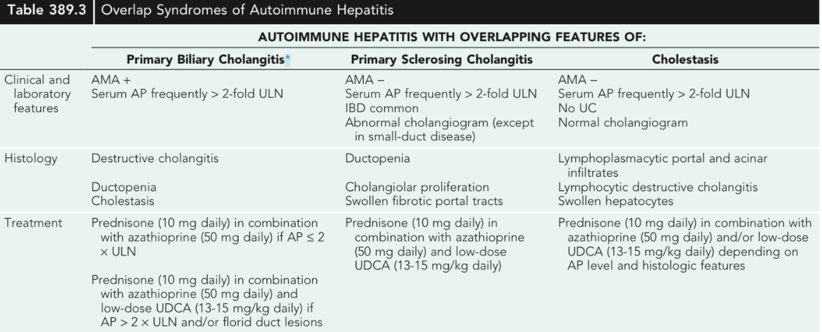
Variants

Slide 61
Differential Diagnosis
Acute viral hepatitis
Chronic viral hepatitis
Metabolic i.e Wilsons disease
Drug Induced
Primary biliary cirrhosis
Primary sclerosing cholangitis

Slide 62
Treatment
Absolute Indications
  Relentless clinical progression
  AST or ALT more than 10 times the ULN
  AST or ALT more than 5 times with gamma globulin more than 2 times of ULN
  Bridging necrosis on histology
Relative Indication
  Mild or no symptoms
  AST is 3-9.9 times the ULN
  AST is less than 5 times ULN but gamma globulin is less than 2 times

Slide 63
Treatment
No Indications
  Asymptomatic with minimal laboratory changes
  AST is less than 3 times
  Burned out or inactive cirrhosis
  Portal hepatitis or decompensated disease
  Known deficiency of thiopurine methyltransferase deficiency
  Previous intolerance to azathioprine or prednisone

Slide 64
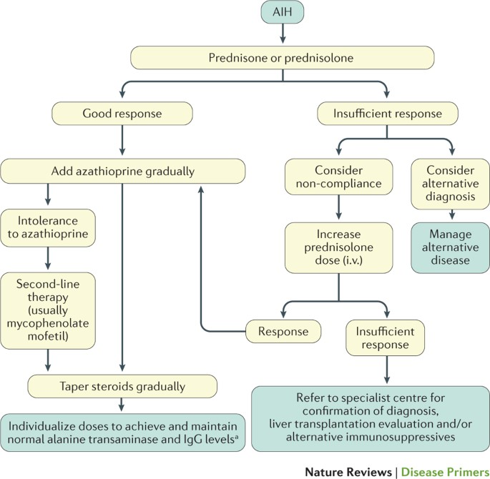

Slide 65
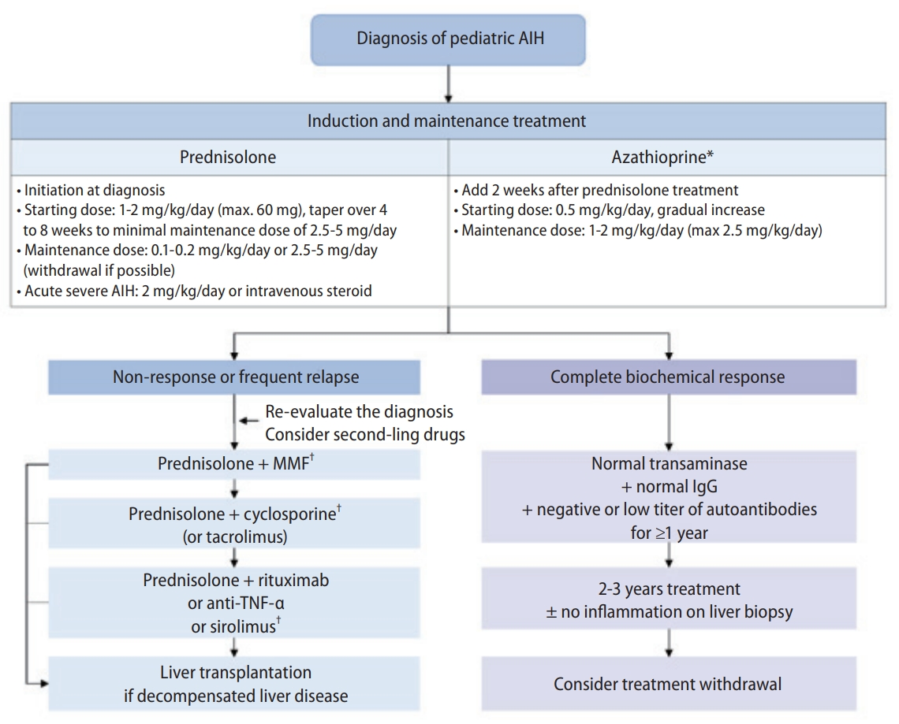

Slide 66
Treatment Endpoints
Remission
Treatment failure
Incomplete response
Relapse
Drug toxicity

Slide 67
Remission
Remission connotes absence of symptoms, resolution of all lab indices of active inflammation and histologic improvement to normal liver tissue or inactive cirrhosis.
Evaluation of the liver tissue before drug withdrawl is essential to establish remission because histologic activity may be present in 55% of pt. who satisfy other requirements of
• •
rem1ss1on.

Slide 68
Remisson contd.
If a remission has ensued,judged clinica lly, biochemically and by liver biopsy,t he drug should be tapered off slowly over about 2 months.
If relapse occurs indefinite low dose prednisone or indefinite azathioprine (50-
lOO mg) can be given.

Slide 69
Treatment Faliure
Treatment fa liure is characterised by worsening of serum AST or bilirubin levels by at least 67%of
the previous va lues, progressive histologic activity or onset of ascites or encepha lopathy.
High dose thera py with prednisone a lone {60 mg da ily) or prednisone( 30 mg daily) in conjunction with azathioprine( SO mg daily) constitues the
standard treatment in this group.

Slide 70
Treatment fa liure contd.
Alter native management regimens include the administration of cyclospori ne, mycophenolate mofetil, ursodeoxyc holic acid, budesonide,6-merca ptopurine, methotrexate and cyclophospha mide.
If liver decompensati on occurs despite the high dose thera py liver transplantation should be considered.

Slide 71
Incomplete Response
Incomplete response connotes clinica l improvement that is insufficient to satisfy the remission criteria.
Faliure to achieve remissoin within three yea rs indicates that the remission is unlikely and
wa rrants discontinuation of conventional treatment.
The administration of azathioprine{2mg/kg daily) as the sole drug or low dose predisone regimen can be done

Slide 72
Drug toxicity
Drug toxicity justifies premature withdrawl of medication or a reduction in dose.
Treatment can usually be continued with the single tolerated drug (prednisone or azathioprine) in an adjusted dose.
Cyclosporine, 6-merca ptopurine and cyclophospha mide also have been used successf ully

Slide 73
TAK E HOME MESSAG E
Suspect Al H as a cause of acute or chronic hepatitis when other causes such as viral, hereditary, metabolic,cholestatic, and drug­ induced diseases, have been excluded.
lmmunosuppressive treatment should be instituted in patients with serum AST or ALT levels greater than 10-fold ULN,at least five-fold ULN in conjunction with a serum ga mma-globulin level
at least 2-fold ULN,and/or histological features of bridging necrosis or multi-lobular necrosis.
AIH must always be suspected because early treatment can reduce the mortality and progression to cirrhosis significantly

Slide 74
Thank You

