Slide 1


Slide 2
Management
Counselling regarding high risk pregnancy & fetal outcome done.
Patient was admitted in HDU of labour room where strict fetomaternal monitoring done.
Multidisciplinary team approach used(Cardiologist/obstetrician/paediatrician/anaesthetist).
All labs sent & scan for fetal viability+ placental localisation done(posterior).
As patient was admitted with lower abdominal pains, analgesia given & pain settled.
Her ECHO was done in Feb-23( RHD, Tight MS,AR,TR,severe pulmonary HTN)opinion from Cardiologist taken for anticoagulants as we were planning for surgery.

Slide 3
As patient was already taking Tab Frusomide 40mg OD,Digoxin 0.25mg half OD,Metoprolol 25mg BD &
Warfarin 2.5mg OD
On advice of Cardiologist same treatment continued except warfarin.
Warfarin stopped 5days before surgery & bridging with LMWH done 3 days prior to surgery.
After completing window period & maintaining INR(2-3) Steroid cover given.
Inj Dexa 12mg 2doses 12hrs apart IM given.
Daily INR,PT & aPTT done.
Fetal monitoring done(CTG,FKCC, Growth scan& Doppler scan)

Slide 4
Doppler shows placental insufficiency.
Growth scan(asymmetrical IUGR)+(Oligo)BPD:33wks,FL:27wks
Her EL.LSCS planned on 16/9/24 at 35+2wks gestation Dueto Prev.1 C/Sec + asymmetrical IUGR+Oligo according to green top guidelines.
Clexane stopped 12hours before surgery.
Anaesthesia fitness taken.

Slide 5
Bed in ICU arranged.
Informed consent for surgery taken.
Contraception counselling & consent for PPIUCD placement taken.
After blood arrangement & making sure of presence of Paediatrician,We proceeded for EL.LSCS on 16/9/24.
Preterm female baby with good apgar delivered.(Wt:2kg)

Slide 6
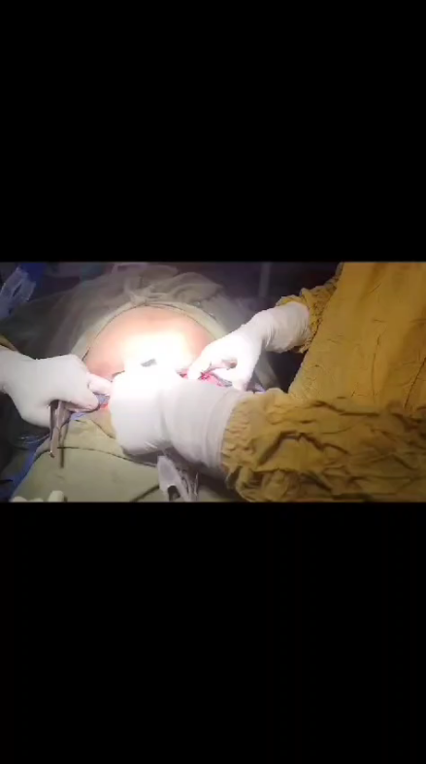

Slide 7
After surgery,patient shifted back to HDU where her strict vitals monitoring & IOP Charting done.
Restricted IV-Fluids with careful chest auscultation given.
LMWH continued after 12hrs of surgery.
Baby kept under observation in nursery for 24hrs & then discharged.
Counselling regarding breastfeeding done.
On 3rd post-op day patient discharged & refer to cardiologist.

Slide 8
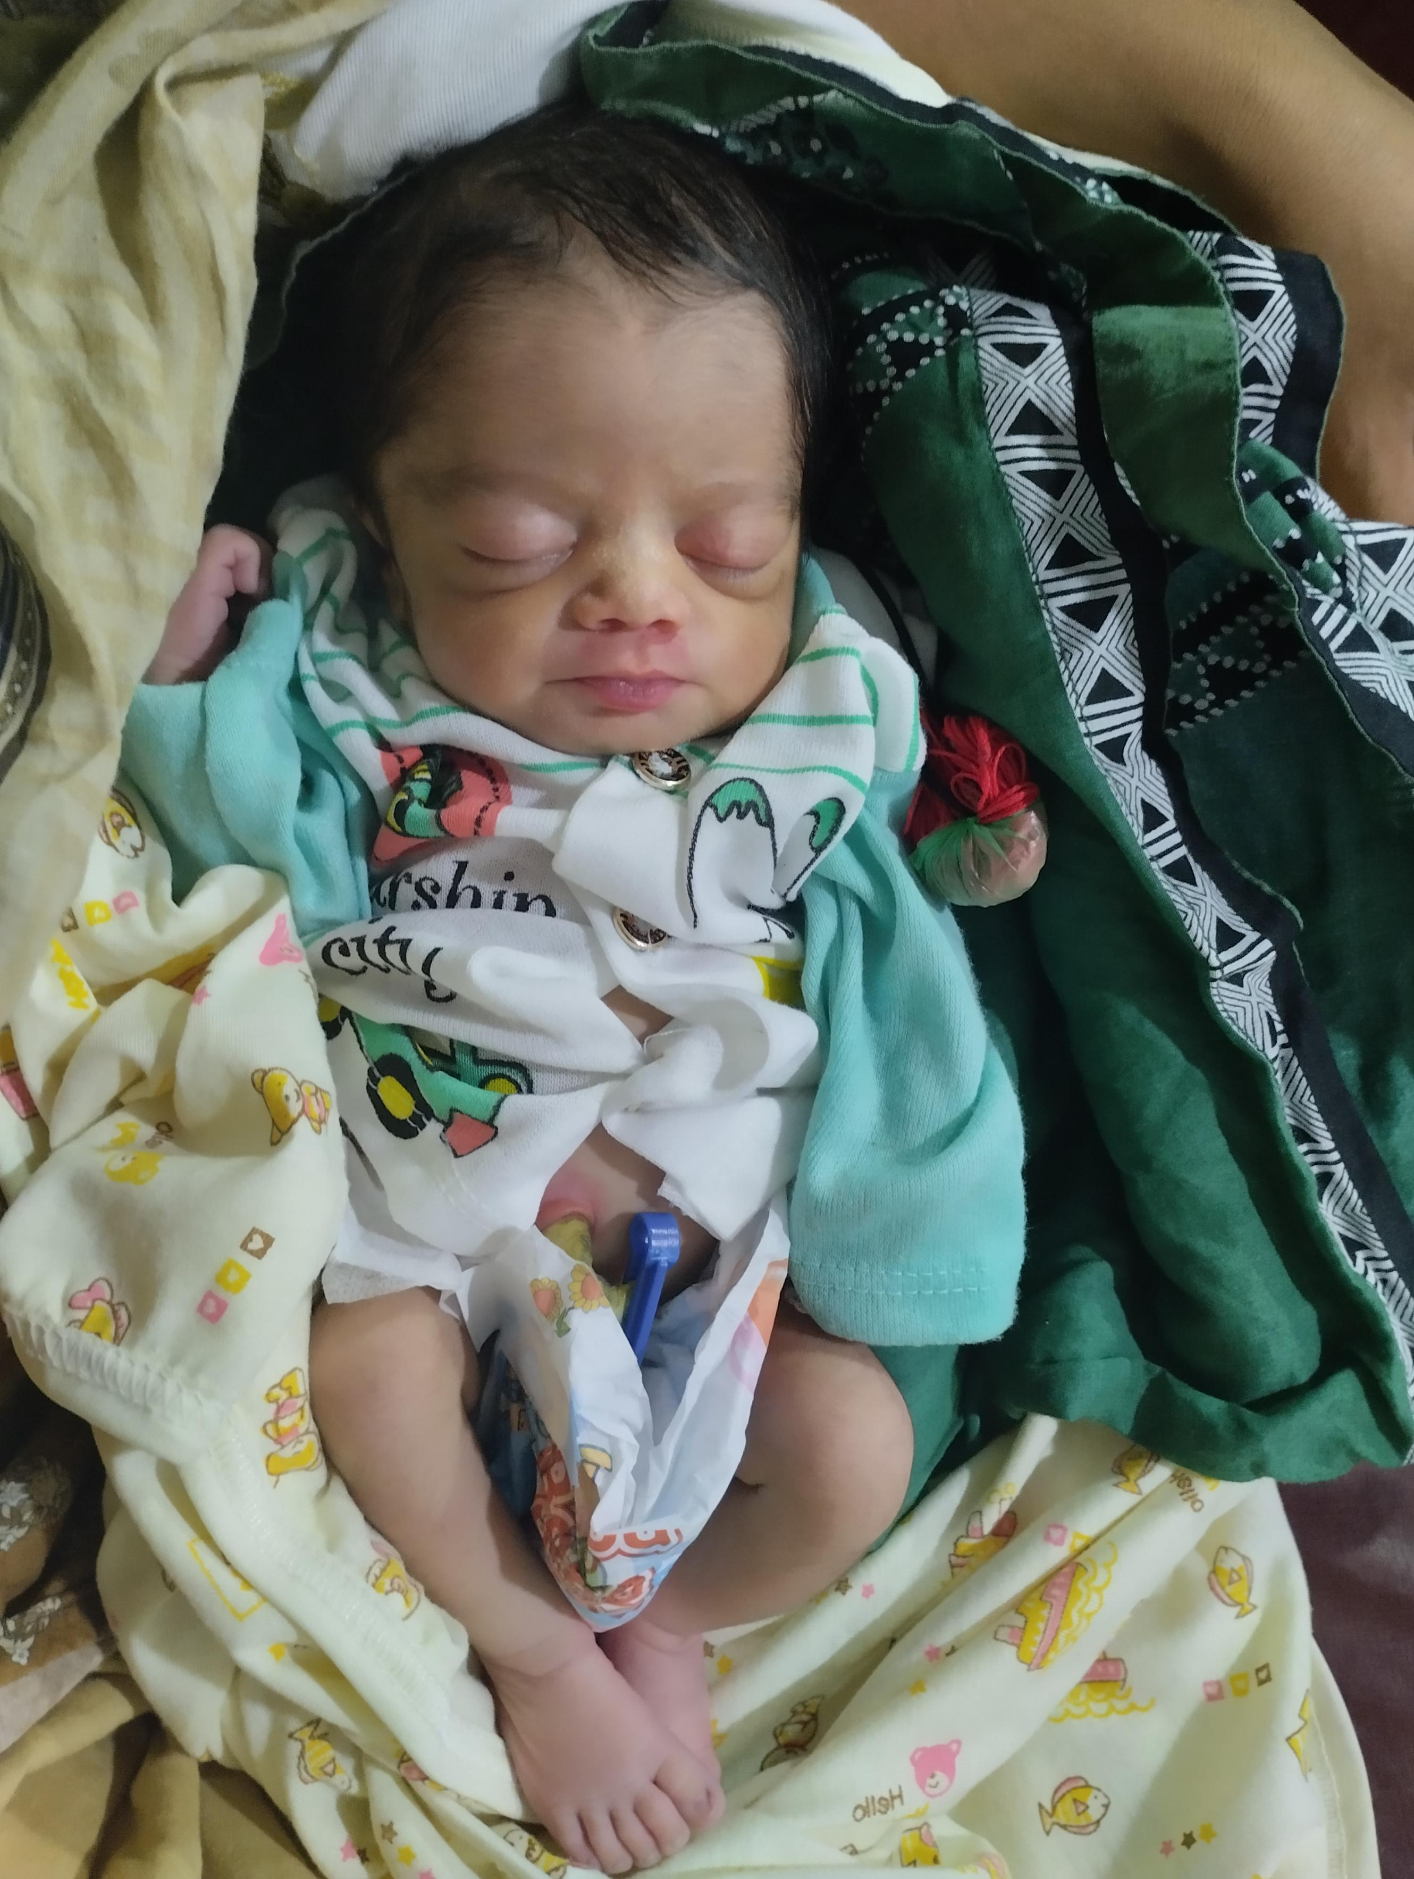
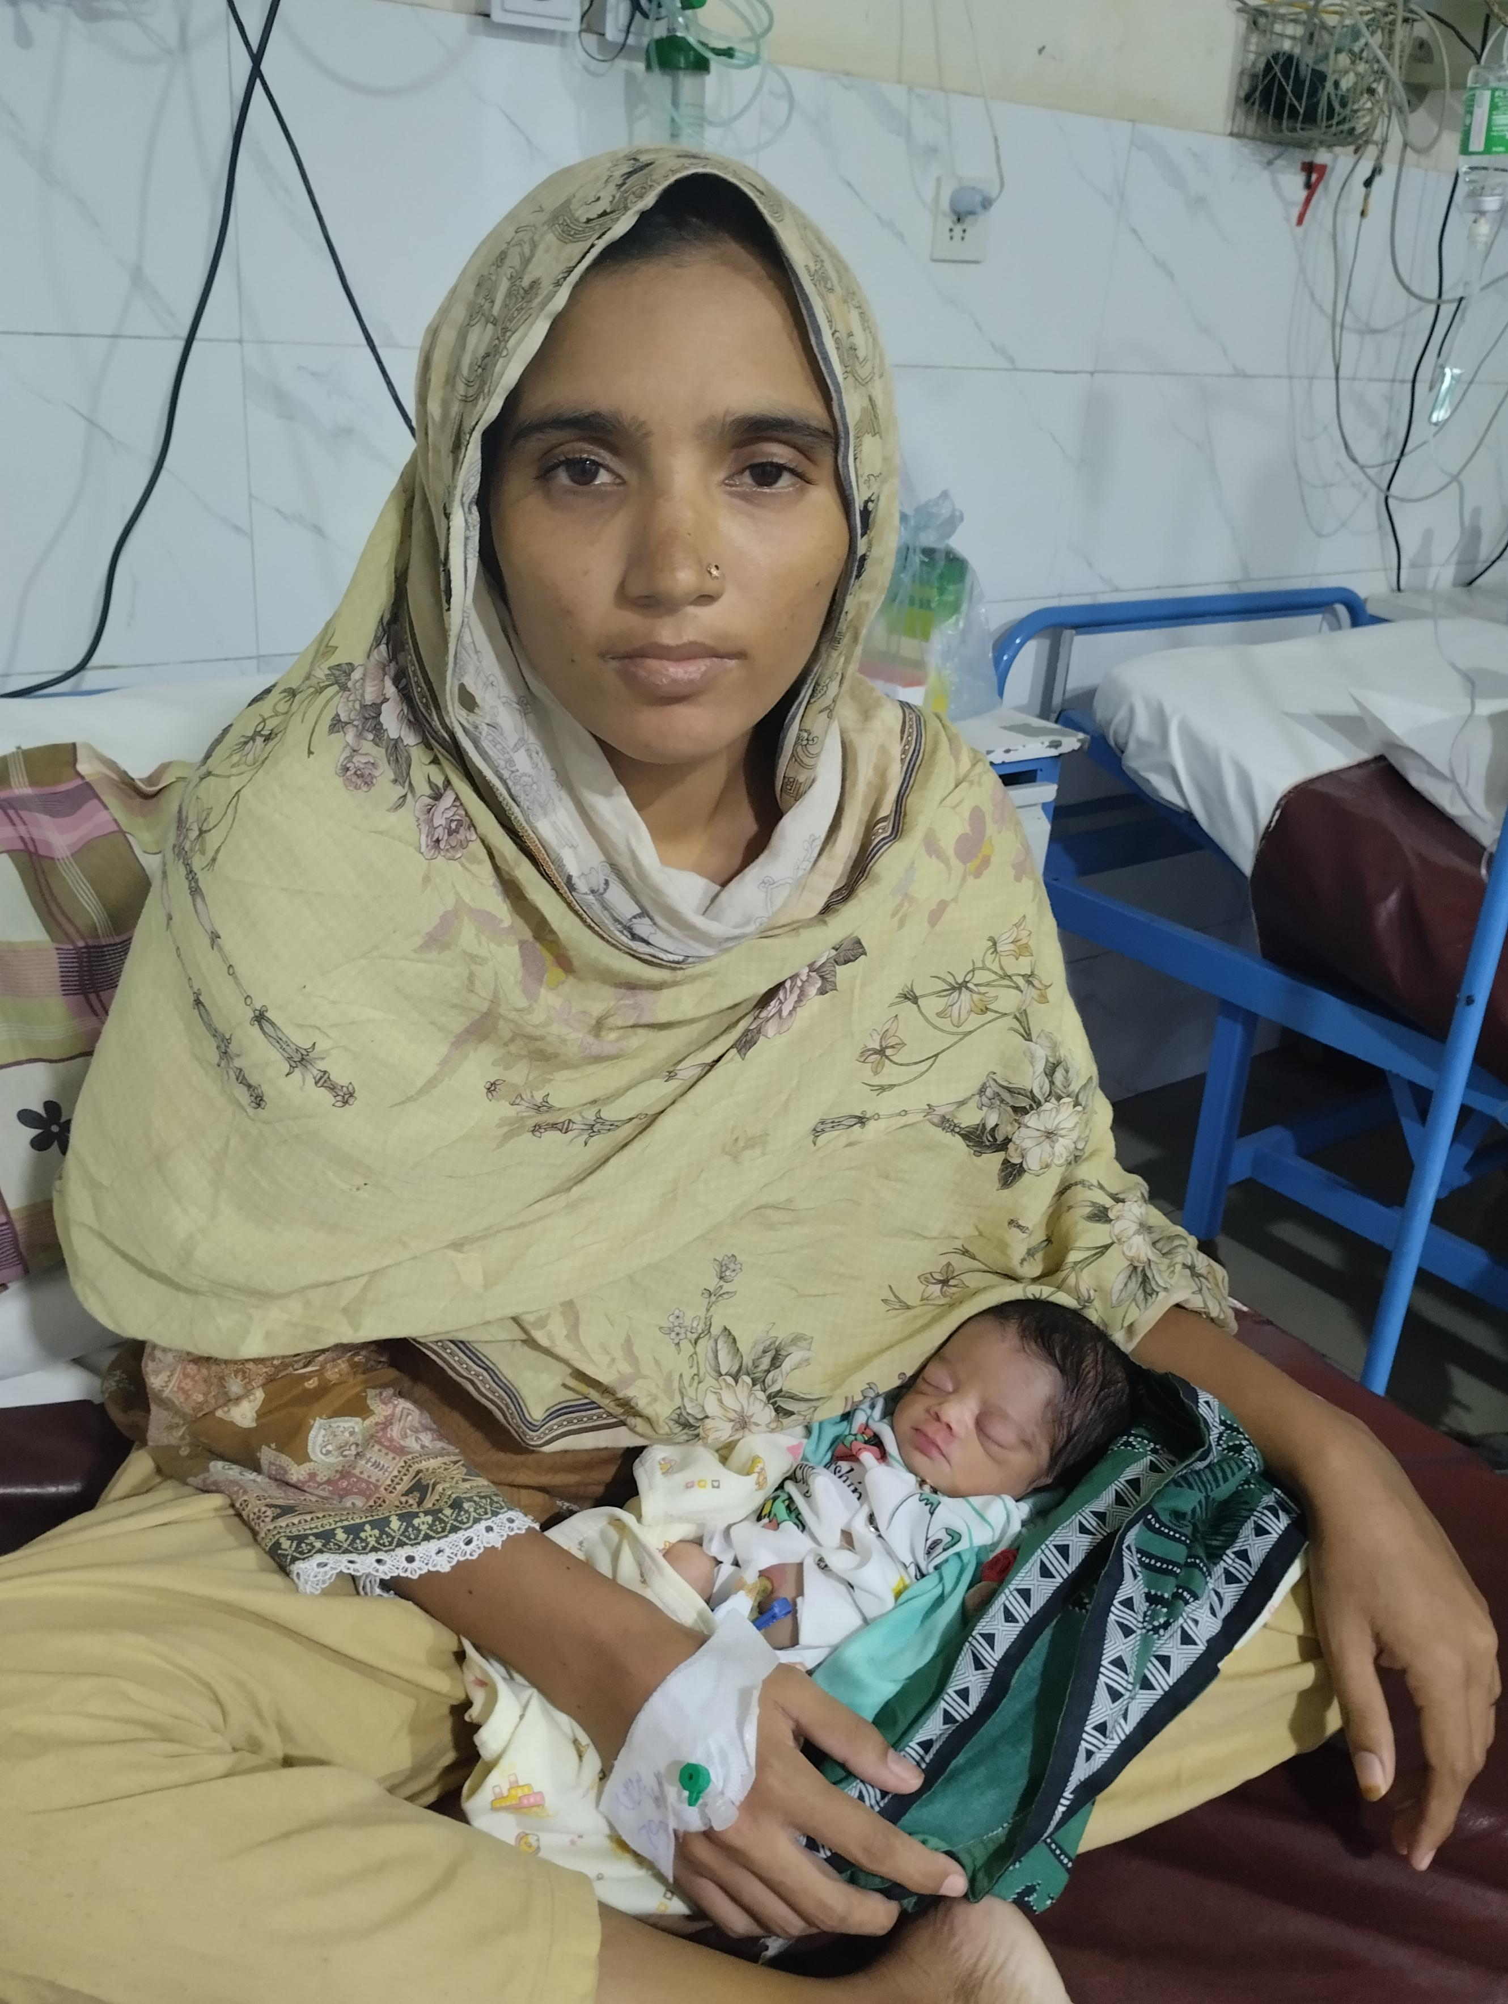

Slide 9
Cardiac diseases in pregnancy
(Rheumatic heart disease)

Slide 10
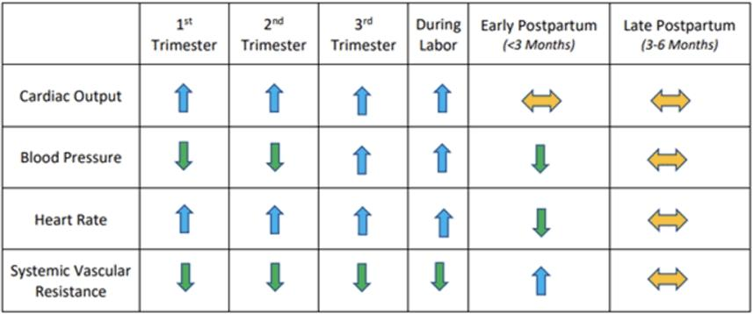

Slide 11
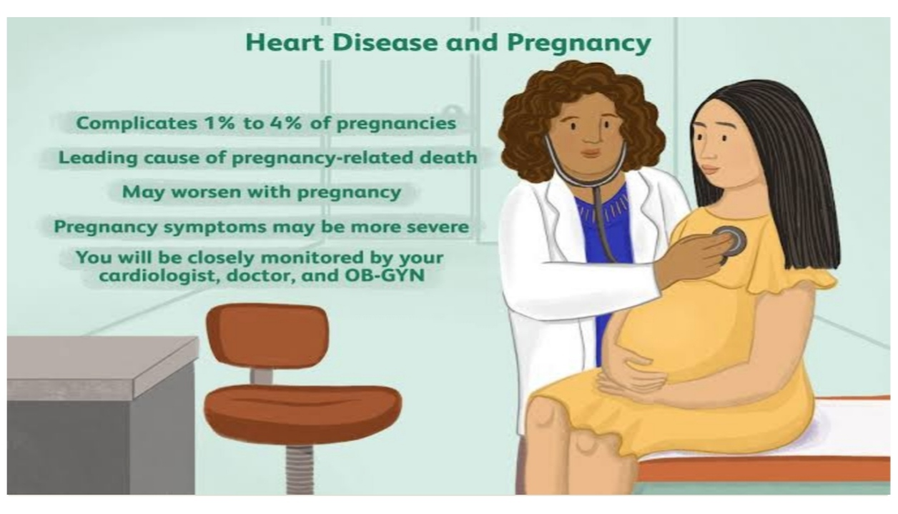

Slide 12
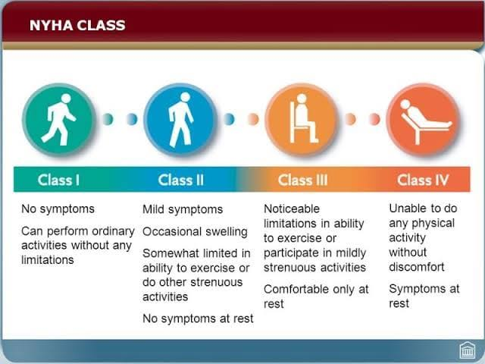

Slide 13
Types of cardiac diseases In pregnancy
Congenital heart disease
Acquired heart disease
Cyanotic
TOF & Eisenmenger syndrome
Acyanotic
Septal defects & PDA
RHD
Cardiomyopathy
MI
Pericardial disease

Slide 14
Rheumatic heart disease
Chronic valvular heart disease develops in at least half of those affected by rheumatic fever with carditis.
Two third of cases occur in women
Mitral valve is affected in more than 90% of cases,aortic valve is next most frequently involved followed by tricuspid & then pulmonary valve
Isolated mitral stenosis occurs in 25% of cases
40% have mixed mitral stenosis & regurgitation
Mitral stenosis remains most common potentially lethal preexisting heart condition in the pregnancy.

Slide 15
Valvular involvement in RHD
Mitral stenosis 90%
Mitral Regurgitation 6.6%
Aortic regurgitation 2.5%
Aortic stenosis 1%
Tricuspid valve stenosis/regurgitation

Slide 16
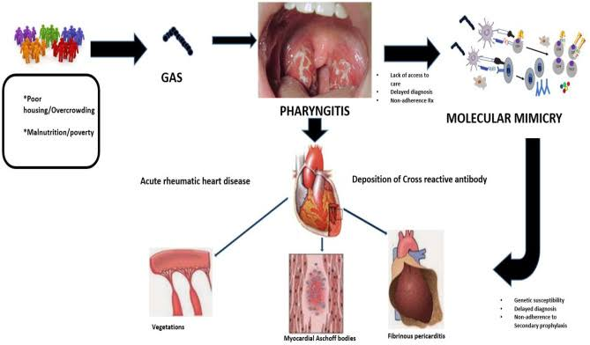

Slide 17
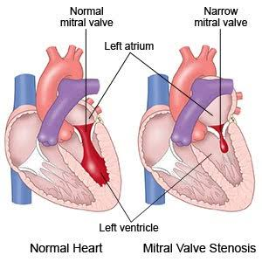

Slide 18
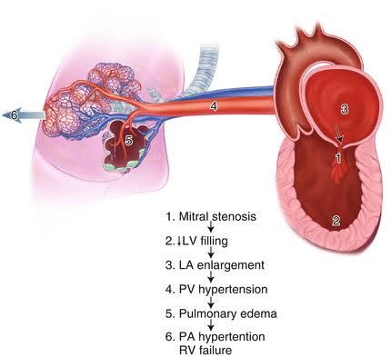

Slide 19
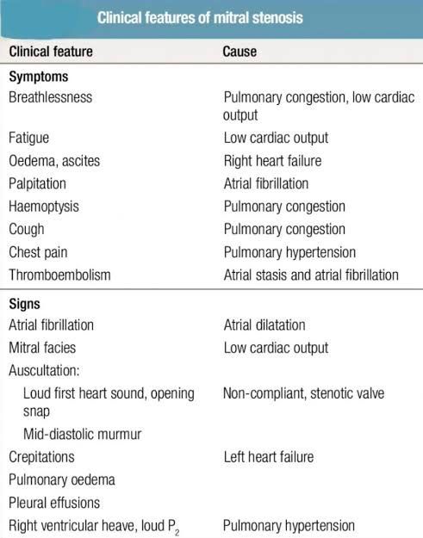

Slide 20
Maternal & fetal risks
Maternal risk
Fetal risk
Restriction of physical activity
Repeated hospital admissions
Maternal mortality
Heart failure
Stroke
Arrhythmias
Thromboembolism
Abortion
IUGR
Oligo
LBW- baby
IUD
Preterm delivery

Slide 21
Outcome & safety of pregnancy related to:
Presence & severity of pulmonary hypertension
Presence of cyanosis
Hemodynamic significance of the lesion
Functional NHA class as determined by level of activity that leads to dyspnea
Most women with pre-existing cardiac disease tolerate pregnancy well if they are asymptomatic or only mildly symptomatic (NYHA Class 2 or less) before pregnancy

Slide 22
MANAGEMENT OF RHEUMATIC HEART DISEASE IN PREGNANCY

Slide 23
Preconception
Visit joint clinic obstetrician/gynaecologist/cardiologist.
Visit cardiologist so that he can explain effect of pregnancy on maternal health.
All investigations can be done before conception as X-rays & cardiac catheterization best avoided in pregnancy.
Any surgical intervention if needed can be done before conception.
Visit the obstetrician to discuss all fetomaternal risk.

Slide 24
Antepartum
First visit early in pregnancy as become pregnant.
Visit every 2-4weeks Until 20weeks then every 2weeks until 24week & then weekly thereafter.
Fetal ECHO by pediatric cardiologist during second trimester.
Dating scan,Growth scan & anomaly scan.

Slide 25
Intrapartum
Minimize cardiovascular stress by giving epidural analgesia& assisted vaginal delivery(Forceps or Vacuum delivery)
Women with mitral stenosis should avoid lithotomy or supine position during delivery.
Caesarean usually necessary for obstetric reasons.
Postpartum
Observation in HDU.
Restricted IV-fluids.
Close vitals monitoring.
Starting Contraception as early as four weeks after delivery if mother not fully breastfeeding
Follow checkup

Slide 26
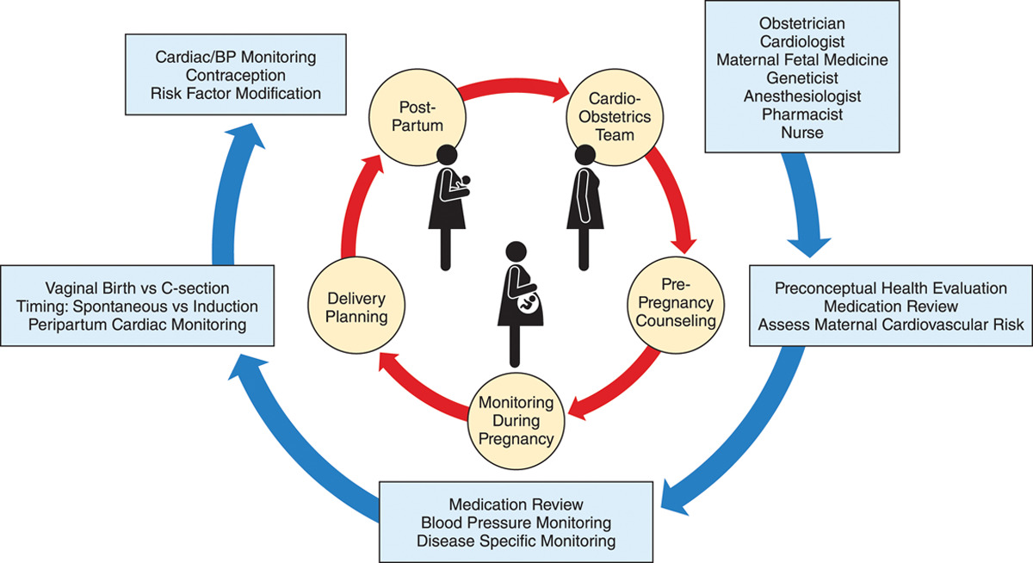

Slide 27
Medical Treatment of RHD in pregnancy
Beta blockers decreases Heart rate,increase diastolic filling time & decreases the risk of pulmonary edema.
Diuretics
Digoxin should only be used if atrial fibrillation occurs because it doesn’t slow the heart rate in sinus rhythm because sympathetic drive easily overcome its mild vagotonic effect.
Thromboprophylaxis

Slide 28
Warfarin crosses placenta & causes embryopathy(chondrodysplasia punctata) between 6-12 weeks & fetal intracerebral hemorrhage in 2nd & 3rd trimesters.
LMWH don’t cross the placenta & have a better safety profile in pregnancy.
INR should be monitored with warfarin therapy.
In case of bleeding or urgent delivery in fully anticoagulated patient,Warfarin is reversed with recombinant human factor V11a,fresh frozen plasma & vitamin k.
Heparin reversed with protamine sulphate.

Slide 29
Pulmonary edema
Prop-up the patient
O2-inhalation
IV- Furosemide
Fluid restriction
If medical therapy fails for those with severe mitral stenosis balloon mitral valvotomy canbe used safely in pregnancy.
Percutaneous balloon valvotomy carries 1% risk of complications.
Closed Valvotomy Fetal mortality 5-15%,maternal mortality 3%
Open Valvotomy Fetal mortality 15-33%, maternal mortality 5%
If open operation on mitral valve required,this should be deferred if possible until after delivery.

Slide 30
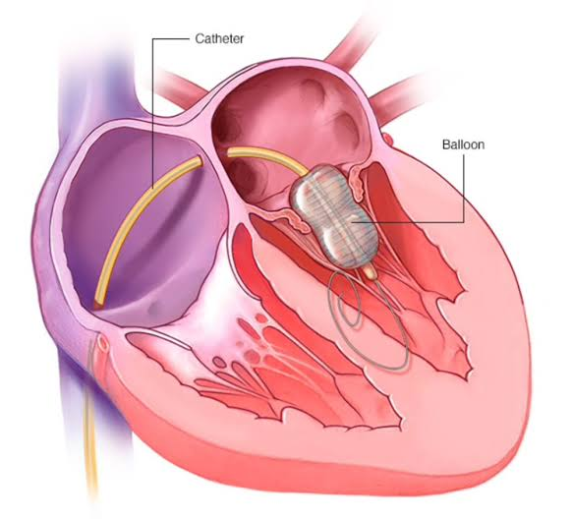
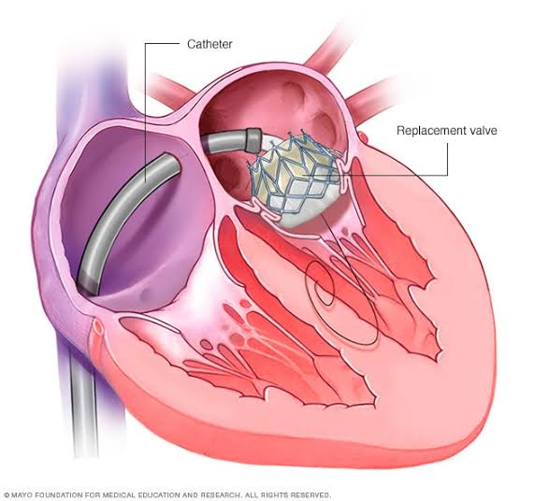

Slide 31
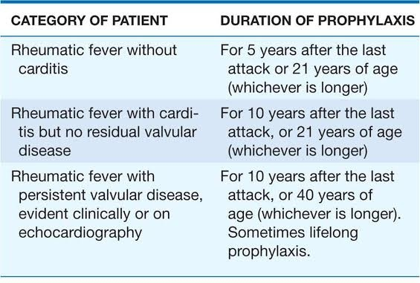
Prevention

Slide 32


