Slide 1


Slide 2
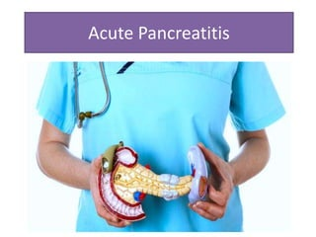
ACUTE PANCREATITIS
DR.ALI NAWAZ
PGR SURGERY UNIT 1
08/11/24

Slide 3
OUTLINE OF THE PRESENTATION
Anatomy of pancreas
Incidence & Etiology
Pathophysiology
Presentation
Differential diagnosis
Investigations
Assessment of severity
Management of acute pancreatitis
Complications

Slide 4
ANATOMY OF PANCREAS
Retroperitoneal structure.15 cm length.
Divided into a head (30% of gland mass) , a body and tail(combined 70% of gland mass).
Weighs about 80 g (80-90% composed of exocrine acinar tissue).
Clusters of endocrine cells known as islets of Langerhans distributed throughout the pancreas contain different cells.
Beta cells( insulin)
A cells ( glucagon)
D cells ( somatostatin)

Slide 5
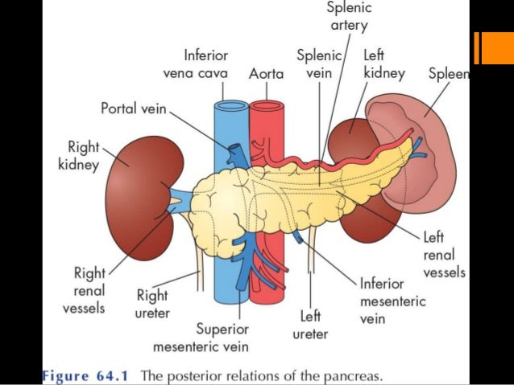

Slide 6
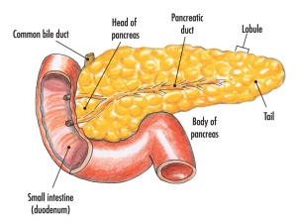


Slide 7
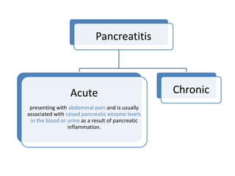
ACUTE PANCREATITIS
Inflammation of the pancreatic parenchyma.
Defined as an acute condition presenting with abdominal pain, a threefold or greater rise in the serum levels of pancreatic enzymes amylase or lipase and / or characteristic findings of pancreatic inflammation on contrast-enhanced CT.

Slide 8
INCIDENCE
3 % of all cases of abdominal pain (UK)
Hospital admission rate 5-50 per 100000 per year worldwide
Can occur at any age with a peak in young men and older women.

Slide 9
ETIOLOGY
Two major causes are;
A) Biliary calculi (50-70% )
B) Alcohol abuse (25%)
Remaining cases may be due to rare causes or be idiopathic.

Slide 10
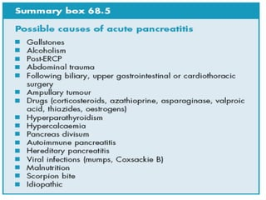
ETIOLOGY

Slide 11
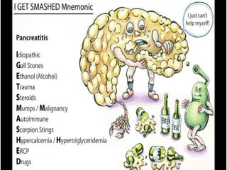
ETIOLOGY

Slide 12
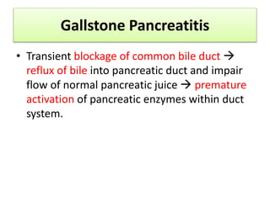
GALLSTONE PANCREATITIS

Slide 13
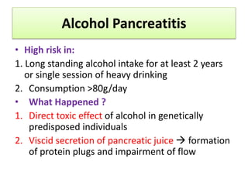
ALCOHOL PANCREATITIS

Slide 14
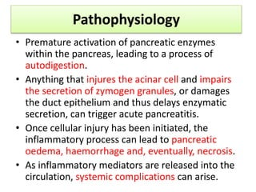
PATHOPHYSIOLOGY

Slide 15
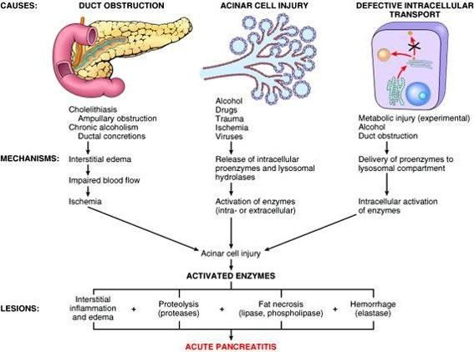
PATHOPHYSIOLOGY

Slide 16
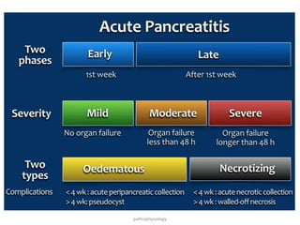

Slide 17
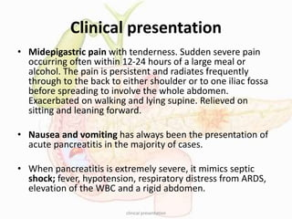
PRESENTATION

Slide 18
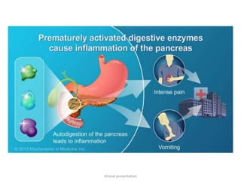
PRESENTATION

Slide 19
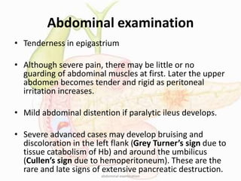
PRESENTATION

Slide 20
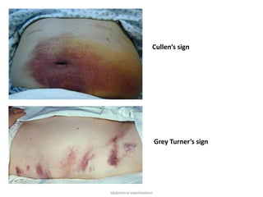
PRESENTATION

Slide 21
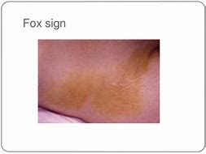
PRESENTATION
FOX'S SIGN IS THE BRUISING IN THE INGUINAL REGION DUE TO ACUTE HEMORRHAGIC PANCREATITIS.

Slide 22
PRESENTATION
PERCUSSION: DULLNESS SUGGESTING ASCITES
AUSCULTATION: AUSCULTATE THE ABDOMEN FOR HYPOACTIVE OR ABSENT BOWEL SOUNDS OR AN ABDOMINAL BRUIT.ILEUS IS COMMON IN PANCREATITIS.
AUSCULTATION OF LUNGS FOR PULMONARY FINDINGS
A) BASILAR RALES
B) ATELECTASIS
C) PLEURAL EFFUSION

Slide 23
DIFFERENTIAL DIAGNOSIS
FOR MILD ACUTE PAIN | FOR SEVERE ACUTE PAIN
ACUTE CHOLECYSTITIS | FECAL PERITONITIS DUE TO PERFORATED COLON
PEPTIC ULCER DISEASE | RUPTURED AAA
INFERIOR WALL MI | RUPTURED ECTOPIC PREGNANCY
ACUTE APPENDICITIS | MASSIVE BOWEL INFARCTION

Slide 24
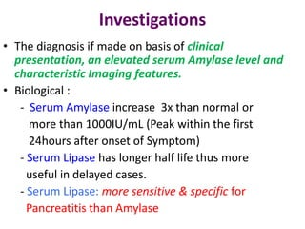
INVESTIGATIONS

Slide 25
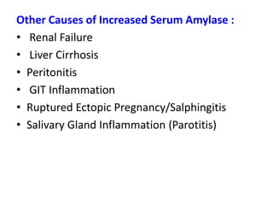
INVESTIGATIONS

Slide 26
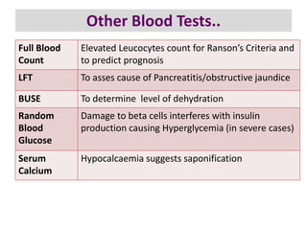

Slide 27
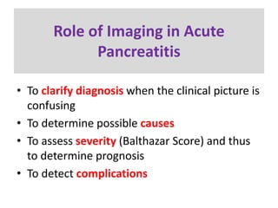
INVESTIGATIONS

Slide 28
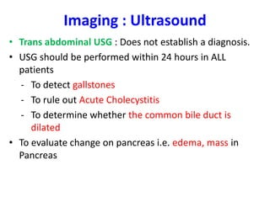
INVESTIGATIONS

Slide 29
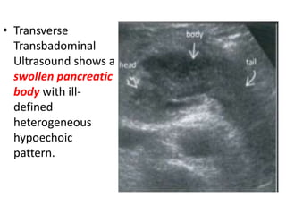
INVESTIGATIONS

Slide 30
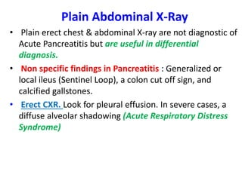
INVESTIGATIONS

Slide 31
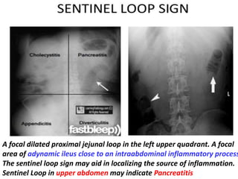
INVESTIGATIONS

Slide 32
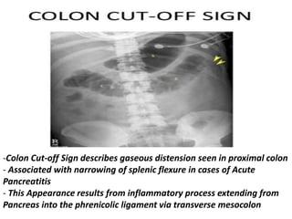
INVESTIGATIONS

Slide 33
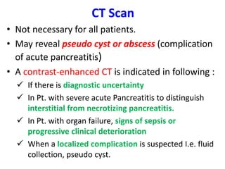
INVESTIGATIONS

Slide 34
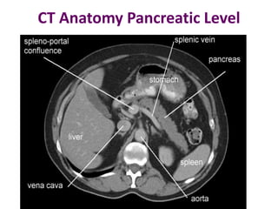
INVESTIGATIONS

Slide 35
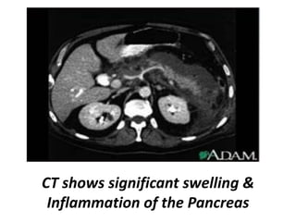
INVESTIGATIONS

Slide 36
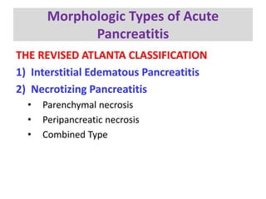

Slide 37
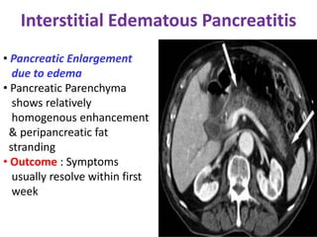

Slide 38
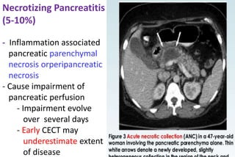

Slide 39
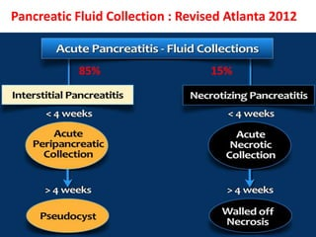

Slide 40
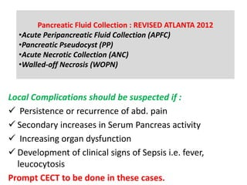

Slide 41
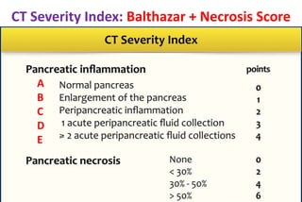

Slide 42
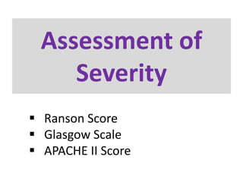

Slide 43
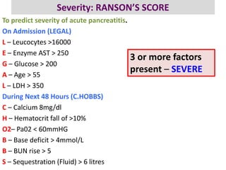

Slide 44
MANAGEMENT OF ACUTE PANCREATITIS

Slide 45
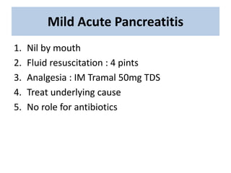

Slide 46
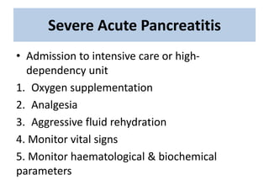

Slide 47
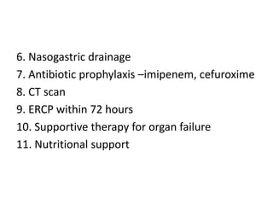

Slide 48
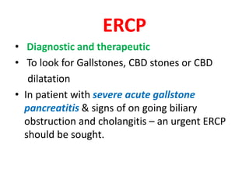

Slide 49
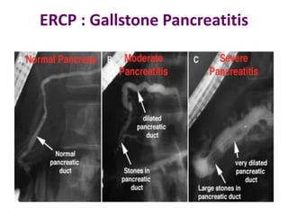

Slide 50
INDICATIONS OF SURGERY IN ACUTE PANCREATITIS
. Infected pancreatic necrosis
. Diagnostic uncertainty
. Condition of pt deteriorates
. In severe necrotizing pancreatitis
. Complications of acute pancreatitis e.g; bowel perforation, bleeding, pseudocyst

Slide 51
REASON OF SURGERY IN OUR PATIENT
DIAGNOSTIC UNCERTAINITY
MIMICKING PERITONITIS
CONDITION OF THE PATIENT NOT IMPROVING (WORSENING ABDOMINAL PAIN AND DISTENTION,INC.TENDERNESS IN RIF)
USG SUSPICION OF FREE FLUID IN ABDOMEN AND PELVIS(HEPATORENAL POUCH,SPLENORENAL POUCH,BETWEEN GUT LOOPS,PARACOLIC GUTTERS) SUGGESTIVE OF PERITONITIS

Slide 52
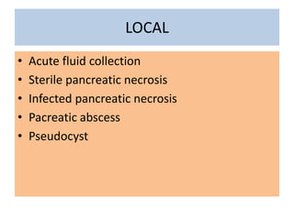
COMPLICATIONS OF ACUTE PANCREATITIS

Slide 53
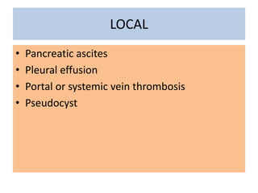
COMPLICATIONS OF ACUTE PANCREATITIS

Slide 54
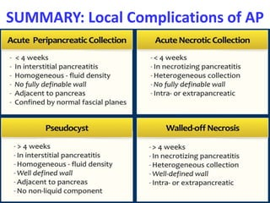
COMPLICATIONS OF ACUTE PANCREATITIS

Slide 55
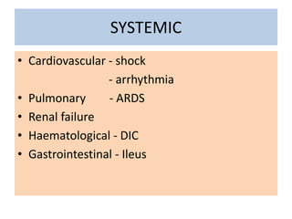
COMPLICATIONS OF ACUTE PANCREATITIS

Slide 56
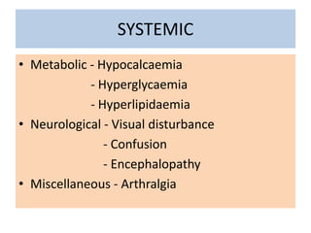
COMPLICATIONS OF ACUTE PANCREATITIS

Slide 57
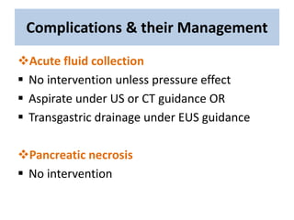
COMPLICATIONS AND THEIR MANAGEMENT

Slide 58
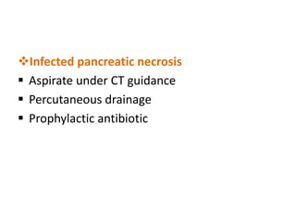
COMPLICATIONS AND THEIR MANAGEMENT

Slide 59
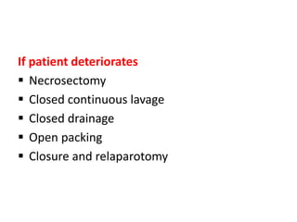
COMPLICATIONS AND THEIR MANAGEMENT

Slide 60
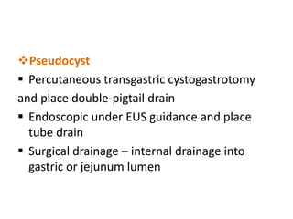
COMPLICATIONS AND THEIR MANAGEMENT

Slide 61


Slide 62


