Slide 1


Clinicopathological conference (CPC)
Medical Unit 3
Dr. Noman Hameed Kamboh(final year)
Dr. Esha Asghar(final year)
Dr. Usama Naseer(final year)
Dr. Zoha Nasir(PGR M3)

Slide 2
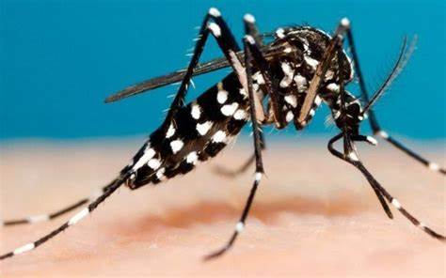
Dengue Fever

Slide 3
Biodata
My Patient Mahtab Bibi d/o M Siddique 28 y/o married Muslim female R/O Liaqat Pur presented to us through ER on 26 Oct 2024.

Slide 4
Presenting Complaint
Fever for 8 days

Slide 5
HOPI
My pt was in USOH 8 days back when developed fever which was sudden in onset,high grade documented 103 °, Intermittent in nature.
Associated with chills , generalized bodyaches , pain with movement of eyes and headache releived on its own and sometimes by taking medicine.
There were no signs of sore throat, itching of eyes, rhinorrhea, neck stiffness, cough, lumps or bumps, abdominal pain, diarrhea, dysuria or constipation.
Patient had a recent travel history from karachi.

Slide 6
Systemic History
In General, loss of appetite is present but no weight gain or loss , no sleep disturbance.
In respiratory system, pt has no cough , chest pain ,shortness of breath.
In CVS, No Chest Pain , SOB, No palpitations, No edema of feet.
In GIT system , No nausea , vomiting, abdominal pain, heartburn, dysphagia, diarrhea on constipation.
In Urinary system, no flank pain, dysuria, burning micturition, polyuria or dysuria.
I'm Nervous system, no tingling, numbness, blackouts, visual loss, vertigo or neck stiffness.

Slide 7

Past medical and surgical Hx
No significant past medical (Tb,HTN,Asthma,Hep,DM,Arthritis,Joint pains, Autoimmune disease)
Surgical (history of two C-sections 7 to 8 years back)

Slide 8
Personal Hx
Not addicted to any drug like smoking ,alcohol ,niswar, pan ,chalia etc.
And was not taking any medications.

Slide 9

Socioeconomic Hx
Lives in uncemented house with 2 rooms and 5 persons in it
Uses Tap water for drinking purpose

Slide 10
General Physical Examination
A young lady of normal built, lying comfortably in the bed.
Pulse is 86/minute regular.
Blood pressure 118/76; temperature 103°F;
Respiratory rate 22/minute.
There is no pallor nor any cyanosis, jaundice,
Clubbing or koilonychia.
There are no Osler's or Heberden's nodes;
Oral Hygiene is poor
No lymph nodes are palpable
JVP is not raised.
Thyroid is normal. There is no bruit over it.
No splinter hemorrhages or palmar erythema.
Discoloration on feet

Slide 11
Abdomen
On Inspection
Midline scar.
Visceral stretch marks present on lower abdmonial region.
umblicus is inverted.
No visible pulsation.

Slide 12
Palpation
Abdomen is soft and non tender
There is no rigidity or guardening.
No Visceromegaly (hepatospleenomegaly)
kidneys and urinary bladder are not palpable.
No mass is palpable.

Slide 13
Percussion
note is resonant all over (fluid shift-, fluid thrill negative-)
except above the liver in 5th intercoastal space.

Slide 14
Auscultation
bowel sounds are audible 1-2 per minute.

Slide 15
Respiratory Examination
Position of trachea is slightly on right side
No Cervical Lymphadenopathy
Normal vesicular breathing with no added sounds

Slide 16

CVS
Apex beat central and in mid clavicular line
S1 + S2 + no added sounds

Slide 17
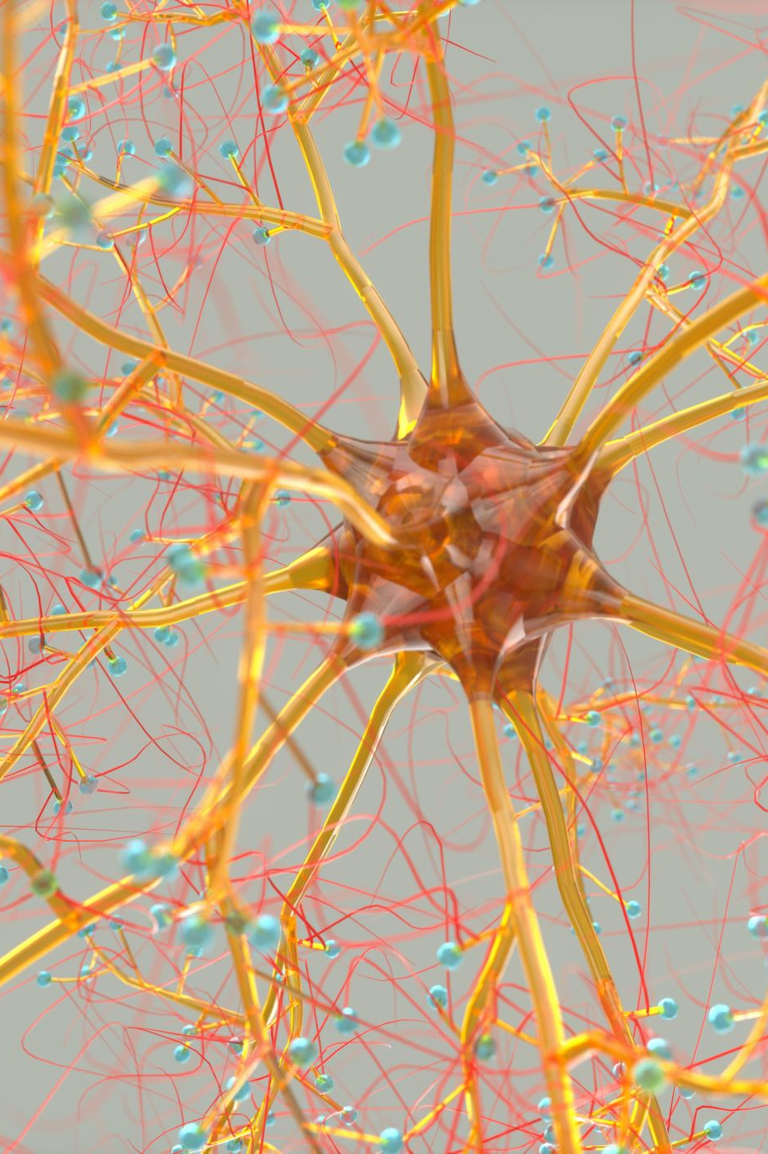
CNS
Speech is normal.
Cranial nerves are intact.
Motor and sensory systems are intact.
Signs of meningeal irritation are absent.
Reflexes Normal

Slide 18
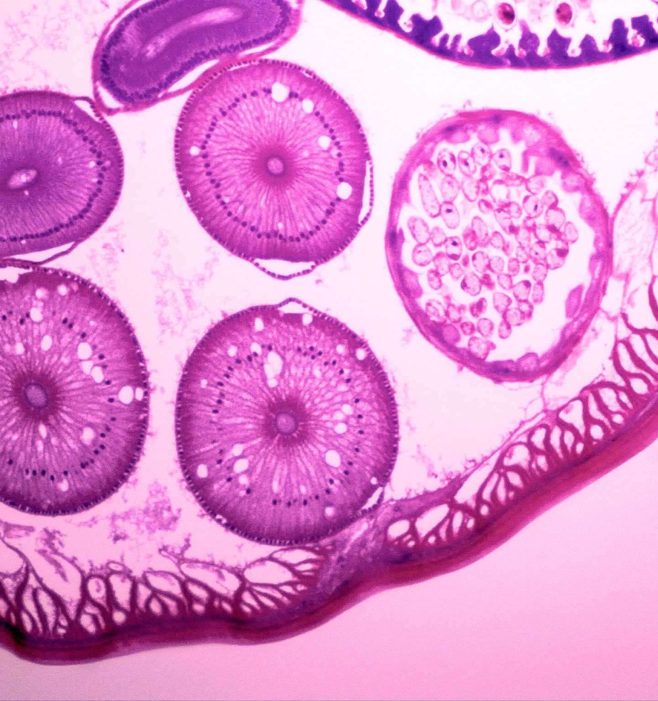
DDx
Dengue
Malaria
Chikungunya
Respiratory Infections
UTI

Slide 19
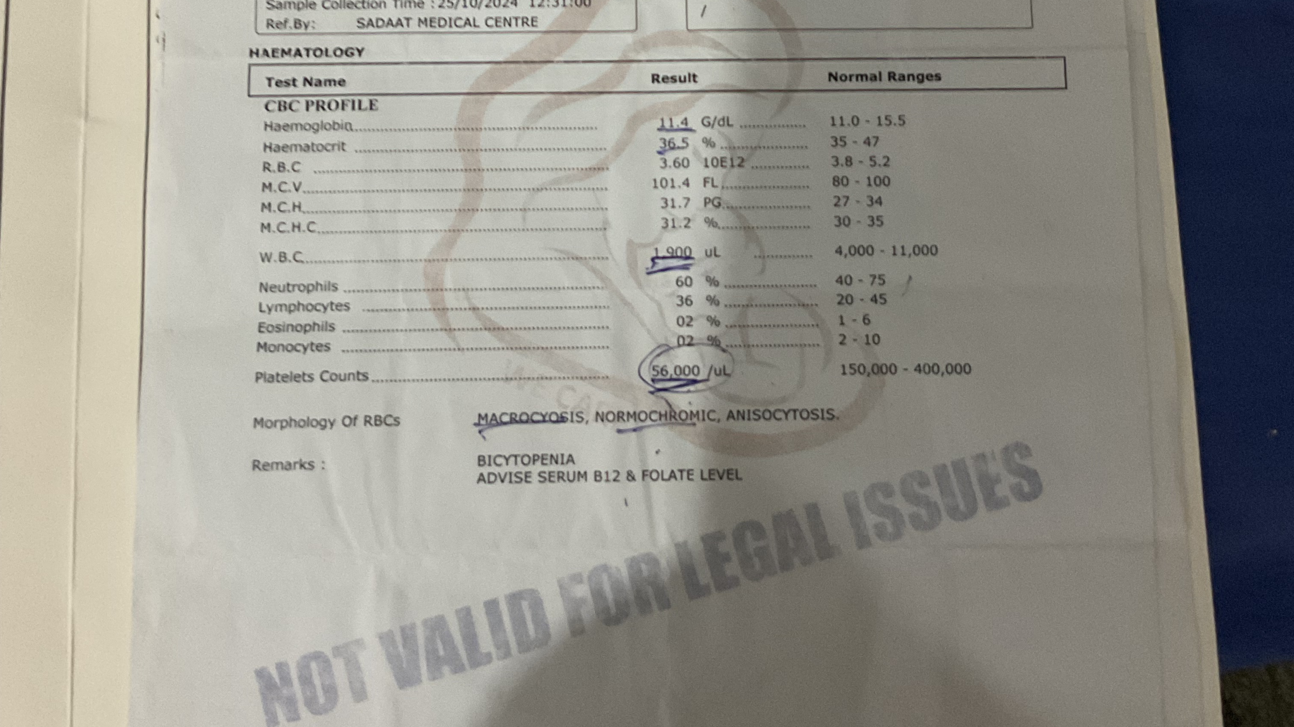
Investigations
Low TLC
Low Platelet Count
Complete Blood Count

Slide 20
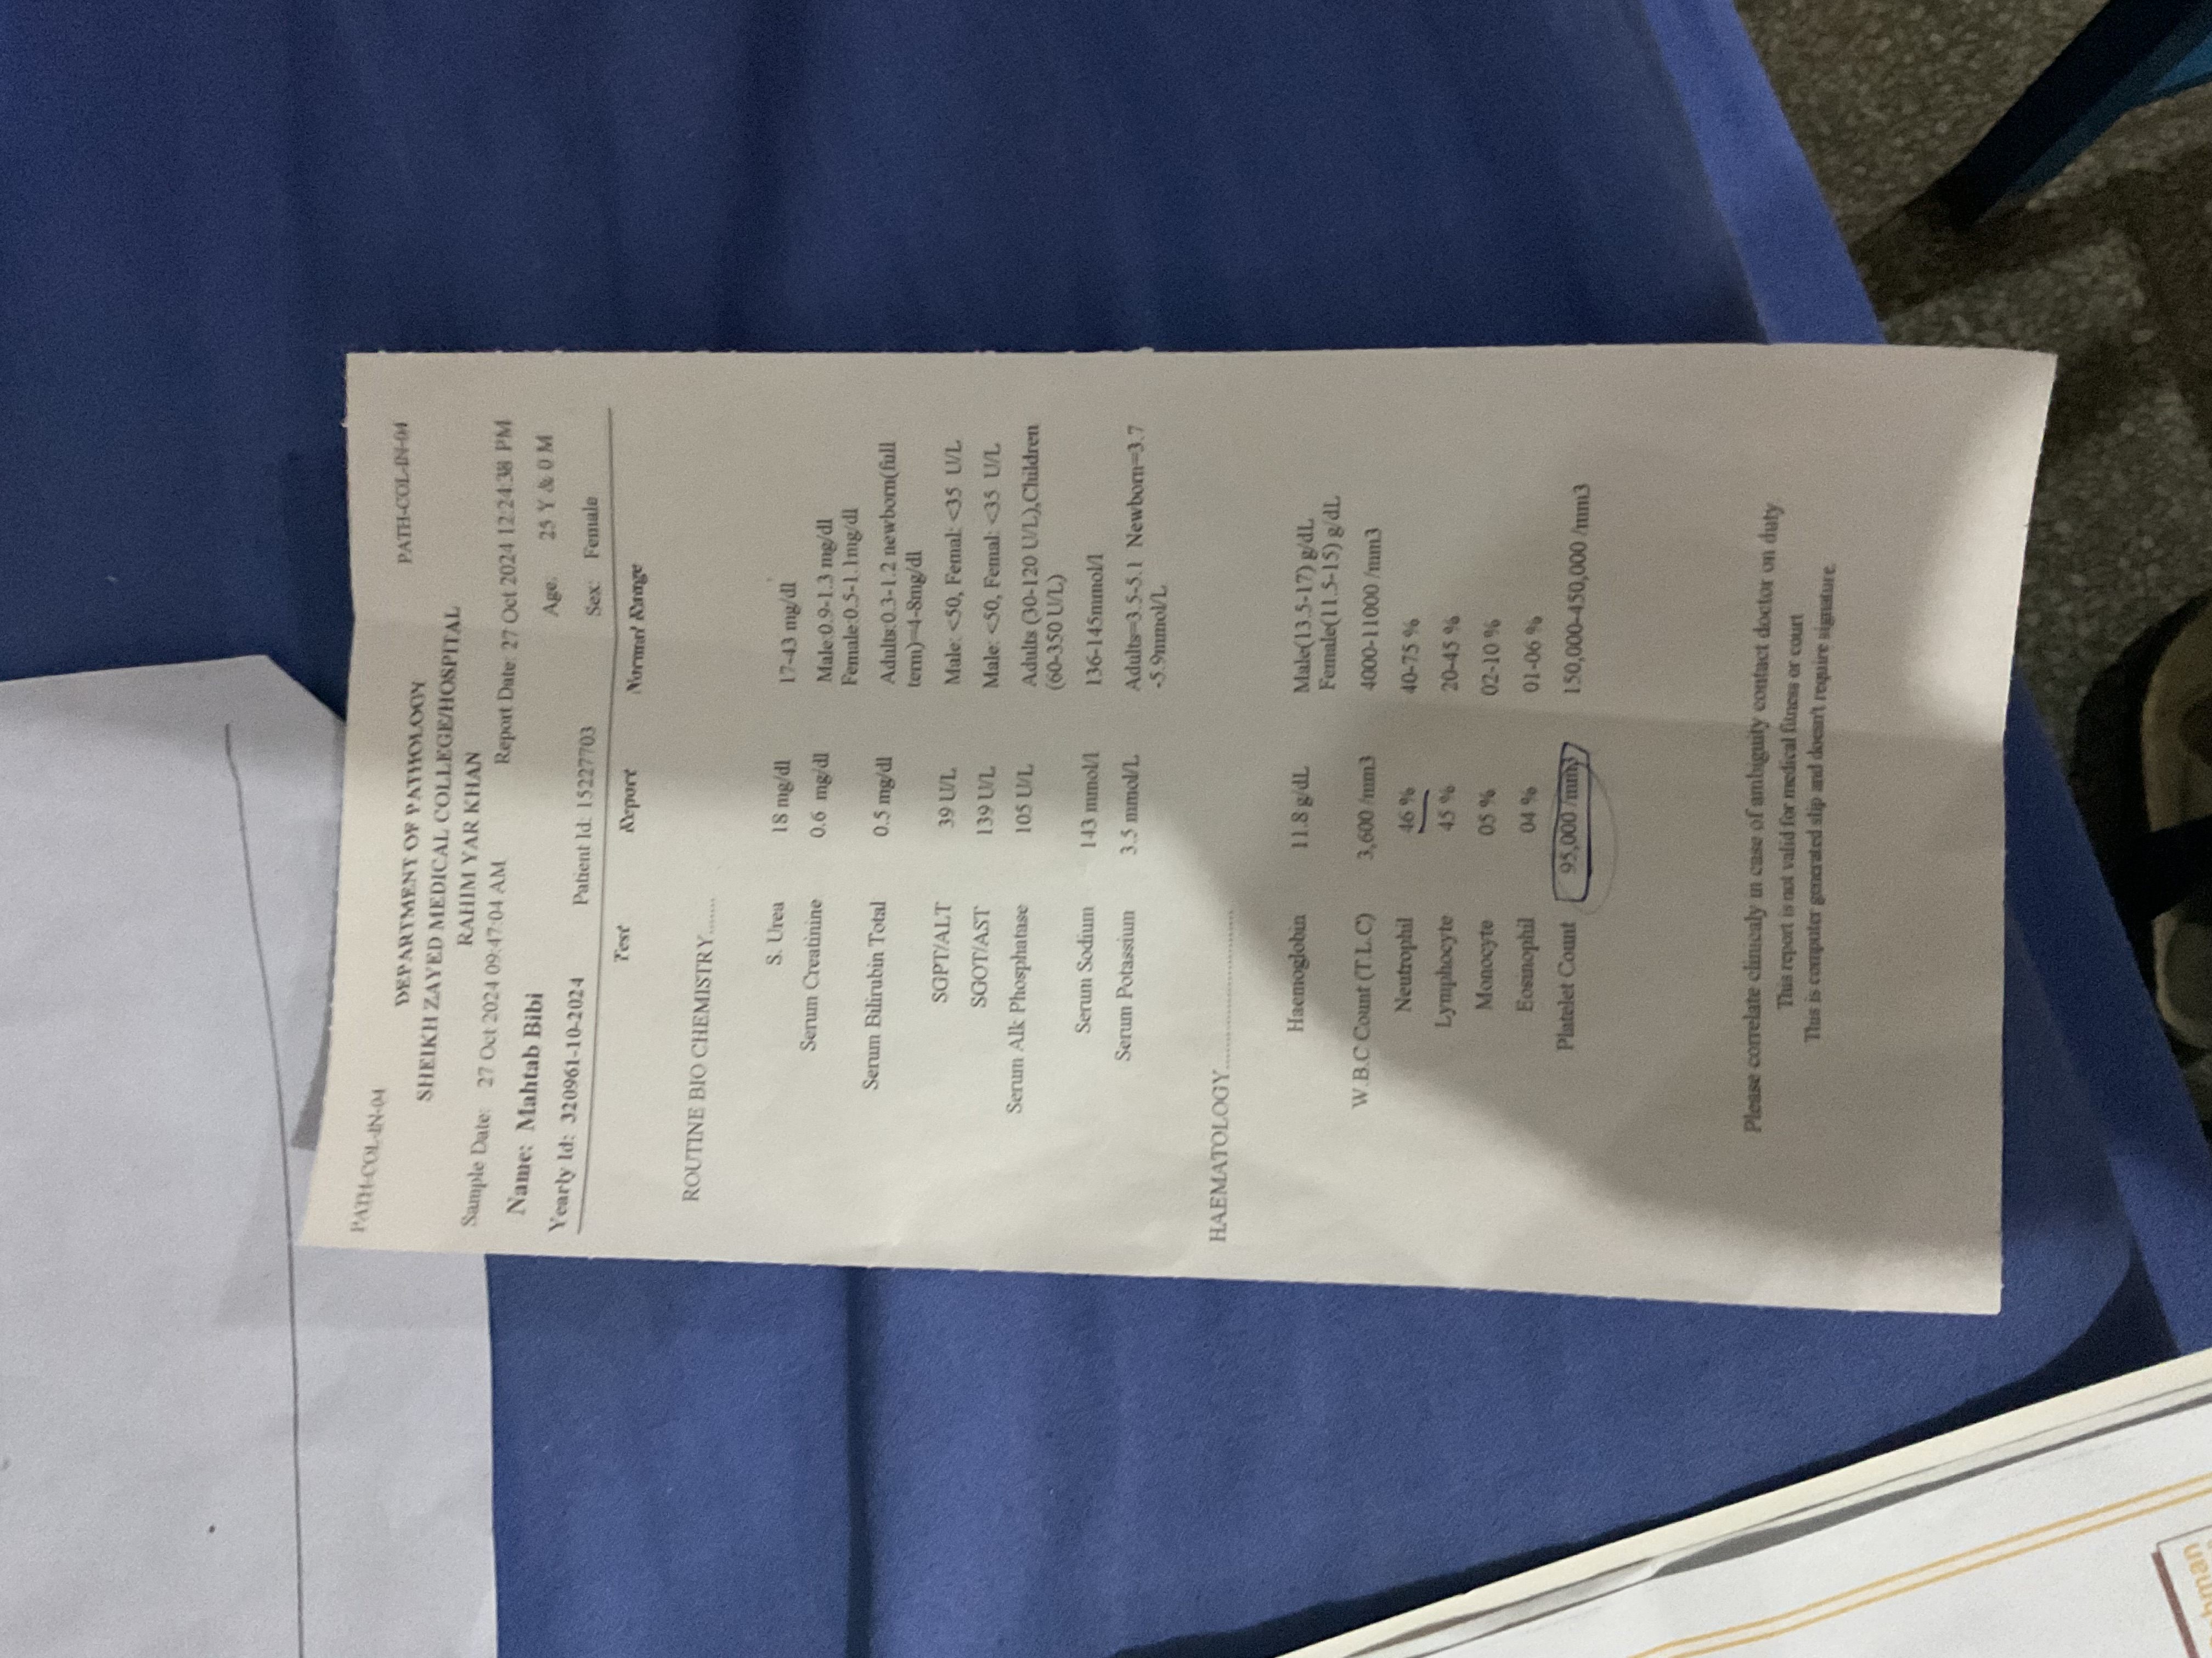
Routine Biochemistry

Slide 21
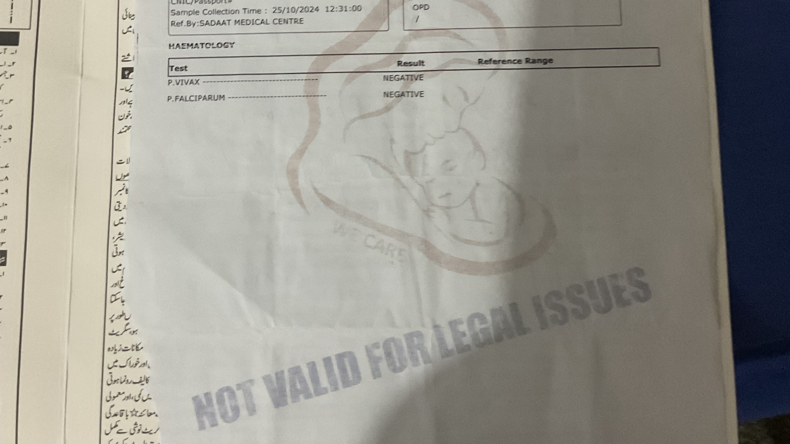
MP Slide
Negative

Slide 22
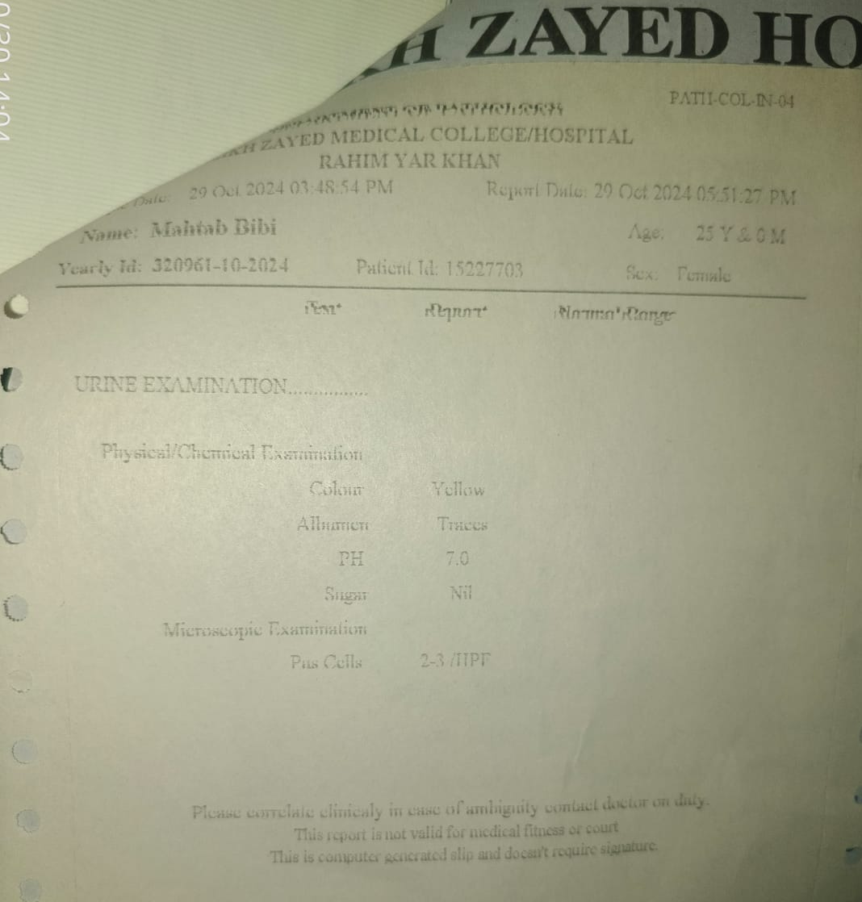
Urine Complete Examination

Slide 23
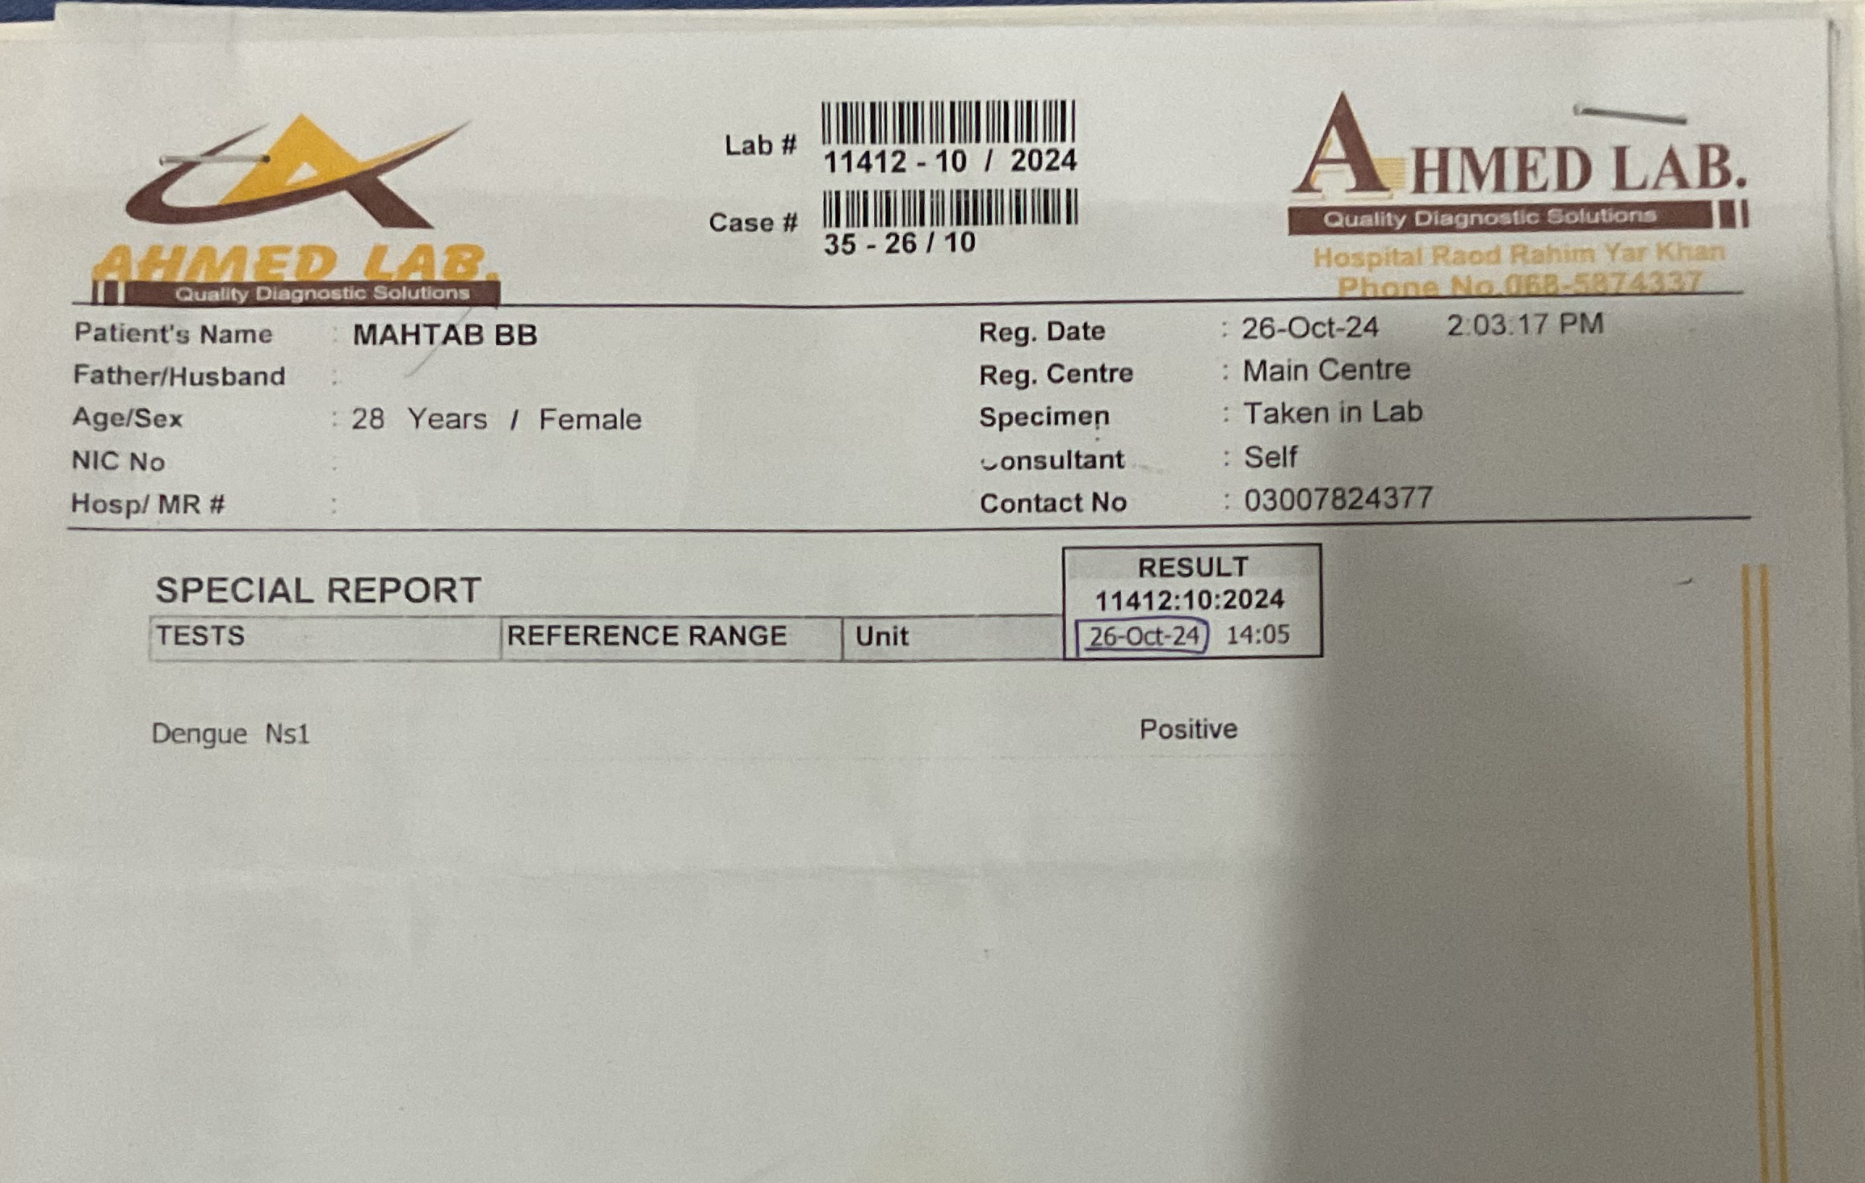
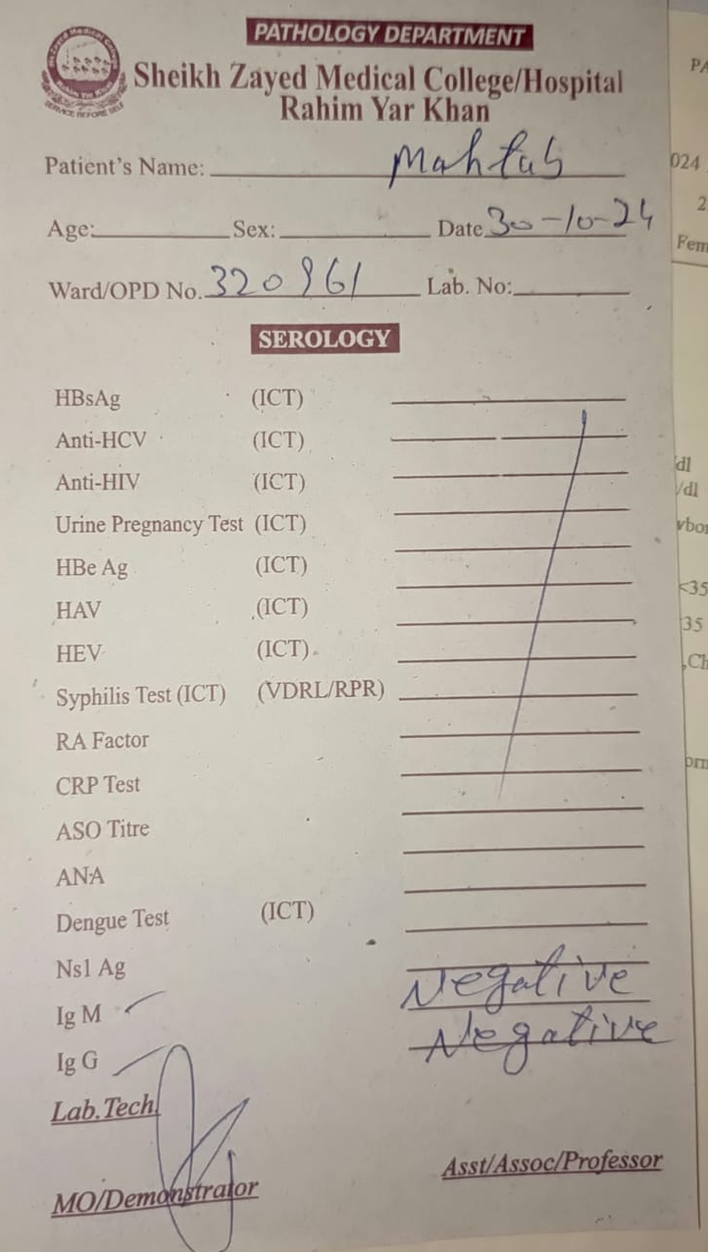
Dengue Serology/NS1

Slide 24

Definite Diagnosis
Based On History, Clinical Examination and Investigation The Definite Diagnosis Is Dengue Fever

Slide 25

Dengue Fever
Introduction

Slide 26
Dengue: The Disease
Infection of tropical and subtropical regions
Nonspecific febrile illness to fatal hemorrhagic disease
Infection caused by a virus and spread by an insect vector – the mosquito

Slide 27
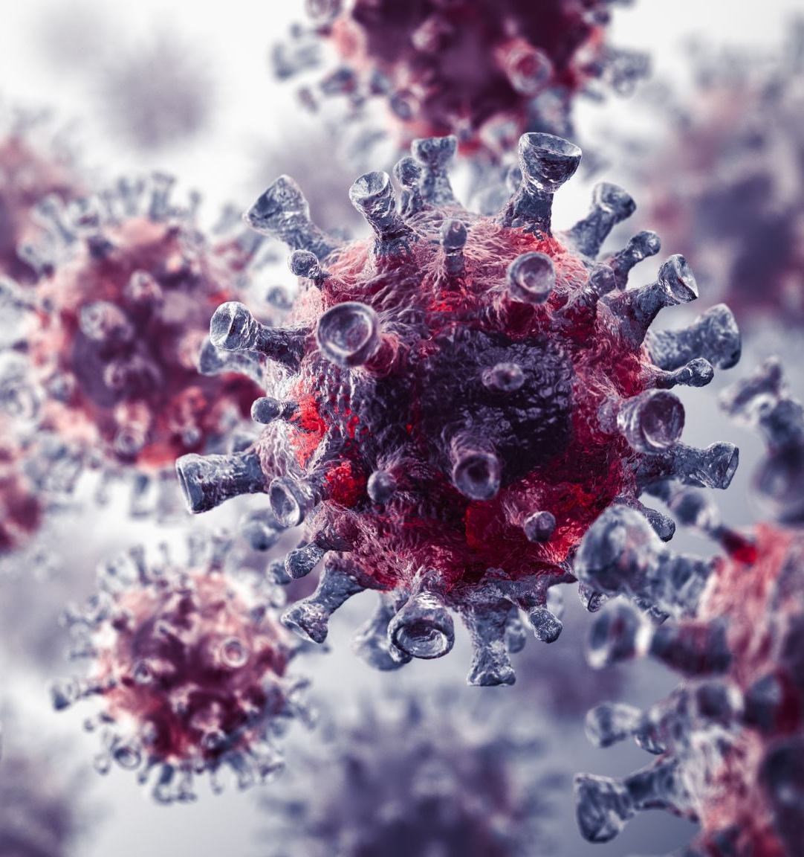
Dengue: The Virus
Flavi viruses: RNA
Arbovirus group
4 serotypes – Den 1- 4
Cycle involves humans and mosquitos
Infection with one virus gives immunity to that serotype only

Slide 28
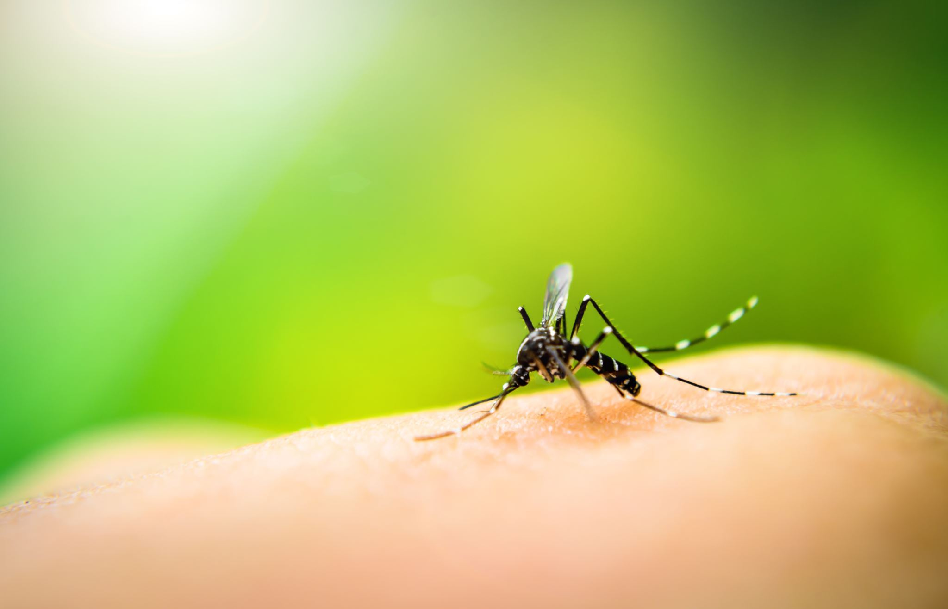
Dengue: The Vector
Aedes Egyptii, A.albopictus less commonly
Domestic day biting mosquito
Prefers to feed on humans
Breeds in stored water
Short flight range
May bite several people in same household

Slide 29
Epidemiology:
The WHO reports that the first case of DF was reported in Pakistan in 1994. However, in Karachi, the pattern of annual outbreaks began in November 2005.
Approximately 400 million infections and 100 million clinically apparent infections occur annually. Untreated severe dengue fever may have a mortality rate of 10% to 20%. However, with appropriate supportive care, the mortality rate can be reduced to approximately 1%.

Slide 30
Pathophysiology
Secondary infection with another serotype leads to antibody mediated enhancement
Heterotypic antibodies are non protective and fail to neutralise the virus
Virus-antibody complexes taken up by monocytes
Virion multiplication in human monocytes is promoted
Activation of CD4+ and CD8+ lymphocytes and release of cytokines
Complement system activated with depression of C3 & C5

Slide 31
Dengue Hemorrhagic Fever: Pathophysiology
Activation of complement system
Disorder of haemostasis involving thrombocytopenia, vascular changes and coagulopathy ensues
Severe DHF with features of shock : DSS
Increased vascular permeability and loss of plasma from vascular compartment causing hemoconcentration & shock

Slide 32
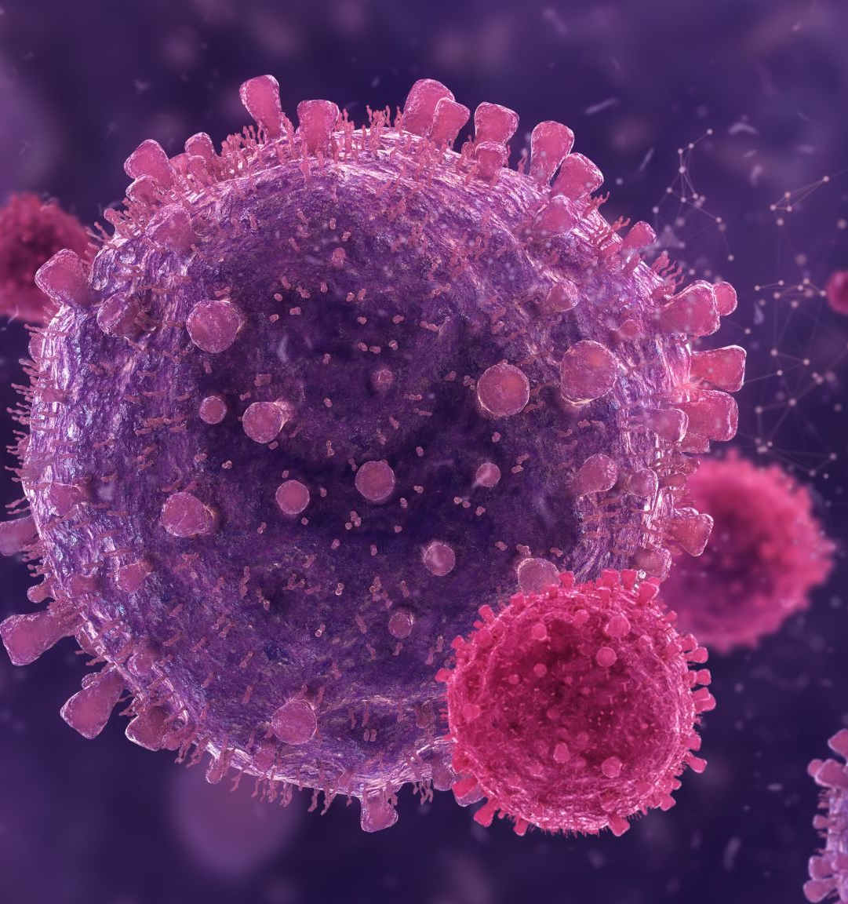
Immune response to Dengue infections
Primary Infection: IgM antibody in late acute/ convalescent stage; later IgG which lasts for several decades
Secondary infection: High IgG level, small rise in IgM
Cross reactions with other flaviviruses
Infection with one serotype does not protect against other serotypes

Slide 33
Dengue Fever: Clinical Features(Acute Phase)
Incubation period 2-7 days
Acute onset includes Fever that is continuous or saddle back with break on 4th/5th day lasting 7-8 days, Associated with
backache,arthralgias,headache,generalised pains(break bone fever), pain on eye movement,URT symptoms, nausea,vomitting,pharyngitis,relative bradycardia,lymphadenopathy
Morbilliform Rash

Slide 34
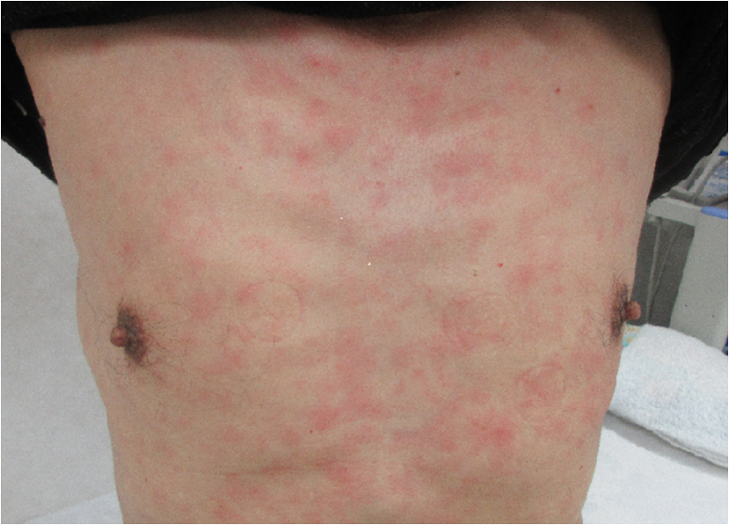
Classical Morbilliform Rash
  Initial flushing faint macular rash appears in 1-2days
  Maculopapular,scarlet,morbiliform blanching rash forms on trunk from days 3- 5, spreading centrifugally sparing palms and soles
  Rash may desquamate on resolution or give rise to petechia on extensor surfaces

Slide 35
Convalescence
Slow and may be associated with prolonged fatigue syndrome arthralgia or depression

Slide 36
Complications
DENGUE HEMORRHAGIC FEVER/DIC
DENGUE SHOCK SYNDROME
SEVERE ORGAN INVOLVEMENT
VERTICAL TRANSMISSION IF INFECTION WITHIN 5 WEEKS OF DELIVERY

Slide 37
WHO Classification Of Dengue Fever

Slide 38
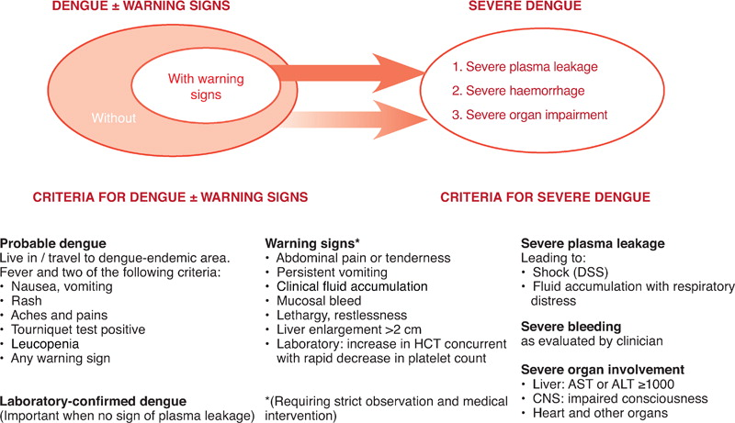

Slide 39
Diagnostic Criteria

Slide 40
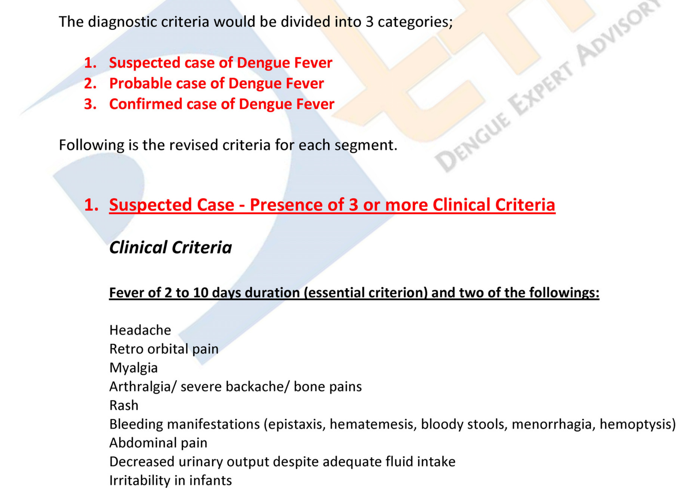

Slide 41
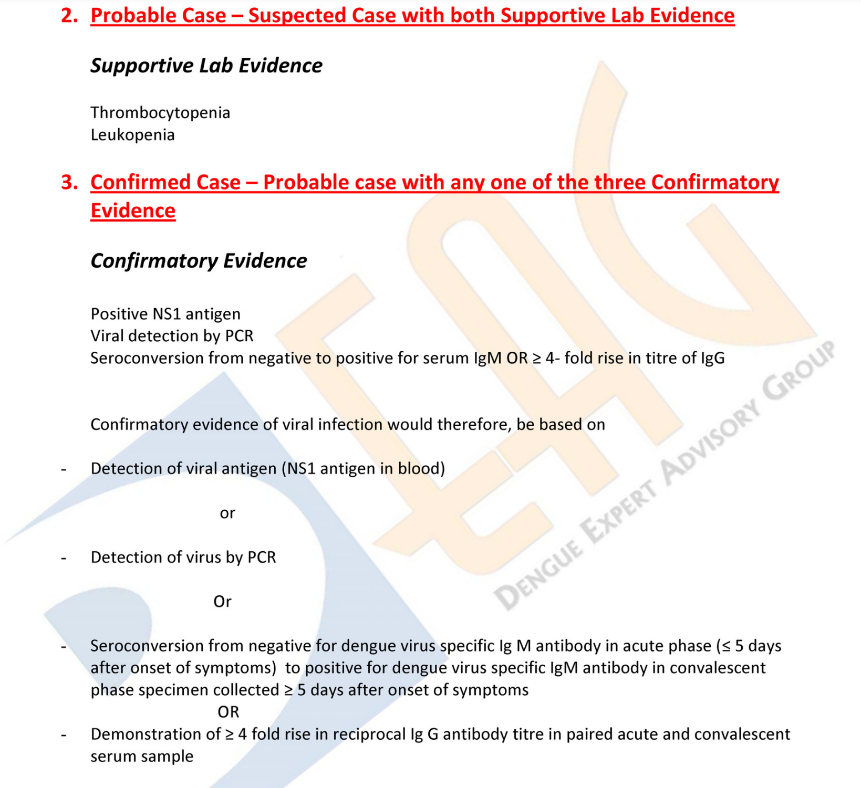

Slide 42
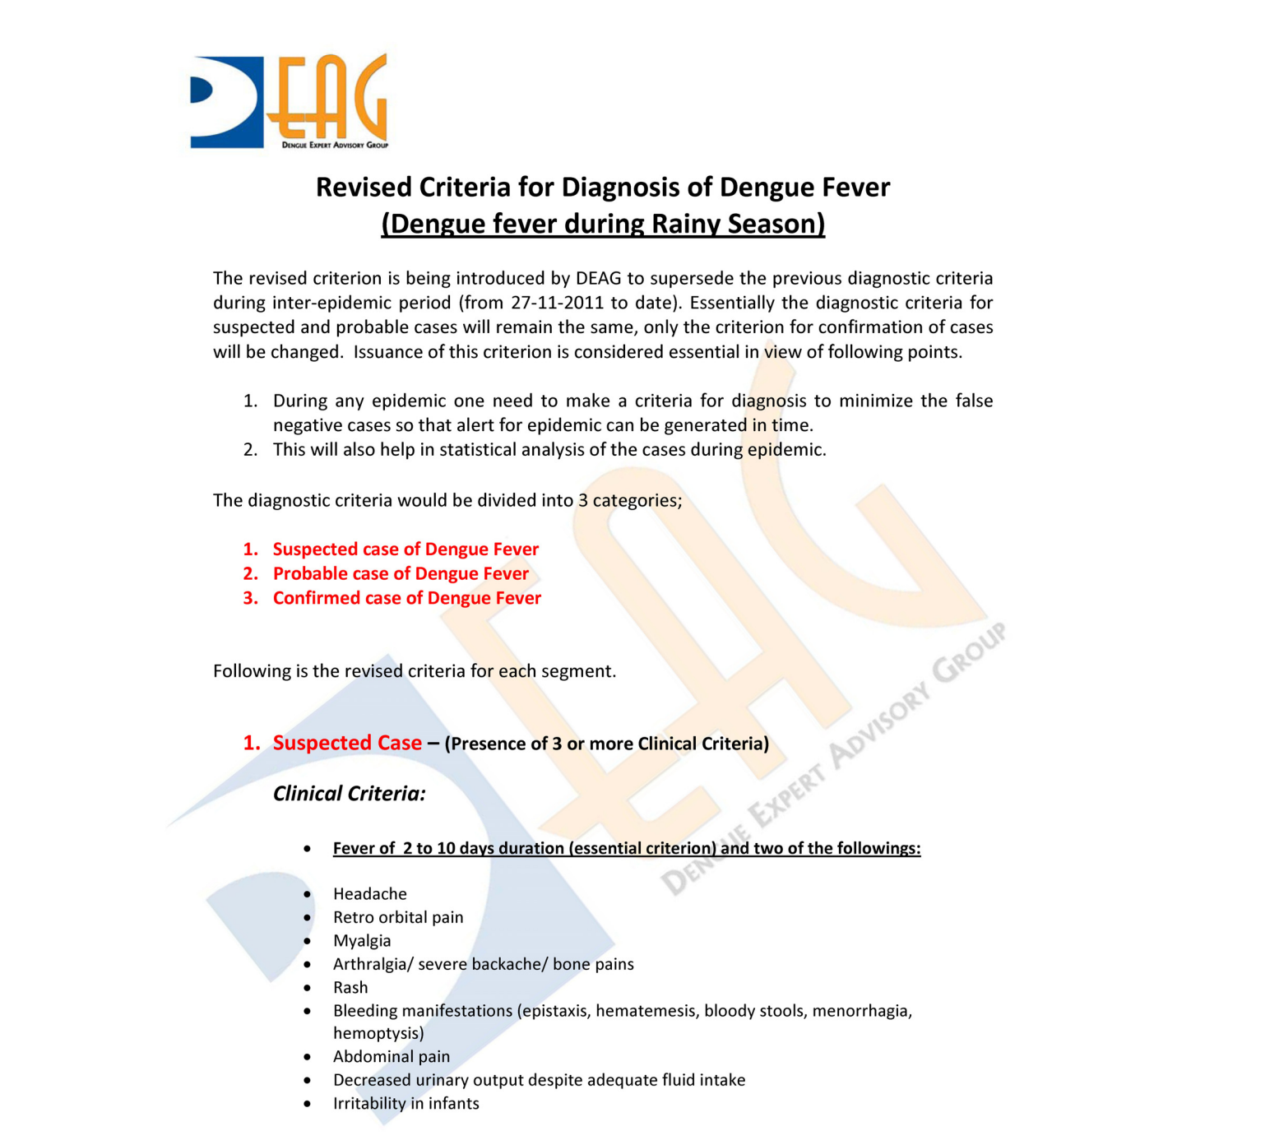

Slide 43
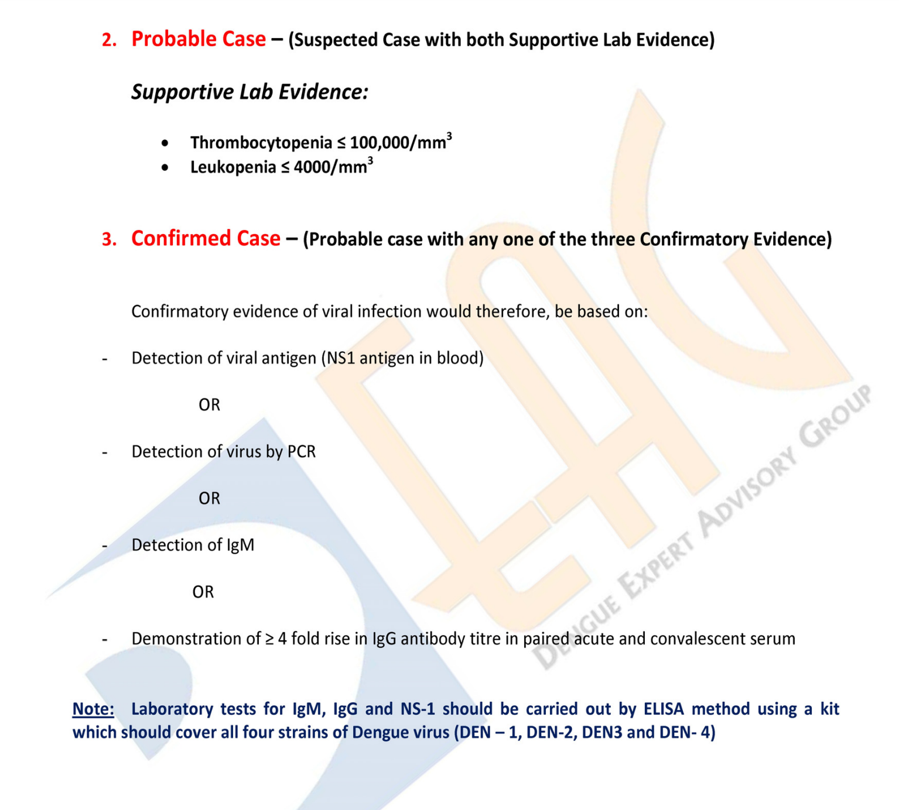

Slide 44
Management

Slide 45
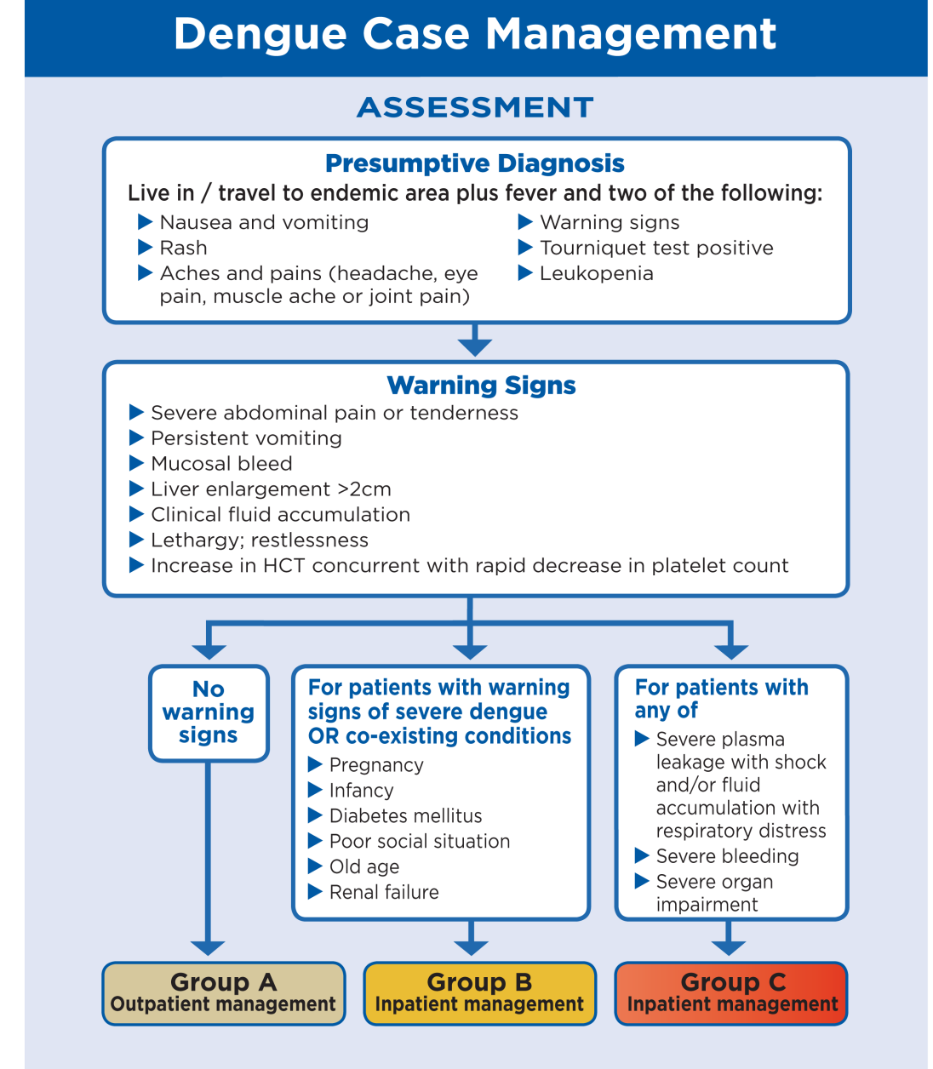

Slide 46
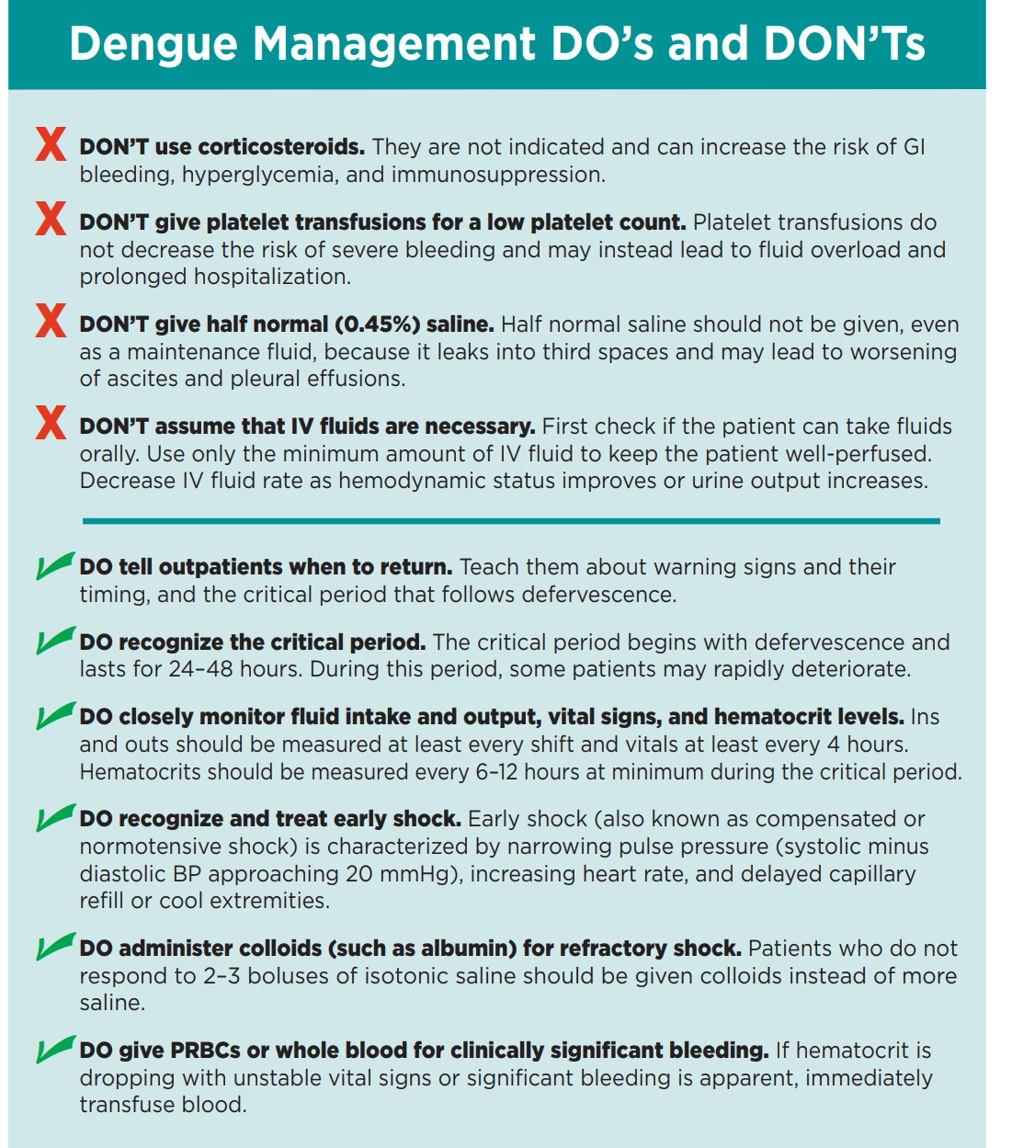

Slide 47
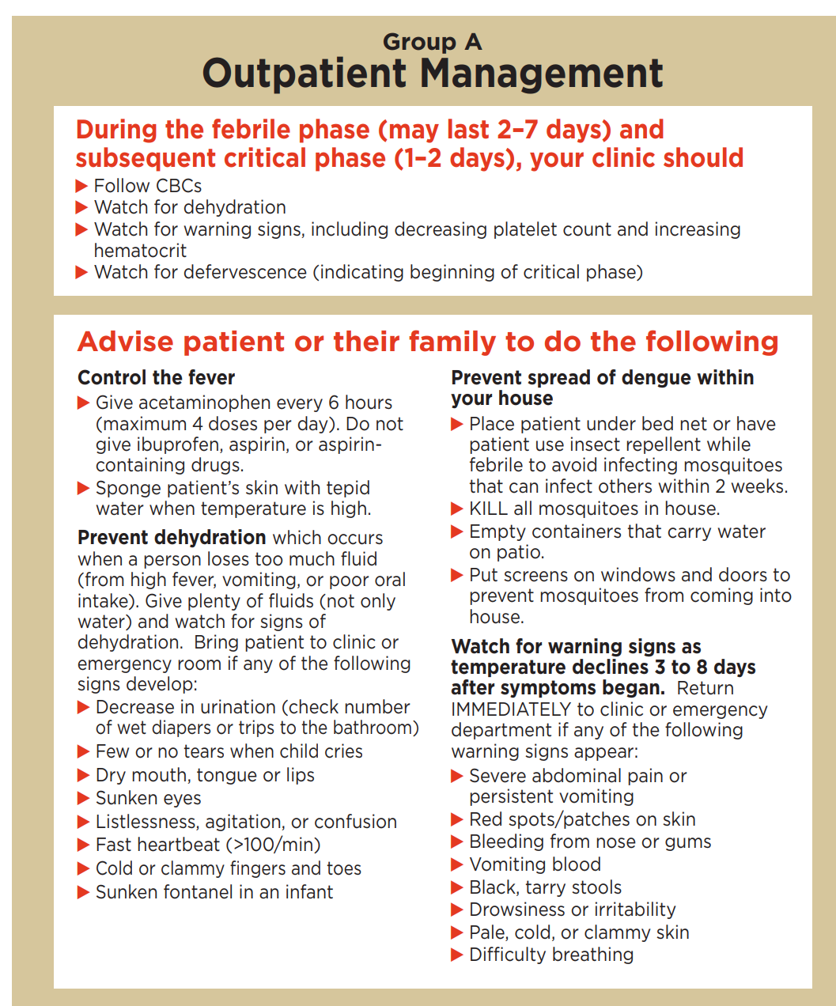

Slide 48
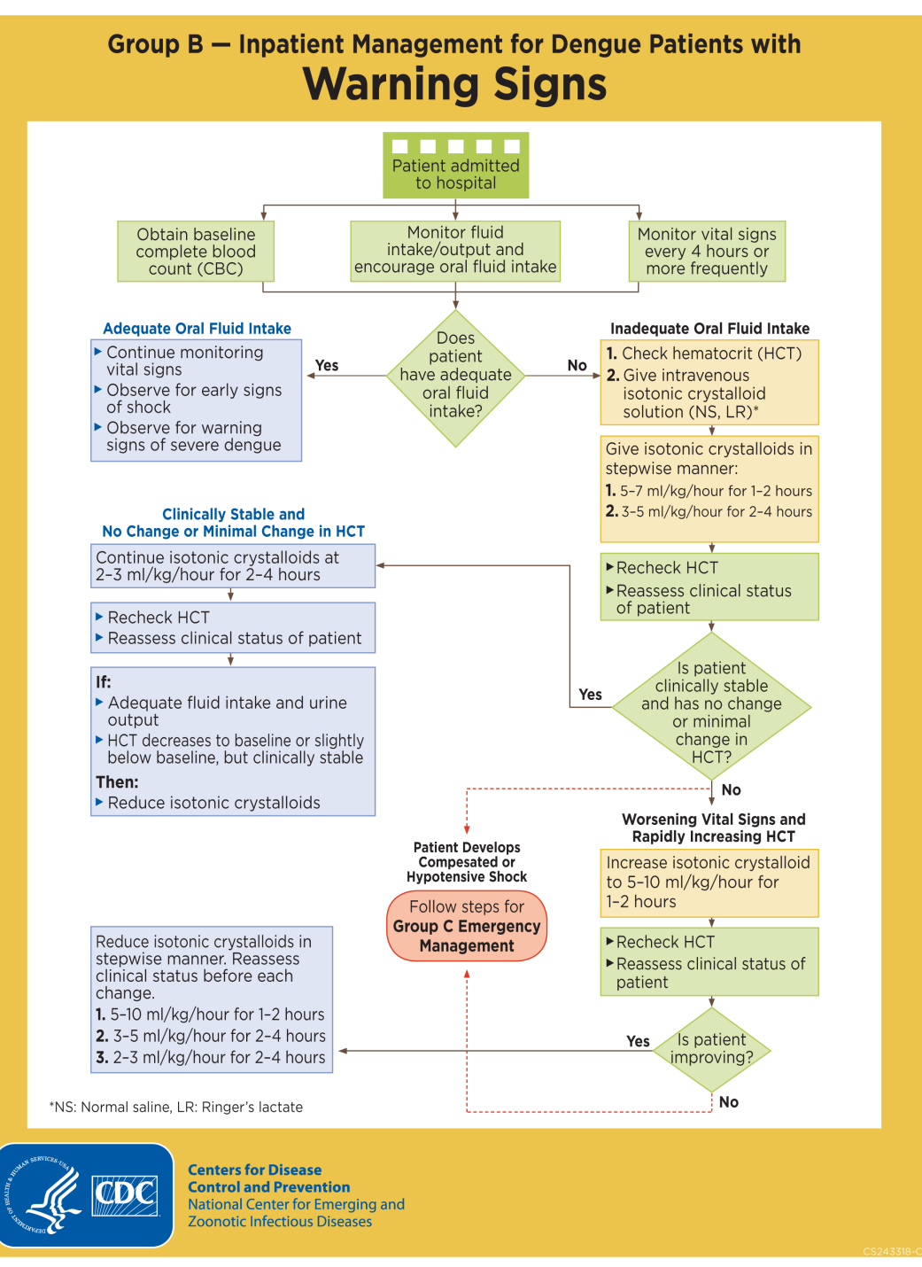

Slide 49
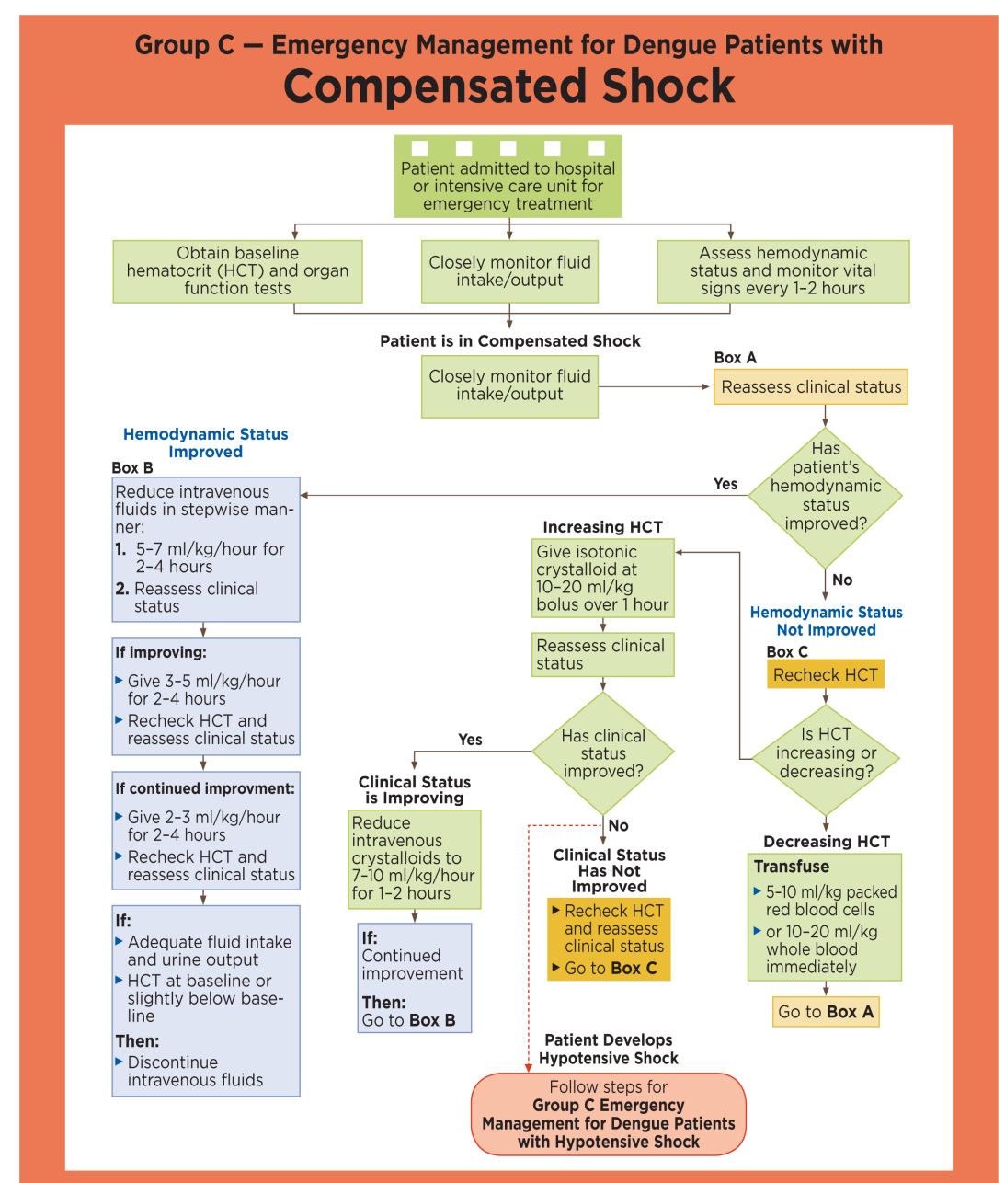

Slide 50
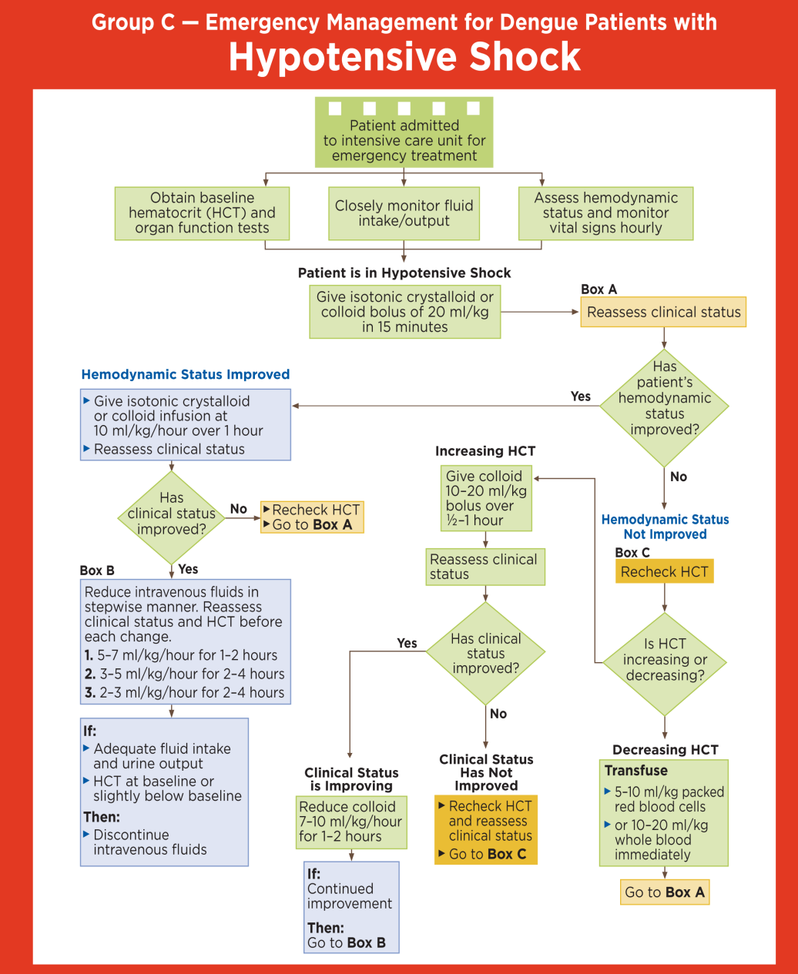

Slide 51
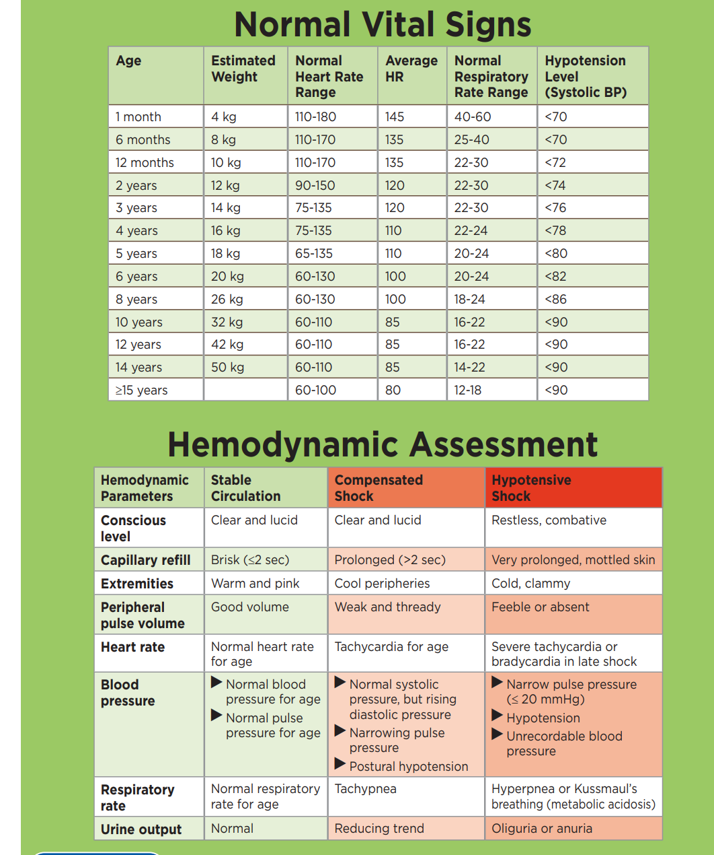

Slide 52
Prevention
The best way to prevent the disease is to avoid bites from infected mosquitoes, especially if you are living in or traveling to a tropical area. This involves protecting yourself and making efforts to keep the mosquito population down.
To protect yourself:
Use mosquito repellents, even indoors.
When outdoors, wear long-sleeved shirts and long pants tucked into socks.
When indoors, use air conditioning if available.
Make sure the window and door screens are secure and free of holes. If sleeping areas are not screened or air-conditioned, use mosquito nets.
If you have symptoms of dengue, speak to your doctor.
To reduce the mosquito population, get rid of places where mosquitoes can breed. These include old tires, cans, or flower pots that collect rain. Regularly change the water in outdoor bird baths and pets' water dishes.
If someone in your home gets dengue fever, make an extra effort to protect yourself and other family members from mosquitoes. Mosquitoes that bite the infected family member could spread the infection to other people in your home.

Slide 53

Dengue Vaccine
A vaccine called Dengvaxia can help prevent dengue in children aged 6 to 16 who have tested positive for the virus before and who live in areas where dengue spreads. The vaccine is about 80% effective, but children need three doses to get full protection against the virus.

Slide 54

Thank you
Special Thanks
Dr. Kiran Akbar (AP)
Dr. Professor Zafar Majeed Kamboh (HOD)

