Slide 1
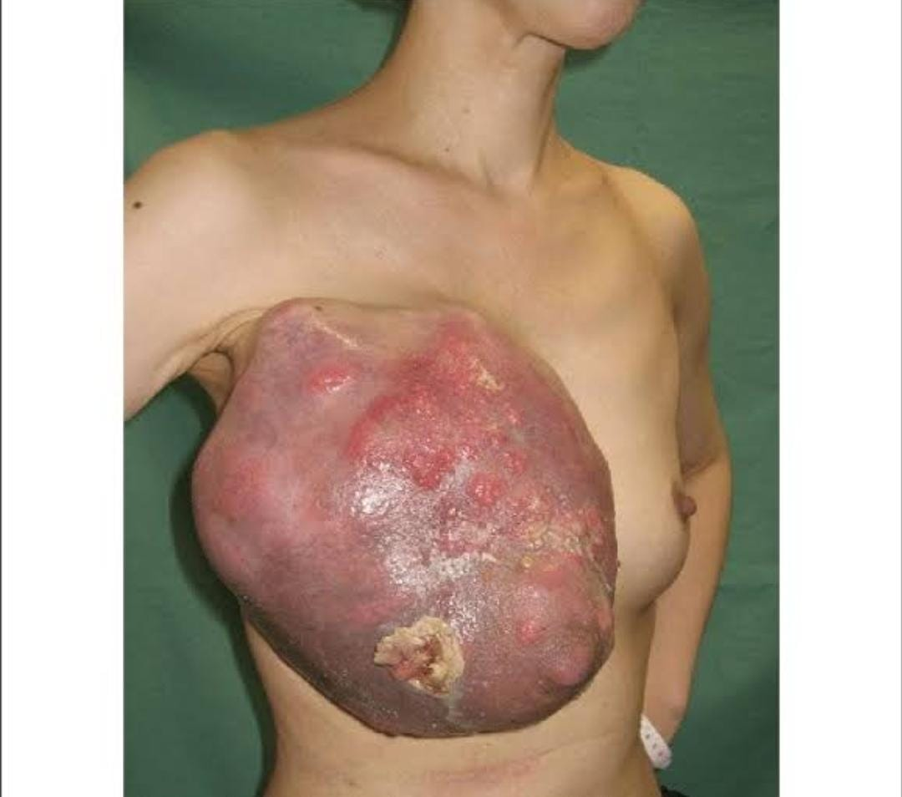
PHYLLODES TUMOR / CYSTOSACRCOMA PHYLLODES
BY:-
DR. Asad Ali Khan
PGR SU-2
MUZAMMIL SHAFIQ
NOOR FATIMA
Final Year MBBS

Slide 2
CASE PRESENTATION OF PHYLLODES TUMOR

Slide 3
HISTORY:-
BIO DATA:-
MY PATIENT RASHIDA ANWAR 35Y OLD FEAMLE UNMARRIED MUSLIM FEMALE RESIDENT OF RAHIM YAR KHAN PRESENTED TO US IN OPD ON 15/06/24
PRESENTING COMPLAIN:-
PAINLESS LEFT BREAST LUMP FOR LAST 4 MONTHS

Slide 4
HOPI:-
MY PT WAS IN USOH 4 MONTHS AGO WHEN SHE NOTICED A LUMP IN UPPER OUTER QUADRANT OF HER LEFT BREAST. IT WAS SINGLE LUMP LOCATED IN UPPER OUTER QUARDRANT OF HER LEFT BREAST WHICH GRADUALLY AND RAPIDLY INCREASED IN SIZE AND BECAME NODULAR IN LAST 2 MONTHS.LUMP WAS NOT ASSOCIATED WITH ANY PAIN SKIN AND NIPPLE CHANGESOR NIPPLE DISCHARGE .
NO ASSOCIATION WITH MENSTURAL CYCLE OF PATIENT. THERE WAS NO HISTORY OF TRAUMA TO BREAST, BONE PAIN, DYSNEA, FEVER OR WEIGHT LOSS

Slide 5
SYSTEMIC INQUIRY:-
CVS:- NO H/O CHEST PAIN,PALPITATIONS,DYSNEA,PND
CNS:-NO H/O VERTIGO, DIZINESS, HEADCHE, WEAKNESS
RESPO:-NO H/O COUGH, SPUTUM, HEMOPTYSIS, BREATHLESSNESS
GIT:-NO H/O ABD PAIN, CONSTIPATION, NAUSEA, VOMITING, DIARREHA
MUSCLOSKELETAL:-NO H/O JOINT PAIN, FATIGUE
SKIN:-NO H/O RASH, ITCHING AND ALLERGY

Slide 6
GYNAEC O LOGICAL H ISTORY:-
MY PT STARTED MENARCHE AT THE AGE OF 13Y.SHE HAS REGULAR MENSTURAL C YC LE O F 7/28 WITH NORMAL MENSTURAL FLOW AND HAS NO DYSMENNORHEA, MASTALGIA, AND INTERMENSTURAL BLEEDING

Slide 7
PAST MEDICAL;:-
NO H/O DM, TB, IHD, PTB, ASTHMA, PCOS, HTN
PAST SURGICAL:-
NOT SIGNICANT
DRUG H ISTORY:-
NO H/O TAKING BIRTH CONTROL PILLS OR OCPS
FAMILY H ISTORY:-
NO H/O OVARIAN AND BREAST CANCER IN THE FAMILY

Slide 8
Differentials:-
Phyllodes Tumor
Giant fibroadenoma
Angiosarcoma
Breast abscess
Breast carcinoma

Slide 9
EXAMINATION:-
GPE:-
I HAVE EXAMINED YOUNG FEAMLE LYING COMFORTABLY ON BED CONCIOUS,COOPERATIVE,WELL ORIENTED WITH TIME, PLACE AND PERSON WITH FOLLOWING VITALS
PULSE=80 B/M BP=130/80 TEMP=98.6 R/R=18 BREATH/M
THERE IS NO LEUKONYKIA, KILONYCHIA, CLUBBING, CYANOSIS, DUPUYTREN CONTRACTURES, PALLOR, JAUNDICE, NECK ENLARGEMENT, PEDAL EDMEA AND SACRAL EDEMA.

Slide 10
LOCAL EXAMINATION:-
INSPECTION:-
A SINGLE MULTINODULAR LUMP OF ABOUT 8*8 CM IN UPPER OUTER QUARDRANT OF LEFT BREAST.LEFT BREAST SEEMS TO BE ASYMMETRICAL WITH LUMP .
NO SCAR MARKS, PROMINENT VEINS, PULSATIONS. NIPPLE AND AREOLA NORMAL WITH NO SKIN CHANGES (PEAU-D’ ORANGE) , NO NIPPLE DISCHARGE.RIGHT BREAST EXAMINATION UNREMARKABLE

Slide 11
PALPATION:-
TEMPRATURE COMPARABLE TO THE SURROUNDING.THERE IS ABOUT 8*9CM HARD, MULTINODULAR LUMP WITH SMOOTH SURFACE AND WELL DEFINED MARGINS IN UPPER OUTER QUARDRANT OF LEFT BREAST,
WHICH IS NOT FIXED TO THE UNDERLYING MUSCLE , SKIN IS PINCHABLE AND LUMP IS MOBILE OVER THE DEPPER STRUCTURES
NO REGIONAL LYMPHANDENOPATHY
RIGHT BREAST IS NORMAL ON EXAMINATION

Slide 12
RELEVANT:-
NO SPINAL TENDERNESS
NO HEPATOMEGALY
NO JAUNDICE NO DYSNEA
NO EVIDENCE OF LYMPHEDEMA OF LEFT ARM,ANY WEAKNESS AND ALTERED SENSATIONS

Slide 13
SYSTEMIC EXAMINATION
CVS:-
S1+S2+0
GIT:-
SNT+ PERCUSSION RESONANT+ NORMAL BOWL SOUNDS
CNS:-
GCS 15/15, SENSORY AND MOTOR SYSTEM INTACT
RESPO:-
NVB + NO ADDED SOUNDS

Slide 14
INVESTIGATIONS:-
Ulrasound breast with axilla
Mammography
FNAC
Core needle biopsy

Slide 15
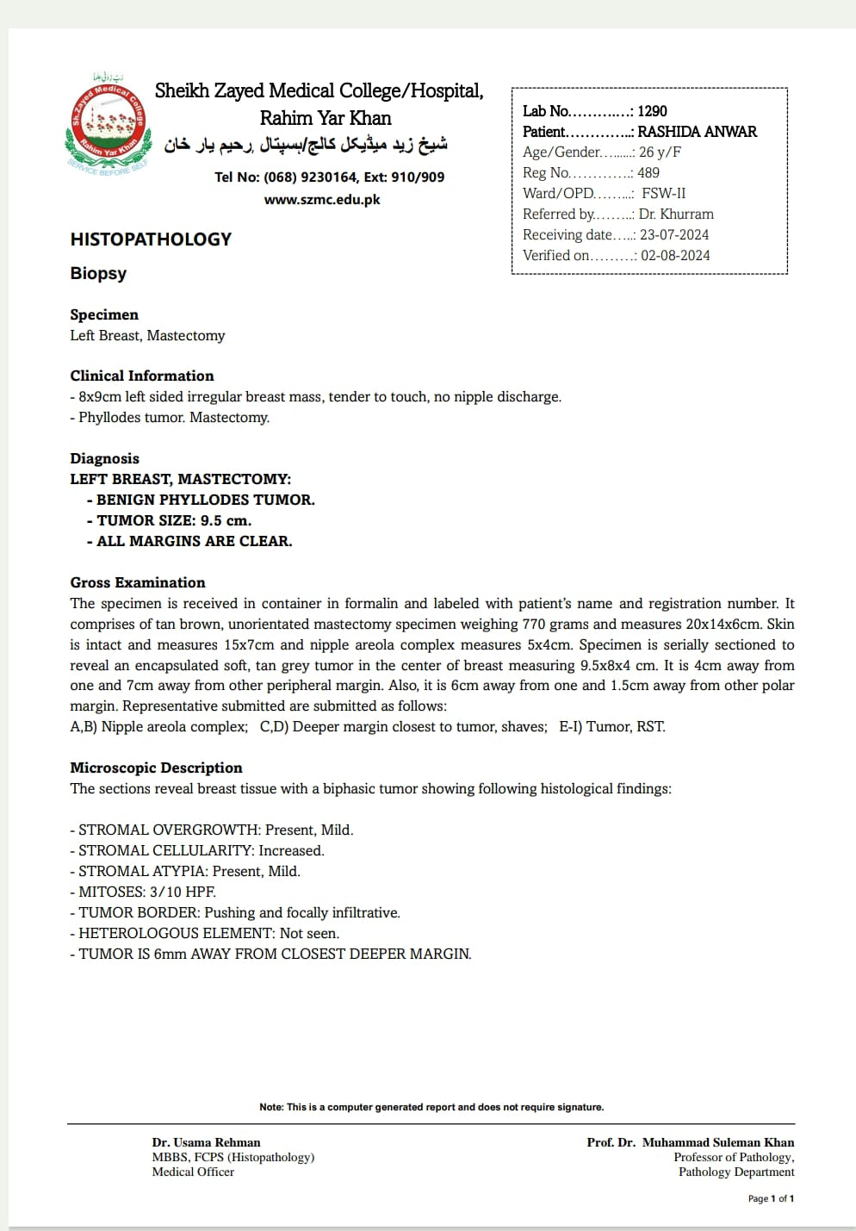
H ISTOPATHOLOGY:-

Slide 16
Objectives:-
1.Introduction
2.Clinical features
3.Classification
4.Histopathology
5.Gross pathology
6.Microscopic pathology
7.Investigations
8.Treatment

Slide 17
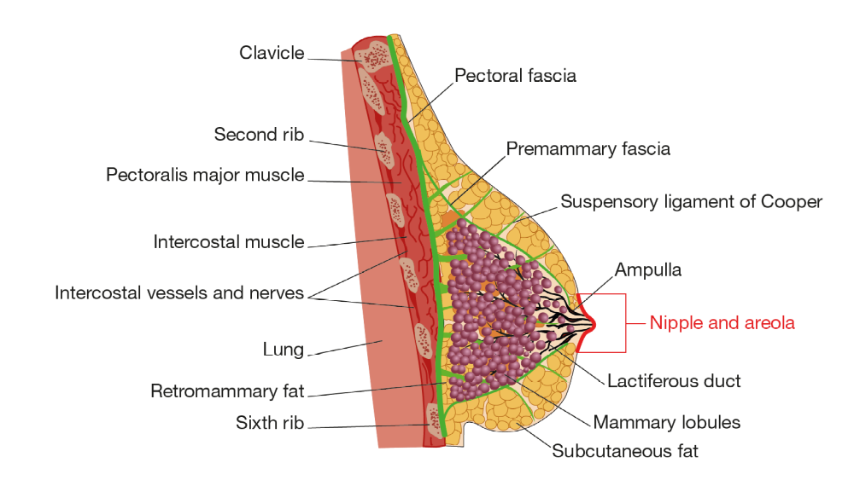
Surgical anatomy

Slide 18
INTRODUCTION:
BENIGN tumor occur in women over age of 30 but can occur in younger age
Large, sometimes massive tumor with unevenly bosselated surface

Slide 19
Clinical features:-
Smooth, rounded, usually painless, multinodular lesion
Large and massive in size
Unilateral
Most common in 3rd and 4th decade
Remains mobile over the chest wall
Bosselated surface with pressure necrosis of skin

Slide 20
Clinical features:-
H/O rapid growth
No fixity to the skin and muscles, no nipple retraction, no lymph node involvement (differentiated point from carcinoma)

Slide 21
Examination
Stretched, Red, Dilated Veins
Smooth non tender fluctuant
Pressure Necrosis
No nipple retraction

Slide 22
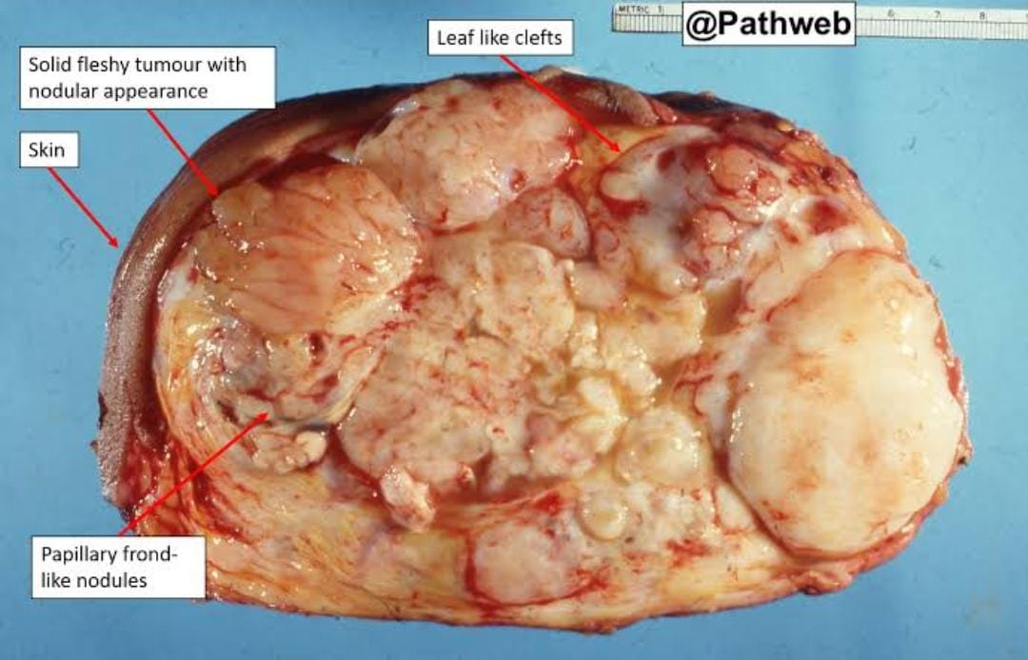
Gross pathology:-
Large
Encapsulated with cystic changes
Connective tissue makes bulk of these tumor with mixed gelatinous solid cystic areas
On cut surface it has soft cystic spaces

Slide 23
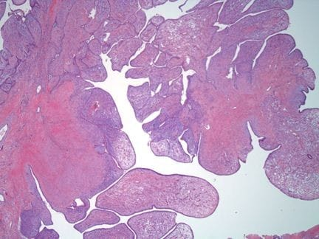
histopathology:-
Sharply demarcated from the surrounding breast tissue which is distorted and compressed
True mixed neoplasm comprising both epithelial and mesenchymal elements resembling a fibroadenoma

Slide 24
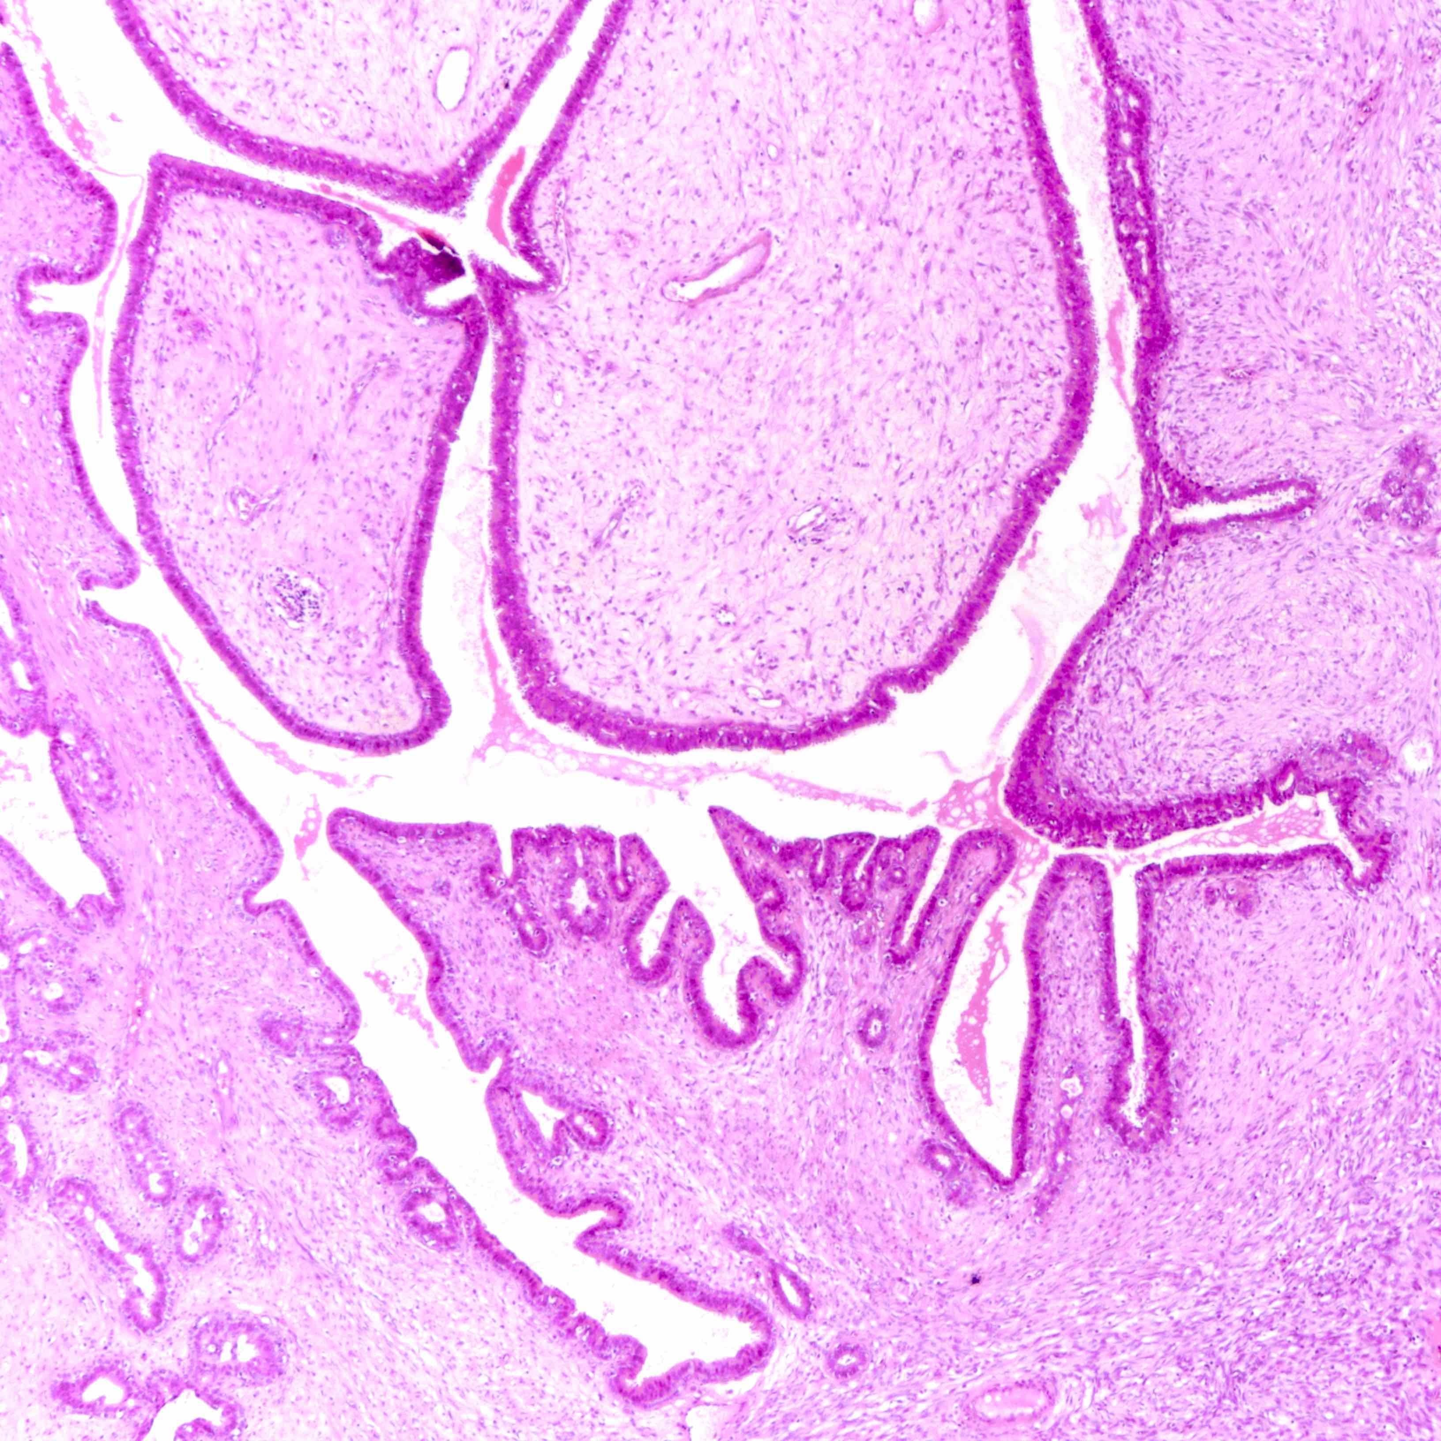
Microscopic STUDY:-
Cystic spaces with leaf like projections hence called phyllodes
Stromal cells are always monoclonal
Some cells have higher mitotic index with infilterating boarders and spread via bloodstream

Slide 25
Classification:-
BEGING BORDERLINE MALIGNANT
Mitotic rate < 4/10 Mitotic rate 4-9/10 Mitotic rate >10/10
Resembles fibroadenoma greater potential for local high power field
Incidence 85% recurrence

Slide 26
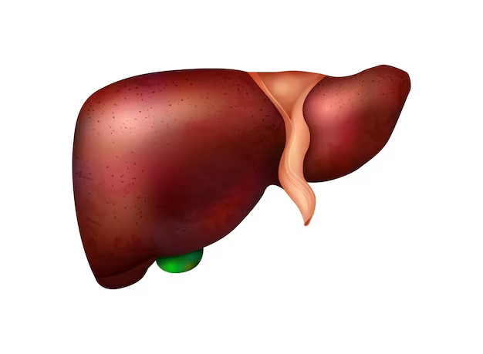
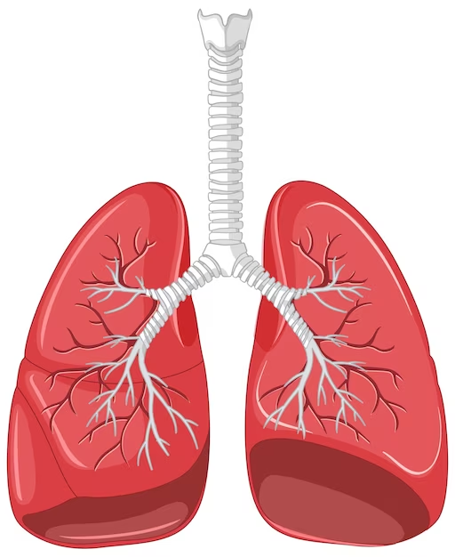
Metastasis:-
Occur through bloodstream
Common sites:-
Liver
Lungs
Bones
Mediastinum

Slide 27
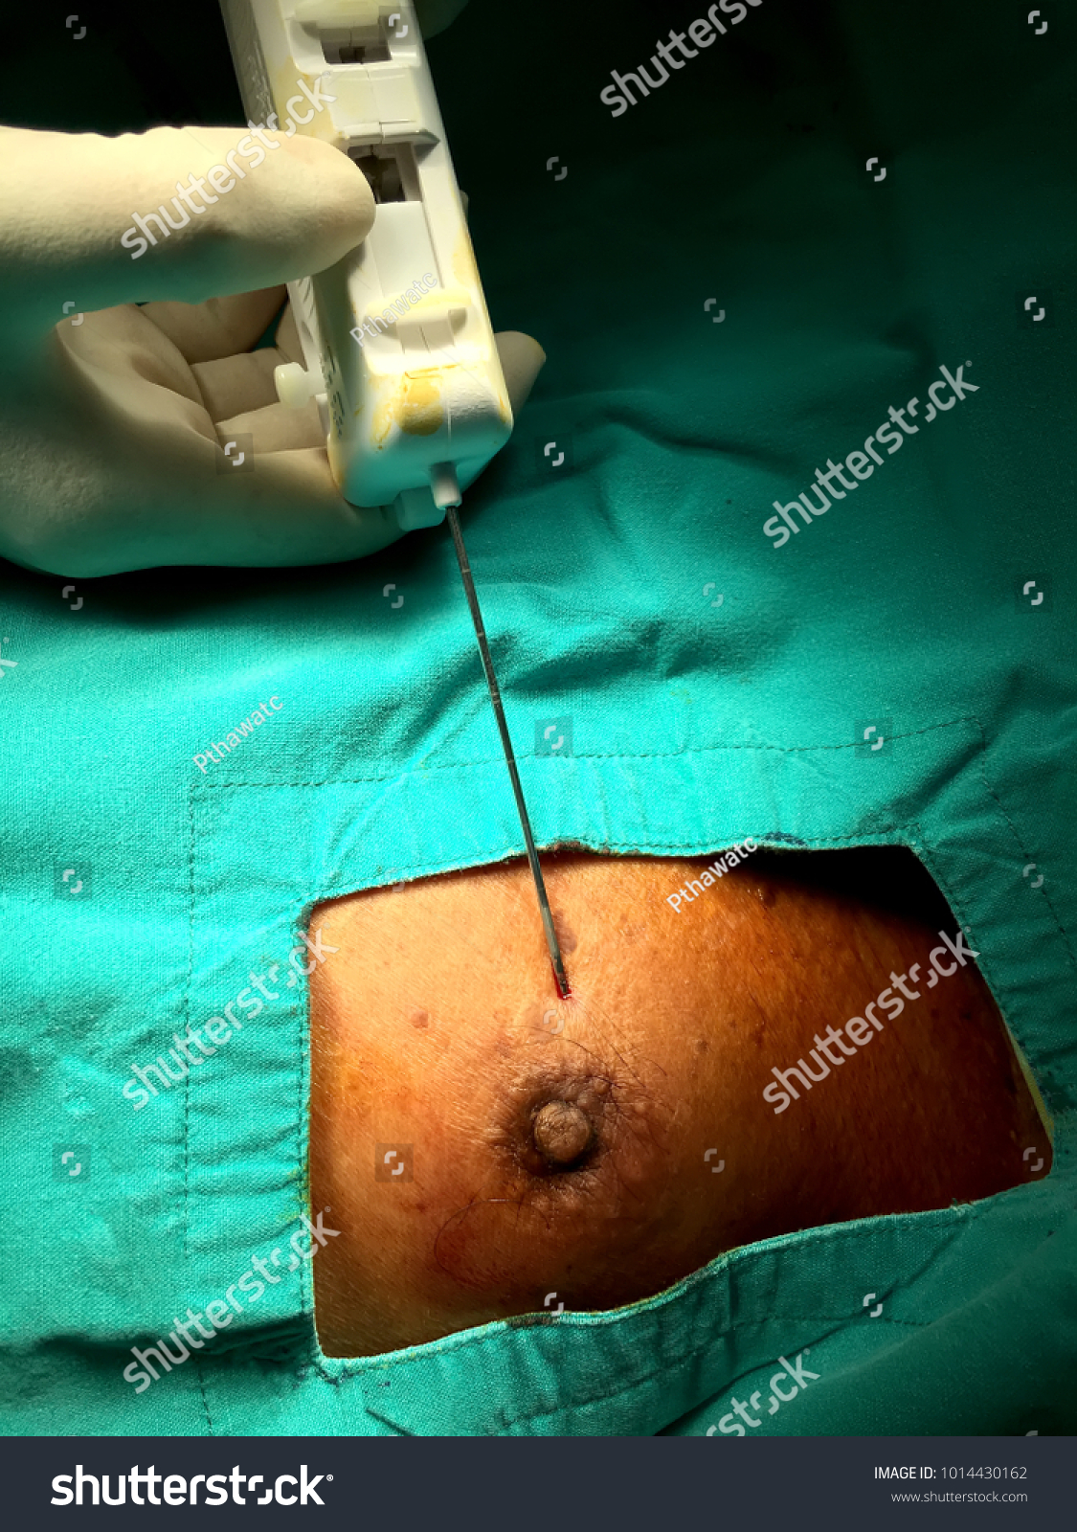
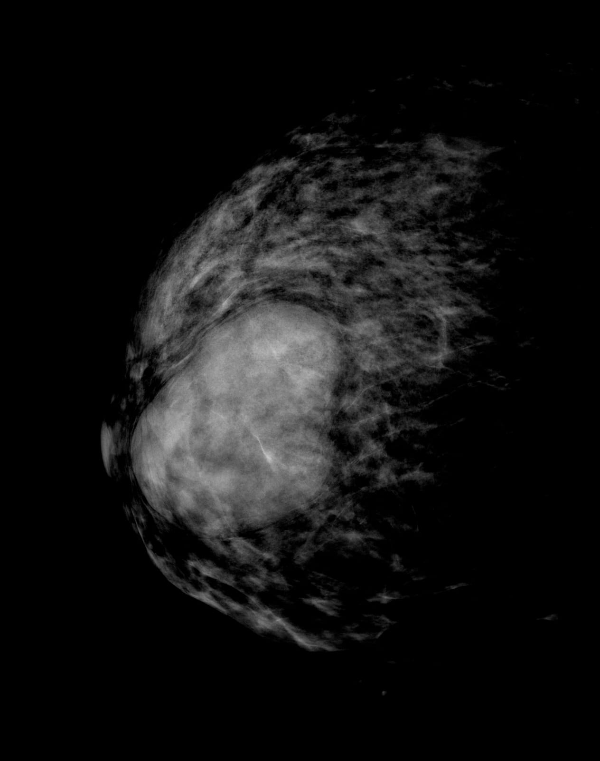
Investigations:
Ultrasound breast with axilla
Mammography
FNAC
Core needle biopsy (Investigation of choice)

Slide 28
Treatment:-
1.Wide local excison:-
With 2cm margin along with overlying skin and underlying pectolal is major because of higher Incidence of local recurrence
2.Mastectomy:
In case of massive tumor or malignant type

Slide 29
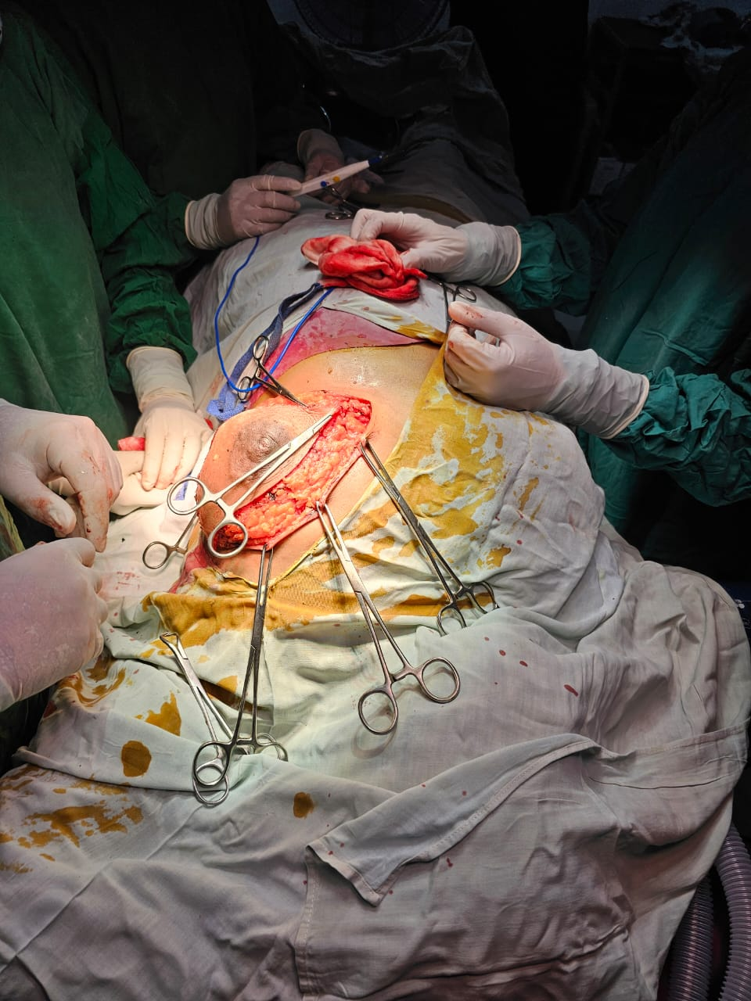
MASTECTOMOY:- (STEP-1)
AN ELLIPTICAL INCISION IS MADE ENCOMPASSING THE NIPPLE AND AREOLA

Slide 30
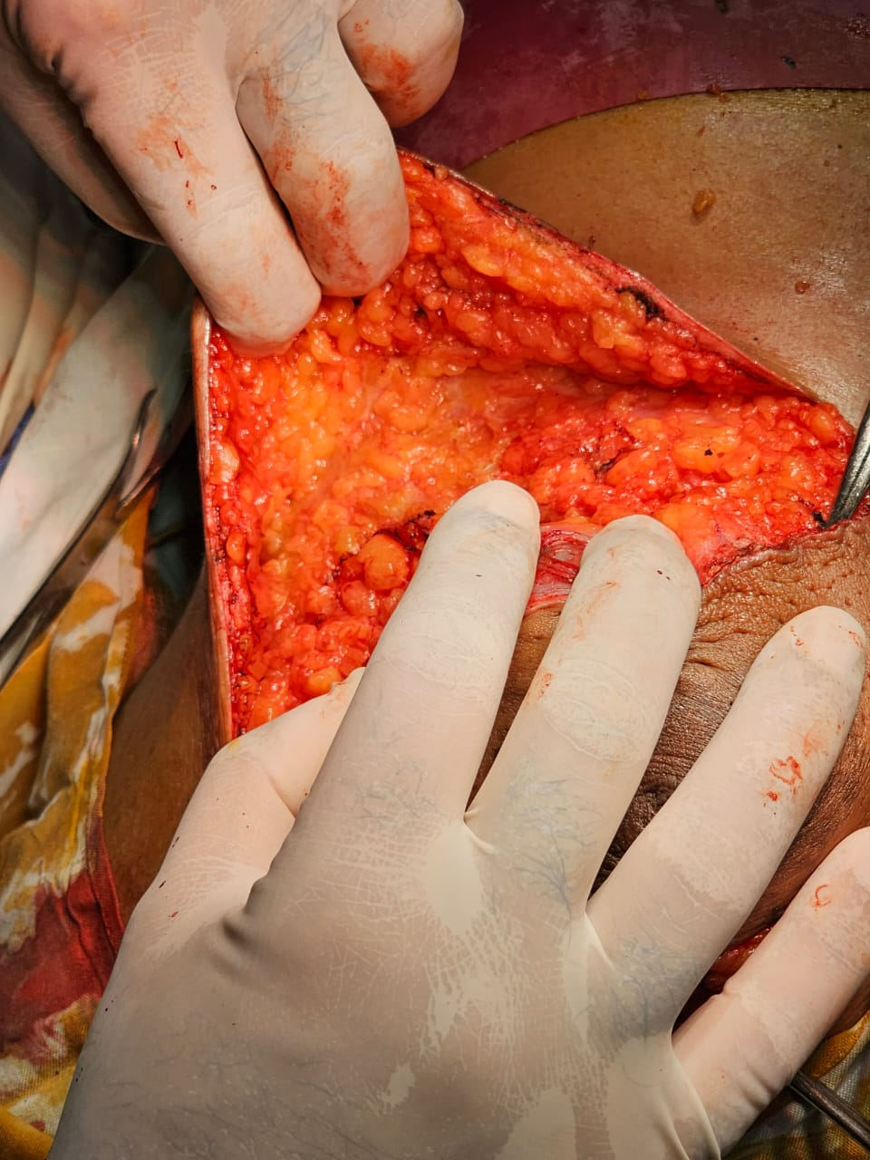
(STEP-2)
RAISING THE FLAPS:-
SKIN AND SUBCUTANEOUS TISSUE ABOUT 8MM THICK
UPPER FLAP IS RAISED UPTO CLAVICLE AND
LOWER FLAP RASIED TO RECTUS ABDOMINIS

Slide 31
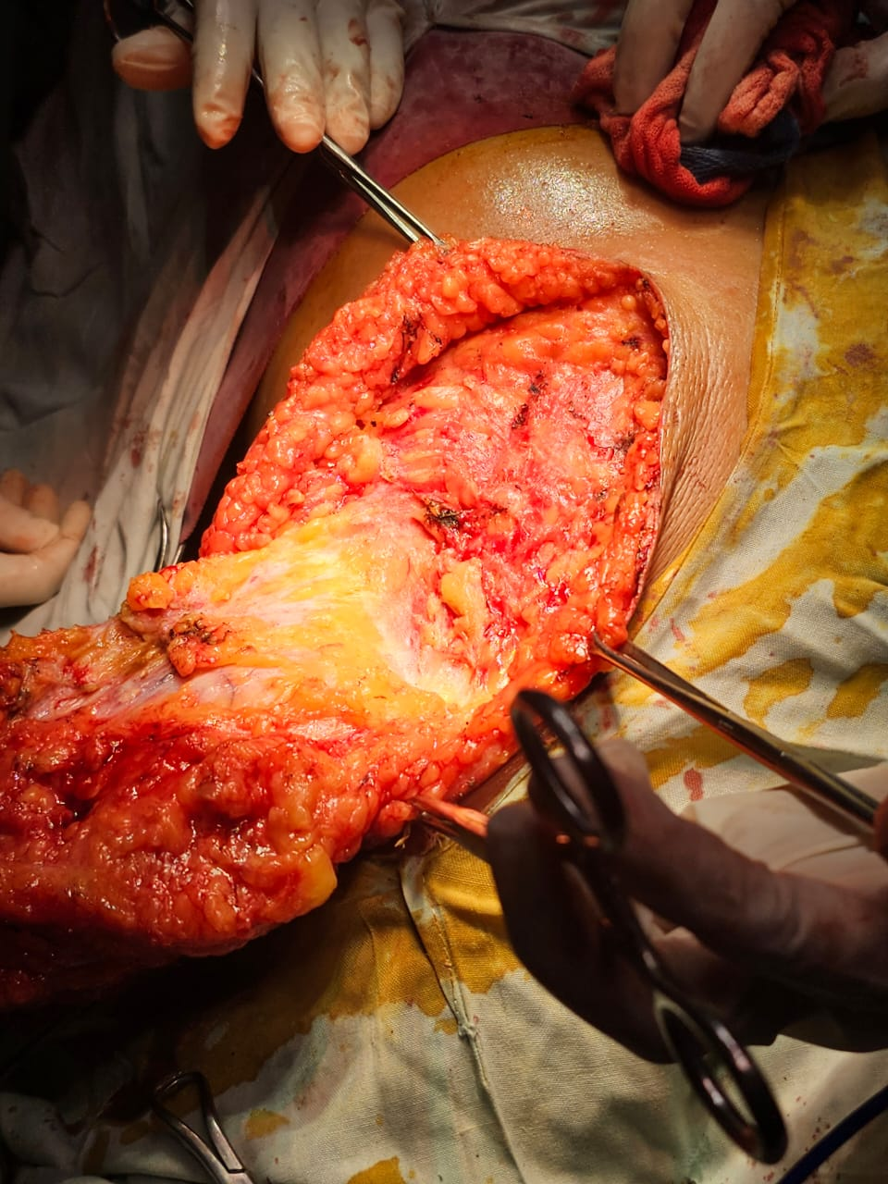
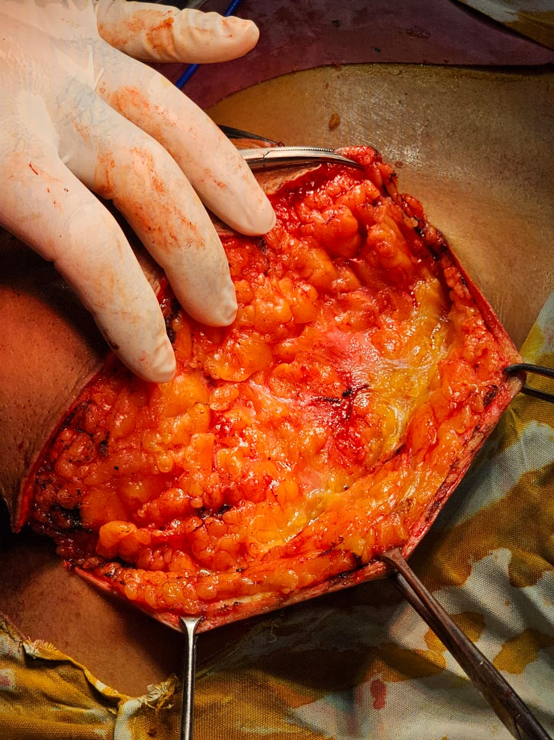
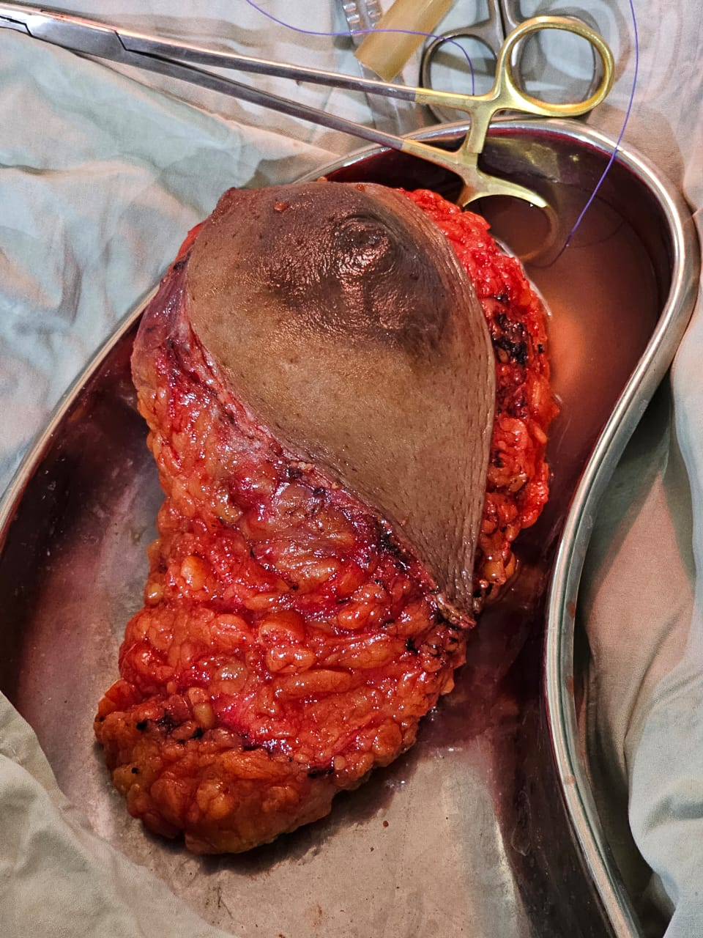
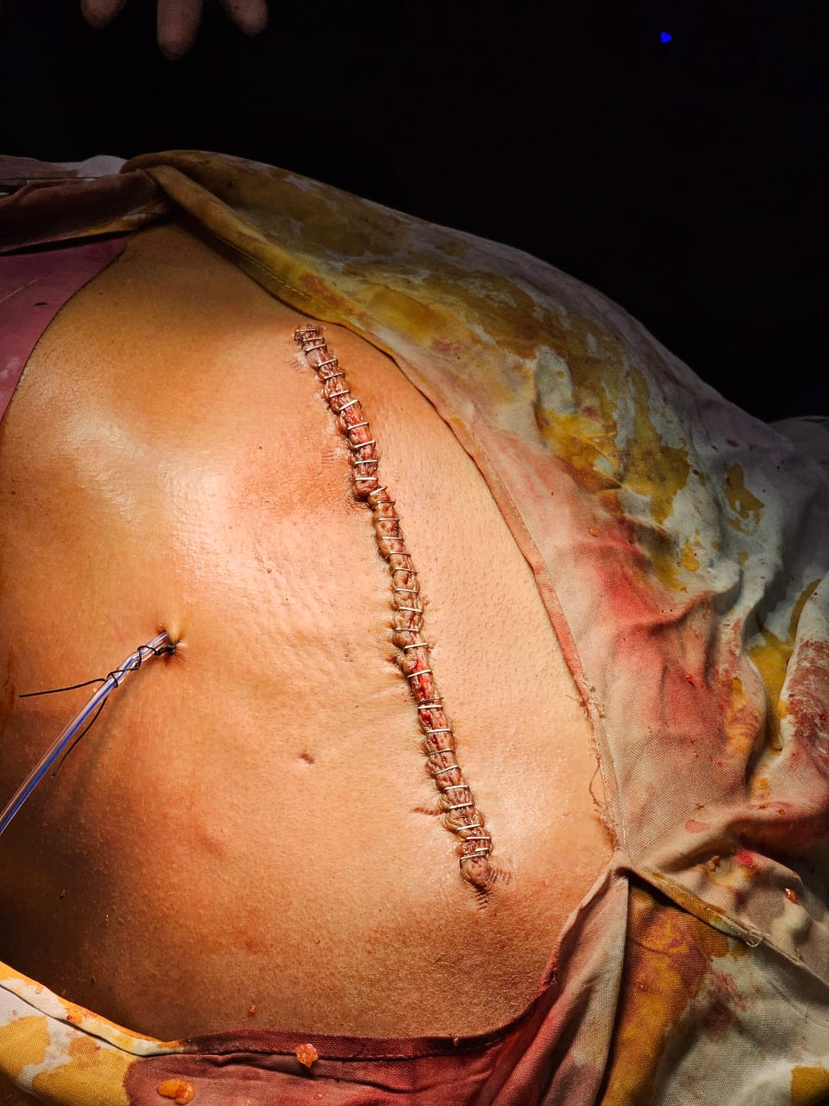
STEP 3:-
REMO VAL OF BREAST
BREST REMOVED ALONG WITH AXILLARY TAIL

Slide 32
Post op complications
Hemorrhage
Infection
Flap Necrosis
Seroma Formation
Local and distant recurrence
Damage to intercostal nerve and long thoracic nerve

Slide 33
Treatment:-
3.Radiotherapy:-
Post op radiotherapy may be offered to women with recurrent or malignant phyllodes tumors
4.C hemotherapy:
Offered for malignant phyllodes

Slide 34
Follow-up
Most recurrence occur in first 2 years
Clinical follow up every 6 month in 1st 2 year then annually

Slide 35
Prognosis
Majority of patients with benign and birder line cured by surgery
Five years survival for malignant 60 to 80 percent

Slide 36


