Slide 1
PHYLLODES TUMOR
Histopathological Features, Differential diagnosis & Molecular/Genetic Updates
Dr. Usama Rehman

Slide 2
Introduction
Rare Fibroepithelial Neoplasm
Morphological continuum - Benign to Malignant
  BENIGN BORDERLINE MALIGNANT
  60-75% 15-26% 8-20%

Slide 3
Epidemiology
Avg age: 40 – 50 years
Can rarely occurs in pediatric age group and male
Site
Most commonly breast
Reported to develop in ectopic breast tissue, including vulva

Slide 4
Pathophysiology
Cellular Origin and Genetics
Originate in the breast stroma, with potential involvement of periductal stromal cells.
Genetic mutations: TP53, MED12 and TGF-β pathway
Hormonal Influence
Estrogen and progesterone receptors are generally low or absent in PT

Slide 5
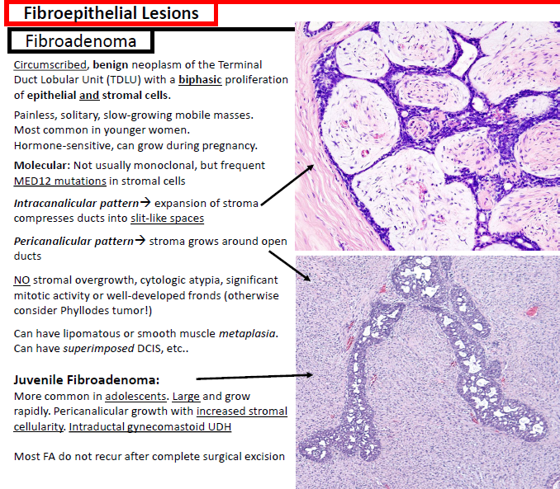
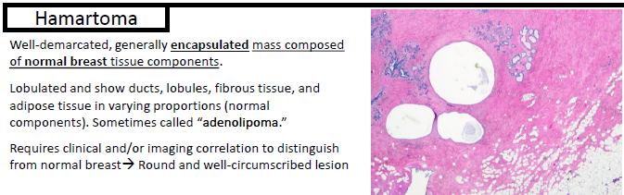
Differential diagnosis

Slide 6
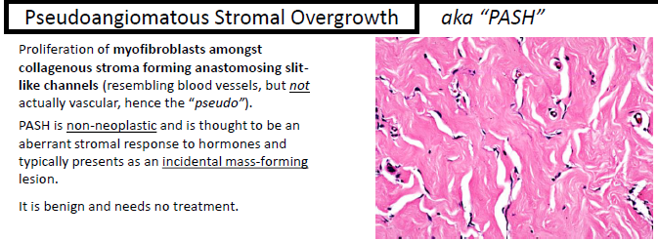
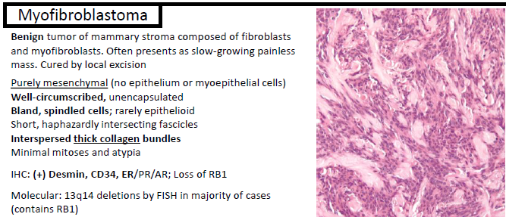
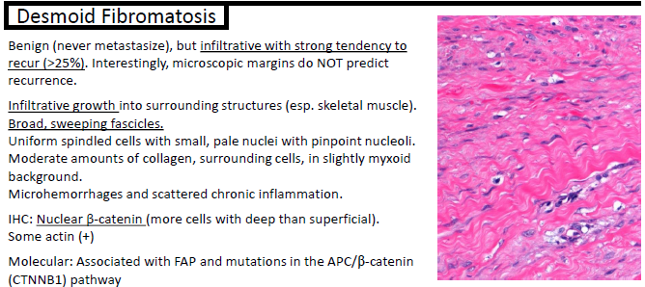

Slide 7
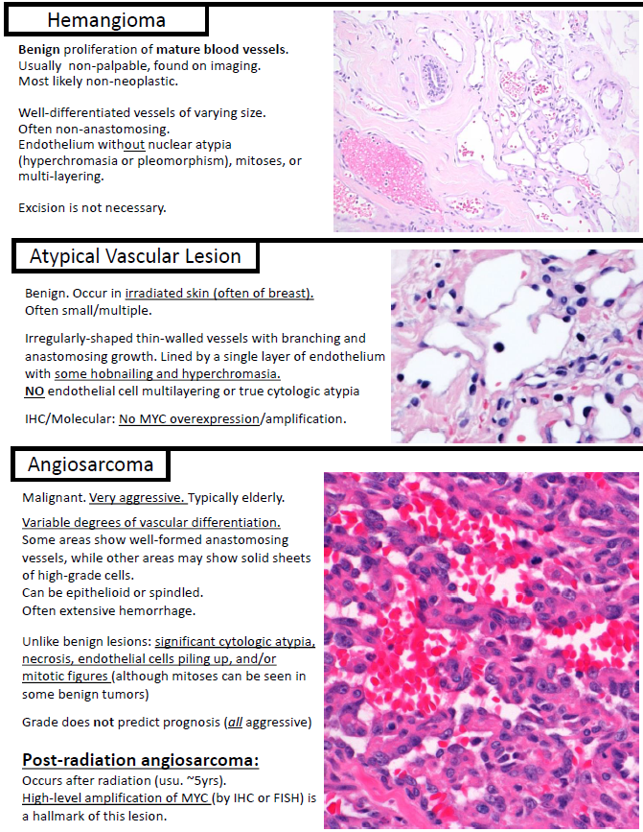
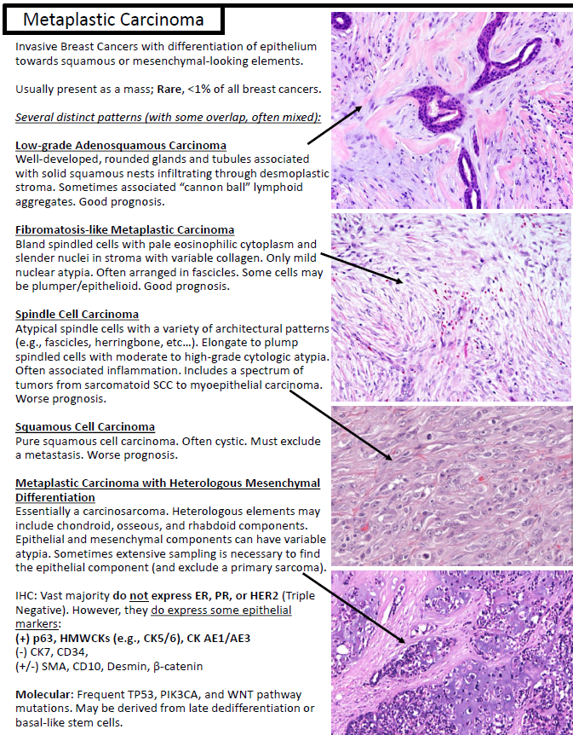

Slide 8
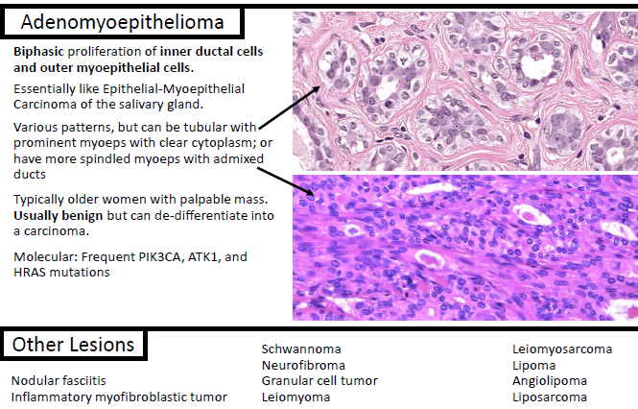

Slide 9
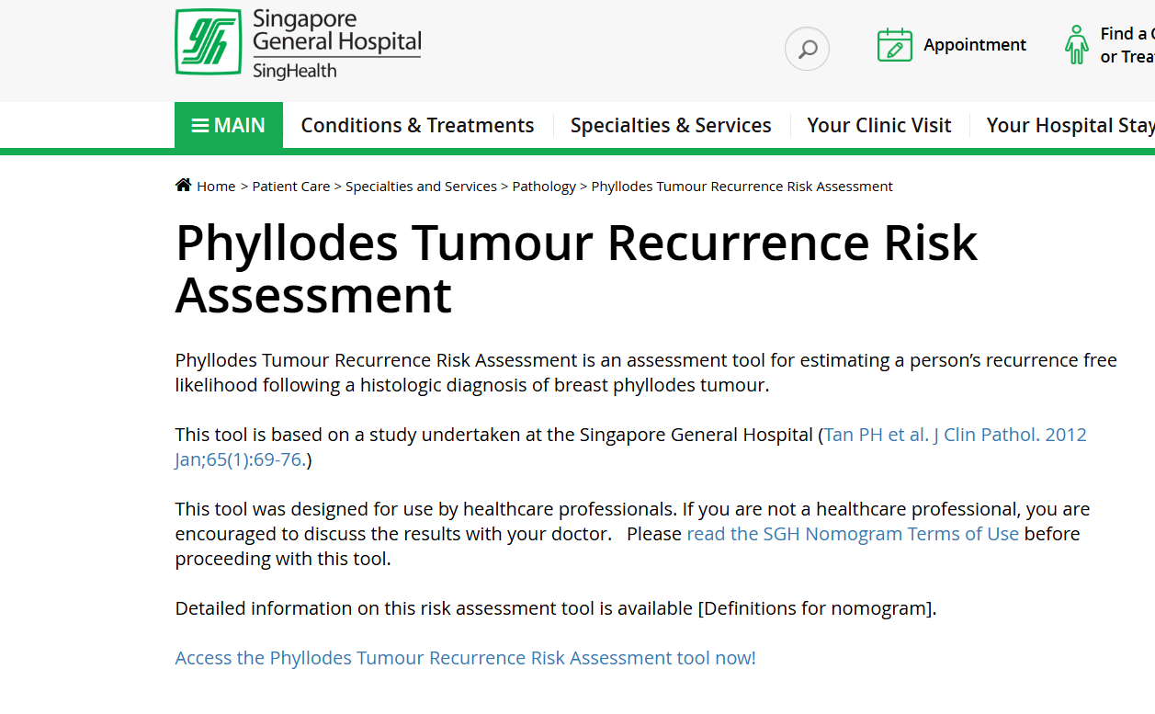
Ref: https://www.sgh.com.sg/patient-care/specialties-services/pathology/pages/phyllodes-tumour-recurrence-risk-assessment.aspx

Slide 10
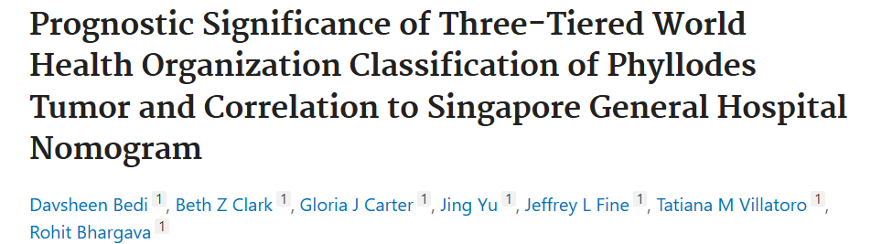
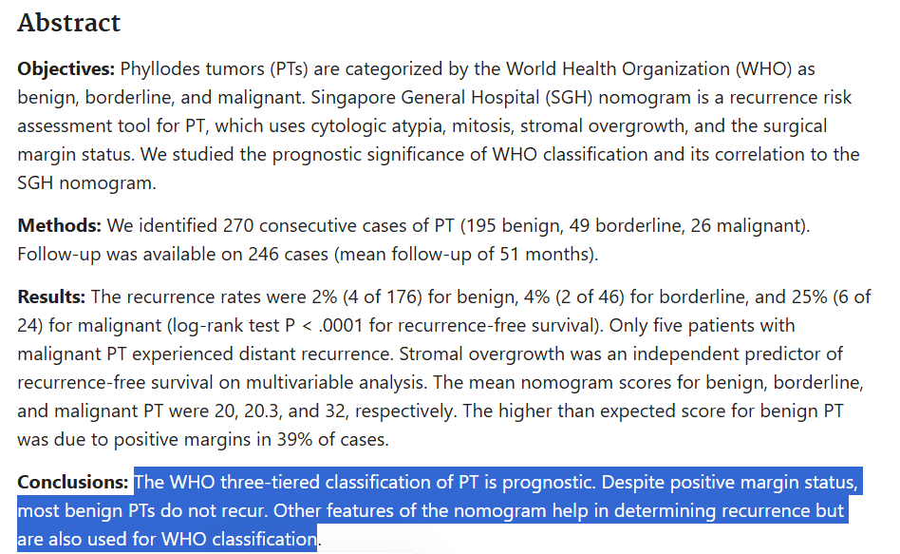

Slide 11
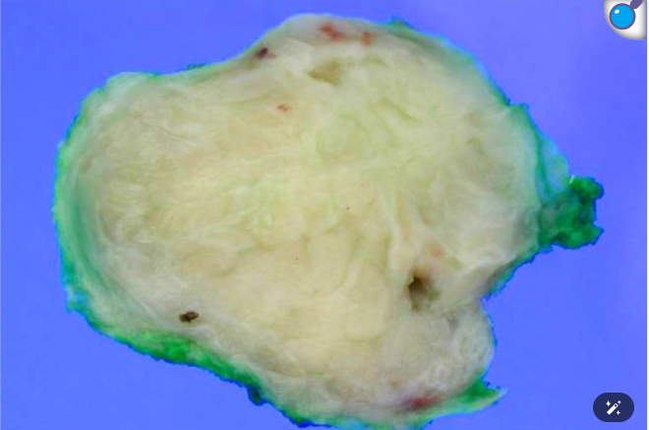
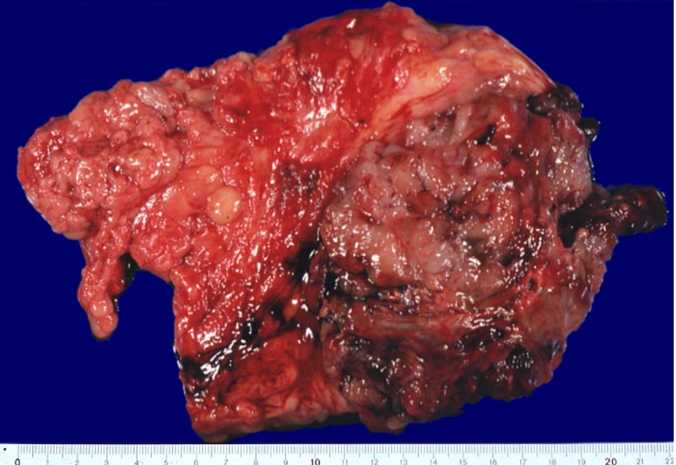
Gross Description
Rounded, shelled out borders
Whorled, bosselated cut surface in a leaf-like pattern

Slide 12
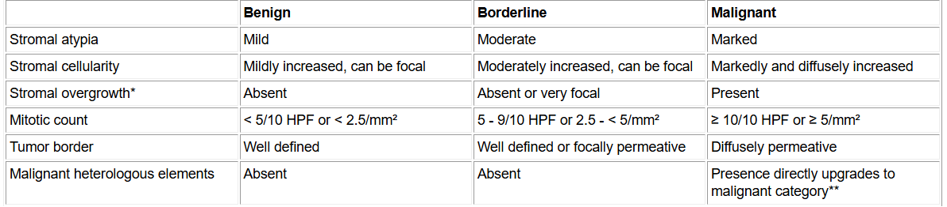

Slide 13
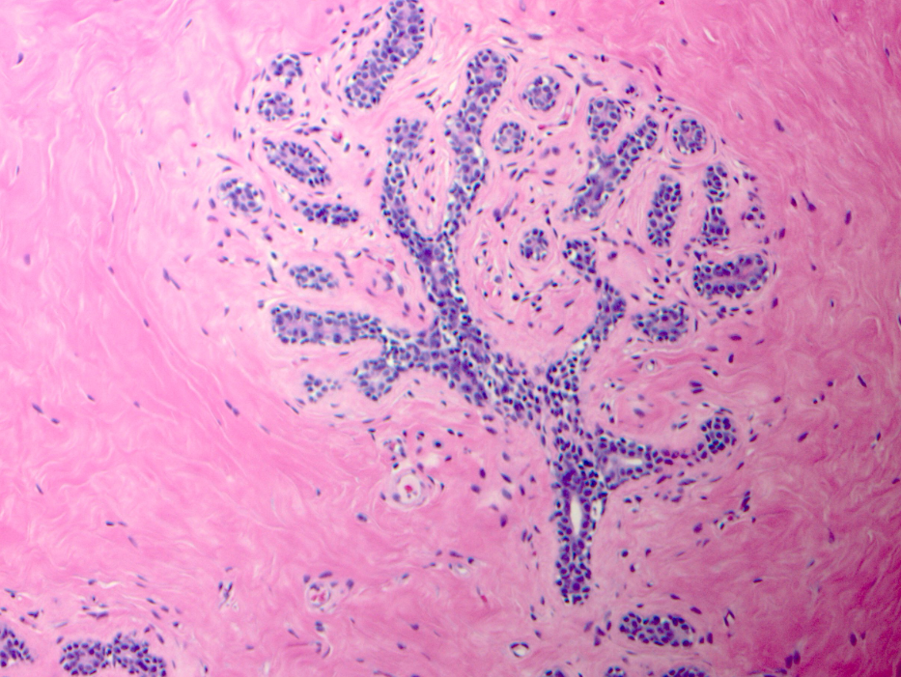
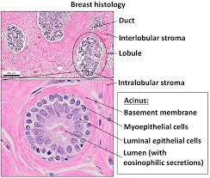

Slide 14
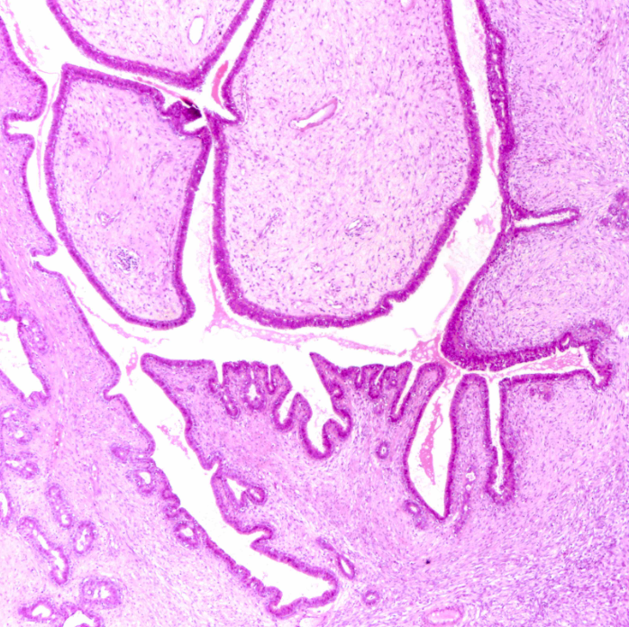
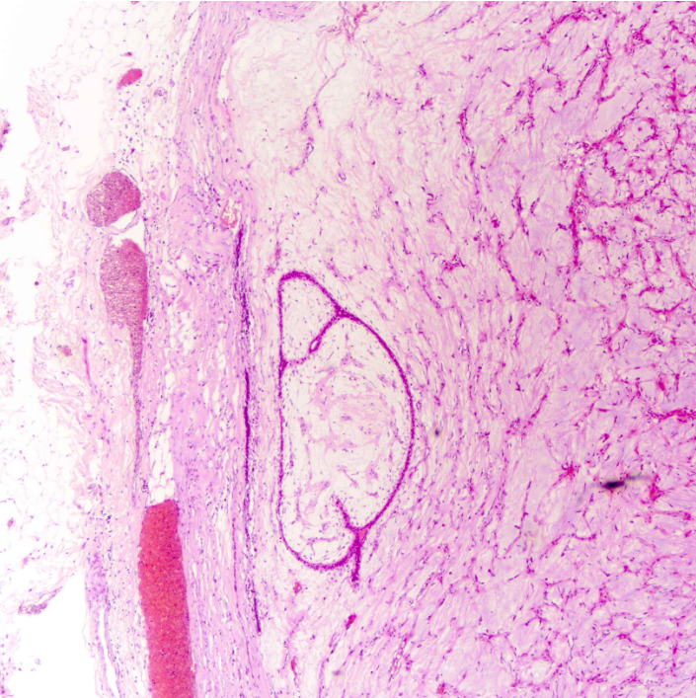

Slide 15
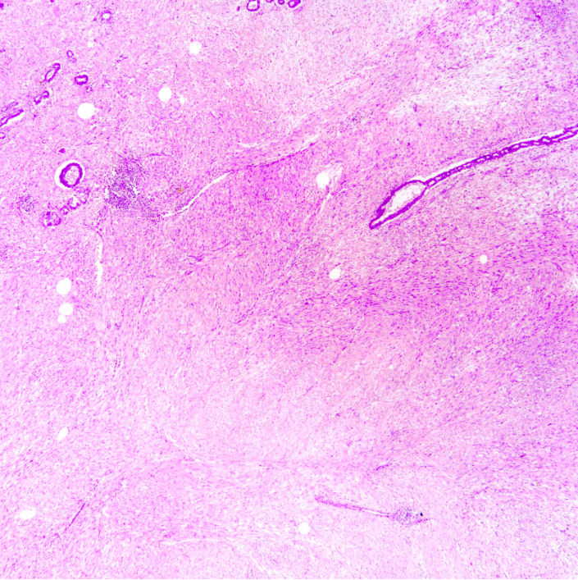
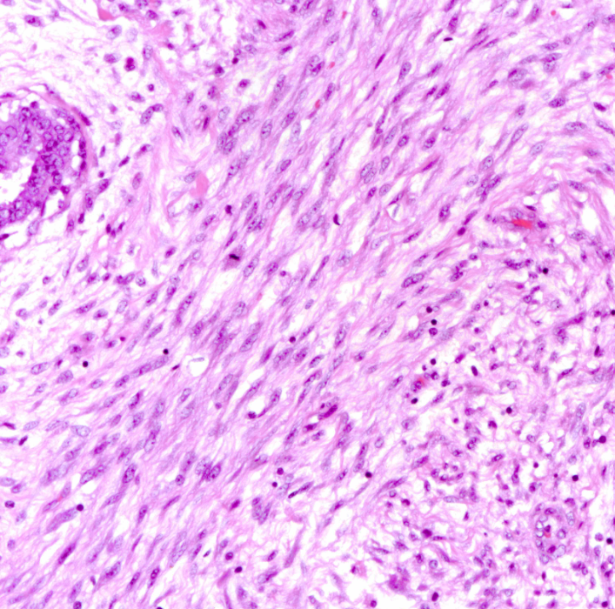

Slide 16
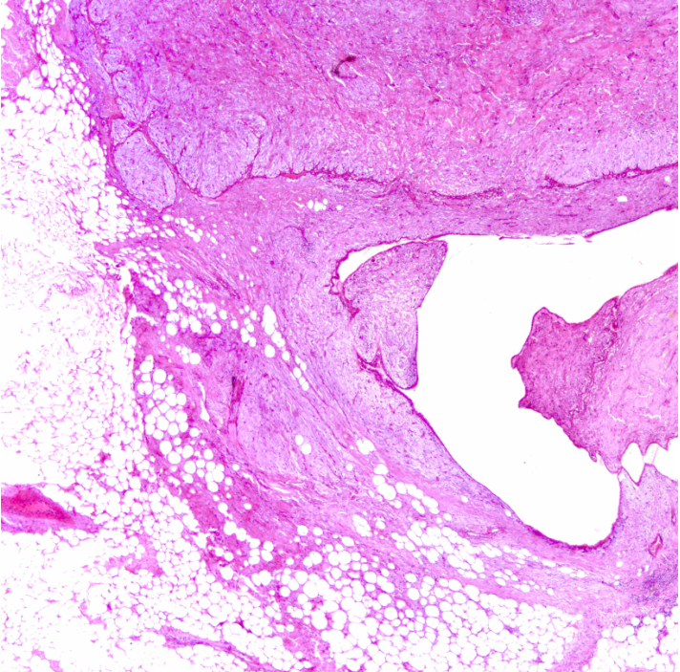
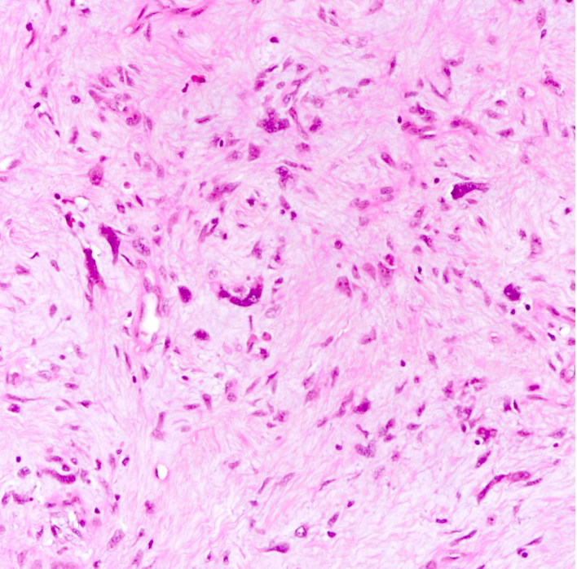

Slide 17
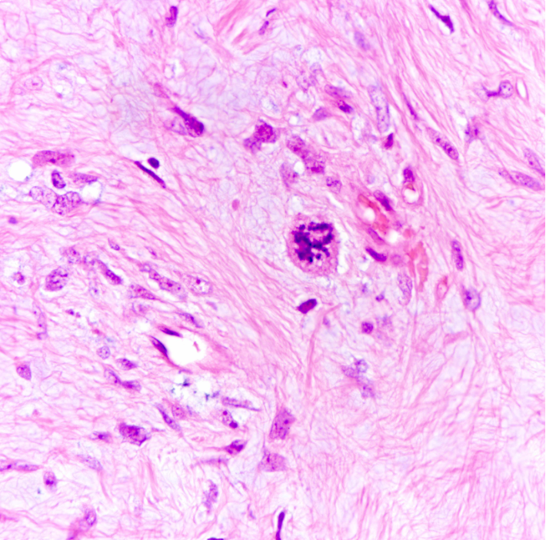

Slide 18
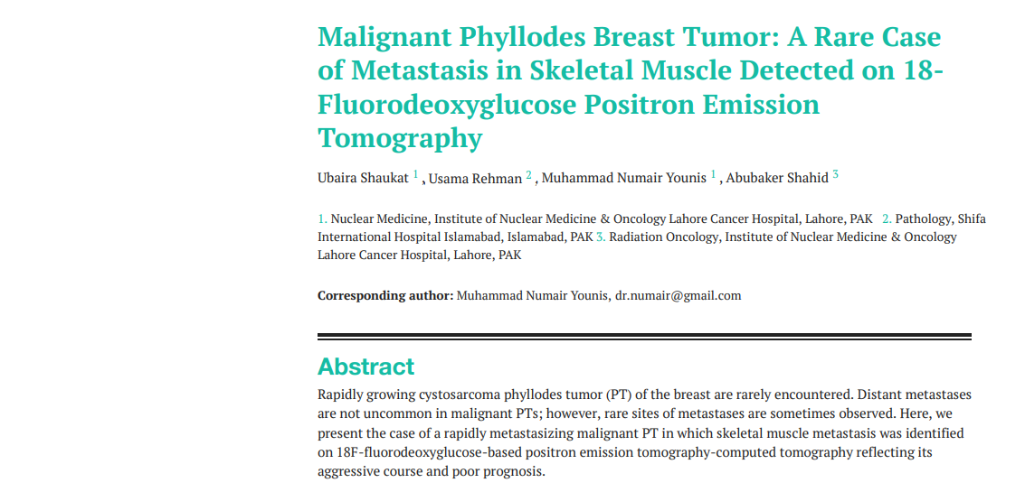

Slide 19
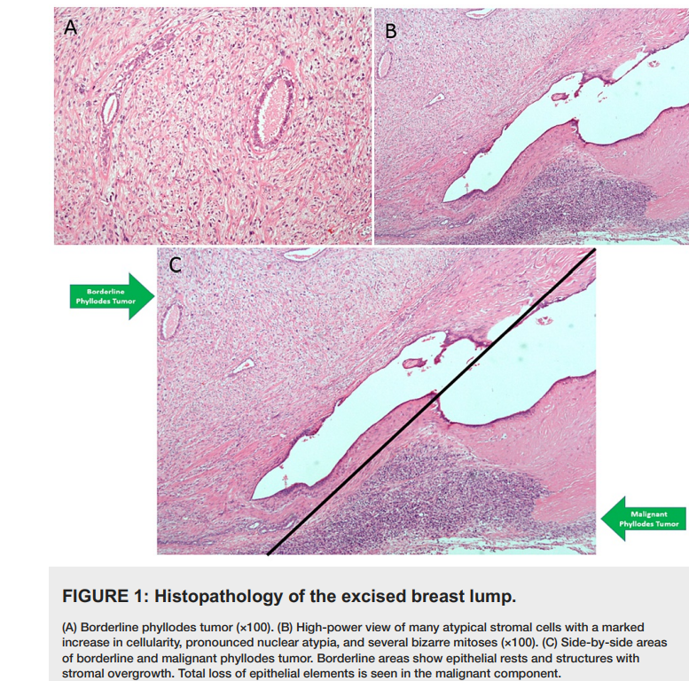

Slide 20
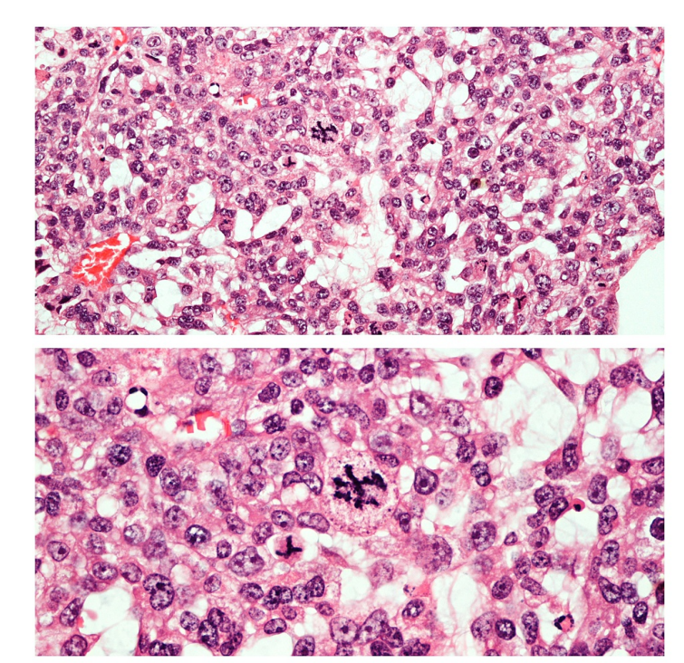

Slide 21
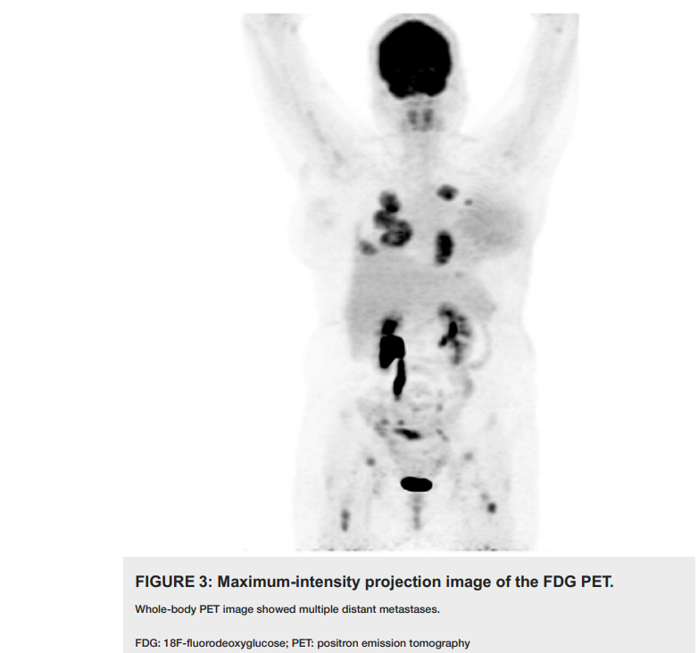

Slide 22
Key Features
Rare tumor
Histopathological Grading
Differential Diagnosis
Clinical Implications

Slide 23


