Slide 1
CLINICOPATHOLOGIC CONFERENCE (CPC)
MEDICAL UNIT-1
28-2-2025

Slide 2
RIGHT SIDED
HEART FAILURE
SADIA ANUM
ANAM NADEEM

Slide 3
HISTORY
BIODATA
Name Sajida
Age 55 years
Gender female
Residency basti Rahim yar khan
DOA 24-2-2025
MOA emergency
Informant Daughter

Slide 4
PRESENTING COMPLAINT
Shortness of Breath (4-5 days)
Abdominal Pain (3-4 days)

Slide 5
HISTORY OF PRESENTING ILLNESS
My patient was in usual state of health 4-5 days ago when she developed shortness of breath and pain in abdomen
PAIN ABDOMEN
Initially was mild in intensity gradually became severe
No radiation of pain
No shifting of pain
Referred pain to intrascapular region
Aggravated by oral intake
Associated with distension of abdomen

Slide 6
HISTORY OF PRESENTING ILLNESS
Not associated with nausea and vomiting
Character
Relieving Factors
Shortness of Breath(3-4 days)
Gradual in onset
Increases on walking
Associated with orthopnea paroxysmal nocturnal dyspnea

Slide 7
HISTORY OF PRESENTING ILLNESS
There is no known history of Diabetes Mellitus, Hypertension,
Tuberculosis, hepatitis B,C
Positive history of Epilepsy

Slide 8
HISTORY OF PRESENTING ILLNESS
These complaints have NO association with
Dysphagia
Malena
Jaundice
Clay colored stools with dark urine
Pruritis
Dysuria

Slide 9
PAST HISTORY
There is a history of epilepsy since 11 years with on and off medication
No history of previous miscarriages
No hx of previous DVT or lower limb swelling

Slide 10
SYSTEMIC INQUIRY
CVS
History of shortness of breath
No history of edema of feet
History of palpitations
Pain in chest intermittent

Slide 11
SYSTEMIC INQUIRY
Respiratory System
History of dry cough
No sputum
No hemoptysis
No wheezing

Slide 12
SYSTEMIC INQUIRY
GIT SYSTEM
Abdominal pain
Distension
No history pf constipation
No history of diarrhea
No Hx of Malena
Heartburn sometimes

Slide 13
SYSTEMIC INQUIRY
Urinary System
No history of
Dysuria
Pain in flanks
Hematuria
Polyuria
Oliguria
nocturia

Slide 14
SYSTEMIC INQUIRY
CNS
No history of
Weakness
Numbness
Tingling sensation
Headache
Visual loss
Diplopia

Slide 15
SYSTEMIC INQUIRY
Locomoter System
No history of
Joint pain
Stiffness
Swelling
Restriction of movement

Slide 16
SYSTEMIC INQUIRY
Endocrine System
No history of polyuria
Polyphagia
Polydipsia
Heat or cold intolerance
Sweating
Weight gain
Mild weight loss present

Slide 17
SYSTEMIC INQUIRY
Menstrual History
Post menopausal since 2006

Slide 18
PAST SURGICAL HISTORY
History of tonsillectomy in childhood

Slide 19
FAMILY HISTORY
Patients father has diabetes mellitus
No family history of hypertension
Ischemic heart disease
Tuberculosis
Any inherited disorders, e.g thalassemia, hemophilia

Slide 20
SOCIOECONOMIC HISTORY
Lives in rural area
Lives in cemented house with 4 rooms, and 5 family members
Use tap water
Family income is around 20,000

Slide 21
PERSONAL HISTORY
History of apetite loss since illness
Loss of sleep
Weight loss undocumented

Slide 22
EXAMINATION

Slide 23
GENERAL PHYSICAL EXAMINATION
General look : Ill looking, middle aged female of normal built and height fully conscious laying in bed comfortably in bed with IV cannula attached on left hand.
Vitals Bp110 /90 mm hg
pulse 118 beats per minute and irregularly irregular
respiratory rate 28 per minute
temperature 98 F

Slide 24
Hands: pallor positive, koilonychia, leukonychia negative ,no wasting and erythema
Face and neck : eyes (jaundice positive and pallor conjuctiva)
neck veins were engorged , JVP is positive ,no palpable nodes
Feet : no pedal edema

Slide 25
SYSTEMEIC EXAMINATION
CVS
Inspection: visible pulsation at apical area , no visible scar marks ,deformity
Palpation:1. apex beat palpable at 5th intercoastal space lateral to midclavicular line ,ill sustained heave
2.Para sternal heave positive no other palpable sound aur thrill
Auscultation:S1and S2 variable intensity of S2
Loud P2 no S3 or S4
PANSYSTOLIC MURMUR OF GRADE 3 AT TRICUSPID AREA ACCENTUATED WITH INSPIRATION
NO PARDIAL RUB

Slide 26
Abdominal EXamination
Abdomen was distended umbilicus was central abdomen moving with respiration
No stria scar marks or visible pulsation
Abdomen was soft and non tender
Liver was palpable 4.5 cm below the right coastal margin, upper border percussed in 5th intercostal space total span of liver is 11.5cm edge is firm in consistency and smooth surface and liver is non tender
No other viscera palpable
Hernial orifices were intact percussion node was dull all over the abdomen
Auscultation normal bowel sounds were heard and no there was no brui

Slide 27
Respiratory system
Respiration was thoracoabdominal
No scar marks visible pulsation or any deformity
Trachea was central
Normal chest expansion and vocal fremitus was also normal
Percussion node was resonant and equal bilaterally
On Auscultation normal vesicular breathing with crackels in left basal area

Slide 28
CNS
Patient seemed to be conscious
GCS was 15 by 15
Speech was normal
Cranial nerves were intact
Sensory and motor systems were intact
No cerebellar signs

Slide 29
Genitourinary system
No significant findings

Slide 30
INVESTIGATIONS

Slide 31
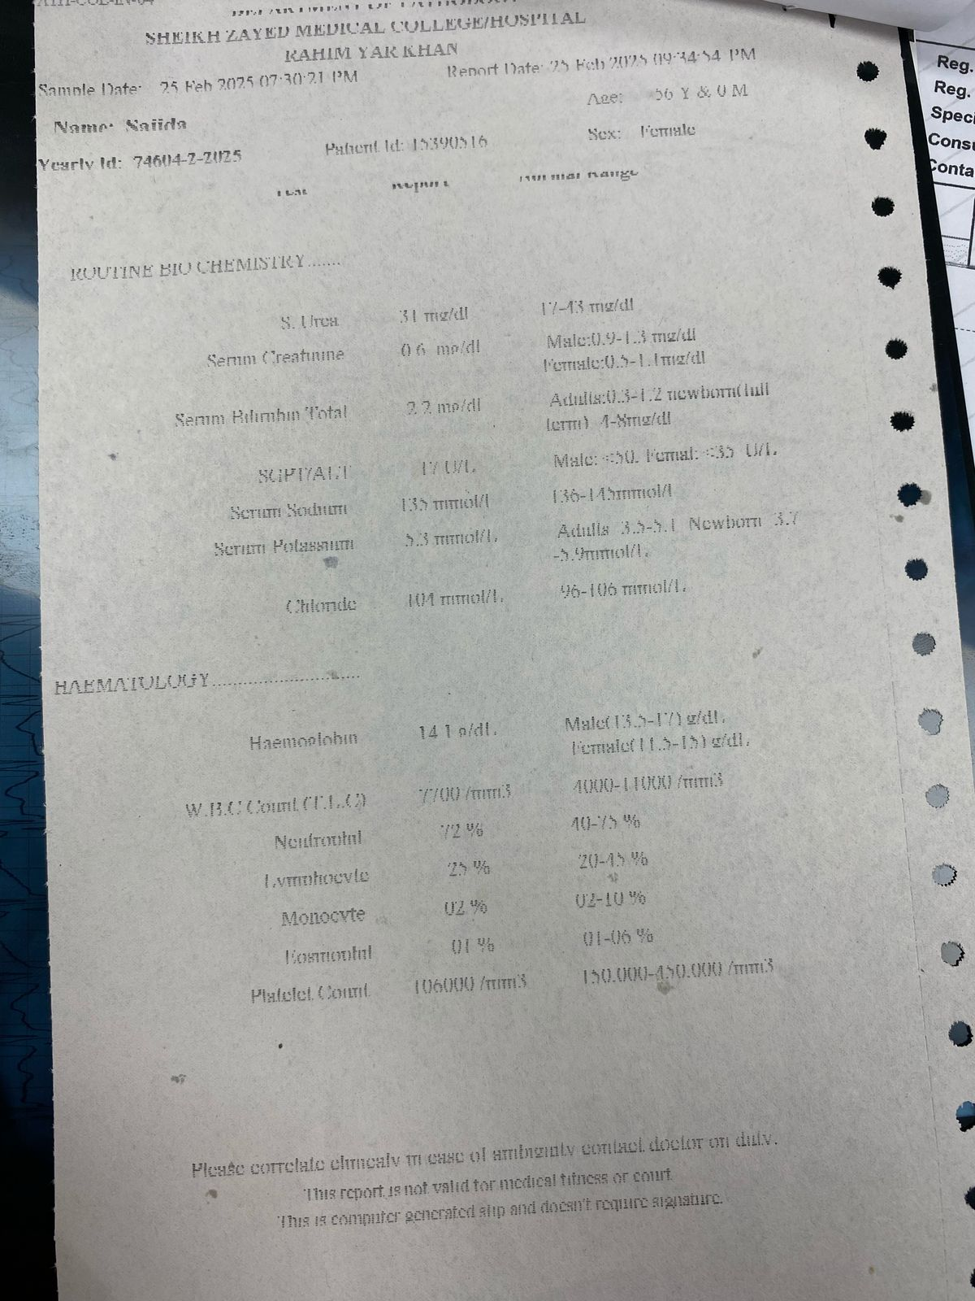
LAB INVESTIGATIONS

Slide 32
ROUTINE BIOCHEMISTRY
ROUTINE BIOCHEMISTRY
S. Urea 31 mg/dl
S. Creatinine 0.6mg
S. Bilirubin Total 2.2 mg/dl
SGPT 17 U/L
Serum Sodium 135 mmol/L
Serum Potassium 5.3 mmol/L
Chloride 104 mmol/L

Slide 33
HEMATOLOGY
Hemoglobin 14.1 g/dl
WBC Count (TLC) 7700/mm3
Neutrophills 72%
Lymphocytes 25%
Monocytes 02%
Eosinophil 1%
Platelet count 106000/mm3
PT 20seconds
INR 1.0

Slide 34
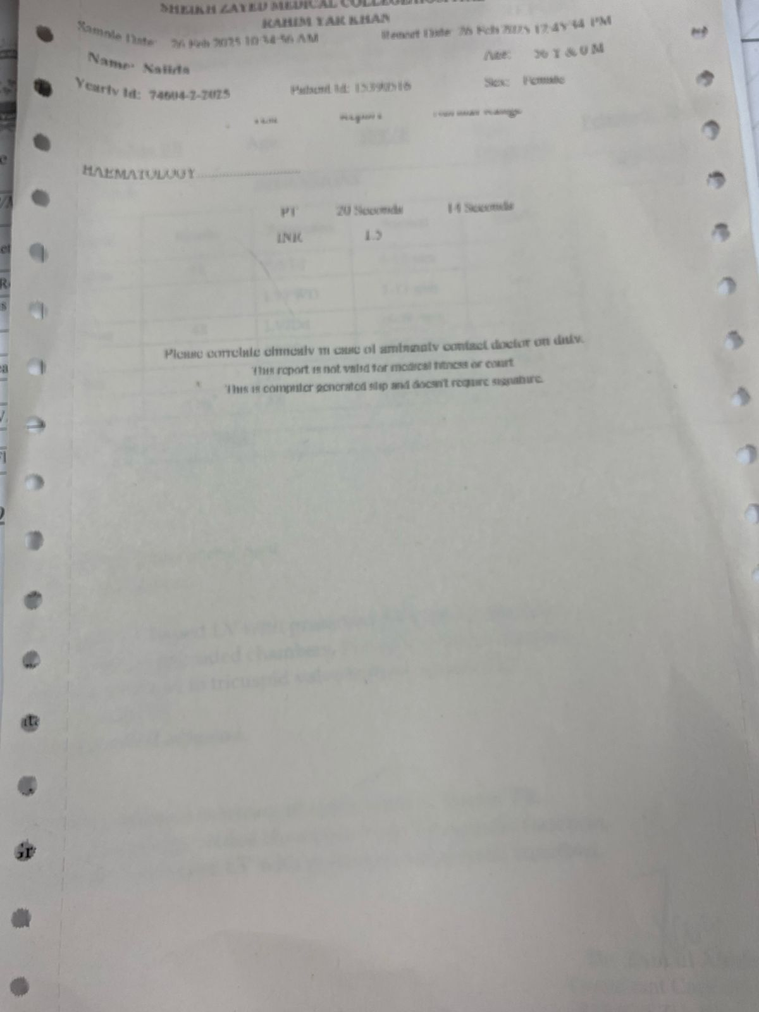
LAB INVESTIGATIONS

Slide 36
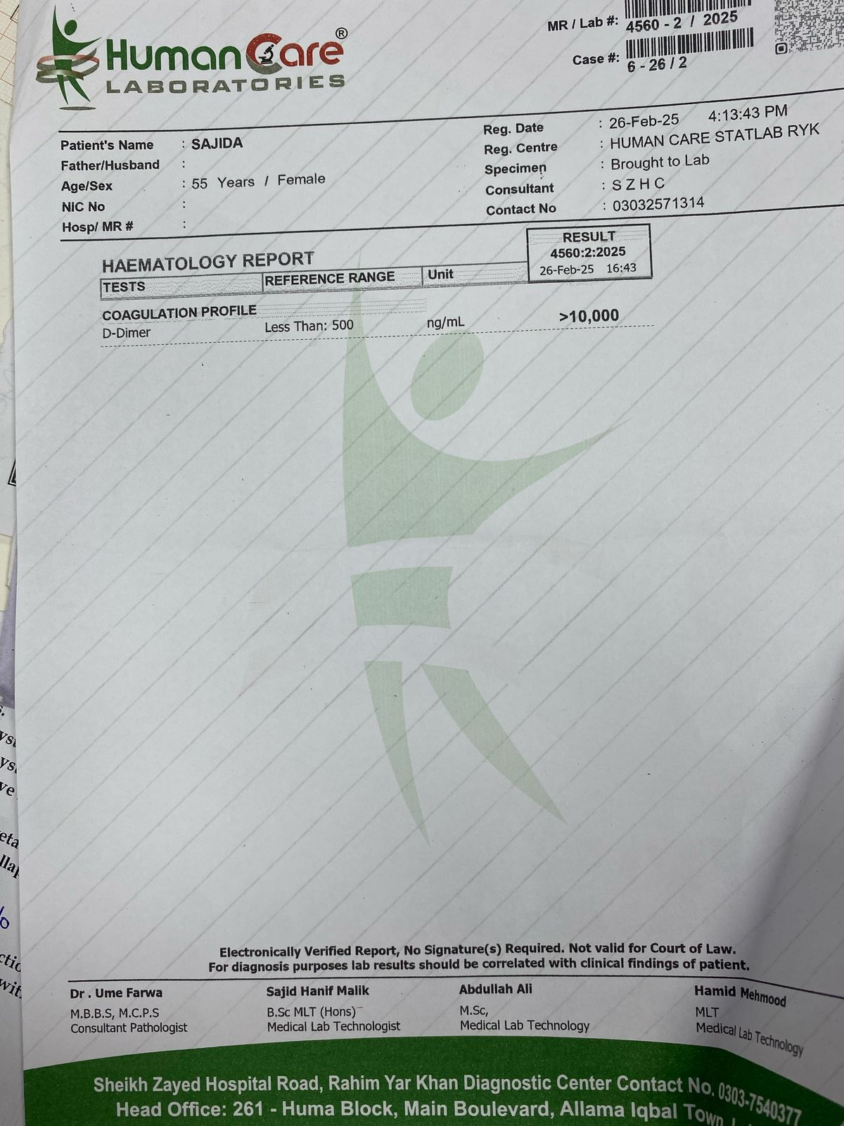
LAB INVESTIGATIONS

Slide 37
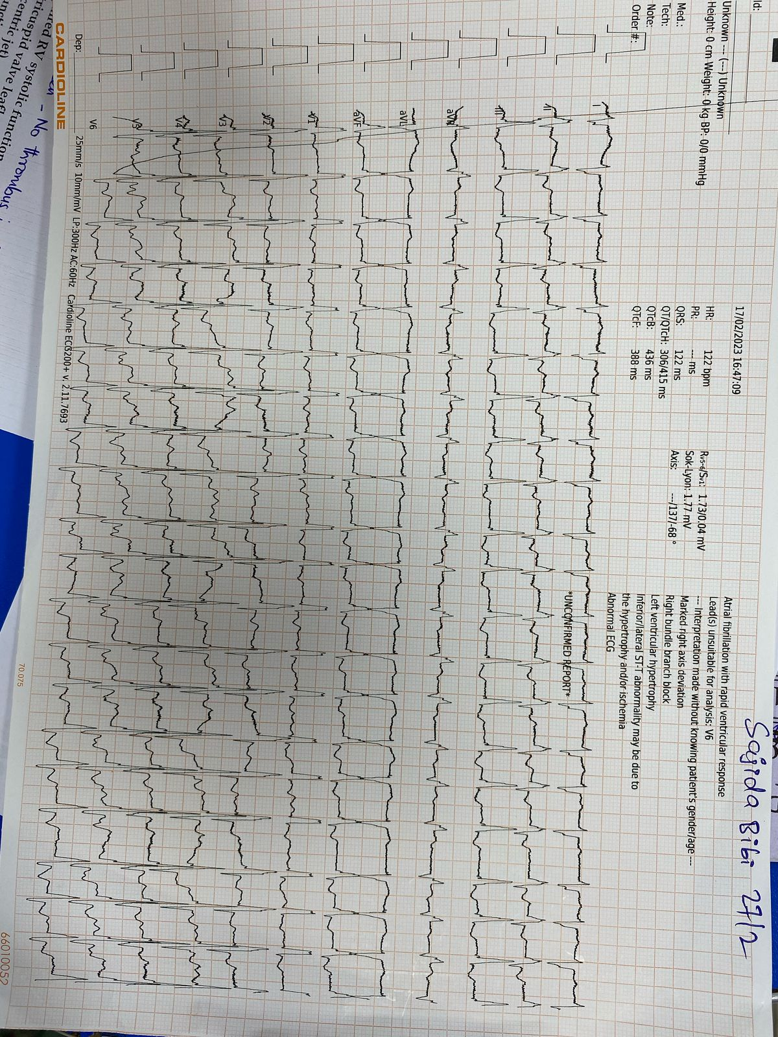
ELECTROCARDIOGRAPHY

Slide 38
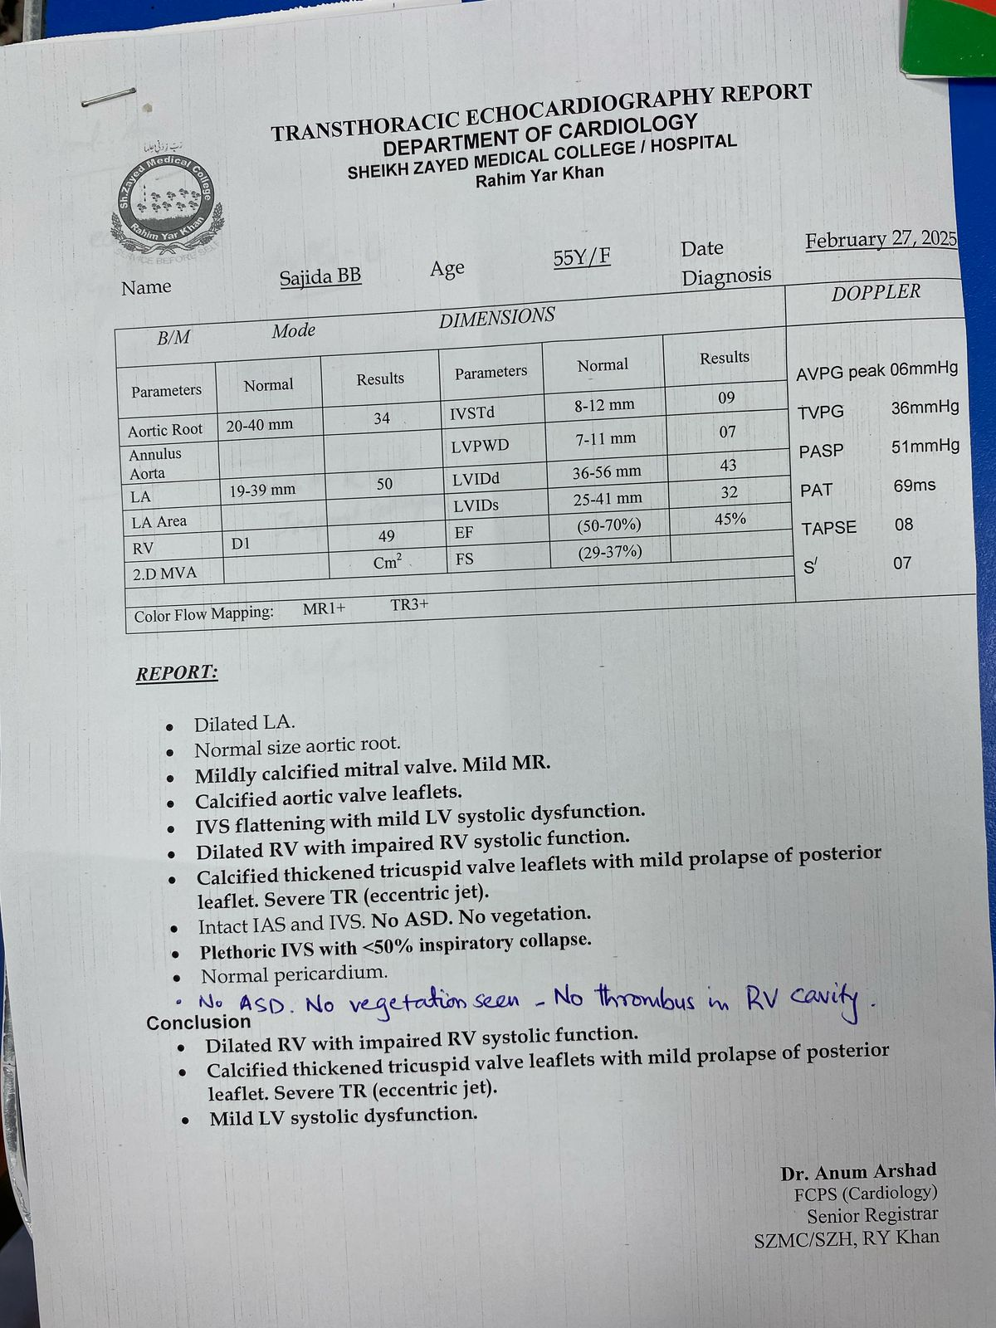
ECHOCARDIOGRAPHY

Slide 39
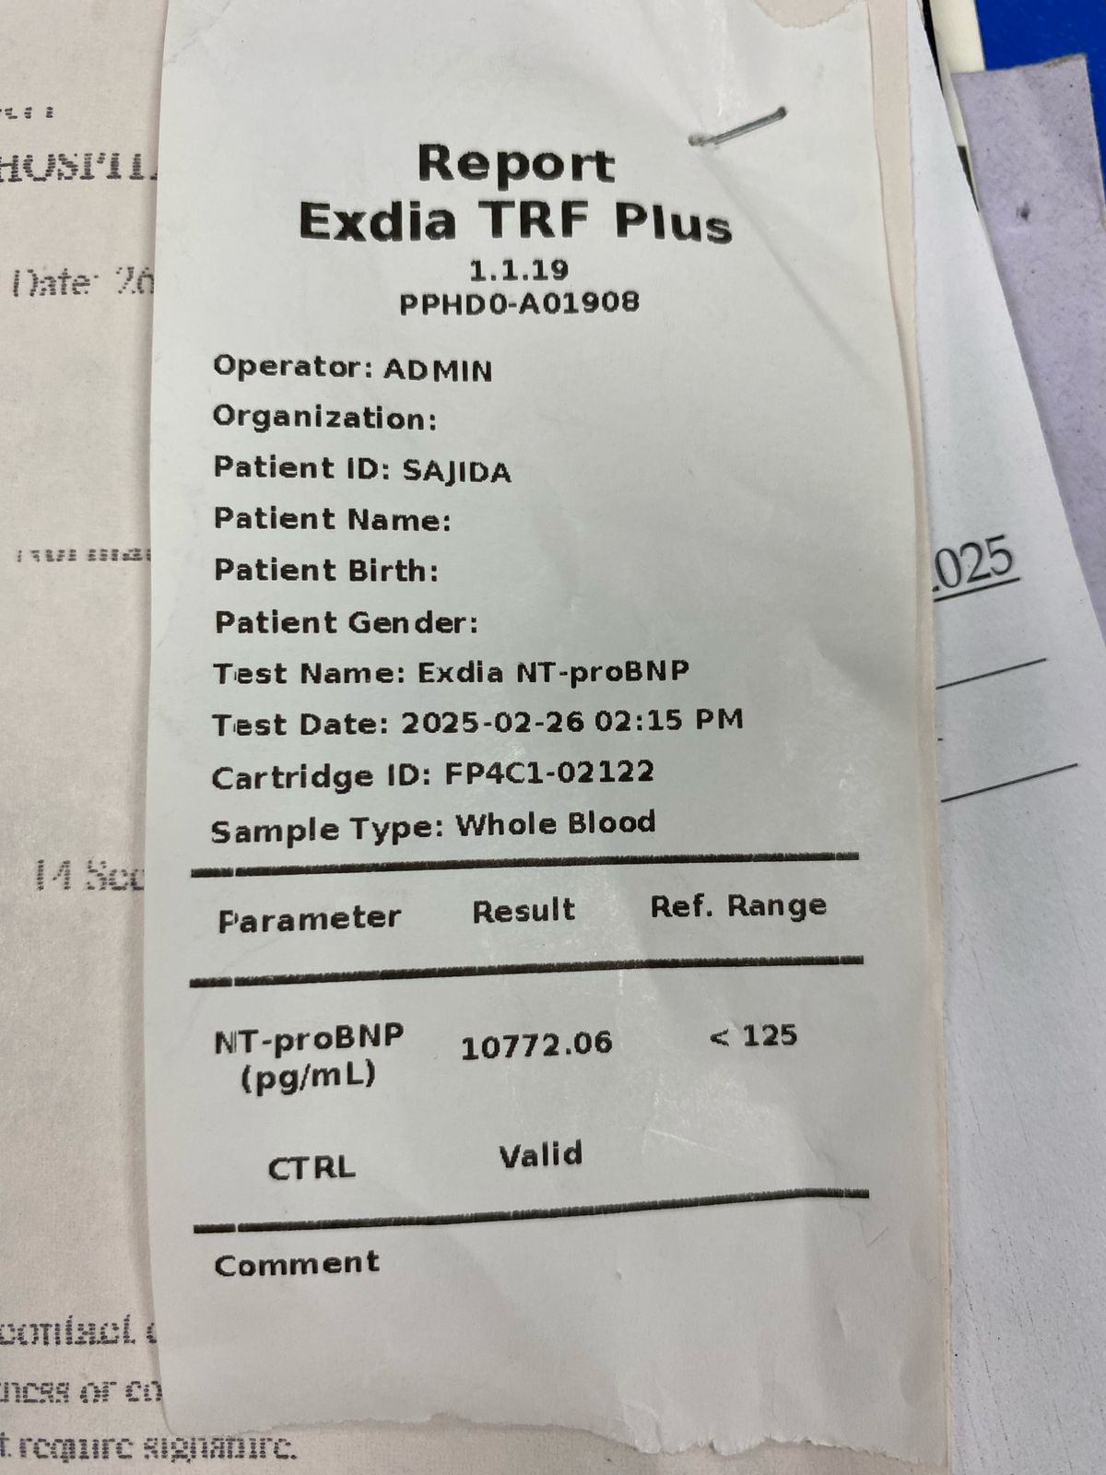
Exdia TRF Plus

