Slide 1
CLINICOPATHOLOGICAL
CONFERENCE
GYNAE UNIT I
AHSAN AMEER (Final Yr) Z17
NISHA RIAZ (Final Yr) Z17
DR.RUMSHA SHAFI (FCPS Trainee)

Slide 2
HISTORY
BIODATA:
Patient name Rukhsana wife of Sajjad, 30 years of age, housewife with no formal education, muslim, resident of Chak Abbas RYK, presented to us in ER on 06-03-2023.

Slide 3
Married for 7 years
P4A0, previous all SVDs, alive and healthy.
LCB: 7 months back
Presented with complaint of:
Continuous PV bleeding 5 months.
Vulval mass noticed 15days

Slide 4
HISTORY OF PRESENTING ILLNESS:
Mrs. Rukhsana had an uneventful SVD at term at periphery 7 months back.
She remained alright for 2 months. Then she started having PV bleeding.
She used to soak 2-3 pads per day with no passage of clots or vesicles.
History of SOB, on mild exertion, palpitations and easy fatigability ,no hx of coughand fever orthopnea or PND.

Slide 5
History of mild lower abdominal pain, anorexia ,weight loss and insomnia for 3 months.
History of vulval growth for last 15 days associated with foul smelling vaginal discharge and low grade fever.

Slide 6
No hx of heat or cold intolerance.
No hx of bruises,epistaxis,gum bleed or per rectal bleed.
No hx of bone pain, chest pain, blurring of vision, headache or haemoptysis.

Slide 7
Patient had evacuations in Private hospitals several times and multiple
blood transfusions were done.
Sample was never sent for histopathology.
With worsening symptoms she presented to us in Labour room, then she is admitted in Gynae Unit 1 for last 28 days.

Slide 8
During her stay, She had 2 episodes of generalized tonic clonic fits.
Her dyspnoea is gradually worsening.

Slide 9
Haematological & Radiological investigations were done. Along with beta-hCG.
She was transfused 6 units of packed cell volume of blood.
Vulval growth biopsy and endometrial Biopsy were taken and sent for histopathology.
Her histopathology reports were followed & she has been put on injectable therapy for last 2 weeks

Slide 10
PAST OBSTETRIC HISTORY:
She is P4, all SVDs, 2 males and 2 females and all her pregnancies were unbooked .There is no hx of Ante-partum ,Intra-partum or Post-partum complications.
All her babies were breastfed and Vaccinated.

Slide 11
PAST GYNAECOLOGICAL HISTORY:
Her Age of menarche is 13 years.
She had a regular menstrual cycle of 5/28 days with no history of dysmenorrhoea, dyspareunia, IMB or PCB.
No history of Contraception or PAP smear.

Slide 12
PAST MEDICAL HISTORY:
No History of Diabetes, Hypertension, TB, Asthma, Malaria.
PAST SURGICAL HISTORY:
Multiple uterine evacuations were done in the recent past

Slide 13
PERSONAL HISTORY:
Normal Bowel and Urinary Habits.
No History of Drug Allergy or addiction.
FAMILY HISTORY:
No history of DM,HTN,IHD.
No family history of Breast, Endometrial, Ovarian or Colorectal carcinoma

Slide 14
SOCIOECONOMIC HISTORY:
She belongs to a lower middle class.
She lives in a non-cemented house of 3 rooms with 6 people with one earning hand. They use tap water. Sanitary conditions are not satisfactory.

Slide 15
EXAMINATION
GENERAL PHYSICAL EXAMINATION
A thin lean young lady,anxious and pale looking ,lying in bed with branula on left hand.
Patient is conscious well oriented in time place & person.

Slide 16
Pallor ++
No jaundice,cyanosis,clubbing, koilonychia, leukonychia, palmar erythema or pedal edema.
Thyroid is not enlarged.
Rt. sided inguinal lymph nodes are palpable.
Her BMI 17 kg/m2

Slide 17
VITALS:
B.P. 100/70 mm of Hg
Pulse: 102 beats/ min
TEMP.: 98F
Resp. Rate: 18 bpm

Slide 18
SYSTEMIC EXAMINATION
CNS -----intact , GCS 15/15, Reflexes, Gait & Speech are Normal
No fasciculation/tremor of focal deficits.
CVS-----S1+ S2+ 0
CHEST---- NVB + bilateral decreased air entry at lung bases.

Slide 19
PER-ABDOMINAL EXAMINATION:
ON INSPECTION---Abdomen distended with central umbilicus.
No prominent veins ,pulsations ,scar marks,or striae.
Hernial orifices are intact.

Slide 20
ON PALPATION:
abdomen is soft with generalized tenderness
14wks size firm mass with irregular margins was felt in the hypogastric region.
Tenderness is present.
Mass is not mobile,lower limit is not reachable,overlying skin is free and temperature is not raised.
No viscero-megaly.

Slide 21
On Auscultation:
No bruit.
Bowel sounds are audible.

Slide 22
On speculum examination:
3×3 cm fungating growth involving clitoris & vulva. Urethral opening not involved.
Vagina : Normal looking
Cervix :normal looking
Foul smelling yellowish discharge.

Slide 23
ON BIMANUAL EXAMINATION:
14 wks size mass with firm consistency uterus not felt separately
fullness in Rt fornix and POD.

Slide 24
DIFFERENTIAL DIAGNOSIS
GTDs
Vulval CA.

Slide 25
INVESTIGATIONS
Blood Group B+ve
Hb 9.7g/dl after 6 units of . . blood transfusions
TLC 8200/mm3
Platelet Count 325000/mm3
Blood Urea 29mg/dl
Serum Creatinine 0.4 mg/dl

Slide 26
LFTS
Serum Billirubin 0.9 mg/dl
SGPT 17U/L
SGOT 16U/L
Sr. Alk.Phosphatase 103 U/L
Sr. Electrolyte within normal range

Slide 27
Viral Markers
Hepatitis B -ve
HBs Ag -ve
HIV -ve

Slide 28
Date Beta hCG
07/03/23 708137 mIU/ mL
22/03/23 2855500 mIU/mL
01/04/23 81800 mIU/mL

Slide 29
ULTRASOUND ABDOMEN & PELVIS:
Bulky uterus with multiple lobulated, mixed echogenic areas covering body of uterus showing aggressive blood flow on doppler study.
B/L hyperstimulated ovaries with enlarged Lft ovary

Slide 30
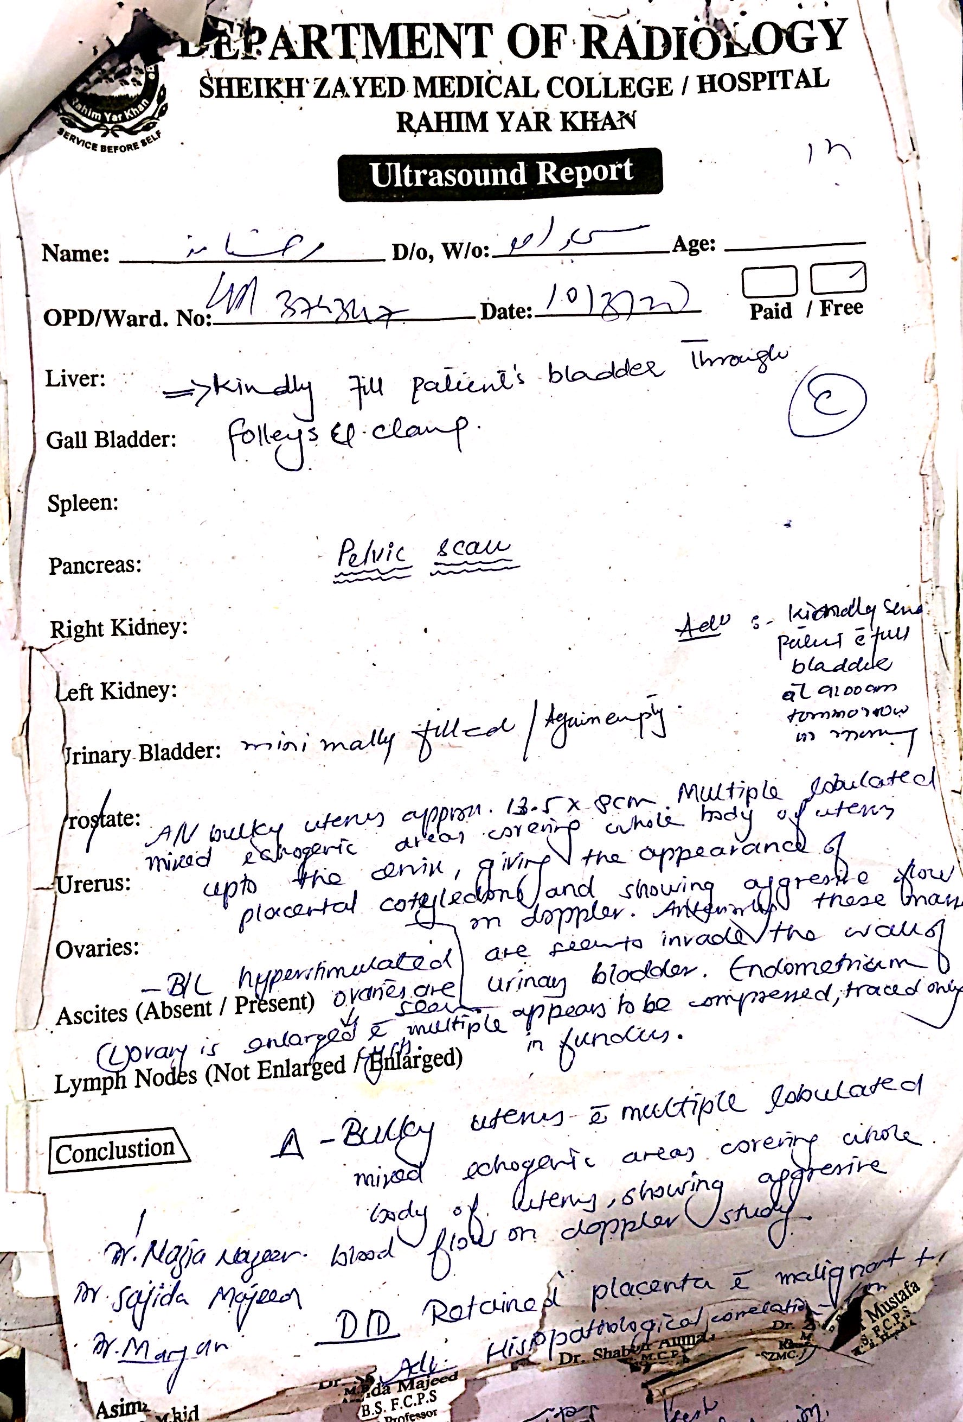

Slide 31
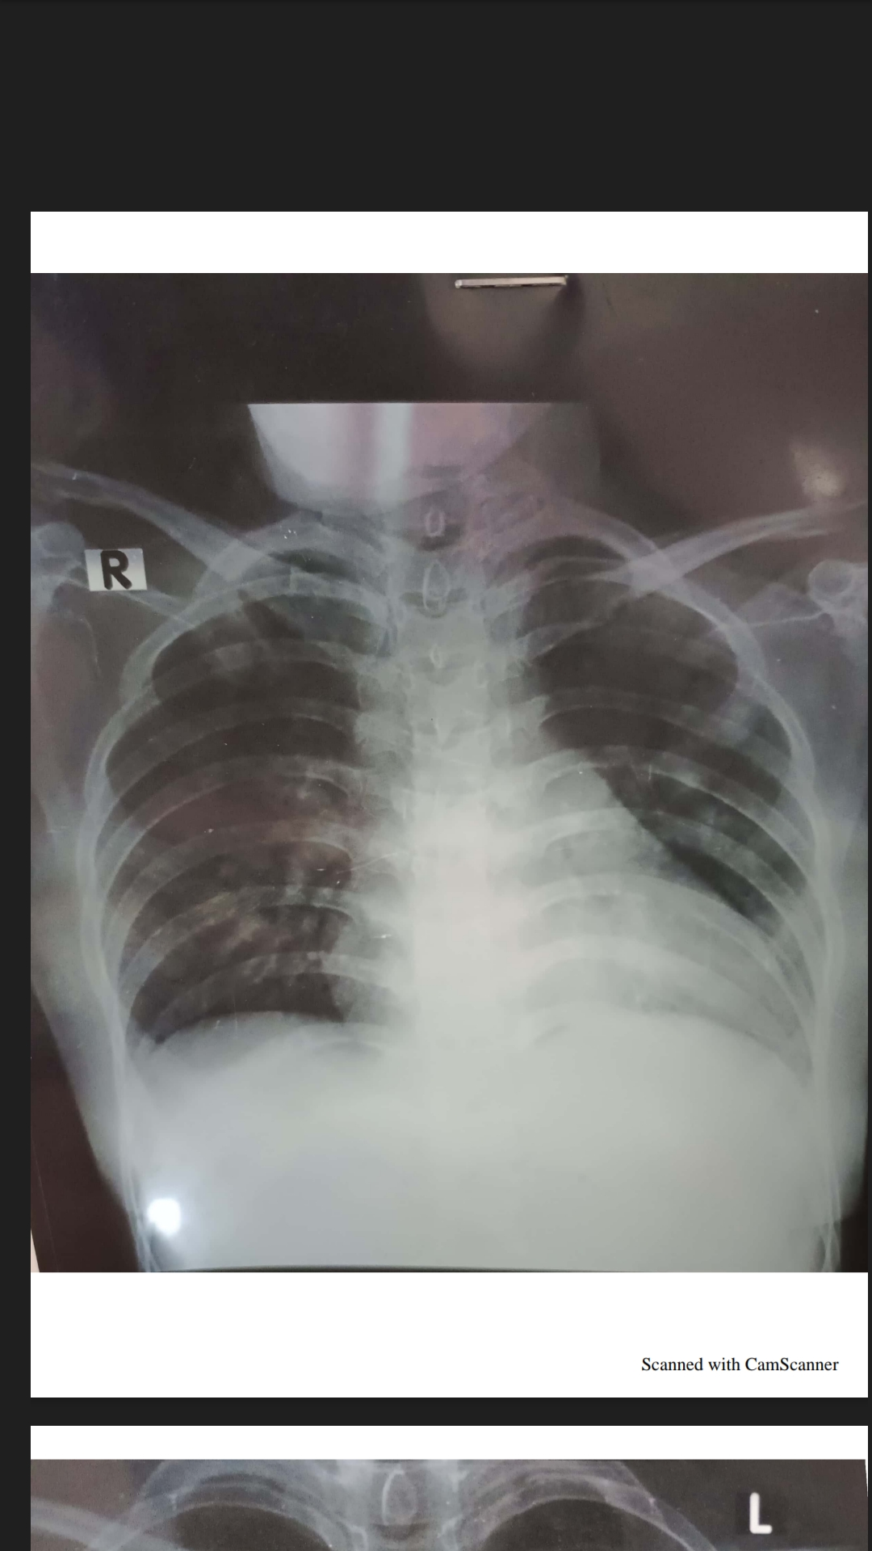
X-RAY CHEST:

Slide 32
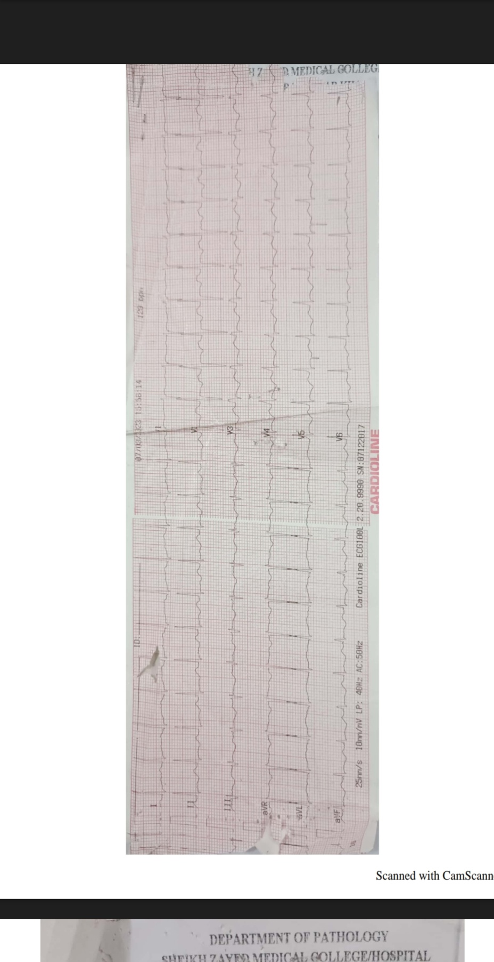
ECG

Slide 33
Echocardiography:
Normal LV size with good LV systolic function.
Normal RV size and systolic function.
EF 60%.
Normal pericardium.

Slide 34
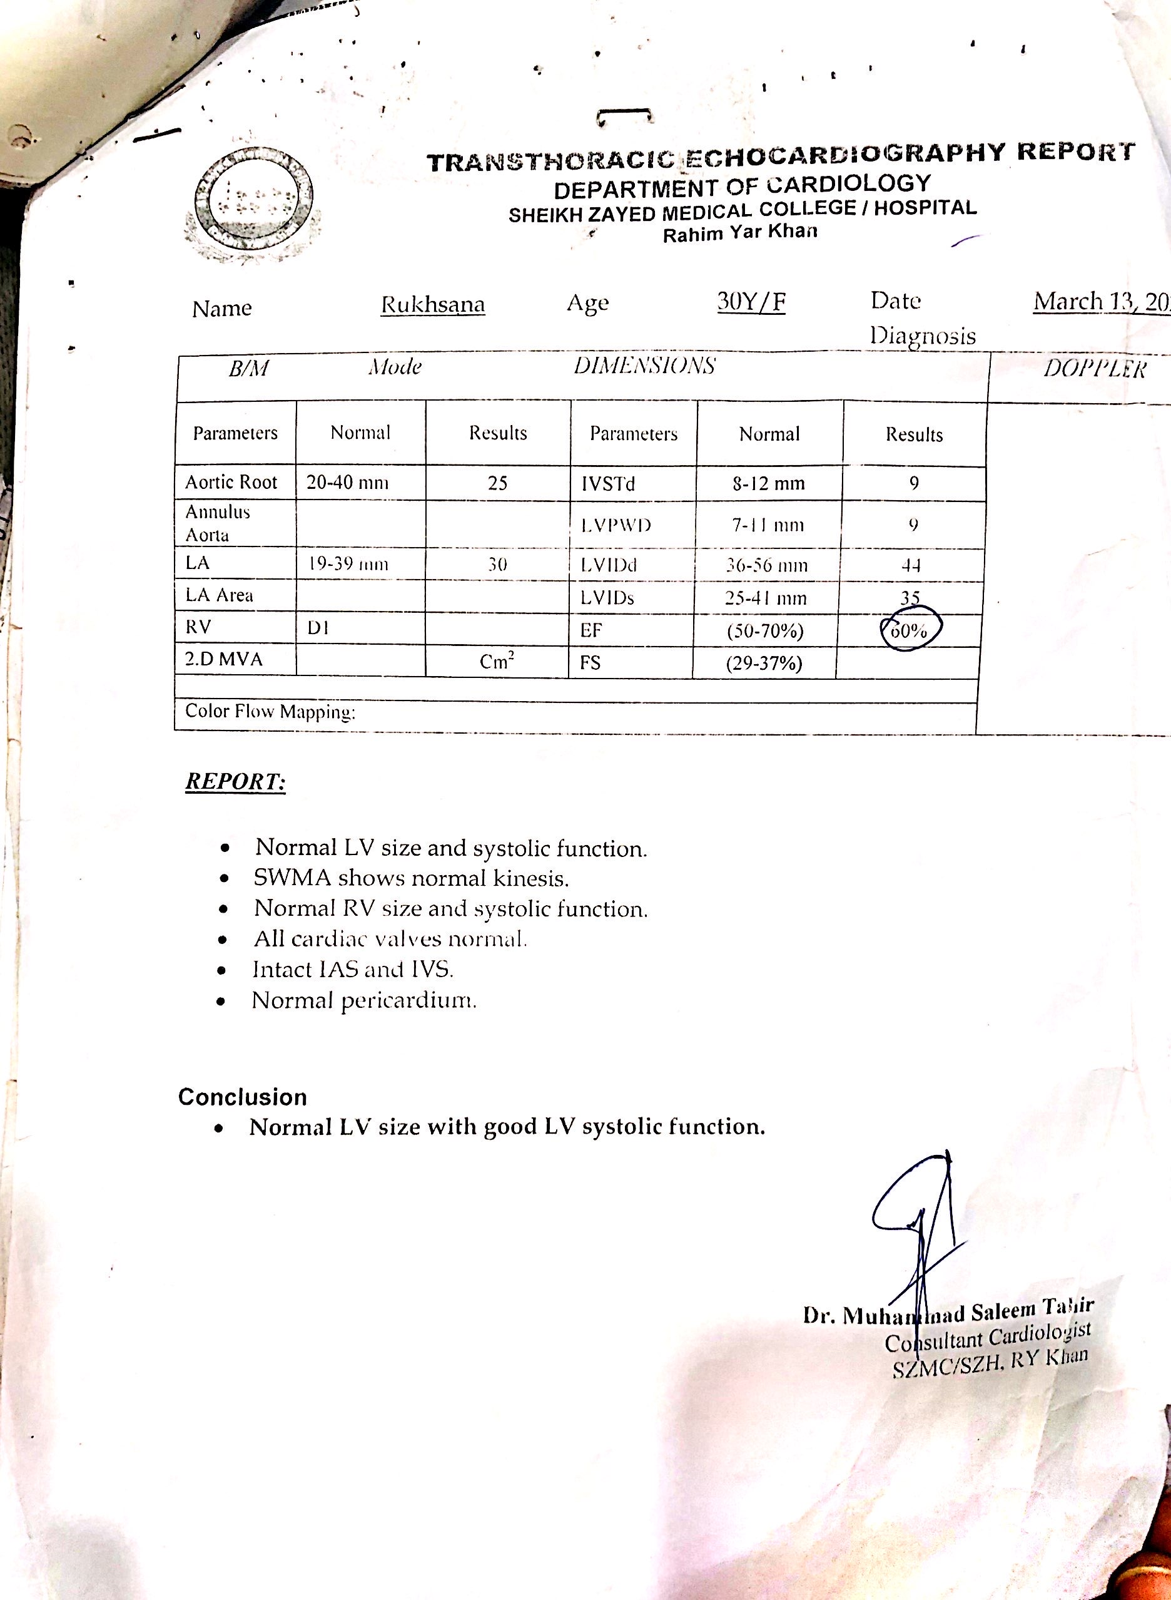

Slide 35
MRI PELVIS WITH CONTRAST:
Bulky uterus with multiple peripheral enhancing masses in endometrium and myometrium.
Pelvic congestion syndrome.
Bilateral inguinal lympadenopathy.

Slide 36
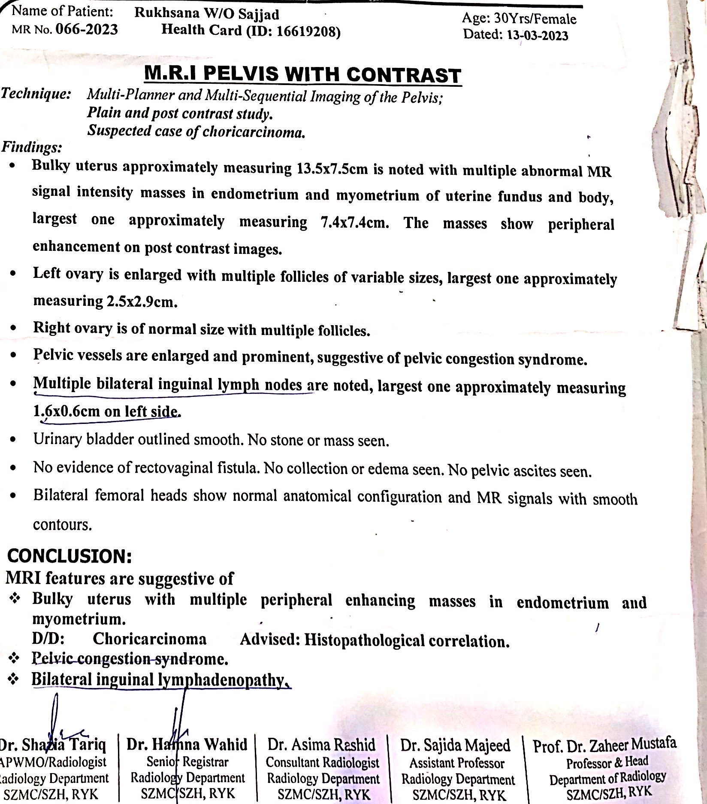

Slide 37
CT SCAN CHEST:
Multiple scattered rounded soft tissue density lesions of variable sizes
in bilateral lungs giving cannon ball appearance, suggestive of metastatic disease.

Slide 38
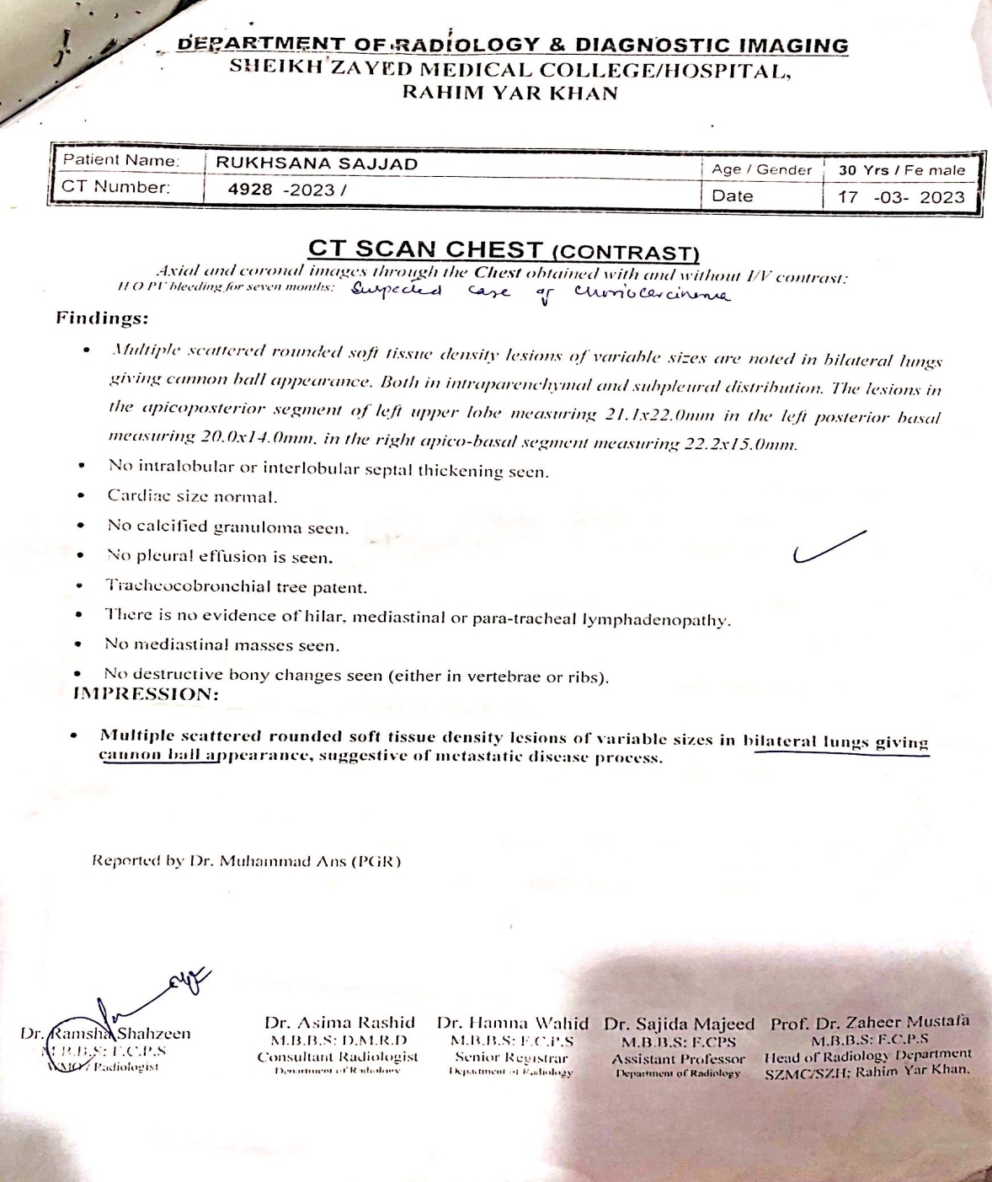

Slide 39
MRI BRAIN WITH CONTRAST:
Thick peripheral rim enhancing rounded lesion in left top parietal region with surrounding complete hemosiderin rim and marked vasogenic perilesional edema and mass effect on the corpus callosum most likely metastatic deposits.

Slide 40
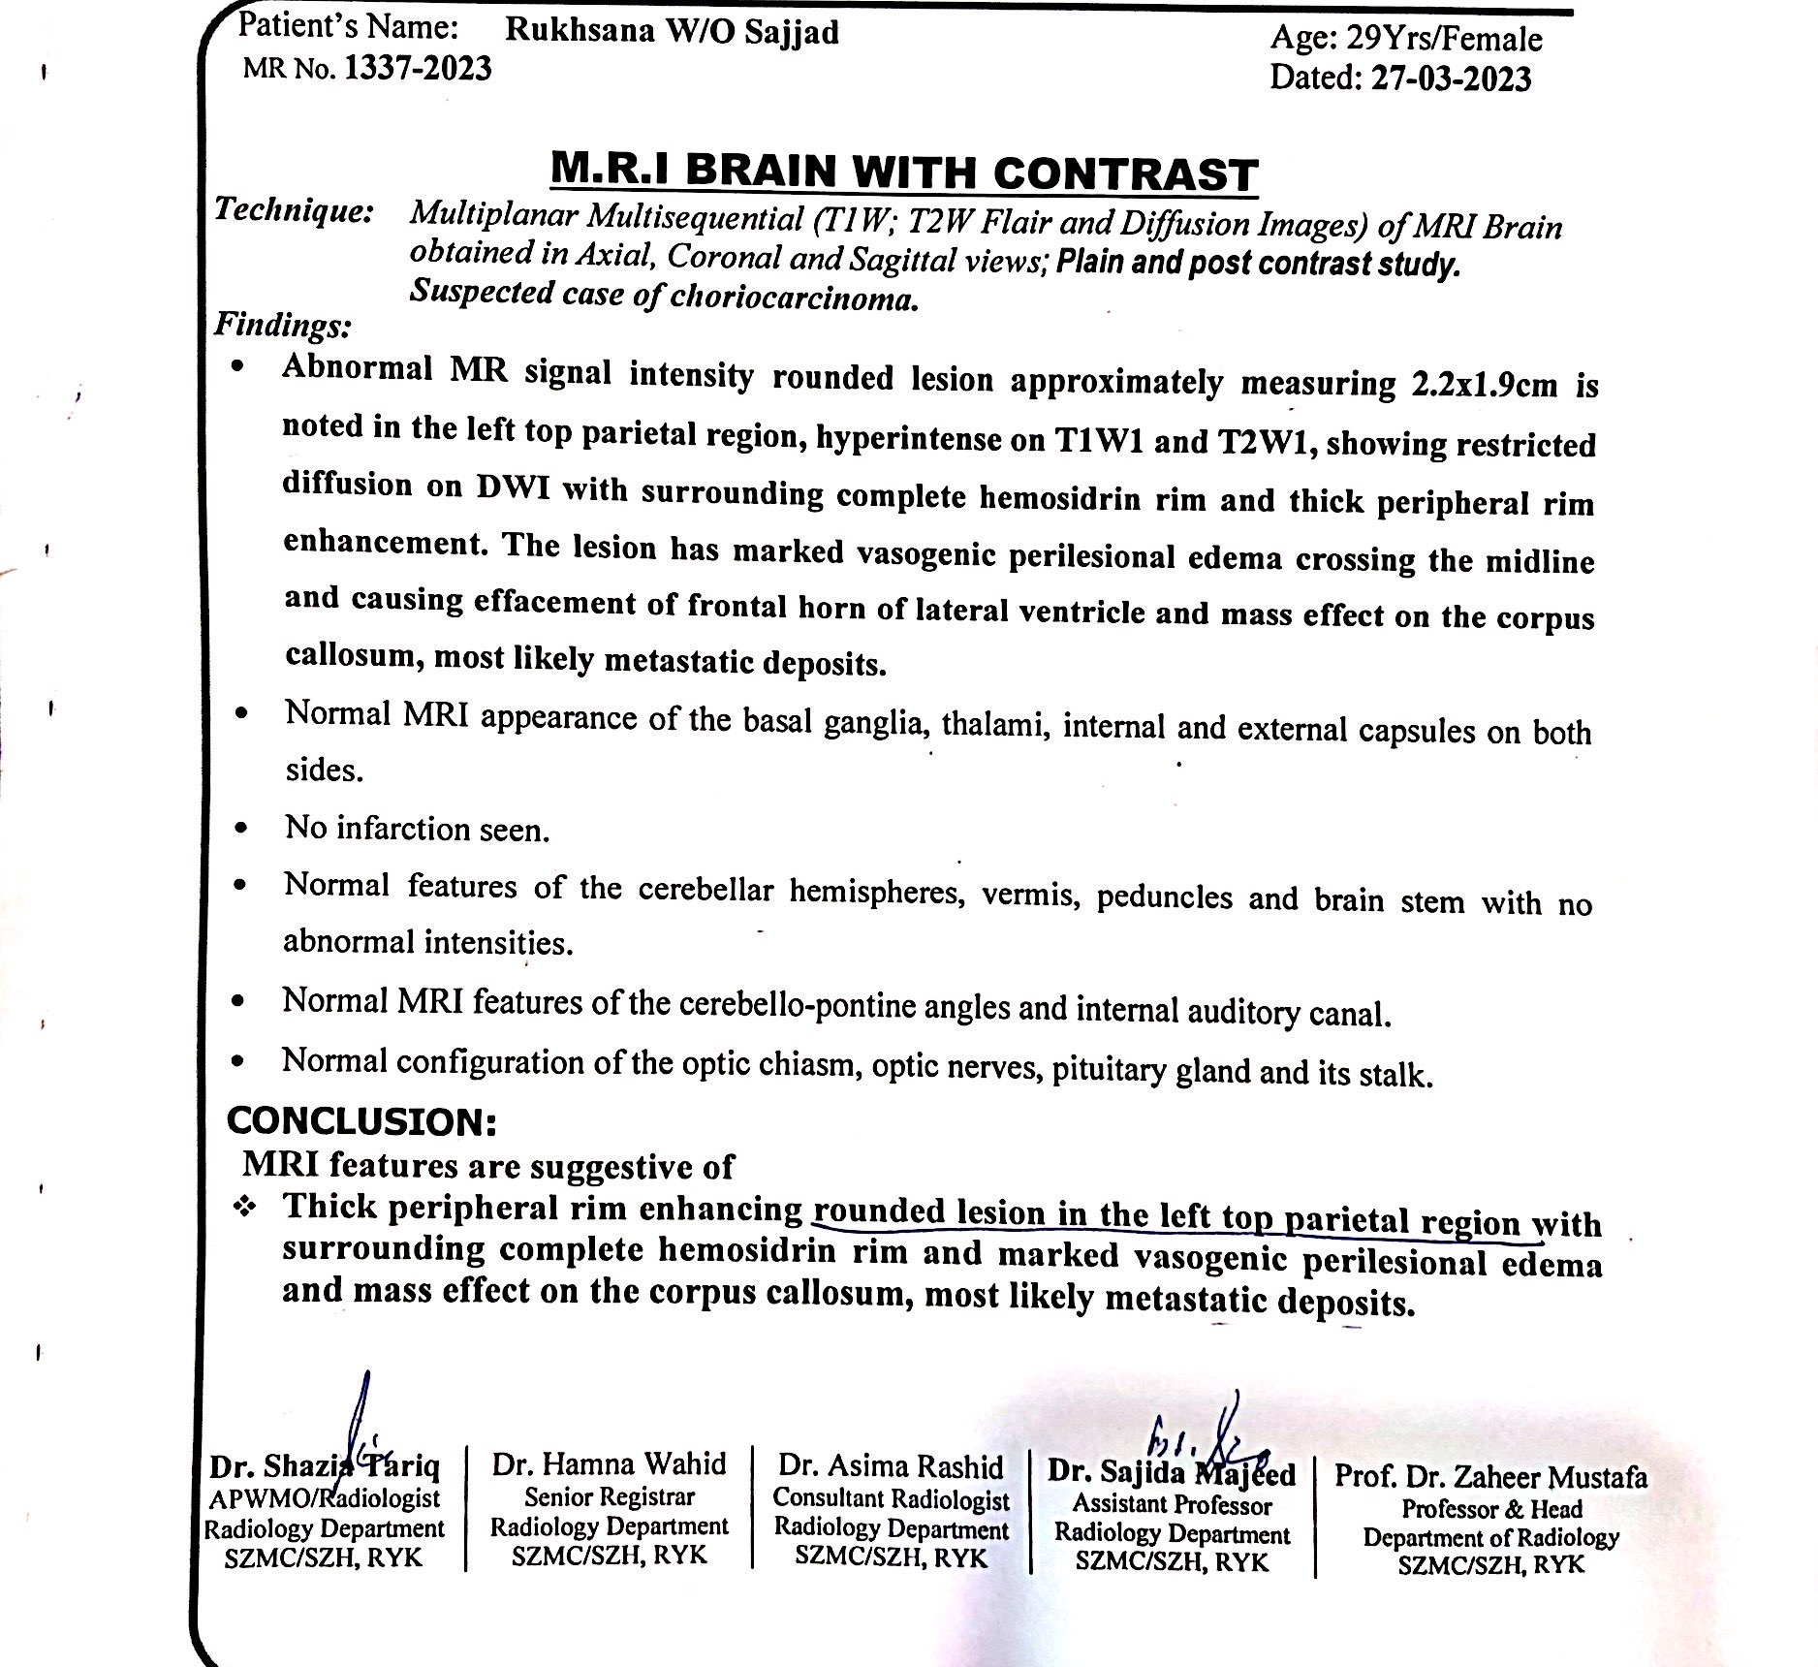

Slide 41
HISTOPATHOLOGY
Vulval growth and endometrial tissue biospy:
Absence of chorionic villi.
Malignant trophoblastic tumor.
Suggestive of Choriocarcinoma.

Slide 42
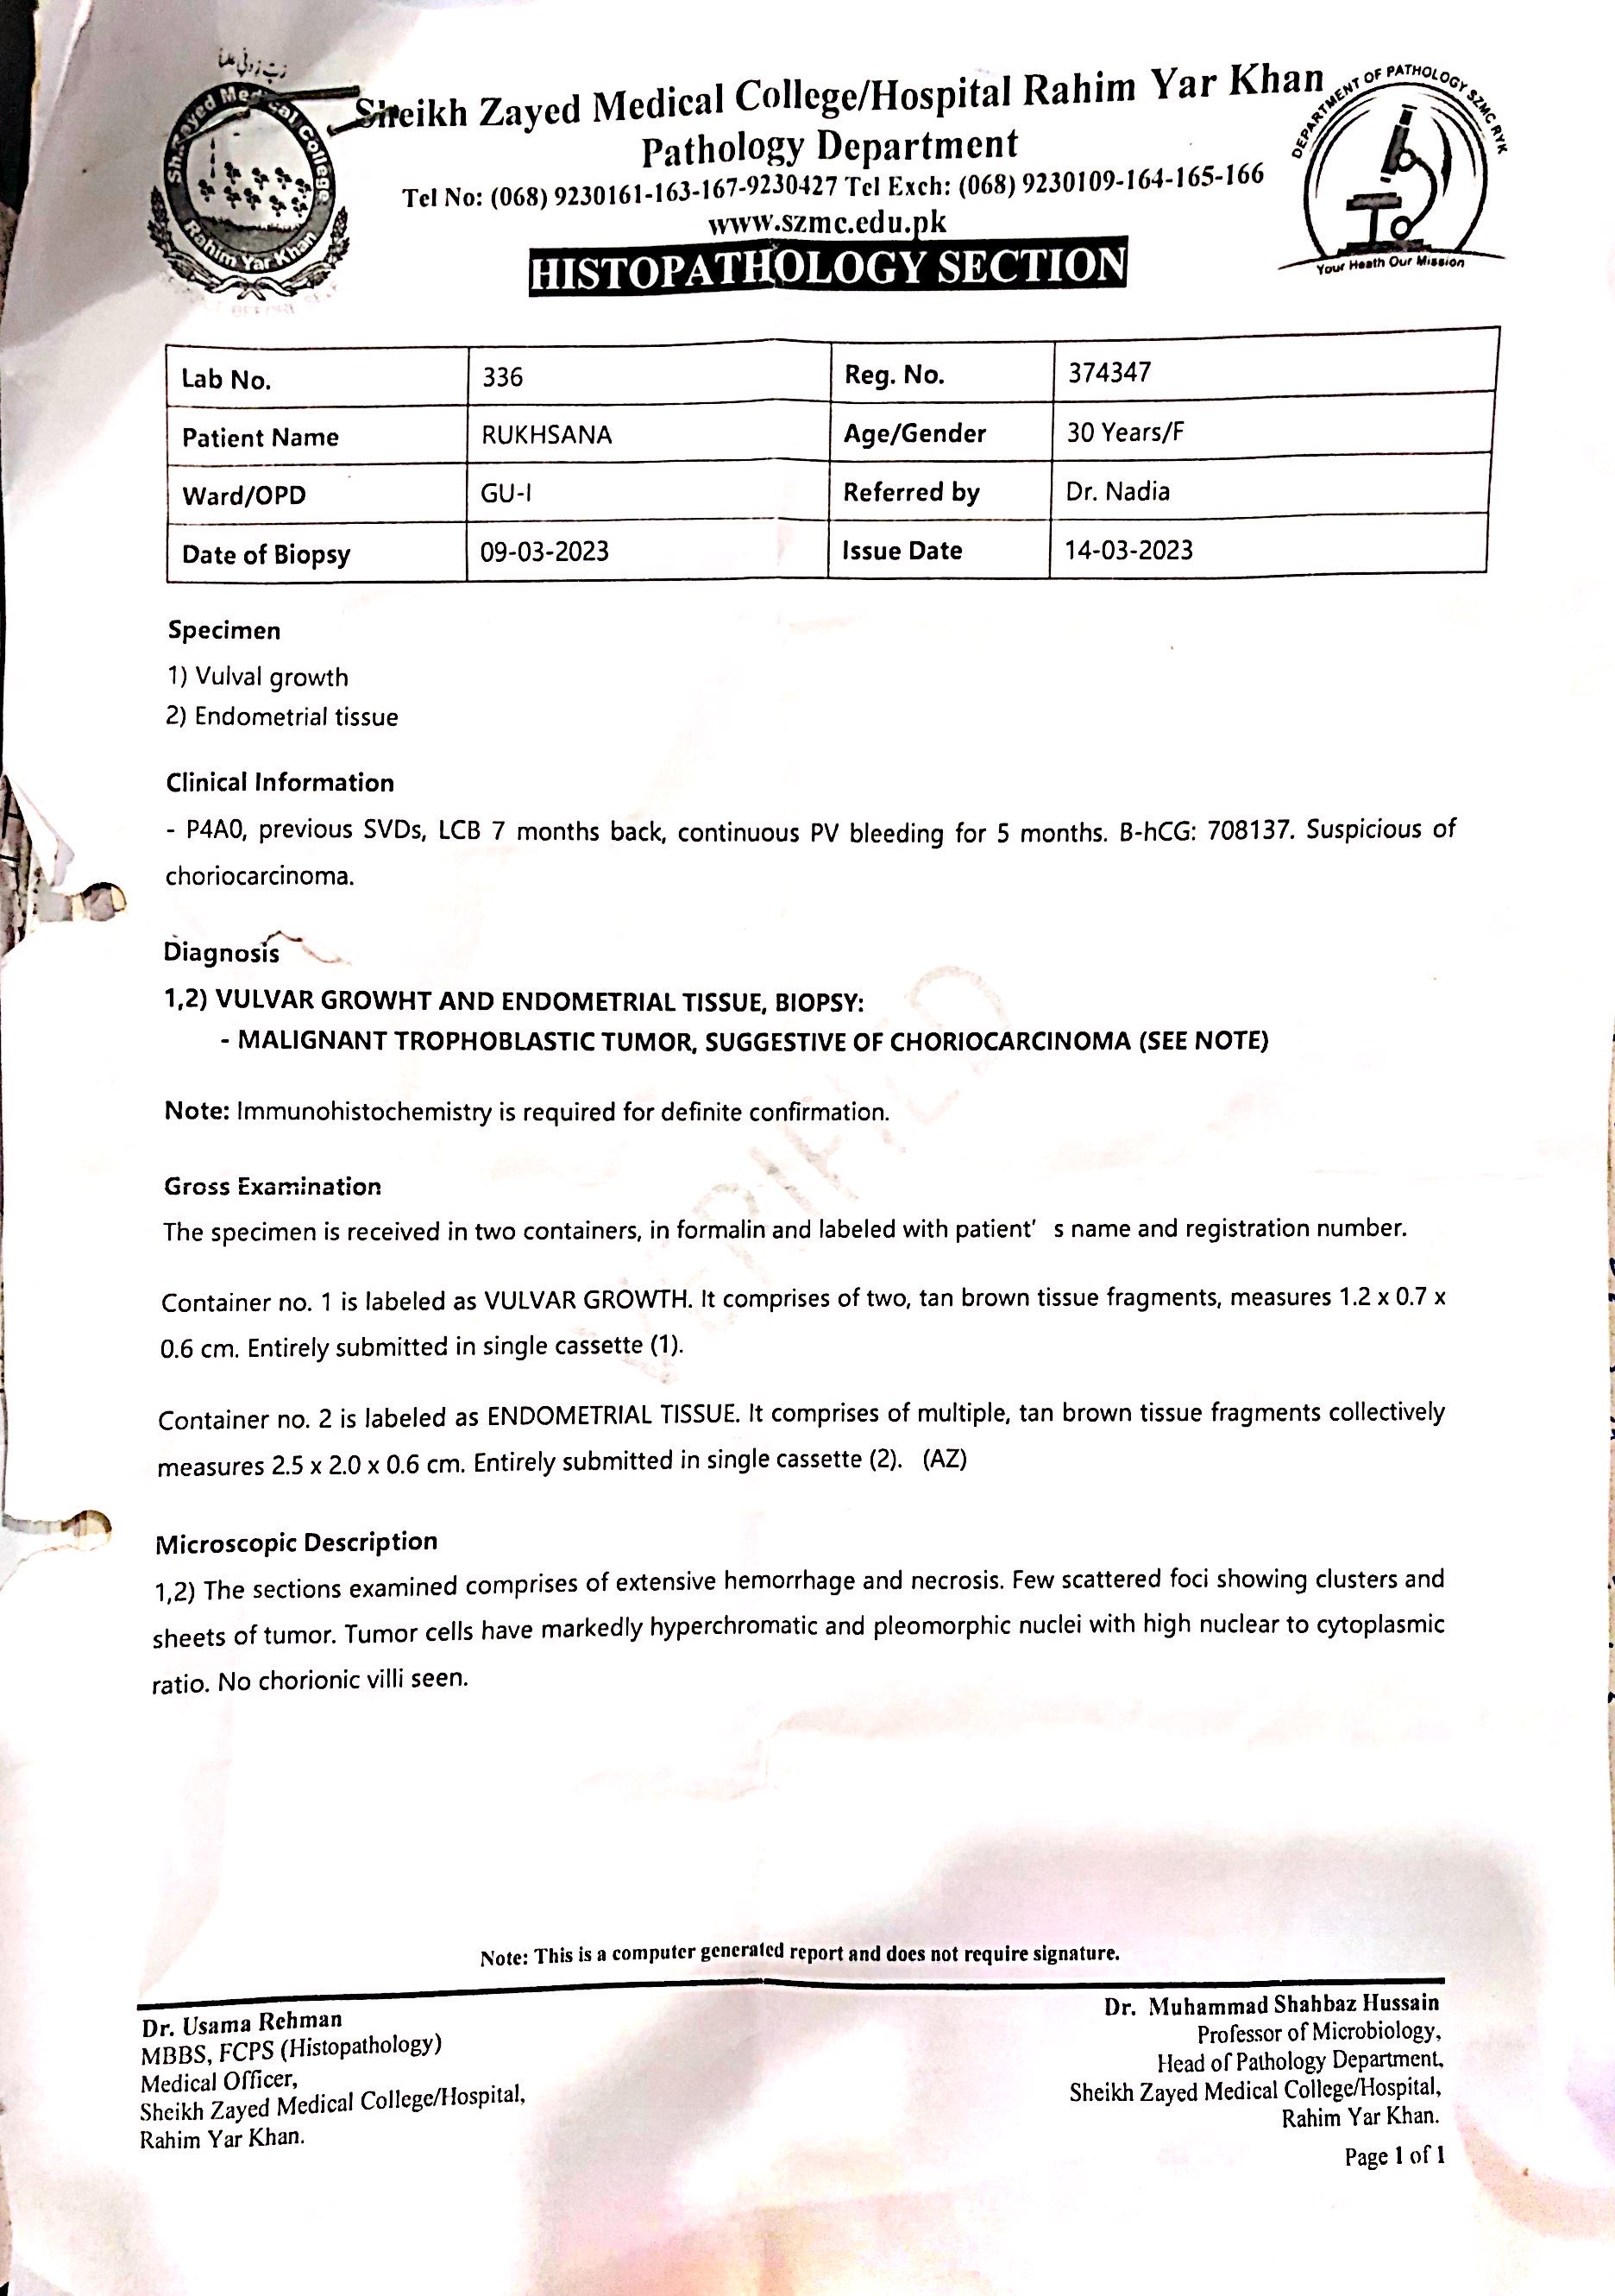

Slide 43
THANK YOU!

