Slide 1
CLINICAL CASE PRESENTATION-II
BATCH A-II, MEDICINE UNIT-II
Dated: 7th March 2025
Presented By:
Muhammad Abdul Rehman Ahmed Roll No. 561
Ali Hassan Roll No. 491
Hooria Fatima Roll No. 602
Uzma Asghar Roll No. 567

Slide 2
Patient History
BY MUHAMMAD ABDUL REHMAN AHMED

Slide 3
Biodata
Name : Ayesha Bibi
Daughter of Ghulam Haider
Age: 45 Years Old
Marital Status: Divorced
Residency: Rukan Pur, Rahim Yar Khan
DOA: 23rd February 2025
MOA: OPD
My patient, Ayesha Bibi, daughter of Ghulam Haider, 45 years old divorced female, resident of Rukan Pur Rahim Yar Khan, came to Medicine Unit-II through OPD 12 days ago on 23rd February 2025.

Slide 4
Presenting Complaint
Involuntary Movements Since 1 Year.
Recurrent Body Pains Since 15 Days.

Slide 5
History Of Presenting Illness
My patient has a history of recurrent multiple bone fractures for the last 15 years.
The patient is bed ridden since 6 months.
She was in usual state of health when:-
Involuntary Movements Of Body:
Localized more towards hands and head.
Gradual In Onset
Progressive In Nature
Continuous
Present At Rest
Aggravated Upon Movement
Unrelieved By Now

Slide 6
History Of Presenting Illness
Recurrent Body Pains:
15 days ago
Sudden In Onset
Very Severe In Intensity
Progressive In Nature
Aching In Character
Diffuse, More Localized Towards Her Pelvis and Legs
Aggravated by Postural Changes, Especially While Sitting
Relieved By Medication
These Episodes Have repeated 10-15 Times In The Past 15 Years.

Slide 7
Systemic Inquiry
Musculoskeletal System:
Frequent History Of Spontaneous Fractures In The Pelvis, Femurs, Right Radius, Right Clavicle
Associated Cracking Sound.
No Associated Bruising Or Swelling
No History Of Proximal Limb Weakness
No History Of Joint Pain Or Swelling
No History Of Early Morning Stiffness

Slide 8
Systemic Inquiry
Central Nervous System (CNS):
No History Of Headache
Dizziness After Excessive Household Work
No History Of Fits
No History Of Urinary And Bowel Incontinence
Gastrointestinal System:
No History Of Constipation, Diarrhea, Or Vomiting
No History Of Abdominal Pain
Her Appetite Is Normal
Patient Has Undergone 20kg Weight Loss In The Last 5 Years

Slide 9
Systemic Inquiry
Cardiovascular System (CVS):
No History Of Palpitations
No Chest Pain
Respiratory System:
No History Of Cough, Sputum, Wheezing
No Chest Pain
Urinary System:
Normal Urine.
No History Of Hematuria, Dysuria, Frothy Urine, Or Burning Micturation

Slide 10
Systemic Inquiry
Gynecological History:
Normal Menstrual 3 Months Ago
History of Amenorrhea since 3 Months
Normal Menarche 14 Years Of Age
Obstetric History:
Patient Is Para 1 With SVD 13 Years Back
No History Of Miscarriages
1 Child Who Is 13 Years Old
Endocrine System:
No Polyphagia, No Polydipsia, No Polyuria
No History Of Heat Or Cold Intolerance

Slide 11
Past Medical History
No History Of Hypertension
No History Of Diabetes Mellitus
No History of Ischemic Heart Disease

Slide 12
Past Surgical History
Patient Had Casting Done Only Once 13 Years Back
Later, She had Manual Splinting Done by Local Quacks
Admitted In Orthopedics Ward 12 Days Ago
No Other Surgical Procedure Has Been Performed

Slide 13
Family History
No History Of Hypertension
No History Of Diabetes Mellitus
No History Of Ischemic Heart Disease
No History Of Asthma

Slide 14
Socioeconomic History
Lives In Non-Cemented House With 4 Rooms
6 Family Members
Uses Tap Water
Patient Is A Divorcee
Dependent Upon Brothers
Family Income Is Around 20,000/ Month

Slide 15
Personal History
No History Of Smoking
History Of Tobacco Chewing
Sleep Is Normal.
Appetite Is Normal
History Of Weight Loss Has Already Been Mentioned

Slide 16
EXAMINATION
By Ali hassan

Slide 17
General Physical Examination
General Appearance:
I have examined a young lady who is sick looking, lying comfortably in bed, with visible head and hand movements.
The patient is conscious and following commands.
She has casts on both her legs.
BP: 110/70 mm Hg
Temperature: 99˚F
Respiratory Rate: 14 breaths per minute
Pulse: 70 bpm
Vitals:

Slide 18
General Physical Examination
On Extension of General Physical Examination:
Patient is Pale With No Jaundice
No Koilonychia Or Leukonychia
No Pedal Edema
No Thyroid Enlargement
No JVP

Slide 19
Systemic Examination
Musculoskeletal System:
No Swelling
No Tenderness
No Restriction Of Movements
In Lower Limbs, There Was:
Bony Tenderness, rest of the examination was not attempted due to pain
In Upper Limbs, There Was:
Normal Movements, No Swelling
No Tenderness
No Deformity

Slide 20
Systemic Examination
CNS:
Higher Mental Functions Are Intact.
Resting Tremors Of Upper Limb That Worsen Upon Movement
Tone Is Normal
Lower Limb Cannot Be Examined Due To Limited Exposure
Pupils Show Sluggish Reaction To Light

Slide 21
Systemic Examination
CVS:
Apex beat in 5th intercostal space medial to mid clavicular line no palpable heart sounds, heart sound no thrill first and second heart sound normal no added sounds

Slide 22
Respiratory System:
Normal vesicular breathing
Trachea central

Slide 23
GIT:
Noraml in shape, no visibale scar marks
Soft non tenderNo visceromegaly

Slide 24
DIFFERENTIAL DIAGNOSIS

Slide 25
DIFFERENTIAL DIAGNOSES
Wilson’s Disease
Huntington Disease
Metabolic Bone Disease/Fanconi Syndrome
Mitochondrial Disorder (Leigh Syndrome)

Slide 26
INVESTIGATIONS
BY Hooria FATIMA AND Uzma ASGHAR

Slide 27
REQUIRED INVESTIGATIONS
1. Required Lab Tests:
CBC
LFTS
RFTS
Serum Ceruloplasmin Levels (low, less than 20 mg/dl in most cases)
Serum Cu++ Levels (low)
24 Hours Urinary Cu excretion (low)
Serum Free Cu Levels ( raised non-ceruloplasmin bound Cu)
2. Specific Biochemical Tests:

Slide 28
Required Investigations
3. Imaging:
Radiograph (X-Ray) Of Fracture Sites
MRI To Check Basal Ganglia
Shows Kayser-Fleischer (KF) Rings In Cornea Upon Slit Lamp Examination
4. Ophthalmic Examination:

Slide 29
Required Investigations
GENETIC TESTING: ATP7B Gene Mutation
LIVER BIOPSY With Copper Quantification

Slide 30
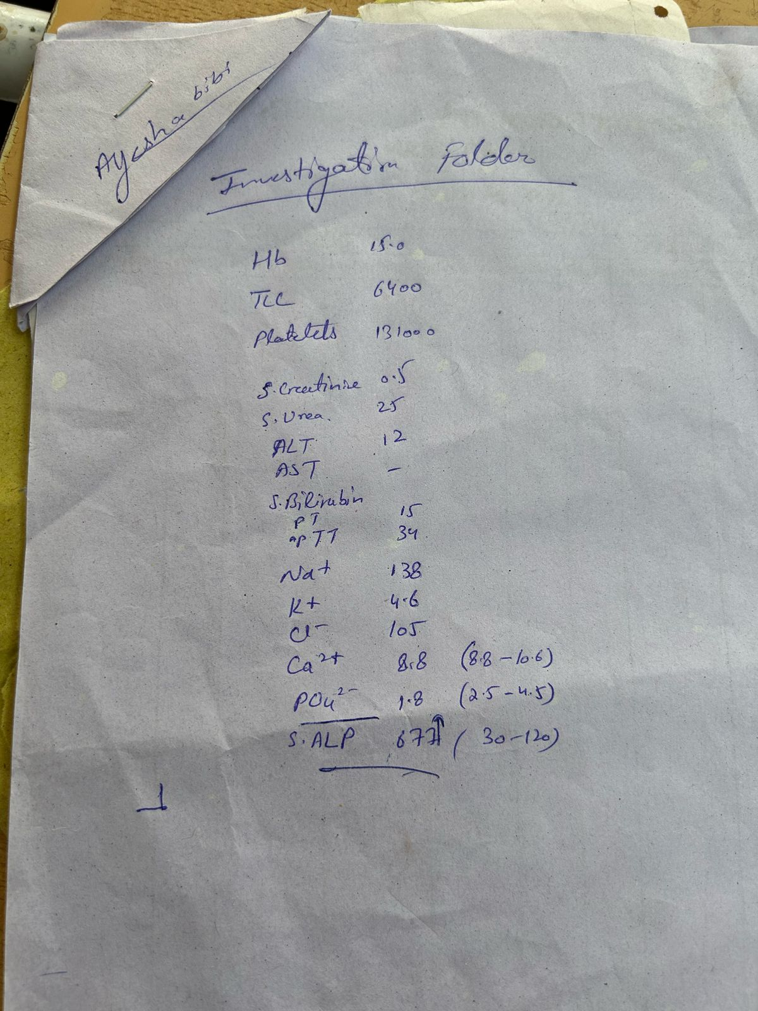
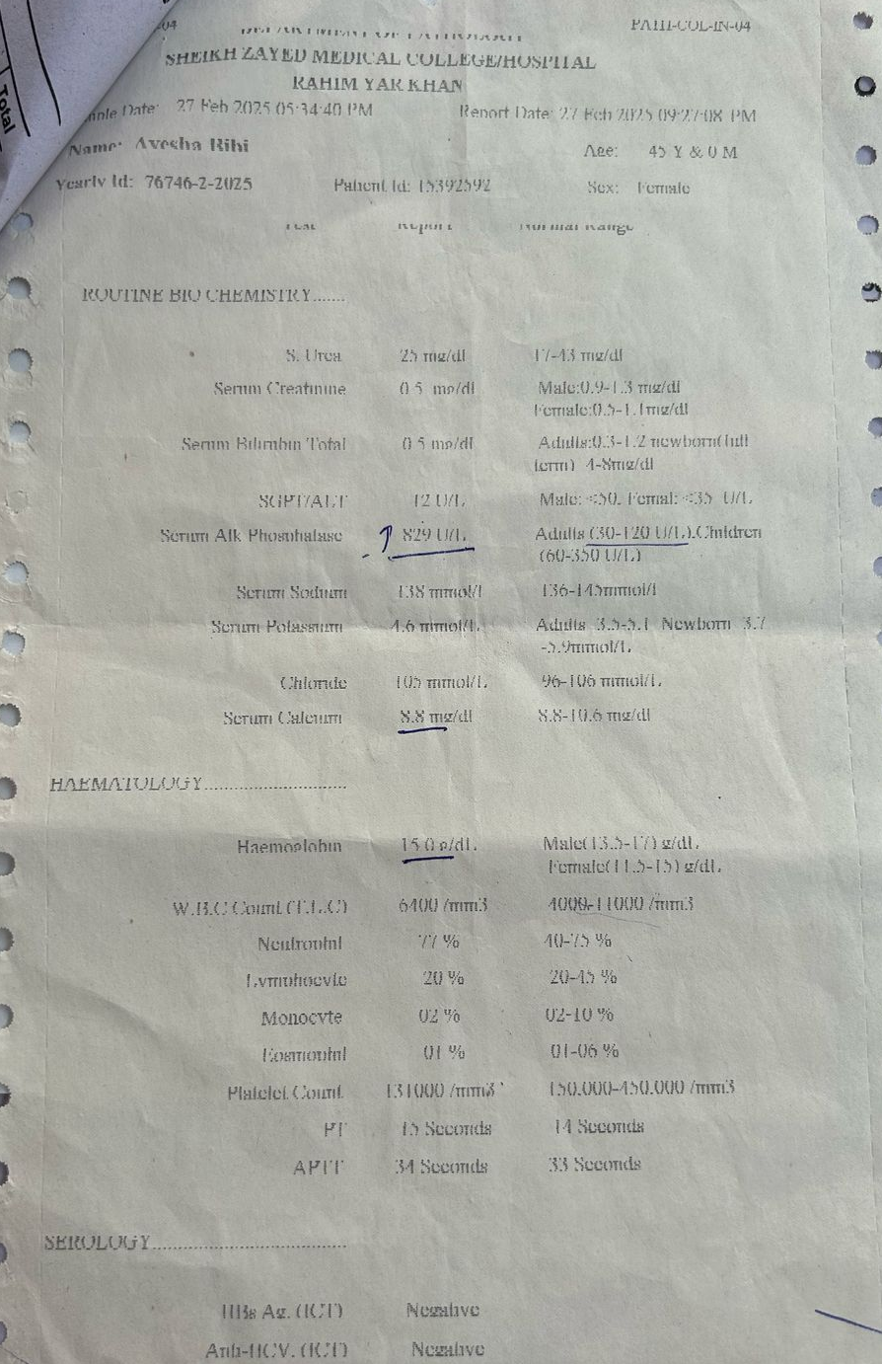
CBC, LFT, SEROLOGY REPORTS
CBC: No Significant Findings
LFTs: Raised ALP(829U/L)
ALT And AST Are Normal
Serology: HBsAg Is Negative
Anti HCV Is Negative

Slide 31
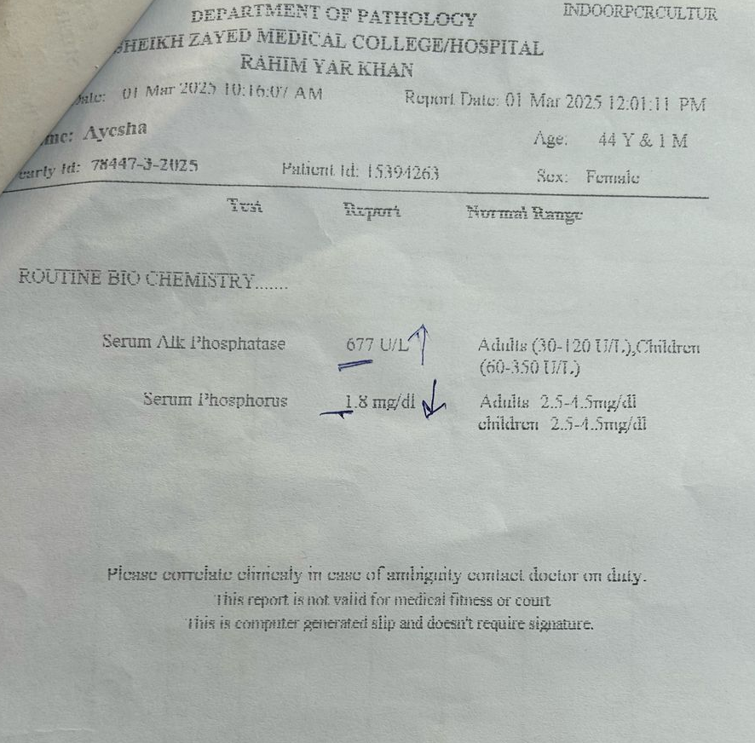
Routine Biochemistry
Dated: 1-3-2025
Serum Phosphate Levels Are Markedly Decreased

Slide 32
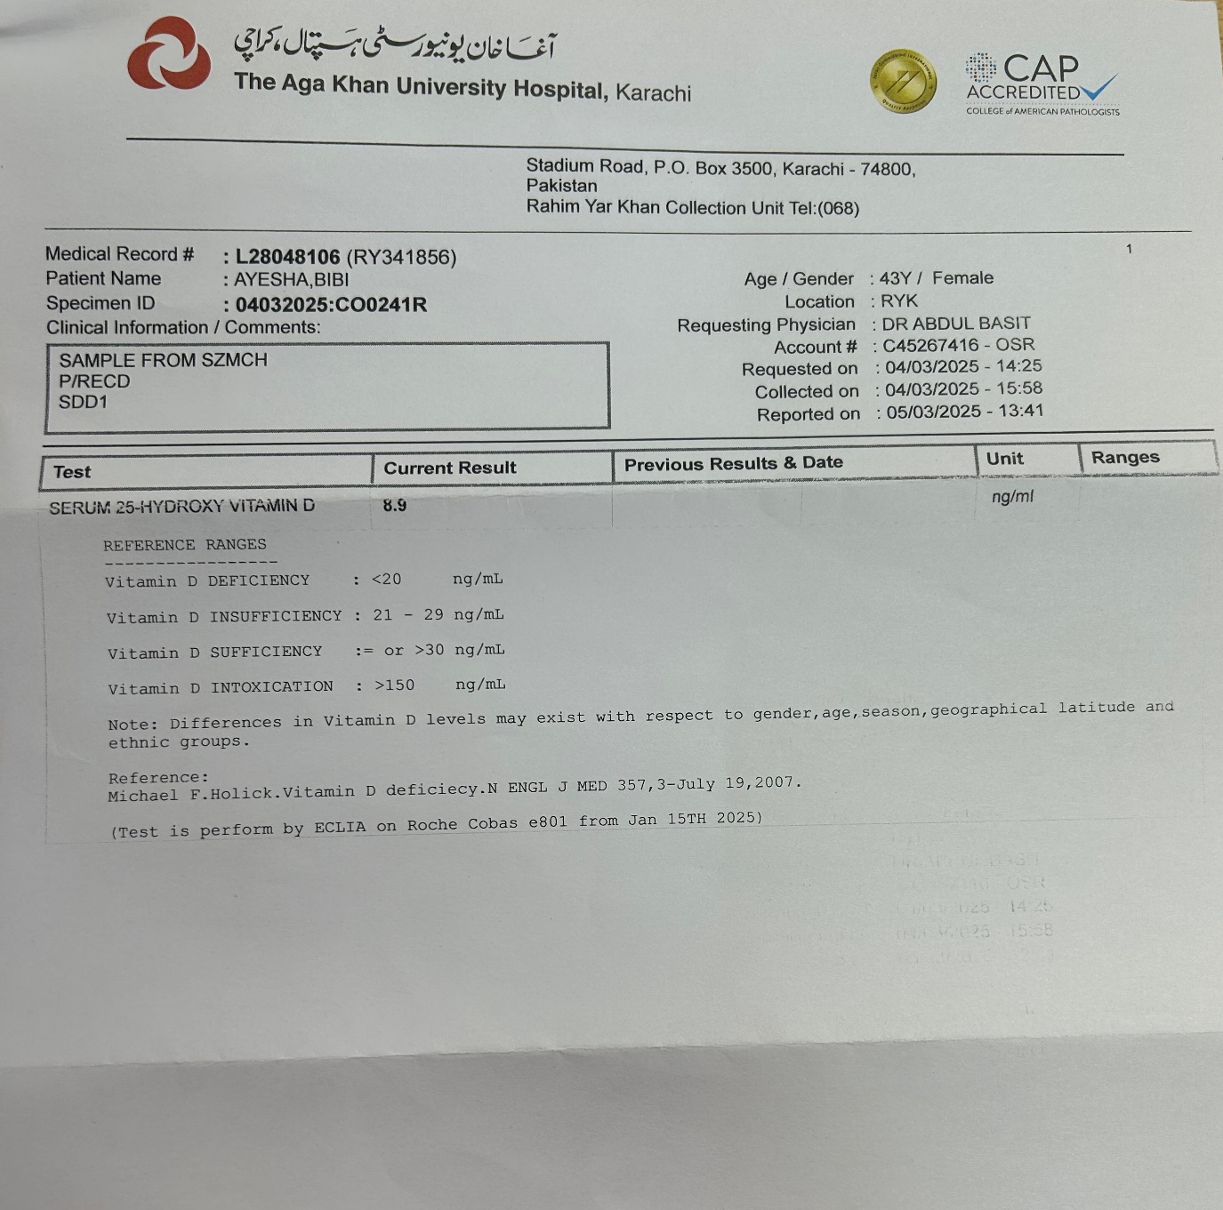
Routine Biochemistry
Vitamin D3 Levels Are Low (8.9ng/ml)

Slide 33
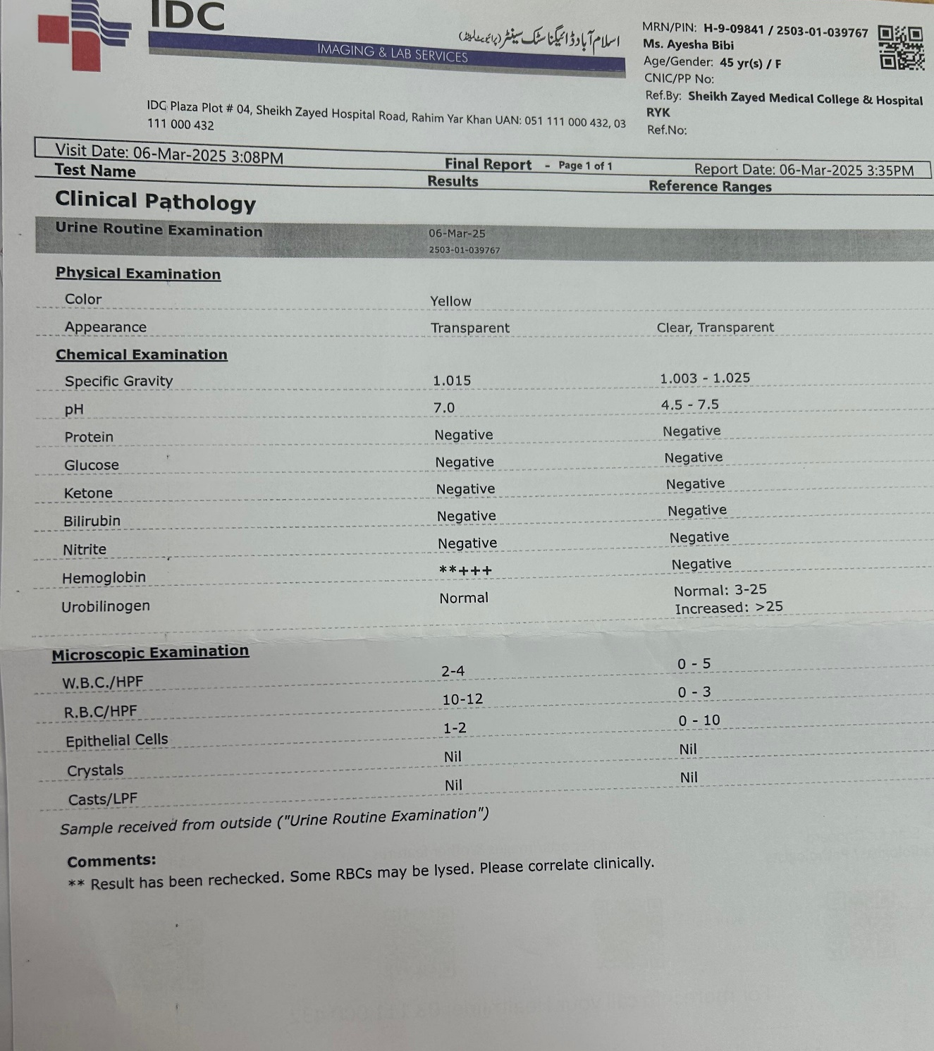
Urine Analysis
Complete Urine Analysis To Check The Type Of RTA1,2
RTA 1: Shows Distal Features
RTA 2: Shows Proximal Features (Due to Bicarbonate Wasting)
Urine pH Greater Than 5.5
Anion Gap Positive
Amino Aciduria, Glucosuria, Phosphaturia
Diagnostic For RTA
Low Serum Bicarbonate Levels
Low Potassium Levels

Slide 34
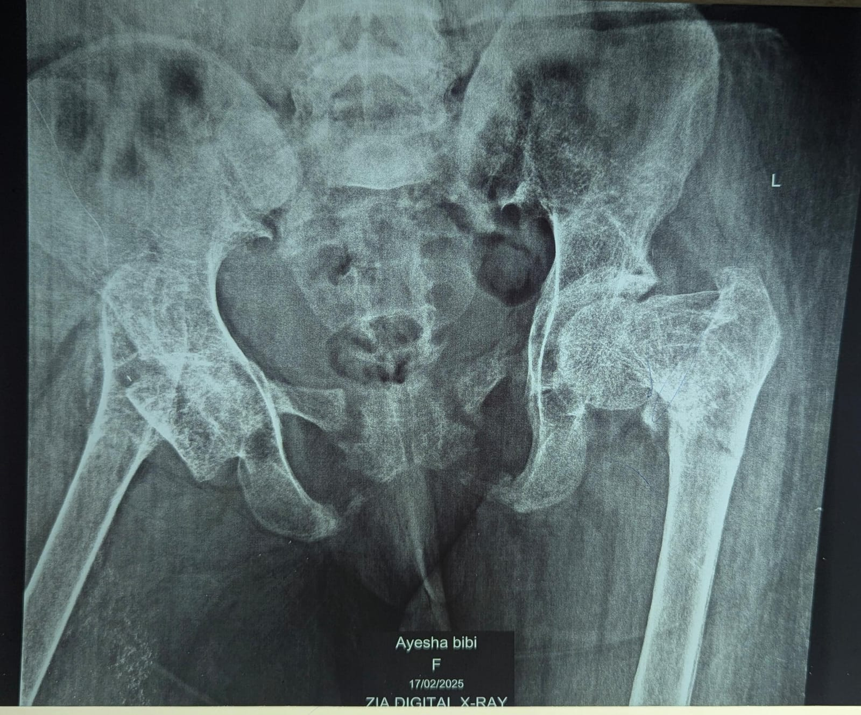
Radiograph
X-Ray Shows Bilateral Femoral Head Destruction
Demineralization Of Hip Bone

Slide 35
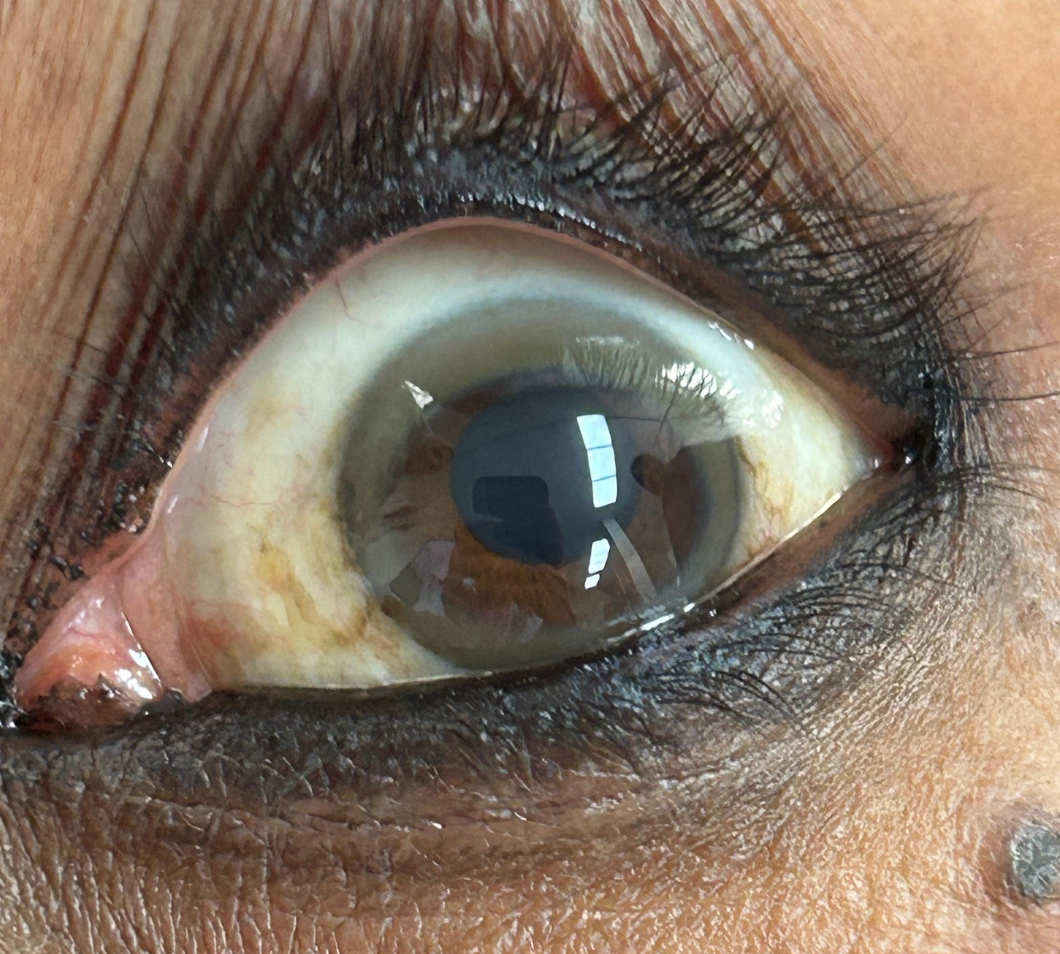
Kayser Fleischer Rings
KF Rings Are Positive.

