Slide 1
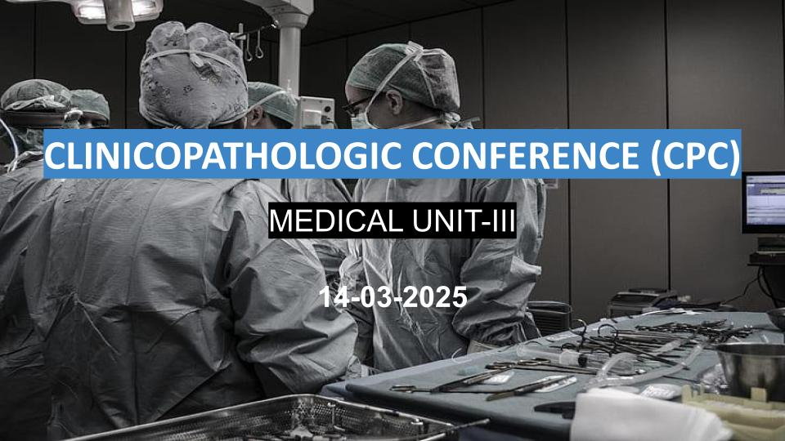
CLINICOPATHOLOGIC CONFERENCE(CPC)
MEDICAL UNIT –3
14-03-2025

Slide 2
HISTORY

Slide 3
History
BIODATA:
Name: Abid Hussain
Father name: Rasheed Ahmad
Age: 19 Years
Marital Status: Married
Religion: Muslim
Occupation: Laborer
Residency: Ahsan Pur
MOA: OPD
DOA: 05-03-2025

Slide 4
Presenting Complaint
Increase in size and number of pre-existing lump (at right side of neck)

Slide 5
History of Presenting Illness
My patient was in USOH 4 months back when he himself noticed single lump in right upper side of neck initially of pea size which is gradually increasing in size
Lump was painless
With no redness and
No discharge coming out of swelling
Later, he also noticed some new lumps of pea size below the chin

Slide 6
History of Presenting Illness
Patient also gave history of fever 2 month back
Fever was gradual on onset
Remittent moderately grade (maximum recorded 101 F) more at night
With no aggravating or relieving factors
Association:
Fever was associated with cough
Cough was mild, Intermittent and productive with no diurnal variation and no specific character
Sputum was small in amount, 2-3 times per day, yellow in color with no hemoptysis no smell

Slide 7
History of Presenting Illness
Fever was not associated with
Chills
Rigors
Fatigue
Pruritus
Sweating
Headache
Joint pain
Painful eye
Dyspnea

Slide 8
Patient started taking ATT after getting his investigation and send home
Patient again visited OPD one week back with the complain that lump was increasing in size only
Cough and fever subside
He also felt some new lumps in same side of neck and now admitted in ward
He is compliant with ATT

Slide 9
Systemic Inquiry:
Resp: There was SOB on exertion mild cough with sputum or hemoptysis
CVS: There was no history of edema, PND, Palpitation
CNS: There was no history of headache, dizziness, numbness, or loss of consciousness
GIT: No nausea, vomiting, or altered bowel movement
Musculoskeletal: There was no muscle atrophy, Joint pain, or pruritus
Urogenital: No oliguria, hematuria, dysuria, or burning micturition
Endocrine: No weight loss, No polydipsia, No polyuria, No polyphagia, No heat or cold intolerance

Slide 10
Past medical: Not significant
Past Surgical: Not significant

Slide 11
Family History
His mother had similar clinical presentation 2 years back with no evidence of investigation and treatment
She was fully cured spontaneously

Slide 12
Social History
Patient lives in non- cemented house with 2 rooms:
11 family members
Animal exposure
Use tap water for drinking
Poor sanitary system

Slide 13
Personal History
Patient is married for 3 years with no child
There is no history of cigarette smoking, naswar or drug addiction
Sleep pattern, appetite and bowel habits were normal

Slide 14
EXAMINATION

Slide 15
GENERAL PHYSICAL EXAMINATION
    General Appearance
    A young boy sitting comfortably of average built and height. He is fully conscious and well oriented with IV line maintained on right forearm.
    Vitals
    Pulse : 81 BPM
    Temp : 98.6 °F
    BP : 110/80 mmHg
    Respiration Rate : 18 breaths per min

Slide 16
  GENERAL PHYSICAL EXAMINATION
    On further general physical examination:
    No cyanosis, koilonychia, leukonychia
    No pallor, jaundice, ptosis
    a lump of right cervical side
    No ulcers in oral cavity and tongue cyanosis
    On swallowing thyroid is not visible

Slide 17
GENERAL PHYSICAL EXAMINATION
  On lymph nodes examination:
  There is single enlarge lymph node in anterior cervical region on right side measuring 3.5x2 cm erythematous, compressible and warmth with no sinus discharge
  Further there are palpable lymph nodes in right submandibular, anterior axillary and superficial inguinal lymph nodes 2 in each region
  These lymph nodes have smooth surface, are distinct, firm, non-tender, mobile and not visible externally.
  All these lymph nodes are non-erythematous, have no warmth, no sinus discharge, no skin puckering.

Slide 18
SYSTEMIC EXAMINATION
  RESPIRATORY SYSTEM
  On inspection, chest is of normal shape, with no scar, striae, visible veins and moving normally With bilaterally Equally with the respiration
  On palpation, there is no tenderness, temperature is normal and normal movements of chest expansion of more than 6 cm
  Trachea is central
  On percussion upper border of liver is in 5th intercostal space, percussion note is resonant bilaterally (anteriorly, posterior and laterally)
  On osculation, breath sounds are vesicular and of normal intensity and character with no added sounds. Vocal resonance is normal and equal on both sides.

Slide 19
  GIT
  Abdomen is normal in shape
  No visible scar marks, striae, visible peristalsis and prominent veins
  On superficial and deep palpation there is no tenderness and mass palpable
  No visceromegaly on visceral palpation
  There are no signs of ascites or free fluid in abdomen present
  CVS
  Apex beat in 5th intercostal space medial to mid clavicular line
  Normal heart sounds (S1 and S2)
  No palpitations noted
  No added heart sounds
  No thrill

Slide 20
  CNS
  GCS is 15/15
  Well oriented and good memory
  Speech is normal
  No significant sensory and motor finding
  Cranial nerves are intact
  No cerebellar signs
  No significant SOMI finding
MUSCULOSKELETAL SYSTEM
  No swelling
  No tenderness
  No restriction of movement

Slide 21
Differential Diagnosis

Slide 22
DIIFERENTIAL DIAGNOSES:
Tuberculous Lymphadenitis (Scrofula)
Lymphoma
Brucellosis
SLE
Sarcoidosis

Slide 23
INVESTIGATIONS

Slide 24
Investigations required are:
Routine Biochemistry
Blood tests
Serology
Urine examination
Ultrasound
Biopsy
CT chest and CT abdomen

Slide 25
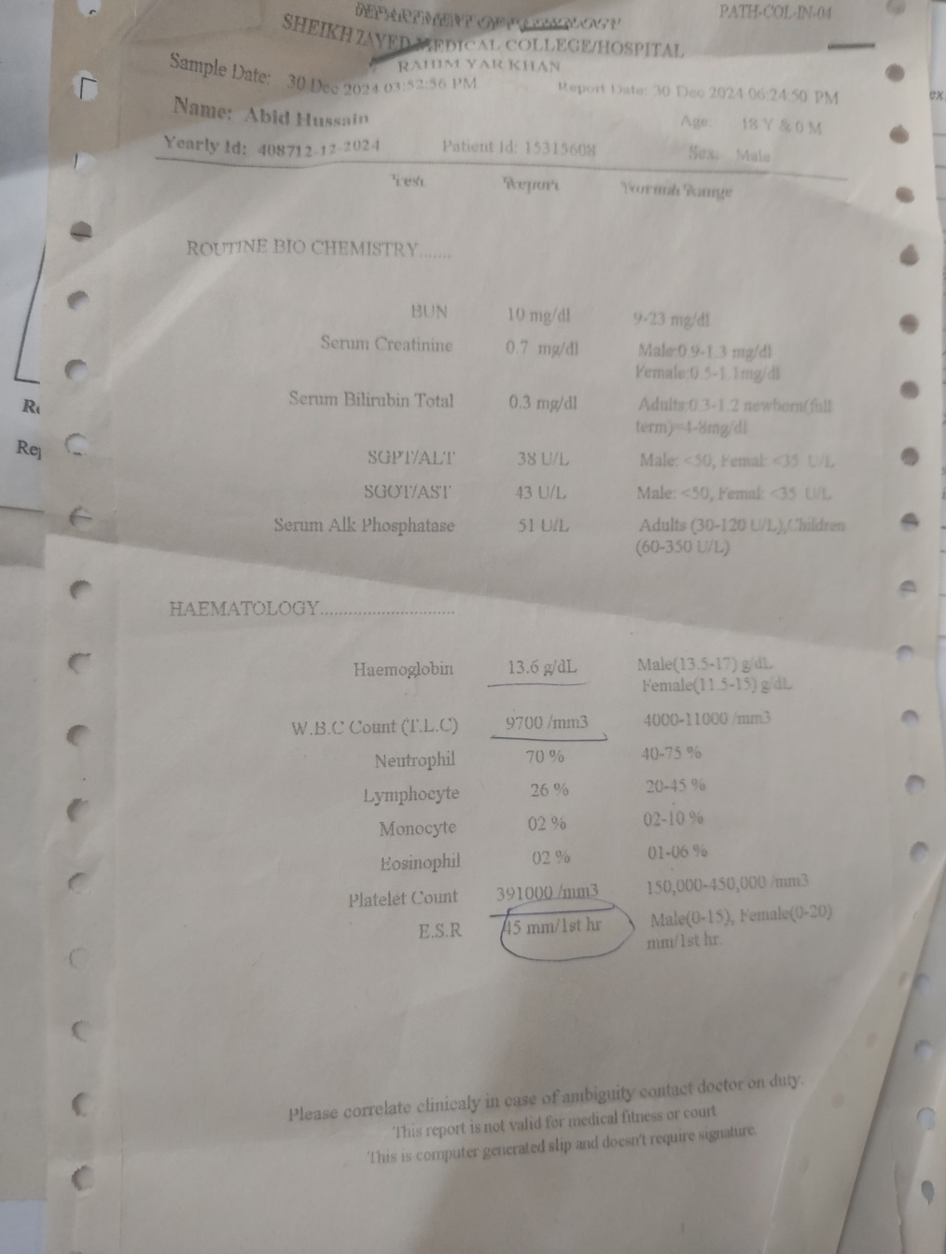
Blood Tests
Haemoglobin is 13.6g/dl
WBC count and platelets were within normal range

Slide 26
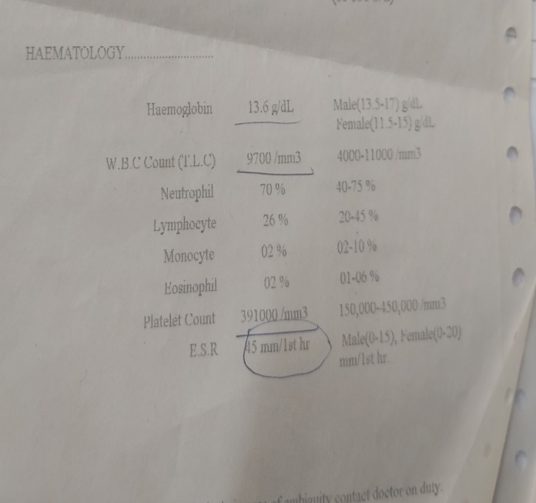
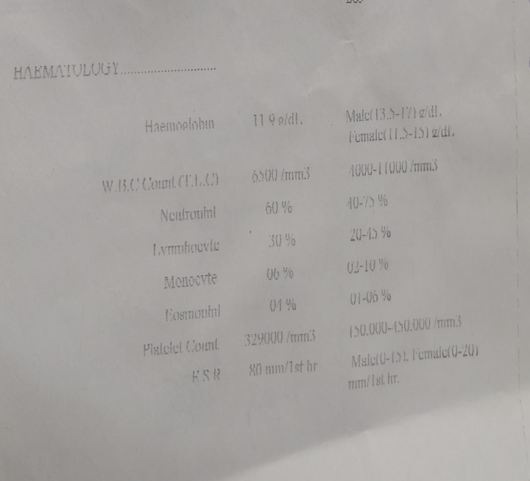
ESR 2 months back is 45 mm/1st hr
ESR now is 80mm/1st hr

Slide 27
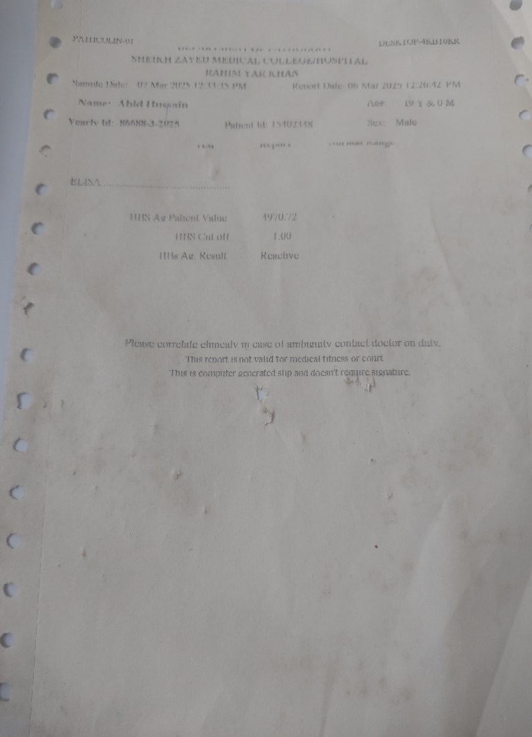
SEROLOGY
ICT test for hepatitis shows Hepatitis-B surface antigen positive
While Hepatitis-C was negative

Slide 28
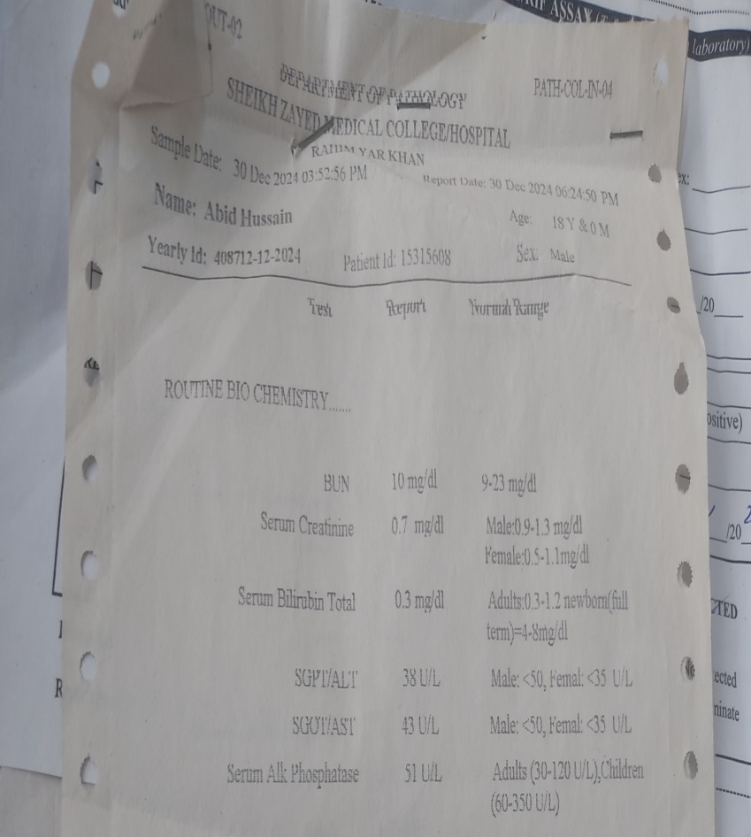
ROUTINE BIOCHEMISTRY
Blood urea ,serum creatinine ,bilirubin ,ALT , AST and alkaline phosphatase were within normal range .

Slide 29
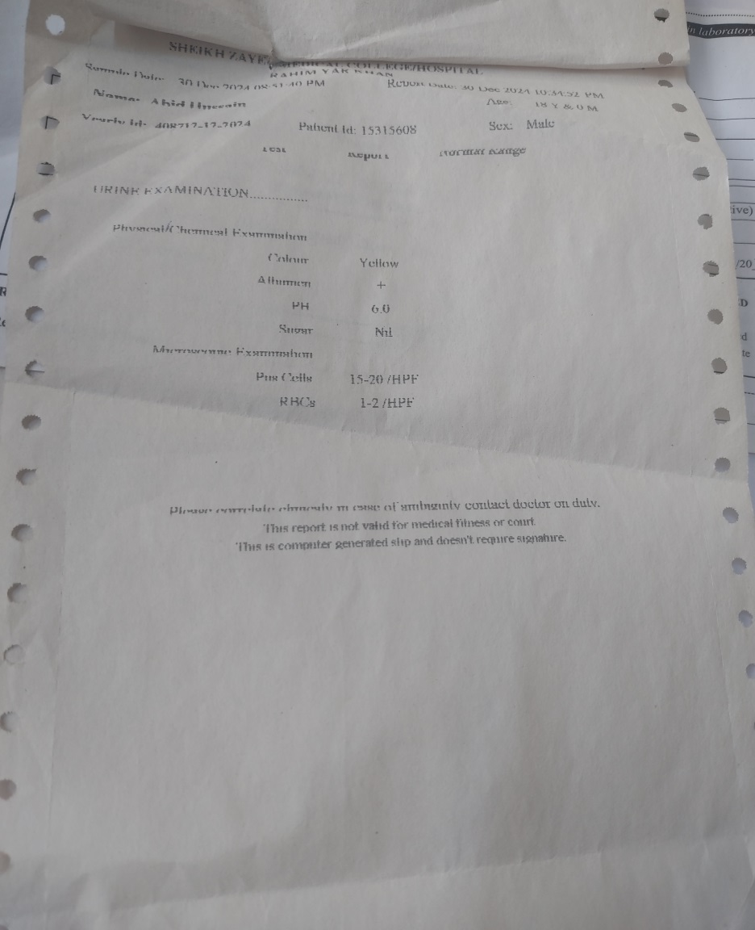
URINE EXAMINATION
Colour : yellow
pH :6.0
Sugar : nil
Microscopic finding show pus cells 15-20 /HPF
RBC :1-2/HPF

Slide 30
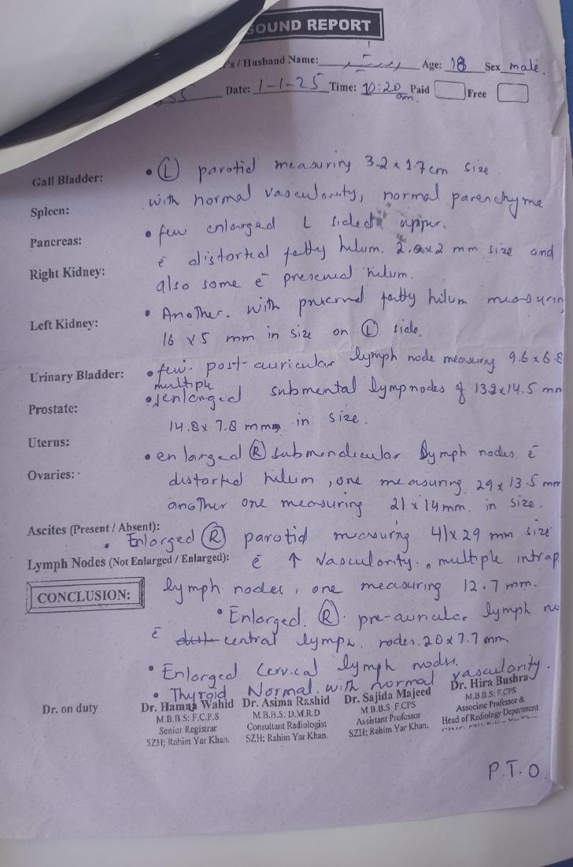
ULTRASOUND
Enlarged post auricular lymph nodes measuring 9.6-6.8
Enlarged submental lymph nodes of 13.2-14.5
Enlarged submandibular lymph nodes
Enlarged cervical lymph nodes
Thyroid was normal

Slide 31
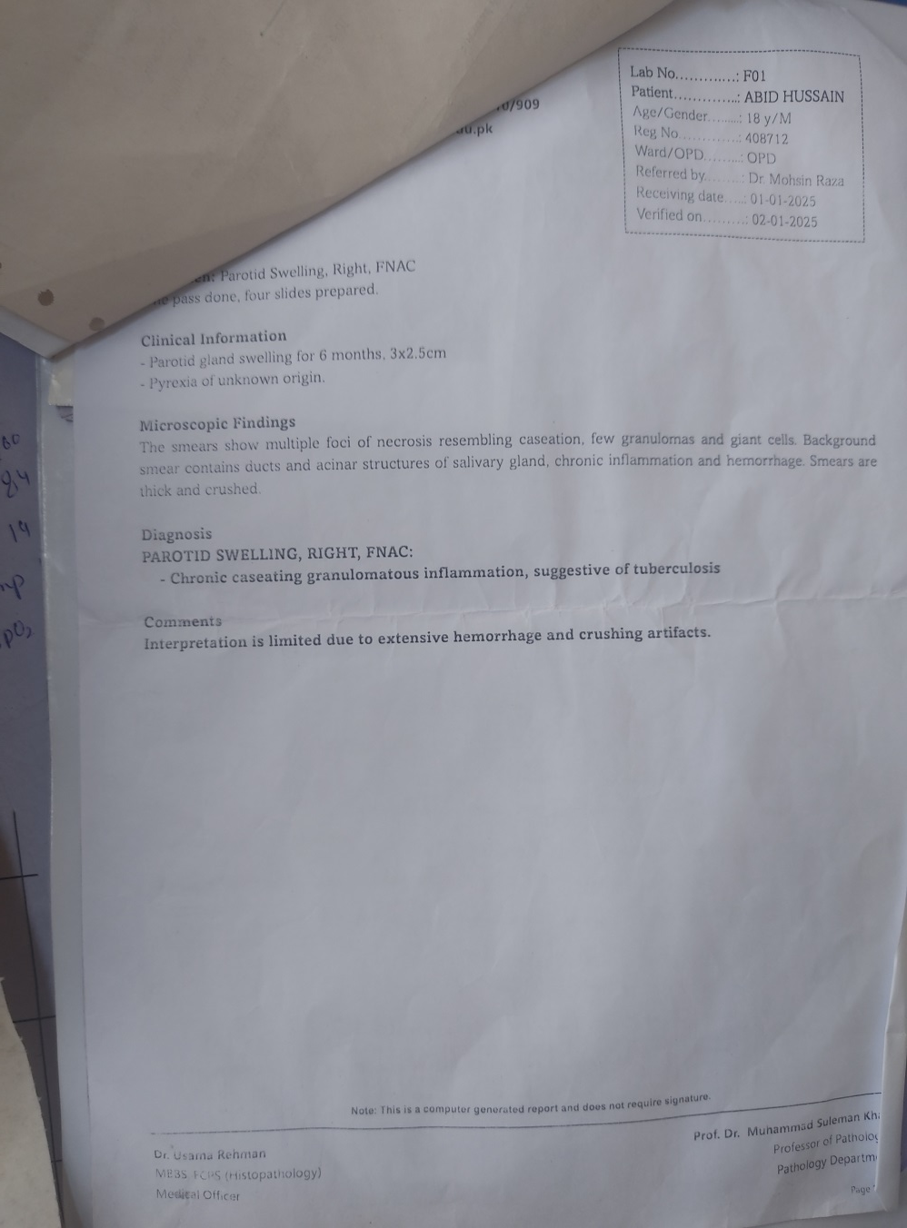
BIOPSY
FNAC report shows that on microscopy there were multiple foci of necrosis resembling caseations ,few granulomas and giant cells .
Background smear show inflamation and haemorrhage.

Slide 32
DIAGNOSIS
Biopsy report shows chronic caseating granulomatous inflamation ,suggestive of tuberculosis

Slide 33
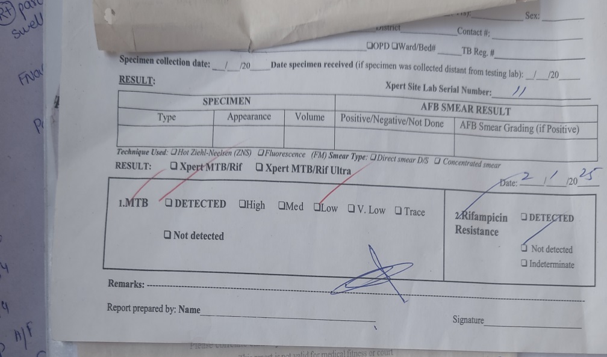
GeneXpert MTB Test
Mycobactarium tuberculosis was detected
Rifampicin resistance was not marked

Slide 34
CT scan Chest and Abdomen
Right lower neck: multiple matted lymph nodes seen in right lower neck
Right axilla :multiple discrete lymph nodes with peripheral enhancement largest being of size of 2.5 *2 cm
Left axilla: few large lymph nodes with fatty hilum and ring enhancement.
Mediastinum : pretracheal :matted sub cm in size prevascular :few enlarge nodes with focus of calcification ,largest one of 32*11mm

Slide 35
B/L upper lobes of lungs: soft attenuation areas with spiculated margins indicative of fibrosis or consolidation .
Small localized fluid collection seen in right transverse fissure of lungs
Abdomen : not significant
Inguinal: benign looking with preserved fatty hilum with largest being of size 22*24mm.
Compiled By: M. SOHAIB AHSAN

