Slide 1
Case presentation
Dr Yarjahan, PGR General Surgery, S-1,SZH, RYK
Abbas haider, final year MBBS SZMC
Mariya, final year MBBS SZMC
Aqsa tariq, final year MBBS SZMC

Slide 2
HISTORY
By: Mariya, Final year MBBS student

Slide 3
BIODATA
My patient Allah ditta s/o Muhammad yusuf ,
age 92 years old
resident of Chowk Bahadarpur, RYK
presented in OPD on 25 February

Slide 4
PRESENTING COMPLAINT, P/C
Pain in abdomen- for 3 months
Constipation- for 2 and a half months

Slide 5
HOPI
My patient was in usual state of health 3 months back when he started experiencing pain in abdomen
which was sudden in onset
progressive in nature
colicky in character,
Intermittent
More prominent towards left iliac fossa
No aggravating factors
Relieved by NSAIDs and painkillers from local practitioners.

Slide 6
It was associated with
Constipation started two and half months back.
That was sudden in onset
progressive in nature
Worsened with passage of time
He used to pass stools after every 3 days with straining
Initially stools were of semi-solid consistency
Then with the passage of time, stools became pencil-like thin
But during this phase passage of flatus was normal
There were no aggravating or relieving factors

Slide 7
Constipation was not associated with
PR bleed
Vomiting
Diarrhea
Abdominal distension
Fever
Yellowness of eyes
Dysphagia

Slide 8
Systemic inquiry
General: There was history of anorexia and significant weight loss (5kg in 2 months)
There was hx of Fatigue or weakness,
but no hx of fever or chills or night sweats .
CNS: No hx of headache, diplopia, dizziness
CVS: No hx of chest pain, palpitations, dyspnea, orthopnea, PND or extremities edema
Respiratory: No hx of cough, SOB, hemoptysis and wheezing
Genitourinary: There was hx of urgency, frequency, intermittency, hesitancy for 6 months.
Musculoskeletal: No joint pain, muscle pain, photosensitivity.

Slide 9
Past medical history
Non significant

Slide 10
Past surgical
Hx of eye operation for cataract (12 years ago)

Slide 11
PERSONAL HISTORY
Formally not educated
Laborer by profession
History of smoking 10 years back
Having normal sleep

Slide 12
Family History
Hx of HTN in family,
But No hx of colon cancer OR
PR bleed in first degree relatives
No hx of TB
No history of any hereditary condition

Slide 13
Examination
By: Aqsa tariq, Final year MBBS student

Slide 14
I have examined patient of average height and built , well oriented to time ,place ,person , having passed cannula on right hand with following vitals
Pulse 88 beats/min
BP 100/60 mmHg
Temp Afibrile
Resp rate 20 /min
Oxygen satuation 94%

Slide 15
He was pale with no jaundice ,koilonychia, leukonychia.
Thyroid not enlarged ,lymph node were not palpable.

Slide 16
Abdominal examination
INSPECTION:
Abdomen was protuberant
Umbilicus central inverted
There were no stria, scar marks, prominent veins, pulsations,
Pubic hair pattern was normal
Hernial orifices were intact

Slide 17
PALPATION
Abdomen soft
On superficial palpation, there was tenderness in LIF
On deep palpation, 9*5 cm lump was palpable in LIF
That was not moving with respiration
Tender
With Carnett sign, lump became less prominent with leg elevation, showing it is intra-abdominal
Margins ill-defined, firm in consistency
Non pulsatile, non-mobile
Not bimanually palpable, ballotable
Fingers can be inserted between both costal margins

Slide 18
PERCUSSION
There as no associated visceromegaly
Percussion note was resonant over the lump
Shifting dullness and fluid thrill were negative.
Upper border of liver was percussed in 5th intercostal space
AUSCULTATION
Bowel sounds were audible

Slide 19
PerRectal, PR Examination
Anal tone and sphincter were normal
No skin tag, fissure or hemorrhoids
No mass felt
There was soft fecal matter in rectum
Prostate examination median sulcus non-obliterated, firm in consistency, upper limit non reachable.
Finger was fecal stained

Slide 20
CVS examination
INSPECTION:
  Jugular Venous Pulse, JVP not raised
  No pedal edema
  No Chest wall deformity
PALPATION:
  Apex beat in Left 5th InterCostal Space of normal character
  No palpable heave or thrill
AUSCULTATION:
  S1 and S2 with no added sounds
  No murmur auscultated

Slide 21
Respiratory system examination
INSPECTION:
  Abdomino-thoracic respiration
  Normal chest shape, no deformity, scar mark, prominent veins or pulsations
  Normal equal movements of chest on both sides
PALPATION:
  Trachea central
  No tenderness or crepitations
  Equal chest expansion on both sides
  Equal vocal fremitus on both sides

Slide 22
Respiratory System Examination
PERCUSSION:
  Percussion note resonant and equal on both sides
AUSCULTATION:
  Normal vesicular breathing
  No added rhonchi or crepitations

Slide 23
CNS Examination
GCS 15/15
Signs Of Meningeal Irritation –ve
Sensory and motor system intact
Cerebellar examination normal
Higher mental functions intact

Slide 24
Differential Diagnoses
Colorectal carcinoma
Diverticulitis
Inflammatory Bowel Disease
Tuberculosis Abdomen

Slide 25
INVESTIGATIONS
By: Abbas Haider, Final year MBBS

Slide 26
INVESTIGATIONS
All Baselines
Viral Markers
USG Abdomen
CT chest, abdomen and pelvis with contrast
Colonoscopy
Biopsy

Slide 27
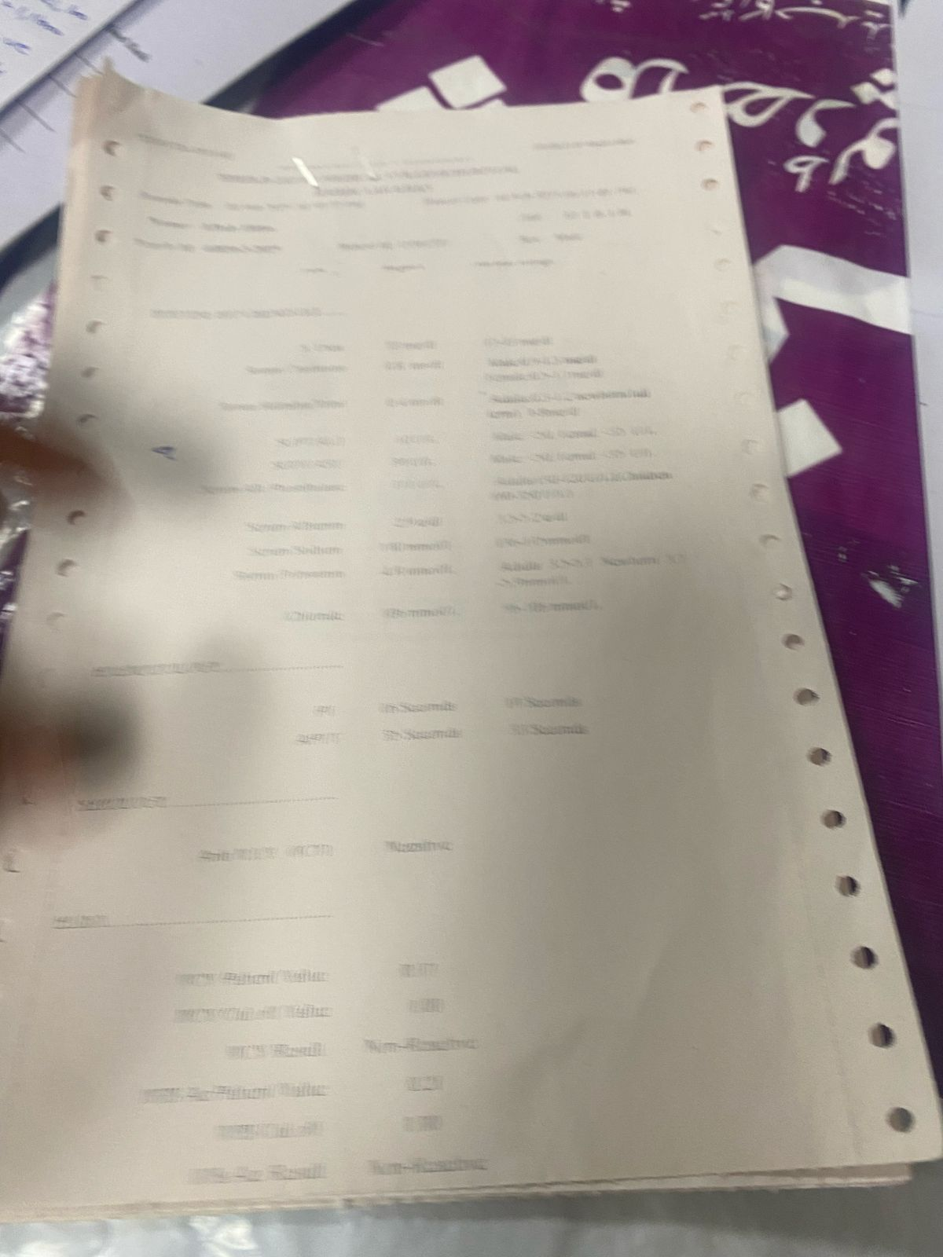
All Baselines and Viral markers

Slide 28
Hematology
Hb 11.5 g/dL (Male=13.5 – 17 g/dL)
WBC count (TLC) 14,500 (4,000 – 11,000 /mm3)
Platelets count 1,54,000 (1,50,000 – 4,50,000 /mm3)
Coagulation Profile
PT 16 sec (14 sec)
aPTT 35 sec (33 sec)
Viral markers/Serology
Anti HCV -ve
HBsAg -ve
Anti HIV -ve

Slide 29
ROUTINE BIOCHEMISTRY
Serum Urea 40 (17-43mg/dL)
S. Creatinine 0.8 (Male 0.9 – 1.3 mg/dL)
Bilirubin Total 0.9 (Adults 0.3 - 1.2mg/dL)
ALT 38 (Male: less than 50 U/L)
ALP 103 (25 – 100 U/L)
Albumin 2.5 (3.5 – 5.5 g/dL)
Sodium 138 (136 – 146 mEq/L)
Potassium 4.4 (3.5 – 5.0 mEq/L)
Chloride 106 (95 – 105 mEq/L)

Slide 30
Tumor Marker
CarcinoEmbryonic Antigen, CEA Levels
  5.16 ng/ml (Normal range= 0 - 2.9 ng/ml)

Slide 31
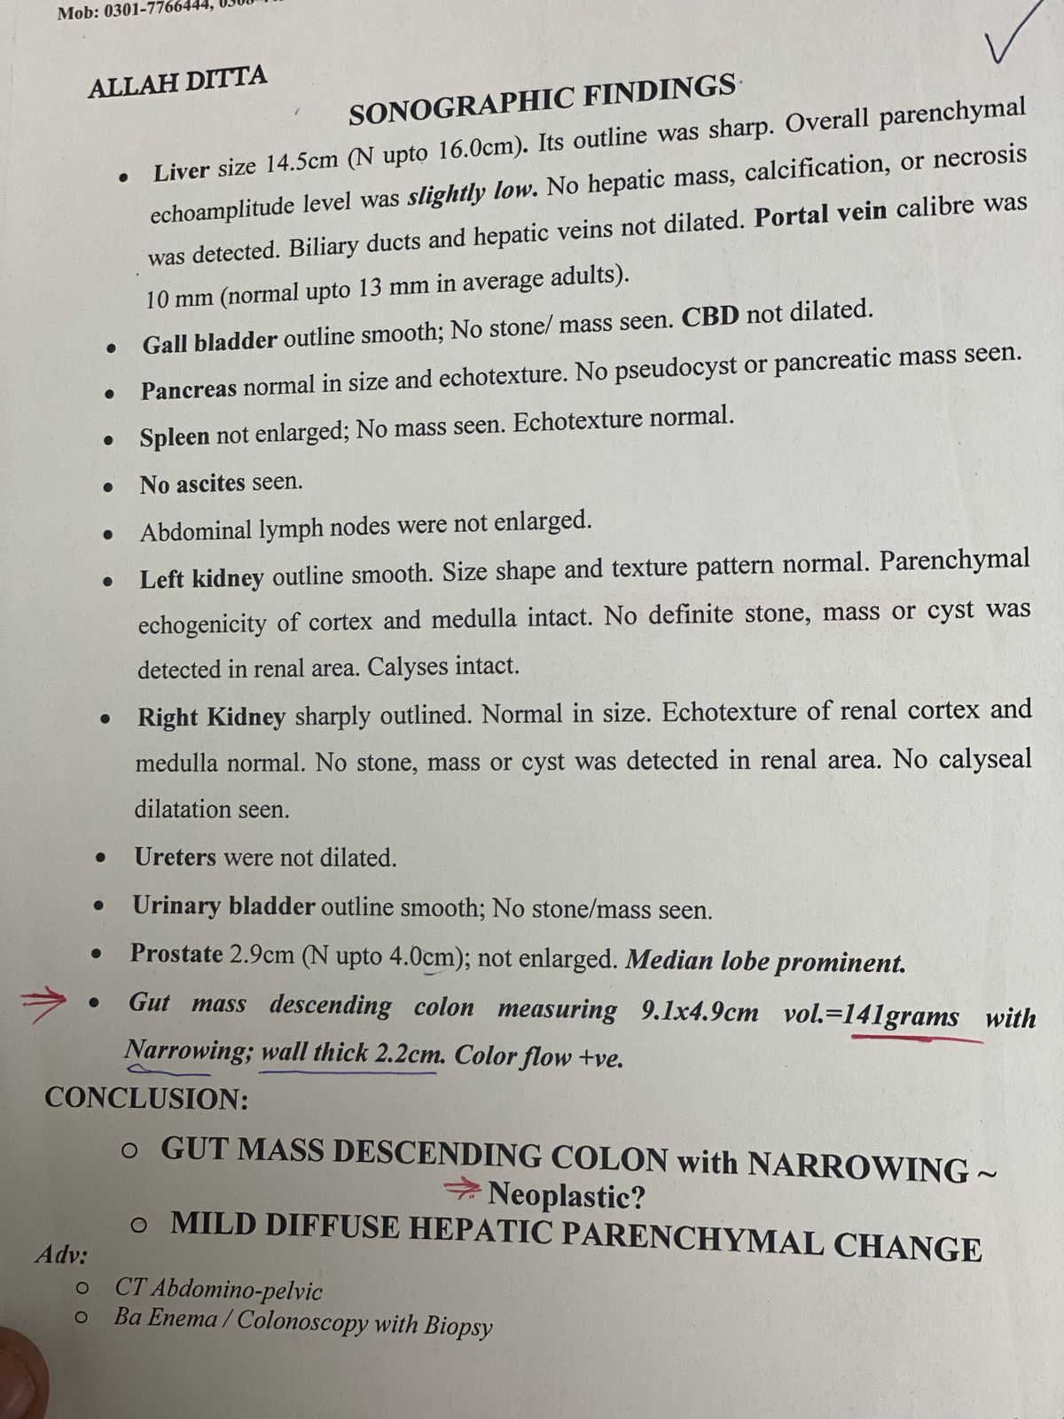
ULTRASOUND
GUT mass descending colon with narrowing
Measuring 9.1*4.9 cm vol. 141 grams
Wall thickness 2.2cm Color flow +ve
Neoplastic?
Mild diffuse hepatic parenchymal change
Prominent median lobe of prostate

Slide 32
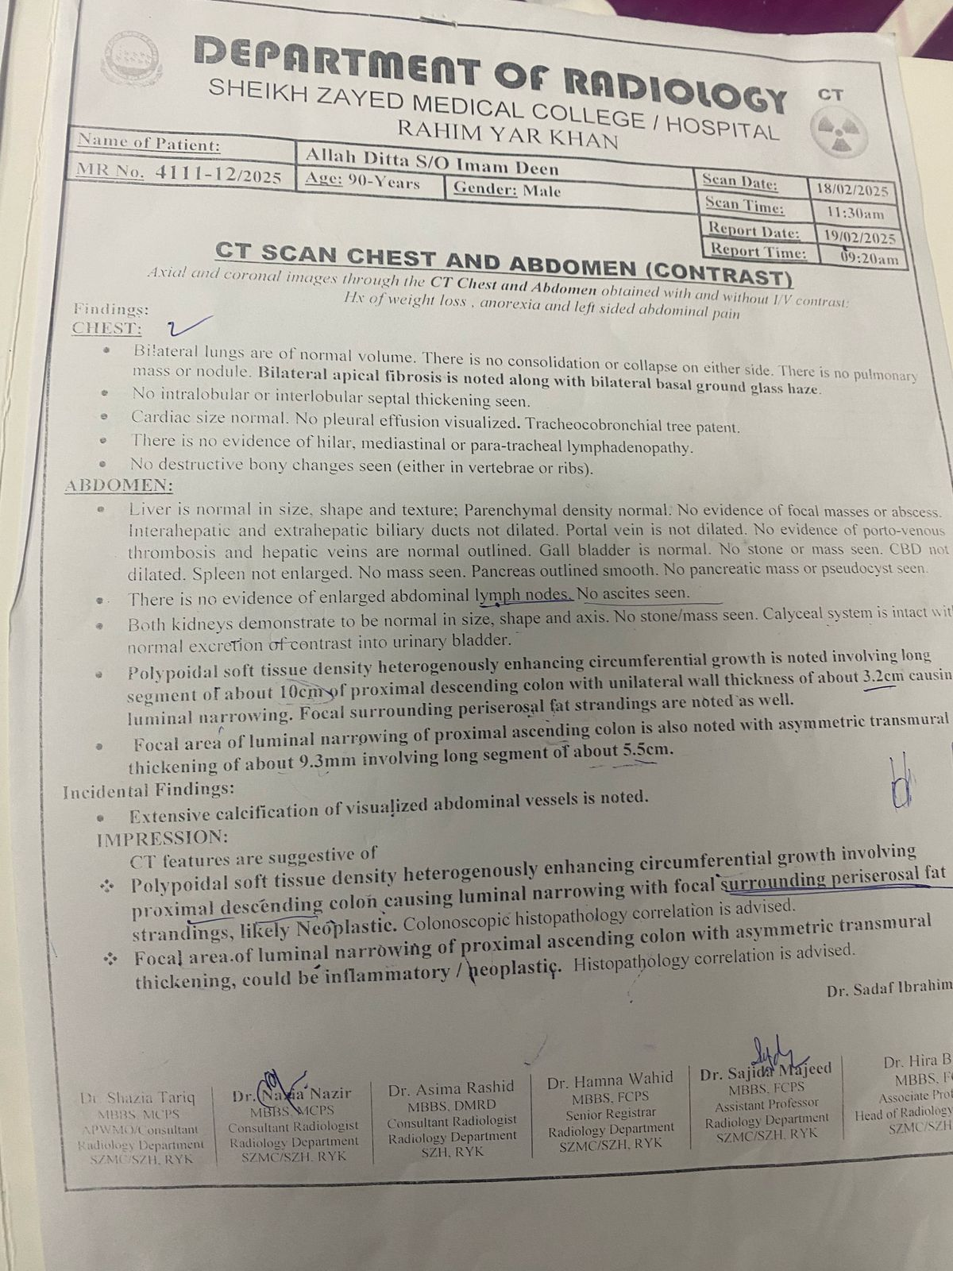
CT SCAN (CAP with Contrast)
CT features are suggestive of
Polypoidal soft tissue density heterogenously enhancing circumferential growth involving proximal descending colon causing luminal narrowing with focal surrounding periserosal fat strandings, likely Neoplastic.
Colonoscopic histopathology correlation is advised.
Focal area of luminal narrowing of proximal ascending colon with asymmetric transmural thickening, could be inflammatory / neoplastic.

Slide 33
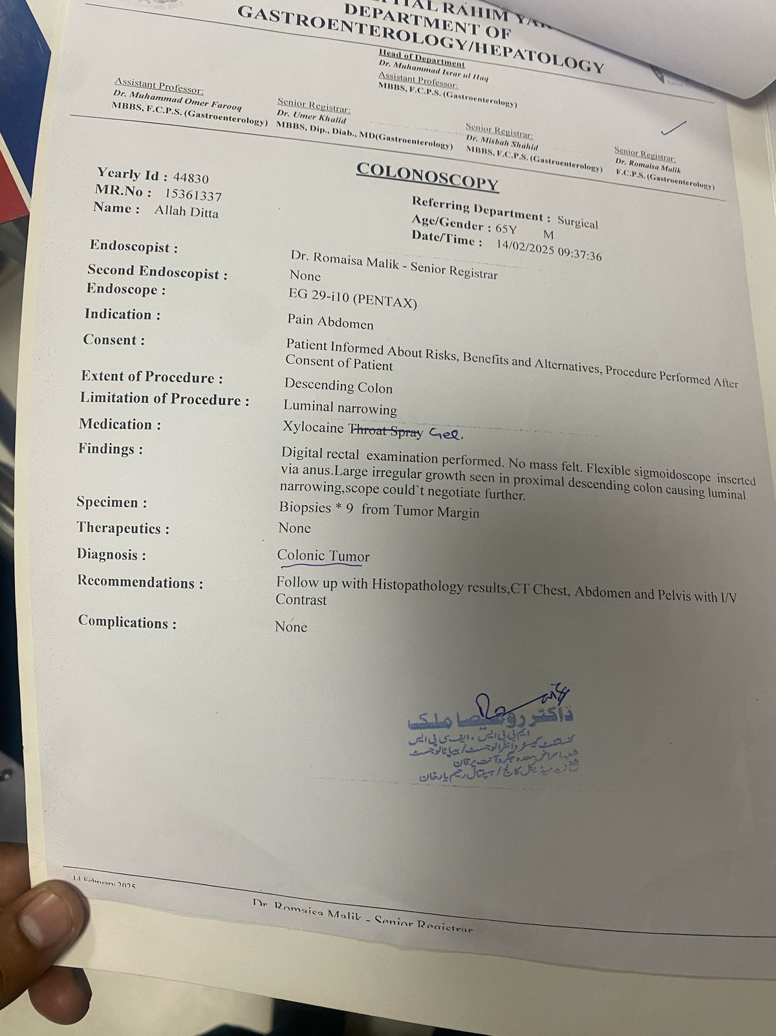
Colonoscopy
Digital rectal examination performed. No mass felt. Flexible sigmoidoscope inserted via anus
Large irregular growth seen in proximal descending colon causing luminal narrowing
Scope couldn't negotiate further.

Slide 34
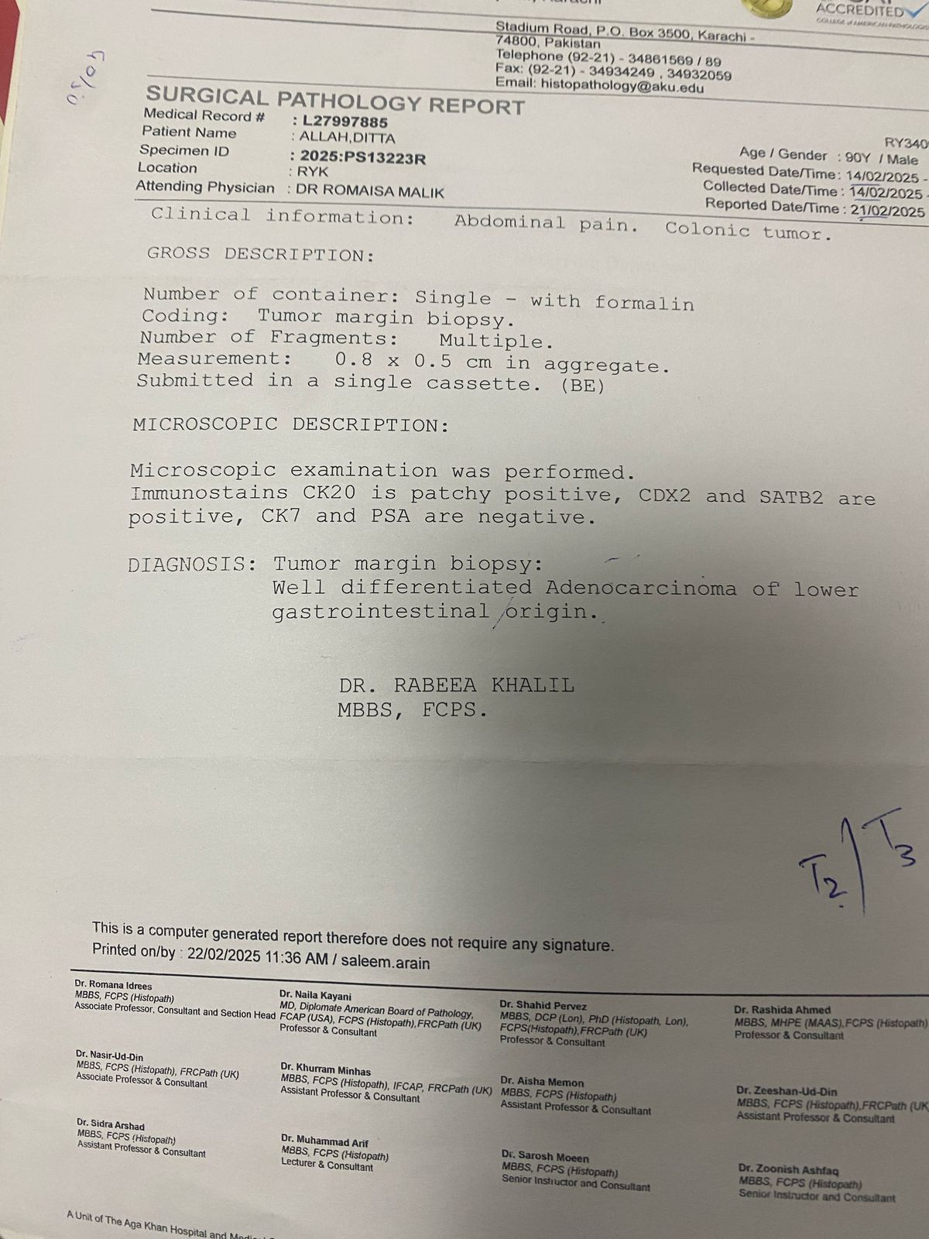
Histopathology Report
Tumor margin biopsy:
Well differentiated adenocarcinoma of lower gastrointestinal origin

Slide 35
Diagnosis
After investigation, we have confirmed that my patient is having
Colon cancer involving proximal descending colon
It is of stage 2 most probably.

