Slide 1

Colon cancer
.
Dr Yar Jahan Khan
PGR Surgical Unit 1, SZH, RYK

Slide 2
Epidemiology:
Third most common type of cancer and second most frequent cause of cancer-related death

Slide 3
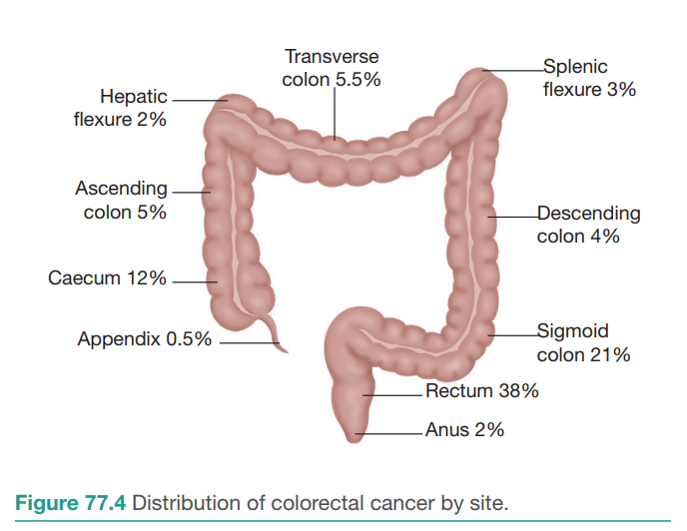
Typical sites of incidence of colon cancer

Slide 4
Risk factor
Polyps (FAP, LYNCH Syndrome, Peutz-Jeghers, Turcot)
Age (>50 years)
Inflammatory bowel disease (IBD)
Diet high in saturated fats such as red meat, low fiber diet, processed meat
Personal or family history of cancer
Obesity
Smoking
Alcohol
Surgical procedures such as ureterosigmoidostomy

Slide 5
Types of colon cancer
95% Adenocarcinoma
Others 5%
  Kaposi sarcoma
  Carcinoid tumor
  Neuroendocrine tumor
  Lymphoma
  GIST

Slide 6
Gross histopathologic types
Annular
Tubular
Ulcerative
cauliflower

Slide 7
Spread of Colon Cancer
Direct Spread (Neighboring structures such as anterior abdominal wall, retroperitoneal structures such as ureter and adjacent organs)
Hematogeneous: Liver, lung, bone, brain
Transcoelomic spread to peritoneum
Lymphatic spread to regional Lymph nodes

Slide 8
Clinical Features
Asymptomatic Incidental Finding
PR bleeding
Abdominal Mass/Lump
Tenesmus
weight loss
Altered bowel habits
Intestinal Obstruction
Anemia/Pallor

Slide 9
Complications
Obstruction
Perforation
Massive Lower GI bleed

Slide 10
Investigations
All baselines
Screening investigations:
  Stool occult blood test plus fecal immunohistochemical staining (Sensitive, if positive go for colonoscopy)
  Sigmoidoscopy with air contrast barium enema (Every five years, it must be performed, if positive, go for colonoscopy)
  Fecal occult blood test plus flexible sigmoidoscopy (Preferred, FOBT annually, sigmoidoscopy five yearly)
  Air contrast barium enema (For detecting polyp >1cm)
  CT colonography (Recent technique, detects lesion >1cm)
  Colonoscopy (Detects lesion <1cm, done after every 10 years)

Slide 11
Tumor Marker
CEA (Recurrence plus follow-up)

Slide 12
Diagnostic Imaging
USG Abdomen (Ascites, Lymph nodes, hepatic mass)
Barium enema (Apple core sign, not done now-a-days)
Colonoscopy and biopsy (Preferred imaging modality, helps in diagnosis plus taking tissue sample. Helps in differentiating synchronous and metachronous tumors)

Slide 13
Staging Investigations
CT Chest, Abdomen, Pelvis with IV and Oral Contrast (Staging, Nodal status, Mets)
Endoscopic USG (Done for Rectal cancer, best for TN Staging)
MRI (Best imaging modality for rectal cancer)
PET CT (Occult mets, diagnostic uncertainty, recurrence and follow-up if CEA levels high after surgery)

Slide 14
Metastatic Investigations
CT Chest (High CEA levels, T3 T4 stage and N1 stage)
Bone scan
CT Brain

Slide 15
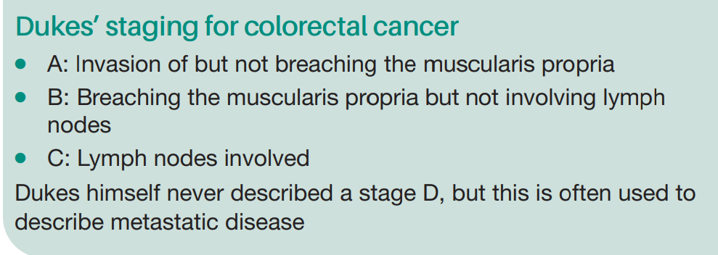
STAGING

Slide 16
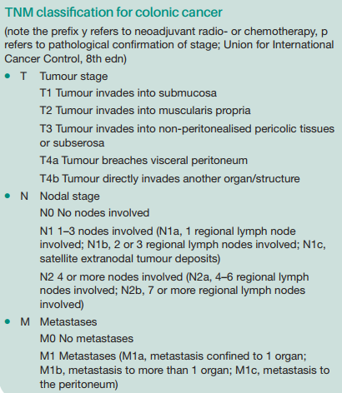

Slide 17
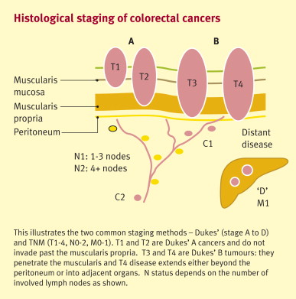

Slide 18
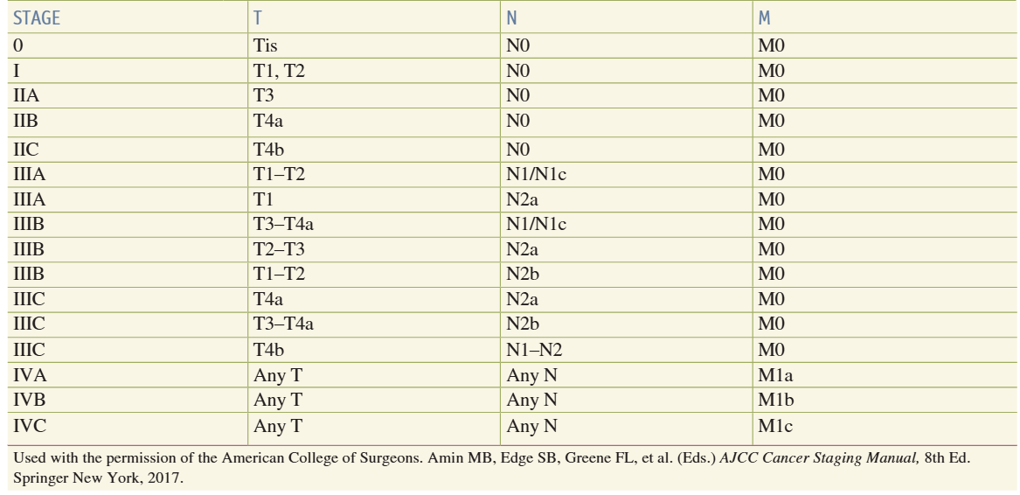

Slide 19
Management
Options
Surgery
Chemotherapy
Radiotherapy

Slide 20
1. Surgery
According to location of tumor:
  For Cecum and Ascending Colon tumor:
  Standard right hemicolectomy (20cm of ileum, cecum, ascending colon, hepatic flexure and 1/3rd portion of transverse colon removed)
  (Ileocolic, Right colic, right branch of middle colic artery ligated)

Slide 21
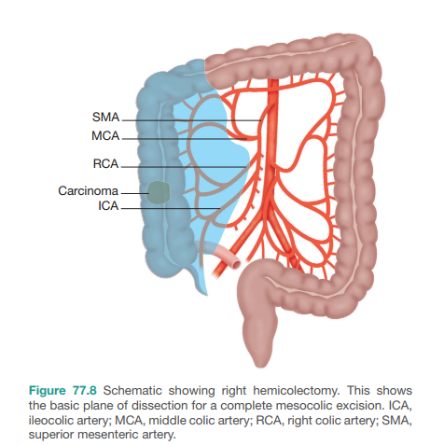

Slide 22
  ii. For Hepatic Flexure Tumor
  Extended right hemicolectomy (20cm of ileum, cecum, ascending colon, hepatic flexure and 2/3rd portion of transverse colon removed)
  (Ileocolic, Right colic, right and left branches of middle colic artery ligated)

Slide 23
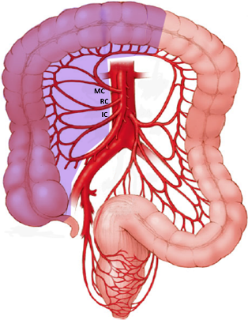

Slide 24
iii. For splenic flexure :
Extended left hemicolectomy (2/3rd portion of transverse colon, splenic flexure and descending colon)
(Middle colic left and right branch, Ascending branch of left colic artery ligated)
OR
Extended right hemicolectomy with ileo colic anastomosis can be done

Slide 25
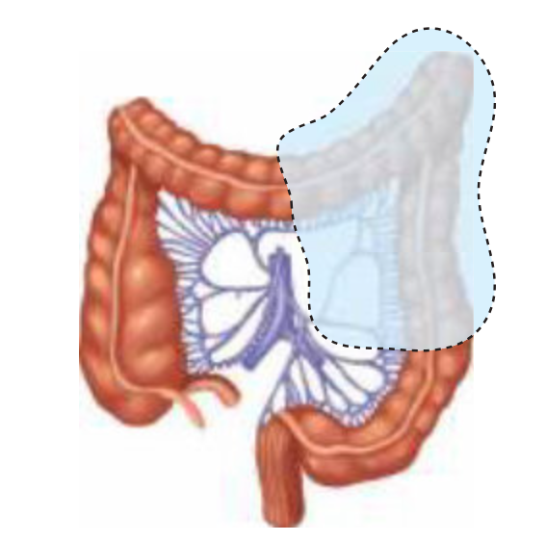

Slide 26
iv. For Descending colon cancer:
Left hemicolectomy (1/3rd portion of transverse colon, splenic flexure and descending colon)
(Middle colic left branch, Ascending branch of left colic artery ligated)

Slide 27
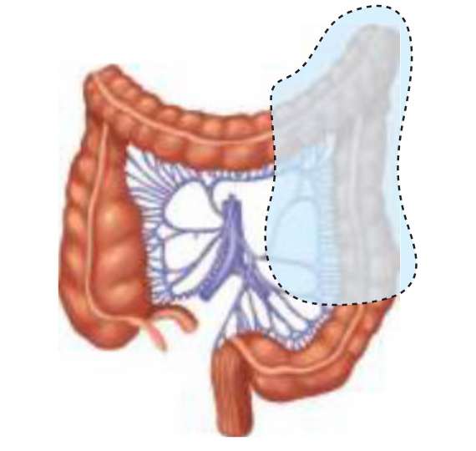

Slide 28
v. For Mid transverse colon tumor:
Segmental resection with colocolic anastomosis can be done.(only in SRB book)

Slide 29
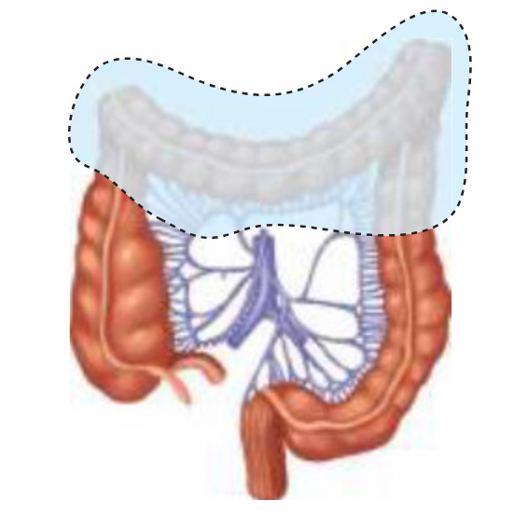

Slide 30
Vi. For Sigmoid Colon Cancer:
  Left Hemicolectomy or sigmoid colectomy(Anastomosis can be created between descending colon and upper rectum) can be done

Slide 31
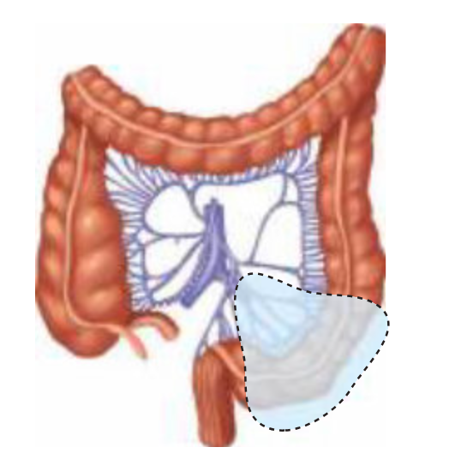

Slide 32
Nodal Dissection (Lymphadenectomy)
D1 (At the level of arterial arcade)
D2 (At the level of named vessel)
D3 (Along central vessel/main trunk: SMA, IMA)

Slide 33
General Principles of Surgery
Safe Margin : Proximal 10 cm, Distal 10 cm
No of LN to be removed: 12 minimum must be removed
In case multiple synchronous tumous total colectomy with ileorectal anastomis can be done or in hnpcc.

Slide 34
Early Stage Cancer ( Stage 1 and Stage 2)
Surgical Resection (Colectomy plus lymphadenectomy plus anastomosis)
For Stage 1: After adequate resection, no need of chemotherapy.
For Stage 2: After adequate resection, no need of chemotherapy, but if patient has high risk features (Grade3 on biopsy, lymphovascular invasion, CEA >5, Less than 12 LN resected)chemotherapy must be given

Slide 35
Stage 3 Cancer
Surgery plus Lymphadenectomy then adjuvant chemotherapy (Folfox regime 12 cycles for 6 months must be given )

Slide 36
Stage 4 Cancer
If localized mets to liver and lungs, then surgery with metastatecomy must be done
If there is organ involvement such as duodenum, that can be removed; then whipple procedure can also be done alongwith colon surgery.

Slide 37
For Non resectable tumor
Palliative care
For obstruction, then bypass procedure or diversion stoma can be done
For hemorrhage, angiographic embolization can be done

Slide 38
Note
If metastatic tumor found during laparotomy
4 things must be looked ( Volume, location, size, mets)
->If tumor is low volume, resectable, isolated mets, we can proceed for resection
->but if tumor is high volume, unresectable, diffuse mets, then simply take biopsy, diversion must be done and post op chemotherapy must be started.
-> No role of neo-adjuvant chemotherapy

Slide 39
Radiotherpy
No role as such
Indication
inoperable
Recurrent

Slide 40
Prognosis
STAGE | PROGNOSIS (5 year)
1 | 80-85 % with surgery
2 | 60-80% with surgery
3 | 30-60 % with surgery
4 | <30 %

Slide 41
Follow-up (European Guidelines)
CEA level (Every 3 monthly for 3 years then 6 monthly for next 2 years, then annually)
Colonoscopy (Annually for 3 years )
CT Scan ( 6 monthly for 3 years)

