Slide 1
Right Heart Failure
Dr Memmona Rashid
PGR Medical Unit 1

Slide 2
Definition of Right Heart Failure:
  Right heart failure (RHF) is a clinical syndrome caused by
  dysfunction of the right heart structures (predominantly the right ventricle [RV] but also the tricuspid valve apparatus and right atrium) or pericardium,
  resulting in impaired ability of the right heart to perfuse the lungs at normal central venous pressures.

Slide 3
Causes of Right Heart Failure:
  Left heart failure
  Pulmonary hypertension
  Right ventricular infarction
  Pulmonary embolism
  Tricuspid or pulmonic valve disease

Slide 4
Symptoms of Right Heart Failure
Dyspnea and fatigue
Angina-like chest discomfort
Abdominal distension, anorexia, and early satiety
Reduced exercise capacity

Slide 5
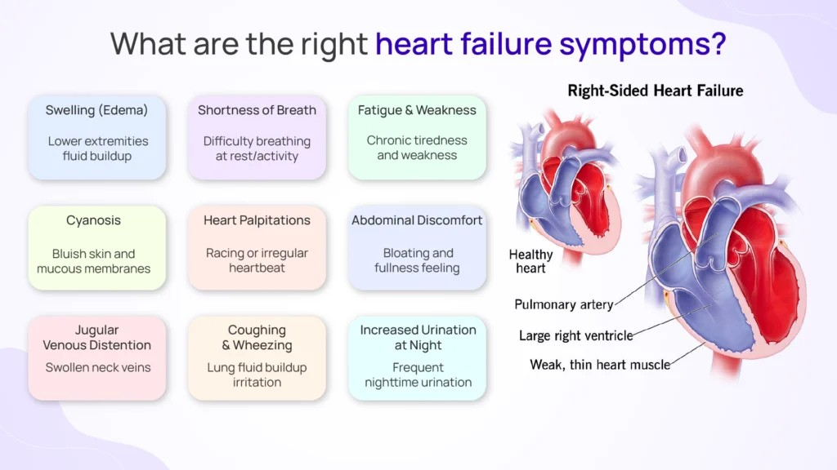

Slide 6
Physical Examination Findings
Cardiac exam:
  Right Ventricular heave
  Loud P2 sound (pulmonary hypertension)
  Tricuspid regurgitation murmur

Slide 7
Physical Examination Findings
Jugular venous distention
Lower extremity edema
Aascites & Hepatomegaly

Slide 8
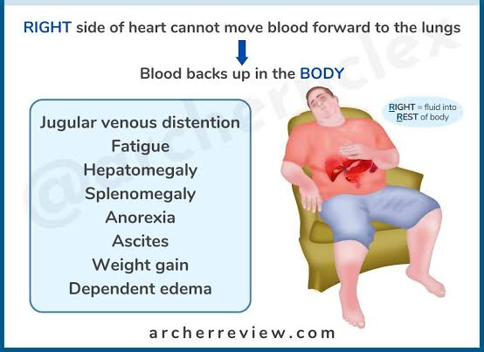

Slide 9
Initial Diagnostic Tests
Basic labs:
  Complete blood count
  Kidney function tests
  Serum electrolytes
  Liver biochemical tests
Special markers:
  Natriuretic peptides (BNP or NT-proBNP)

Slide 10
Lab Findings in Chronic RHF
Kidney function: Evidence of chronic kidney disease, elevated BUN/Cr ratio
Congestive hepatopathy:
  Mild to severe bilirubin elevation
  Normal to mildly elevated alkaline phosphatase
  Elevated aminotransferases in one-third of patients
  Hypoalbuminemia (due to malnutrition or protein loss)
  Mildly elevated prothrombin time

Slide 11
Electrocardiography & Chest Radiography
ECG findings:
  Atrial fibrillation
  Right axis deviation
  Right Bundle Branch Block
Chest X-ray:
  Enlarged right heart border
  Signs of left-sided HF

Slide 12
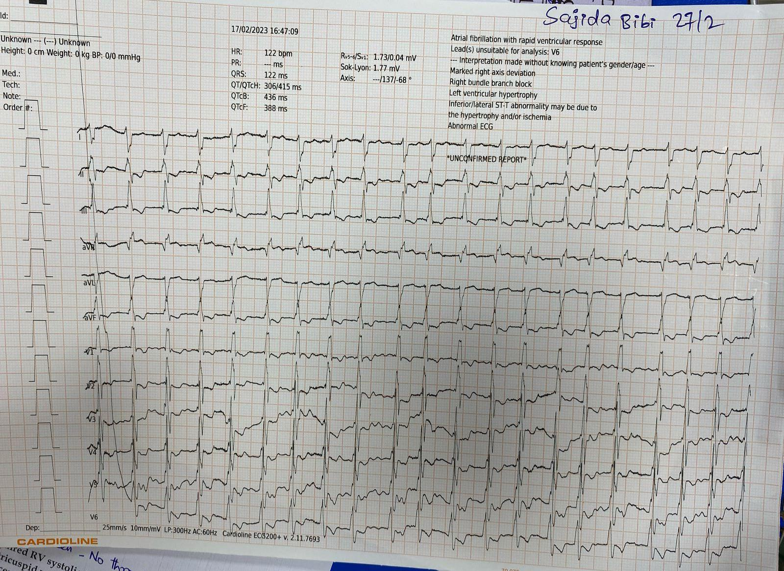

Slide 13
Complications of Right Heart Failure
Volume Overload
Peripheral edema
Ascites and pleural effusion
Hepatic congestion

Slide 14
Complications of Right Heart Failure
Arrhythmias & Sudden Cardiac Death
Atrial fibrillation, flutter
Ventricular arrhythmias in severe cases
Increased risk of sudden death

Slide 15
Complications of Right Heart Failure
Renal Dysfunction (Cardiorenal Syndrome)
Decreased renal perfusion
Progressive chronic kidney disease
Worsening fluid retention

Slide 16
Complications of Right Heart Failure
Gastrointestinal & Hepatic Complications
Congestive hepatopathy
Intestinal edema

Slide 17
Complications of Right Heart Failure
Respiratory Complications
Hypoxemia and respiratory failure
Secondary pulmonary infections due to congestion

Slide 18
Complications of Right Heart Failure
Progression to Left Heart Failure
Septal shift and LV dysfunction
Escalating need for advanced heart failure therapies

Slide 19
Management of Right Heart Failure

Slide 20
General Management Principles
Maintenance of oxygen delivery to tissues
Optimization volume status
Hemodynamic support
Management of arrhythmias
Advanced therapies for refractory cases
Palliative care options
Activity restriction when needed

Slide 21
Supplemental Oxygen & Ventilatory Support
Use oxygen for SpO2 < 90%
Mechincal ventilation for severe cases
Reduces hypoxia mediated pulmonary vasoconstriction

Slide 22
Optimization of Volume Status
Volume overload management:
  Diuretics as first-line (IV for gut edema)
  Ultrafiltration for refractory cases
  Specific scenarios:
  Pulmonary arterial hypertension: Careful diuretic use
  Avoid volume depletion in PE, RVMI
  IV fluid challenges for volume repletion when necessary

Slide 23
Monitoring & Lifestyle Modifications
Daily symptom, sign, and weight monitoring
Sodium restriction (<3 g/day)
Fluid restriction (1.5–2 L/day)

Slide 24
Arrhythmia Management
Common in RHF patients
Risk of sudden death
Manage according to underlying cause:

Slide 25
Activity Restriction
Avoid competitive sports in symptomatic HF

Slide 26
Specific Therapy for Acute RHF
Pulmonary embolism: Anticoagulation, thrombolysis, or thrombectomy
RV myocardial infarction: Reperfusion therapy (PCI or fibrinolysis)
Myocarditis (e.g., giant cell, eosinophilic): Immunosuppressive therapy
Cardiac tamponade: Pericardiocentesis or surgery
SVC/IVC obstruction: Treat underlying cause (e.g., malignancy, thrombosis)

Slide 27
Specific Therapy for Chronic RHF
HFrEF and HFmrEF:
Guideline-directed medical and device therapy
Pulmonary hypertension: Pulmonary vasodilators, tailored to PH group
Chronic myocarditis (e.g., sarcoidosis): Immunosuppressive therapy

Slide 28
Specific Therapy for Chronic RHF
Chronic thromboembolic PH:
Anticoagulation
pulmonary endarterectomy

Slide 29
Management of Refractory Right Heart Failure
Approach to Refractory Volume Overload
Initial Steps:
  Diuretic dose uptitration
  Combination diuretic therapy
When Diuretics Fail:
  Hemodialysis or hemofiltration for fluid removal

Slide 30
Management of Refractory Right Heart Failure
Managing Low Cardiac Output
Inotropic Support:
  IV inotropes for RV/LV systolic dysfunction
  Temporary use until specific cause is addressed
Example:
  Acute RV infarction: inotropes + vasopressors + fluid resuscitation
  Revascularization for RV recovery

Slide 31
Role of Digoxin
Limited Role in Isolated RHF:
  No clear benefit for RV function or exercise capacity
In HFrEF with RHF:
  Digoxin for persistent symptoms despite guideline-directed therapy

Slide 32
Mechanical Circulatory Support
Indications:
  Severe RHF due to LV or RV dysfunction
  Refractory to standard therapies
Support Devices:
  RV assist devices
  LVAD adjustments for septal bowing
  ECMO for temporary support

Slide 33
Heart and Lung Transplantation
When to Consider:
  Severe, irreversible RHF or biventricular failure
  Failure of medical and device therapies

Slide 34
Palliative Care in Refractory RHF
  Persistent NYHA class IV symptoms
  High comorbidity burden
  When quality of life takes priority over aggressive interventions

Slide 35
Thromboembolism & Stroke Risk
Venous stasis and
Clot formation
Increased risk of thromboembolism

Slide 36
Open floor for questions, suggestions and case discussions

