Slide 1
Mrs Rukhsana presented to us in a state of agony, she was bleeding per vaginal from 5 months, severely anaemic, had multiple uterine evacuations and infected vulval growth.
After history and examination we suspected her a case of GTD, although it presents rarely with vulval growth.
We sent beta hcg which was 7 lac, this also strengthen our diagnosis.
Histopathology of vulval growth confirmed it to be a case of choriocarcinoma.

Slide 2
We collaborated with oncology department , her MRI pelvis, CT chest, MRI brain, Echocardiography and fundoscopy was done.
Her FIGO risk score came out 15 , which falls in ultra high risk group.
Multiagent chemotherapy with EMA/CO is started.
One of the chemotherapy drug, Actinomycin D was not available in market, with the help of worthy principal sir we were able to arrange it.
Now pt is receiving second cycle of chemotherapy.

Slide 3
Choriocarcinoma
Dr. Rumsha shafi
Pgr gynae unit 1

Slide 4
Learning objectives:
Be able to recognise the clinical features of gestational trophoblasti disease.
Have good knowledge of diagnosis and management of GTD
Be able to counsel a woman with gestational trophoblastic disease
Have an appreciation of the need and response of medical intervention.
Be able to understand further followup of disease.

Slide 5
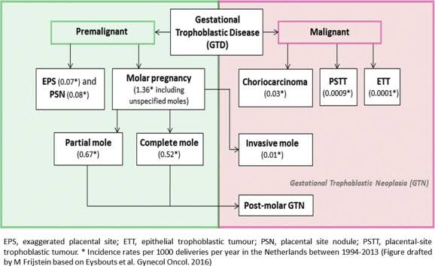
Gestational trophoblastic diseases:
Gestational trophoblastic Disease is a spectrum of proliferative abnormalities Of trophoblasts associated with pregnancy.

Slide 6
Choriocarcinoma:
It is one of the most malignant tumor arising in the body of uterus.
Exhibits a geographical distribution.
Europe and USA 1:40,000 pregnancies
10 times more common in south east Asia 9.2/40,000 pregnancies.
Older women with high parity and belonging to low socioeconomic group runs a higher risk of developing this malignancy.

Slide 7
Origin:
Choriocarcinoma occurs following a
Molar pregnancy: 50% cases
Abortion: 25% cases
Term pregnancy: 20% cases
Extrauterine pregnancy: 5% cases

Slide 8
Clinical presentation:
Symptoms and signs:
Depends on site of growth
Persistent or irregular bleeding following an abortion, a molar pregnancy or a normal delivery. Bleeding can be profuse or only blood stained discharge. Pyrexia and cachexia are açcompanying symptoms.
Amenorrhea: because of a very high level of hcg.
Dyspnoea+ haemoptysis: lung metastasis

Slide 9
Neurological symptoms such as hemiplegia, convulsions,headache and visual disturbances : brain metastasis
ON EXAMINATION:
vaginal metastasis appears as a bluish red vascular tumor which bleeds easily on touch.uterus may be enlarged.

Slide 10
Diagnosis:
Diagnosis is made on basis of clinical features
Raised serum beta Hcg level
USG scan of liver and pelvis
X-ray of lungs
CT scan of lungs and brain.
Histological evidence when available.

Slide 11
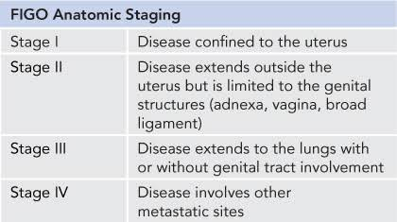
Figo staging:

Slide 12
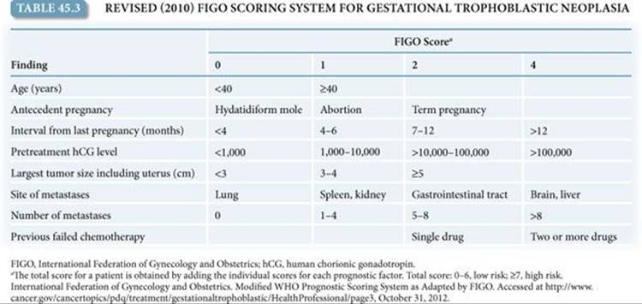

Slide 13
A risk score of
6 or < : low risk
7-12 : high risk
13 or > : ultra high risk

Slide 14
Treatment :
Treatment of choriocarcinoma is mainly
CHEMOTHERAPY
For both local and distant metastasis.
Staging and FIGO risk scoring decides whether single or multiple drug therapy is required.

Slide 15
Low Risk disease management
Single drug therapy;
METHOTREXATE / Actinomycin D
In low risk pt’s ( FIGO score of 6 or<).
METHOTREXATE is given IM with oral folinic acid.
MTX is a folic acid antagonist and interferes with the formation of nucleic acid and mitosis in malignant cells thereby arrests the growth.
Side effects: ulcerative stomatitis , gastric haemorrhage, skin reaction,alopecia,bone marrow depression leading to anaemia, leucopenia and agranulocytosia, liver and kidney damage.

Slide 16
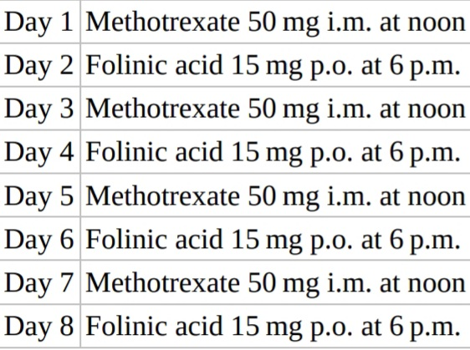
The low risk methotrexate and folinic acid treatment schedule:

Slide 17
Repeated at interval of 10-14 days, until 3 consecutive weekly negative reports for hcg in serum.
Then further 3 cycles to ensure eradication of any residual disease that is below the level of serological detection.
Patients who have an inadequate response to methotrexate, shown by hcg plateau or rise are given second line therapy which is single agent
Actinomycin D.

Slide 18
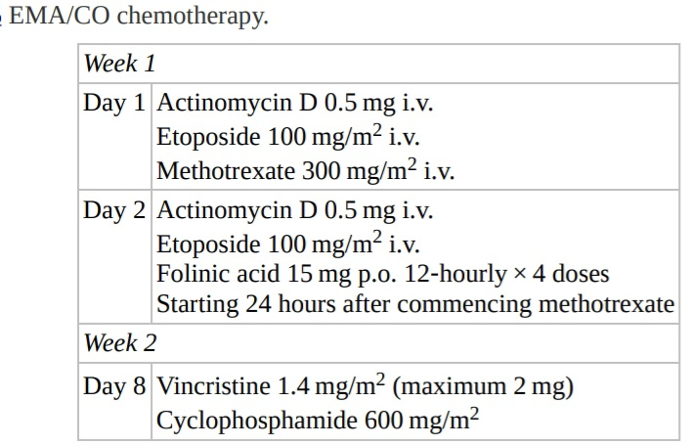
High risk disease management:
Combined chemotherapy:

Slide 19
The course is repeated every 2 weeks depending on recovery from toxicity of drugs given in previous cycle and is continued 6 weeks after normalisation of hcg.
SIDE EFFECTS:
EMA/CO is myelosuppressive , CSF are required to minimize risk of neutropenic sepsis.
Nausea, vomiting – 5 HT3 receptor antagonist with domperidone
Peripheral neuropathy.

Slide 20
ULTRA high RiSK disease management:
It is a new term to try to define those high risk patients at greatest risk of death either early or late.
Early deaths occured within 4 weeks of admission due to organ failure asaociated with fatal haemorrhage, metabolic upset from tumor lysis and very advanced disease.
Late deaths were from mutiresistance disease.
In these patients low dose therapy with etoposide and cisplatin is given on days 1 and 2 and repeated weekly for upto 3 weeks until pt. Is able to tolerate standard dose therapy.

Slide 21
For pt. With brain metastasis methotrexare dose is increased to 1g/m2 and intrathecal methotrexate is given along with etoposide to ensure adequate CNS penetration.

Slide 22
Salvage of EMA/CO failures:
EMA-CO- 18-20% pts develop resistance.
EP-EMA (etopoaide, cisplatinum,methotrexate, actinomycin D)
TP/TE ( paclitaxel cisplatin/paclitexal etoposide)
VIP (etoposide,ifosfamide,cisplatin)
BEP ( bleomycin,etoposide, cisplatin)
FA (5-fluorouracil,actinomycin D)

Slide 23
Surgery:
Surgery is rarely indicated.
Indications of hysterectomy:
High risk cases older than 40 years, multiparous
Chemotherapy resistance
Large size growth in uterus
Intraperitoneal haemorrhage due to uterine perforation

Slide 24
Role of radiotherapy is limited to acute bleeding from brain, liver and vaginal metastasis.
Solitary lung metastasis-thoracotomy or lobectomy
Slitory brain tumor- Craniotomy

Slide 25
Follow up of a case of choriocarcinoma
Serum beta hcg is done every week till it becomes negative.
Once negative, it is repeated 2 weekly for 3 months
Thereafter every month for 1 year
And then 6 monthly for rest of life.

Slide 26
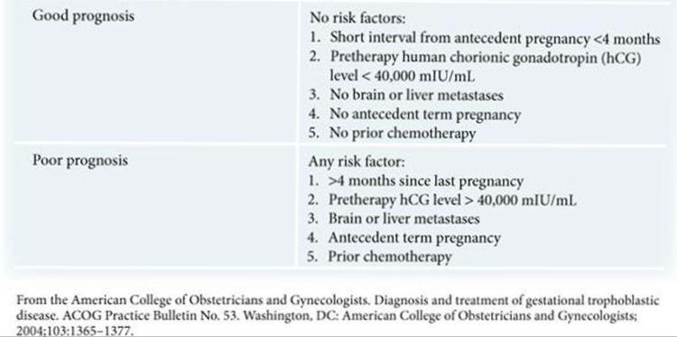
Prognosis:
With chemotherapy, cure rate is 100% in low risk groups.
And 90% in high risk groups.

Slide 27
Subsequent fertility:
Fertility is not affected by single agent therapy with methotrexate or EMA/CO.
Pregnancy should be deferred for 12 months after treatment to avoid any teratogenic effect on developong oocytes, and to minimize the confusion from rising beta hcg level between a new pregnancy and disease relapse.

Slide 28
Counselling:
About followup with beta hcg.
Fertility rate is not affeted.
1:70 risk of repeat molar pregnancy, therefore recommend early usg and beta hcg .
Discuss contraception.

Slide 29
Contraception:
 | COC/P/ CVR | BARRIER METHODS | CIC | POP | DMPA /NET-EN | LNG /IMPLANT | CU-IUD | LNG-IUD
Gestational trophoblastic disease a) Decreasing or undetectabl beta hcg levels | 1 | 1 | 1 | 1 | 1 | 1 | 3 | 3
b)Persistently elevated beta- hcg levels or malignant disease | 1 | 1 | 1 | 1 | 1 | 1 | 4 | 4

Slide 30
Risk of relapse:
Once the hcg level has fallen to normal, risk of relapse is < 4% for pt. In low risk category,
8% for high risk category.
Recurrences occur within first 12 months after treatment.

Slide 31


