Slide 1
PRE-OPERATIVE PREPARATION
After workup, patient stayed in ward for 10 days
Cardiac and pulmonary fitness was taken (Echocardiography and PFTs were done)
Spirometry started on 1st day
Compression stockings were given to the patient
Egg whites were encouraged as patient’s serum albumin was low
After optimization of the patient, informed consent was taken
Procedure explained to the patient
And patient was put on elective list 17/3/2025 Monday.

Slide 2
12 hours before the surgery, solid and liquid diet was stopped
Prophylactic antibiotic was given 1 hour before incision
2 pints of blood were arranged

Slide 3
SURGERY

Slide 4
PROCEDURE
Exploratory Laparotomy
+ Extended Left Hemicolectomy
+ Spleenectomy
+ Nephrectomy
+ Metastatectomy
proximal ileostomy
+ Drain Placement
+ Formal Closure

Slide 5
1. Mobilization of the colon with incision from Line of Toldt

Slide 6
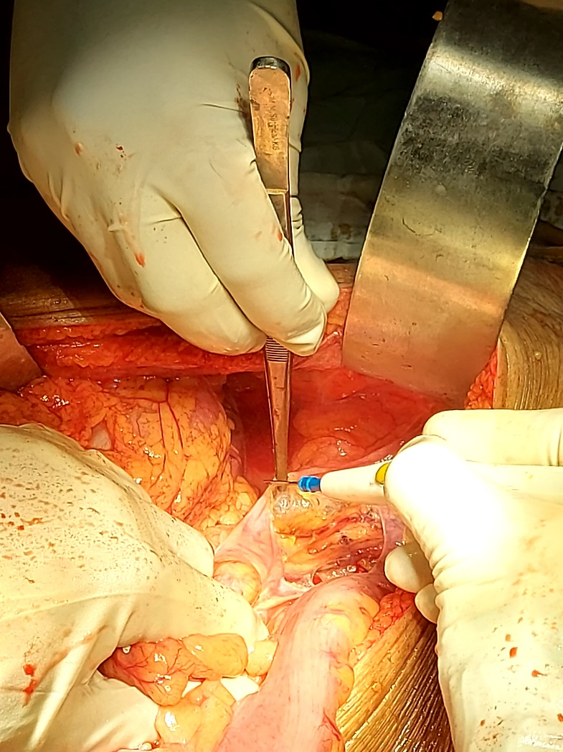

Slide 7
2. Mobilization of splenic flexure along with spleenectomy

Slide 8
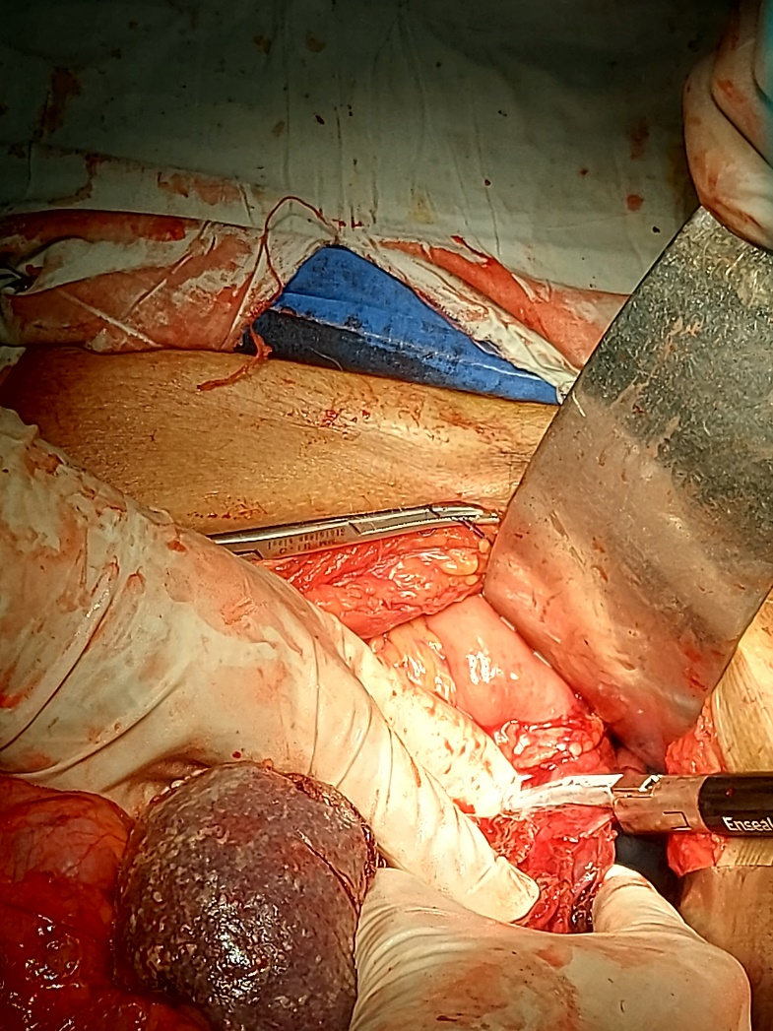

Slide 9
3. En-bloc resection of the mass along with splenectomy and nephrectomy

Slide 10
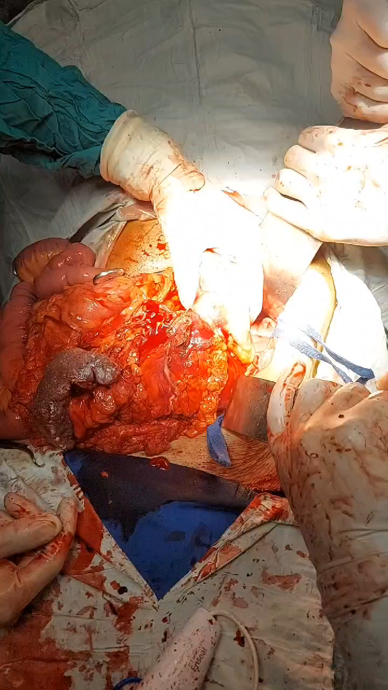

Slide 11
4. Extended Left Hemicolectomy

Slide 12
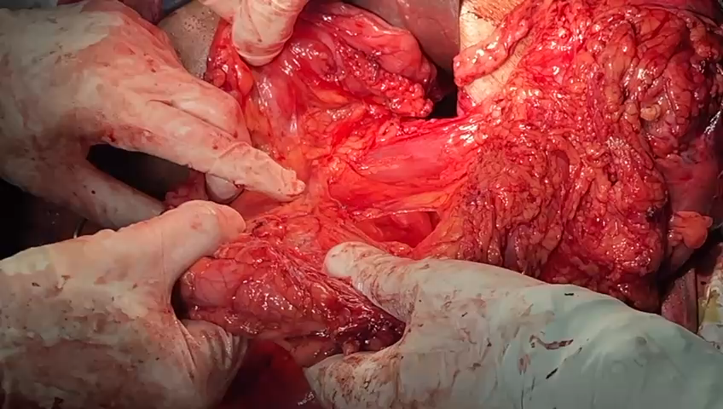

Slide 13
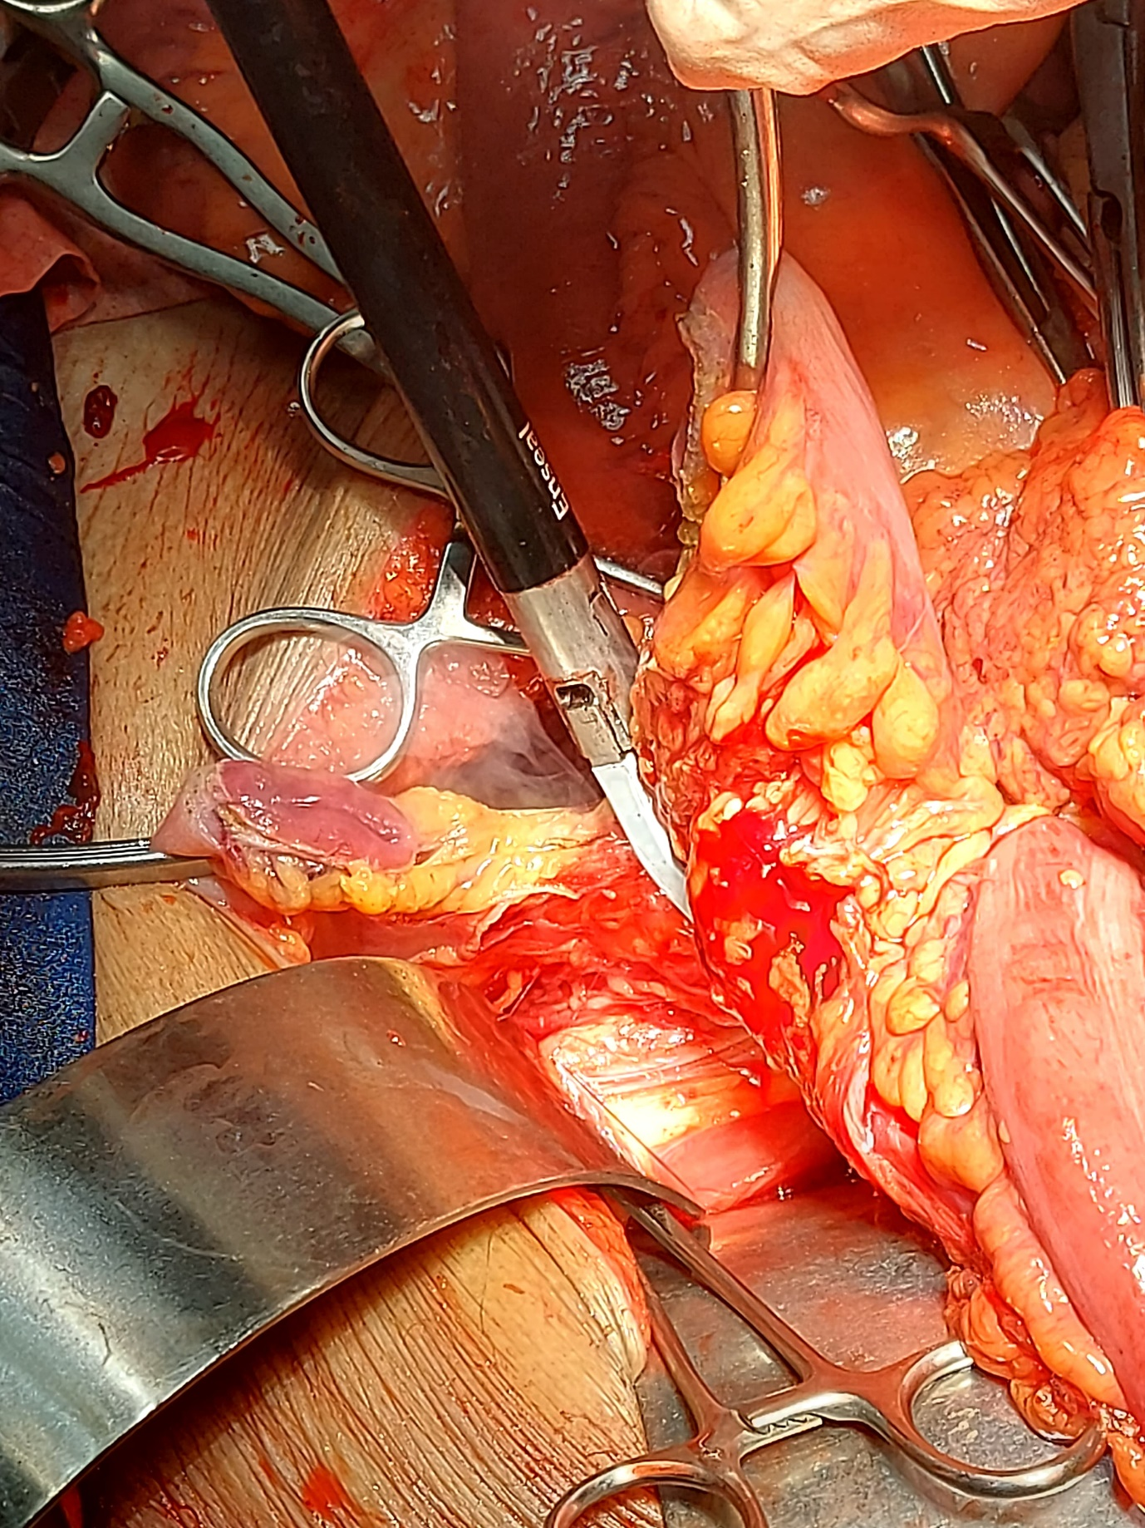

Slide 14
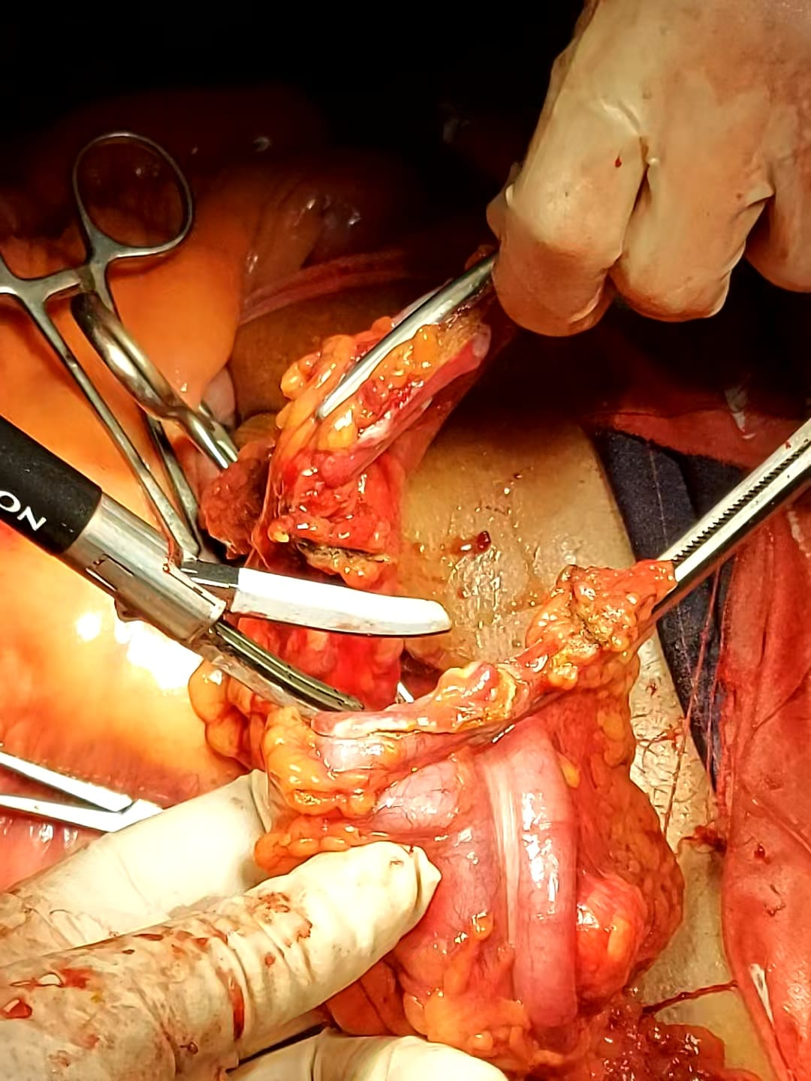

Slide 15
5. End to End Anastomosis done

Slide 16
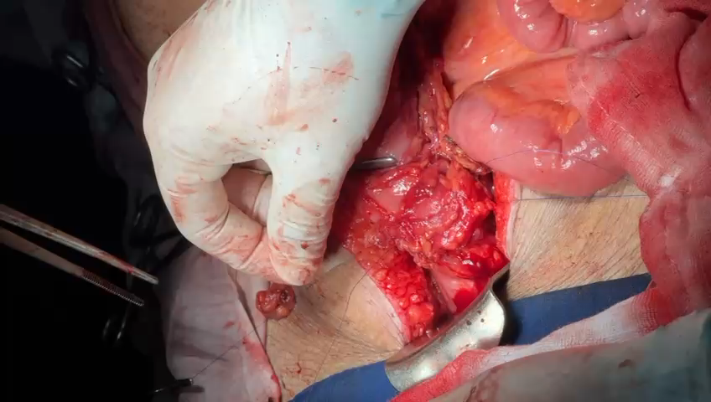

Slide 17
Specimen extracted

Slide 18
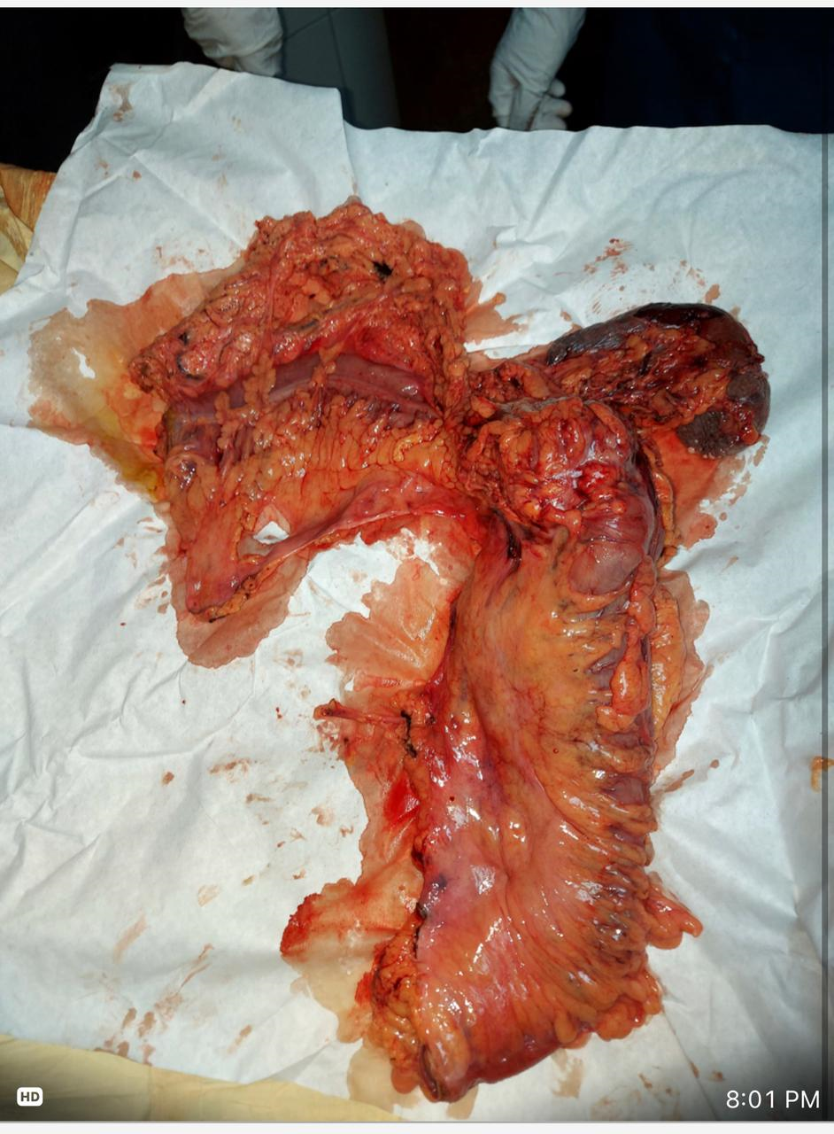

Slide 19


