Slide 1
Clinico-pathological Conference (CPC)
Department of General Surgery,
Surgical Unit 2,
Sheikh Zayed Medical College and Hospital, Rahim Yar Khan, Punjab, PAK

Slide 2
Biodata:
A 65 year old, married, muslim male, farmer by profession, resident of Kot Samaba, RYK, Presented through OPD, on 22-02-2025, with
Presenting Complaints;
  Abdominal Pain for 6 months.
History of Presenting Illness:
Our patient was in usual state of health 6 months back, when he started having complaint of abdominal pain, gradual in onset, continuous, localized to epigastric region, mild to moderate I intensity, non radiating, aggravated by food intake, not relieved by medication. Associated with GERD, vomiting, and weight loss.

Slide 3
6 months back, our patient went to the local practitioner for abdominal pain. He was prescribed medicine and was sent home.
The very next day, in the morning, he had one episode of melena. After one and half hour, patient had one episode of hematemesis. vomiting was non-projectile, 2-3 cups per episode and contained food contents and blood clots.

Slide 4
Systemic Inquiry:
Respiratory system;
Off and on cough without sputum ,no SOB, chest pain,
Cardiovascular system;
No palpitation, orthopnea, PND, pedal edema
Genitourinary system;
No dysuria, pyuria, anuria, flank pain
Central nervous system;
No headache, blurring of vision, fits, ALOC, vertigo
Musculoskeletal system;
Non-significant.

Slide 5
Past Medical History:
There was no significant past medical history.
Past Surgical History:
There was no significant past surgical history.
Personal History:
Smoker(10 pack years),weight loss, decreased appetite with no history of recreational drug abuse.
Family History:
There was no significant history of any carcinoma in family.
There was also no history of DM, HTN, Hep. B/C, TB in any close or distant relative.

Slide 6
Socioeconomic History
There are seven family members with two earning hands living in Mud house using tap water with average hygiene and lower middle class status.

Slide 7
Immediately after this, the patient presented to ER of SZH.
After initial resuscitation, patient was referred to the Gastroenterology department.
On 29-11-2024, on Oesophagogastroduodenoscopy (OGD), there was normal upper, middle and lower esophagus. Multiple ulcers with overlying slough were seen at the junction of body and antrum. Thickened pylorus was seen. Scope couldn’t negotiate further. No biopsy sample was taken at that time due to active bleed. The diagnosis of gastric ulcer (Forest Class 2C) was made.
CT Abdomen and pelvis with oral and IV contrast was ordered.

Slide 8
Findings:
Symmetrical circumferential wall thickness of the pylorus. The stomach was distended.
On 09-01-2025, OGD showed post lavage normal fundus and body of the stomach. Thickened infiltrated mucosa, seen involving pyloric canal. And pylorus. Scope passed across after maneuvering through normal bulb and descending duodenum.
Diagnosis of pyloric canal infiltration/partial gastric outlet obstruction was made.
Biopsy samples were taken from the lesion on OGD and sent to histopathology.

Slide 9
Histopathology showed minute focus of poorly differentiated adenocarcinoma, with signet ring cells features.
After histopathology report, patient was referred to the surgical OPD for further management.
After his initial visit to the surgical OPD, patient lost his follow up for one month.
On 21-02-2025, patient again presented to the surgical OPD, and admitted for management.

Slide 10
On Examination:
GPE:
A thin lean emaciated male, with average height and built, having following vitals,
BP=100/70mmHg
Pulse=84bpm
Temp=100oF
RR=16bpm
He was pale, with no jaundice, clubbing, paronychia, leuconychia, Heberden or Bouchard’s nodes.
There were no enlarged or palpable lymph nodes.
JVP was not raised.

Slide 11
Systemic examination:
GIT:
On inspection, abdomen was scaphoid, with no scar marks, striae, visible pulsations, prominent veins. Umbilicus was central and inverted.
On palpation, abdomen was soft, and non tender. There was diffuse, palpable epigastric mass, measuring approximately 5x4cm in size.
Succussion Splash was audible.
There was no visceromegaly.
On percussion, there was no fluid thrill or shifting dullness.
On auscultation, bowel sounds were audible, with no bruit.
Rest of the systemic examination was unremarkable.

Slide 12
On subsequent follow up, there was significant weight loss, fatigue and lethargy. The abdominal pain was consistent, with frequent episodes of vomiting.
After pre-operative preparation, Exploratory laparotomy followed by Billroth II gastrostectomy with Retrocolic Roux-en-Y Gastrojejunostomy was performed. Abdomen was closed temporarily, due to the suspicion of the portion of the transverse colon being de-vascularized during the procedure.

Slide 13
On Re-look laparotomy, the middle portion of the transverse colon was necrozed, which was resected. And rest of the segments of the colon were brought out as colostomy with mucous fistula.
Postoperative care in the surgical ward, initially on IV fluids, and antibiotics with subsequent start on oral liquids and soft diet was done.
Patient was discharged with colostomy bad applied. And called on follow up after one week, and 2 weeks with Histopathology report.

Slide 14
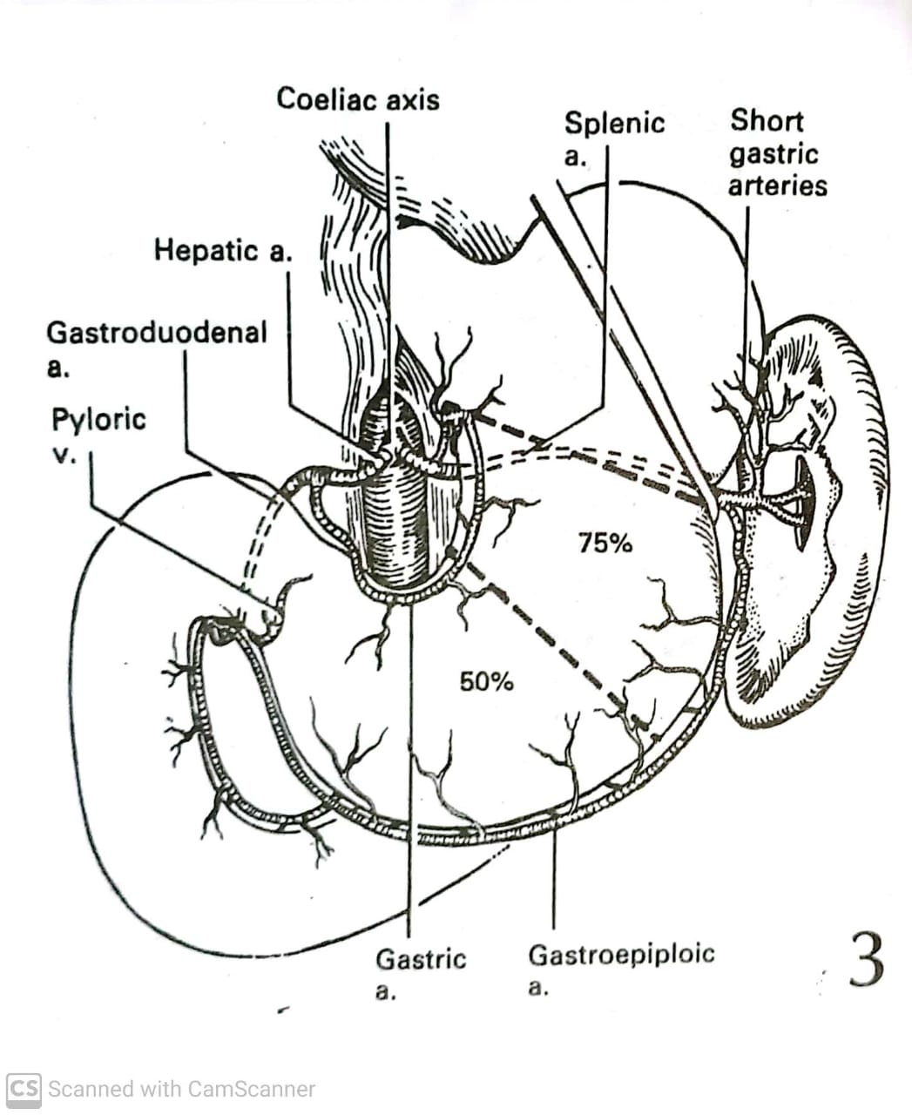

Slide 15
Carcinoma Stomach
By
Dr. Syed Mustafa Haider
Postgraduate Resident
FCPS – Surgical Unit 2
SZMC/H, RYK
04-04-2025

Slide 16
Nervous System:
Intrinsic nerves;
The myenteric plexus of Auerbach and
The submucosal plexus of Meissner. Compared with the rest of the gut, the submucosal plexus of the stomach contains relatively few ganglionic cells, as does the myenteric plexus in the fundus.
Extrinsic supply; derived mainly from the vagus nerves (cranial nerve X), fibers of which originate in the brainstem.
Vagal fibers are both afferent (sensory) and efferent. The efferent fibers are involved in the receptive relaxation of the stomach and the stimulation of gastric motility, as well as having the well-known secretory function.
The sympathetic supply is derived mainly from the coeliac ganglia.

Slide 17
MICROSCOPIC ANATOMY:
1. Surface Epithelial cells
2. Specialized Cells:
Parietal Cells, produce HCL through hydrogen–potassium-ATPase proton pump,
Chief Cells, produce pepsinogen.
Endocrine Cells,
G Cells produce gastrin
ECL Cells produce Histamine
D Cells produce somatostatin

Slide 18
Phases of Gastric Secretion:
Cephalic phase;
Mediated by vagal activity, secondary to sensory arousal.
Gastric phase;
Response to food within the stomach.
Intestinal phase;
The presence of chyme in the duodenum and small bowel inhibits gastric emptying, and acidification of the duodenum leads to the production of secretin, which inhibits gastric acid secretion.

Slide 19
Gastroduodenal motor activity
The motility of the gastrointestinal tract is modulated by its intrinsic nervous system in three phases(90 minutes) through migrating motor complex (MMC).
Phase I:
In the fasting state, and after food has cleared, there is a period of quiescence in the small bowel lasting in the region of 40 minutes.
Phase II:
There follows a series of waves of electrical and motor activity, also lasting about 40 minutes, propagated from the fundus of the stomach in a caudal direction at a rate of about three per minute
Phase III
Duodenal slow waves are generated in the duodenum at a rate of about 10 per minute, which potentiate into the small bowel, which lasts for about 10 minutes.
From the duodenum, the MMC moves distally at 5–10 cm/min, reaching the terminal ileum after 1.5 hours.

Slide 20
GASTRIC CANCER
Caracinoma of the stomach is a major cause of mortality worldwide.
Its prognosis tends to be poor, with cure rates little better than 5–10%, although better results are obtained in Japan, where the disease is common.
Gastric cancer is a curable disease and early diagnosis is key to success.
Unfortunately, late presentation is common.
The only curative treatment is resectional surgery.

Slide 21
Incidence:
UK-approximately 15 per 100 000 per year,
USA, 10 per 100 000 per year,
Eastern Europe, 40 per 100 000 per year.
Japan, 70 per 100 000 per year.
Men are more affected by the disease than women and, the incidence increases with age.
Carcinoma of the distal stomach and body of the stomach is most common in low socioeconomic groups, whereas the increase in proximal gastric cancer seems to affect principally higher socioeconomic groups.

Slide 22
Clinical features
Early gastric cancer has no specifc features.
Advanced cancer;
Early satiety,
Bloating,
Distension
Vomiting.
Upper GI bleeds.
Obstruction leads to dysphagia, epigastric fullness.
Weight loss can be profound.
With pyloric involvement the presentation may be of gastric outlet obstruction syndrome.

Slide 23
Clinico-pathological Classification:
The Laurén classifcation which consist of two types:
1.Intestinal gastric cancer
The tumour resembles a carcinoma elsewhere in the tubular gastrointestinal tract and forms polypoid tumours or ulcers; it probably arises in areas of intestinal metaplasia.
2.Difuse gastric cancer (often with signet ring cell)
Infltrates deeply into the stomach without forming obvious mass lesions but spreads widely in the gastric wall.

Slide 24
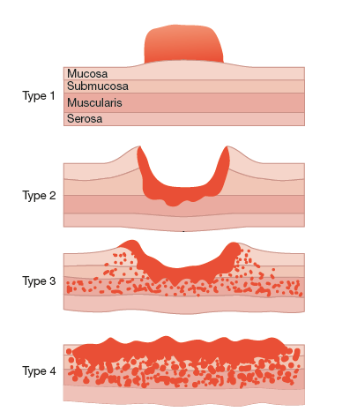
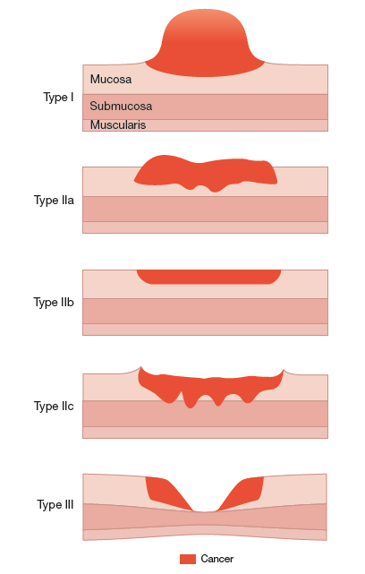
Early Gastric Carcinoma
Advanced Gastric Carcinoma

Slide 25
WHO Histological Classification:
Adenocarcinoma – most common
Papillary adenocarcinoma – most common type
Tubular adenocarcinoma.
Mucinous adenocarcinoma.
Signet-ring adenocarcinoma.
Adenosquamous carcinoma.
Squamous Cell Carcinoma – rare, common near OG junction, if occurs
Undifferentiated Carcinoma.
Others- unclassified carcinoma.

Slide 26
CT Abdomen with and without Contrast:
Demonstration of lesions facilitated by negative contrast agents (water or gas):
A polypoid mass with or without ulceration
Focal wall thickening with mucosal irregularity or focal infiltration of the wall
Ulceration: gas-filled ulcer crater within the mass
Infiltrating carcinoma: wall thickening and loss of normal rugal fold pattern.

Slide 27
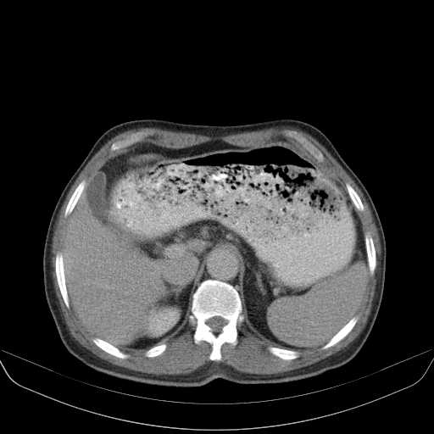
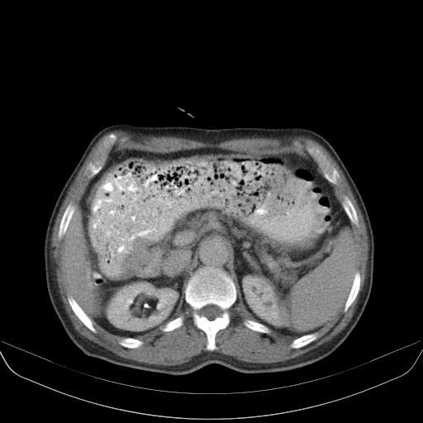
A
B

Slide 28
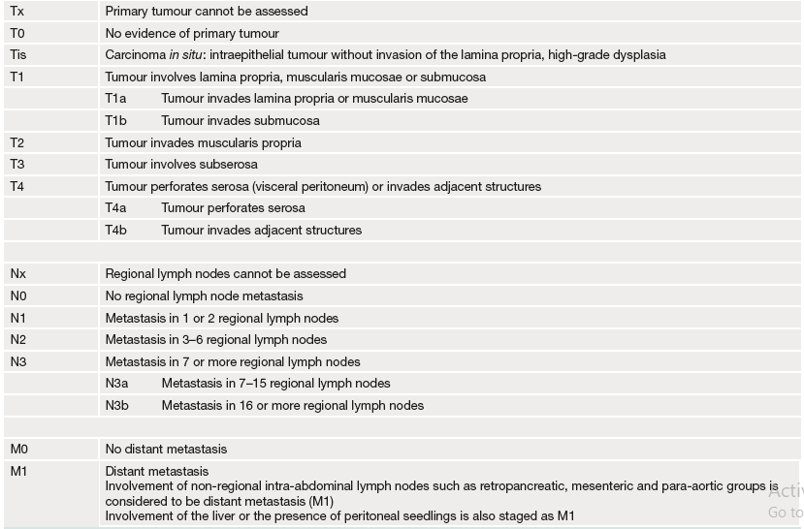
International Union Against Cancer (UICC) grading of gastric cancer

Slide 29
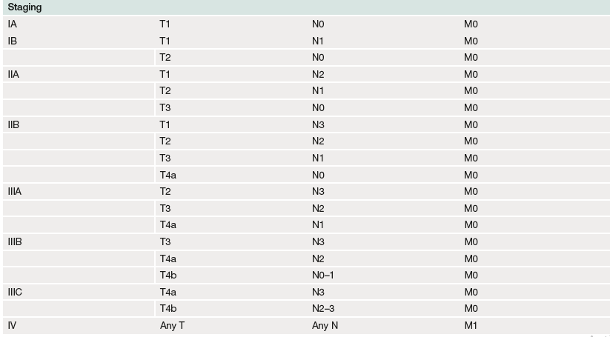
International Union Against Cancer (UICC) staging of gastric cancer

Slide 30
Lymphatic drainage
Lymphatic drainage of the stomach is the key to understanding radical surgery for gastric cancer.
The lymphatics of the antrum drain into the right gastric lymph node superiorly and right gastroepiploic and subpyloric lymph nodes inferiorly.
The lymphatics of the pylorus drain to the right gastric suprapyloric nodes superiorly and the subpyloric lymph nodes situated around the gastroduodenal artery inferiorly.
The eferent lymphatics from suprapyloric lymph nodes converge on the para-aortic nodes around the coeliac axis,
whereas the eferent lymphatics from the subpyloric lymph nodes pass to the main superior mesenteric lymph nodes situated around the origin of the superior mesenteric artery.
The lymphatic vessels related to the cardia communicate freely with those of the oesophagus.

Slide 31
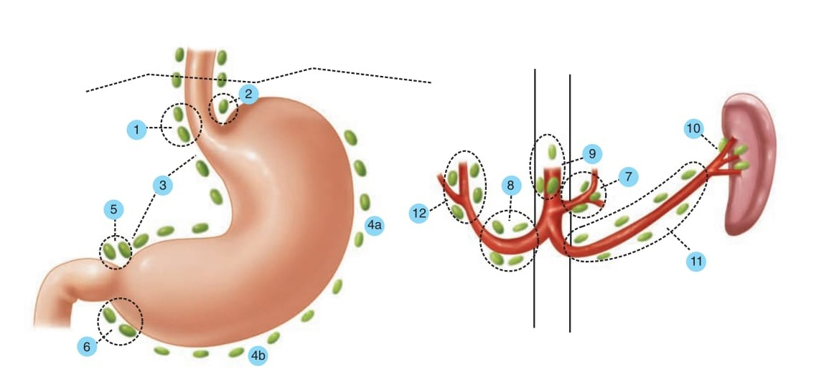

Slide 32
Neoadjuvant chemotherapy:
ECF Chemotherapy
Epirubicin, Cisplatin and 5-Fuorouracil [5-FU];
FLOT4 Chemotherapy
Fuorouracil, Leucovorin, Oxaliplatin, Docetaxel

Slide 33
Surgical Options:
Radical Total Gastrectomy
Subtotal Gastrectomy (Billroth 2)
Palliative Surgery
Palliative Radiotherapy
Palliative Chemotherapy

Slide 34
Indications:
Benign Gastric Ulcer
Duodenal Ulcer disease (Partial gastrectomy with truncal vagotomy)
Gastric Malignancy (Distal Stomach)
Invasion of Tumors arising from other organs i.e. Transverse Colon.

Slide 35
Pre-operative Preparation:
Correction of;
Electrolyte abnormalities.
Anemia.
Coagulation defects.
Smoking should be stopped.
Pre-operative systemic antibiotics preferebly 2nd & 3rd generation cephalosporins.

Slide 36
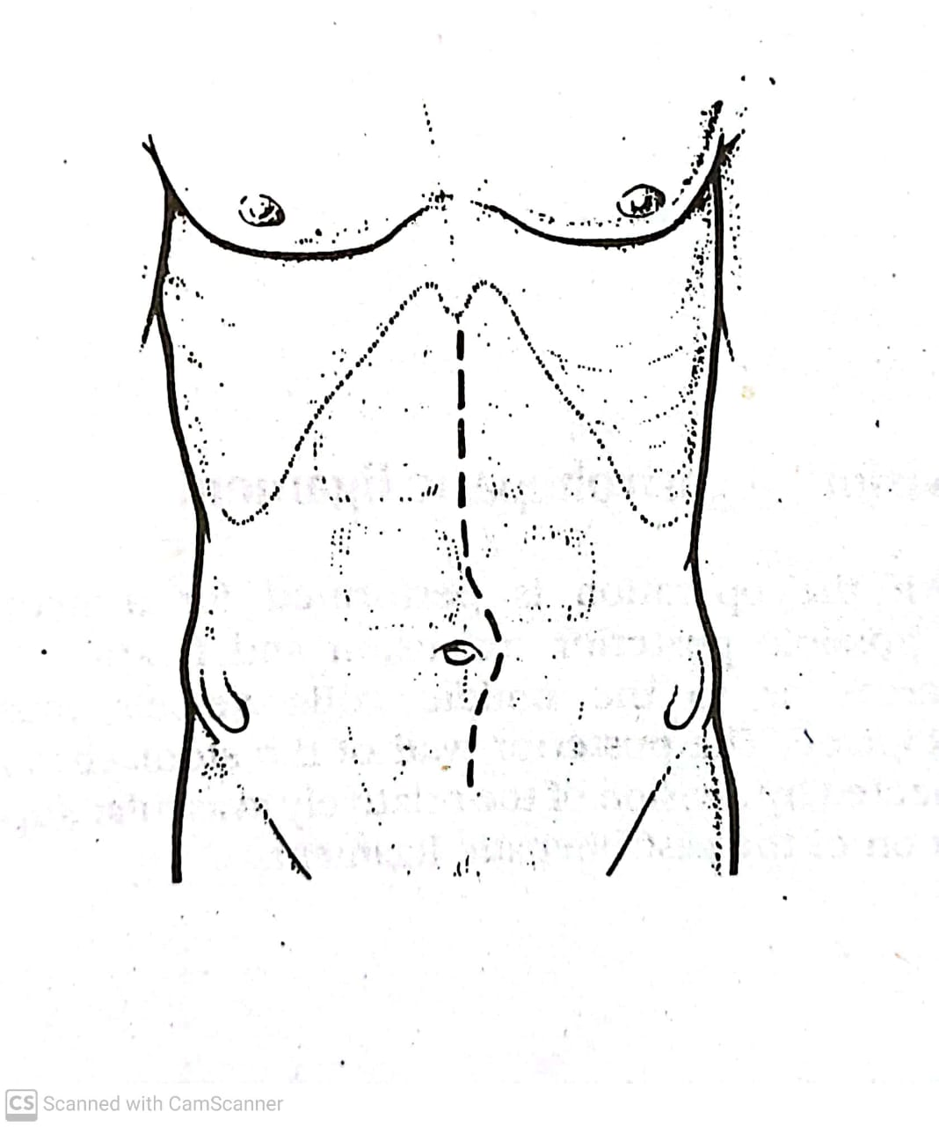
Incision

Slide 37
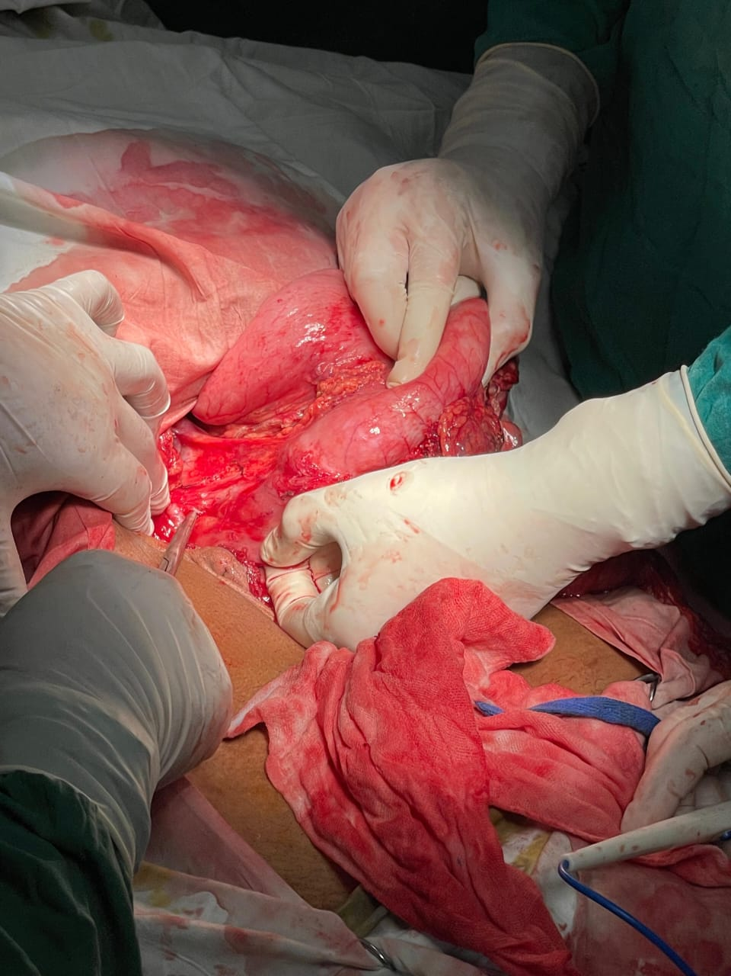
A. Division of gastrohepatic ligament, evident by arrows

Slide 38
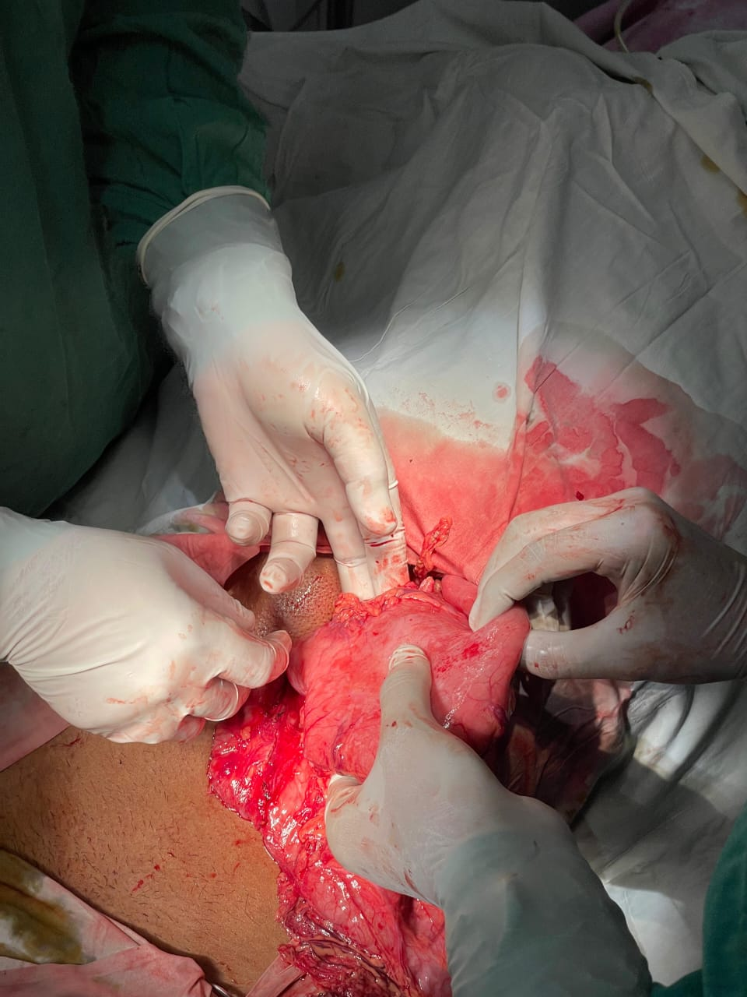
B. Mobilization and preparation of Greater Curvature, following division of left gastroepiploic vessels

Slide 39
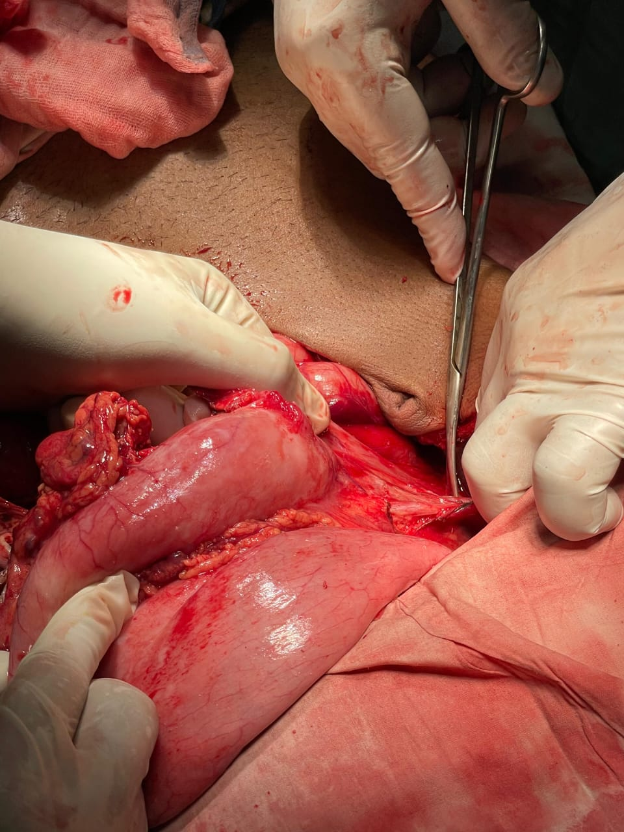
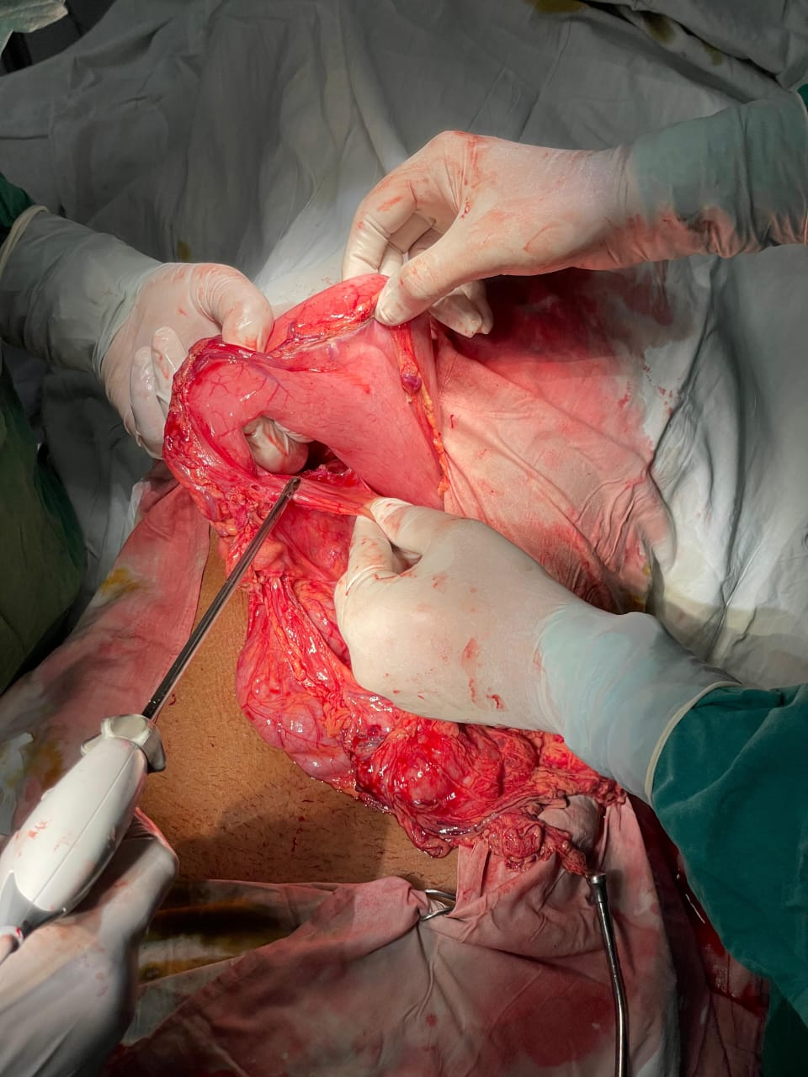
C. Ligation of right gastric vessels and preparation of lesser curvature
D. Division of duodenum

Slide 40
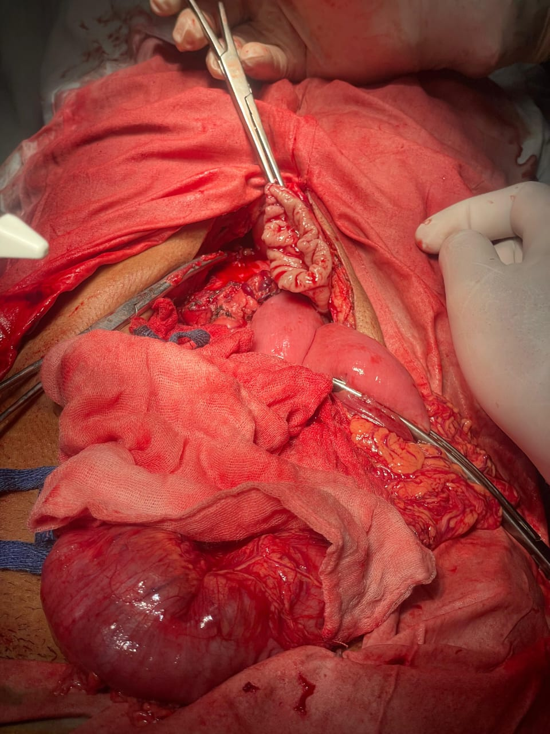
Jejunal loop
Transverse Colon
E. Proximal division of the stomach after closure of duodenal stump, evident by arrows

Slide 41
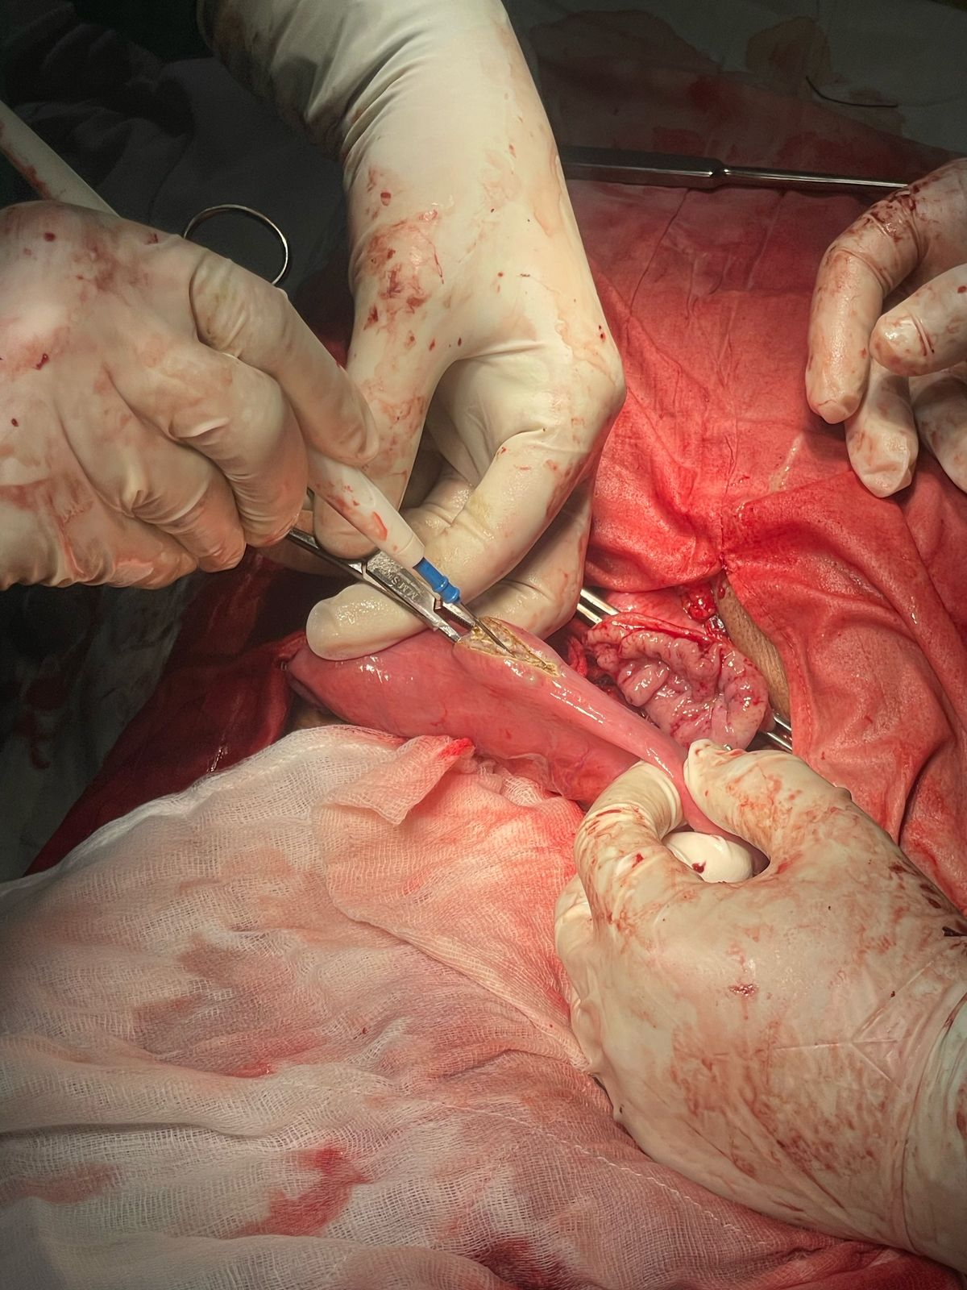
F. Gastrojejunostomy: Sutured Technique

Slide 42
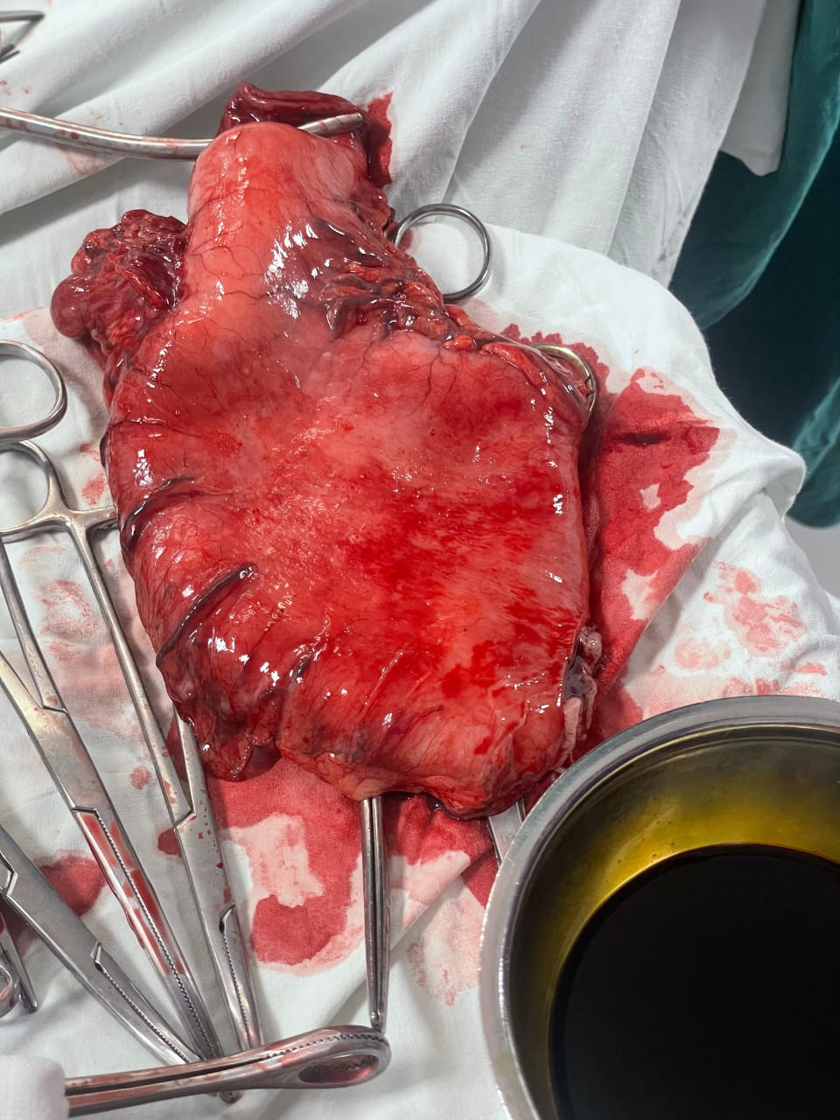
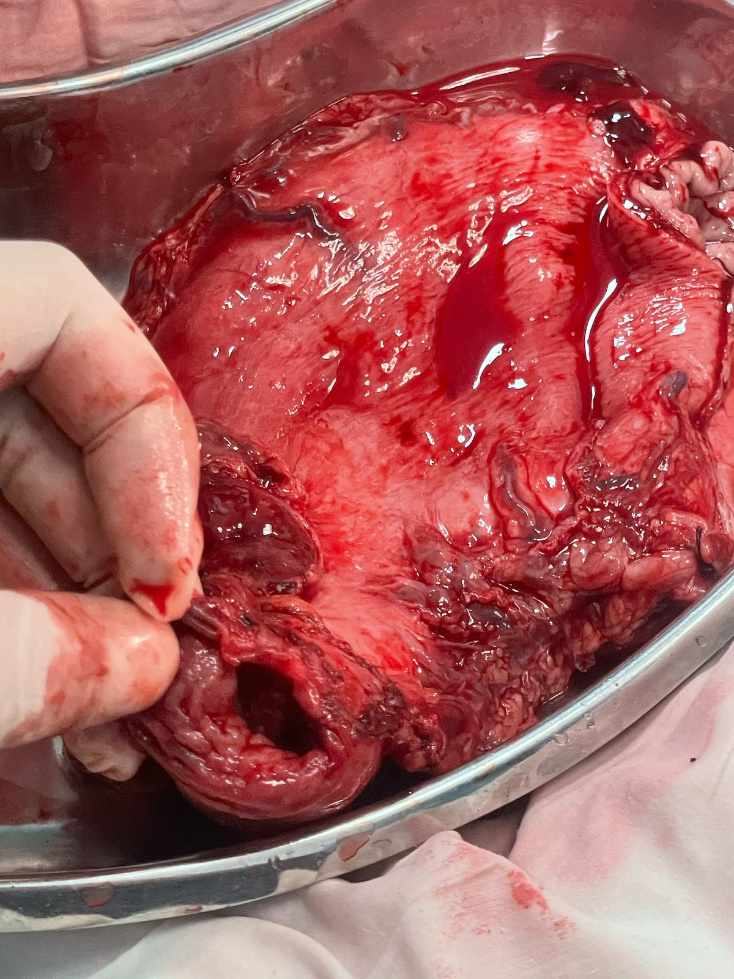
G. Gastrectomy Specimen following resection
H. Posterior surface of Gastrectomy Specimen

Slide 43
Postoperative Complications:
Early Complications:
Hemorrhage
Anastomotic leakage
Duodenal stump dehiscence
Anastomotic edema or scarring
Retrogastric hernia
Hernia through the mesocolon
Jejunogastric intusussception

Slide 44
Late Complications:
Small Stomach Syndrome – loss of receptive relaxation
Bile Vomiting
Early Dumping
Late Dumping
Diarrhea
Nutritional Deficiency i.e., Vitamin B12, Iron, Calcium, Vitamin D
Malignant Transformation – at least 10 years

