Slide 1


Slide 2
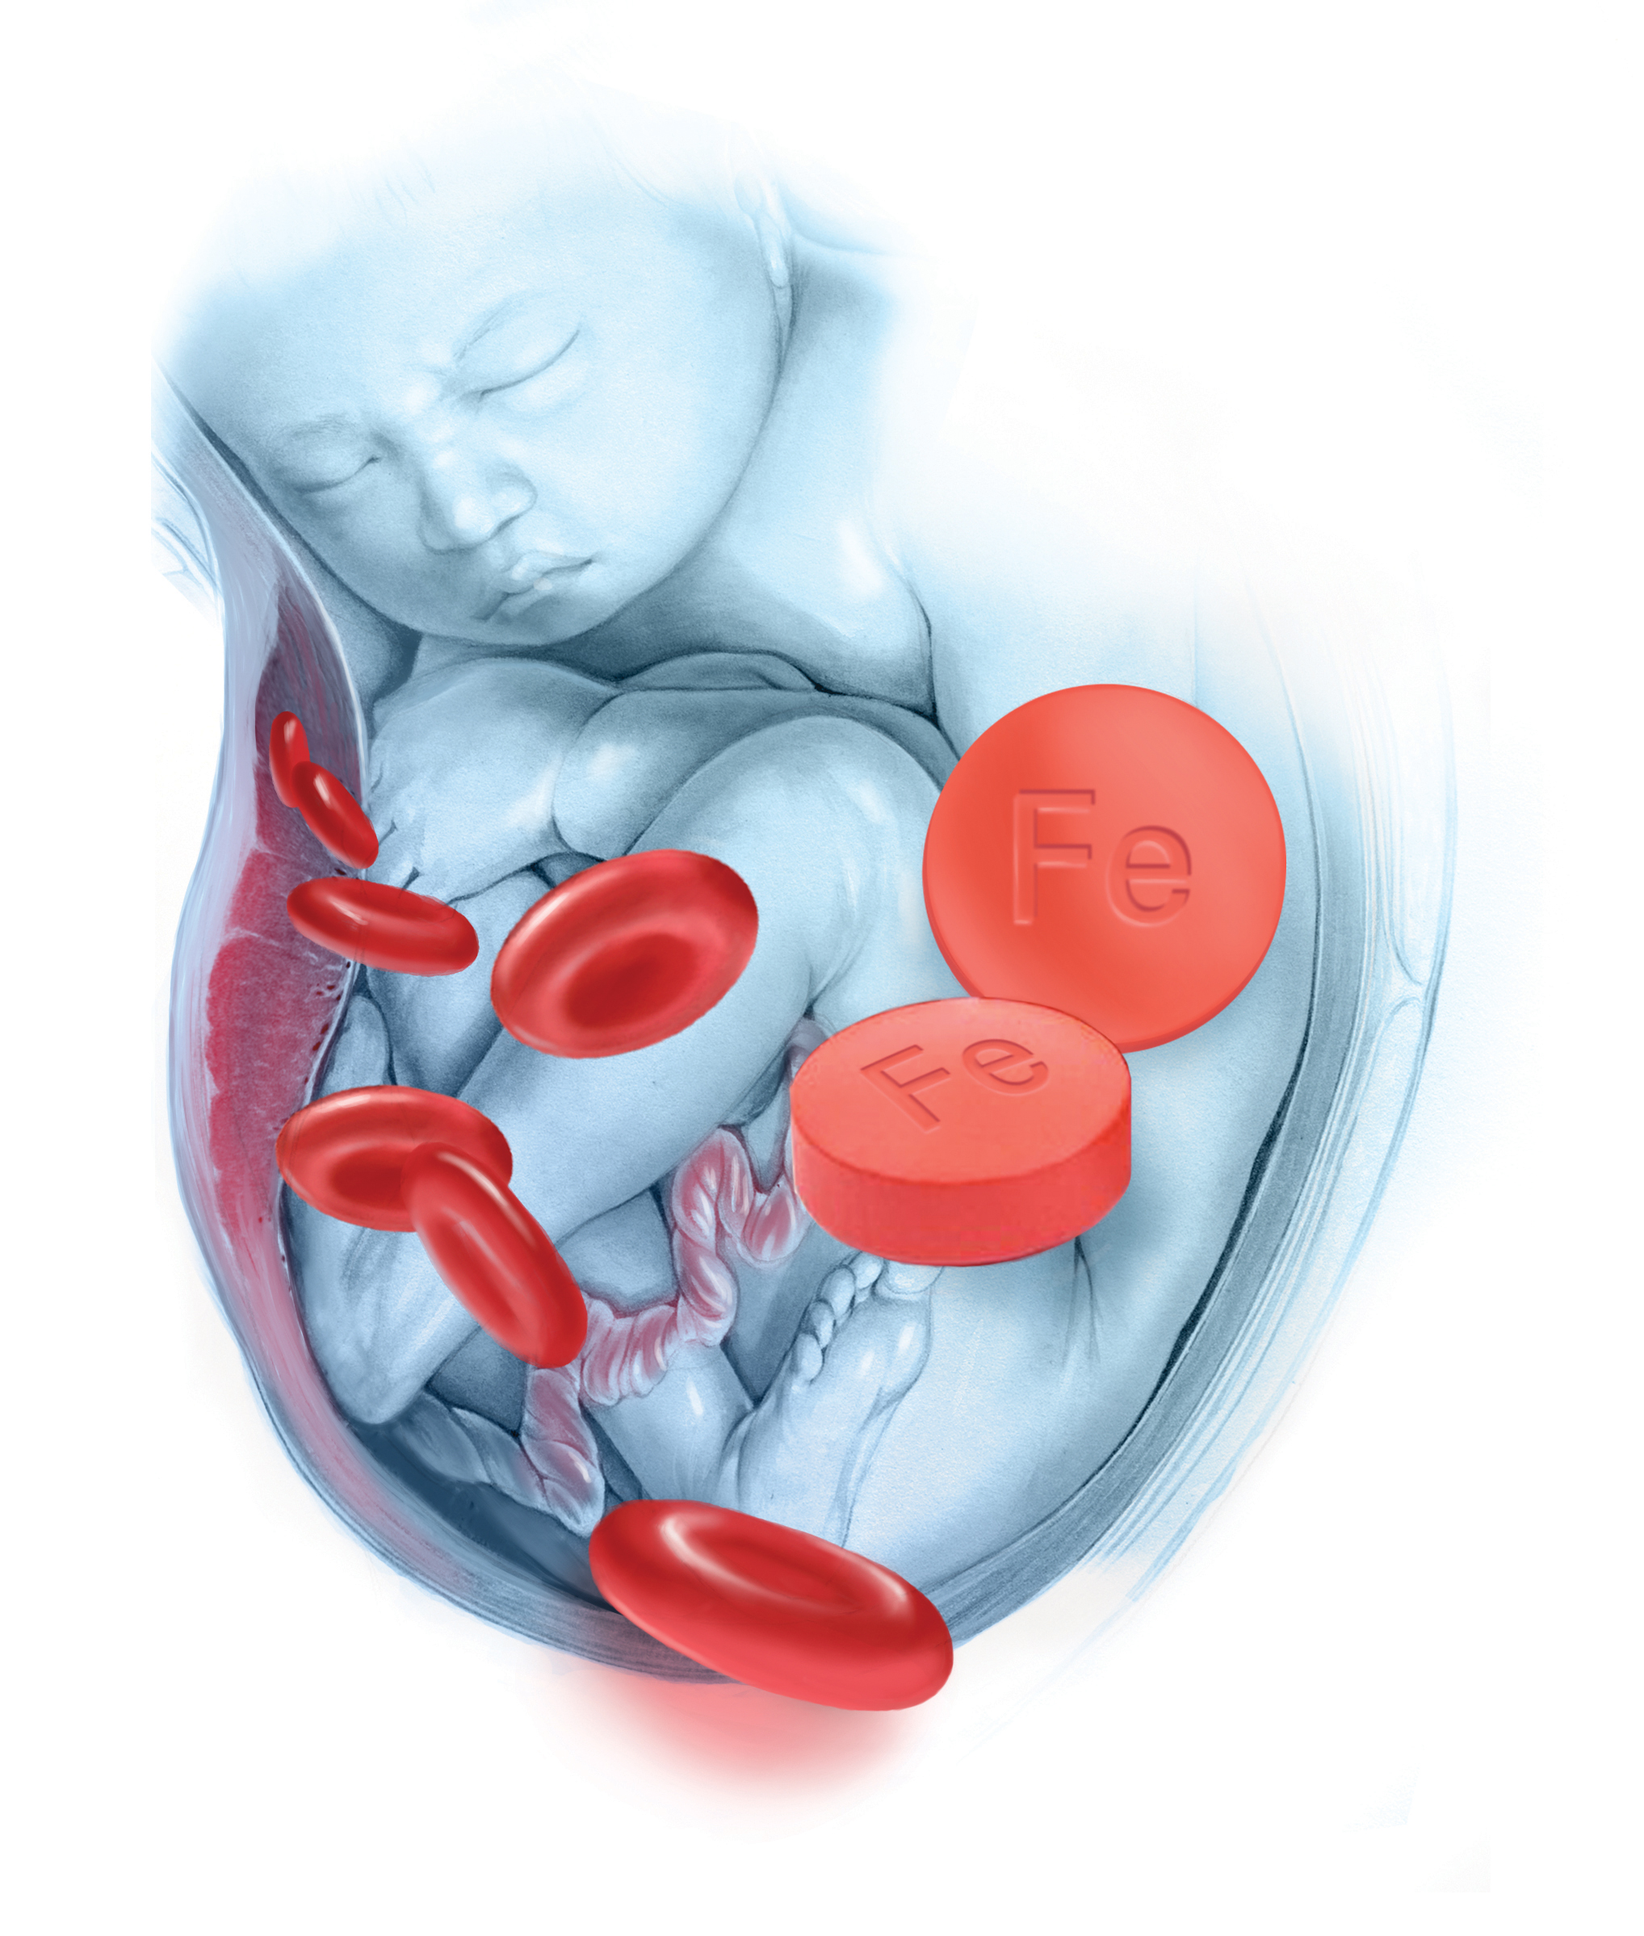
IRON DEFICIENCY ANEMIA IN PREGNANCY
DR SHAISTA MEHMOOD
PGR GYNAE UNIT-1
SHEIKH ZAYED HOSPITAL

Slide 3
Management:
Admission – severe iron deficiency anemia during pregnancy
Initial counselling – high risk pregnancy, associated maternal and fetal risks, need for hospital admission and blood transfusion
Dietary & Nutritional counselling
Examination and Investigations
Packed cell transfusions
Monitoring and response to treatment
Discharge plan (IV iron schedule, oral supplements, dietary counselling)
Follow up plan

Slide 4

Iron deficiency anemia in pregnancy

Slide 5
REASON TO CHOOSE THIS TOPIC why?
  COMMONEST MEDICAL DISORDER IN PREGNANCY WITH INCREASED MATERNAL MOBIDITY AND MORTALITY
  IT CAN BE PREVENTABLE WHEN ADDRSSED AT TIME WITH SIMPLE AND CHEAP MEASURES

Slide 6
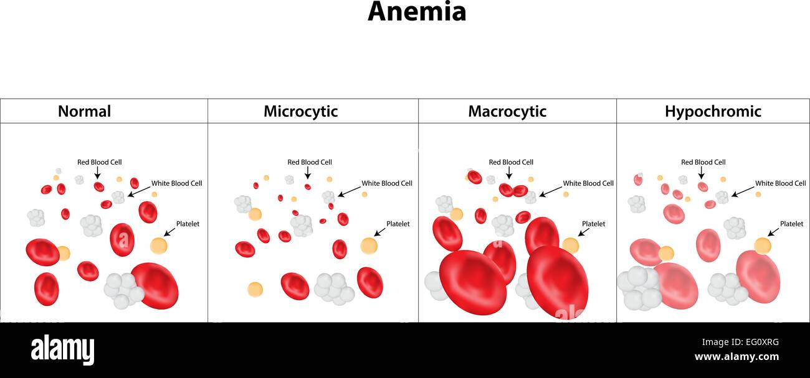
incidence
30- 50% DURING PREGNANCY
  IRON DEFICEINCY > 90%
  FOLATE DEFICIENCY 5%
  B 12 DEFICIENCY VERY RARE

Slide 7
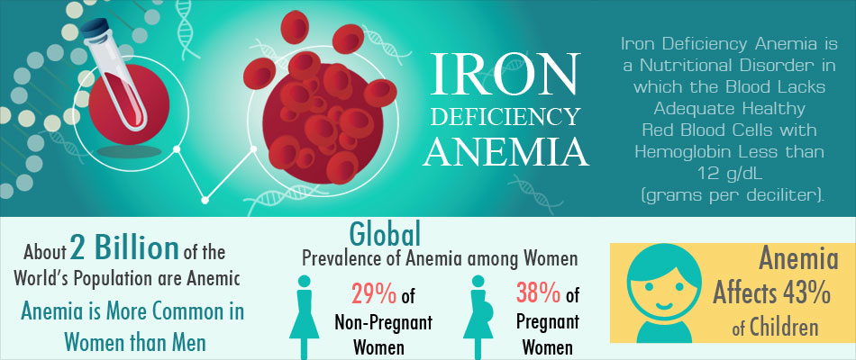

Slide 8
Definition (IRON DEFICENCY ANEMIA)
According to World Health Organization (WHO):
Anemia in pregnancy is defined as Hemoglobin (Hb) concentration <11g/dl at any time during pregnancy.
Severity Classification:
MILD ANEMIA Hb 10.0 – 10.9 g/dl
MODERATE ANEMIA Hb 7.0 – 9.9 g/dl
SEVERE ANEMIA Hb <7.0 g/dl

Slide 9
According to RCOG (Royal College of Obstetricians and Gynaecologists):
Anemia in pregnancy is defined as:
First Trimester: Hb <11g/dl
Second and third trimester: Hb <10.5 g/dl
Postpartum : Hb <10 g/dl

Slide 10
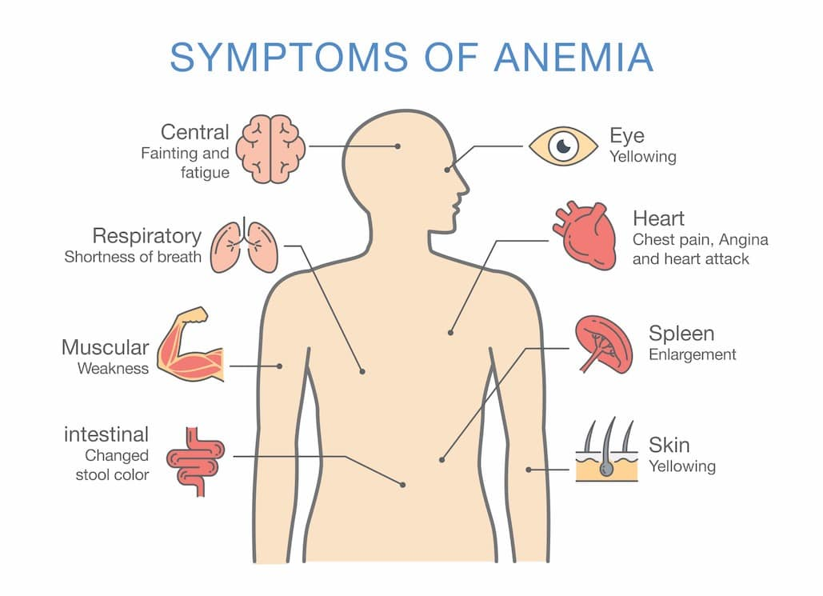
Clinical presentation
Asymptomatic
Non specific :
  Tiredness & Weakness
  Palpitation
  Poor concentration
  Headache ,Dizziness
  Hair loss
  Dyspnea
  Pica intake
  Dec appetite
  Ringing in ears
  Cold intolerance

Slide 11
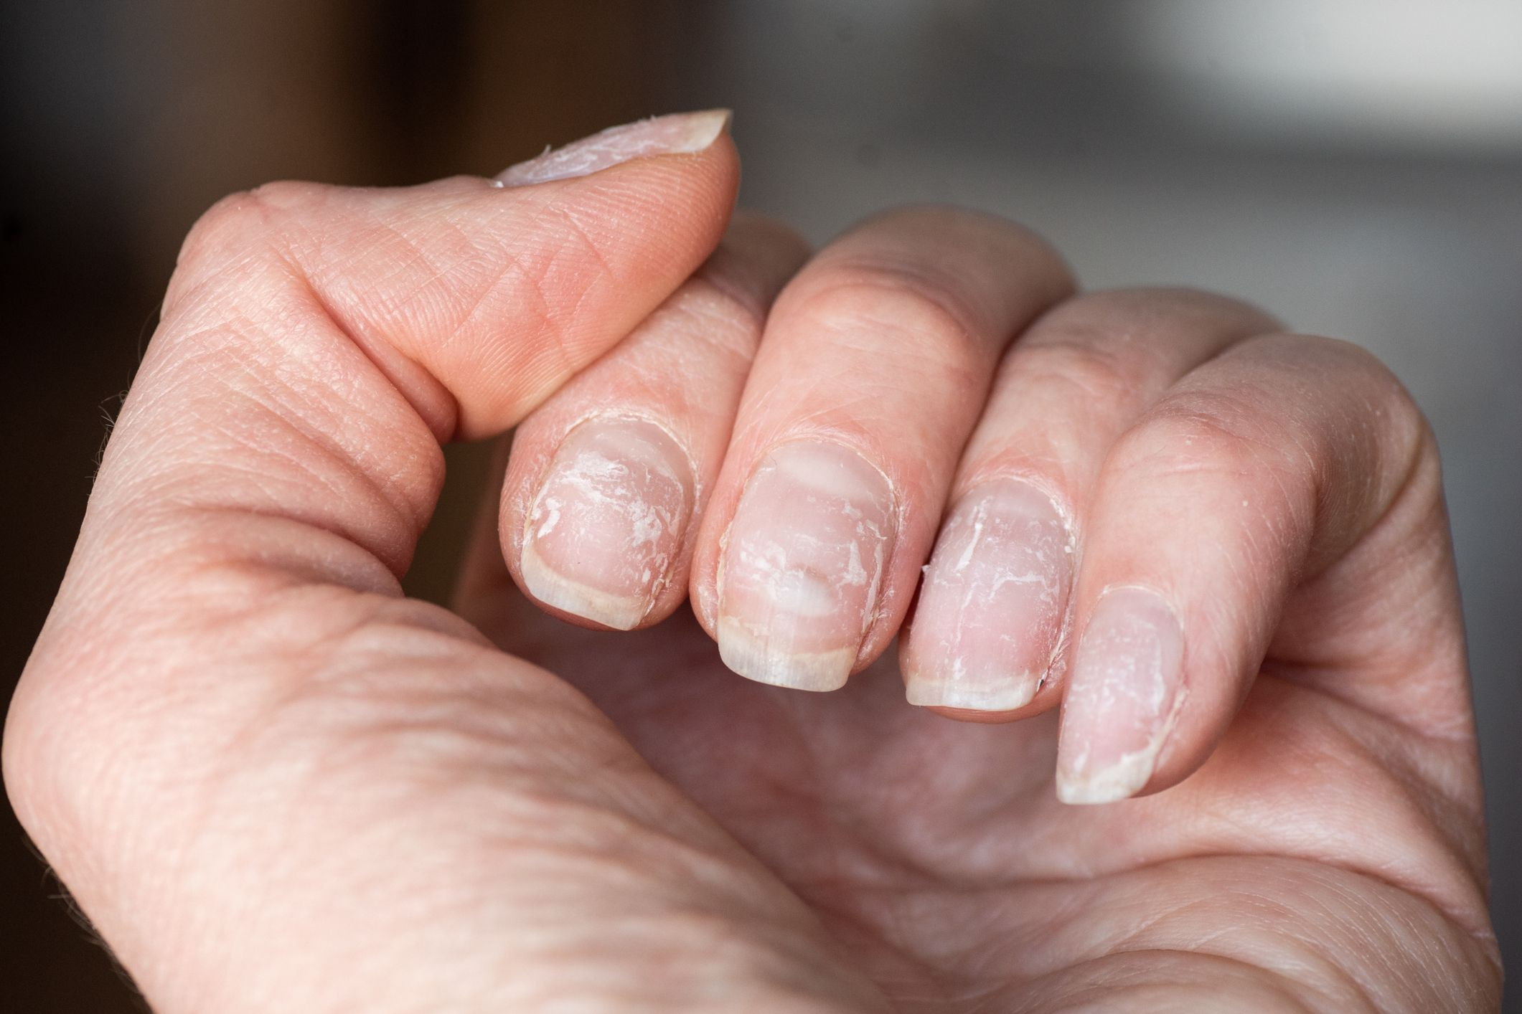
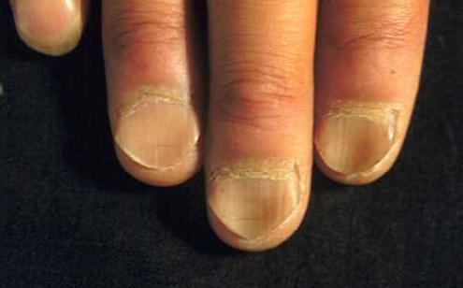
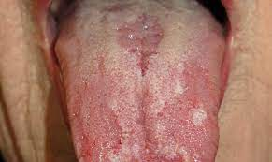
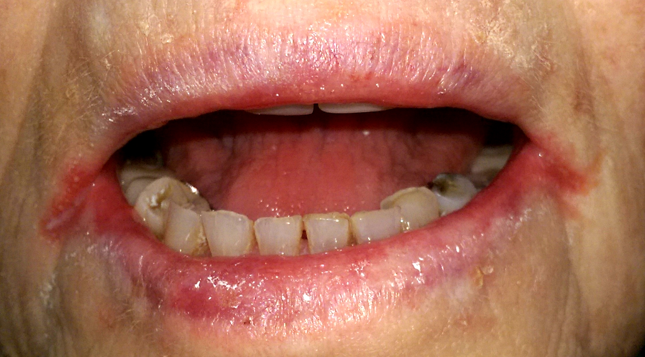
Signs of Anemia
Pallor
brittle nails / koilonychias
pedal edema
Glossitis
Angular stomatitis
Tachycardia
Flow Murmur

Slide 12
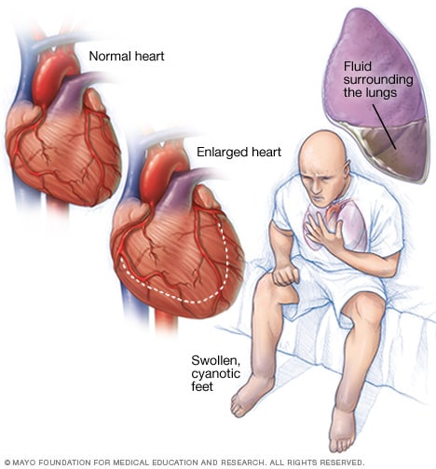
ACUTE PRESENTATION
SOB
Acute cardiac failure
Pulmonary edema

Slide 13
CLASSIFICATON OF ANEMIA
Nutritional deficiency anemia → B12,folate, iron
Blood loss → APH , PPH, hematemesis , hemoptysis , PR bleed ,hematuria , worm infestation
Hemolytic → Microangiopathic hemolytic anemia, methyldopa induced
Hereditary → VWD ,Thalasemia
Bone Marrow suppression → Aplastic anemia
GIT Disorders

Slide 14

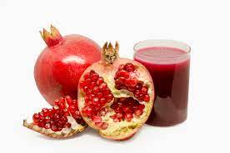
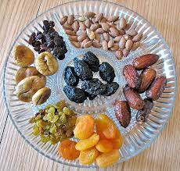
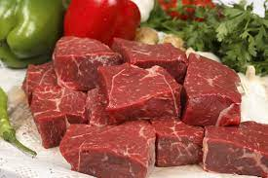
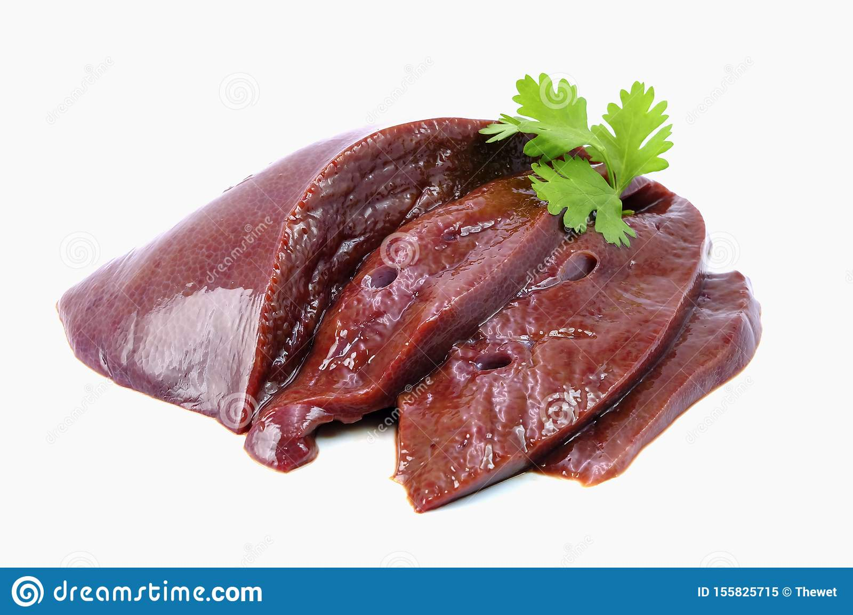

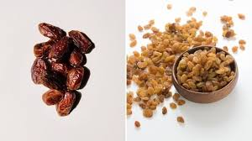
Iron rich foods

Slide 15
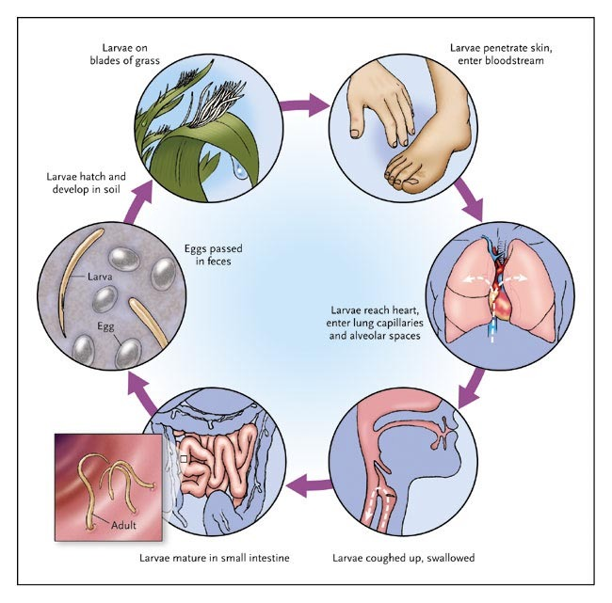
Anemia due to worm infestation

Slide 16
DIAGNOSIS
History:
Symptoms
- Dietary History
Menstrual History
Obstetrical History
Past Medical History
Drug History
Examination:
General Signs
Vital Signs
Severe Cases
Obstetrical Examination

Slide 17
Laboratory INVESTIGATIONS
BG & Rh factor
CBC
Peripheral blood smear
Reticulocyte Count
IRON STUDIES:
- Serum Ferritin (<15ng/ml - diagnostic of iron deficiency anemia)
- Serum transferrin levels
Serum Iron
TIBC
Stool examination → ova and cyst for worms
Hb Electrophoresis

Slide 18
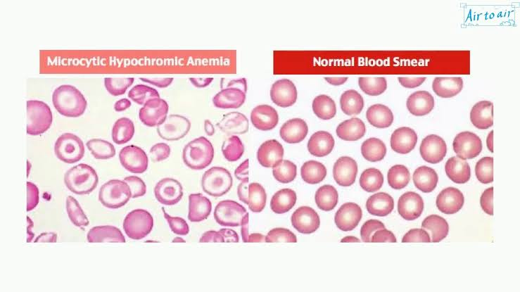
CBC WITH PERIPHERAL MORPHOLOGY
Notes:
In iron def anemia RBCS are Microcytic becoz the mature RBCs undergoes rapid division d/t iron def that result in microcytosis.there my b a mixed pictures of normocytosis or microcytosis

Slide 19
RBC INDICES
RBC INDICES | Normal Value
Hb | 12-16 g/dl
RBC | 4-5 x 10⁶ u/l
WBC | 4.5 -11 x 10 u/l
PLT | 150 – 450 x 10 u/l
Hct | 36 - 46 %
MCV | 80-100 fl
MCH | 28-34 pg
MCHC | 32 – 36 g/dl
Notes:
Measure size shape quality of RBCs, that carries oxygen from lungs to every cells gives them ox to row reproduce and healthy , MCV → average size of RBCs : MCH→ Avg. amount of Hb in single RBC ; MCHC → Hb in RBC & also include calculation of size & vol of RBC.

Slide 20
RBC INDICES VALUES
Microcytic hypochromic anemia
Dec MCV
MCH
MCHC
Iron Def Anemia
Dec MCV
MCH
Normal MCHC
Thalasemia
HbA <95%
HbA 2 >3.5%
HbF >2%
Tear drop cells
THALASEMIA
Ferritin
<15 ug/dl
Confirm
Iron Deficiency Anemiia
Target cells
Pencil cells

Slide 21
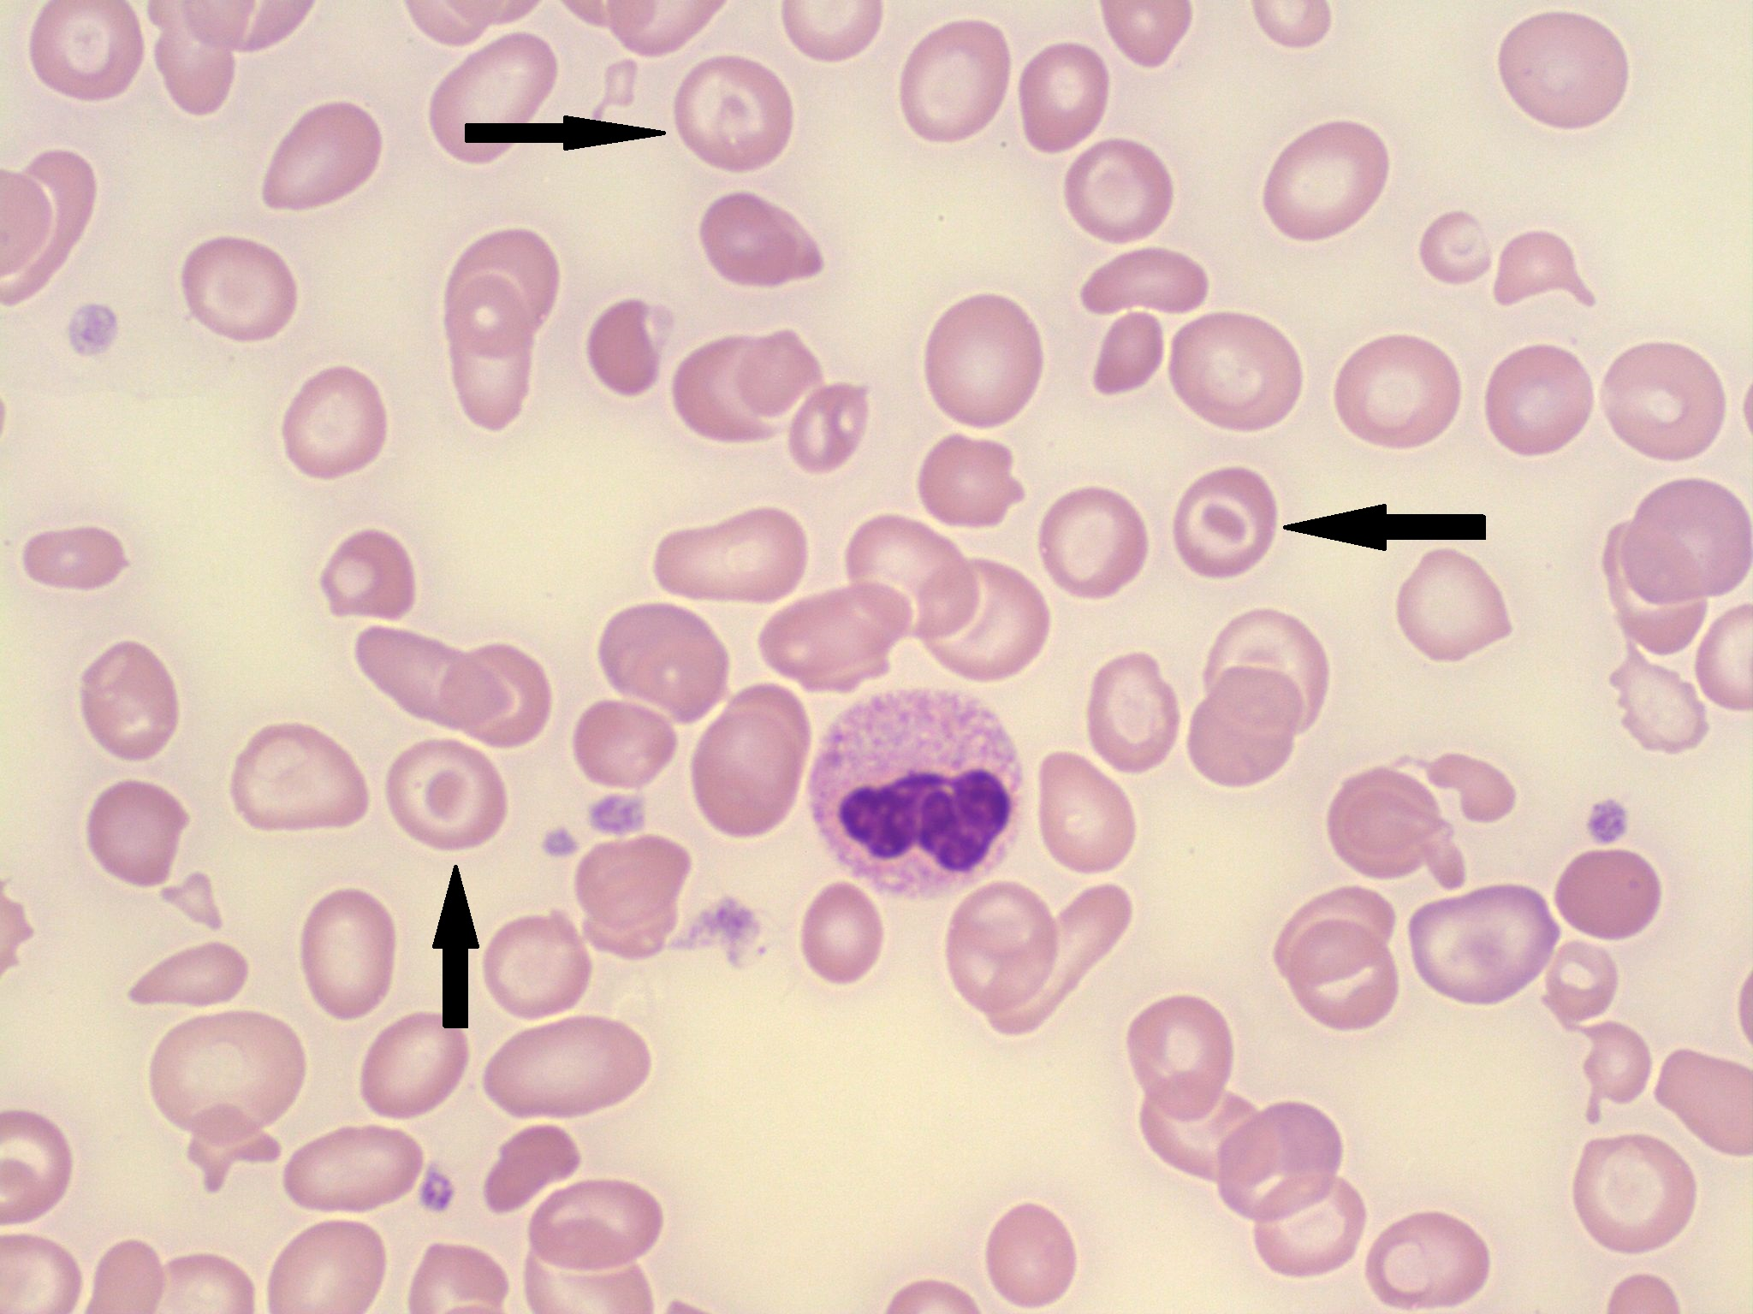
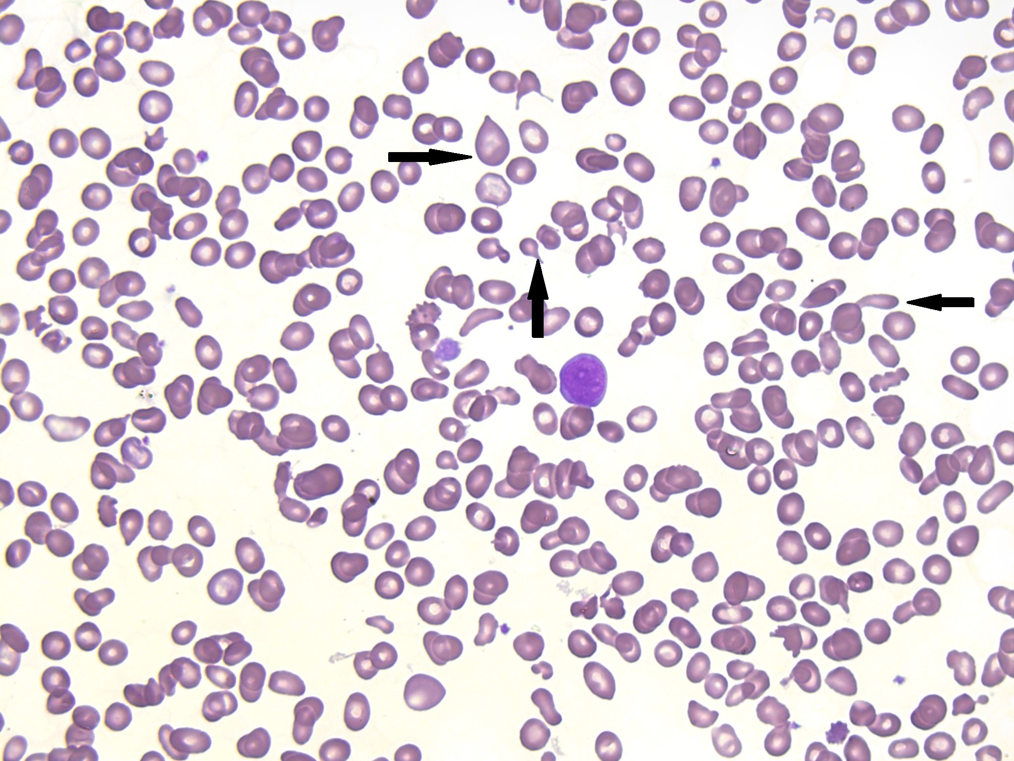
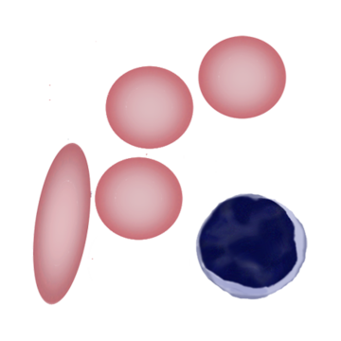
Target cells
Tear drop cells
Pencil cells

Slide 22
Sequence of events
Dec serum Iron → dec serum Ferritin → inc. TFR → inc TIBC
Dec MCV ,MCH ,MCHC → MICROCYTOSIS , HYPOCHROMIA , TARGET CELLS → Dec Hb
Notes:
Dec % Saturation (15%) on RBC INDICES

Slide 23
COMPLICATIONS
  MATERNAL
      SUSCEPTIBILITY TO INFECTON DUE TO DEC IMMUNITY
      HIGH OUTPUT CARDIAC FAILURE IF HB <7
      RISK OF PPH
      PUERPERIAL PYREXIA D/T DEC IMMUNITY
      PIH
      PRE ECLAMPSIA
FETAL
  IUGR
  PRE TERM DELIVERY
  IUD
  MISCARRIAGE
  NEONATAL ANEMIA
  IMPAIRED COGNITIVE FUNCTION

Slide 24
Managements :
Establish The Cause & Treat It
Correct Deficiency
Replenish Iron Stores

Slide 25
Recommended daily iron intake:
  non-anemic in pregnancy → 30-60 mg of elemental iron
Therapeutic daily dose
  (If serum ferritin <30mg/dl ) → 120-240 mg of elemental iron
  Post Partum hb <10 → 100-200mg/dl of elemental iron for 3 months

Slide 26
IRON ABSORBTION
FACTORS THAT INCREASES ABSORBTION | FACTORS THAT DECRESES ABSORBTION
Haem iron (red meat, fish, poultry ) | Tannins in tea & coffee
Vitamin C | Food rich in calcium
Ferrous form (Fe²⁺⁾ | Antacids
Empty stomach

Slide 27
Management
Depends on gestational age and severity of anemia
Mild → 10.5 – 9.5 g/dl
Moderate → 7-9.5 g/dl
Severe → 4-7 g/dl
Very severe → < 4 g/dl

Slide 28
Gestational age
IST TRIMESTER
2nd & 3rd TRIMESTER
IN ANY TRIMESTER
Mild to moderate anemia
ORAL IRON THERAPY
Poor compliance
Intolerance
Inadequate response
Mild to moderate anemia
Hb < 10.5 g/dl
Oral iron < 30 wks
IV IRON > 30 weeks
Severe anemia
Hb < 7 g/dl
Blood transfusion
Very severe anemia
Hb < 4 g/dl
Pack cell
transfusion
(under cover of Lasix)
Notes:
NO IV IRON IN IST TRIMESTER d/t free radical causes toxicity to placental membrane

Slide 29
COMPLICATIONS OF BLOOD TRANSFUSIONS
MILD FEBRILE REACTIONS SETTLE DOWN SPONTANEOUSLY
SERIOUS ANAPHYLACTIC REACTION
RISK OF TRANSMISSION OF INFECTIONS LIKE HCV, HBV ,HIV
TRANSFUSION ASSOCIATED CIRCULATORY OVERLOAD (TACO)
TRANSFUSION RELATED ACUTE LUNG INJURY(TRALI)
HYPOCALCEMIA D/T MULTIPLE BLOOD TRANSFUSION

Slide 30
Anemia in postpartum period
Hb < 10 g/dl
Single dose IV iron
Iron sucrose
(within 24 hr )
Hb > 10 g/dl
IV therapy
Oral iron + Folic acid
6-12 weeks
Discharge on oral iron
If feritin level normal
If not tolerated

Slide 31
How to check response of treatment
Clinical improvement in symptoms
Repeat Hb after 2-3 weeks of treatment
Continue treatment for 3 months after normalizing Hb and 6 weeks postpartum to replenish iron stores

Slide 32
Oral / IV formulations of Iron
Both has same efficacy and response develop after 3-4wks (rise 0.8g/dl/wk)
Oral iron | Parentral iron
Poor compliance | Effective for oral intolerance, gastric surgery , malabsorption syndrome
Intolerance | Contraindication in acute infection / CLD
Tolerance inc. if taken with meal but absorption dec | Quicker supply
Cost effective | No issue of compliance
No need of IV acess
No anaphylactic reaction | Anaphylactic reaction

Slide 33
How to calculate dose of iron
Formula (Ganzoni formula)
Total Iron Deficit = ( Normal Hb – Pt. Hb ) x weight x 2.21 + 1000
Where:
-2.21 = constant used to estimate the amount of iron needed to raise Hb of 1g/dl per kg of body weight
-1000mg = iron stores that needs to be replenished

Slide 34
Formula (Ganzoni formula)
Iron deficit = ( Normal Hb – Pt. Hb ) x weight x 2.21 + 1000
Example:
= (11-09) x 60kg x 2.21+1000
= 1265.2 mg
1265.2/200 = 6.32
So total 06 doses of IV iron will be given to the patient on alternate days.

Slide 35
ORAL IRON FORMULATION | DOSE |  | ELEMENTAL IRON
1- Ferrous Sulphate
Ibert folic | BD | 100mg + 800 ug Folic acid
Fervit |  | 47mg
Fefol vit |  | 47mg
2-Ferrous Fumarate
FEFAN DS | 600 | 150 mg
3- Ferrous Gluconate
Sangobion |  | 30mg

Slide 36
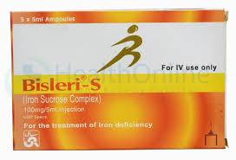
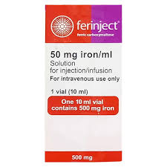
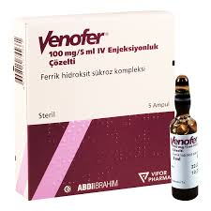
Parentral iron formulations
Iron sucrose ( venofer )
Iron polymaltose ( Bisleri )
Haemacare ( succinylate)
Carboxymaltose ( ferinject)

Slide 37
PREVENTION
  IRON RICH FOOD Eg EGG ,MILK ,MEAT, LEGUMES, DRY FRUITS, PULSES
  SAFE WATER DRINKING
  AVOID BARE FOOT WALKING
  IRON SUPPLEMENTATION DURING PREGNANCY
  TREATMENT OF CHRONIC DISEASES
  AVOID DRUGS THAT CAUSE HEMOLYTIC ANEMIA
  AVOID SHORT INTER PREGNANCY INTERVAL
  USE OF CONTRACEPTIVE METHOD
  NEED to Educate the community through social medias,talkshows,bcz it can be preventable with cheap measures

Slide 38


Slide 39


