Slide 1


Slide 2
CLINICOPATHOLOGICAL CONFERENCE
GYNAECOLOGY DEPARTMENT UNIT 1 SHEIKH ZAYED COLLEGE AND HOSPITAL RAHIM YAR KHAN
SENIOR REGISTRAR: DR .SALEHA BABAR
PGR :DR SHAISTA
PRESENTED BY
IRAM SALAM ROLL NO 591
HAFSA IZAZ ROLL NO 546
AYESHA FATIMA ROLL NO 617

Slide 3
HISTORY OF THE PATIENT
BIODATA
Mrs. Shagufta w/o Muhammad Yasin 30 yrs old housewife,with no formal education ,married for 9 yrs
G5P3A1
last child born 1yr ago through SVD
resident of Khanpur admitted to labour room via O.P.D on 6 April 2025 .
L.M.P :USOD
EDD:15 –may-2025 (according to the recent scan )
DOP:8months of pregnancy (according to patient)

Slide 4
PRESENTING COMPLAINT
Gestational amenorrhea for 8 months
Easy fatigability ,palpitations and SOB for 1 month

Slide 5
History of presenting illness
1st trimester:
she concieved spontaneously during her regular menstrual cycle . Her pregnancy was confirmed on U.S.G after 2 and half month of missed periods .
She took folic acid supplements regularly during her first trimester after confirmation .
She had mild, watery , and non itchy vaginal discharge for which she took medications and her condition improved.
She also experienced mild nausea but no vomiting during her first trimester .
No history of fever, flu, rash ,fatigue, S.O.B and palpitations.
NO baseline investigations were carried out .

Slide 6
2nd trimester
Quickening was felt at 5th month of gestation.
My patient experienced mild S.O.B , fatigue, lethargy.
She took calcium supplements but no history of iron intake during this period.
she had an antenatal visit at 6th month where an ultrasound was done and the patient was reassured about her pregnancy.
she did not experience polydipsia , polyphagia ,polyuria , epigastric pain , blurring of vision , headache , nausea , vomiting and chronic diarrhea, vaginal bleeding and discharge.
Fetal anomaly scan was not done.

Slide 7
3rd trimester:
The abdominal size was propotionate to the months of gestation.
My patient experienced worsening of S.O.B , dizziness , palpitations ,and extreme fatigue that she was unable to do house chores.Her dietary intake was deficient in iron and proteins .She had history of chronic hemarrhoids.No history of PICA perianal itching, and chronic diarrhea.
She had not experienced chest pain , orthopnea and PND .
She got herself checked up at 7th month at THQ Khanpur where her labs revealed very low Hb and she was referred to SZH for correction of anemia.

Slide 8
After admission :
She was admitted in SZH at 6 April where her workup for anemia and anemia typing was done.
4 units of packed cell were transfused, vitals monitoring and CTG was performed.
After anemia correction, the plan is to discharge her with plan i/v iron infusions on alternate days.

Slide 9
Past obstetrics history
G5P3A1
First baby is female born 7 years ago
Second baby is male born 4 years ago
She had a miscarriage at the time of third pregnancy 5 months after previous childbirth for which she underwent Dilatation and curretage
Third baby is male born 1 year ago
All children were born through SVD at term at hospital ,alive, healthy , breastfed and vaccinated
There is no history of antepartum and postpartum complications.
There is no history of blood transfusions during her previous pregnancies

Slide 10
Gynaecological history
Menarche at 13 years of age
Regular menstrual cycle of 3/28 days soaking 2 pads per day with no clots
No history of dysmenorrhea,dyspareunia intermenstrual bleeding,postcoital bleeding and HMB.
She has never used any contraceptive measures.
Pap smear was not done.

Slide 11
Past medical history
She had a chronic history of haemorrhoids for last 10 years as mentioned earlier .It was associated with mild pain and rectal bleeding when she defecates.NO active bleeding was reported during her pregnancy .
There is no history of DM, HTN, asthma, TB, hepatitis B and C or chronic liver or renal disease.

Slide 12
Past surgical history
No significant past surgical history

Slide 13
Drug history
My patient has not taken any additional medications during her pregnancy . Iron supplements were not taken.
Received Blood transfusion 4 packed red blood cell with no h/o any transfusion reactions
She has no known allergy to any medication .

Slide 14
Personal history
She has normal sleep pattern and bowel habits.
She is non smoker,non addictive to any drug
Her dietary habits are poor as there is no intake of green leafy vegetables, red meat, fruits and iron rich food as mentioned earlier.

Slide 15
Family history
There is no history of DM, HTN, asthma , TB, Hepatitis B and C and any carcinoma of breast , uterus and intestines in her family .

Slide 16
Socioeconomic history
She belongs to lower middle class family . Her husband is the only bread winner of the family . She lives in non cemented house of 2 room with 9 family members . They use regular tap water

Slide 17
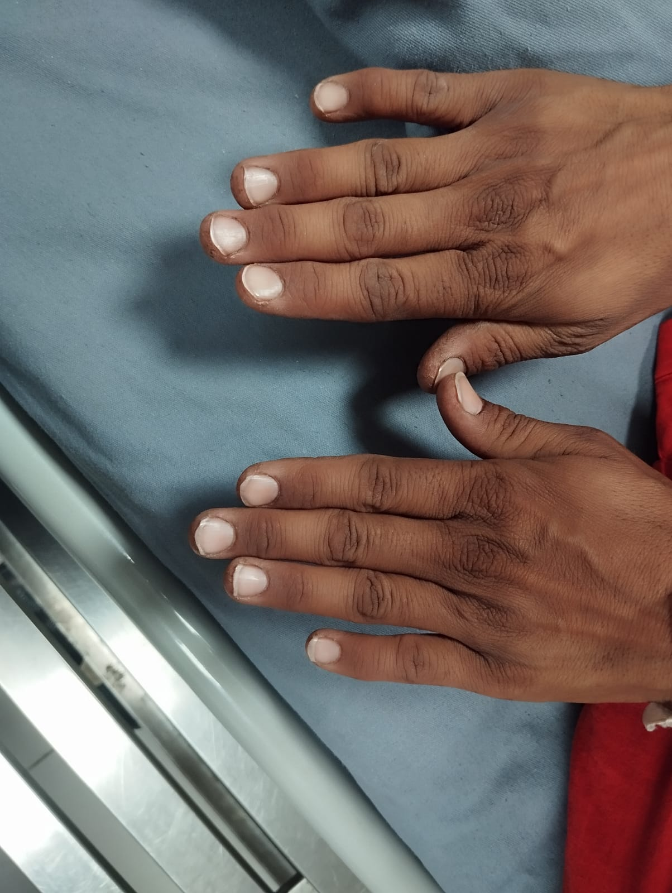
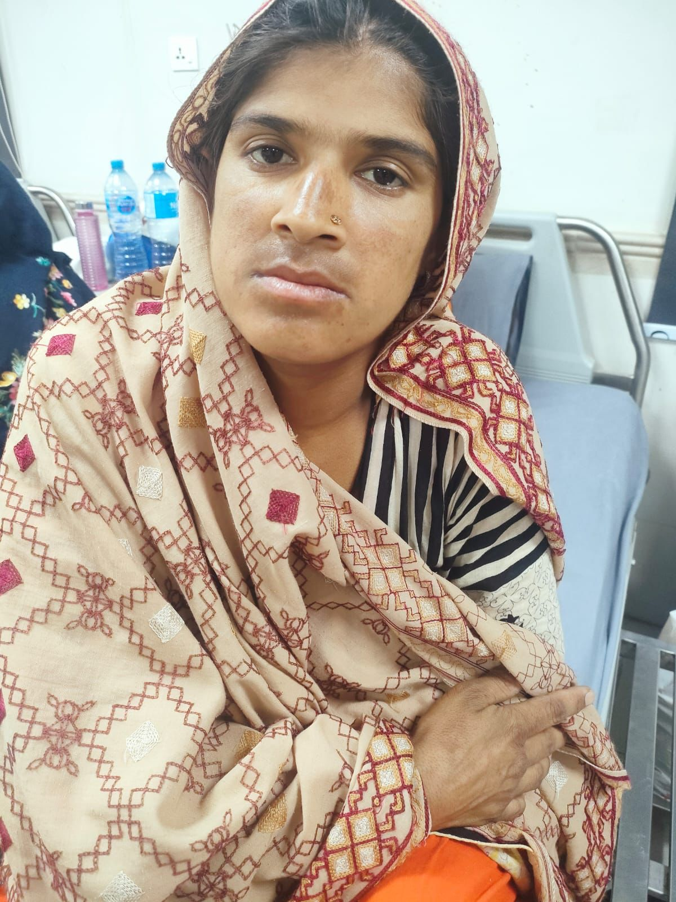
General physical examination
A young lady comfortably sitting, pale looking, well oriented in time, place and person with following vitals
B.P: 110/70
PULSE RATE: 88 bpm
RR :22 breaths/min .
.She has palmar and conjunctival pallor , having koilonychia with no jaundice, clubbing ,edema and leukonychia .

Slide 18
GPE continued…
All accessible lymph nodes were not palpable
thyroid was not enlarged
JVP was not raised
No varicose veins were seen
breast was of normal size, color and contour ,no lump felt

Slide 19
Systemic examination
CVS : on inspection, jvp was not raised , no pedal edema . On palpation, apex beat was felt in 5th intercostal space and was of normal character.no palpable heave or thrill. Auscultation revealed S1 and S2 with no added heart sounds and murmur
Respiratory system: on inspection, chest was of normal shape with normal and equal movements on both sides. on palpation , trachea was central ,no tenderness and crepitations and no vocal fremitus. percussion noteswere resonant and equal with normal vesicular breathing on auscultation.
CNS: GCS was 15/15. no SOMI , blurred vision. Cerebellar examination was normal.

Slide 20
ABDOMINAL EXAMINATION
INSPECTION the abdomen was protuberant,moving symmetrically with respiration
The umbilicus was central and everted
Linea nigra and striae gravidarum were present
No scar mark,visible veins and pulsations
PALPATION
Symphysiofundal height: 32cm
Lie was longitudinal cephalic
Presenting part 5/5
No palpable uterine contractions
Fetal weight is estimated to be around 2kg
Liquor seems to be adequate
Auscultation : fetal heart sounds were auscultated and were about 140 bpm

Slide 21
INVESTIGATIONS
CBC with peripheral morphology
Serum ferritin
Viral markers
Urine complete examination
Blood grouping and cross matching
Blood sugar random
Ultrasound
CTG

Slide 22
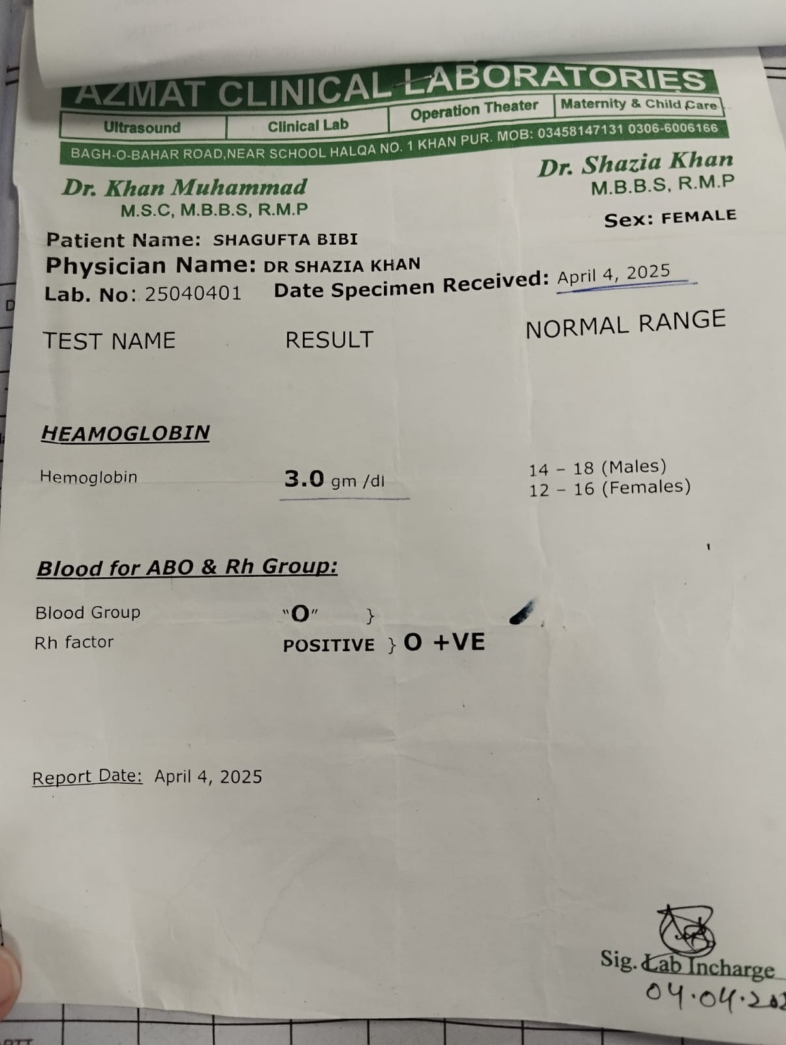
Maternal investigations
CBC
Haemoglobin: 3.0 gm/dl ( in pregnant females ( >11gm /dl in 1st and 3rd trimester and >10.5gm in 2nd trimester )
Blood group : O positive

Slide 23
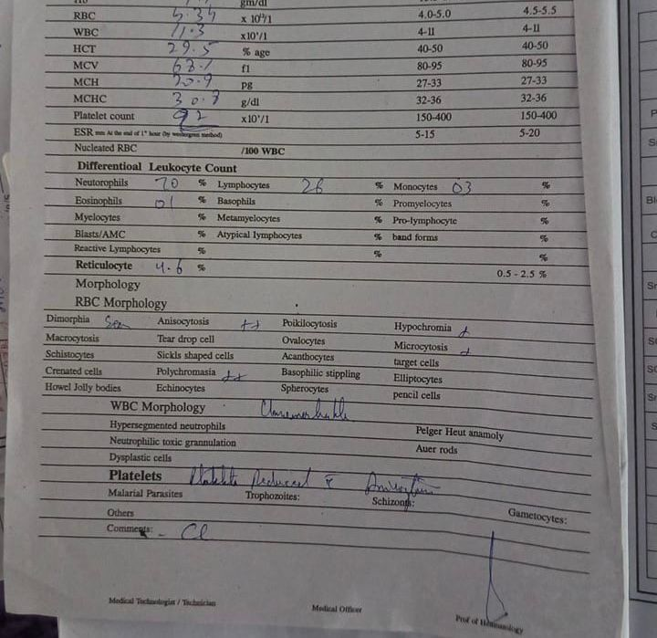
PERIPHERAL MORPHOLOGY
MCV : 68.1FL
MCH : 20.9pg(27-31pg)
MCHC : 30.8g/dl(32-36gm/dl)

Slide 24
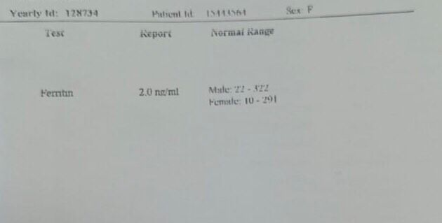
Serum ferritin :2ng/ml

Slide 25
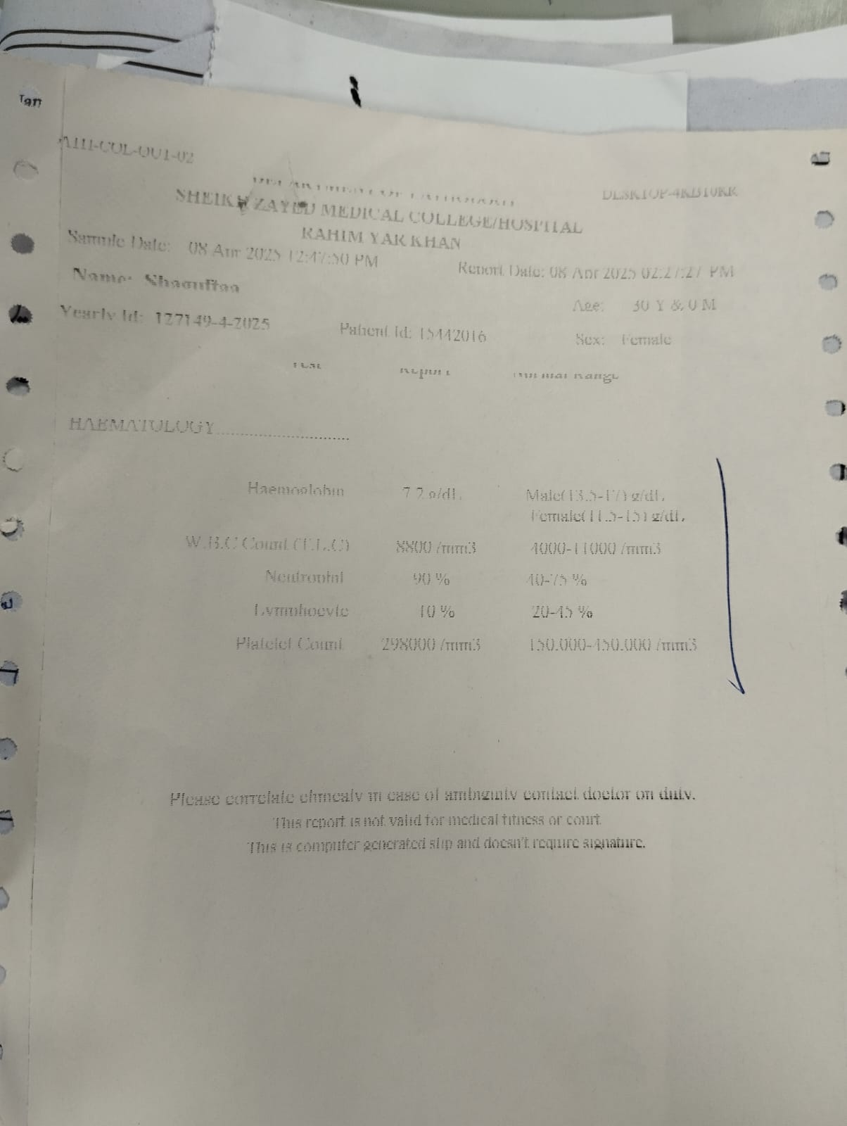
WBC count(TLC): 8800/mm3 (4000-11000/mm3)
Platelet count: 2,98,000/mm3 (normal;1,50,000-4,50,000/mm3)

Slide 26
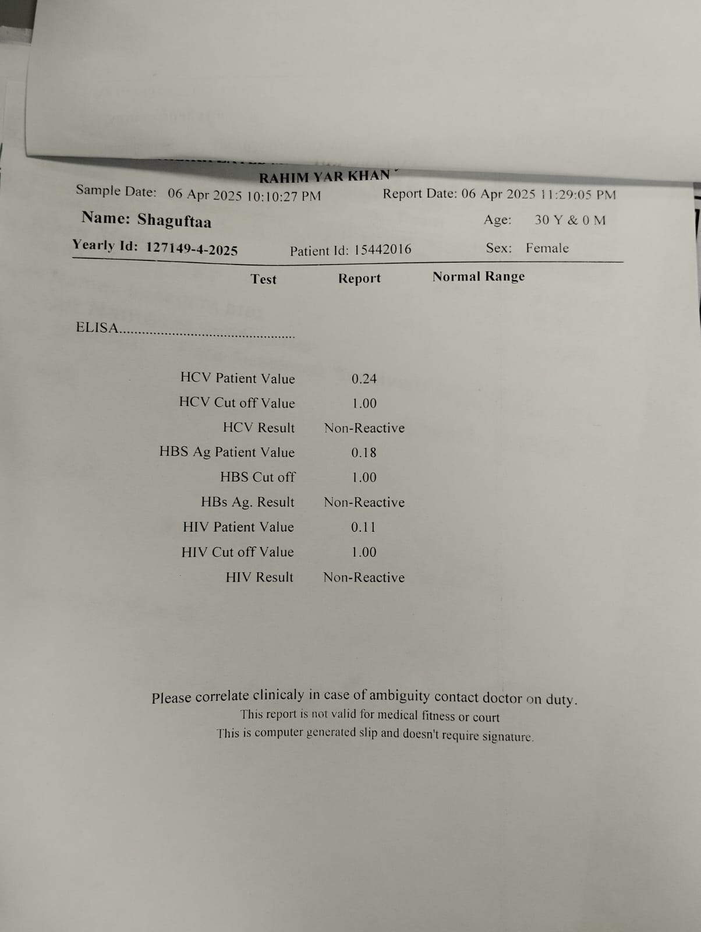
Viral markers
HCV result non reactive
HBS Ag result Non reactive
HIV RESULT :Non reactive

Slide 27
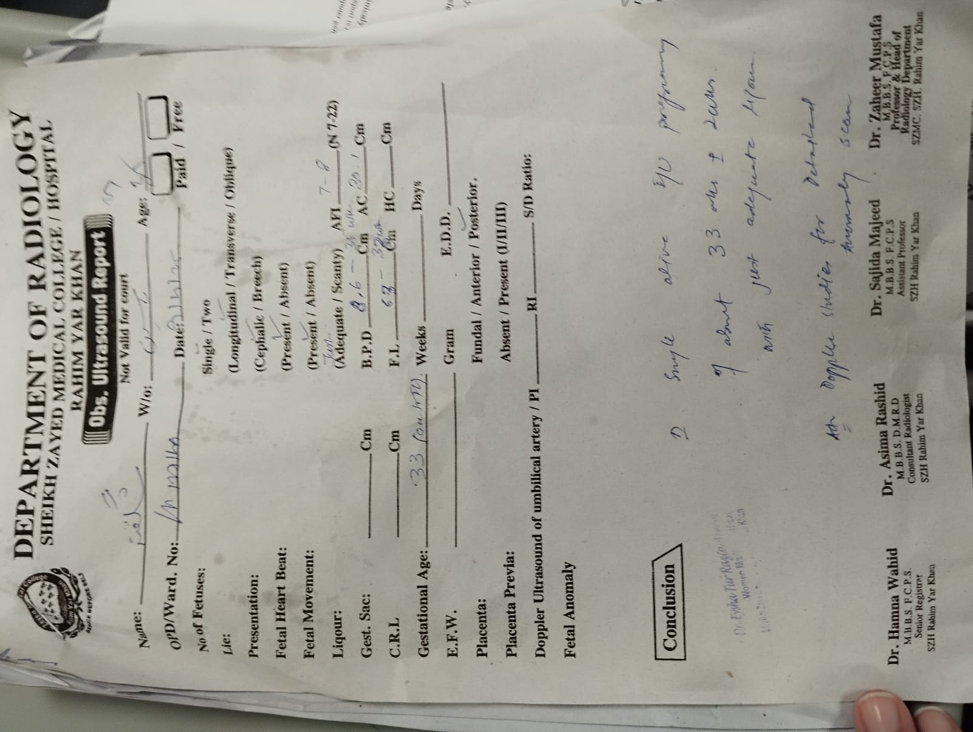
FETAL INVESTIGATIONS
OBSTRETIC .U.S.G SCAN
According to ultrasound report,
There is single alive fetus, lying longitudinaly cephalic , Fetal heart beats and fetal movements are present. Liqour is adequate, AFI :7-8(7-22)
Gestational age :33wk
Placenta :posterior

Slide 28
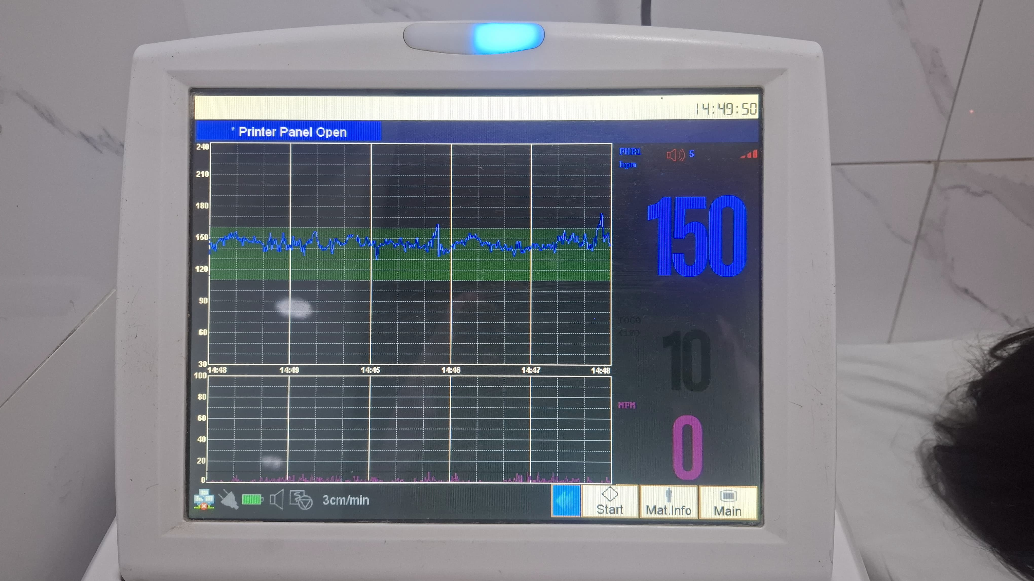
CARDIOTOCOGRAPHY
Baseline line fetal heart rate lies between 140-150b/m
Reactive CTG with normal variability and 2 accelerations
There is no deceleration .

Slide 29
CASE SUMMARY
MYT patient Shagufta W/o MUHAMMAD YASIN 30 yr old housewife G5P3A1 ALL SVDs LAST CHILD BORN 1yr ago admitted in GYNAE ward for anemia typing and correction .she has shortness of breath on exertion and easy fatiguability and haemorrhoids with rectal bleeding .
ON examination ,she is vitally stable with pallor and koilonychia .
On investigation , her Hb was 3.0 g/dl with microcytic hypochromic picture on peripheral smear and sr .Ferritin was 2ng/ml(10-291)

Slide 30


