Slide 1
CLINICAL CASE PRESENTATION-II
BATCH A-III, MEDICINE UNIT-II
Dated: 23RD MAY 2025
Presented By:
ADAN IQBAL Roll No. 640
ZAINAB BATOOL Roll No. 483
WIDA SOHAIB Roll No. 586

Slide 2
Patient History

Slide 3
Biodata
Name : Mr. Mudasir Hussain
Son of Mr. Sanaullah
Age:19 Years Old
Marital Status: Unmarried
Residency: Bamboo Sheikh, District Ghotki
Occupation:Trainee at Navy(recruited 2 weeks ago)
DOA: 20 May,2025
MOA: Emergency
My patient, Mr Mudasir Hussain , son of Mr Sanaullah , 19years old unmarried, Muslim ,Male,trainee at Navy,resident of bamboo sheikh , District Ghotki , came to Medicine Unit-II through emergency 2 days ago on 20th MAY 2025.

Slide 4
Presenting Complaint
Generalized body pain and weakness of all four limbs for 2 days.
Vomiting and decreased urine output for 1 Day.

Slide 5
History Of Presenting Illness
My patient was in usual state of health 2 days ago as he performed 100 push ups and 50 sit ups as a penalty, though he did not do any strenuous exercise in past 2 weeks other than his routine training.
  ■ The pain was sudden in onset, progressive, generalized and diffuse in nature ,aggravated by movement, relieved by taking rest, followed by weakness of all 4 limbs.
  ■The weakness was gradual in onset , progressive, involved bilateral lower limbs first(more significant in left lower limb)followed by bilateral upper limbs weakness . He was able to walk with support , though he could not climb stairs . There was no relieving or aggravating factors.it was associated with low output ,dark colored urine.

Slide 6
History Of Presenting Illness
Not associated with swelling , fatigue, tingling sensastion,headache ,vision loss ,hearing problems ,urinary retention or incontinence ,dizziness ,facial weakness ,rash ,dysphonia ,dysphagia, no history of drug(heroin, cocaine)intake, with normal understandable, logical speech, with no history of fits or trauma.
The vomiting was sudden in onset,2 episods,small in quantity,watery,white in color, non projectile, relieved with medication, with no aggravating factors documented(spicy food,meat,emotional stress).Not associated with food intake, fever, abdominal pain ,diarrhea, constipation, blood in vomitus blood in stool , polyuria ,polydipsia ,unconsciousness ,headache, vertigo or deafness .

Slide 7
Systemic Inquiry
Musculoskeletal System:
There was generalized body pain with difficulty in climbing stairs.
.
No History Of joint Pain , swelling ,redness ,backache , rash.

Slide 8
Systemic Inquiry
Central Nervous System (CNS):
Difficulty in walking.
No History Of headache , dizziness ,Fits , difficulty speech,visual disturbance ,vertigo , involuntry movements.
Gastrointestinal System:
There is vomiting ,abdominal pain , yellow discoloration of sclera.
No History Of Constipation, Diarrhea, Abdominal distension ,dysphagia , blood in vomitus.
His Appetite Is Normal , with no change in weight.

Slide 9
Systemic Inquiry
Cardiovascular System (CVS):
There is SOB on exertion.
No History Of Palpitations,Chest Pain,orthopnea,PND,Pedal edema.
Respiratory System:
There is shortness of breath.
No History Of Cough, Sputum,hemptysis, Wheezing, Chest Pain,allergic rhinitis.
Urinary System
Dark colored,low output Urine.
No History Of Dysuria, Frothy Urine, Or Burning Micturation,renal colic,urgency or incontinence.

Slide 10
Systemic Inquiry
7)Endocrine System:
No history of Polyphagia, Polydipsia, Polyuria, Heat Or Cold Intolerance.

Slide 11
Past Medical History
No History Of Hypertension, Diabetes Mellitus, Ischemic Heart Disease,Asthma,Hepatitis B/C.No history of blood transfusion.

Slide 12
Past Surgical History
No past Surgical history has Been reported.

Slide 13
Family History
No history of Hypertension,Diabetes Mellitus, Ischemic Heart Disease, Asthma or history of similar disease.

Slide 14
Socioeconomic History
Lives In Cemented House With 4 Rooms
5 Family Members
Uses Tap Water with adequate sainatary measures
Belongs to lower middle class family

Slide 15
Personal History
No History Of Smoking,Tobacco Chewing
Sleep and Appetite are Normal
No History Of Weight Loss or Weight gain has been reported.

Slide 16
DIFFERENTIAL DIAGNOSIS

Slide 17
RHABDOMYOLYSIS WITH ASSOCIATED AKI
MUSCLE EXUASTION

Slide 18
EXAMINATION

Slide 19
General Physical Examination
General Appearance:
I have examined a young male who is lying comfortably on bed ,conscious,oriented with time ,place and person with IV Cannula on right hand .
BP: 130/90mm Hg.
Trousseau sign was positive while observing BP whereas Chvostek sign was negative.
Respiratory Rate: 28 breaths per minute.
Oxygen saturation is 95 percent .
Pulse:120 bpm.
JVP not raised .
Temperature: Afebrile.
Vitals:

Slide 20
General Physical Examination
On Extension of General Physical Examination:
Hands were pallor with no Koilonychia, Leukonychia ,clubbing ,Cyanosis , Splinter haemorrhages ,Palmer erythema ,tremors or Muscle wasting.
There was yellow discoloration of sclera and pallor of conjunctiva.
There were no Oral ulcers, Tongue cheilosis, Candidiasis ,Thyroid Enlargement ,Enlarged lymph nodes or Pedal edema.

Slide 21
Systemic Examination
CNS:
Higher Mental Functions were normal.
GCS was 15/15.
There were no signs of meningeal irritation.
All Cerebellar signs were negative .
Sensory system was normal with cranial nerves intact .

Slide 22
Systemic Examination
Motor system :
There was decrease in tone and power in both upper and lower limbs
Power was 4/5 in all the four limbs .
There were no wasting of muscles , fasciculations and change in bulk in all four limbs .
All Reflexes were normal with plantar down going .

Slide 23
GIT:
On Inspection, The shape of abdomen was normal. Abdomen was moving with respiration. Peristalsis was not visible. Umblicus was inverted and central in position. There were no scar marks , striae or prominent vein . Hernial orifices were intact
On Palplation,There were no tenderness, rigididty .No viscera , mass or lymph nodes palpable .
On percussion , upper border of liver was found at 5th intercostal space and the total liver span was 12 cm .
Rest of the visceral percussion was not significant.
There was no shifting dullness or fluid thrill .
On Asculation , Bowel sounds were 3 to 5 per minutes ,of normal intensity . No Renal , Hepatic or Splenic bruit were Found.

Slide 24
Systemic Examination
CVS:
On Inspection of Precordium , There was no visible pulsations ,scar marks or any deformity .
On Palpation ,Apex beat was in 5th intercostal space medial to mid clavicular line .
On percussion , Area of Cardiac Dullness was preserved .
On Ascultation, S1 and S2 were audible without any added sounds .

Slide 25
Respiratory System:
On Inspection , Respiratory rate is 28/min . Respiration was Abdomino-thoracic .Shape of the chest was normal. No Deformity ,Prominent vein or pulsations visible . Chest was moving equally on both sides with respiration and there was use of accessory muscles .
On Palpation , no tenderness or crepitus demonstrated. Expansion of chest was 4 cm .Vocal fremitus was normal .
Anterior and Posterior percussion was normal .
On Ascultation ,There was normal vesicular breathing without any added sounds . Vocal resonance was normal.

Slide 26
INVESTIGATIONS

Slide 27
REQUIRED INVESTIGATIONS
CBC
Urine complete
Electrolyte complete profile
RFTS
LFTS
Abdominal Scan
ECG

Slide 28
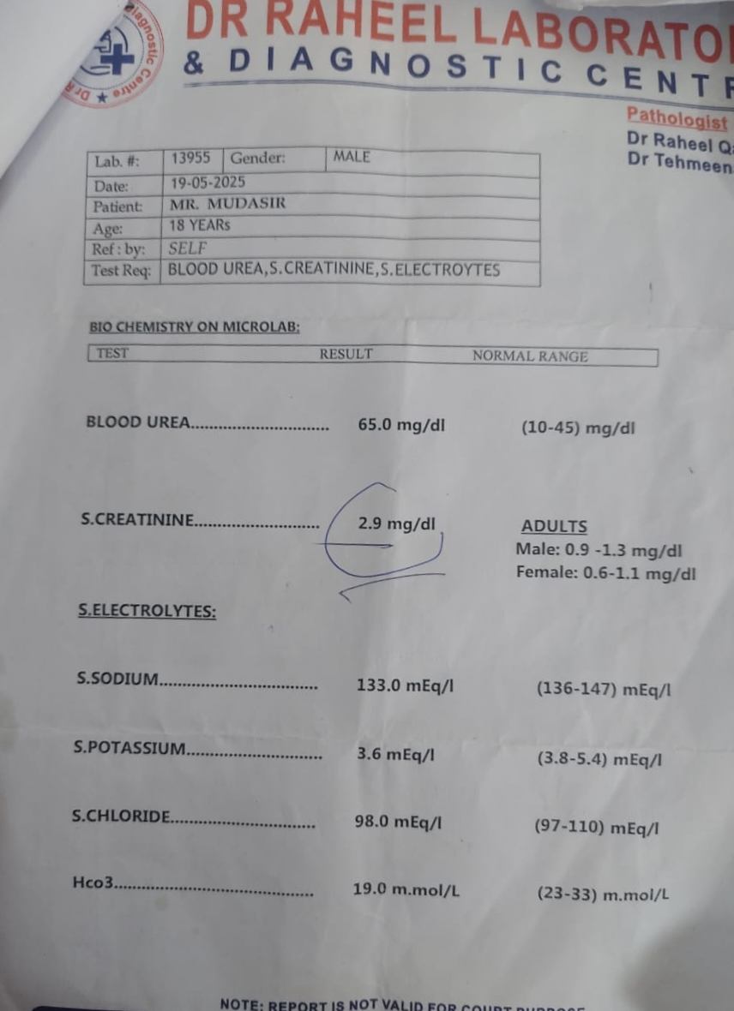
Biochemistry done on 19 May,2025
SERUM CREATININE= 2.9 mg/dl
SERUM SODIUM=133mEq/l
SERUM POTASSIUM =3.6mEq/l
SERUM CHLORIDE =98mEq/l
HCO3= 19 mmol/l

Slide 29
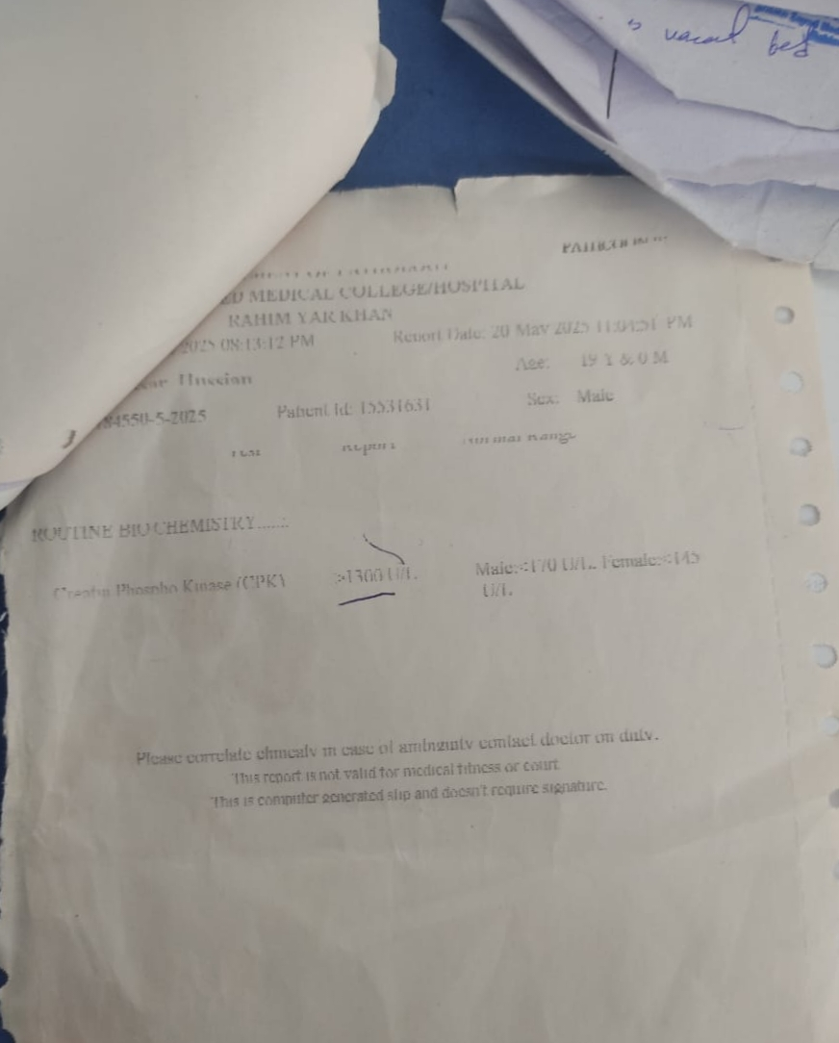
ROUTINE
BIOCHEMISTRY
CREATINE PHOSPHOKINASE GREATER THAN 1300 U/L

Slide 30
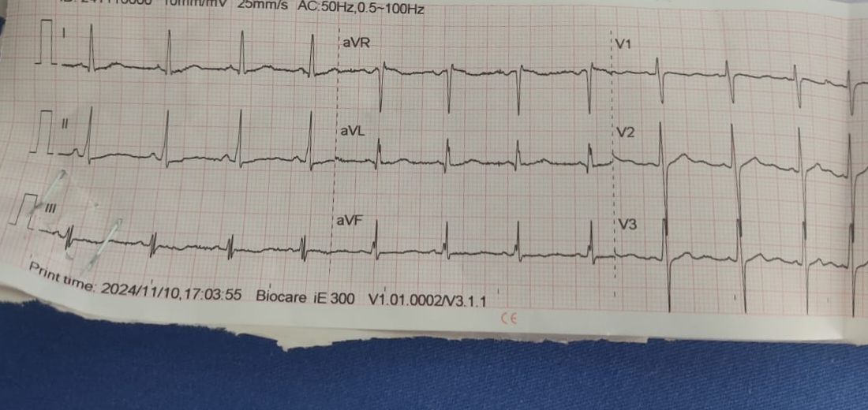
ECG
PEAKED T -WAVES .
PROLONGED PR INTERVAL .

