Slide 1
CLINICOPATHOLOGIC CONFERENCE (CPC)
MEDICAL UNIT-2
23-05-2025

Slide 2
TETANUS
AMNA IRFAN
KINZA SALEEM
LAIBA MAJEED

Slide 3
HISTORY
Biodata:
Name: Yousaf
Father Name: Laal Baksh
Age: 16 years
Marital status: Unmarried
Residecy: Rajanpur
Occupation: Farmer
Mode of admission: Opd
Date of admission: 8 May 2025

Slide 4
PRESENTING COMPLAINT
Body stiffness for 2 days
Inability to open the mouth for 2 days

Slide 5
HISTORY OF PRESENTING ILLNESS
My patient was in usual state of health 2 days back when he developed generalized body stiffness,which was sudden in onset, progressive in nature, continues, triggered by light,touch, and noise.
Associated with body pain and neck extension.
He also complaint of inability to open the mouth, which was sudden in onset, continuous, progressive in nature,with no aggravating and relieving Factors.

Slide 6
HISTORY OF PRESENTING ILLNESS
Patient has no irritability, sweating and tachycardia
Condition was not associated with fever, headache, dysphagia, breathing difficulty and seizures
Patient was bare footed most of the time and has history of multiple small wounds or lacerations on both feet which are healed now.patient has no history of any road traffic accident

Slide 7
SYSTEMIC INQUIRY
General
Patient has normal sleep and normal appetite

Slide 8
SYSTEMIC INQUIRY
CNS
Patient has history of generalized rigidity all over the body and difficulty in speech
No history of headache,loss of consciousness,weaknss of limbs,,visual disturbances,parasthesia,tremors, memory loss.

Slide 9
SYSTEMIC INQUIRY
GIT SYSTEM
Patient has history of abdominal pain
No history of Nausea, Vomiting,Dysphagia
There is no diarhea , abdominal distension , yellow discoloration of eyes and pruritis.

Slide 10
SYSTEMIC INQUIRY
Musculoskeletal
Patient has history of inability to open the mouth
Patient has no history of joint pain,rash,and photosensitivity.

Slide 11
SYSTEMIC INQUIRY
Respiratory System
Patient has no history of SOB,no cough, sputum, allergic rhinitis.

Slide 12
SYSTEMIC INQUIRY
Urinary System
There is no oliguria, dysuria, burning micturation or hematuria

Slide 13
SYSTEMIC INQUIRY
Endocrine System
There is no history of polyphagia, polydipsia, polyuria
No history of heat and cold intolerance
And no history of weight loss

Slide 14
PAST MEDICAL AND SURGICAL
Patient has no significant past medical and surgical history

Slide 15
DRUG HISTORY
There is no previous drug history or any hospitalisation

Slide 16
IMMUNIZATION HISTORY
Patient is not vaccinated

Slide 17
FAMILY HISTORY
No history of hypertension and diabetes mellitus or any similar condition in family

Slide 18
SOCIOECONOMIC HISTORY
Patient is farmer as well as shepherd by occupation
He lives in non cemented house with 2 rooms and 9 family members and use tap water for drinking.
Patient has the history of animal exposure

Slide 19
PERSONAL HISTORY
Patient is non smoker and no history of alcohol and other addiction

Slide 20
EXAMINATION

Slide 21
GENERAL PHYSICAL EXAMINATION
A 16 years old boy laying comfortably on bed well oriented with time place and person.There was an IV cannula inserted on his right hand. He did not seem to have any respiratory difficulty or dismorphic features.

Slide 22
GENERAL PHYSICAL EXAMINATION
Vitals
Pulse;88bpm
Respiratory rate ;22breath per min
Temperature;98.6F
BP;100/60 mmHg

Slide 23
LOCAL WOUND EXAMINATION
There were multiple abrasions on sole of both feet most of them were healed and non infected wounds

Slide 24
NEUROLOGICAL EXAMINATION
GCS : 15/15
Cranial nerve involvement:
There was trismus (difficulty in opening the mouth)
rest of other cranial nerve examination was normal.

Slide 25
NEUROLOGICAL EXAMINATION
Motor examination
There was increase in tone of muscles.(body stiffness)
Power 5/5
Deep tendon reflexes were brisk.
No involuntary movements.
NO signs of meningial irritation
Sensory system was intact.
Cerebellar examination is normal.

Slide 26
RESPIRATORY EXAMINATION
Chest was of normal shape with normal and equal movement on both sides
Breathing was normal and there was no use of accessory muscle
Trachea was central .
No tenderness,laryngeospasm ,stridor , crepitations and normal vocal fremitus . Percussion notes were resonant and equal on both sides with normal vesicular breathing.

Slide 27
GASTROINTESTINAL EXAMINATION
Shape and contour was normal.
Umblicus was central and hernial orifices were intact
There were no Palpable lymph nodes.
No abdominal tenderness but there was rigidity or gaurding response on stimulus of touch.
No viceromegaly found.

Slide 28
MUSCULOSKELETAL EXAMINATION
No joint deformity
no proximal myopathy

Slide 29
CARDIOVASCULAR EXAMINATION
JVP was normal
apex beat felt in 5th ICS and was of normal character
no palpable heave or thrill
S1 and S2 were heard with no added sounds

Slide 30
DIFFERENCIAL DIAGNOSIS
Tetanus
Dystonic drug reaction
Convulsion disorders
Strychnine poisoning

Slide 31
INVESTIGATIONS

Slide 32
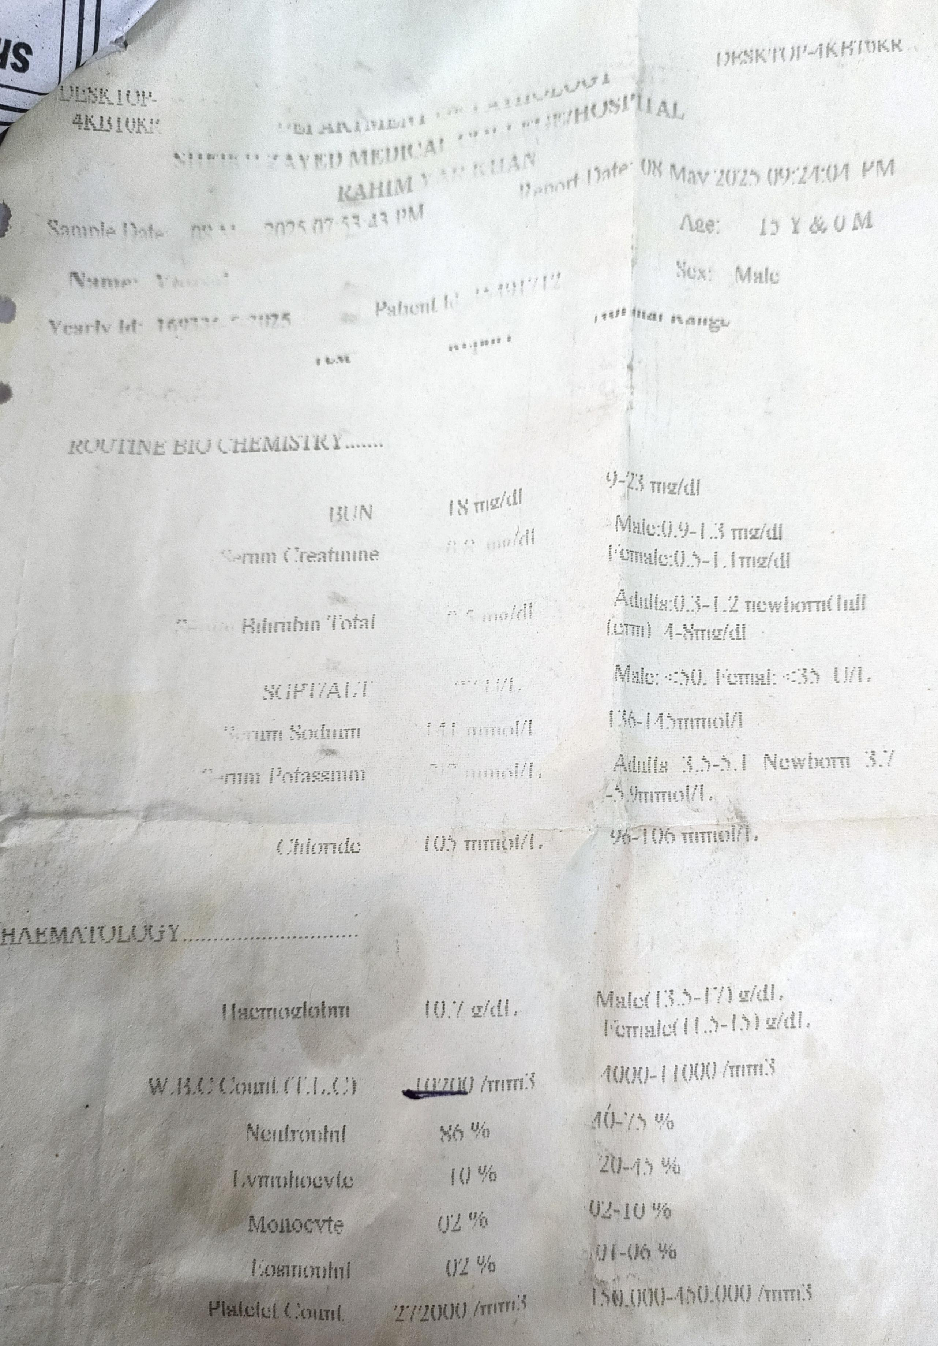
LAB INVESTIGATIONS

Slide 33
INVESTIGATIONS
Diagnosis is made on clinical grounds mostly
Rarely any investigation is required:
Wound swab for pcr
Wound swab for culture of C.tetani.

Slide 34
HEMATOLOGY
Baseline investigation of my patient is as follows:
Hb. 10.7g/dl
TLC. 10,200/mm cube
Platelet count. 272000/mm cube
Patient routine biochemistry is also normal

Slide 35
MANAGEMENT

Slide 36
MANAGEMENT
Neutralise absorbed toxin:
1. Human tetanus antitoxin IM/IV
2. Human IVIG
To prevent further toxin production
1. Debride wound
2. Metronidazole(500mg) IV every 6 to 8 hour/Penicillin G 2 to 4 million units IV every 4 to 6 hour for 7 to 10 days

Slide 37
MANAGEMENT
To control spasm
1. Nurse in a quiet room
2. Avoid unnecessary stimuli
3. Give IV diazepam
4. If spasm continue paralyse patient and continue
General measures
1. Maintain hydration and nutrition
2. Treat secondary infections
3. Vaccination following recovery

