Slide 1

CHILDHOOD TETNUS
By
DR. Muhammad Hashim
Pgr pediatrics medicine unit 1
Sheikh zayed hospital RYk

Slide 2
Overview
Definition
Epidemiology
Etiology
Pathophysiology
Clinical aspects
Diagnosis
Treatment
Complication
Management
Control and prevention

Slide 3
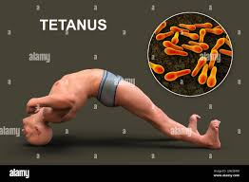
Definition
Tetanus is acute, spastic, paralytic illness caused by neurotoxin produced by Clostridium tetani.

Slide 4
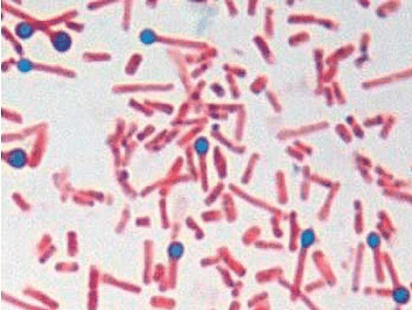
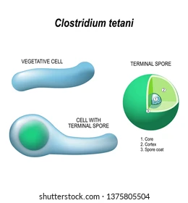
Etiological Agent
Clostridium tetani:
Gram-positive, spore forming, obligate anaerobe.
Natural habitat :
Soil,dust and the alimentary tract of animals.

Slide 5
Spores are resistant to heat and most antiseptics but not to autoclave vegetative cells are killed by antibiotics, heat and disinfectant
produce a potent exotoxin called tetanospasmin
Second most common poisonous substance
Lethal dose is 10-⁵mg/kg

Slide 6
Epidemiology
Tetanus occurs worldwide
More common in developing and under develop countries
Tetanus neonatorum is common due to lack of MCH care.
Tetanus, particularly the neonatal form a significant public health problem in non-industrialized countries.
The World Health Organization estimates that 38000 deaths reported worldwide in 2017 as a result of tetanus .More than 18000 were under 5 years of age.
Most of mortality occurs in south Asia and Africa

Slide 7
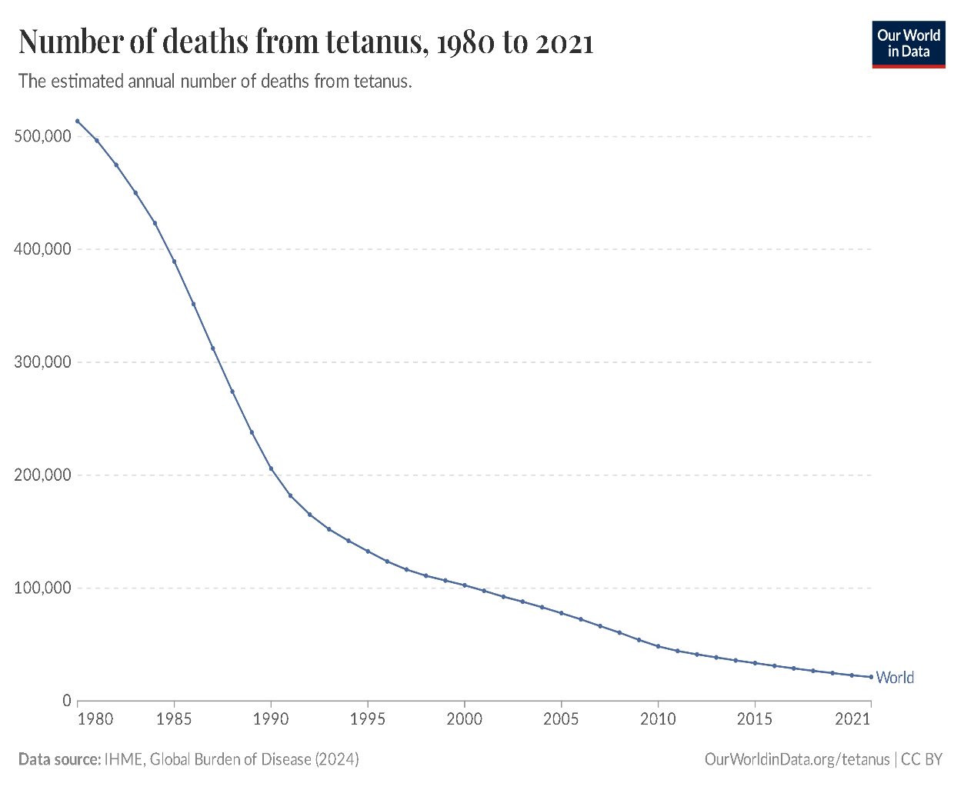
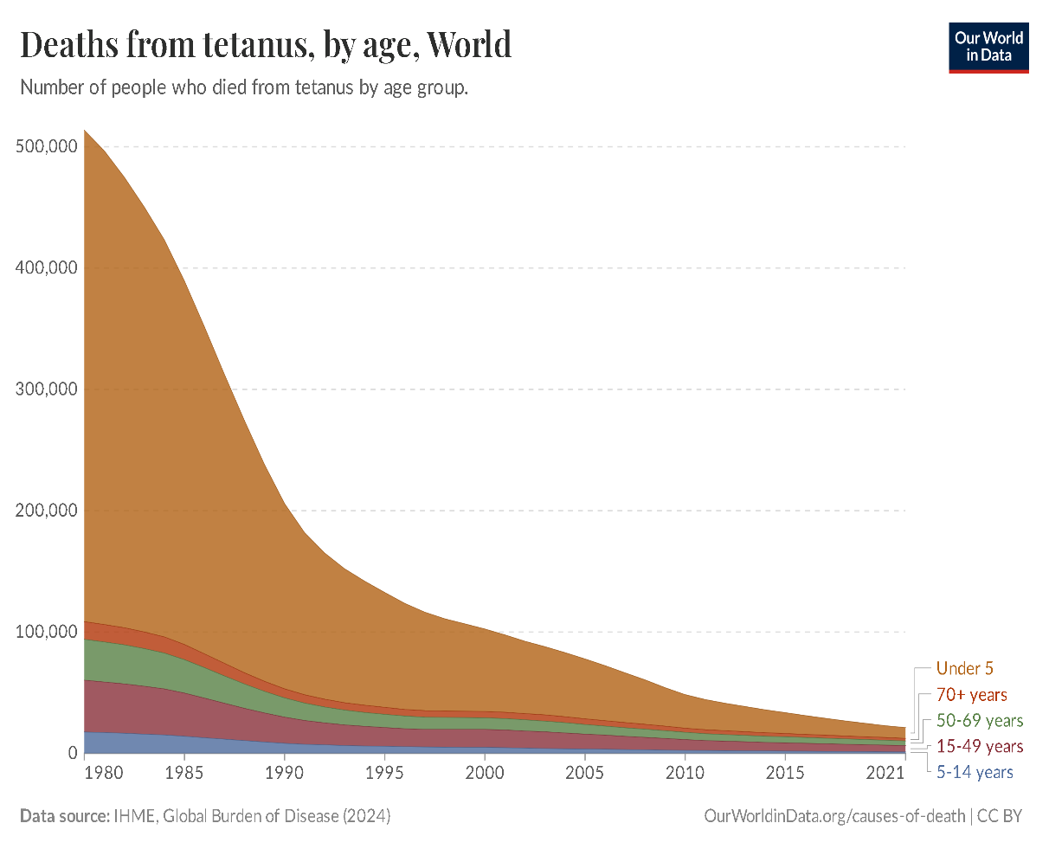

Slide 8
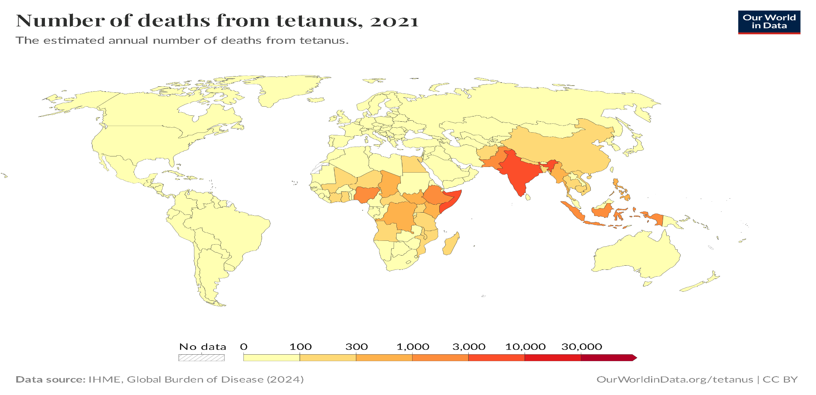

Slide 9
Pathogenesis
Tetanus begins when spores of Clostridium tetani enter damaged tissue
traumatic injuries penetrating wound inflected by a nail, splinter, fragment of glass or unsterile injection.it is also associated with animal bite, ear and other body piercing
The spores transform into rod-shaped bacteria and produce the neurotoxin tetanospasmin (also so known as tetanus toxin)
This toxin is inactive inside the bacteria, but when the bacteria die, toxin is released and activated by proteases.
Finally it interferes with neurotransmission at spinal synapses of inhibitory neurons.
This results to uncontrolled spasms and reflexes

Slide 10
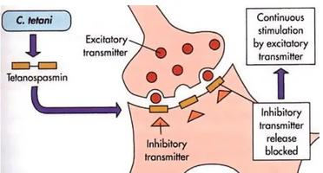
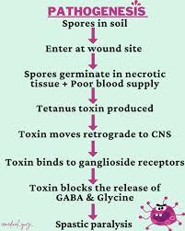
Pathogenisis

Slide 11
Clinical features
Head ach, restlessness, and irritability
Lock jaw (reflex trismus)
Spasm of pharyngeal muscles
Risus sardonicus (Mouth kept slightly open)
Opisthotonos position
Acute asphyxia
Pain and tingling at the site of wound
Pain in neck, back and abdomen
Refusal of feeding

Slide 12
localized tetanus
Painful spasm of muscle and adjacent to the wound site
Proceed to generalized tetanus
Cephalic tetanus
Involve bulbar musculature and cranial nerves
Retracted eyelids, deviated gaze, trismus, risus sardonicus and spastic paralysis of tongue and musculature
Neonatal tetnus
Infentile form of gen.tetanus
3-12 days after birth
Difficulty in feeding,crying,paralysis and diminished movements
Stifness and rigidity to touch
umbilical source

Slide 13
Diagnosis
There are currently no blood tests that can b used to diagnose tetanus
clinical presentation of patient associated with tetanus are the essential factors of diagnosis.
history of injury and possible contamination.
Spatula test: touching the oropharynx with spatula or tongue blade
Reflex spasm of masseter muscle and bite the spatula

Slide 14

Treatment
Supportive care:
Isolation in a quit dark room.
Maintain fluid, nutrition, and electrolytes.
Oxygen inhalation if required
Local wound care:
Incision & drainage of pus.
Debridement (Removal of necrotic tissues & foreign bodies)

Slide 15
Treatment
Control of spasm:
Diazepam 0.1-0.2mg/kg upto 15-40mg/kg/day
drug dosage can be decrease 5-10mg/day and sustained for 2-6 weeks
Magnesium sulfate cane be used to control autonomic dysfunction
Baclofen
Immunization
Injection tetanus toxoid 0.5ml intramuscularly
Passive immunization with human anti- tetanospasmin immunoglobulin (3000U-6000U)
antibiotics
Metronidazole 30mg/kg/day
Parenteral pencilline G 100,000 U/kg/day
Broad spectrum antibiotics to treat or prevent infection.

Slide 16
Complications
Aspiration pneumonia
Respiratory arrest
Vertebral fracture
Laceration of tongue, lips, buccal cavity
Rhabdomyolysis
Gastric ulcer with without hemorrhage
Autonomic dysfunction

Slide 17
Control and Prevention:
Tetanus is a vaccine preventable disease.
Immunization of mother with 2 doses of TT during 2nd trimester of pregnancy can prevent Neonatal tetanus.
Infants & children should be immunized by primary active immunization with DPT at 6, 10,14 weeks.

Slide 18
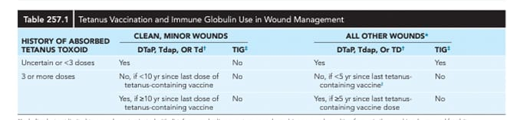
Control and prevention

Slide 19
Prognosis
GOOD PROGNOSTIC FACTORS
Long incubation period
Absence fever
Localized disease
BAD PROGNOSTIC FACTORS
Onset of trismus <7days
Onset of generalized tetnus spasm <3days after onset trismus
Suquelae of brain injuries HIE, CP

Slide 20
prognosis
Most fatalities occur in first week
Fatality rate of general tetanus is 35%
Fatality rate of neonatal tetanus is >75%
Cephalic tetanus has poor prognosis

Slide 21
Thank you

