Slide 1

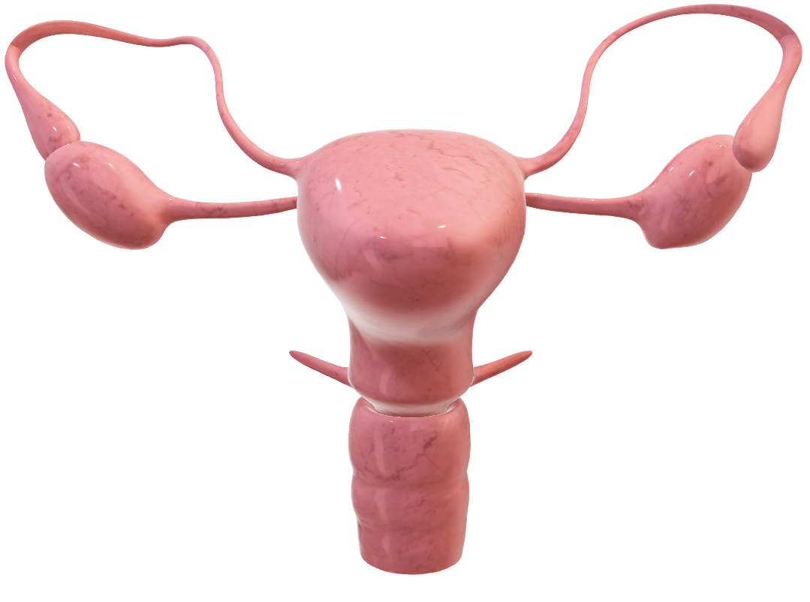
Dr. Arsheea Maryam (SR)
Dr. Faiza Sattar (PGR)
Dr. Natasha Irum (PGR)
Khansa Iqbal (Final Year)
Javeria Batool (Final Year)
Nuzhat Fatima (Final Year)
Clinicopatholgical Conference
Gynae Unit - II

Slide 2
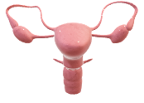
Clinicopatholgical Conference
Gynae Unit - II
Presented by:
Khansa Iqbal (Final Year)
Nuzhat Fatima (Final Year)
Javeria Batool (Final Year)
Dr. Natasha Irum (PGR)
Dr. Faiza (PGR)
Dr. Arsheea Maryam (SR)
Dr. Faiza Sattar (PGR)
Dr. Natasha Irum (PGR)
Khansa Iqbal (Final Year)
Javeria Batool (Final Year)
Nuzhat Fatima (Final Year)

Slide 3


Slide 4

Biodata
Presenting Complaints
History of presenting illness
Obstetric History
Gynecological History
Past Medical History
Past Surgical History
Family History
Personal History
Socioeconomic History

Slide 5

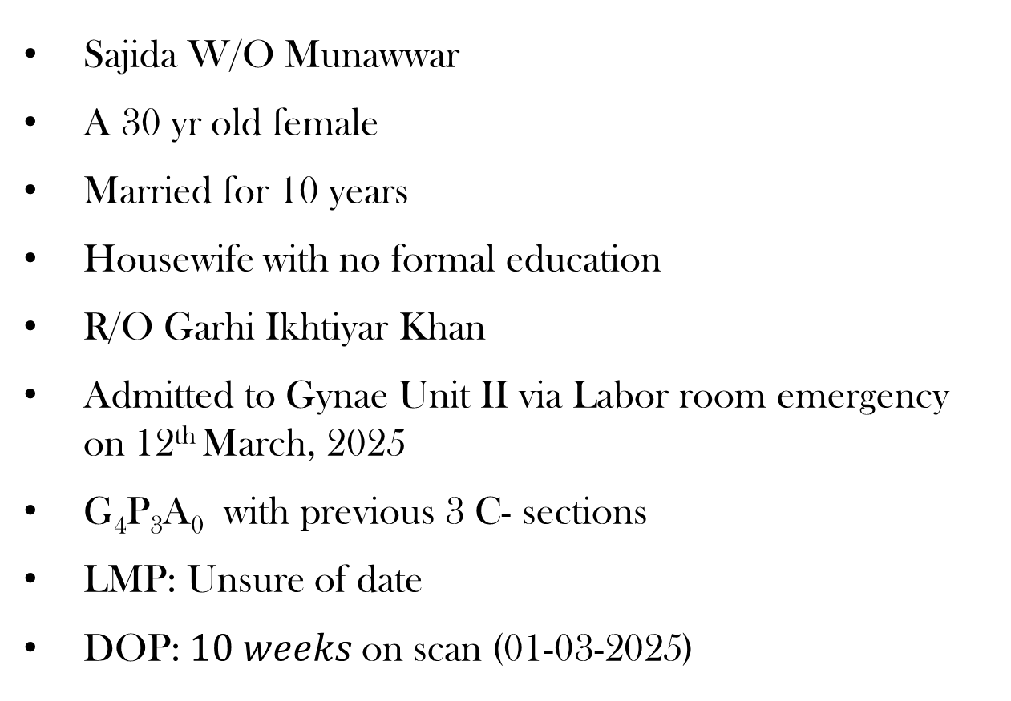
Biodata
Biodata
Presenting Complaints
Sajida W/O Munawwar
A 30 yr old female
Married for 10 years
Housewife with no formal education
R/O Garhi Ikhtiyar Khan
Admitted to Gynae Unit II via Labor room emergency on 12th March, 2025
G₄P₃A₀ with previous 3 C- sections
LMP: Unsure of date
DOP:$10 weeks$on scan (01-03-2025)
History of presenting illness
Obstetric History
Gynecological History
Past Medical History
Past Surgical History
Family History
Personal History
Socioeconomic History

Slide 6
Presenting Complaints
Biodata
Presenting Complaints
History of presenting illness
Obstetric History
Gestational amenorrhea – 3 months
Lower Abdominal Pain – 15 days
Per Vaginal Bleeding – 15 days
Gynecological History
Past Medical History
Past Surgical History
Family History
Personal History
Socioeconomic History

Slide 7
Biodata
History of Presenting Illness
Presenting Complaints
History of presenting illness
My patient presented at 10 weeks of gestation, she conceived spontaneously, came to know about her pregnancy through missed periods
Pregnancy was confirmed by Urine Pregnancy Test
There was no history of nausea, excessive vomiting, flu, fever or rash
She took folic acid supplements regularly
Dating scan wasn’t done
Obstetric History
Gynecological History
Past Medical History
Past Surgical History
Family History
Personal History
Socioeconomic History

Slide 8
Biodata
History of Presenting Illness
Presenting Complaints
History of presenting illness
Now she presented in labor room with complaints of lower abdominal pain & mild per vaginal bleeding for last 15 days
Lower abdominal pain was gradual in onset, mild to moderate in intensity, dull in character, continuous, with no aggravating or relieving factors, not associated with any gastrointestinal or urinary symptoms
PV bleeding was mild & intermittent
Obstetric History
Gynecological History
Past Medical History
Past Surgical History
Family History
Personal History
Socioeconomic History

Slide 9
Biodata
Obstetric History
Presenting Complaints
History of presenting illness
Obstetric History
She is a mother of 2 daughters and one son, all alive & healthy, breast fed & fully vaccinated
All pregnancies were full term, delivered by LSCS (Lower Segment Caesarean Section) under spinal anesthesia with no antepartum, intrapartum or post partum complications
Gynecological History
Past Medical History
Past Surgical History
Family History
Personal History
Socioeconomic History

Slide 10
Biodata
Gynecological History
Presenting Complaints
History of presenting illness
Obstetric History
Her age of menarche was 13 yrs
She had a regular 7/30 days menstrual cycle with normal flow not associated with dysmenorrhea, dyspareunia, intermenstrual & postcoital bleeding
She soaked 2 – 3 pads per day
There was no history of passage of clots
No contraceptive method was practiced
No Pap smear was taken
Gynecological History
Past Medical History
Past Surgical History
Family History
Personal History
Socioeconomic History

Slide 11
Biodata
Past Medical History
Presenting Complaints
History of presenting illness
Obstetric History
Gynecological History
There was no history of Diabetes Mellitus, Hypertension, Ischemic Heart Disease, Asthma & Tuberculosis
Past Medical History
Past Surgical History
Family History
Personal History
Socioeconomic History

Slide 12
Past Surgical History
Biodata
Presenting Complaints
History of presenting illness
Obstetric History
Gynecological History
There was no significant past surgical history other than previous 3 caesarean sections
Past Medical History
Past Surgical History
Family History
Personal History
Socioeconomic History

Slide 13
Biodata
Family History
Presenting Complaints
History of presenting illness
There was no history of
Hypertension
Diabetes Mellitus
Tuberculosis
Ischemic Heart Disease
Bleeding disorders
Breast, uterine or intestinal carcinoma in her family
Obstetric History
Gynecological History
Past Medical History
Past Surgical History
Family History
Personal History
Socioeconomic History

Slide 14
Biodata
Personal History
Presenting Complaints
History of presenting illness
Obstetric History
She had a disturbed sleep and appetite
She had normal bowel & bladder habits
She had no history of smoking or any other addiction
Gynecological History
Past Medical History
Past Surgical History
Family History
Personal History
Socioeconomic History

Slide 15
Socioeconomic History
Biodata
Presenting Complaints
History of presenting illness
Obstetric History
Her husband is a laborer by occupation & the only earner in the family
She lives in a rented house with 5 family
members
Gynecological History
Past Medical History
Past Surgical History
Family History
Personal History
Socioeconomic History

Slide 16


Slide 17

A 30 yr old female with BMI of 24 kg/m² lying comfortably, cooperative & well oriented in time, space & person with IV branula on right hand.
Vitals:
Pulse rate: 100 bpm
Blood pressure: 110/60 mmHg
Respiratory rate: 22/min
Temperature: 98°F
She was pale looking
Clubbing, koilonychia, cyanosis, jaundice or pedal edema are not present
Thyroid gland is not enlarged
Accessible lymph nodes were not palpable

Slide 18
A 30 yr old female with BMI of 24 kg/m² lying comfortably, cooperative & well oriented in time, space & person with IV branula on right hand.
Vitals:
Pulse rate: 100 bpm
Blood pressure: 110/60 mmHg
Respiratory rate: 22/min
Temperature: 98°F
She was pale looking
Clubbing, koilonychia, cyanosis, jaundice or pedal edema are not present
Thyroid gland is not enlarged
Accessible lymph nodes were not palpable

Slide 20
CNS EXAMINATION
RESPIRATORY EXAMINATION
CVS EXAMINATION
BREAST EXAMINATION
ABDOMINAL EXAMINATION
PER SPECULUM EXAMINATION
BIMANUAL EXAMINATION

Slide 21

CNS EXAMINATION
CNS EXAMINATION
RESPIRATORY EXAMINATION
CVS EXAMINATION
GCS: 15/15
Patient was alert and oriented in time, place
and person
BREAST EXAMINATION
ABDOMINAL EXAMINATION
PER SPECULUM EXAMINATION
BIMANUAL EXAMINATION

Slide 22
RESPIRATORY EXAMINATION
CNS EXAMINATION
RESPIRATORY EXAMINATION
CVS EXAMINATION
Trachea was central
Normal vesicular breathing
No added breath sounds
BREAST EXAMINATION
ABDOMINAL EXAMINATION
PER SPECULUM EXAMINATION
BIMANUAL EXAMINATION

Slide 23
CVS EXAMINATION
CNS EXAMINATION
RESPIRATORY EXAMINATION
Apex beat palpable in the left 5th intercostal space, 1 cm medial to the mid-clavicular line
First and second heart sounds audible, with no added sounds
CVS EXAMINATION
BREAST EXAMINATION
ABDOMINAL EXAMINATION
PER SPECULUM EXAMINATION
BIMANUAL EXAMINATION

Slide 24
BREAST EXAMINATION
CNS EXAMINATION
RESPIRATORY EXAMINATION
Breasts were symmetrical bilaterally
No mass palpable in all four quadrants
Axillary lymph nodes were not palpable
Nipples were everted with no visible discharge
CVS EXAMINATION
BREAST EXAMINATION
ABDOMINAL EXAMINATION
PER SPECULUM EXAMINATION
BIMANUAL EXAMINATION

Slide 25
ABDOMINAL EXAMINATION
CNS EXAMINATION
RESPIRATORY EXAMINATION
Inspection:
Slightly round in shape, moving with respiration,
umbilicus is central and inverted, striae gravidarum
present, no visible pulsations or prominent veins, hernial orifices were intact, Pfannenstiel scar mark of LSCS present
CVS EXAMINATION
BREAST EXAMINATION
ABDOMINAL EXAMINATION
PER SPECULUM EXAMINATION
BIMANUAL EXAMINATION

Slide 26
ABDOMINAL EXAMINATION
CNS EXAMINATION
RESPIRATORY EXAMINATION
Palpation:
Abdomen was soft, tenderness present in lower abdomen on deep palpation, with no visceromegaly, mass or rigidity
Percussion:
Percussion note is resonant
Auscultation:
Bowel sounds are audible, no bruit is heard
CVS EXAMINATION
BREAST EXAMINATION
ABDOMINAL EXAMINATION
PER SPECULUM EXAMINATION
BIMANUAL EXAMINATION

Slide 27
PER SPECULUM EXAMINATION
CNS EXAMINATION
RESPIRATORY EXAMINATION
CVS EXAMINATION
Cervix is normal looking
External os is closed
Mild per vaginal bleeding observed
BREAST EXAMINATION
ABDOMINAL EXAMINATION
PER SPECULUM EXAMINATION
BIMANUAL EXAMINATION

Slide 28
CNS EXAMINATION
BIMANUAL EXAMINATION
RESPIRATORY EXAMINATION
CVS EXAMINATION
BREAST EXAMINATION
Cervical tenderness was present
ABDOMINAL EXAMINATION
PER SPECULUM EXAMINATION
BIMANUAL EXAMINATION

Slide 29


Slide 30
BLOOD
PROFILE
LFTs & RFTs
ULTRASONOGRAPHY
SERUM β HCG

Slide 31
BLOOD PROFILE
BLOOD
PROFILE
Blood group & Rh factor: AB +ive
CBC:
Hemoglobin: 6.1 g/dl
TLC: 14700/mm³
Platelet count: 195000/mm³
BSR: 105 mg/dl
Viral markers:
HbsAg: Negative
Anti-HCV: Negative
Anti-HIV: Negative
LFTs & RFTs
ULTRASONOGRAPHY
SERUM β HCG

Slide 32
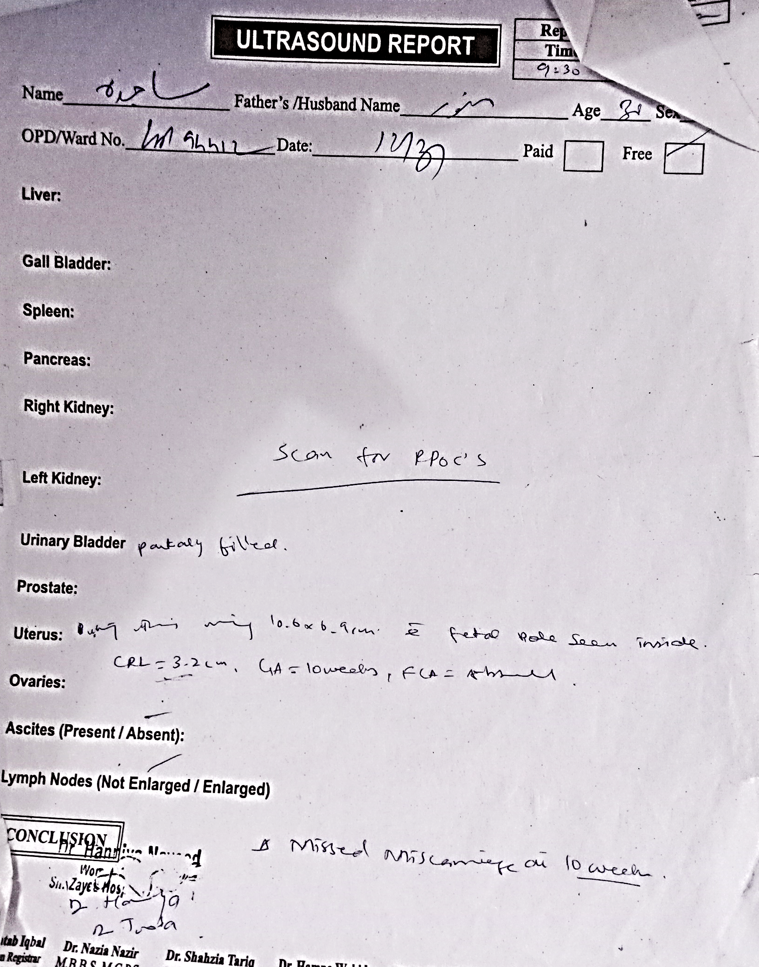
LFTs & RFTs
BLOOD
PROFILE
LFTs:
Serum Bilirubin: 0.6 mg/dl
ALT/ SGPT: 19 U/L
RFTs:
Blood urea: 12 mg/dl
Serum creatinine: 0.5 mg/dl
LFTs & RFTs
ULTRASONOGRAPHY
SERUM β HCG

Slide 33
BLOOD
PROFILE
ULTRASONOGRAPHY
LFTs & RFTs
Her ultrasound done on 12-03-2025 showed a missed miscarriage at 10 weeks
ULTRASONOGRAPHY
SERUM β HCG

Slide 34
BLOOD
PROFILE
SERUM β hCG
LFTs & RFTs
  Serum β-hCG = 28210mIU/L
ULTRASONOGRAPHY
SERUM β HCG

Slide 36
Missed abortion
Incomplete abortion
Ectopic pregnancy
Molar pregnancy

Slide 37


Slide 38
CASE SUMMARY
A 30-year-old female, G4P3, Previous 3 C sections, at 10 weeks of gestation (missed abortion on USG) admitted in labor room for management.
On examination, she is pale looking having vitals of
BP: 110/60 mmHg
Pulse: 100 bpm
Respiratory rate: 22/min
Abdominal examination: Mild tenderness in lower abdomen
Speculum examination: Mild per vaginal bleeding & cervical tenderness
Her blood group is AB+ive
Hb: 6.1 g/dl
TLC: 14700/mm³
MANAGEMENT
As Pt presented with Hb 6.1 g/dl & was severely anemic, we planned to do PCV transfusion to build up her Hb. 4 packed cell volume were transfused until her Hb was 10 g/dl
Patient was planned for suction & evacuation on elective list after cervical ripening
Pre-anesthesia assessment was done

Slide 39
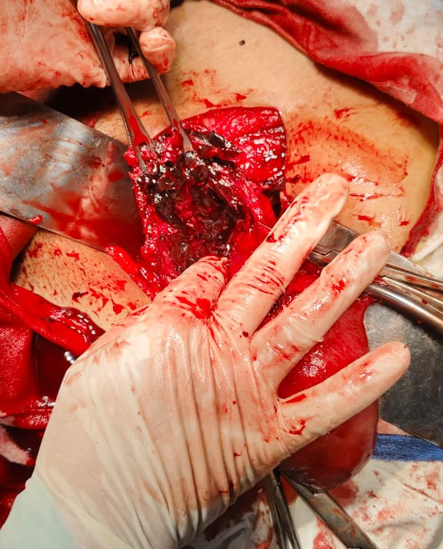
CASE SUMMARY
A 30-year-old female, G4P3, Previous 3 C sections, at 10 weeks of gestation (missed abortion on USG) admitted in labor room for management.
On examination, she is pale looking having vitals of
BP: 110/60 mmHg
Pulse: 100 bpm
Respiratory rate: 22/min
Abdominal examination: Mild tenderness in lower abdomen
Speculum examination: Mild per vaginal bleeding & cervical tenderness
Her blood group is AB+ive
Hb: 6.1 g/dl
TLC: 14700/mm³
MANAGEMENT
As Pt presented with Hb 6.1 g/dl & was severely anemic, we planned to do PCV transfusion to build up her Hb. 4 packed cell volume were transfused until her Hb was 10 g/dl
Patient was planned for suction & evacuation on elective list after cervical ripening
Pre-anesthesia assessment was done

Slide 40
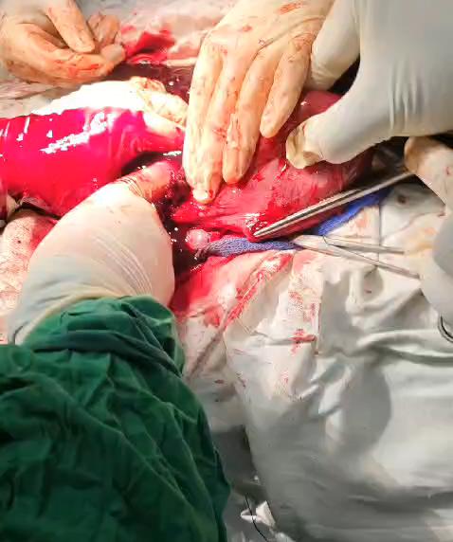
MANAGEMENT
As Pt presented with Hb 6.1 g/dl & was severely anemic, we planned to do PCV transfusion to build up her Hb. 4 packed cell volume were transfused until her Hb was 10 g/dl
Patient was planned for suction & evacuation on elective list after cervical ripening
Pre-anesthesia assessment was done

Slide 41
INTRAOPERATIVE FINDINGS
A mass of about 6×6 cm with hematoma which was fully embedded in the previous uterine scar
Pt was bleeding profusely & proceeded for hysterectomy

Slide 42
INTRAOPERATIVE FINDINGS
A mass of about 6×6 cm with hematoma which was fully embedded in the previous uterine scar
Pt was bleeding profusely & proceeded for hysterectomy
DEFINITIVE DIAGNOSIS
Caesarean Scar Ectopic Pregnancy

Slide 43
INTRAOPERATIVE FINDINGS
A mass of about 6×6 cm with hematoma which was fully embedded in the previous uterine scar
Pt was bleeding profusely & proceeded for hysterectomy
DEFINITIVE DIAGNOSIS
Caesarean Scar Ectopic Pregnancy
POST OP CARE
  We shifted the patient to HDU
  Kept her under observation for 48 hours
  Her vitals were stable
  Her B.P was 120/70 mm of Hg
  Pulse was 82 beats/min
  Temp was 98°F
  Her bowel sounds were audible
  Her output was adequate
  We discharged and advised her to follow up after 1 week, for stitch removal

Slide 44
DEFINITIVE DIAGNOSIS
Caesarean Scar Ectopic Pregnancy
POST OP CARE
  We shifted the patient to HDU
  Kept her under observation for 48 hours
  Her vitals were stable
  Her B.P was 120/70 mm of Hg
  Pulse was 82 beats/min
  Temp was 98°F
  Her bowel sounds were audible
  Her output was adequate
  We discharged and advised her to follow up after 1 week, for stitch removal
FOLLOW UP
  Follow up after 1 week for stitch removal & patient’s general well being

Slide 45
POST OP CARE
  We shifted the patient to HDU
  Kept her under observation for 48 hours
  Her vitals were stable
  Her B.P was 120/70 mm of Hg
  Pulse was 82 beats/min
  Temp was 98°F
  Her bowel sounds were audible
  Her output was adequate
  We discharged and advised her to follow up after 1 week, for stitch removal
FOLLOW UP
  Follow up after 1 week for stitch removal & patient’s general well being

Slide 46
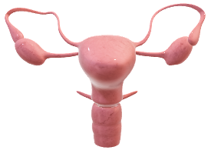

Slide 47
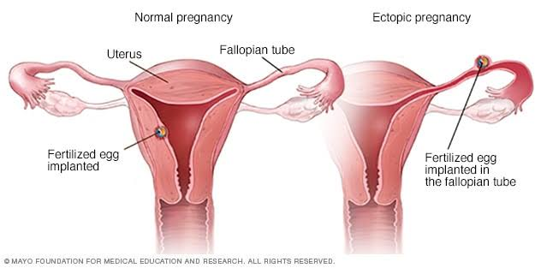
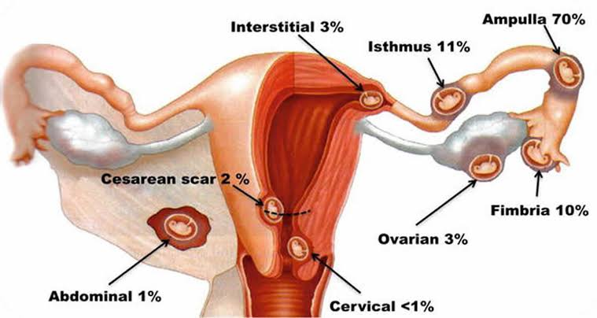
What is Ectopic Pregnancy?
Implantation of a conceptus outside the normal uterine cavity

Slide 48
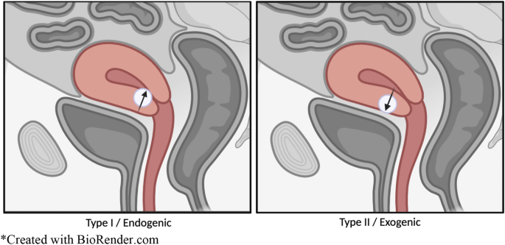
Sites
TUBAL (Fallopian tubes)
Ampulla 74%
Isthmus 12%
Fimbrial 5%
Interstitial 2%
NON-TUBAL
Ovaries 2%
Abdominal /peritoneal 1%
Cervical
LSCS scar
Cornual

Slide 49
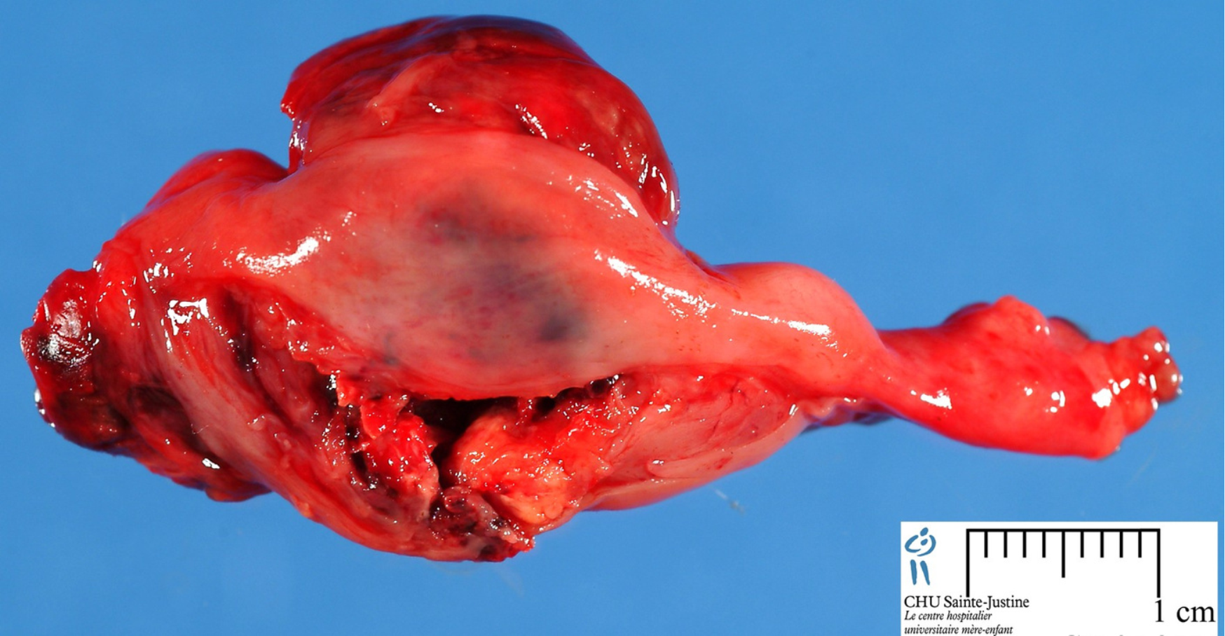
Caesarean Scar Ectopic
Types:
1. Endogenic:
When the pregnancy implants on the scar & grows towards the uterine cavity or cervico-isthmus space
2. Exogenic:
The gestational sac is deeply
embedded in the scar defect,
often in a well vascularized area
& grows outward towards the
bladder & abdominal cavity

Slide 50
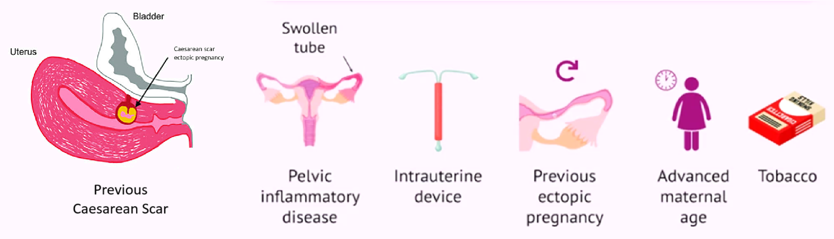
Pathology
Retention of Trophoblast /Embryo in the tube d/t
Delayed/ impaired transport of the fertilized ovum through the tube
Any alterations in the tube
Endometrial & myometrial
disruption or scarring (Caesarean
scar ectopic)

Slide 51
Risk Factors
Gestational
amenorrhea
Lower
abdominal
pain
Irregular vaginal
bleeding

Slide 52
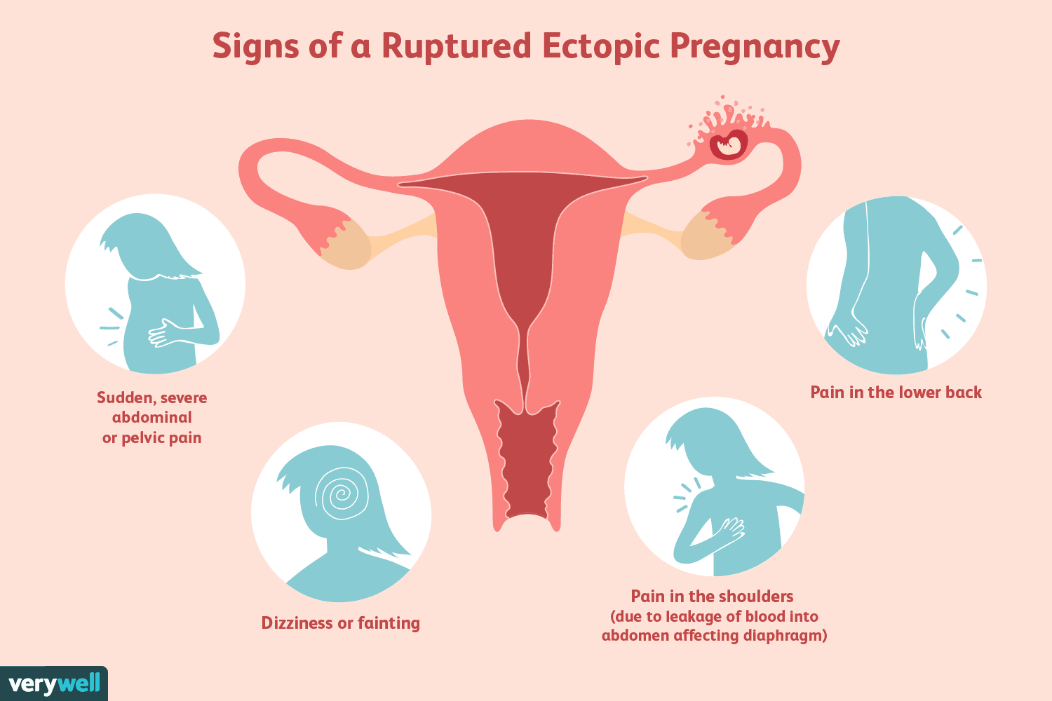
Clinical Presentation
Classic TRIAD (in 50% patients)
Gestational
amenorrhea
Lower
abdominal
pain
Irregular vaginal
bleeding

Slide 53
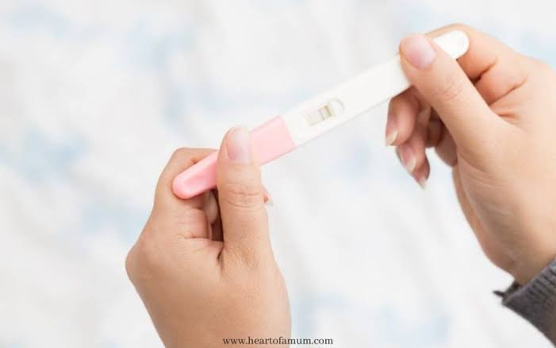
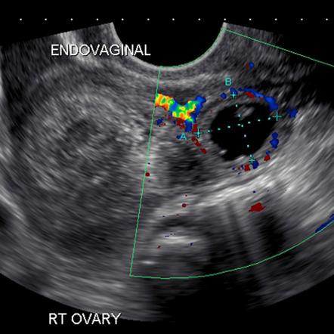
Signs of a ruptured ectopic pregnancy
Gestational
amenorrhea
Lower
abdominal
pain
Irregular vaginal
bleeding

Slide 54
Investigations
  BASELINE (Blood grouping and Rh factor, BSR, CBC,
Viral markers, Urine complete)
  Pregnancy test
  Serum Beta-hCG level
  Ultrasound--TVS
  Laproscopy
  Expectant
  Medical
  Surgical

Slide 55
Management
  Expectant
  Medical
  Surgical

Slide 56
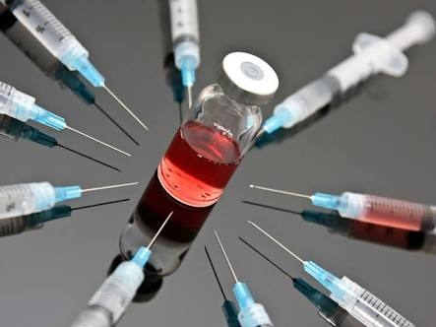
Controlled Expectant Management
  69% resolved spontaneously
Clinically:
  Stable asymptomatic woman
  Absent Hemoperitoneum
Biochemical:
  Baseline serum B-hCG concentrations <1000-1500 IU/l
USG:
  A tubal mass < 3.5 cm
  Absence of recognizable fetal heart on ultrasound
Follow up:
  Serial B-hCG measurements (<5 IU/L)
  TVS (to assess the size of adnexal mass)
  Expectant
  Medical
  Surgical

Slide 57
Medical Management
Indications:
Un-ruptured EP <3.5 cm
Absent Hemoperitoneum
Non-viable pregnancy
β-hCG <5000 IU /l

Slide 58
Medical Management
Methotrexate (Anti-folate)
Administration:
  IM / Local
Doses:
  50mg/m² single dose
Follow up:
If the serum B-hCG
  falls >15% between days 4 and 7 >>> good prognostic factor
  falls <15 % >>> second dose can be considered

Slide 59
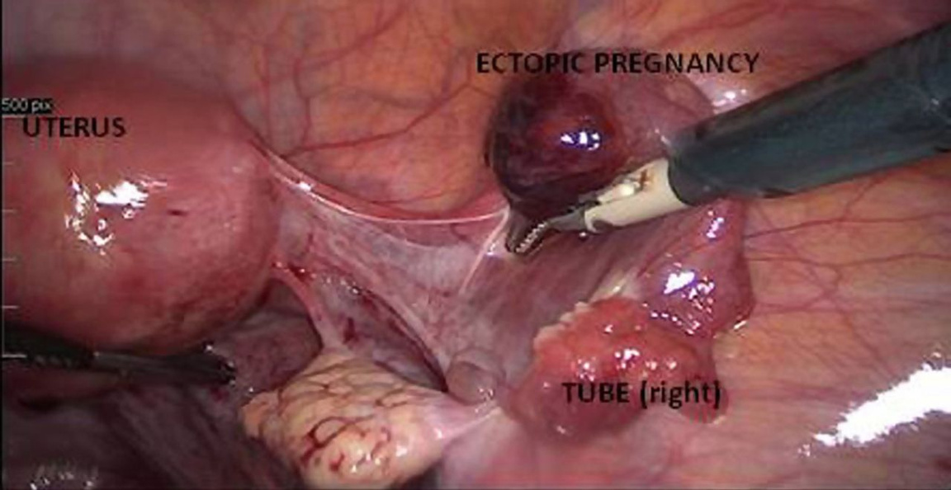
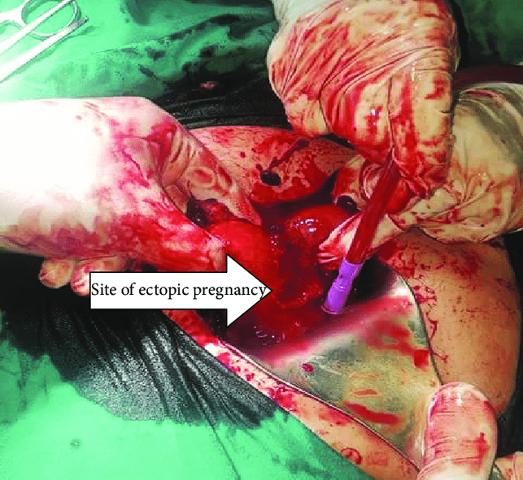
Surgical Management
Indications:
Sac >3.5 cm
Presence of Hemoperitonium
Presence of FCA
β-hCG >5000 IU /l

Slide 60
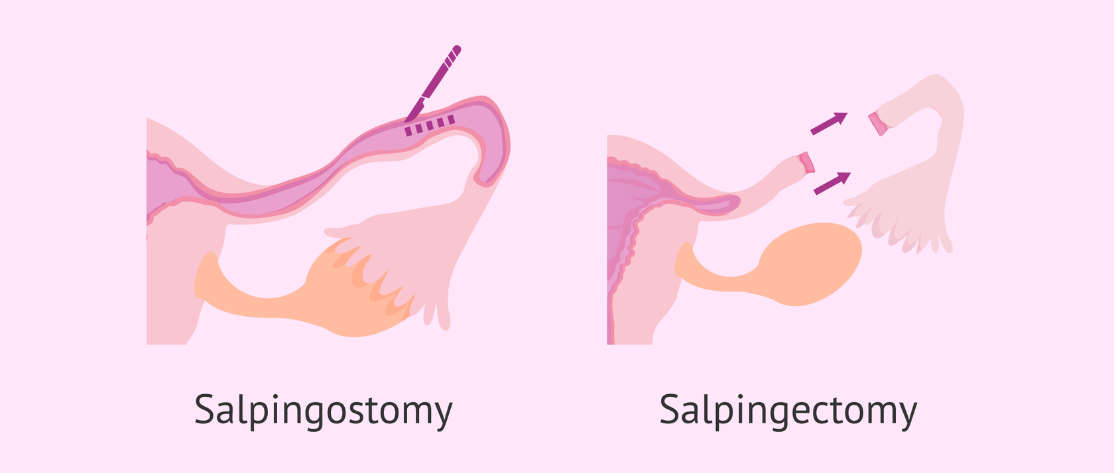
Surgical Management

Slide 61
Surgical Management

Slide 62
Surgical Management
Caesarean scar ectopic pregnancy:
Surgical evacuation
Abdominal/ Laparoscopic resection
Hysteroscopic management

Slide 63
Counselling
  Recurrence Risk ---------> about 16%. So, she must report early in next pregnancy.
  Contraception---------> for at least 3 months
  Anti D ---------> to Rh-ve, non-sensitized women.

