Slide 1


Slide 2
Clinicopathological conference
Gynae department unit 3

Slide 3
Topic:Placenta previa accreta spectrum
  Head of department: MADAM Saima zulfiqar
  Assistant professor : Dr. farhana shabnam
  SENIOR REGISTRAR: dr. aSIFA
  PGR : DR. SAmreen KANWAL & DR. IQRA SHEIKH
PRESENTED BY :
HAFSA KHALID ROLL NO 628
MUHAMMAD TAHIR ZAFAR ROLL NO 592

Slide 4
HISTORY OF THE PATIENT
BIODATA
30 yrs old Ms Hina w/o Mr Shakir Mehmood married for 8 yrs,teacher
G4P2A1 previous 2 c sections
Last child born 6yrs ago
resident of basti kareemabad admitted to labour room via O.P.D on 9 April 2025 .
L.M.P :25-July-2024
EDD: 1-may-2025
DOP:36+5weeks

Slide 5
PRESENTING COMPLAINT
She was admitted for
Em. LSCS due to placenta previa accreta and severe oligohydramnios.
She was referred from private setup.

Slide 6
History of presenting illness
conceived spontaneously
Chronic hypertensive
took folic acid supplements
h/o vaginal spotting on and off in 1st trimester
remained in usual state of health.
Baseline investigation(CBC) was normal.

Slide 7
Quickening at 5th month of gestation.
took aldomet and loprin regularly
took iron and calcium supplements
Anomaly scan done at 20 weeks showng no gross abnormalities but low lying placenta was diagnosed Routine investigations were normal
No vaginal spotting,bleeding observed

Slide 8
perceived normal fetal movements.
abdominal size was propotionate to the months of gestation.
Compliant with all medications
No h/o weakness, fatigue, SOB, or palpitations ,headache,blurring of vision.
tetanus vaccination in 7th and 8th month.
No history of vaginal bleeding or discharge
Booked in pvt set up sadiqabad and referred

Slide 9
After admission :
baseline investigations(CBC,URINE R/E ,VIRAL MARKERS, BSR, BLOOD GROUP) along with special investigations (LFTS AND RFTS) were performed
Departmental scan was performed for placental localization and mapping of placenta accreta spectrum
6 units of Blood and 4 units of FFPS were arranged and consulted with Hematologist,Blood bank personnell,Anesthetist,ICU Team ,surgeon and urologist were on call
High risk consent was taken regarding complication during surgery intraoperative hemorrhage,HYSTERECTOMY,bladder and bowel injury,need of massive blood transfusion along with ICU care
Her Emergency cesarian Hysterectomy was planned

Slide 10
Past obstetrics history
G4P2A1
1 F and 1 M Alive issue via lscs with no intrapartum and postpartum complications
Both A/h breastfed and fully vaccinated

Slide 11
Gynaecological history
Menarche at 13 years of age
Regular menstrual cycle of 5/28 days soaking 1 pad per day with no clots
No history of dysmenorrhea,dyspareunia intermenstrual bleeding,postcoital bleeding and HMB.
She has never used any contraceptive measures.
Pap smear was not done.

Slide 12
Past medical history
no history of DM, HTN, asthma, TB, hepatitis B and C or chronic liver or renal disease.

Slide 13
Past surgical history
PREVIOUS 2 C – SECTION
No other significant history

Slide 14
Drug history
no known allergy to any medication .

Slide 15
Personal history
She has normal sleep pattern with normal bladder and bowel habits.
She is non smoker,not addictive to any drug .
No history of blood transfusion.

Slide 16
Family history
Mother >>Hypertensive
Father >>Diabetic +Ischemic heart disease
no history of asthma , TB, Hepatitis B and C carcinoma of breast , uterus and intestines in her family .

Slide 17
Socioeconomic history
She belongs to middle class family .Her husband is a landlord. Family income is 1 lac per month . She lives in cemented house of 5 room with 5 family members . They use regular tap water

Slide 18
General physical examination
A young lady comfortably sitting, well oriented in time, place and person with following vitals
B.P: 135/90 mm of hg
PULSE RATE: 88 bpm
RR :16 breaths/min .
No palmar and conjunctival pallor , koilonychia with no jaundice, clubbing ,edema and leukonychia .

Slide 19
GPE continued…
All accessible lymph nodes were not palpable
Orodental hygiene is normal
thyroid was not enlarged
JVP was not raised
No varicose veins were seen
breast was of normal size, color and contour ,no lump felt

Slide 20
Systemic examination
CVS : apex beat palpable in left 5th intercoastal space 1cm medial to midclavicular line ,S1 and s2 with no added sounds
Respiratory system: trachea was central ,normal vesicular breathing
CNS: GCS was 15/15,patient was oriented with time,place. and person

Slide 21
ABDOMINAL EXAMINATION
INSPECTION the abdomen was protuberant,moving symmetrically with respiration
The umbilicus was central and everted
Linea nigra and striae gravidarum were present
Pfannenstial scar is visible with no visible veins and pulsations
PALPATION
Sfh 36CM
Lie was longitudinal cephalic
Presenting part 5/5
No palpable uterine contractions
No scar tenderness
Liquor seems to be adequate
Auscultation : fetal heart sounds were auscultated and were about 140 bpm

Slide 22
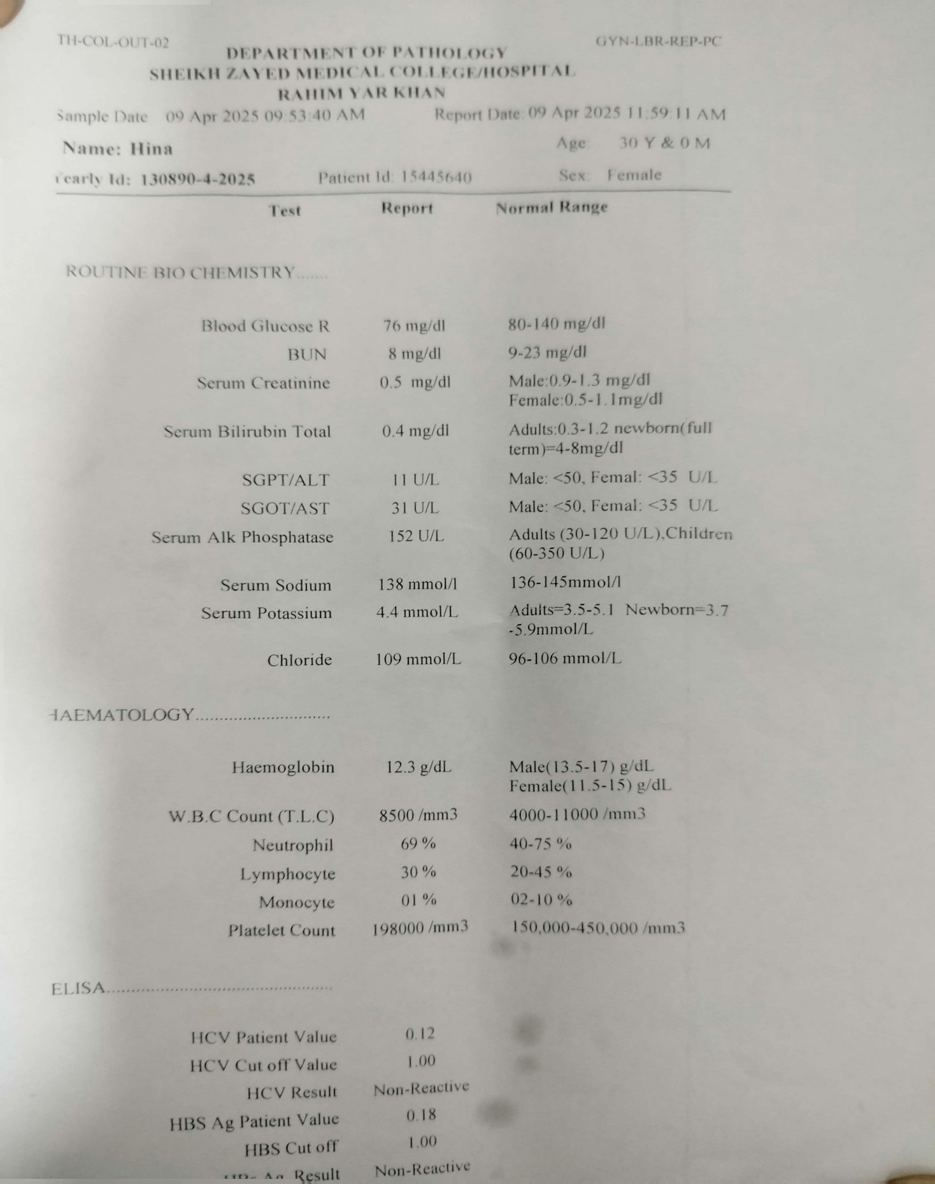
investigations

Slide 23
OBS Scan Done, Showing Single Alive Intrauterine Pregnancy With Abnormally Invasive Placenta Previa Increta. ( Grade -2 PAS )

Slide 24
MANAGEMENT

Slide 25
CASE SUMMARY
30 Years Old Ms Hina G₄P₂A₁ Prev.II C/S At 36+5 Weeks Of Gestation Came With Scan Showing Placenta Previa Accrete Spectrum(Grade 2) And Reduced Liquor With No C/O PV Bleeding Or Spotting
On Abd Exam.
SFH=36cm;LIE=l/C;P/P=5/5;p/C=nil;FHR=135-145/Min
Her Preop Hb Was 12.3g/DL

Slide 26
We planned and prepared the patient
for emergency cessarian hysterectomy to reduce intra operative hemorrhage
as placenta was previa increta

Slide 27
Case discussed with husband and family members regarding complications of surgery i.e
Operative hemorrhage
Need of massive blood transfusions,
Hysterectomty
Risk of bladder and bowel injury
ICU care
Informed consent to proceed.
2. Blood products availability made ensure by contacting with blood products personelle and hematologist.

Slide 28
Case discussed and preanesthesia done by senior anesthetist
MDT involvement by taking urologist,surgeon on board
Availability of bed in ICU made ensure.
Patient shifted to OT TABLE WITH FULL PREPARATION OF OBS HYSTERECTOMY (6 UNITS OF BLOOD AND 6 UNITS OF FFPS IN HAND AND 4 DONORS OF BLOOD STAND-BY)
Procedure started By SENIOR OBSTETRICIAN Keeping laise on with HEAD OF DEPARTMENT.

Slide 29
PROCEDURE & INTRA-OPERATIVE FINDINGS:
Abdomen opened by pfannenstiel incision
Intraoperatively, placenta was previa percreta grade 3-A
(There was bulge of placenta between lower segment of uterus and bladder). Bladder was badly adherent and separated by sharp dissection
Uterine incision given 3 to 4 cm above placental margin using non touching technique of placenta
And baby delivered.
Cord clamped and uterine incision closed .

Slide 30
CESARIAN HYSTERECTOMY proceeded with placenta in situ to reduce intra operative hemorrhage
Adjuvant med tranexamic acid and vit K
4 units of blood and 4 units of FFPS transfuse intra operatively
Estimated blood loss= 2 to 2.5 liters
Post-op condition of patient; she was maintaining her vitals without ionotropic support.
Bp 120/70mmHg, PR=94 bpm, RR=20/min.
Urine output 700 ml.
After keeping in observation for half hour,
Patient shifted to icu for critical care

Slide 31
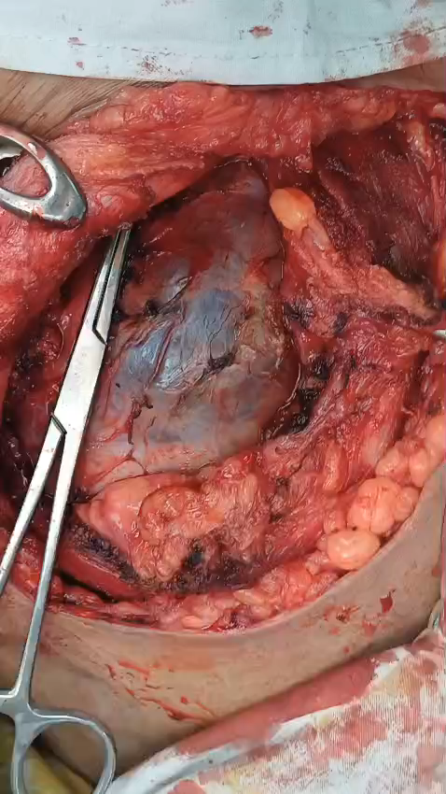

Slide 32
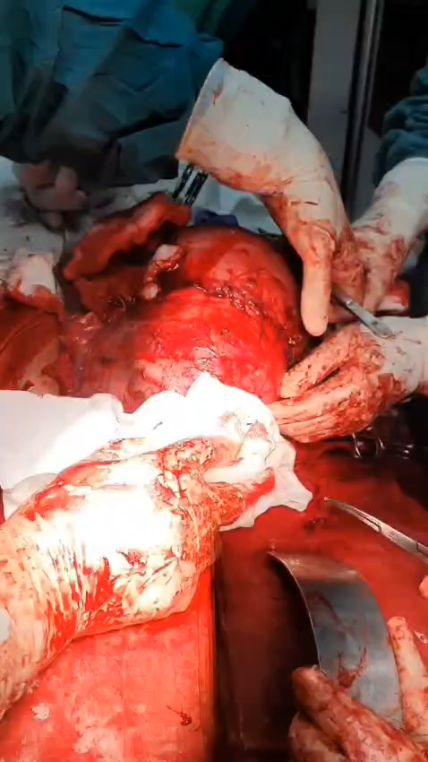

Slide 33
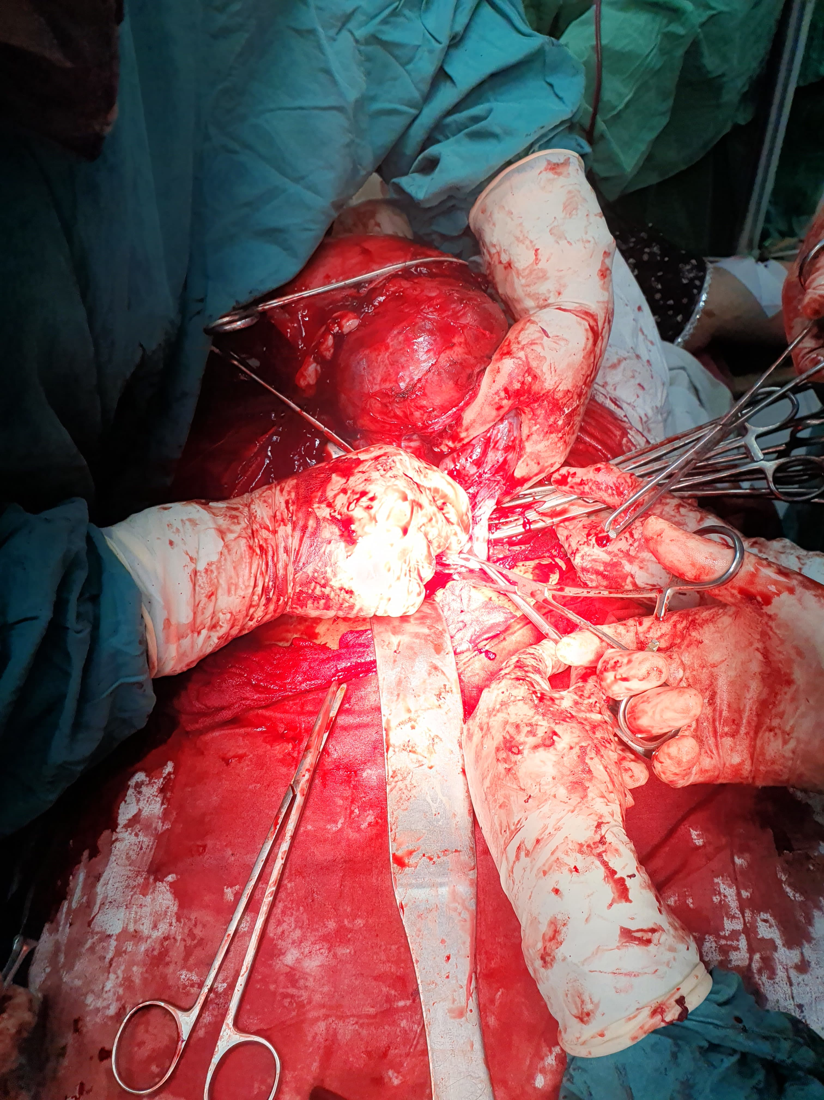

Slide 34
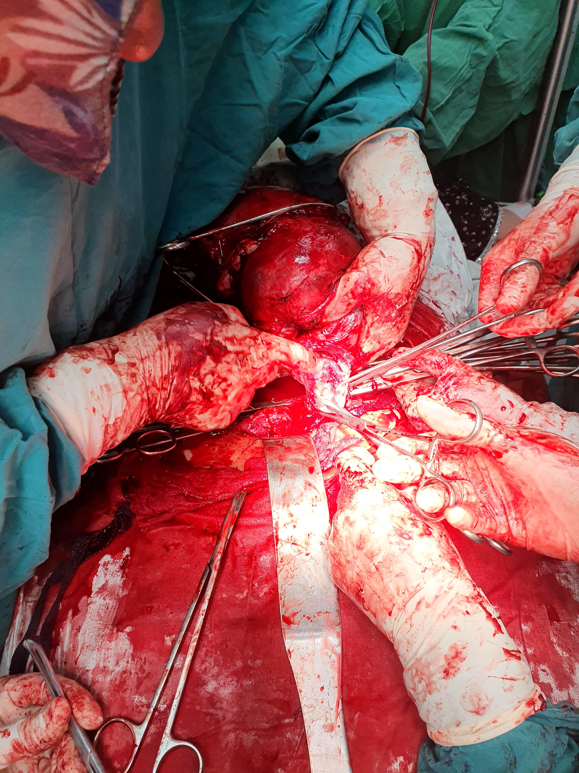

Slide 35
Next day, patient was extubated and as her condition was satisfactory so shifted to high dependency unit (HDU) in labor room.
Post operative labs done.
Patient remained in labor room for 2 days ,was conscious, well-oriented, maintaining saturation at room air and maintaining her vitals without ionotropic support, mobilized.
On exam; Abdomen was soft and non tender, stitch line healthy, bowel sounds audible.
PATIENT DISCHARGED.

Slide 36
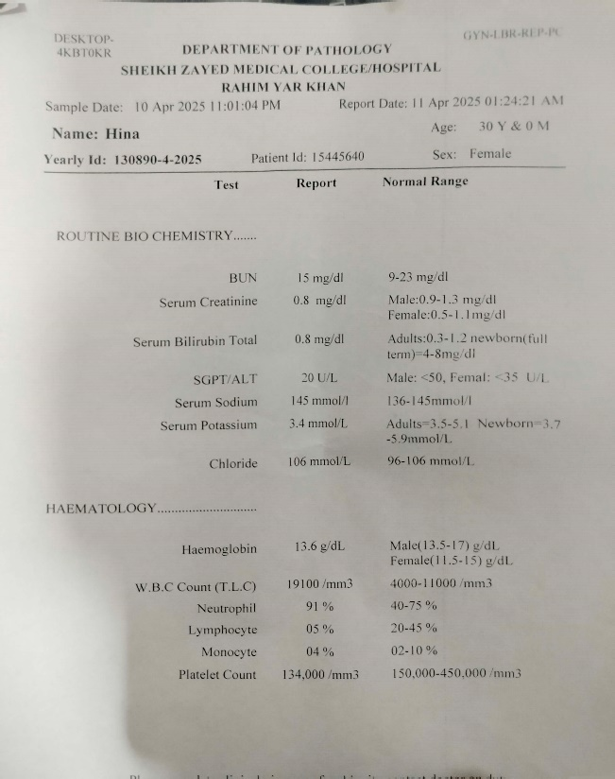
Post-op investigations

Slide 37


