Slide 1


Slide 2
CLINICAL CASES
ECTOPIC PREGNANCY
Presented by:
Dr Arsheea Maryam

Slide 3

CASE NO.1
  A 21 years old university student,G2P0A1,presents in OPD for consultation. Her LMP is 2 months back and had 1 episode of brownish vaginal spotting. Her vital signs are stable. Abdomen is soft and non tender.
  TVS: empty uterine cavity. Ectopic pregnancy mass of 22mm in right fallopian tube with no FCA. No free fluid in pelvis.
  β-hCG: 800 IU/L

Slide 4

CASE NO.1
  A 21 years old university student,G2P0A1,presents in OPD for consultation. Her LMP is 2 months back and had 1 episode of brownish vaginal spotting. Her vital signs are stable. Abdomen is soft and non tender.
  TVS: empty uterine cavity. Ectopic pregnancy mass of 22mm in right fallopian tube with no FCA. No free fluid in pelvis.
  β-hCG: 800 IU/L

Slide 5
CASE NO.2
  A 28 years old school teacher,G2P1,presents in OPD for consultation. Her LMP is 2 months back and had history of brownish vaginal spotting. Her vital signs are stable. Abdomen is soft and non tender.
  TVS: empty uterine cavity. Ectopic pregnancy mass of 25mm in right fallopian tube with no FCA. No free fluid in pelvis.
  β-hCG: 800 IU/L ,repeat level after 48 hr 1100 IU/L

Slide 6
CASE NO.2
  A 28 years old school teacher,G2P1,presents in OPD for consultation. Her LMP is 2 months back and had history of brownish vaginal spotting. Her vital signs are stable. Abdomen is soft and non tender.
  TVS: empty uterine cavity. Ectopic pregnancy mass of 25mm in right fallopian tube with no FCA. No free fluid in pelvis.
  β-hCG: 800 IU/L ,repeat level after 48 hr 1100 IU/L

Slide 7
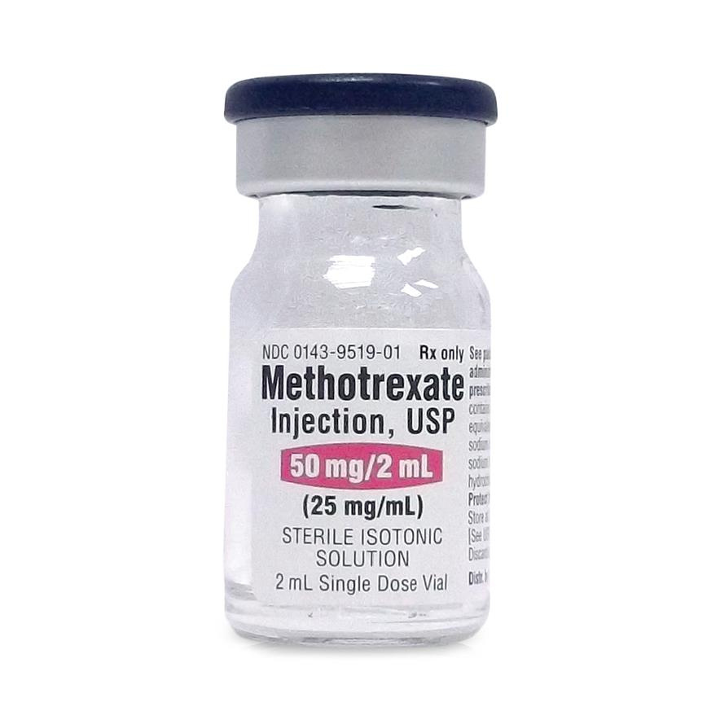

Slide 8
CASE NO.3
  A 28 years old female, P3 (prev 1 cs), presents in emergency with complains of mild vaginal bleeding, abdominal pain, vomiting and diarrhea for 1 day. Her menstrual cycle is 4 weeks late. She is uncomfortable, pulse 110bpm, BP 100/70 mmHg. Abdomen tender with guarding present. Pelvic examination tender, cervical os closed with mild brownish bleeding.
  TVS: Empty uterine cavity. Left sided tubal ectopic pregnancy, CRL =7 weeks with FCA+ve . Free fluid present in POD

Slide 9
CASE NO.3
  A 28 years old female, P3 (prev 1 cs), presents in emergency with complains of mild vaginal bleeding, abdominal pain, vomiting and diarrhea for 1 day. Her menstrual cycle is 4 weeks late. She is uncomfortable, pulse 110bpm, BP 100/70 mmHg. Abdomen tender with guarding present. Pelvic examination tender, cervical os closed with mild brownish bleeding.
  TVS: Empty uterine cavity. Left sided tubal ectopic pregnancy, CRL =7 weeks with FCA+ve . Free fluid present in POD

Slide 10


Slide 11
CASE NO.4
  A 20 years old female, G2P1 prev 1 caesarean, presents in LR at 5 months of gestation, with complains of severe abdominal pain for 1 day and syncopal attack 1 hour ago.
  On examination she is pale, looking anxious with cold peripheries. Pulse 130bpm, BP 80/60mmHg
  Abdomen distended, tense and tender. Abdominal tap confirmed hemoperitoneum
  USG: About 18 weeks size fetus with absent cardiac activity and massive free fluid in abdominal and pelvic cavity.

Slide 12
CASE NO.4
  A 20 years old female, G2P1 prev 1 caesarean, presents in LR at 5 months of gestation, with complains of severe abdominal pain for 1 day and syncopal attack 1 hour ago.
  On examination she is pale, looking anxious with cold peripheries. Pulse 130bpm, BP 80/60mmHg
  Abdomen distended, tense and tender. Abdominal tap confirmed hemoperitoneum
  USG: About 18 weeks size fetus with absent cardiac activity and massive free fluid in abdominal and pelvic cavity.

Slide 13


Slide 14
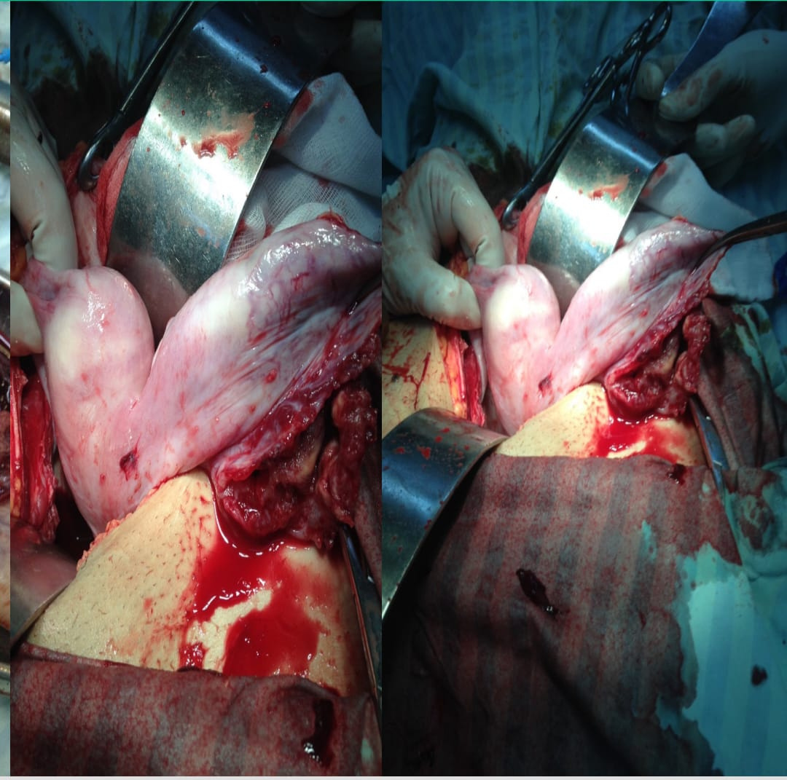
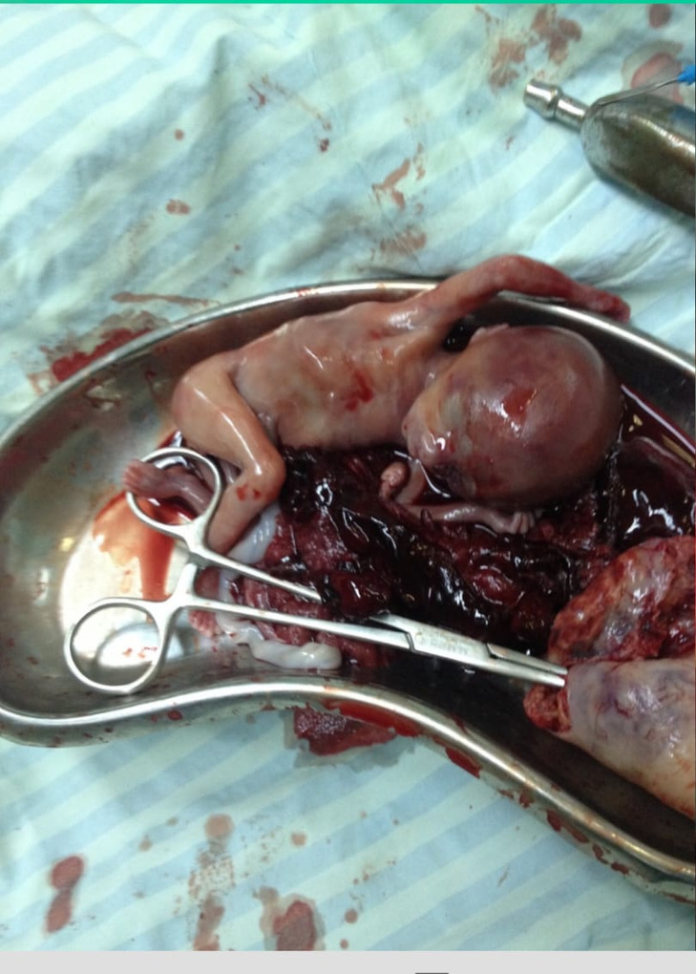

Slide 15


Slide 16

TAKE HOME MESSAGE
  Any female of reproductive age presenting with abdominal pain,
  syncope or shock is Pregnant, until proved otherwise.
  Every pregnancy is Ectopic Pregnancy until clearly demonstrated to
  be intrauterine.

Slide 17


