Slide 1
Radiological evidence of placenta accreta
SENSITIVE MODALITIES:
1- Sonography (Grey scale + Doppler )
2- MRI ( SSFSE SEQUENCE )

Slide 2
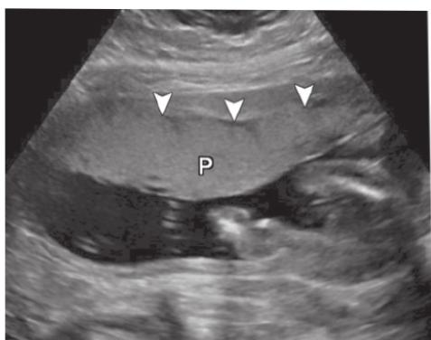
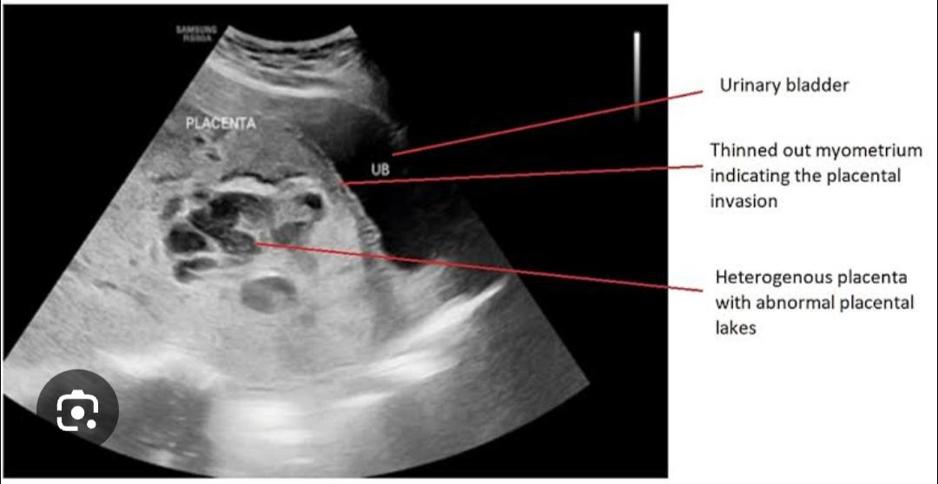
SonographIC evidence
Abnormalities
NORMAL

Slide 3
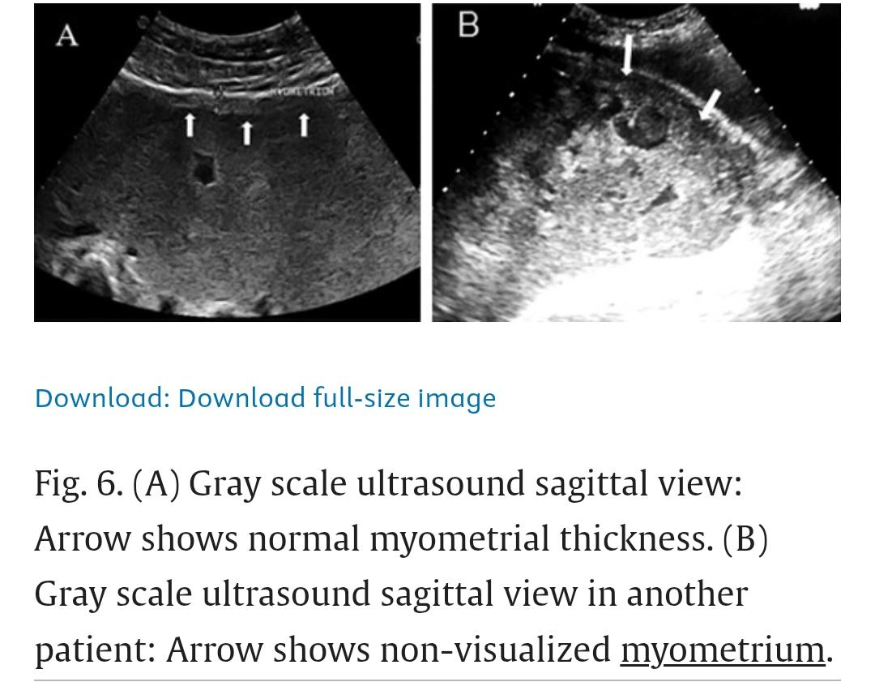
NORMAL VS ABNORMAL

Slide 4
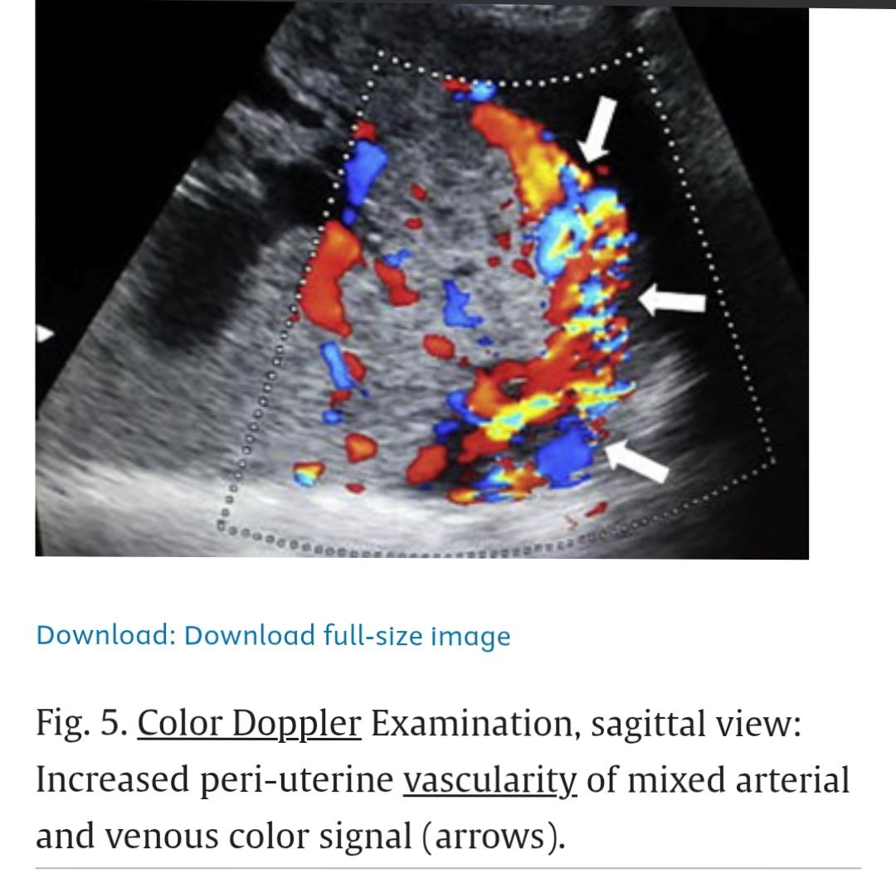
ON DOPPLER

Slide 5
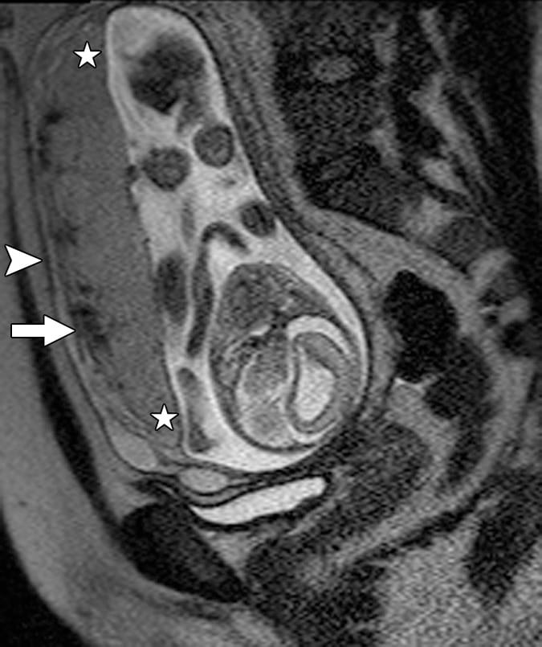
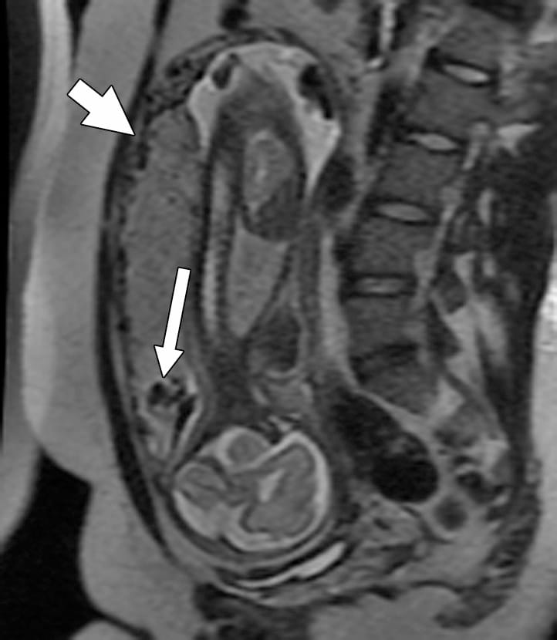
Imaging evidence on MRI
NORMAL VS ABNORMAL

Slide 6
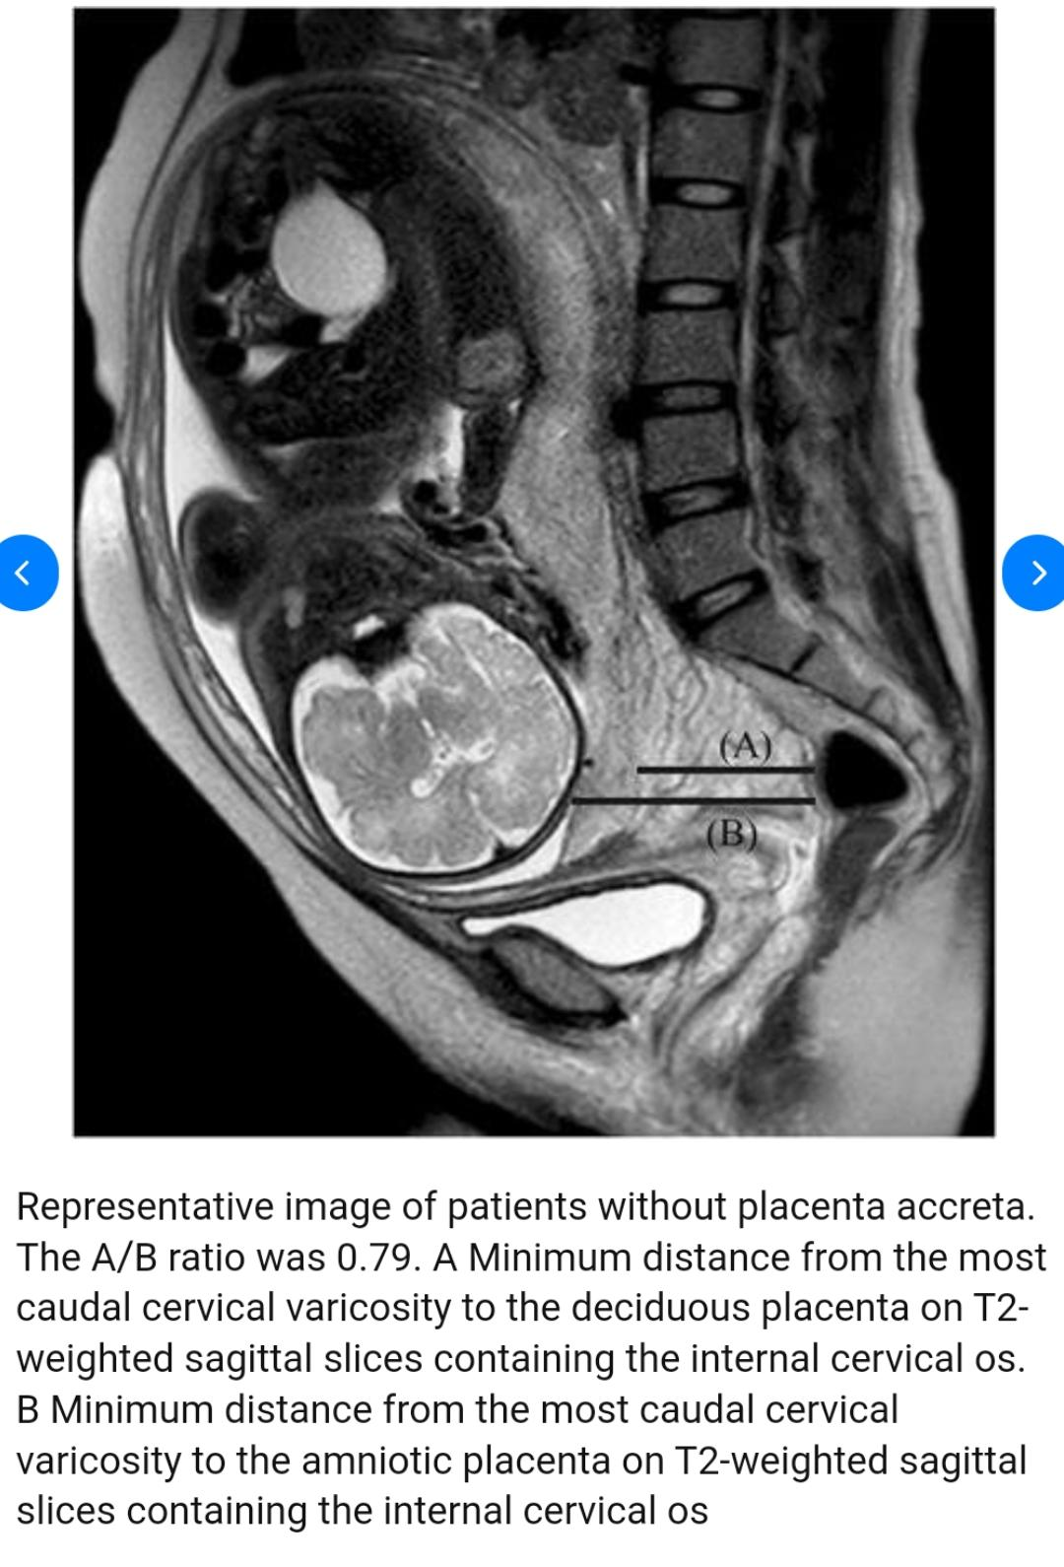
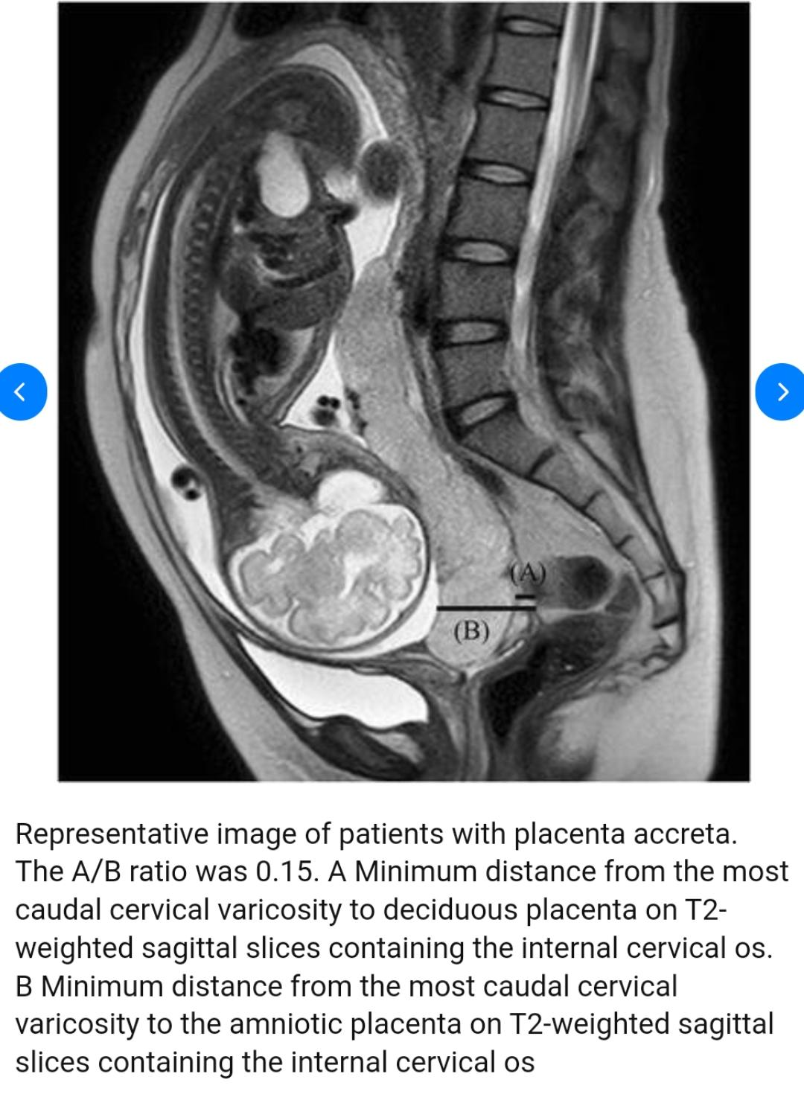
MRI is best for posterior and lateral walls placenta evaluation which is difficult on ultrasound.

