Slide 1


Slide 2
Transverse Myelitis
Dr. Ammara Jabbar
PGR, Medical Unit-I
Sheikh Zayed Medical College/Hospital
Rahim Yar Khan

Slide 3
OVERVIEW
Myelitis is a rare inflammatory condition of spinal cord characterised by pyramidal (motor), sensory, and/or autonomic dysfunction to varying degrees.
Deficits are not always bilateral and do not necessarily affect all long tracts within the cord.
The term “transverse” originally referred to the clinical finding of a band-like horizontal area of altered sensation usually at the dermatomal level of the lesion within the cord.
Affects any age, according to underlying cause.

Slide 4
CAUSES
Trauma
Infection
  Viral – coxsackie, Polio, EBV, Herpes Virus, HIV
  Bacterial – Pyogenic, tuberculosis, syphilitic,
  Others – parasitic, fungal, schistosomiasis,
Vascular – arteritis, anterior spinal artery occlusion
Nutritional myelopathy
Miscellaneous – post infectious, post vaccinal inflammation,sarcoidosis, Neuromyelitis optica
Collagen vascular disease – SLE, sjogren syndrome, MCTD
Idiopathic

Slide 5
What is the most common site of transverse myelitis?
Mid Thoracic Region

Slide 6
CLINICAL FEATURES
Isolated spinal cord dysfunction with no evidence of a compressive lesion:
Time course:
  Onset over hours to days
  Progression over days to weeks
Fever may be present and acute or subacute onset of paralysis or paraparesis

Slide 7
Continued….
Segmental spinal cord dysfunction, commonly thoracic
  Paresthesiae ascending from the feet with or without back pain at or near the level of the myelitis
  Weakness that preferentially affects the flexors of the legs and the extensors of the arms (pyramidal distribution of weakness)
  Sphincter dysfunction
  Autonomic dysfunction is common: bowel and bladder dysfunction, temperature dysregulation, or labile blood pressure
  Can have total motor and sensory loss below the level
Spinal shock (implies poor prognosis)

Slide 8
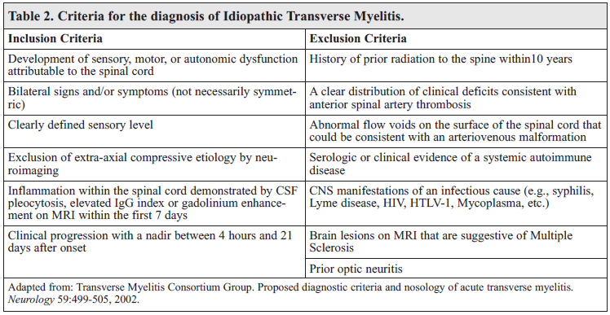
Diagnostic Criteria

Slide 9
MANAGEMENT
Resuscitation:
If level high may need intubation
Specific therapy:
Early neurologist and neurosurgical opinion
High dose steroids (standard of care, not based on RCTs)
  IV methylprednisolone
Consider plasmapheresis:
— Typical dosing is 1.5 plasma volumes in five treatments over 10 days
— Best when initiated within the first two weeks after the onset of symptoms (clinical improvement in up to 43% of patients up to 2 months)

Slide 10
Continued….
Case reports of:
— IV immunoglobulin
— Cyclophosphamide
— Rituximab
— Azathioprine
Supportive care and monitoring:
Reassurance and psychological support
Care of bowel (Manual evacuation may be needed)
Care of bladder (Catheterization)
Care of skin (to prevent bed sores)
Passive physiotherapy
Spasticity may be helped by baclofen, diazepam, tizanidine
Re-habilitation

Slide 11
PROGNOSIS
Overall Prognosis:
one-third of patients recover with little to no lasting effects
one-third retain a moderate degree of residual disability
one third remain severely disabled

Slide 12
Continued….
Poor prognostic indicators:
Rapid progression of symptoms
Back pain
Spinal shock
Absent central conduction on somatosensory evoked potential testing
Associated with recovery:
Early plasmapheresis
Progression and risk of relapse also depends on the underlying cause

Slide 13
THANK YOU

