Slide 1
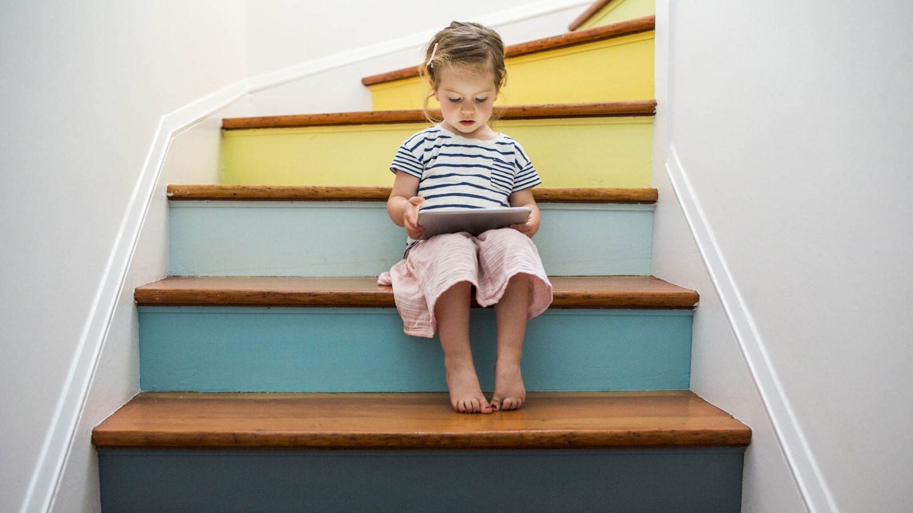
Clinicopathological Conference
Paediatrics Unit 1

Slide 2

HISTORY

Slide 3
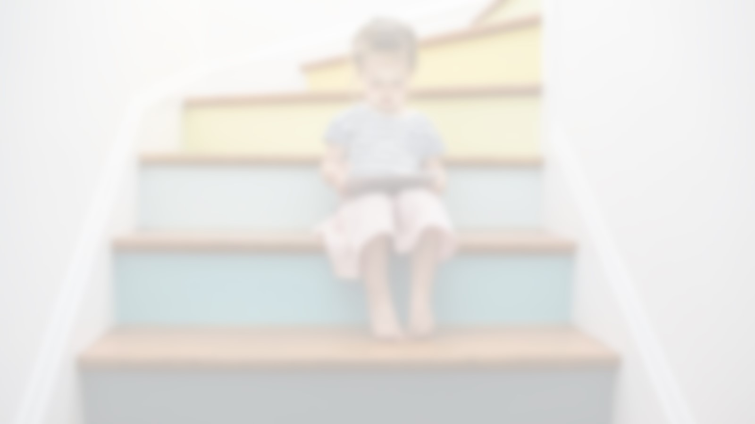
Biodata
Patient: Asia Bibi D/O Ghulam Rasool
Age; 12 year
Sex: female
Residence: Daharki , District Ghotki province Sindh)
Admission Date: 13-04-2025 via Emergency
Admit in Pediatrics Ward Unit 1

Slide 4
Chief Complaint
Fever for 4 days
Lockjaw and generalized body spasms for 3 days.

Slide 5
History of presenting illness
A 12-year-old previously healthy girl developed fever for 4 days which was gradual in onset , high-grade, non-documented ,not associated with rigors, chills, headache, or seizures ,ear discharge but associated with lock jaw and generalized body spasm
There is history of thorne prick injury while playing followed by wound manipulation with an unsterile needle.

Slide 6
Systemic Inquiry
CNS: No history of headache, vertigo, blurring of vision, weakness of any side of body and fits.
CVS: No history of palpitations, orthopnea, paroxysmal nocturnal dyspnea
Respiratory System: No history of cough, flu, dyspnea, chest pain, wheeze
GIT: No history of nausea, vomiting, diarrhea, constipation
Urinary System: No history of burning micturition, oliguria, anuria.

Slide 7
Treatment History
Initially treated by a local physician with IV medications but no record available (no response was noticed)
Parents brought her to pediatrics emergency of Sheikh Zayed Hospital where she was admitted and shifted to PICU
Treatment was given in form of supportive care, active and passive immunization and medicine to control the spasm.
Clinical improvement reported by mother after IV/oral medications at SZH

Slide 8
Past History
No significant past medical history of DM,HTN, asthma , TB, or chronic illnesses.
No significant past surgical history

Slide 9
Birth History
Pre-natal: There was no history of any illness, infection, drug intake, trauma & radiation exposure to mother.
Natal: She was delivered at term, through SVD conducted by a dai at home, her condition was healthy & no resuscitation measures were taken.
Post-natal (first week): She was feed breastmilk with in 1 hours of birth, there was no history of fever, jaundice, lethargy, fits, respiratory distress, blue discoloration, vomiting, diarrhea & hospital admission during 1st week.

Slide 10
Feeding History
Breastfeeding: started with in 1 hour after birth, 5 - 6 times/ day, 5 – 6 mins/ feed, for 2 years
Artificial feeding: No history.
Weaning: It started at 6 month of age biscuits and home made semisolid food and given 2-3 times/day
Current diet: Roti and salan and no feeding in illness due to lock jaw

Slide 11
Immunization History
Unvaccinated did not follow EPI schedule for vaccination.(no tetanus toxoid or other vaccines).

Slide 12
Developmental History
Normal
Social Smile: 1 month
Neck holding: 3 months
Sitting with support: 6 months
Hold objects in hands: 6 months
Crawling:10 months
Standing: 1 year
Walking: 15 months
Talking single words: 12 months
Dry by day: 2 years
Dry by night: 3 years

Slide 13
Family History
Both mother and father are 30Y old
Parental cousin marriage.
2 brothers aged 5 and 3 years
No history of disease in other family children

Slide 14
Social History
Parents have not received any formal education
Father is a laborer and mother is a housewife by profession.
Monthly income is 20000 PKR
Non-cemented house and poor sanitary conditions

Slide 15
Environmental History
Poor environmental conditions
Tap water usage

Slide 16
Personal History
Child is active
School performance is average

Slide 17
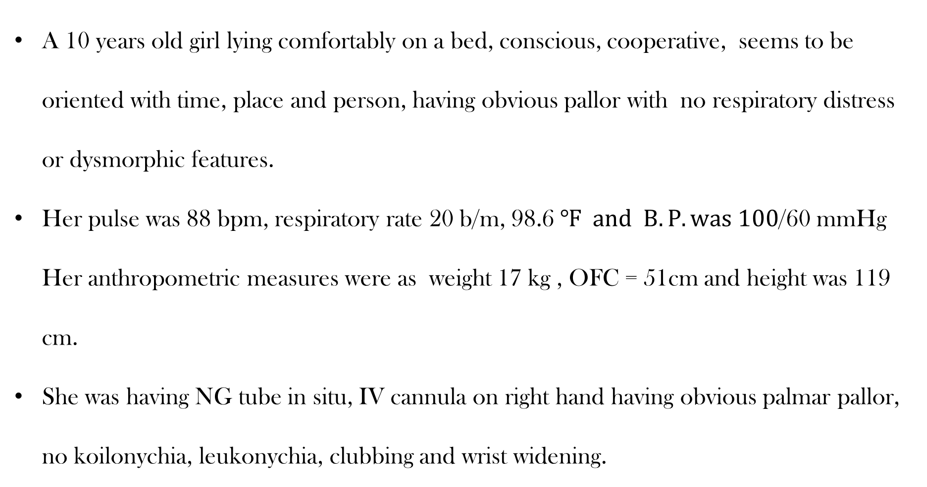
General Physical Examination
A 10 years old girl lying comfortably on a bed, conscious, cooperative, seems to be oriented with time, place and person, having obvious pallor with no respiratory distress or dysmorphic features.
Her pulse was 88 bpm, respiratory rate 20 b/m, 98.6 $℉ and B.P. was 100$/60 mmHg Her anthropometric measures were as weight 17 kg , OFC = 51cm and height was 119 cm.
She was having NG tube in situ, IV cannula on right hand having obvious palmar pallor, no koilonychia, leukonychia, clubbing and wrist widening.

Slide 18
General Physical Examination
No signs of cyanosis, jaundice and edema.
Lymph nodes were not palpable.
BCG scar was not present.
Oro-dental hygiene was good. No ear discharge, no nasal deformity and discharge.
Thyroid was not enlarged.

Slide 19
Systemic Examination
CVS: JVP was not raised , no pedal edema .
Apex beat was felt in 5th intercostal space and was of normal character.
No palpable heave or thrill.
S1 and S2 with no added heart sounds and murmur
Respiratory system: Chest was of normal shape with normal and equal movements on both sides.
Trachea was central, no tenderness and crepitation's and no vocal fremitus. Percussion notes were resonant and equal with normal vesicular breathing on auscultation.

Slide 20
Systemic Examination
CNS: GCS was 15/15.
No SOMI and blurred vision
Cerebellar examination was normal.
Sensory system: All sensory modalities are intact.
Motor System: Power was 5/5. Tone was normal. Tendon jerks and plantar reflexes were intact. Gait and coordination was normal.

Slide 21
Systemic Examination
GIT: Abdomen shape and contour was normal.
Umbilicus was central, hernial orifices were intact and no palpable lymph nodes.
No abdominal tenderness, rigidity, liver and spleen were not enlarged, both kidneys and urinary bladder was palpable.
No fluid thrill and shifting dullness.
Bowel sounds were audible.

Slide 22
INVESTIGATIONS

Slide 23
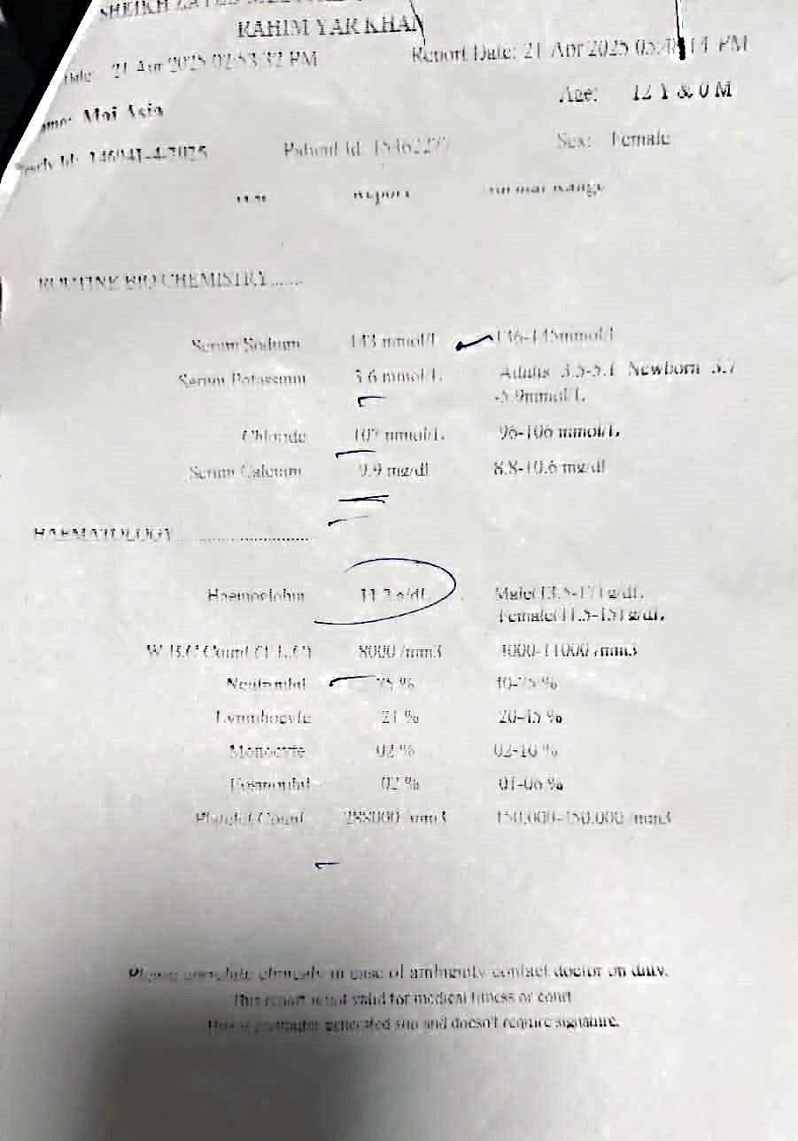
On her CBC, Hb was mildly reduced.

Slide 24
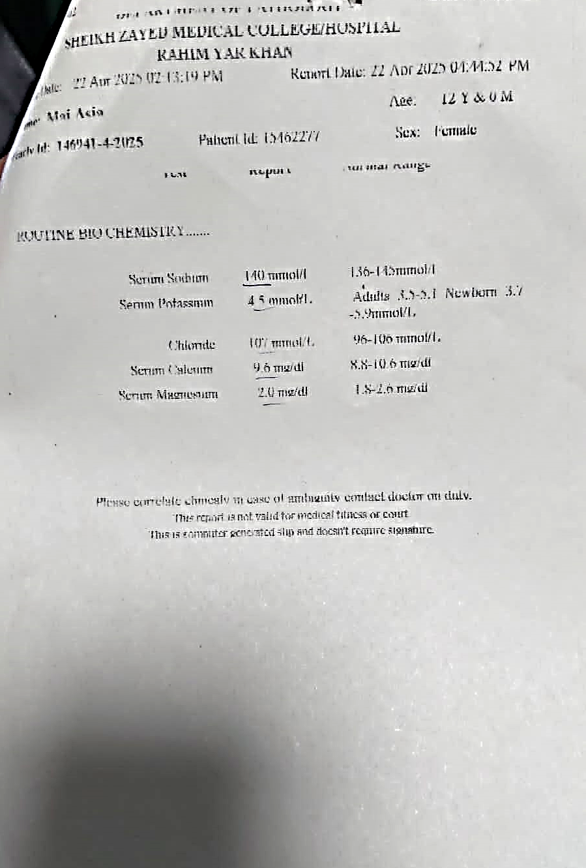
Serum electrolytes were normal.

Slide 25

MANAGEMENT

Slide 26
Supportive treatment
Maintained a calm and quiet environment, with dim lighting and reduced noise
Enteral feeding with a nasogastric tube used
All remaining thorns were removed and wounds carefully cleaned and debrided to prevent further toxin production
Monitoring of vital signs, neurological status and respiratory function done to detect and manage any complications
Diazepam and phenobarbitone given to control muscle spasm

Slide 27
Treatment
Inj. Tetanus toxoid was given.
Tetagan (tet. Immunoglobulin) 6 ampule intramuscularly on each thigh
Benzyl penicillin
Metronidazole

Slide 28
Daily Progress
Day 1 : Spasm did not controlled sedation increased
Day 2: spasm start on stimulus sedation increased
Day3: patient sedate and spasm controlled.NG feed started
Day4: continue same dose of sedation for further 3 days and ng feed increase gradually
Day7:sedation decrease

Slide 29
Summary
A 12 year old unvaccinated girl presented via emergency with fever, lock jaw and generalized body spasm 3 days back. She gave history of thorn prick and then manipulation of wound by unsterile needle.
On examination there was lock jaw ,hypertonia and generalized body spasm in response to noise ,light and touch .She was diagnosed as a case of generalized tetanus.

Slide 30
Thank you

