Slide 1
CLINICOPATHOLOGICAL
CONFERENCE
PAEDS UNIT 2
LAIBA AKHTAR 506
RANA HAMZA TAYYAB
MUHAMMAD Hammad Naseer

Slide 2
BIODATA
Name: Ansa Saddam
Father’s name: saddam hussain
age: 6 years
Resident of : Basti Kohar khan
Mode of admission: Emergency
Date of admission: 09-08-25

Slide 3
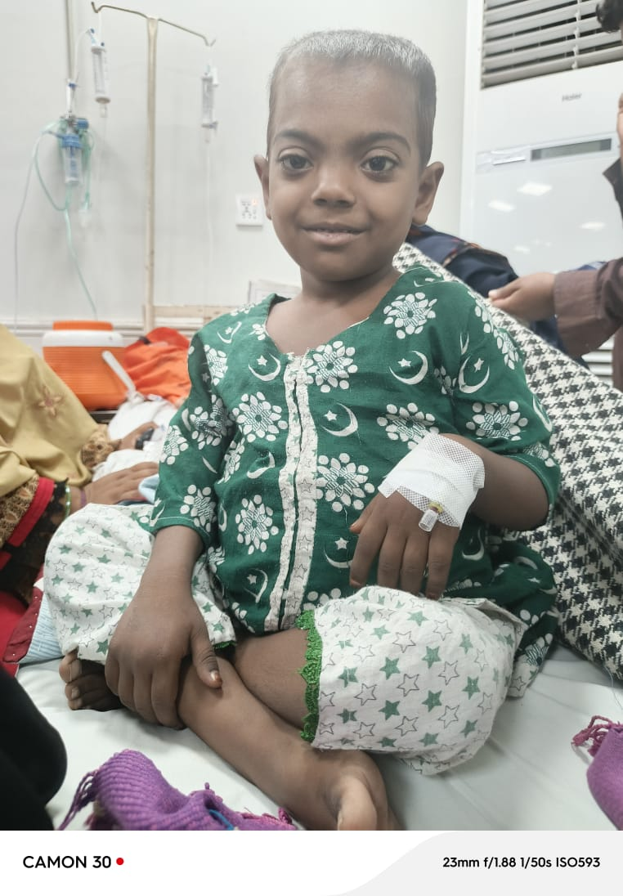
Presenting Complaints
fever ----3days
abdominal pain---2 days

Slide 4
History of Presenting Illness
Patient is a known case of thalessemia.She presented to ER with complaint of fever and abdominal pain. fever was sudden in onset,continuous,high grade,non-documented, no diurnal variation,releived by medication and cold sponges,aggravated after blood transfusion, associated with rigors and chills,increased thirst,headache,body pains(back and leg pains) and burning micturition. Fever is not associated with neck stiffness,fits,ear discharge,SOB, diarrhea or vomiting.
Abdominal pain was sudden in onset,severe,localized to left flank and continuous. Patient could not lie on her left side. Pain is releived by medications,not associated with food intake,vomiting,diarrhea or constipation

Slide 5
Treatment history
no local treatment for present illness
antipyretics given at home that temporarily relieved fever
admitted to SZH,IV medications are given
CBC,RFTs,Urine biochemistry, USG abdomen is done
Fever and pain severity and duration is decreased. Child is no more irritable

Slide 6
Systemic Inquiry
CNS : headache is present. No vertigo, dizziness, ALOC, fits
Genitourinary : Burning micturition, dysuria, dark colored urine present with hematuria
Musculoskeletal : Leg and back pain present, no joint pain or swelling
CVS : Palpitations present, no SOB,chest pain
Respiratory : no Cough,sputum or SOB

Slide 7
Past history
First Visit
Patient is a known case of beta-Thalessemia major since the age of 9 months diagnosed by doctors of SZH on the basis of CBC, peripheral smear and Hb electrophoresis, when she presented with the complaints of SOB, jaundice, fever, diarrhea. Her blood group is A+ and she is registered case in Thalessemia centre of SZH. Her Hb was 5.6 on her first visit,she got admitted for 1 day and 3pints of packed RBCs each of quantity of 70ml were transfused.
Course of disease
Quantity and frequency of transfusion increased over time
100ml of packed RBCs once every month since age of 1year
150 ml of packed RBCs once every 20th day since age of 3 year
250-300ml od packed RBCs once every week since age of 5 year
duration of each transfusion was 2-3hours.

Slide 8
Past history
patient is advised to get transfusion when Hb falls below 7.
blood is screened and cross-matched before each transfusion.
blood is mostly arranged by thalessemia centre and sometimes their own donor. Good compliance for transfusions.
adverse effect after transfusion was noted in the form of fever which was treated by antipyretics
Recent Transfusion
is done on 09-08-25 which was 250ml.duration of transfusion 2h.pre-transfusion Hb was 5.5,post-transfusion Hb is 6.8. She’s given 200ml in 4h duration,post-transfusion CBC and urine analysis reports are awaited.
Patient is a known case of Hep C since Dec,2024.diagnosed by viral marker and PCR.No treatment for Hepatitis is started yet.

Slide 9
Drug History
Calcium and folic acid supplements since her diagnosis
Oral iron chelation therapy started since the age of 3 years
Deferasirox 500mg OD
Antipyretics for fever ( brufen syp)
patient has poor compliance to drugs.

Slide 10
Birth History
Antenatal : no history of infection,drugs intake or radiation exposure. Mother was hypertensive but didn’t use any medication for it.
Natal : delievery was at term in hospital. Mode of delievery C-section
child was healthy, normal cry at birth
Postnatal : child was given formula milk 2h after birth,breastfeed started at 3rd day. No illness or hospital admission in first week

Slide 11
Vaccination
Only BCG was done
Developmental Milestones
all the developmental milestones were acheived in expected duration. no developmental delay

Slide 12
Nutrition History
Breastfeed for 2.5 years, supplemented by formulamilk and cowmilk
weaning strated at age of 8-9 months (chori,fruits)
Current diet : 1roti/day OR 1plate rice/day
no counselling regarding prevention of iron rich diet. she eats banana,apple and plum in fruits and only chicken in meat (no beef or mutton)
Calorie intake (1000 kcal/day)

Slide 13
Family History
age of parents Mother 35 years, Father 35 years
no consanginous marriage
1 elder sister age 10 year. No history of abortion or child death in family
2 thalessemia cases of mother’s cousins (maternal uncle’s sons). No case of thalessemia in first degree relatives of child.

Slide 14
Socioeconomic history
parents are not formally educated
Own cemented house,well aerated,1 bathroom,satisfactory sanitary condition, 4persons in 1 room
use tap water for drinking
mother and grandmother do stitching. Monthly income+ financial support from a donor --25k
patient’s family is bearing the disease burden by themselves with the help of one donor and thalessemia centre and it has significant impact on patient’s family.

Slide 15
Personal History
child is playful,doesn’t go to school,.
patient’s family is counselled about splenectomy. splenectomy is planned after vaccination.
they are not counselled about recent therapeutic advancements such as gene therapy or bone marrow transplant
Disease has significant impact on daily life and activities of the child and parents are very concerned about disease outcome and long term management and prognosis.

Slide 16
.
          EXAMINATION

Slide 17
.
I have examined a 6 years old girl concious seems to be oriented with time, place and person with IV line on right hand with obvious hemolytic facies .
Her vitals are HR 140 BPM , RR 30 / min, BP 110/80 mmHg , temperature 100.2 F. Her anthropometic measures are weight 14 kg, Height 102cm

Slide 18
General Physical Examination
Her skin is hyperpigmented with hemolytic facies in form of frontal bossing, malar prominance, depressed nasal bridge and maxillary hypertrophy. Oral hygiene is satisfactory . Her ear examination is normal. BCG scar mark is present . She has pallor but there is no jaundice , no clubbing , no cynosis. No lymphadenopathy and no thyroid enlargement . No petechiae , no bruises and no pedal oedma .

Slide 19
SYSTEMIC EXAMINATION
Abdomen ;
is distended , non-tender with centrally placed inverted umblicus with no visible veins, no striae and no scar marks. Liver ia palpable 5 cm below right costal magin , upper border is palpable in 6th ICS with span of 12 cm. Liver is firm with regulae margins, smooth borders, non-pulstile , non-tender and left lobe is palpable.
Spleen is palpable 12 cm below left costal margin, firm in consistancy with regular margins, smooth borders and non-tender. No evidance of free fluid in abdomen . Bowl sounds are audible . Examination of back is normal .

Slide 20
Continued
Genitalia are prepubertal.
CVS ;
No visible precordial bulge or abnormal pulsations
Apex beat is in 5th ICS, mid clavicular line, normal character , no thrill.
S1 and S2 are audible with no added sound

Slide 21
Continued
RESPIRATORY SYSTEM
Symetrical chest movement, no retractions.
Trachea central, equal chest expansion .
Resonant note bilaterally. Vesicular breath sounds with no added sounds .
CNS ;
Cranial nerves intact, Tone normal in all four limbs

Slide 22
Continued
power 5/5 , deep tendon reflexes present and symetrical . sensory system grossly intact . NO SOMI.

Slide 23
Continued
SUMMARY
Ansa Saleem a 6 years old female with marked palor , frontal bossing , mxillary hypertrophy , hepatomegaly and massive spleenomegaly. An IV cannula is in place in right hand with no local complications. Respiratory , cardiovascular and neurological systems are within normal limits.

Slide 24
.
INVESTIGATIONS

Slide 25
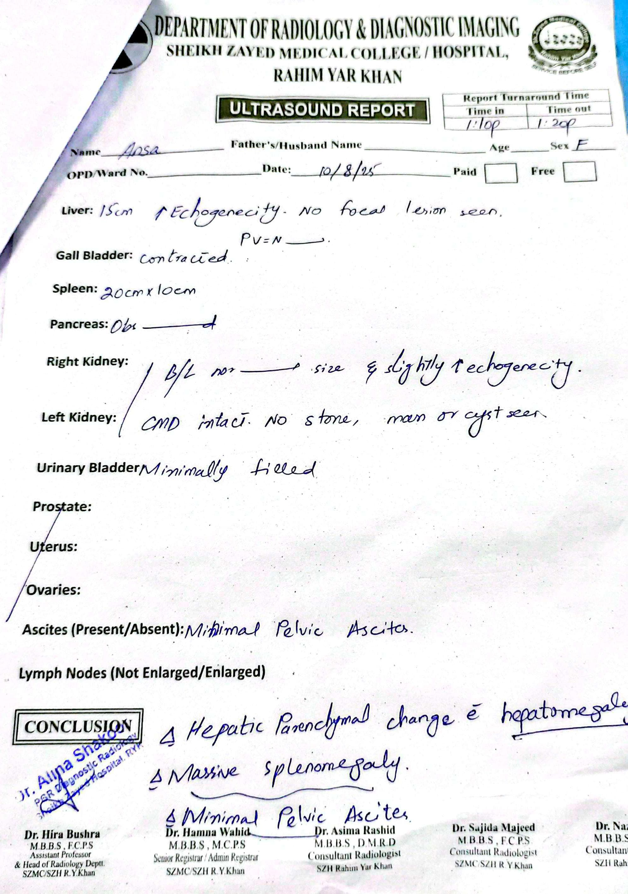
ULTRASOUND REPORT:
HEPATOMEGALY
SPLEENOMEGALY
Minimal Pelvic Ascites

Slide 26
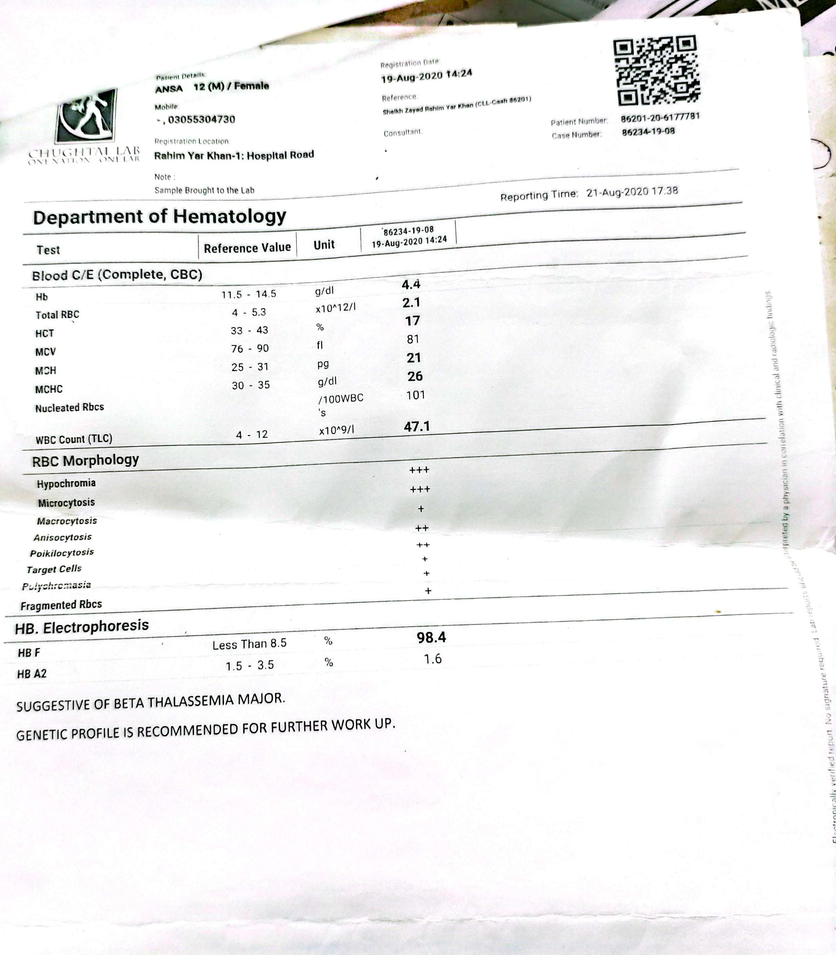
CBC :
Hb 4.4 g/dl (dec)
Total RBCs 2.1 × 10’12/l(4-5.3 × 10’12/l)
MCH ⬇︎
MCHC ⬇︎
WBCs ⬆︎
RBC MORPHOLPGY:
Target cells
Hypochromia
Anisocyotosis
Poikilocytosis
Microcytosis
Macrocytosis
HB ELECTEOPHEROSIS
HBF 98.4 %
HB A2 1.6%

Slide 27
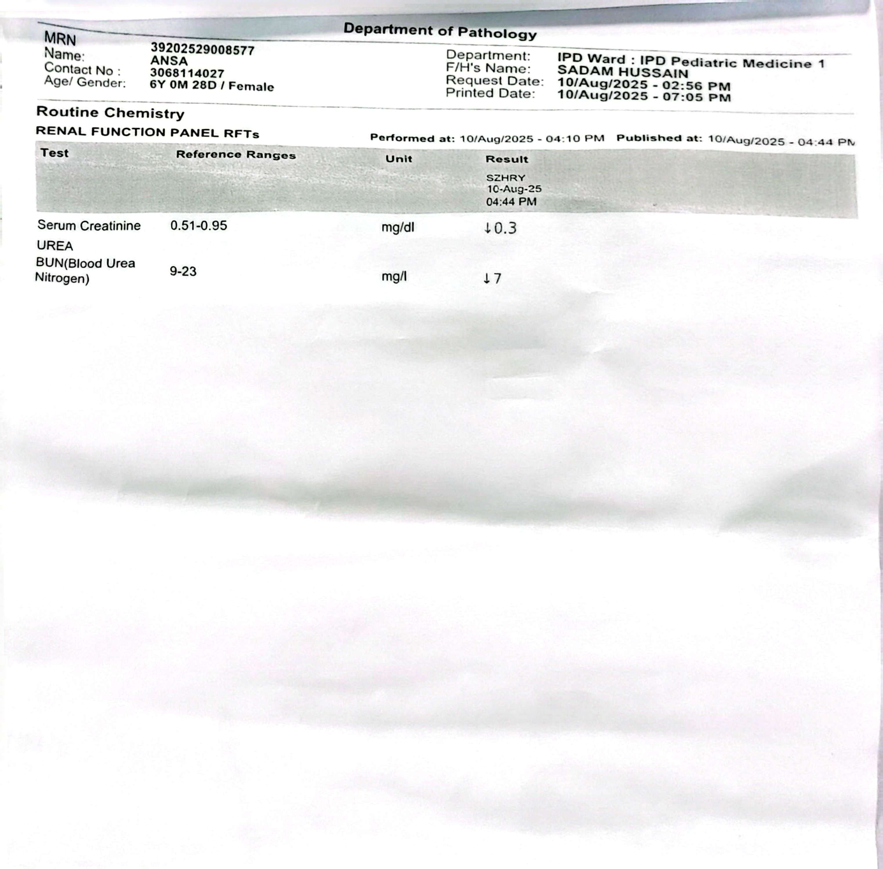
RFTS
Serum Cr 0.3 mg/dl ⬇︎ (0.5_0.95 mg/dl)
BUN 7 mg/dl ⬇︎(9_23 mg/dl)

Slide 28
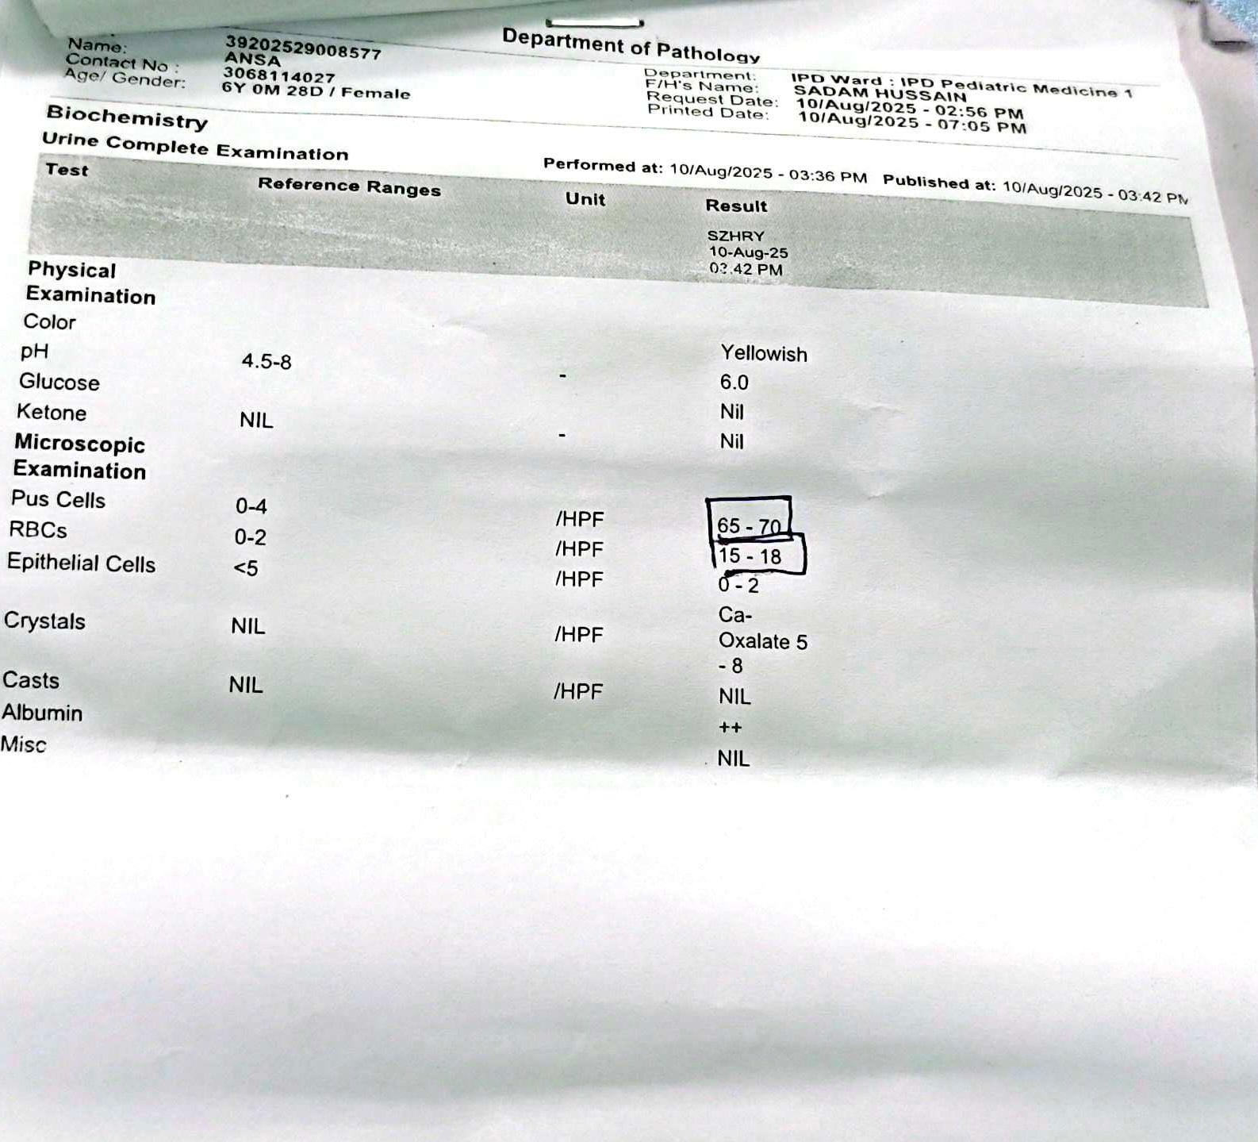
URINE Microscopic examination:
Presence of :
Pus cells
RBCs

Slide 29


