Slide 1
Clinicopathological
Conference
Peads Unit 1
Hibba tul Munir 566
Urooj Tariq 557
Rana Hamza Tayyab 630

Slide 2
HISTORY

Slide 3
BIODATA
Mahjabeen
D/O Gull Baig
2 years old girl
Informant mother
Resident of Dera Bhugti
Presented via emergency
On 28 July 2025

Slide 4
PRESENTING COMPLAIN
Bluish Discoloration of skin and mucous membrane for 1 day
Respiratory Distress for 1 day

Slide 5
HISTORY OF PRESENT ILLNESS
My patient is a diagnosed case of Tetralogy of Fallot since 1 year of age.
According to her mother she was in USOH 1 day back, when child was playing at home and she noticed suddenly increased bluish discoloration of lips, nails which then progressed to other body parts followed by respiratory distress and irritability.
.

Slide 6
Continued....
Respiratory distress was sudden in onset, having severity of grade II aggravated by mild physical activity like playing and crying partially relieved by knee chest position not associated with cough or fits.
It was followed by an episode of altered level of consciousness for which patient was brought in emergency of SZH and admitted there for further management

Slide 7
SYSTEMIC INQUIRY
CNS: History of Altered level of conciousness, no hx of fits, dizziness, headache, weakness of any body part
CVS: History of cyanosis, no hx of chest pain
Respiratory: History of respiratory distress, no hx of cough, wheeze or sneezing
GIT: No hx of diarhea, vomiting, constipation or abdominal pain
Genitourinary: No hx of burning micturation, anuria, oliguria

Slide 8
TREATMENT HISTORY
PAST TREATMENT :
Patient was treated initially from different private hospitals. Her condition improved temporarily. She has been admitted to SZH once before as well with same complaint
PRESENT TREATMENT :
Parents bring the child in paeds emergency of SZH where she was admitted, IV line passed, oxygen inhalation started, shifted to PICU.
Clinical improvement was noticed after medication.

Slide 9
PAST HISTORY:
My pt was diagnosed with TOF at 1 year of age via echocardiography. She has had intermittent cyanotic spells in the past usually during crying and exertion for which she was hospitalized multiple times.
Not any significant past surgical history.

Slide 10
BIRTH HISTORY:
Prenatal:
No Hx of any illness, infection, drug intake, trauma, and radiation exposure to mother.
Natal:
She was delivered at term thru SVD conducted by Dai at home. Her condition was healthy and no resuscitative measures were taken.
Postnatal:
She was feed artificial milk within 1hr of birth. There was no hx of any neonatal illness and hospital admission during 1st week.

Slide 11
FEEDING HISTORY:
Breastfeeding: Not breastfeed at all
Artificial Feeding: Given formula milk, diluted with 2 parts of water 6-7 times a day.
Total calorie intake per day: 160.8kcal/day
Weaning: Started at 6 month of age (Banana, Biscuit, Home made semisolid food was given 2-3 times per day).
Current Diet: Formula milk, Roti, Salan.

Slide 12
IMMUNIZATION HISTORY:
Unvaccinated didn’t follow EPI schedule for vaccination.

Slide 13
DEVELOPMENTAL HISTORY:
Development type:
Age:
Gross Motor
Fine motor and vision
Hearing and speech
Social behavior
10 months
10 months
12 months
9 months

Slide 14
FAMILY HISTORY:
Age of mother is 22 years
Age of father is 25 years
No parental consanguinity
2 brothers
No hx of abortion
No history of disease in other family members

Slide 15
SOCIAL HISTORY:
Parents have not received any formal education.
Father is labourer by occupation and mother is housewife.
Monthly income almost 20000
Low socioeconomic status
Non cemented house,having 2 rooms and poor sanitary condition

Slide 16
ENVIRONMENTAL HISTORY:
Poor environmental condition
Tap water usage

Slide 17
PERSONAL HISTORY:
Behaviour of child is irritable
Having no specific habits and interests

Slide 18
EXAMINATION

Slide 19
GENERAL PHYSICAL EXAMINATION
A 2yr old girl weighing 8 kg who is conscious,irritable,with IV cannula on left foot having obvious cyanosis and clubbing with no respiratory distress or dysmorphic features.
Having pulse rate 103bpm,respiratory rate 32 b/m,Temp.98F,BP 90/60 mm Hg.
Her anthropometric measures were OFC 46cm, MUAC 11cm,Length 80cm.
No signs of dehydration,pallor,jaundice and pedal edema.

Slide 20
Continued...
lymph nodes were not palpable.
Kilonychia,Leukonychia were not present.
BCG scar was not present.
No ear discharge,nasal deformity and discharge.
Thyroid was not enlarged

Slide 21
SYSTEMIC EXAMINATION
CVS:
Precordium was of normal shape
Prominent pulsations were present in precordium along lower sternal border.
Bulging and scar mark was not present.
Apex beat was in left 5th ICS lateral to mid clavicular line
Parasternl heave was present
soft second heart sound
Ejection systolic murmur at left upper sternal border,having grade of 4/6, loud in intensity with no radiation.

Slide 22
Respiratory System:
Chest was of normal shape with normal and equal movements on both sides.
Trachea was central.
No tenderness and crepitations.
Percussion note was resonant and equal with normal vesicular breathing

Slide 23
CNS:
GCS was 15/15.
No SOMI.
Visual focusing and following and light reflex are normal.
Facial movements and response to sound are normal.
SENSORY:
All sensory modalities are intact.
MOTOR SYSTEM:
Power was 5/5,Tone was normal,Tendon jerks and plantar reflexes were intact.

Slide 24
GIT
Abdomen shape and contour was normal.
Umblicus was central,hernial orifices were intact and no palpable lymph nodes.
No abdominal tenderness,rigidity.
No visceromegaly.
No fluid thrill and shifting dullness.
Bowel sounds were audible.

Slide 25
CASE SUMMARY:
A 2 year old girl weighing 8kg known case of Tetralogy of Fallot now presented to emergency with acute cyanotic spell, respiratory distress and altered level of conciousness.O/E the child was cyanotic with obvious clubbing. In precordium, loud ejection systolic murmur having grade4/6 present in left upper parasternal area.

Slide 26
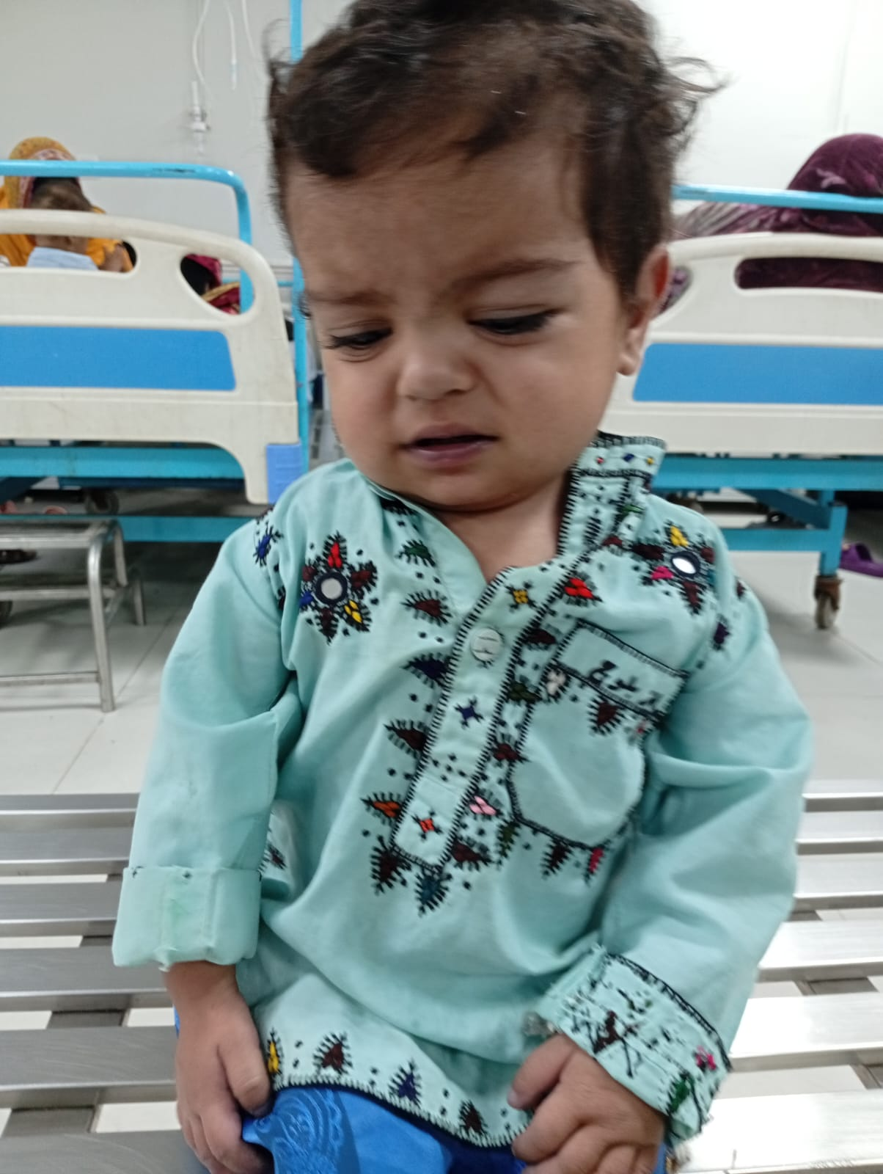

Slide 27
DIFFERENTIAL DIAGNOSES:
Tatrology of Fallot with Tet Spell
TGA with intact VSD
VSD With pulmonary stenosis

Slide 28
INVESTIGATIONS

Slide 29
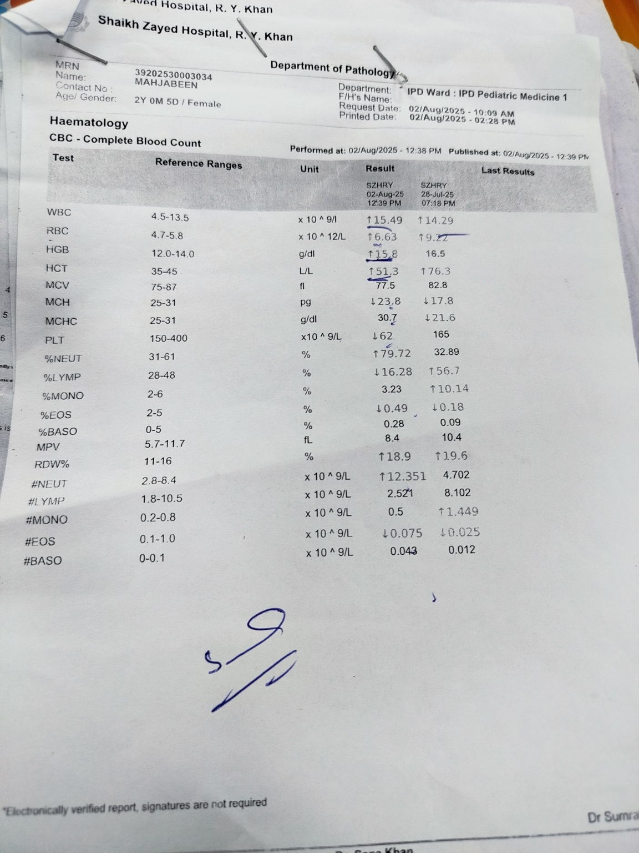
INVESTIGATION
CBC
WBC; 15.49( 4.5-13.50) x 10^9/L
HbG; 15.8( 12.0-14.0) g/dL
Hct:51 (35-45)
RBC; 6.63 ( 4.7-5.8) x10 ^12/L
Platelets; 62 ( 150-400) x 10^9/L

Slide 30
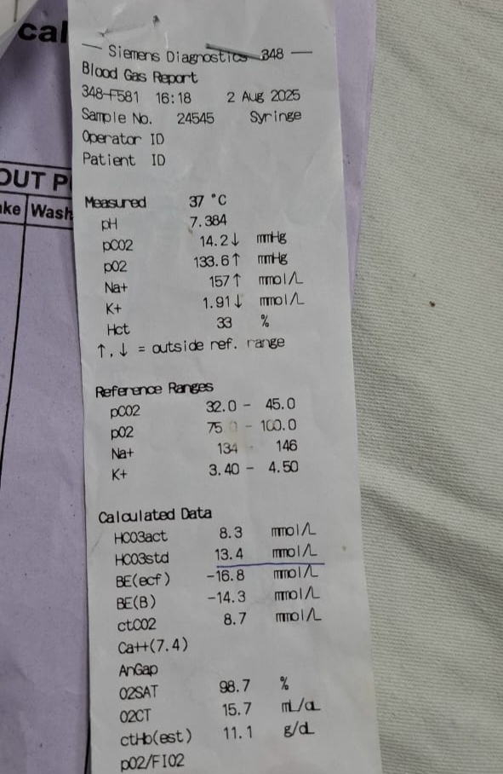
ABGs
.pH; 7.26( 7.35- 7.45)
. pCO2 ; 14.2 mmHg( 27- 40 mmHg)
. HCO3; 8.3 mmol/L(20-24mmol/L)
indicates metabolic acidosis
2

Slide 31
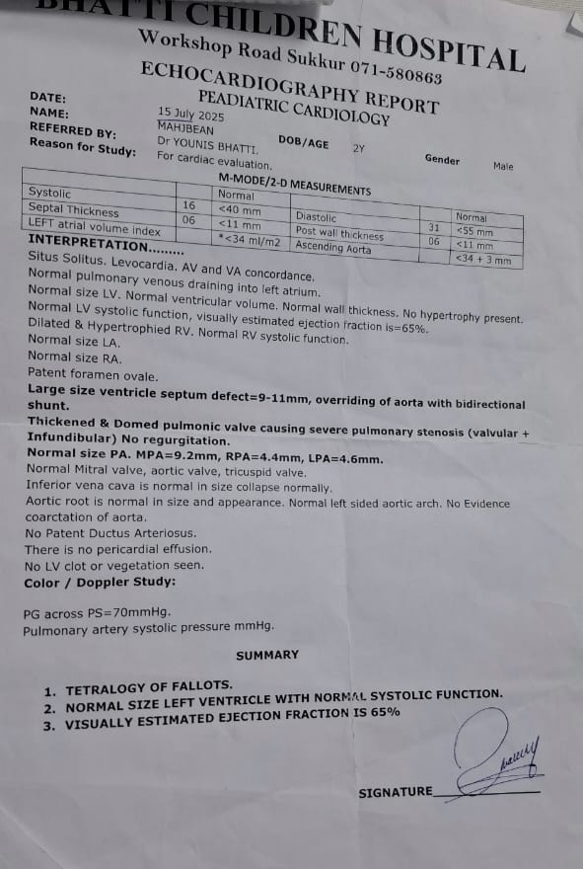
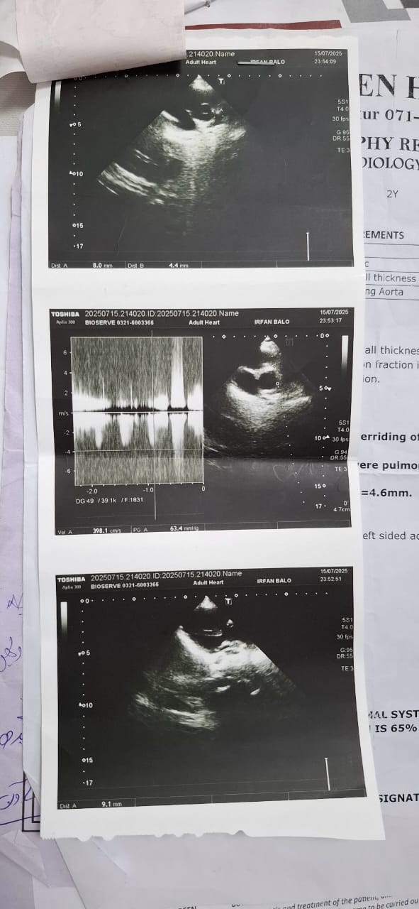
ECHO CARDIOGRAPH
. RV Hypertrophy ,
VSD(9-11mm),
Overriding of aorta
Thick pulmonic valve

Slide 32
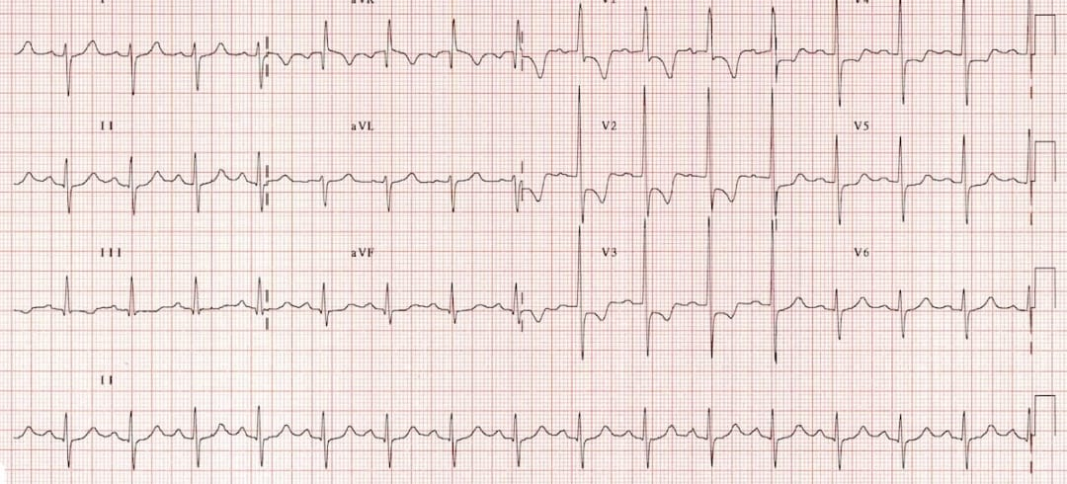
ECG
Significant right-axis deviation and pronounced RV hypertrophy—tall R waves in V₁–V₂, deep S waves in V₅–V₆.

Slide 33
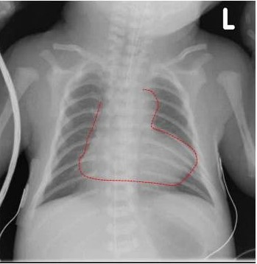
X-RAY
This chest X-ray shows a boot-shaped heart
Pulmonary vascular markings appear decreased

Slide 34
TREATMENT
Admission of patient
Pass IV line
Knee to chest position
Give 100% O2
Inj. N/S
Inj. Morphine + Inj. Metomide
Inj. NaHCO3
Inj. Ceftriaxone
Tab Inderal

Slide 35
THANK YOU

