Slide 1
THALASSAEMIA
Dr Saira Mahmood
PGR PEDIATRIC MEDICINE UNIT 2

Slide 2
CONTENTS
Introduction of Thalassaemia
EPIDEMIOLOGY
GENETICS
Types and Genetics
Clinical Manifestation
APPROACH TO THALASSEMIA PATIENT
Treatment/Protocols in Thalassemia Center
New advances in Thalassemia

Slide 3
DEFINITION
In 1930,thalassemia was derived from greek word “THALLASA” meaning sea because this disease was prevalent in
Mediterranean region
Thalassemia is a group of inherited disorders of hemoglobin synthesis characterized by a reduced or absent one or more of the globin chains of adult hemoglobin.
They characterised by varying degrees of ineffective hematopoiesis and increased hemolysis

Slide 4
EPIDEMIOLOGY
• Recent data indicate that about 7% of the world population is carrier of hemoglobin disorder.
Thalassaemias are prevalent in populations of Mediterranean, Middle East, Indo Pakistan, and Central & South East Asia. They are also common in African countries. Every year 100,000 children are born with thalassaemia major. About 80-90 million people are carriers of βeta Thalassaemia and constitute 1.5 % of world’s population.
In Pakistan β-thalassemia (β-thal) trait frequency is Carrier frequency is 5.4% and there are approximately 13.2 million carriers in Pakistan. About 6,000 affected children are born per year with a frequency of 17 children per day. There are 60,000 registered patients in Pakistan. High number of carriers and increased incidence of consanguineous marriages (60 % first cousin, 15% second cousin, 15% inter biradari) are the main reason for the high birth rate of Thalassaemia Major children

Slide 5
TYPES AND GENETICS

Slide 6
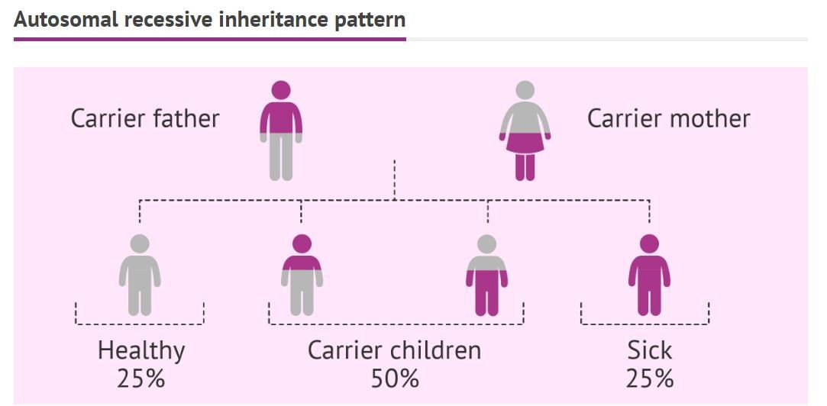

Slide 7
CHANCES IN EACH PREGNANCY
Parents | Normal | Trait | Disease
N=trait | 50% | 50% | None
Trait+trait | 25% | 50% | 25%
Disease+trait | None | 50% | 25%
Disease+disease | None | None | 100%

Slide 8
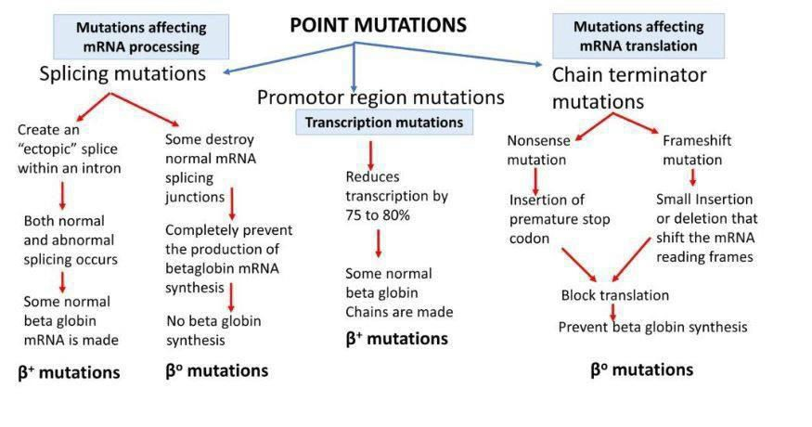

Slide 9
BETA GLOBIN GENE MUTATIONS IN PAKISTAN
FR 8-9 | 37.8%
IV S1-5 | 27%
FR 41-42 | 12.9%

Slide 10
Normal Hemoglobin
Embryonic hemoglobin detected from 3rd to 10th week of gestationand represent Hb Gower1(ζ2ε2), Hb Gower 2(α2ε2), Portland 1 (ζ2γ2), and tetramers.
Fetal hemoglobin (HbF) (α2γ2) contributes to major oxygen carrier during pregnancy starting from 6 weeks to 6th month postnataly
Adult hemoglobin(α2β2) replaces HbF after birth

Slide 11
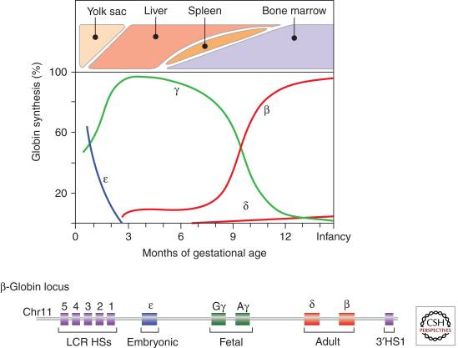

Slide 12
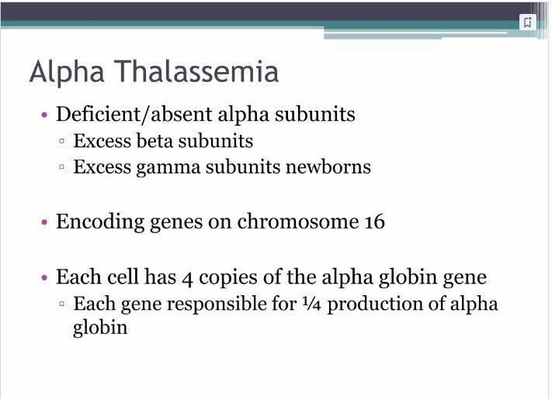

Slide 13
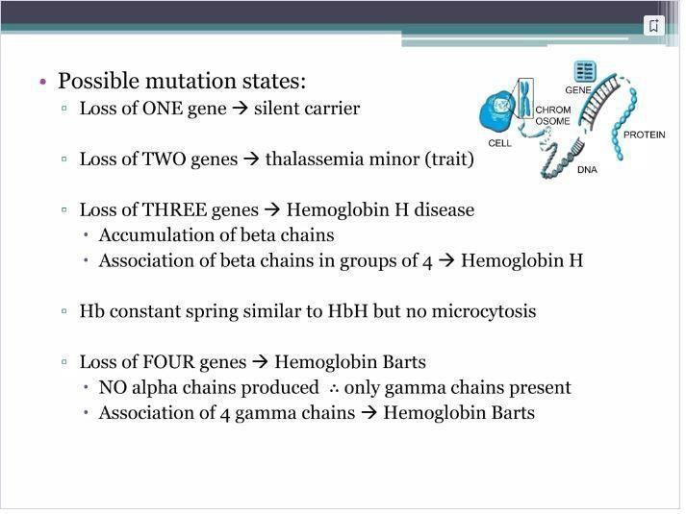

Slide 14
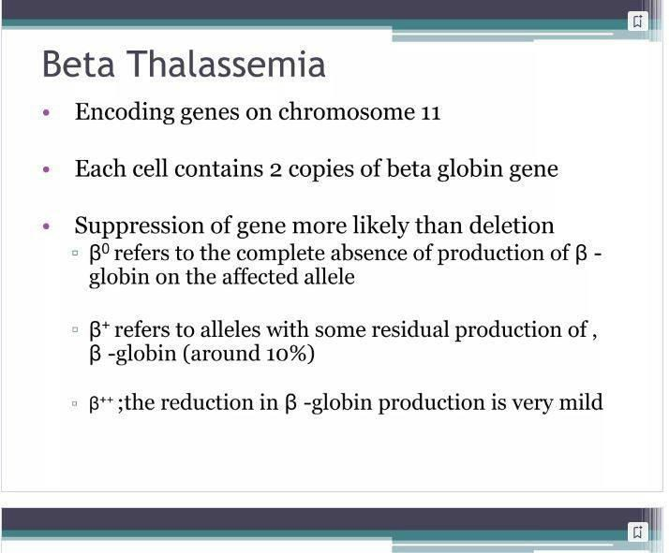

Slide 15
BETA THALSSEMIA GENE MUTATION DETAILS
β⁰ /β {THALASSEMIA MINOR} | Normal,variable Microcytosis | β/β⁺
)+/Aβββ | Elevated A_{2,} | β/β⁰
ββ | Variable Elevation Of F
 | Usually Asymptomatic
 | Anemia+jaundice
 | Differntiate From Ida
 | Anemia Not Responding To One
 | Month Course Of Oral Iron
 | MENTZER INDEX=RBC/RBC
 | COUNT
β+ THALASSEMIA | Microcytosis Nucleated Rbc | β⁺/β⁺
INTERMEDIA(NTDT) | HBF 70-95%%A2 2% Trace A | β⁰/β⁰
 | ON AND OFF REQUIRE BLOOD
 | TRANSFUSION
β⁰ THALASSEMIA | Microcytosis Nucleated Rbc | β⁰/β⁰
(THALASSEMIA MAJOR | HBF 98%A2 2% | β⁰/β⁺
TDT)

Slide 16
α_Thalassemia mutations
ĀA/AA | α_Thalassemia Silent Carrier | Totally Asymptomatic
ĀA/ĀA ĀĀ/AA | α_Thalassemia Trait | Normal Or Mild Anemia Microcytosis
ĀĀ/AĀ | Hbh Disease | Mild Anemia Transfusion Not Required Microcytosis Hypochromia
ĀĀ/ĀĀ | Hydrops Fetalis | Lethal In Utero Without Transfusion Anisocytosis ,Poikilocytosis

Slide 17
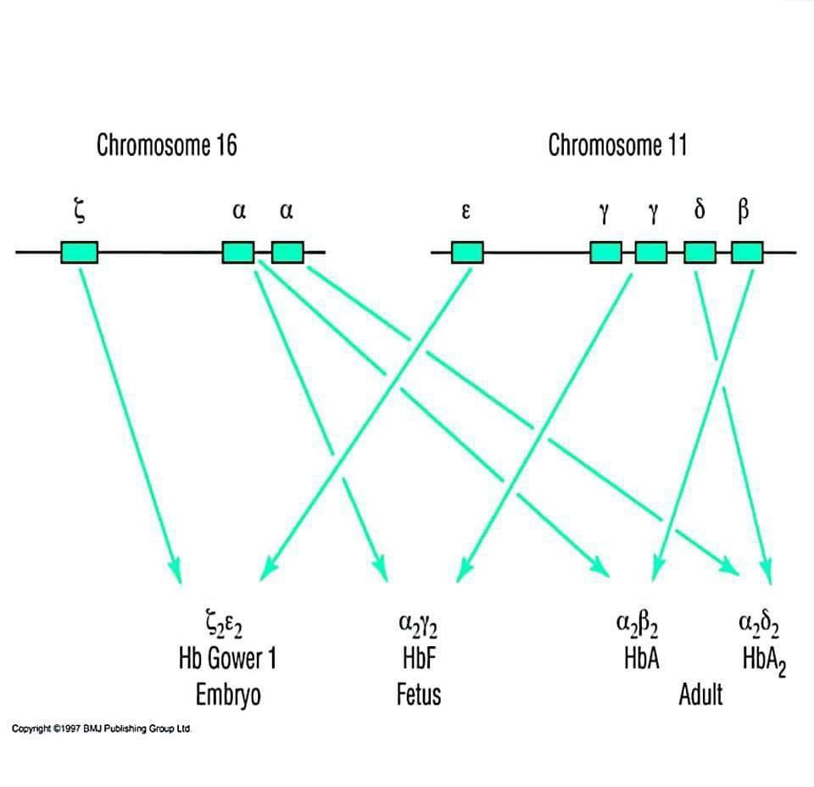

Slide 18
PATHOPHYSIOLOGY
Disturbance of ratio between Alpha & non alpha globin chain synthesis then absent or decrease production of one or more globin chains
Formation of abnormal Hb structures
Ineffective erythropoiesis
Excessive RBCs Destruction
Iron Overload
Extra-medullary hematopoiesis

Slide 19
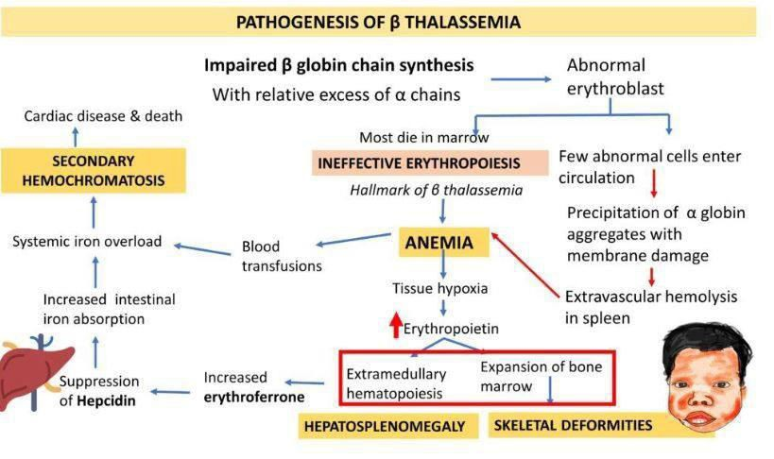

Slide 20
Clinical manifestations
and investigations of
thalassemia

Slide 21
Clinical manifestations of Beta thalassemia:
Minor (asymptomatic, mild pallor, normal life expectancy)
Intermedia(moderate anemia, hepatospelenomegaly, growth failure, jaundice and thalassemic facies.

Slide 22
Beta thalassemia major:
General features:
Pallor
Fatigue
Dyspnea on exertion
Palpitations
Poor appetite
Poor growth

Slide 23
Features of hemolysis:
Jaundice
Hyperurecemia(gout)
Gallstones

Slide 24
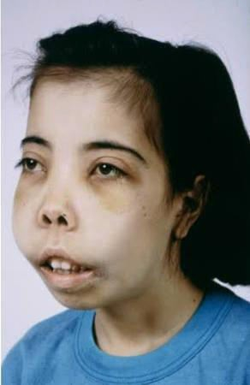
Features of excessive erythropoisis:
Maxillary overgrowth
Frontal bossing
Depressed nasal bridge
Chronic sinusitis

Slide 25
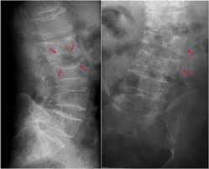
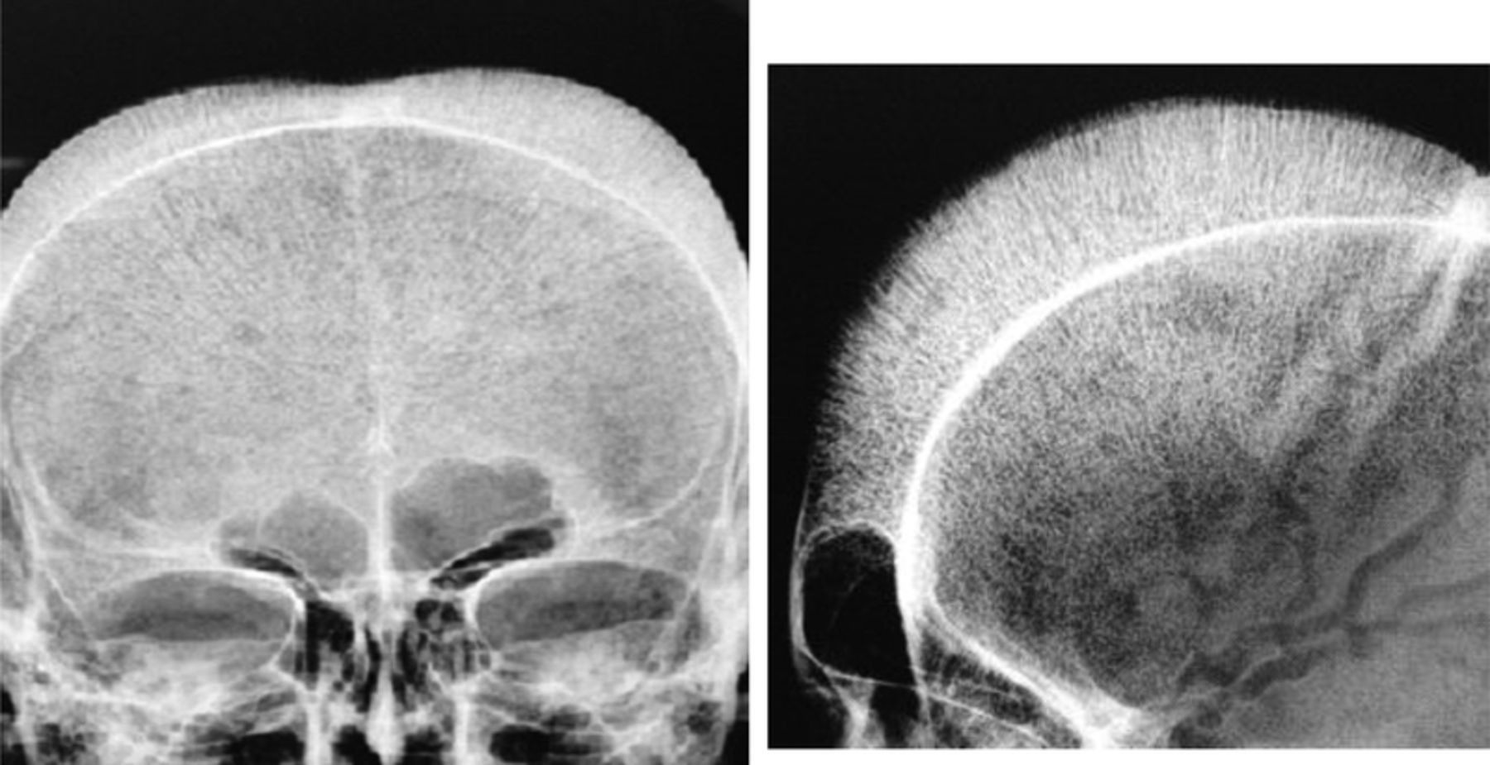
Excessive erythropoisis:
•Bone changes
Medullary expansion
Cortical thinning(increased risk of fractures)
Bone pain, backache
Vertebral expansion leading to spinal cord
compression(neurological manifestations)
•Extra medullary changes
Hepatomegaly splenomegaly

Slide 26
Clinical manifestations of iron overload:
Endocrine failure
Short stature, Delayed puberty, Diabetes mellitus,
Hypoparathyroidism
Hepatic involvement Hepatic fibrosis, cirrhosis
cardiac involvement
Arrhythmias, pericarditis, cardiomyopathy, CCF

Slide 27
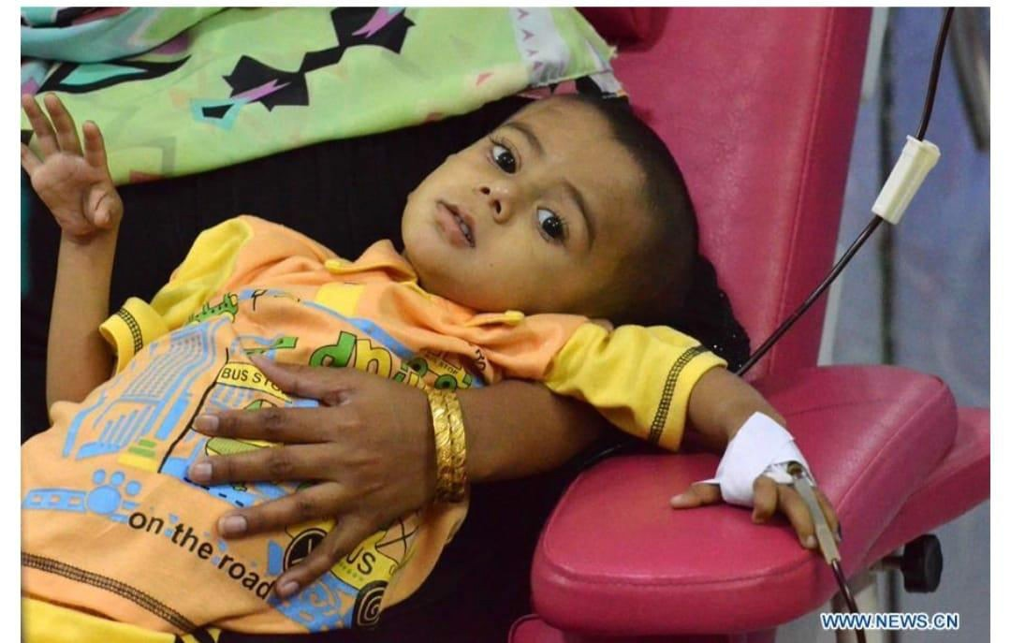
Investigations

Slide 28
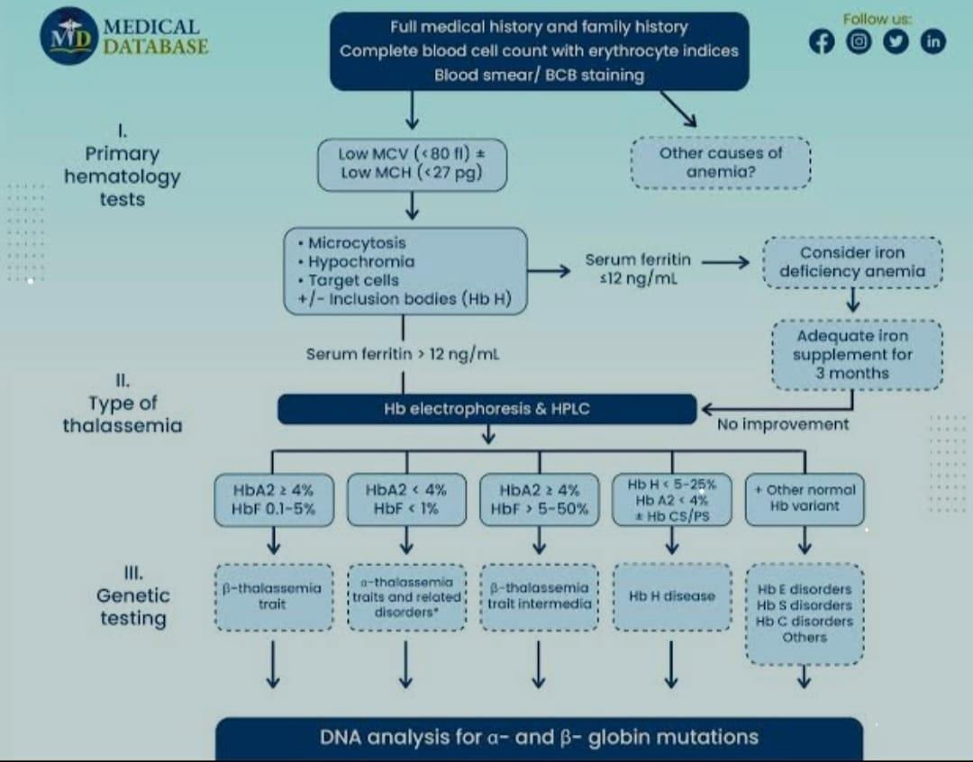
Approach to new case:

Slide 29
CBC with peripheral morphology:
Low HB, Low MCV, Low MCHC, High RDW.
Retics count (3-8 %).
Anisocytosis.
Poikilocytosis.
Nucleated RBCs.
Inclusion bodies.
RDW decreased.

Slide 30
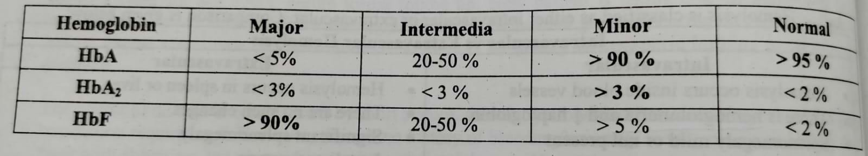
HB electrophoresis:
▪Child after 7-8 months age.
▪Hb electrophoresis of parents if patient is recently transfused.
▪
4-6 weeks after blood transfusion.

Slide 31
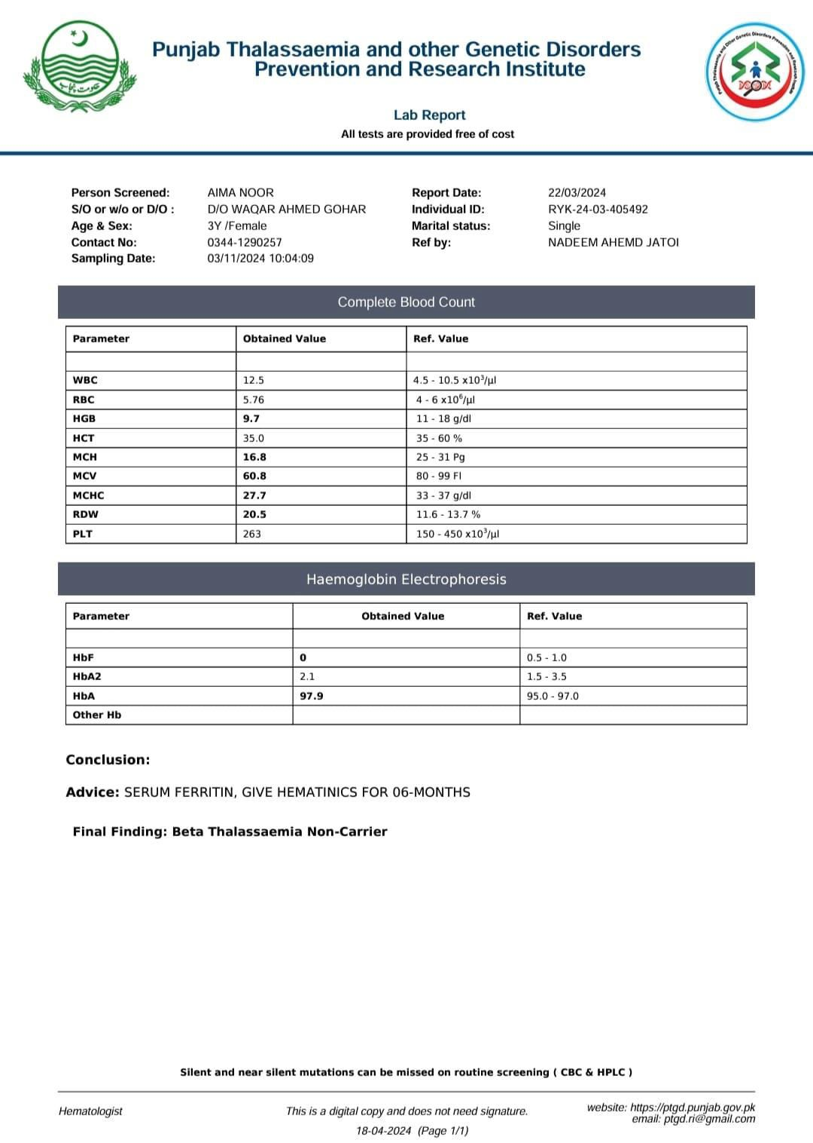

Slide 32
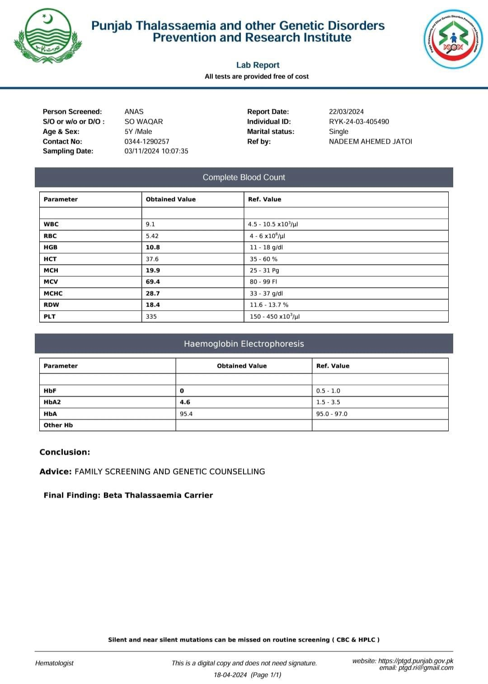

Slide 33
Molecular diagnosis:
▪Gap-PCR use for identification of DNA deletions, rearrangements.
▪More than 300 mutations are identified and 40 mutations are critical.
▪Most common mutations in Pakistan are;
➢Fr 8-9 37.8 %
➢IV S1-5 27%.
➢Fr 41-42 12.9%.

Slide 34
Others :
Serum ferritin level.
Liver function test.
Viral markers.
X-ray skull shows thalassemic changes( hair on end appearance)

Slide 35
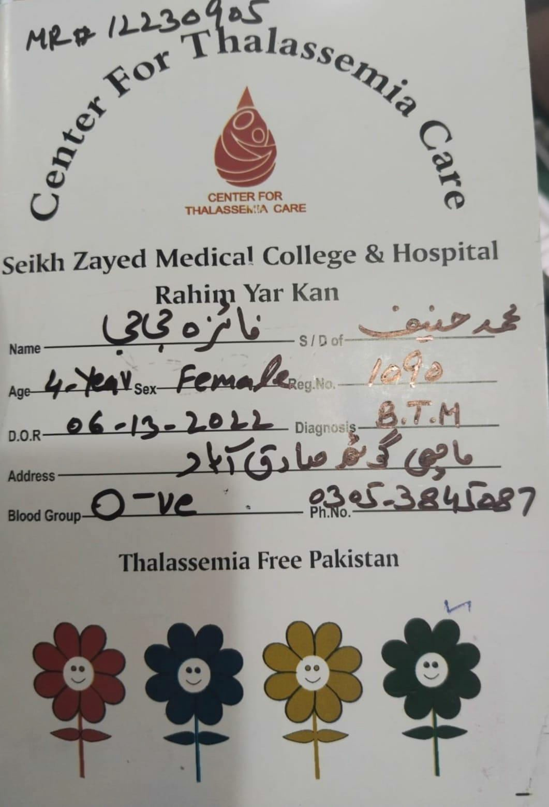

Slide 36
Approach to old case of Thalassemia:
Review previous labs;
▪CBC.
▪HB electrophoresis.
▪Molecular diagnosis.
For iron overload complications.
For chelation.
Others.

Slide 37
For iron overload complications:
Liver;
  Serum ferritin.
  Liver function test.
  Liver MRI for iron content.
Endocrine ;
  Thyroid profile.
  Bone chemistry.
  Fasting blood glucose, OGTT.
  S/E and ACTH.
Cardiac ;
  ECG ,echocardiography.

Slide 38
For chelation :
➢Monthly RFTs ,urine C/E,LFTs. (DEFIRASIROX)
➢Weekly serial CBC, Uric acid levels. (Deferiprone)
➢Hearing and visual assessment. (Deferoxamine).

Slide 39
Others :
▪X-ray skull for thalassemic facies.
▪Hepatitis screening.
▪Serum iron studies.
▪Serum ferritin level.

Slide 40
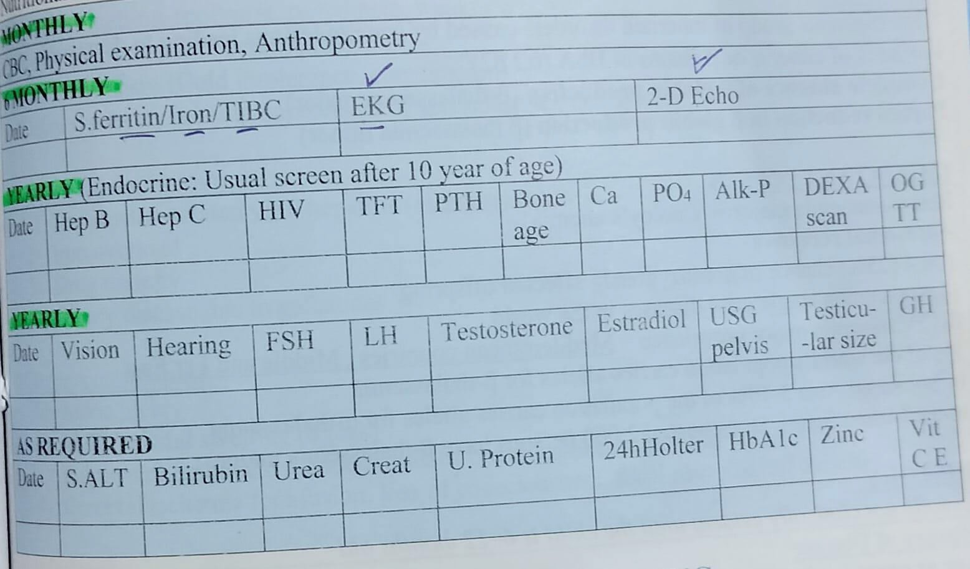
Preventative monitoring chart:

Slide 41
Screening and Antenatal diagnosis:
WHO protocol for screening:
Targeted screening of affected families for carrier. Counselling.
Prenatal diagnosis as early as possible. Termination of affected pregnancy.

Slide 42
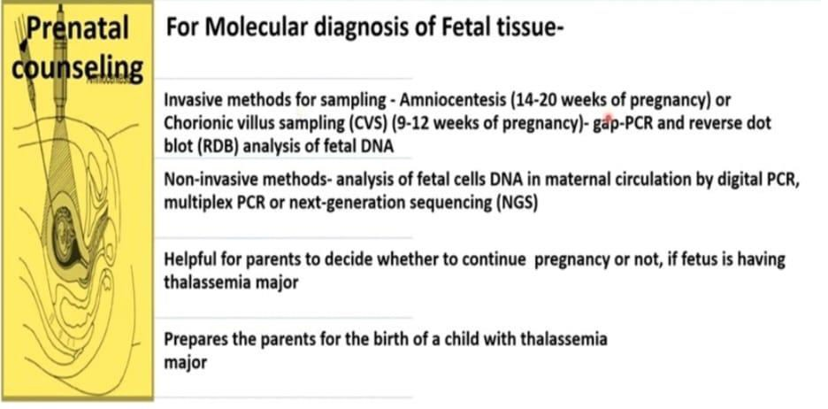

Slide 43
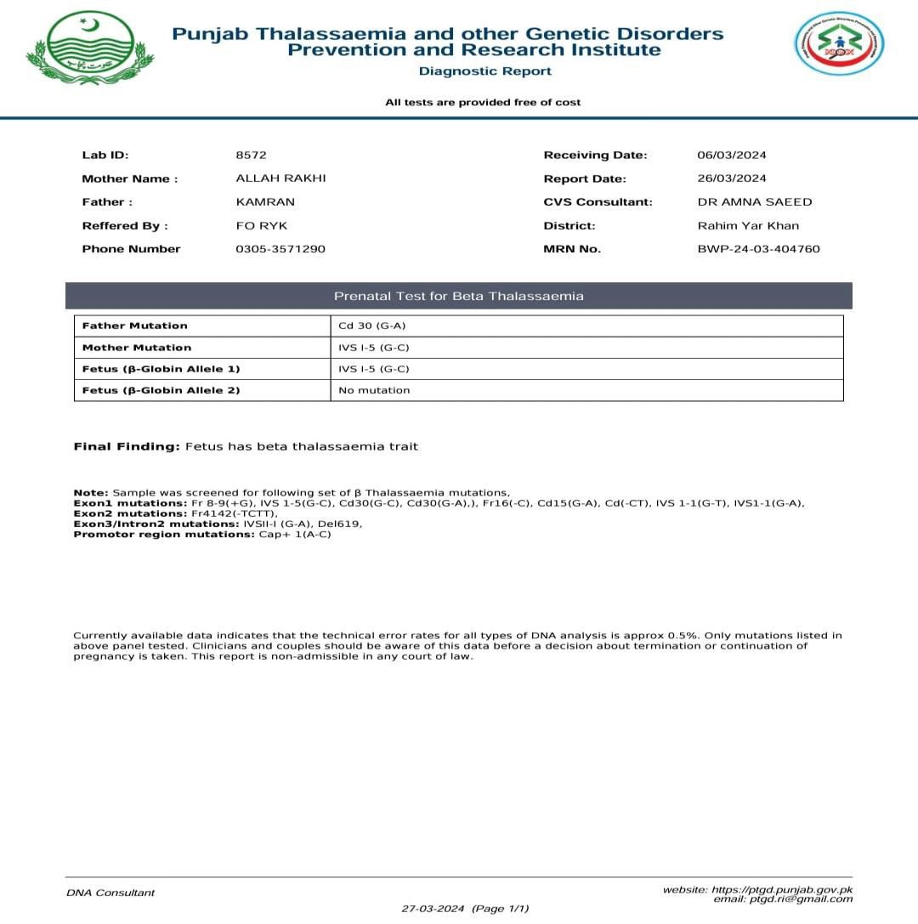
Reports of CVS:

Slide 44
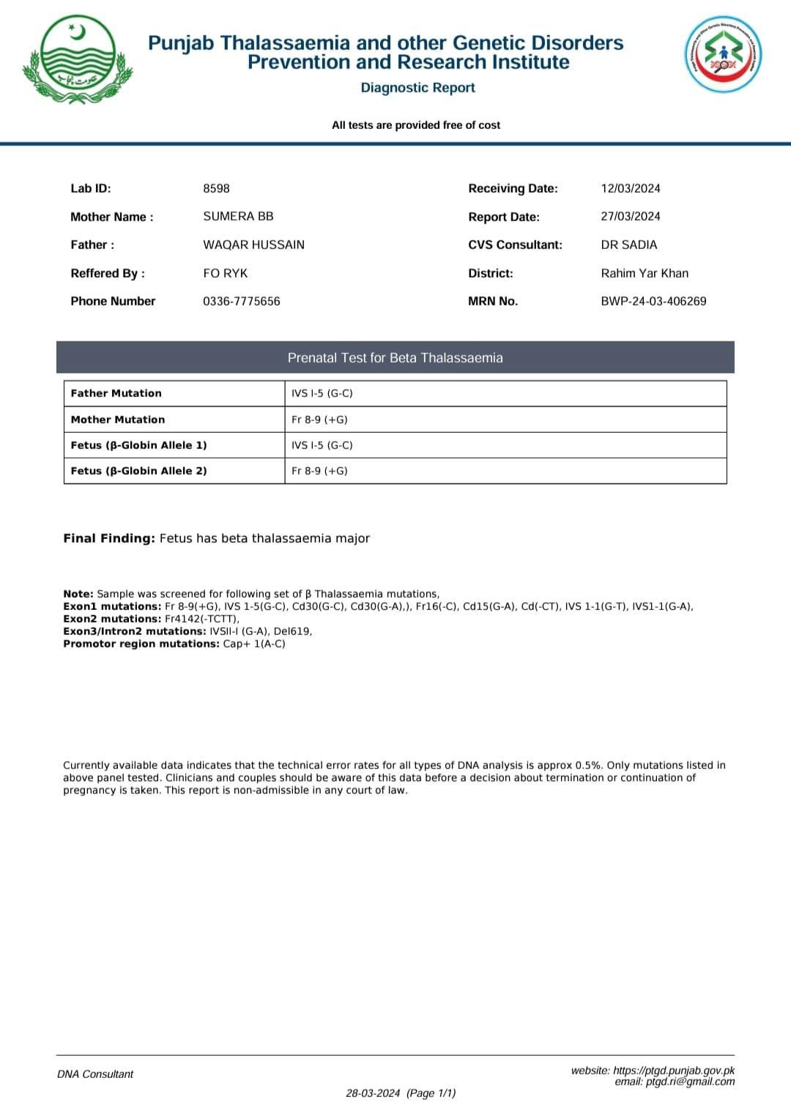

Slide 45
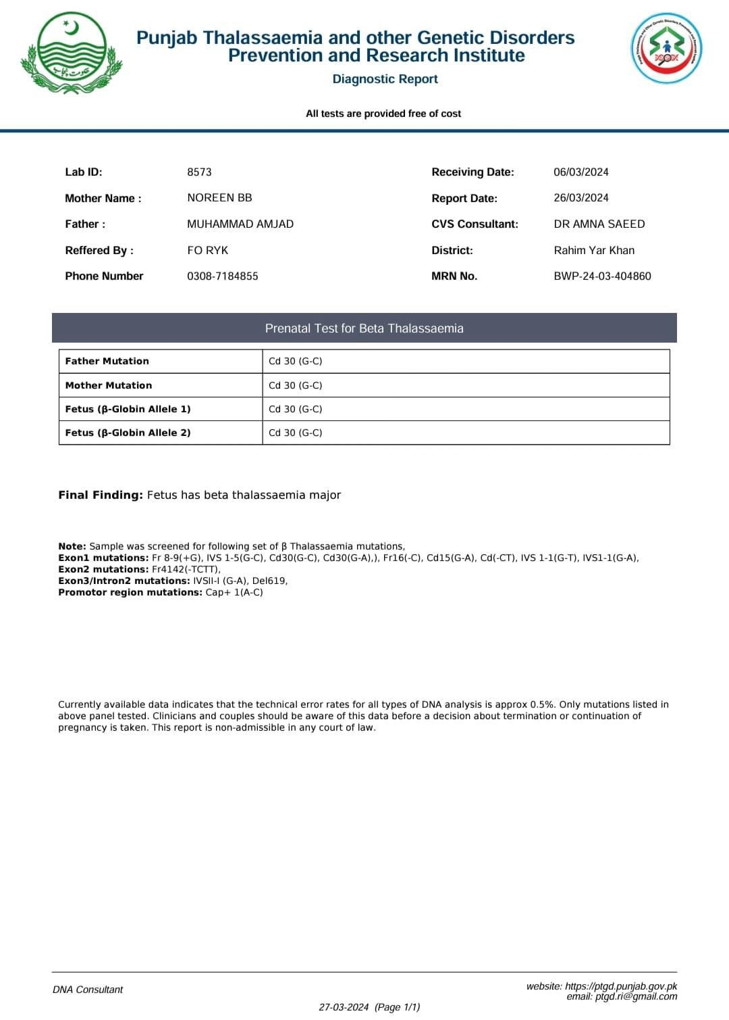

Slide 46
TREATMENT

Slide 47
Treatment protocol in CTC of szh
General
Genetic counseling
Dietary Counseling

Slide 48
Specific:
Transfusion Therapy
chelation:
Iron
Desferroxamine, Deferasirox, Deferiprone (oral).
HbF Augmentation: Hydroxyurea, Thalidomide Splenectomy
•Curative Treatment:
Stem cell transplantation : BM or Cord blood Gene Therapy

Slide 49
Indication for Blood Transfusion
Multifactorial
Hb <7 on 2 occasions 2 weeks apart
Thalassemic facies
Growth failure
History of blood transfusion for at least one year

Slide 50
Considerations Before Transfusion
Pretransfusion Hb
PCV (washed and leukoreduced)
Volume
Duration of transfusion
Blood Grouping & CM
Screening for Hepatitis, HIV, Syphilis
Record maintainance
Yearly Blood Requirement

Slide 51
Blood Transfusin Regimens
Low transfusion regimen
HB between 4-8 g/dl
High transfusion regimen
HB between 9.5-10.5
Lower requirement of blood per year ,no visceromegaly ,good growth rate
Supra transfusion regimen

Slide 52
Complications of Iron Overload:
Liver
Endocrine:
Grwoth Failure Delayed Puberty Osteoporosis
Cardiac Hemosiderosis
Infections

Slide 53
Iron Chelation Therapy
When to Start Iron Chelation
1yr of regular transfusions or 12 or more transfusions
S. Ferritin more than 1000
Liver Iron more than 2500 ug /g dry weight Age above
2year
Iron chelation options
Deferoxamine/desferoxamine
Defasirox
Deferiprone

Slide 54
Deferoxamine/Desferoxamine
Half Life :30 min
Route of administration: S/C or IV over 8hrs diluted in distilled water 500mg in 5ml
MOA: chelates non-transferrin bound iron
Dose: 20-60mg/kg
Complications/Limitations:
Poor compliance
Reactions Ototoxicity Retinal changes Bone dysplasia

Slide 55
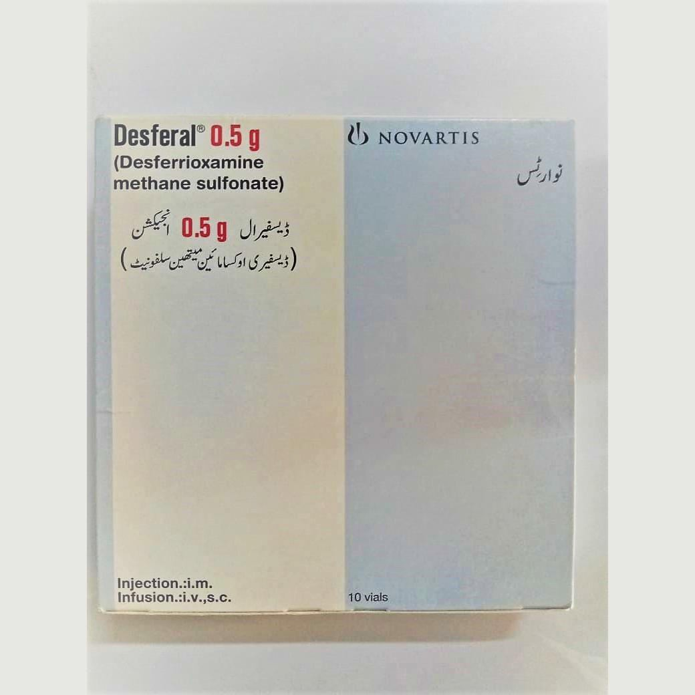

Slide 56
Deferasirox
Half Life: 16 Hours
Route of administration: Oral
MOA: chelates free iron
Dose: 20-40mg/kg/day OD taken on empty stomach (dispersible tablet )
Complications:
GI uspet Nephrotoxicity Hepatotoxicity

Slide 57
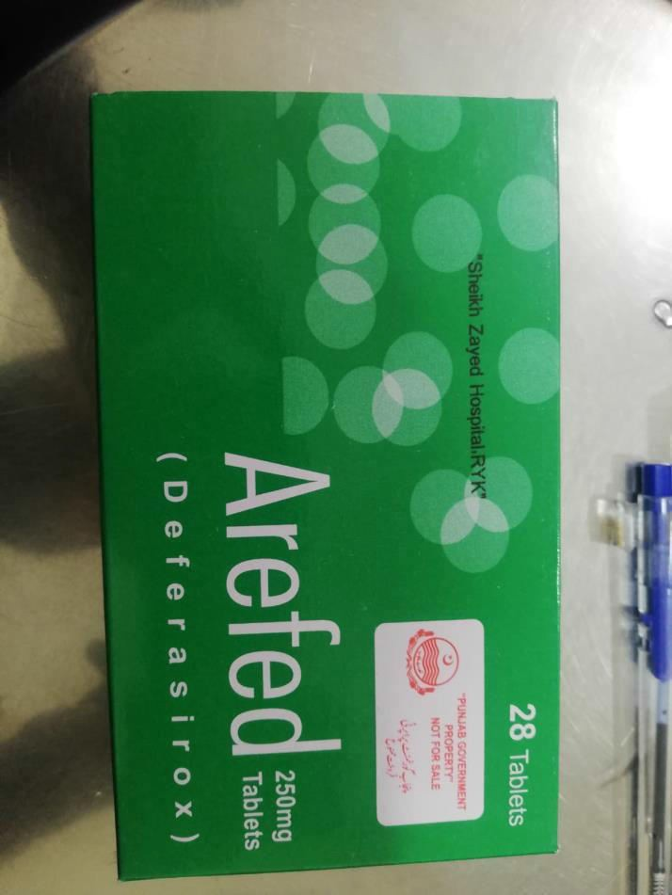
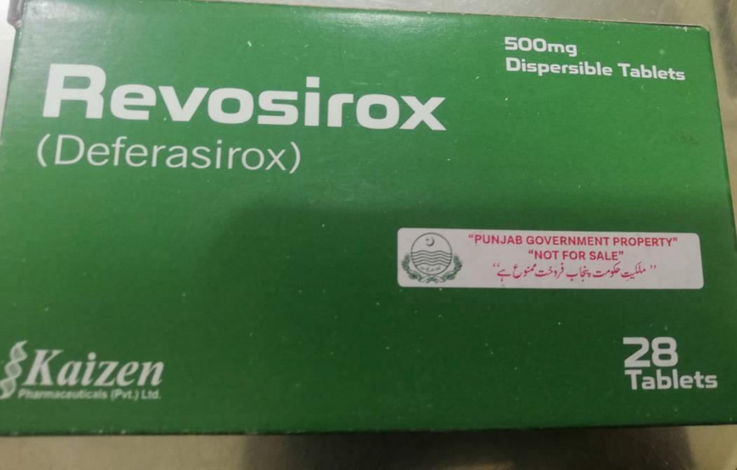

Slide 58
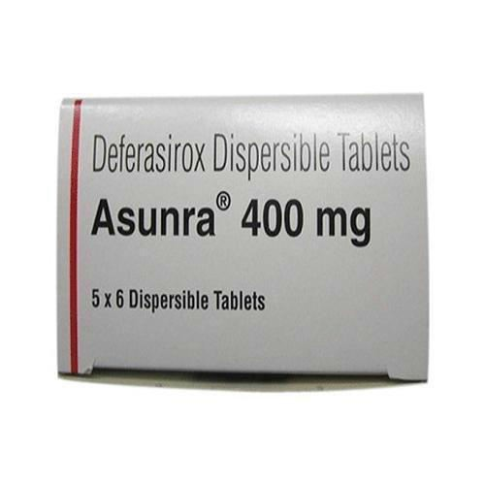

Slide 59
Deferiprone
Half Life: 03 hour
Route of administration: oral
MOA: chelate unbound iron
Dose: 25mg/kg/dose tds OR 75mg
/kg/day
Complications:
Agranulocytosis Liver Damage Increases Uric acid

Slide 60
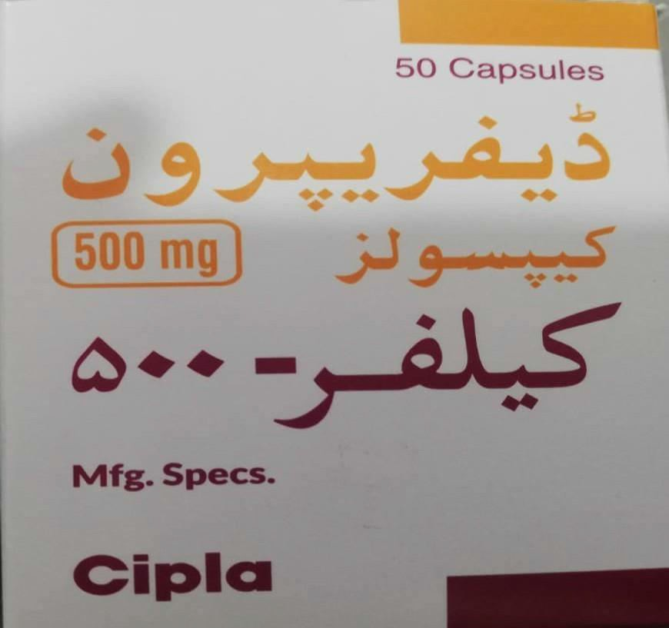

Slide 61
Follow up while on Iron Chetaion Therapy
Deferoxamine:
Annual Hearing and visual assessment, Growth Monitoring
Deferasirox:
Monthly LFTs,RFTs,UCE
Deferiprone:
Weekly CBC, Monthly LFTs, Uric Acid levels

Slide 62
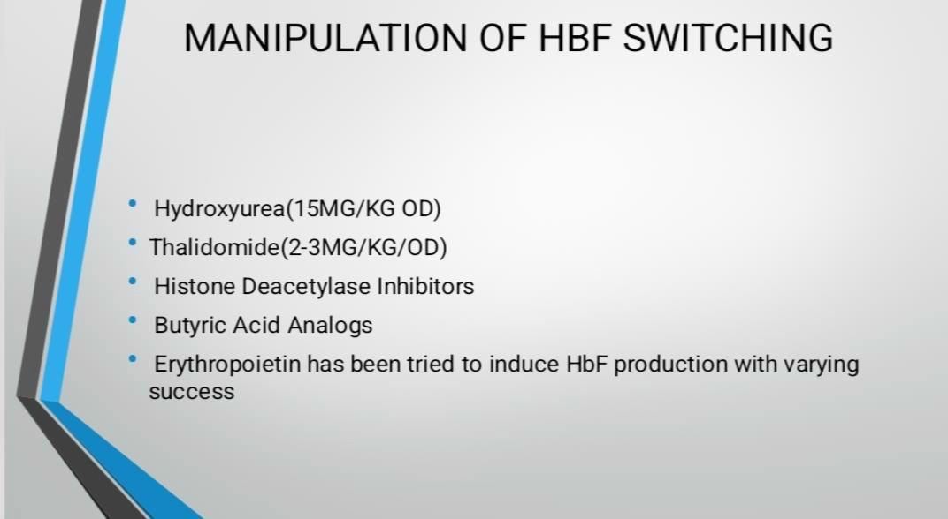

Slide 63
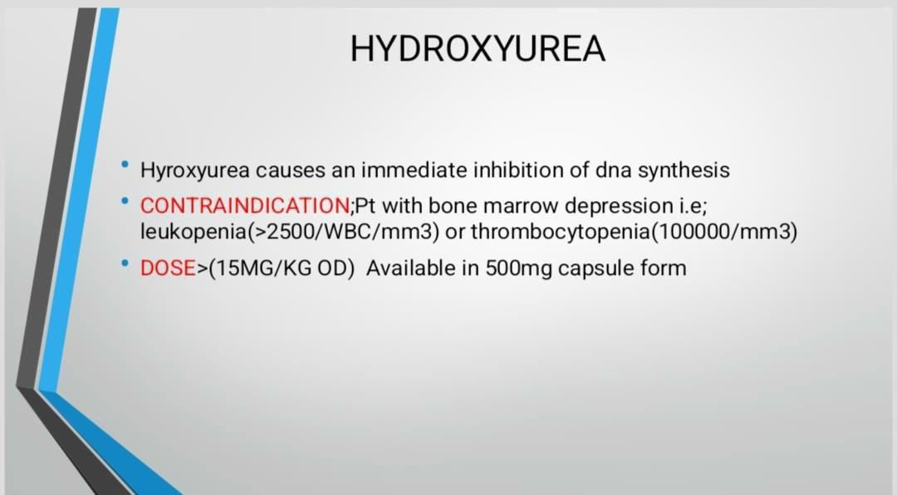

Slide 64
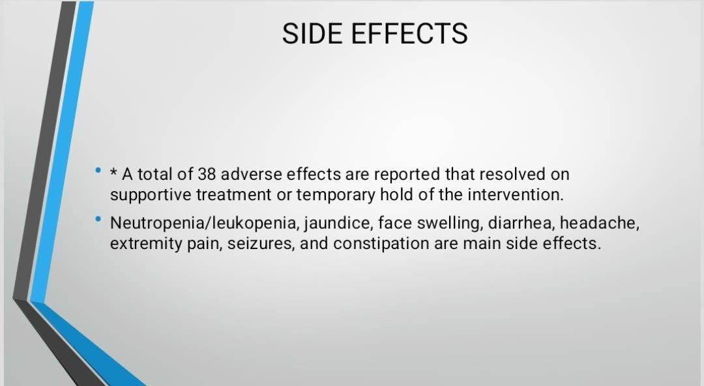

Slide 65
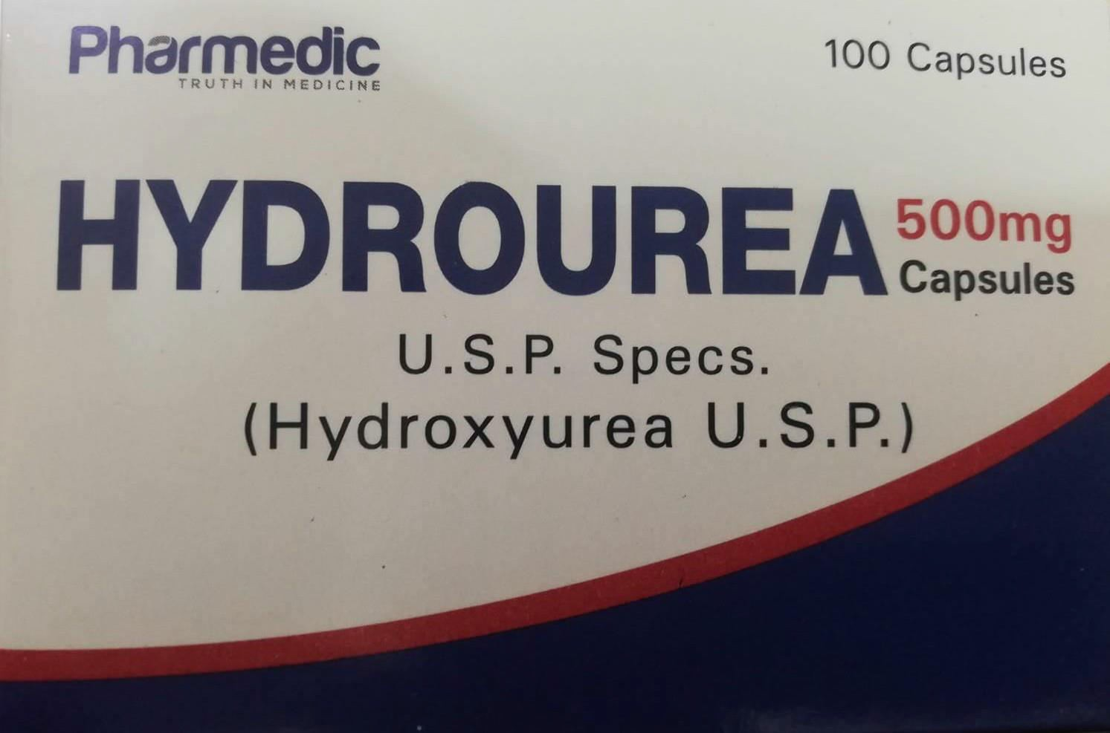

Slide 66
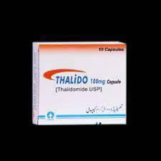

Slide 67
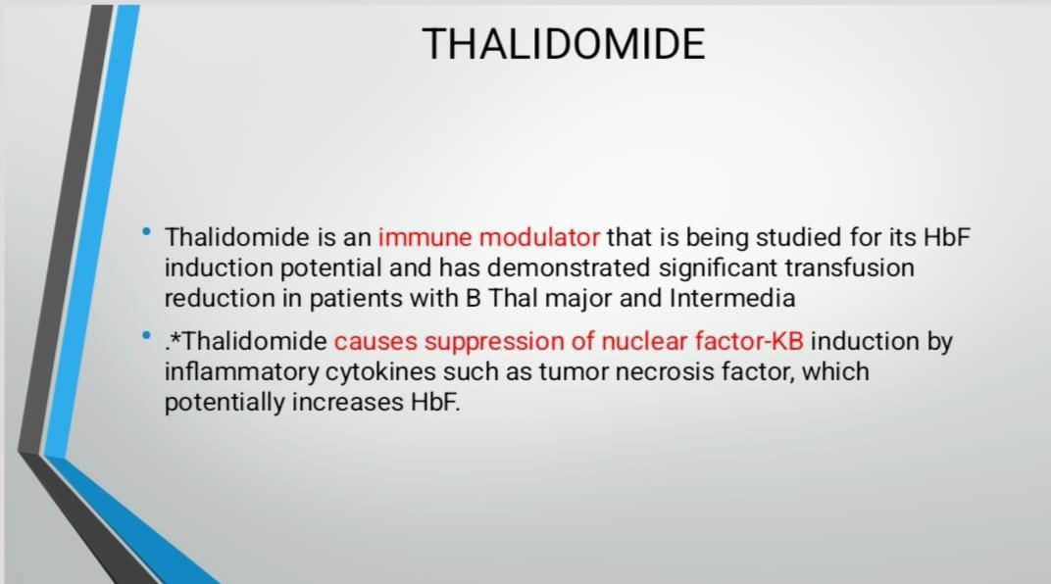

Slide 68
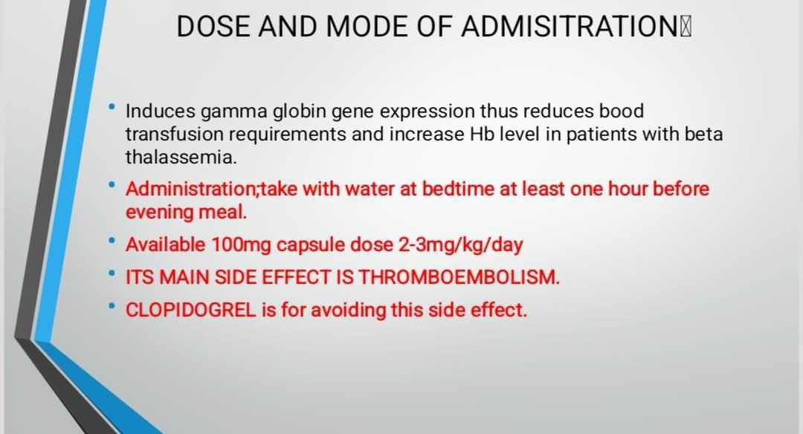

Slide 69
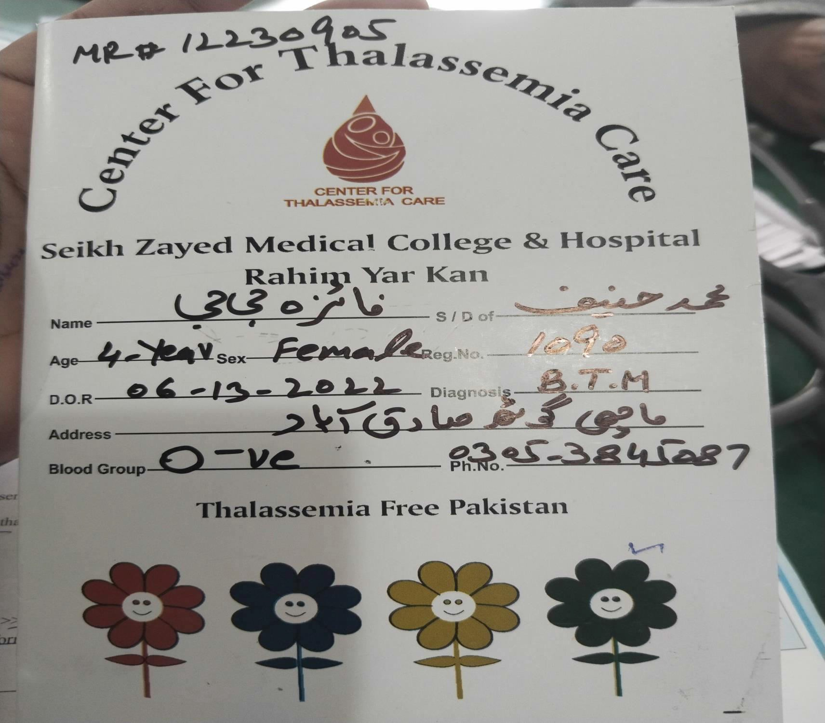

Slide 70
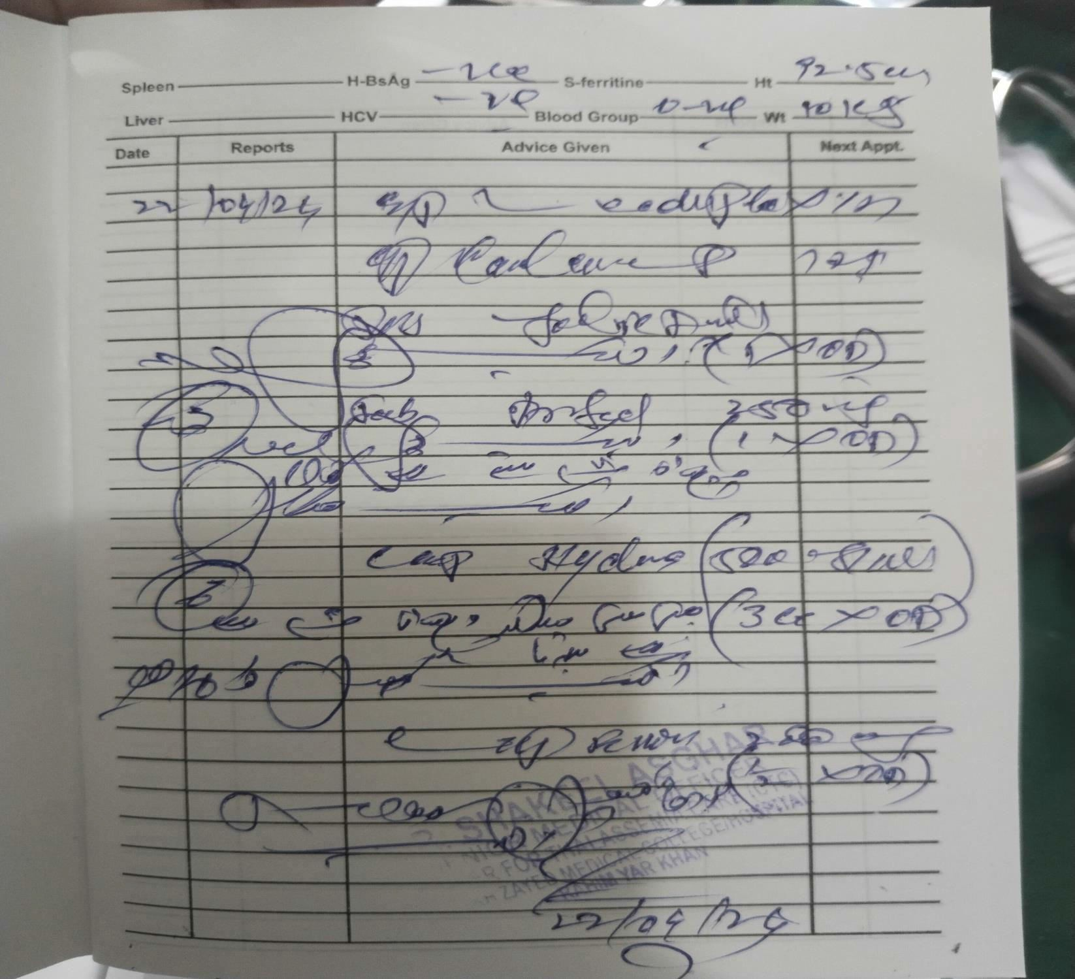

Slide 71
Splenectomy
Indications
Preparation
Complications
prophylaxis

Slide 72
Dietary Counselling
Cu & Zinc Supplements
Adequate nutrition
Restrict iron rich diet
Tea/coffee intake
Vit C
Ca & vit D
Salt restriction in cardiac failure

Slide 73
•Recent Advances In Treatment of
Thalassemia

Slide 74
STEM CELL TRANSPLANTATION
This is only the curative therapy available today
. Sources of stem cells: Bone Marrow, Peripheral Blood, Cord Blood, Fetal Liver
.•Though expensive, it is cost effective as compared to yearly cost of
regular blood transfusion and chelation therapy
cost 8-10 lakhs.
Umblical cord stem cells have good results(lower GVHD, longer engraftmen

Slide 75
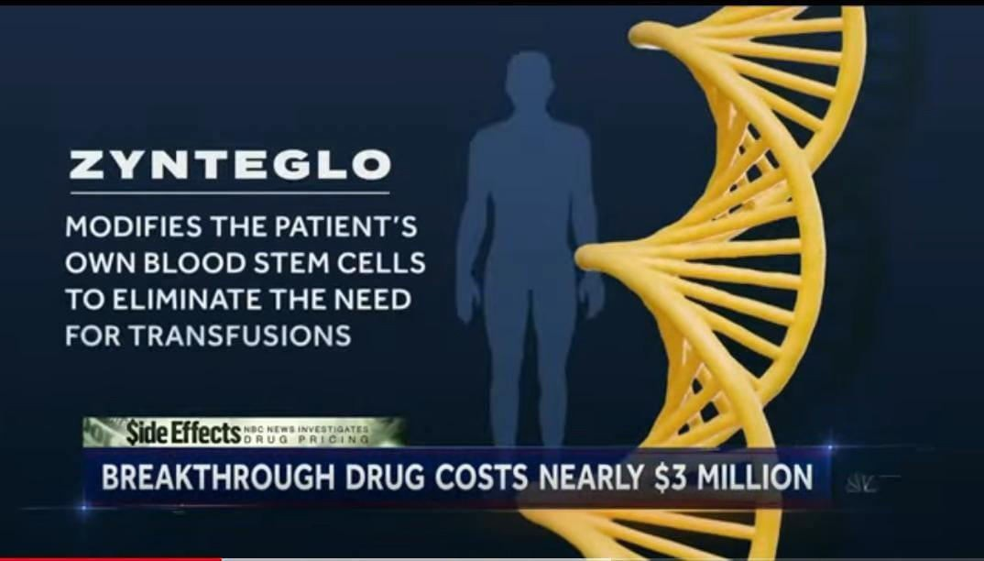

Slide 76
NEW GENE THERAPY ZYNTEGLO
ZYNTEGLO works by adding functional copies of a modified form of the beta-globin gene (βA-T87Q-globin gene) into a patient's own hematopoietic (blood) stem cells (HSCs) to allow them to make normal to near normal levels of total hemoglobin without regular RBC transfusions
APPROVED BY FDA
VERY COSTLY

Slide 77


