Slide 1
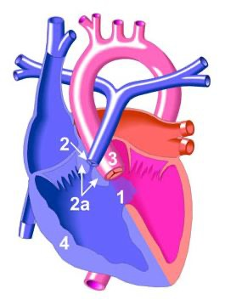

Tetralogy of Fallot
Dr FAWAD AHMAD PGR PEADS UNIT I

Slide 2
OVERVIEW:
Definition
Pathophysiology
Clinical Features
Examination
Tet Spells and its management
Diagnosis
Other Anomalies
Management
Complications
Prognosis

Slide 3
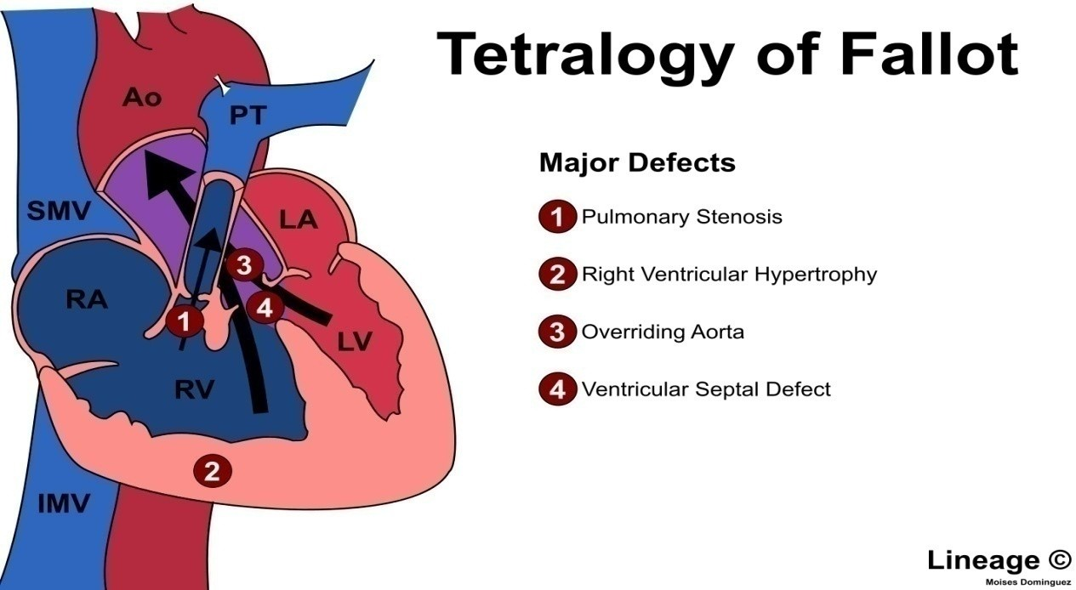
Definition
TOF ..Conotruncal family of heart lesion
primary defect is pulmonary valve stenosis
Leads other major defects :

Slide 4
Risk Factors
Poor maternal nutrition
Viral illness during pregnancy.rubella German measles
Presence of down syndrome or Digeorge syndrome in baby
Drinking alcohol and smoking during pregnancy

Slide 5
Pathophysiology
.
.
RVO obstruction
Timing of onset of symptoms Severity of cyanosis
Degree of RVH
RVO Obstruction…..
Mild to Moderate obstruction
Balanced shunt across VSD ……..Acyanotic/Pink TOF
Severe RVO Obstruction
.Cyanosis at birth+worsen when shunt begin to close
.

Slide 6
Pathophysiology
Physiologically the pulmonary stenosis causes concentric right ventricular hypertrophy without cardiac enlargement and an increase in right ventricular pressure.
When the right ventricular pressure is as high as the left ventricular or the aortic pressure, a right to left shunt occurs

Slide 7
Once the right and left ventricular become identical, increasing severity of pulmonary stenosis reduces the flow of blood into the pulmonary artery and increases the right to left shunt.
As the systolic pressures between two ventricle are identical there is little or no left to right shunt and the VSD is silent.

Slide 8
The flow from the right ventricle into the pulmonary artery occurs across the pulmonary stenosis producing an ejection systolic murmur
More severe the pulmonary stenosis, the less the flow into the pulmonary artery and the bigger the right to left shunt, more the cyanosis

Slide 9
Clinical manifestations
.
Mild degree of outflow obstruction;L to R shunt
Cyanosis not present at birth & occur in first few months of life
Severe degree of RV outflow obstruction
Neonatal cyanosis due to RVO obstruction
Pulmonary blood flow partially/Totally dependant on flow Through ductus arteriosis…

Slide 10
Older children with long standing Cyanosis have
Dusky blue skin
Grey sclera
Engorged blood vessels
Marked clubbing
In older children +unrepaired teratology having Dyspnea on exertion

Slide 11
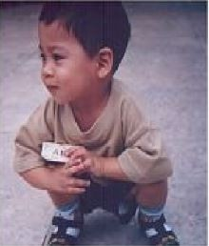
Child play actively for a short time/sit/lie down
Easy fatigability & dysponea on exertion
Squatting position for the relief of dyspnea
Usually able to resume physical activity after a few minutes of squating
Squatting position

Slide 12
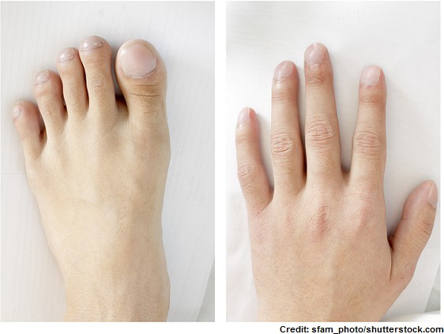
General Physical Examination
Varying degrees of cyanosis
Conjunctival congestion
Clubbing of the fingers and toes
(occurs after 3 months of age)
Stunted growth
Precordium may be bulged
due to right ventricular hypertrophy.

Slide 13
CARDIOVASCULAR SYSTEM EXAMINATION
Cardiac findings in cyanotic tetralogy of Fallot:
A long ejection systolic murmur at the upper and mid left sternal border
A loud, single S2 are characteristic auscultatory findings of TOF
A continuous murmur is heard if a PDA or large collateral vessels are present
Apex beat is tapping in character, but not shifted
A systolic thrill &Left parasternal heave may be present
The first heart sound (S1) is usually normal

Slide 14
Investigations
CBC—polycythemia,thrombocytopenia,Wbcs may be inc in infection
ABGs—Metabolic acidosis
CRP,Blood c/s –if infection present or suspicion of infective endocarditis
CXR
Ecg &Echocardiogram
MRI brain—If thrombosis/abscess is suspected

Slide 15
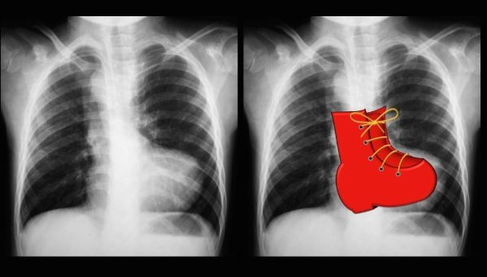
Chest X-ray
Boot shaped heart
(due right to ventricular hypertrophy).
Oligaemic lung fields.
Hilar vessels are few,
Lung vessels also few.

Slide 16
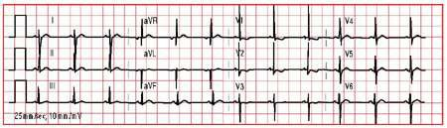
Electrocardiogram:
Right axis deviation and evidence of right ventricular hypertrophy.

Slide 17
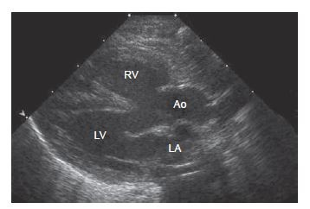
Echocardiography
All 4 components of TOF
Look for VSD size,position,number
Degree of pulmonary obstruction
Associated anomalies

Slide 18
Cardiac catheterization:
Not done routinely should be done before surgery for
Aberrent coronary artry
MAPCAs
For adequete pulmonary vasculature
OTHER FINDINGS:
Right ventricular pressure is equal to systemic pressure
Pulmonary artery pressure is reduced
Oxygen saturation of aorta is reduced

Slide 19
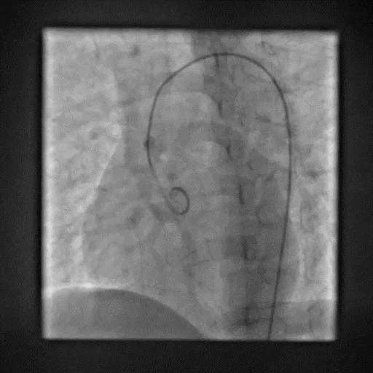
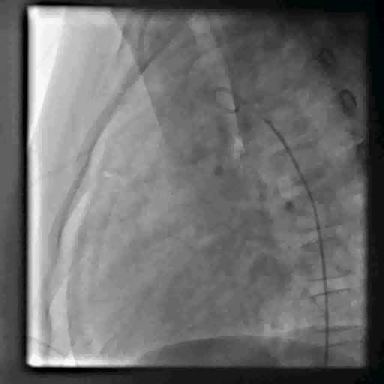
Aortography or coronary arteriography:
outlines the course of the coronary arteries. In 5-10% of patients with the tetralogy of Fallot, coronary artery abnormalities may be present

Slide 20
ASSOCIATED ANOMALIES
Tetralogy of Fallot may present with other anatomical anomalies, including:
Stenosis of the left pulmonary artery, in 40%
A bicuspid pulmonary valve, in 60%
Coronary artery anomalies, in 10%
PDA may be present
Congenital absence of the pulmonary valve

Slide 21
Treatment
Counsel the parents about disease, treatment option & prognosis
Treatment options :
Medical
Surgical

Slide 22
Medical
Neonate with severe cyanosis is treated with IV infusion of prostaglandin E1(0.05 - .1 mcgm/kg/min) to keep the ductus arteriosus patent & thereby to improve pulmonary circulation and is life saving.

Slide 23
Maintain Hydration
Avoide Exertion
Fluid & Nutrition
Provide High Calorie Diets To Ensure Growth
Supplement Vitamins & Minerals
Maintain Oral Hygeine
Propranolol : 0.25-1mg/Kg/Day Orally To Be Continued To Prevent Cyanotic Spell
Supplement Iron 3-6 Mg/Kg/Day Elemental Iron Orally To Promote Maturation Of Rbc

Slide 24
Surgical
What is the definitive surgery for TOF?And when will you advise corrective surgery?
Surgical option is suggestive as soon as1st cyanotic spell is experienced
In relative stable patients it can be done by 4-6 months of age
Corrective surgery is
Resection of RVOT
Patch closure of VSD
Valvotomy(opening valve surgically)Velvectomy(replacing valve)if Pulm stenosis

Slide 25
Complications of Corrective Surgery
.
.
.
.
Pulmonary Regurgitation Tricuspid Regurgitation Right heart failure
Heart block(RBBB) as AV node is closure to VSD Myocardial Infarction (due to injury of aberrent
coronary artries)
.

Slide 26
All these shunts enhance blood flow from systemic circulation to pulmonary artry
Blalock Taussig shunt—Right subclavian artery with right pulmonary artery
Waterston’s shunt—PA anastomose with ascending aorta
Pott’s shunt ----------PA anastomose with descending aorta

Slide 27
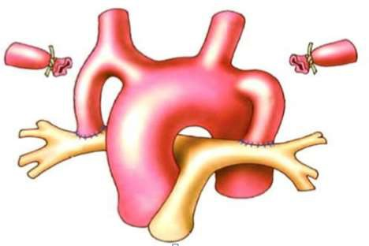
Palliative surgery
Classic Blalock-Taussing shunt: anastomosed between the subclavian artery and the ipsilateral PA, is usually performed for infants older than 3 months because the shunt is often thrombosed in young infants.
Classic Blalock- Taussing shunt

Slide 28
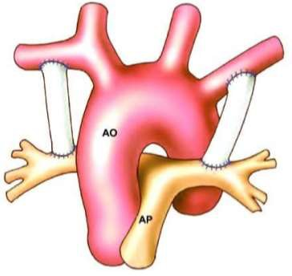
Modified Blalock-Taussing shunt : a Gore-Tex interposition shunt is placed between the subclavian artery and the ipsilateral PA.
This is the most popular procedure for any age, especially for infants younger than 3 months of age.
Modified Blalock- Taussing shunt

Slide 29
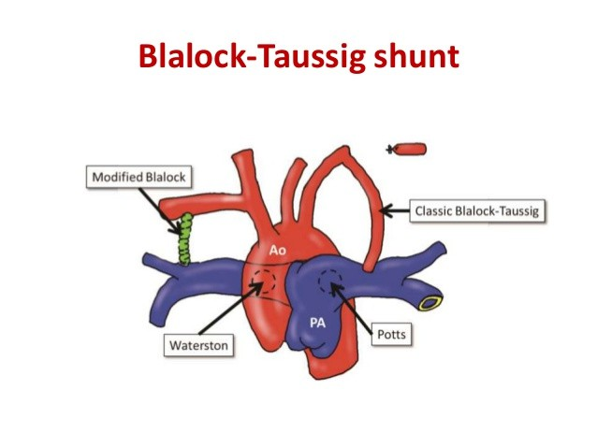

Slide 30
COMPLICATIONS
Hyper cyanotic spells(Tet spells)
Cerebral thrombosis
Age less than 2 years
Brain abscess
Age more than 2 years
Infective endocarditis
Other Complications are:
Failure to thrive and delayed puberty (chronic disease)
Development delay (prolonged hypoxia)
Gum disease (polycythemia)
Arthritis of small joints (arthropathy) Thrombocytopenia (polycythemia)

Slide 31
Hypercyanotic Spells
Also called ‘Tet spells’
Common complication in of TOF in first 2 years of life They occur when degree of obstruction increases
Risk factors of Tet spells
Early morning (inc catecholamines)
Vigorous cry(inc oxygen requirement)
Exercise(inc oxygen requirement)
Dehydration episode(dec blood volume)

Slide 32
CLINICAL FEATURES:
Tachypnea
Restlessness
Gasping respiration
Increase in cyanosis
Disappearance of murmur
Hypoxia
Metabolic acidosis
MAY FOLLOWED BY>>>>Generalized weakness… Sleep..Unconsiousnes..Fits..Hemipresis

Slide 33
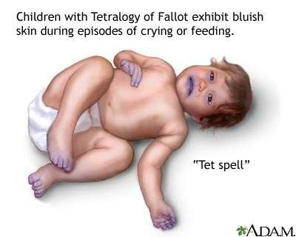

Slide 34
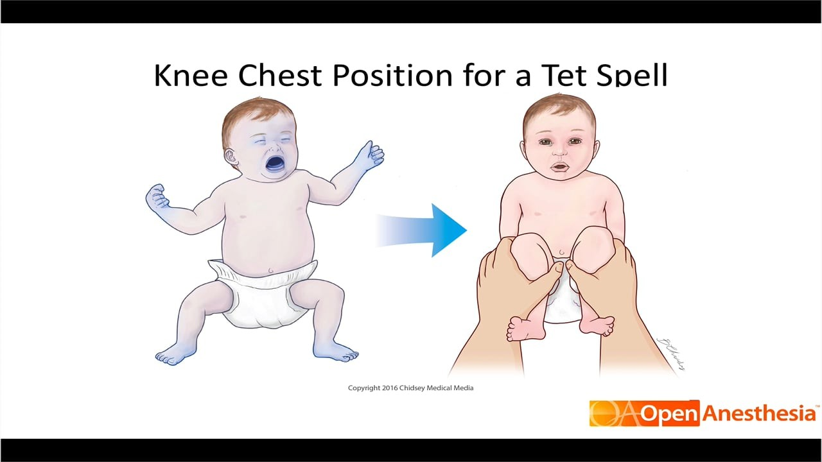
Treatment of tet spells
knee chest position>>This Inc SVR and Inc pilmonary blood flow
Give O2 3-5 L/min does not correct cyanosis directly but may promote vesodilation of pulmonary artry .INC flow to lungs

Slide 35
Morphine s/c (0.1-0.2mg/kg)
◻ causes sedation, thus decreasing oxygen requirement.
NaHCO3 (1-2mEq/kg)
◻ corrects metabolic acidosis and thus dec tachypnea.
Norma saline (10ml/kg)
◻ corrects dehydration , promotes RV filling.
Dextrose water 10%(2-4ml/kg)
◻ corrects hypoglycemia which occurs in spell , also can counter hypoglycemia caused by beta blockers.
Oral propanalol (0.1-0.2mg/kg)
◻ relieves RVOT by relaxing infundibular septum, dec heart rate and thus dec
I/V phenylephrine
◻ inc SVR and promotes pulmonary flow

Slide 36
PROGNOSIS
After successful total correction, patients are generally asymptomatic and are able to lead unrestricted lives.
If left untreated, TOF carries a 35% mortality rate in the first year of life,
and a 50% mortality rate in the first three years of life.
Patients with untreated TOF rarely progress to adulthood.

Slide 37
Thank you

