Slide 1


Slide 2

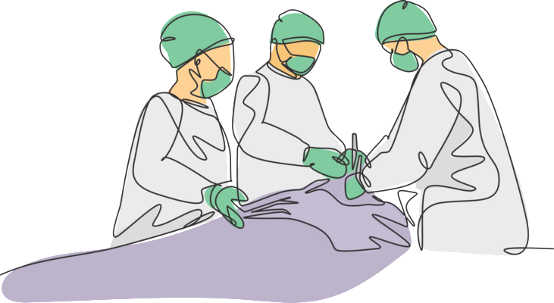
ClinicoPathological conference
Surgical unit ii
By :
ayesha safdar 526
Aimen hassaan 468
Muhammad hassan 542
Pgr : dr. Iqra Hameed

Slide 3

HISTORY
BIODATA
My patient Sardara Mai W/O Manzoor Hussain, 62 years old female, married, muslim, resident of Rajanpur, housewife, presented to Surgical Unit 2 via Emergency on 12th of september 2025 with presenting complaint of:
PAIN in right upper abdomen for 8 days
YELLOW DISCOLORATION OF EYES for 7 days
VOMITING for one day

Slide 4
History of presenting Illness
My patient was a known case of cholelithiasis for 5 years.
She was in usual state of health 8 days back when she developed pain in right upper abdomen.Pain was;
Gradual in onset
Severe in intensity
Colicky in character
No radiation or shifting of pain
No aggravating factor
Temporarily relieved by pain killer injection(no name documented)
Not Associated with nausea ,diarrhea,constipation or abdominal distension .

Slide 5
History of presenting Illness
After one day she developed yellow discoloration of eyes which was;
sudden in onset
Progressively increasing
No aggravating or relieving factors .
Associated with generalized itching started two days after discoloration ,gradual in onset ,severe ,not associated with skin rash ,no aggravating or relieving factor .
Yellowness of eyes was also associated with clay coloured stools, dark coloured urine ,reduced appetite and fever.
Not associated with heaviness in right hypochondrium .

Slide 6
History of presenting Illness
she had 3 episodes of vomiting 1 day back that was
One cup full in quantity, non-projectile, contained food contents.
Colour of vomitus was yellow.
Related to meal intake (right after she eats anything)
No foul smell.
No aggravating or relieving factor .
Not associated with burning epigastrium , heametemesis, melena , diarrhea , constipation

Slide 7
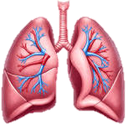
SYSTEMIC HISTORY
RESPIRATORY SYSTEM:
There was no history of cough, Hemoptysis , chest pain, breathlessness or wheezing .

Slide 8
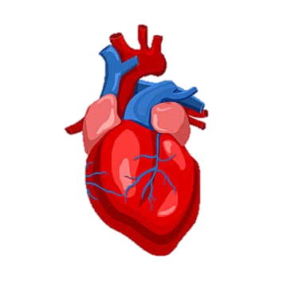
Cardiovascular system
There was no history of:
Orthopnea or PND.
Palpitations
Edema
Chest pain

Slide 9

Central nervous system
There was history of headache .
There was no history of
Vertigo
dizziness
Weakness of any body part
Numbness/Tingling
Syncope, Fits
Visual disturbances
Insomnia , Paraesthesia

Slide 10
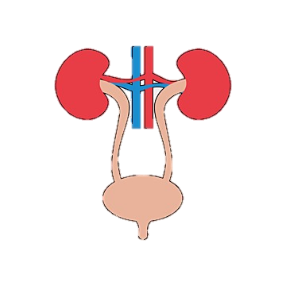
Genitourinary system
There was no history of:
Dysuria,
Hematuria,
Burning micturition,
Pain in flanks,
Incontinence or dribbling,
Urethral discharge.

Slide 11
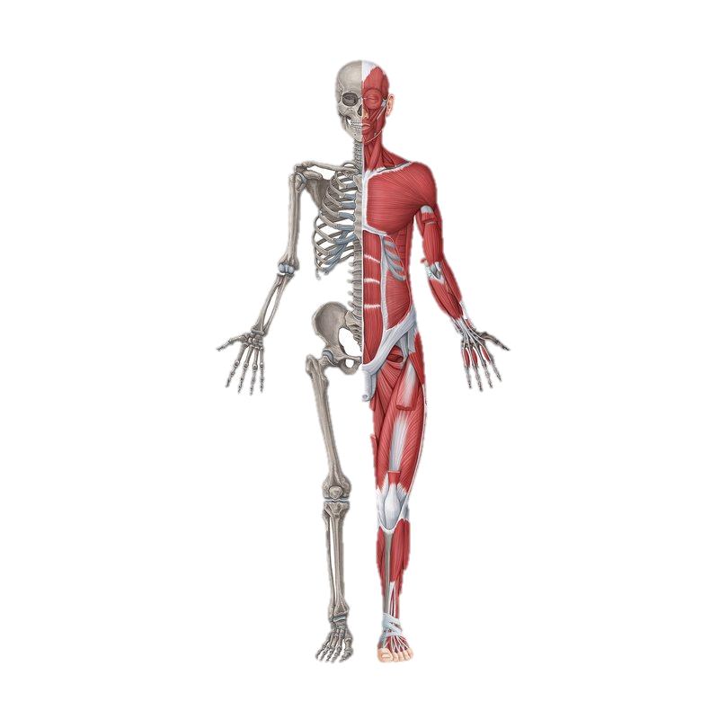
Musculoskeletal system
There was no history of:
Weakness, paralysis, contracture
Pain/stiffness of joints
Pain/stiffness of back
difficulty in movements

Slide 12
Endocrine system
No polyuria, polydipsia
No heat or cold intolerance

Slide 13

Past Medical History
No HTN, DM, TB, IHD
No prior hospitalization
No prolonged use of any medications
No history of blood transfusion or trauma

Slide 14

Past Surgical History
There is history of hysterectomy 10 years back .

Slide 15

Family History
No history of HTN, DM, TB, IHD, Hepatitis in the family
No history of similar illness .

Slide 16
Personal History
No History of smoking .
Sleep was normal, but appetite was reduced
There was no history of;
Altered bowel habits .
Significant weight changes .

Slide 17
Gynaecological history
She has 4 sons and 9 daughters .
She had menarche at 14 years of age .
Menopause at 45 years of age .

Slide 18
Socioeconomic History
Lives in her own non-cemented house.
There are 2 rooms with 6 family members .
Use unfiltered tap water
one earning person : Earns around 20 thousand Rs/month.

Slide 19
EXAMINATION

Slide 20
General Appearance:
I have examined an old aged female of average weight and height with following vitals:
BP: 100/60 mm Hg
Temp:100 Fahrenheit
Pulse: 75bpm
RR:18 breaths/min

Slide 21
General physical examination
On hands : No clubbing, koilonychias, leukonhychia, palmer erythema, or cyanosis
In eyes : conjunctival pallor and jaundice present
No neck swelling
JVP was not raised
No lymph nodes were palpable
No pedal edema

Slide 22
GIT examination
On inspection: Abdomen was flat
umbilicus was of normal shape, inverted and central
Previous hysterectomy scar was present in hypogastrium.
No visible mass, striae, veins and pulsations.

Slide 23
GIT examination
Palpation:
On light palpation : no guarding or rigidity
On deep palpation : abdomen was soft & tender , tenderness in right hypochondrium
No mass palpable
On visceral palpation: No visceras are palpable.

Slide 24
GIT examination
Percussion: upper border of liver in right 5th intercostal space. No fluid thrill and shifting dullness.
Auscultation: Normal bowel sounds audible. No hepatic or renal bruit

Slide 25
Respiratory examination
Inspection: Respiratory rate 18 breaths/Min. respiratory movements are equal on both sides , no deformity present, respiration is thoracoabdominal
Palpation: Trachea central , no tenderness , crepitus , vocal fremitus is normal on both sides
Percussion: resonant all over the chest
Auscultation: normal vesicular breathing , no added sounds , vocal resonance normal

Slide 26
Cardiovascular system
Inspection : no chest deformity, bulging, scars , pulsations
Palpation: Apex beat in left 5th ICS medial to mid clavicular line , No parasternal heave or thrill present.
Auscultation: normal 1st and 2nd heart sound, no added sounds

Slide 27
CNS examination
Patient was alert and well oriented with time, place, and person.
Higher mental functions were intact.
GCS was 15/15.
Motor system : intact
Sensory system : intact
SOMI : negative

Slide 28

INVESTIGATIONS

Slide 29
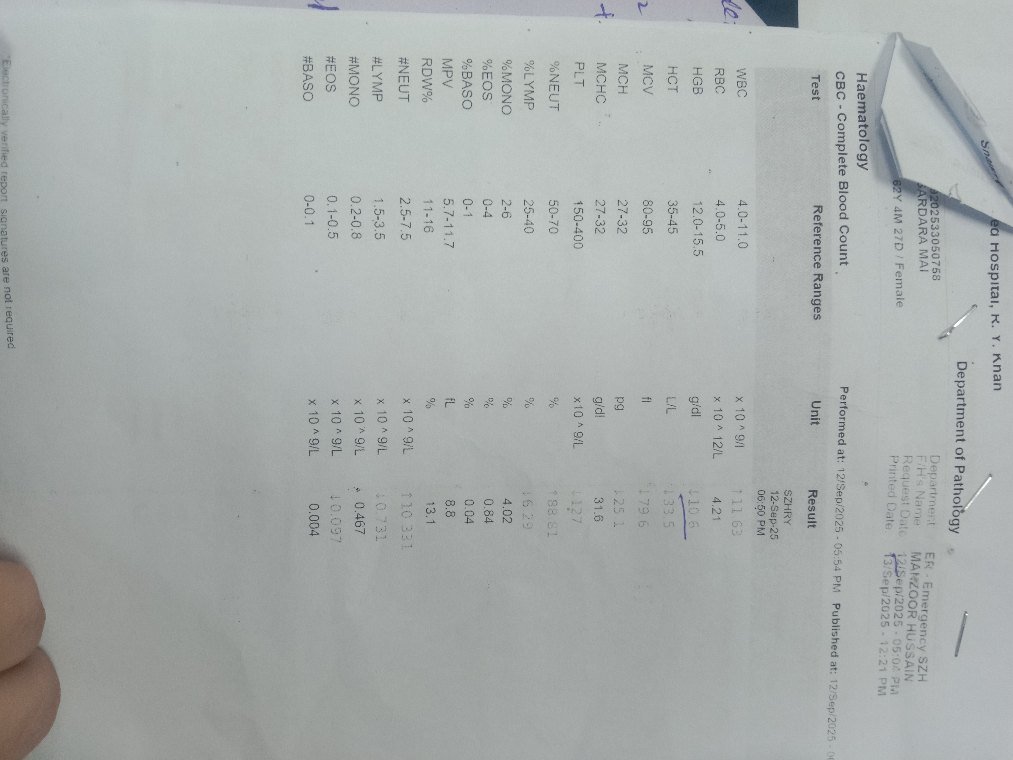
cbc
WBC : 11.63 X 10^9/L
  Ref range: 4-11 X 10^9/L
HB: 10.6 g/dl
  Ref range: 12-15.6 g/dl
PLATELETS : 127 X 10^9/L
  Ref range: 150-400 X 10^9/L

Slide 30
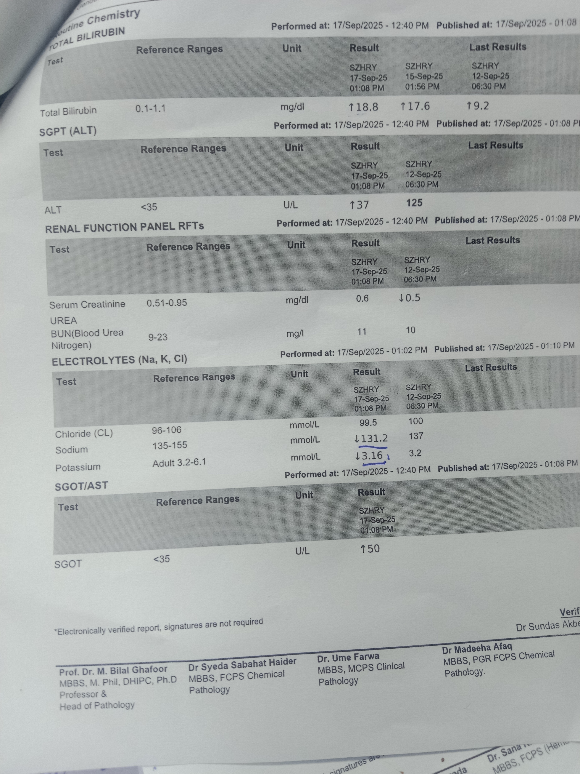
lfts
ALT : 125 U/L [RAISED]
  Ref range: <35 U/L
AST : 50 U/L [RAISED]
  Ref range: <30 U/L
GGT : 386 U/L [RAISED]
  Ref range: <38 U/L
ALKALINE PHOSPHATASE : 1355 U/L [RAISED]
  Ref range: 596 U/L
RFTS AND ELECTROLYTES : NORMAL

Slide 31
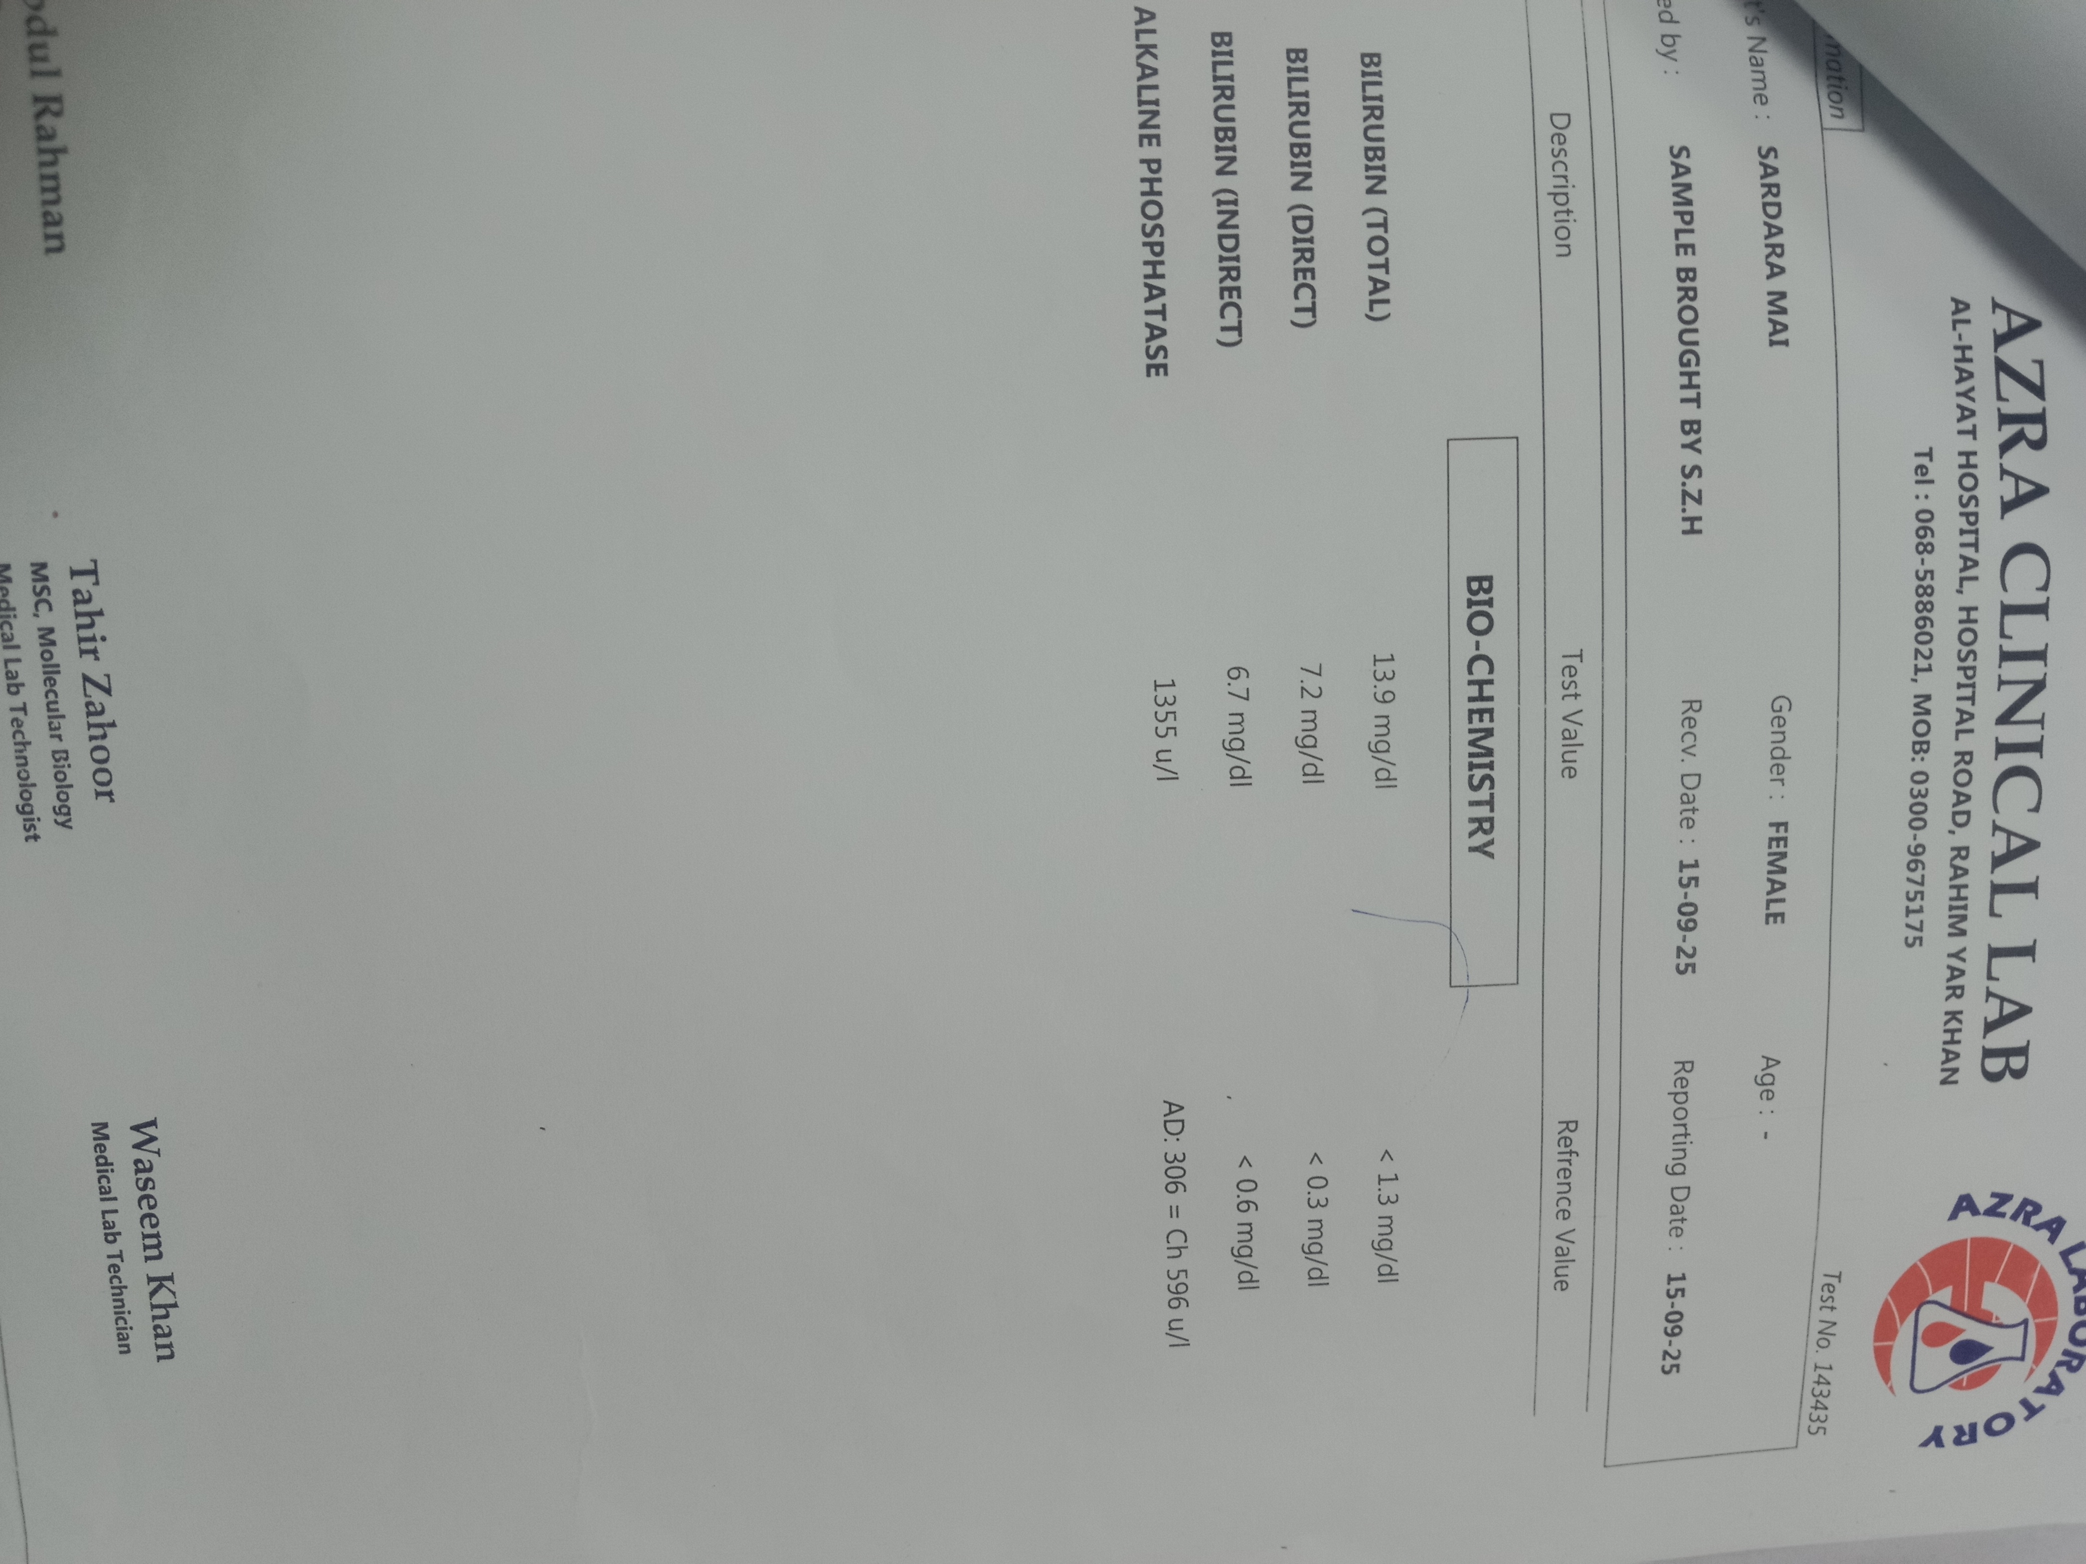
Bilirubin levels
TOTAL BILIRUBIN : 13.9 mg/dl
  Ref range: <1.3mg/dl
DIRECT BILIRUBIN : 7.2 mg/dl
  Ref range: <0.3mg/dl
INDIRECT BILIRUBIN : 6.7 mg/dl
  Ref range: <0.6mg/dl

Slide 32
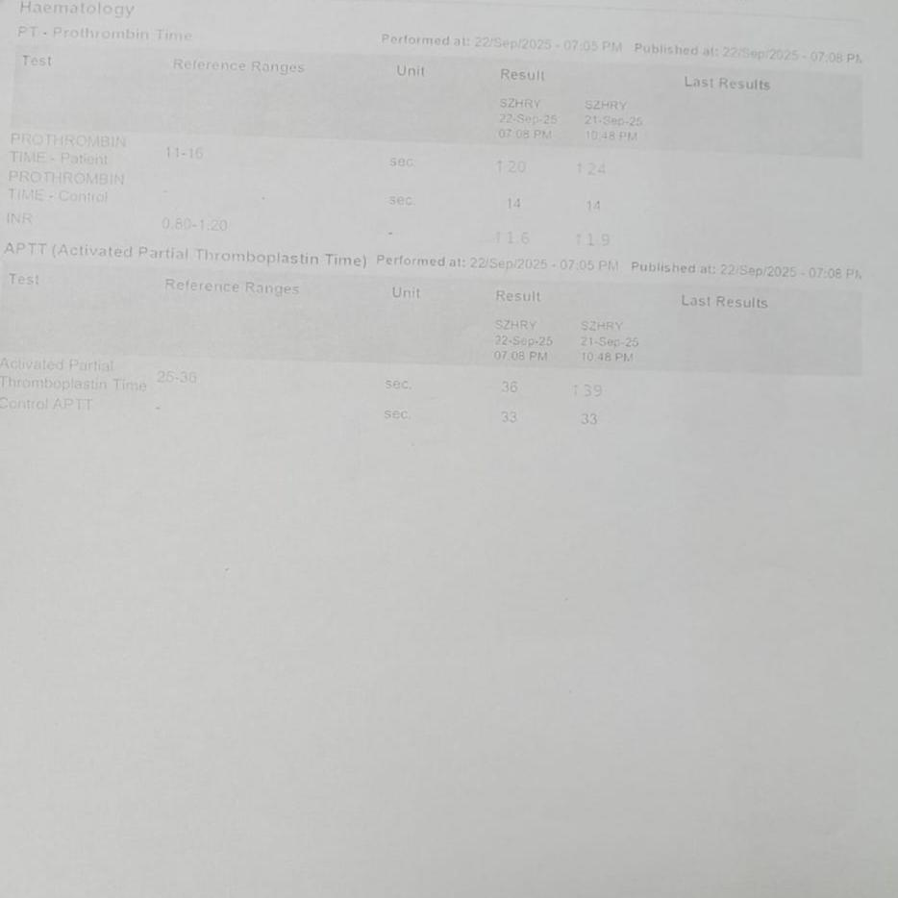
PT, INR, APTT
PT : 24 sec
  Ref range: 14-16 sec
INR : 1.9 sec
  Ref range: 0.8-1.2 sec
APTT : 39 sec
  Ref range: 25-35 sec

Slide 33
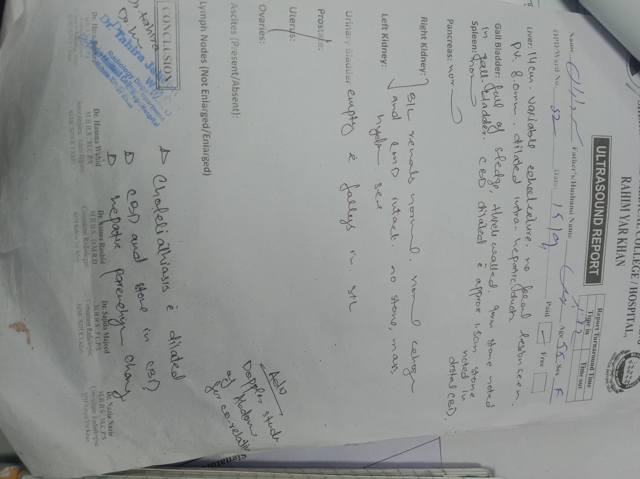
Ultrasound
Ultrasound abdomen shows gallbladder full of stones with dilated CBD and a stone of size 1.5cm in distal CBD as well

Slide 34
DIFFERENTIAL DIAGNOSIS

Slide 35
Differential Diagnosis.
Obstructive jaundice due to choledocolithiasis
Acute cholangitis
CHOLELITHIASIS /MIRIZZI SYNDROME
Ca head of pancreas
cholangiocarcinoma
CBD strictures

Slide 36
RULLING OUT DIFFERNTIAL DIAGNOSIS
Differential diagnosis | Exclusion points
Acute cholangitis | No high grade fever or rigors at presentation
Mirizzi Syndrome | USG shows distal CBD stone inside duct, not extrinsic compression at cystic duct.
CA Head of pancreas | No palpable gallbladder (Courvoisier negative); no weight loss, no mass on USG.
Cholangiacarcinoma | No hilar mass/stricture on USG; acute stone seen instead.
CBD stricture | History of gallstones; clear obstructing stone on imaging, no prior surgery or trauma to suggest benign stricture.

Slide 37
Final Diagnosis
Obstructive jaundice due to CHOLEDOCHOLITHIASIS

Slide 38
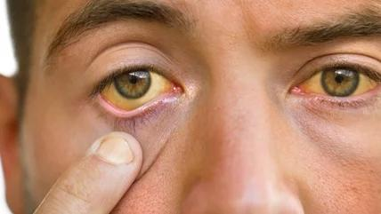
Obstructive jaundice
Presented by
Dr Iqra Hameed
UKSO Prof. Dr Hassan Abbas

Slide 39
Learning objectives
Jaundice and it’s types
Obstructive jaundice
  Etiology
  Presentation
  Investigation
  Management
Choledocholithiasis
  Epidemiology
  Risk factors
  Features
  Complications
  Investigations
  Management

Slide 40

What is jaundice ?
Jaundice is yellowish discoloration of skin , sclera and mucous membranes due to hyperbilirubinemia and deposition of bile pigments.
It is usually detectable clinically when the plasma bilirubin levels exceed 50umol/L i.e. 3mg/dL
Jaundice is not a disease but a clinical sign that can occur in many different diseases

Slide 41
Types of jaundice
Prehepatic or hemolytic jaundice
Hepatic or intra hepatic jaundice
Posthepatic or obstructive jaundice

Slide 42
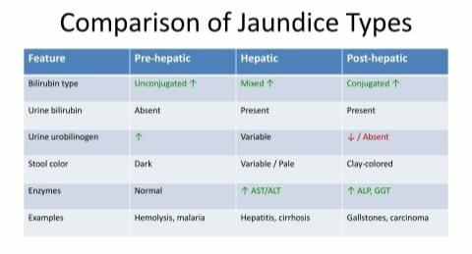

Slide 43
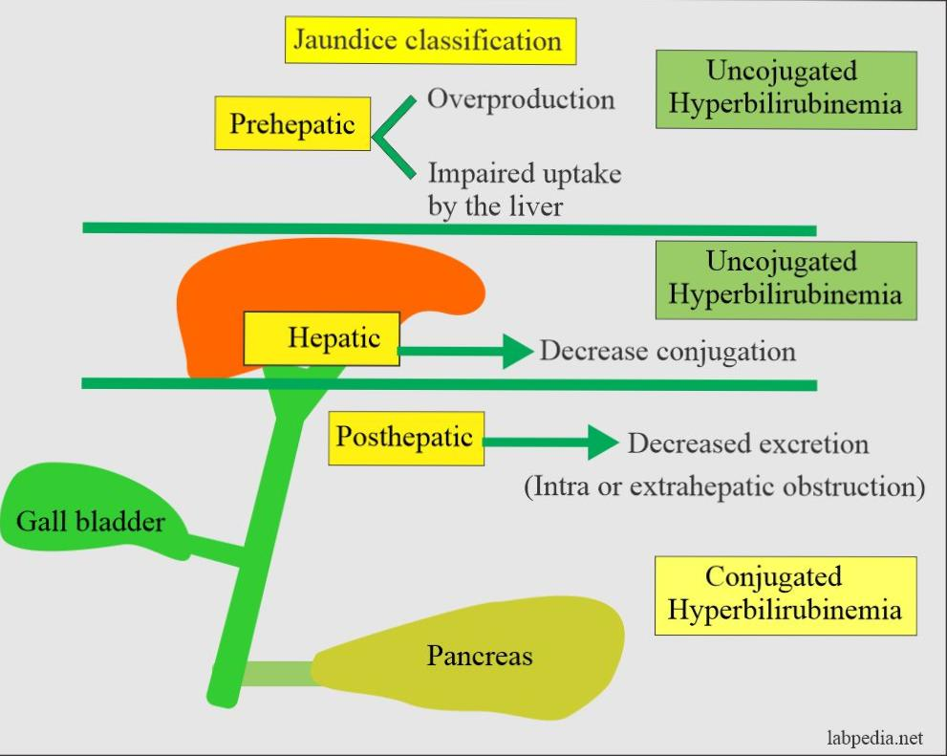
Types of jaundice

Slide 44
Obstructive jaundice
This type of jaundice occurs due to an obstruction in the bile duct , which prevents bile and bilirubin from being excreted into intestines. The bilirubin then backs up in the bloodstream
ETIOLOGY ;
Luminal causes;
Choledocholithiasis
Gallstones [Mirizzi syndrome]
Parasitic infection (ascaris lumbricoids, cholonorchis senesis)

Slide 45
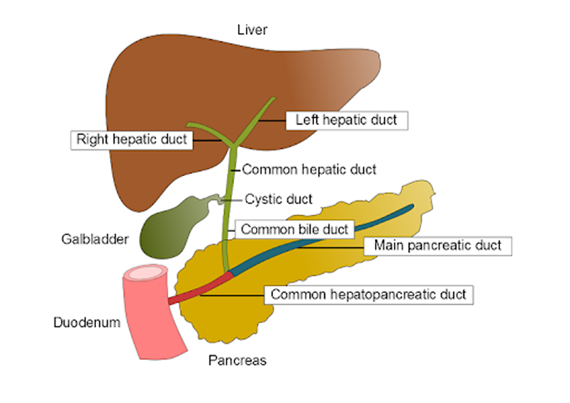
Extrinsic causes
Carcinoma head of pancreas
Ampullary , peri ampullary tumors
Mural causes
Benign Bile duct strictures,
Malignant strictures of bile duct
cholangiocarcinoma

Slide 46
Clinical presentation
Yellowish discoloration of skin and sclera
Dark colored urine
Clay colored stool
Pruritis
RUQ pain
Nuasea , vomiting , anorexia , weight loss
Fatigue ,malaise

Slide 47
LAB investigations
CBC
LFTs { CONJUGATED BILIRUBIN [RAISED] , ALP [ RAISED], GGT [RAISED] AST,ALT [ MILD ELEVATION ]
SERUM PROTEINS AND COAGULATION PROFILE [ PROTHROMBIN TIME
(PT , INR ) PROLONGED ] , SERUM ALBUMIN [ DECREASED]
STOOL AND URINE EXAMINATION{ BILE PIGMENTS AND BILE SALTS PRESENT in urine}
TUMOR MARKERS [CA 19-9 , CEA ] IF MALIGNANCY IS SUSPECTED

Slide 48
IMAGING INVESTIGATIONS
ULTRASONOGRAPHY : 1ST LINE INVESTIGATION
CT ABDOMEN
MRCP [MAGNETIC RESONANCE CHOLANGIOPANCREATICOGRAPHY ] non invasive and excellent for bile duct anatomy and level of obstruction
ERCP invasive , diagnostic + therapeutic e.g . For stent placement , stone extraction
PERCUTANEOUS TRANSHEPATIC CHOLANGIOGRAPHY , alternate when ercp is not available

Slide 49
Management
Improve general condition of patient
supportive measures :
IV fluid and electrolyte correction , nuitritional support , low fat and high protein diet
Pruritis relief with antihistamines or ursodeoxycholic acid
Measures to reduce complications :
Prevention of infective complications
Correction of coagulation disorders
Prevention of renal failure
Prevention of hepatic encephalopathy

Slide 50
Prevention of infective complications
Use of IV prophylactic antibiotics ( cephalosporins , aminoglycosides , pipracillin ) in all jaundice patients :
With rigors and pyrexia
Undergoing emergency biliary preocedures
Elderly patients
With CBD stones even if not jaundiced

Slide 51
Correction of coagulation disorders
Prolonged prothrombin time
in patients of severe hepatic disease due to deficiency of vit K dependant factors
Rx :
vit K injection ,FFPs transfusion

Slide 52
Prevention of renal failure
Hyperbilirubinemia causes renal vasoconstriction which can result in GFR reduction
Rx :
Adequate hydration { iv fluids 5% dextrose saline 12-24 hrs before surgery }
Hourly UOP monitoring

Slide 53
Prevention of hepatic encephalocephathy
Liver failure in ptients with complete bile duct obstruction , chronic hepatocellular disease
If jaundice is severe or impending signs of liver failure :
Percutenous drainage
Endoscopic sphincterotomy in peri-ampullary ca
Promethazine or chlorpromazine for sedation

Slide 54
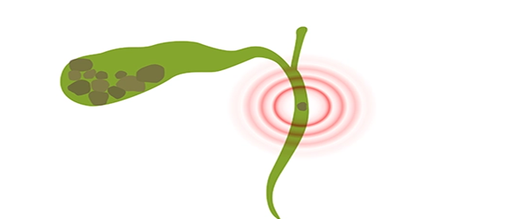
choledocholithiasis
Choledocholithiasis Presence of gallstones in the common bile duct (CBD)
Pathophysiology:
Primary stones: Form de novo in CBD (rare) - brown pigment stones due to bacterial infection, bile stasis
Secondary stones: Migrate from gallbladder (90%) - usually cholesterol or mixed stones

Slide 55
EPIDIMIOLOGY
Prevalence: 8-18% of patients with gallstones develop choledocolithiasis
Age: Peak incidence 50-70 years
Gender: Female predominance (2:1) - decreases with age
Geography: Higher in Western countries

Slide 56
Risk factors
Primary (5 F's)*: Female, Fat, Fertile, Forty, Fair
Secondary:
- Choledochal cysts, biliary strictures
- Previous sphincterotomy
- Periampullary diverticulum
- Duodenal obstruction
- Bacterial infections (E. coli, Klebsiella

Slide 57
Additional Features:
Clay-colored stools, dark urine
Pruritus (bile salt deposition)
Nausea, vomiting
(Courvoisier's sign negative - palpable gallbladder rare)

Slide 58
Complications
Acute Complications:
Acute Cholangitis*:
  - Due to ascending bacterial infection
  - Life-threatening sepsis
  - Requires emergency decompression
Acute Pancreatitis*:
  - Stone impaction at ampulla
  - Gallstone pancreatitis (most common cause)
  - Can progress to necrotizing pancreatitis and can be fatal

Slide 59
Chronic complications
Portal hypertension
Cholangiocarcinoma (rare, long-standing cases)
  Hepatic abscess formation
  Biliary-enteric fistula
  Secondary biliary cirrhosis

Slide 60
Lab investigations
Liver Function Tests:
Obstructive Pattern:
↑↑ Alkaline phosphatase (ALP) - earliest marker
↑↑ Gamma-glutamyl transferase (GGT)
↑ Total/Direct bilirubin (>2mg/dL for jaundice)
↑ ALT/AST (mild-moderate elevation)
Additional Tests:
Complete Blood Count: Leukocytosis in cholangitis
Amylase/Lipase: Elevated in associated pancreatitis
Prothrombin Time: Prolonged due to vitamin K malabsorption
Blood cultures: Positive in 50% cholangitis cases

Slide 61
Diagnostic modalities
NON-INVASIVE:
Ultrasound (USS) - First-line
Computed Tomography (CT)
Magnetic Resonance Cholangiopancreatography (MRCP)
INVASIVE:
Endoscopic Retrograde Cholangiopancreatography (ERCP)
Endoscopic Ultrasound (EUS)
Intraoperative Cholangiography

Slide 62
MANAGEMENT
Medical Management:
Resuscitation: IV fluids, oxygen, monitoring
Antibiotics: Broad-spectrum (second or third generation cephalosporins/Ciprofloxacin + Metronidazole)
Analgesia: Opioids for severe pain
Emergency decompression: Within 24-48 hours if severe
Conservative Options:
Wait and see for small stones (<4mm) - 85% pass spontaneously

Slide 63
Management
Endoscopic Management (First-line):
ERCP + Sphincterotomy + Stone Extraction:
Success rate: 85-95%
Techniques: Balloon extraction, basket retrieval, mechanical lithotripsy
Large stones: Lithotripsy (mechanical/electrohydraulic/laser)

Slide 64
Surgical Management:
Laparoscopic CBDE:
Transcystic approach: For small stones, favourable anatomy
Choledochotomy: For large stones, requires advanced skills
Open Common Bile Duct Exploration (CBDE):
Indications: Failed ERCP, large stones (>2cm), multiple stones
Approaches: Choledochotomy, transduodenal sphincteroplasty
Drainage: T-tube vs. primary closure

Slide 65
OPEN CHOLICYSTECTOMY+CBDE:
OPERATION PREPARTION
Skin prepared in routine manner
Appropriate prophylactic anti-biotics given before surgery
INCISION AND EXPOSURE:
Kocher’s incision is most commonly used but other incisions are also used which includes right transverse or right para-median incision

Slide 66
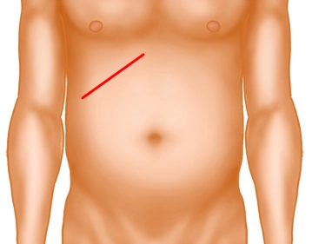
Procedure:
Abdomen is opened through a 7-10cmright upper quadrant incision parallel to the costal margin (kocher’s incison)
Skin subcutaneous tissue and anterior rectus sheath is incised
Rectus abdominis is incised transversely

Slide 67
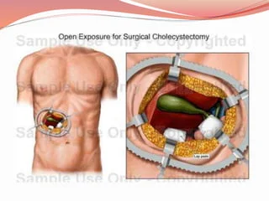
Peritoneum is opened
Gall bladder is examined and three sponges are placed around the gall bladder. These sponges are retracted with deaver’s retractor by assistants.
  The first packs the colon downwards
  Second is placed to retract stomach and duodenum laterally
  Third one is placed over the visceral surface of liver

Slide 68
Choledocotomy / CBD exploration
CBD is palpated which lies anterior to portal vein to right of hepatic artery
Stay sutures placed on anterior CBD wall
Longitudinal incision of almost 1cm is given on anterior wall of CBD and extended with scissors.
CBD was explored proximally and distally with desjardin stone forceps and 2cmx1cm stone was extracted

Slide 69
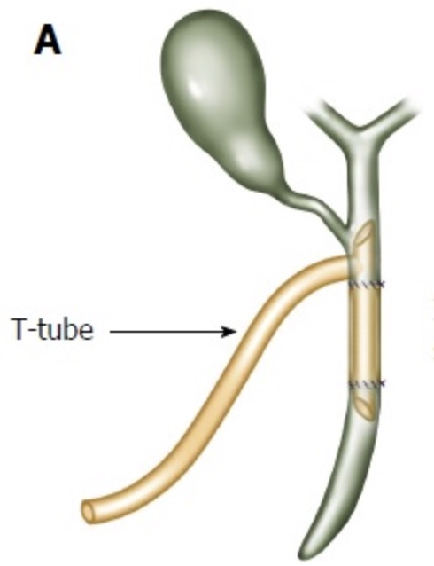
T- Tube placement:
CBD patency was checked by passing a feeding tube and ensuring free flow of saline into the ampulla
T-tube was inserted with short limb to the hepatic duct and long limb to duodenum and secured in place.

Slide 70
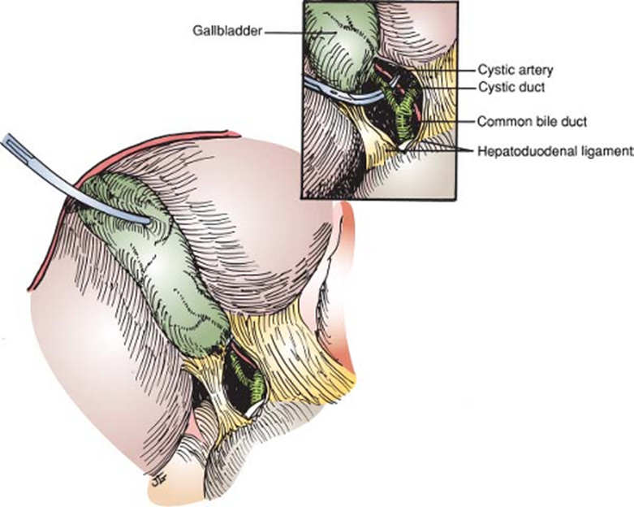
Gall bladder neck retracted laterally and peritoneum overlying calot’s triangle is incised.
Cystic duct and cystic artery ligated and divided.

Slide 71
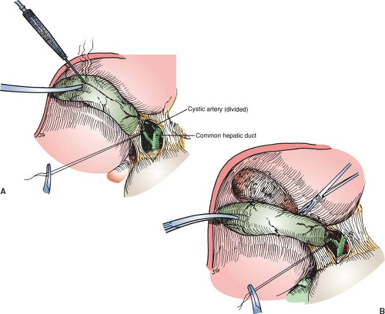
Gall bladder is dissected from the cystic plate.
Dissection begins at the fundus of the gallbladder. Gallbladder being taken off the liver bed with electrocautery.
Sheath, muscles, subcutenous tissue and skin closed respectively

Slide 72
Prognosis and Prevention
Prognosis:
Excellent with prompt treatment:
Endoscopic clearance: 95% success rate
Mortality: <2% with early intervention
Cholangitis mortality: 10-30% if delayed treatment

Slide 73
Long-term Outcomes:
Recurrence rate: 4-24% depending on underlying pathology
Complete stone clearance prevents complications
Normal life expectancy post-treatment

Slide 74
Post-operative Complications of Open Cholecystectomy + CBD Exploration
Early Complications;
Hemorrhage (intra-abdominal / wound)
Bile leak → biliary peritonitis,
Biloma formation
wound infection,
intra-abdominal abscess formation
Respiratory issues → atelectasis, pneumonia (esp. after upper abdominal incision)
Thrombophlebitis / DVT
Retained CBD stone

Slide 75
Late Complications
Biliary stricture → obstructive jaundice,
cholangitis
Incisional hernia
Adhesive intestinal obstruction
Chronic diarrhea / dyspepsia (“post-cholecystectomy syndrome”)

Slide 76
Follow-up Protocol:
  LFTs at 1, 3, 6 months post-treatment
  USG abdomen if symptoms recur
  Long-term monitoring for elderly patients

Slide 77
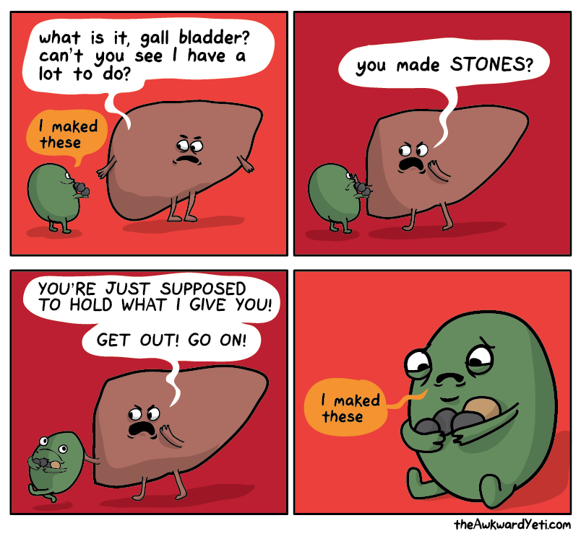

Slide 78
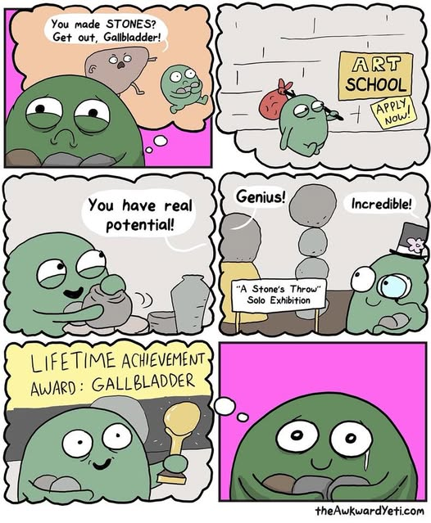

Slide 79
Thank you

