Slide 1
Cerebral venous thrombosis
By:
DR. Sidra Rafique
PGR medical unit 3
Under kind supervision of
DR ZAFAR MAJEED

Slide 2
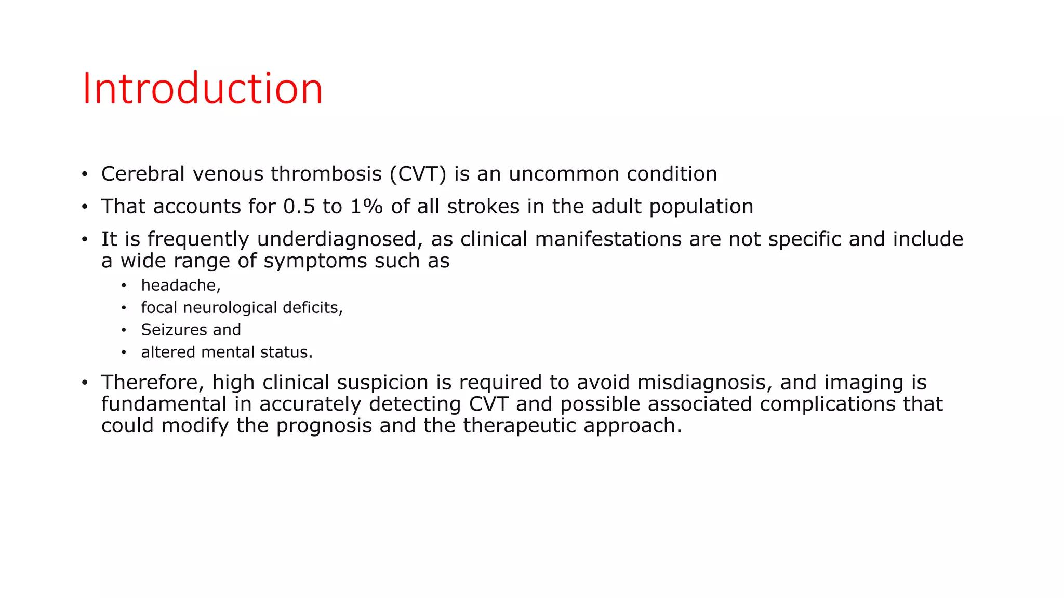

Slide 3
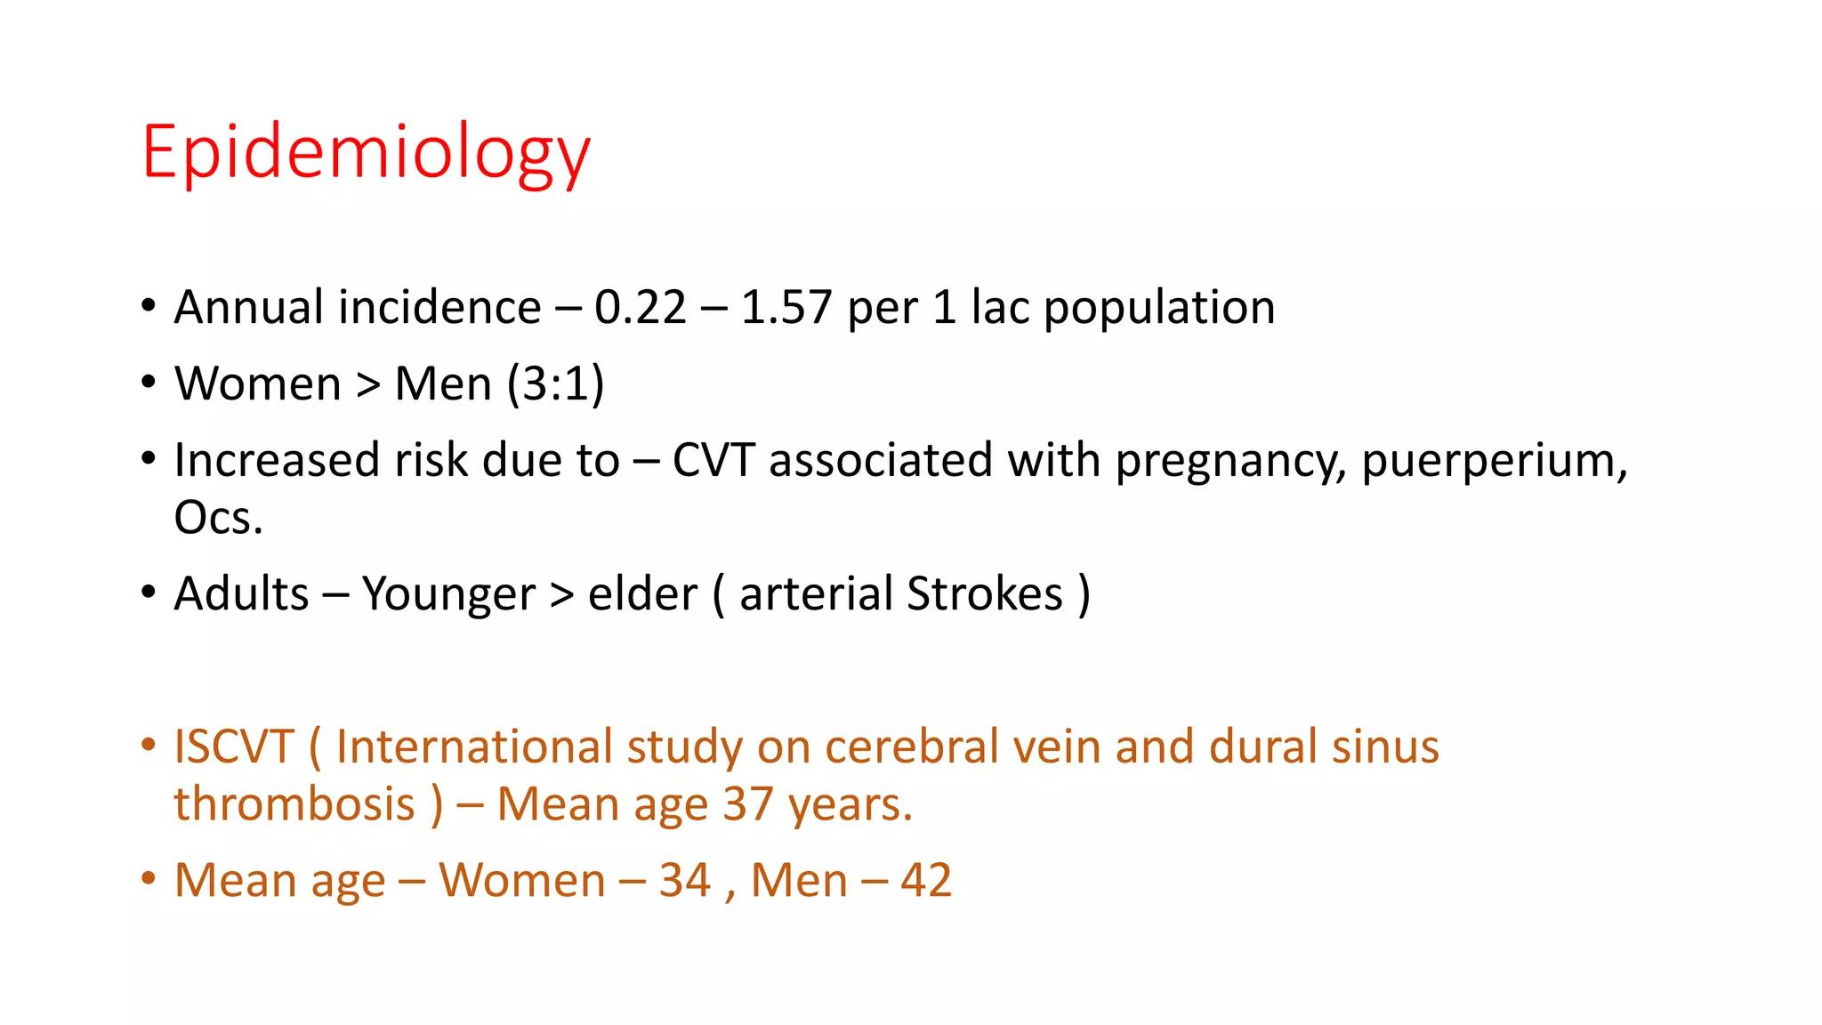

Slide 4
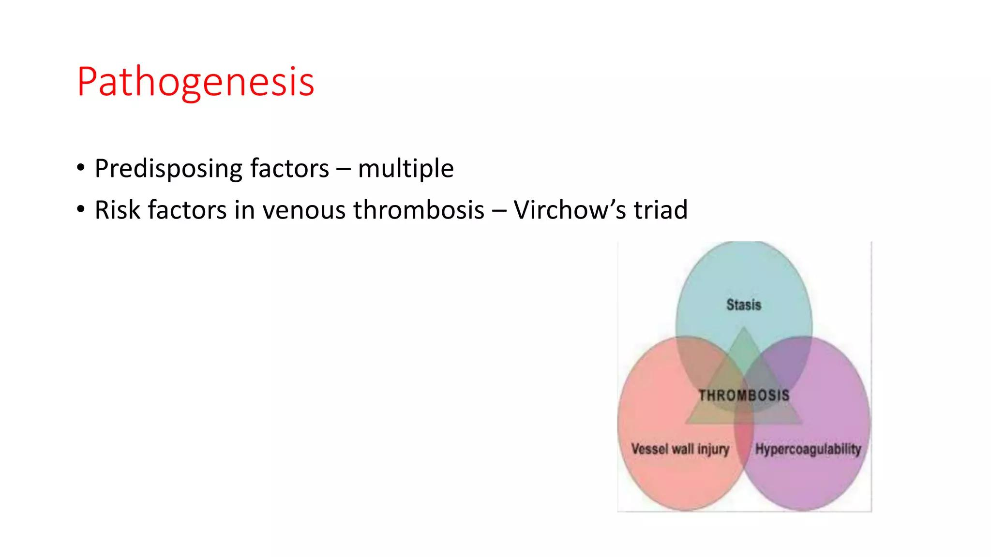

Slide 5
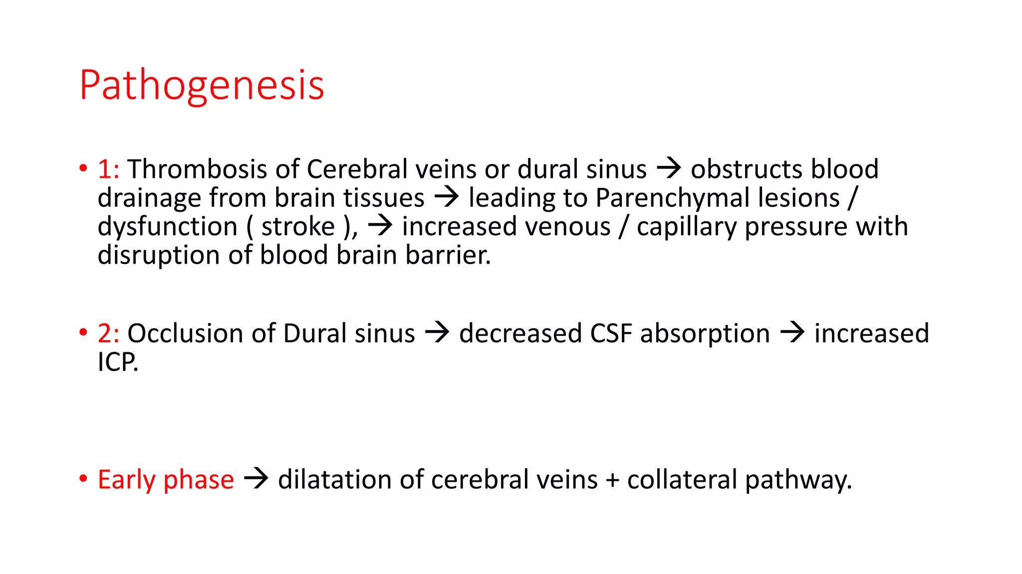

Slide 6
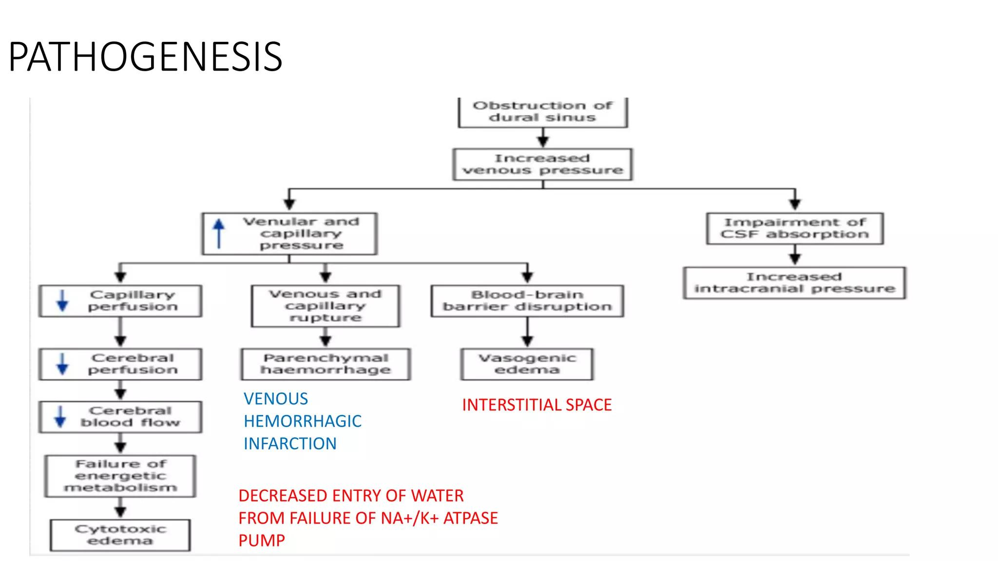

Slide 7
Pathophysiology of Hypercoagulability in PregnancyPregnancy triggers all three components of Virchow’s Triad → hypercoagulability + venous stasis + vascular injury
1. Hypercoagulability
Increased clotting factors:
↑ Fibrinogen (Factor I)↑ Factors VII, VIII, IX, X, XII
↑ von Willebrand factor
Reduced anticoagulants:
↓ Protein S levelsAcquired resistance to Activated Protein C
Reduced fibrinolysis:
↑ Plasminogen activator inhibitors (PAI-1 from endothelium, PAI-2 from placenta) → inhibit tissue plasminogen activator (tPA) → less clot breakdown👉 Result: Shift toward thrombosis (more clot formation, less clot breakdown).

Slide 8
2. Venous Stasis
Enlarged uterus compresses iliac and inferior vena cava veins → slows venous return from lower limbs.Progesterone relaxes vascular smooth muscle → venodilation → further stasis.
Result: Blood pooling, especially in the legs and pelvis → ↑ DVT risk.
3. Vascular Injury
Delivery (especially cesarean section) causes endothelial damage.
Placental separation → exposure of decidual/placental tissue factor (very procoagulant).

Slide 9
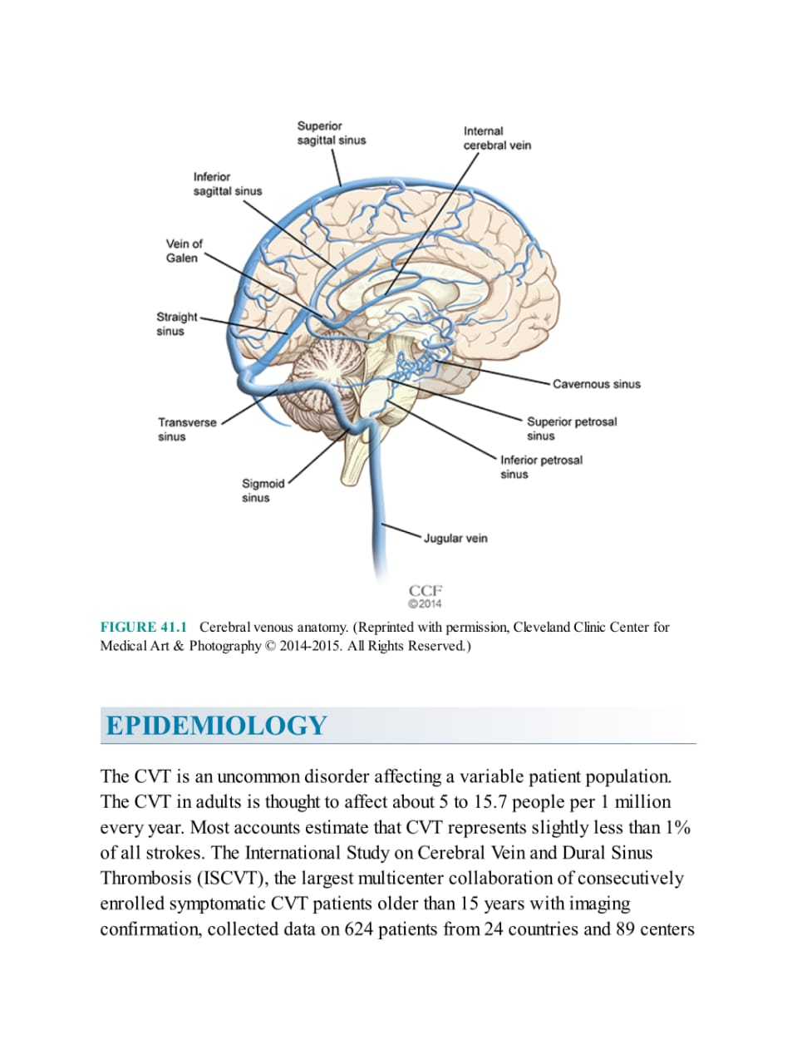

Slide 10
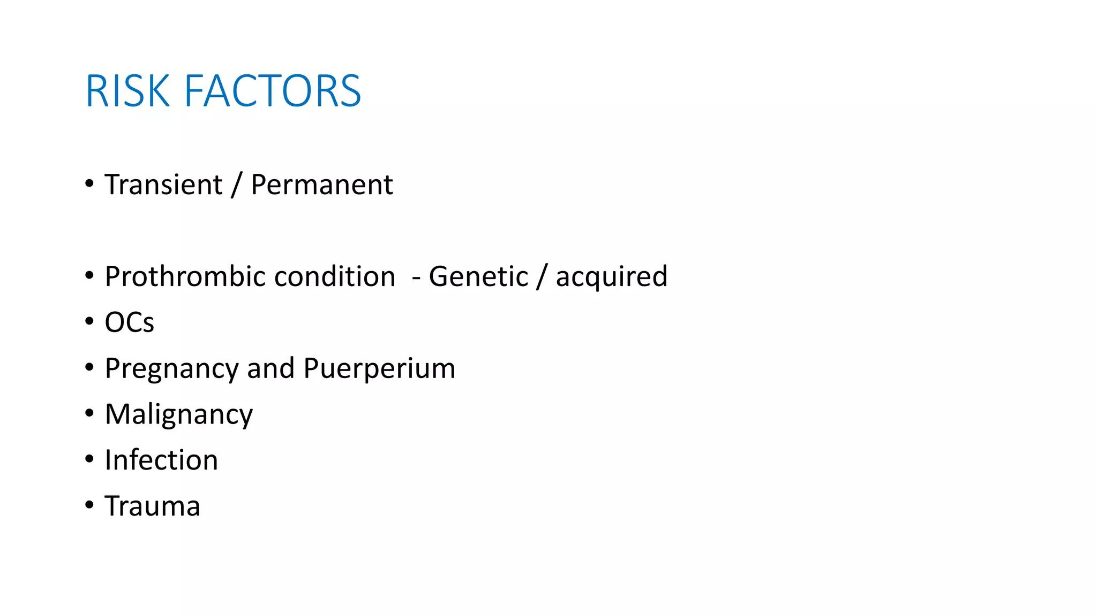

Slide 11
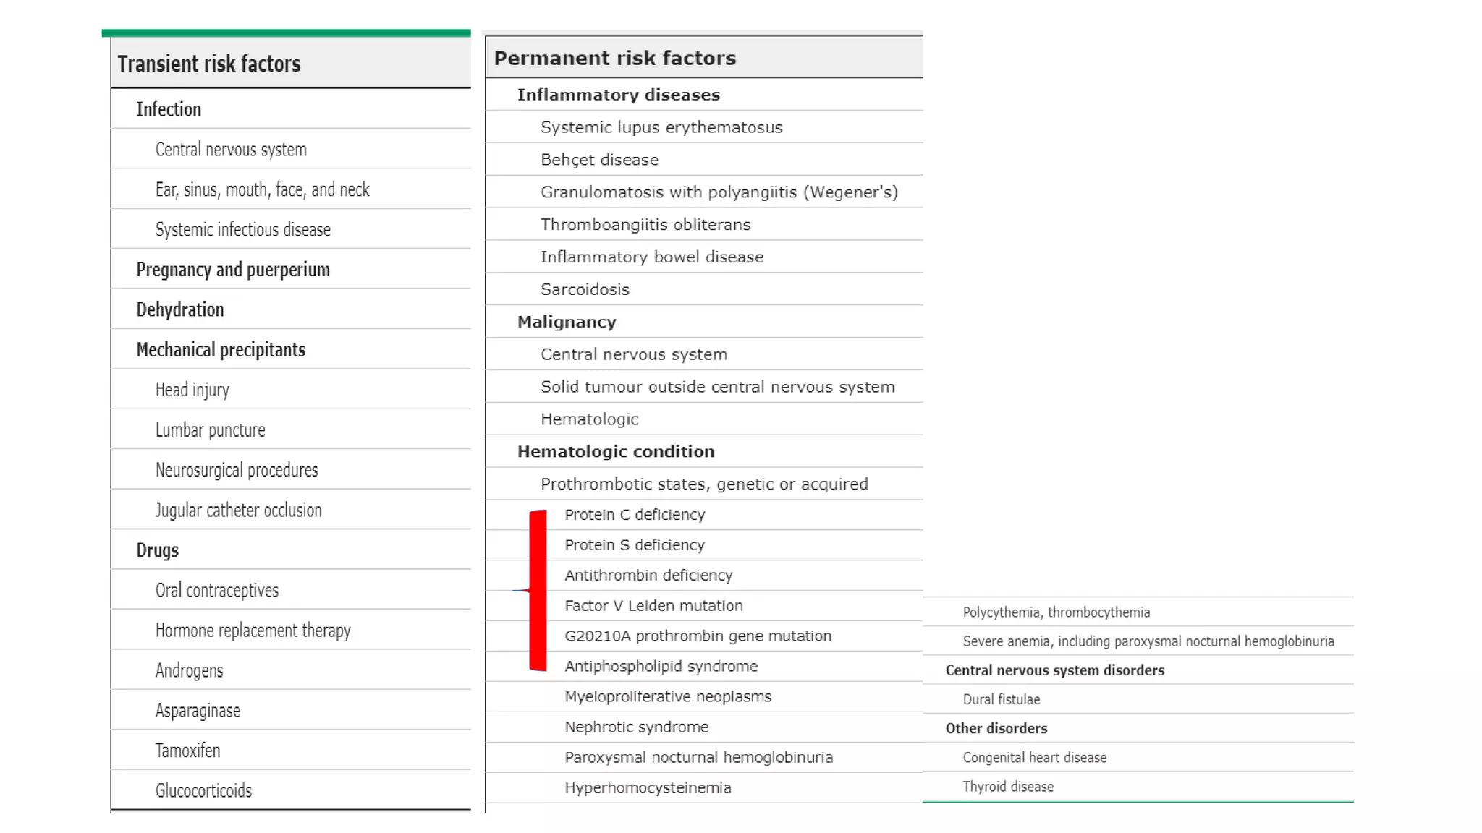

Slide 12
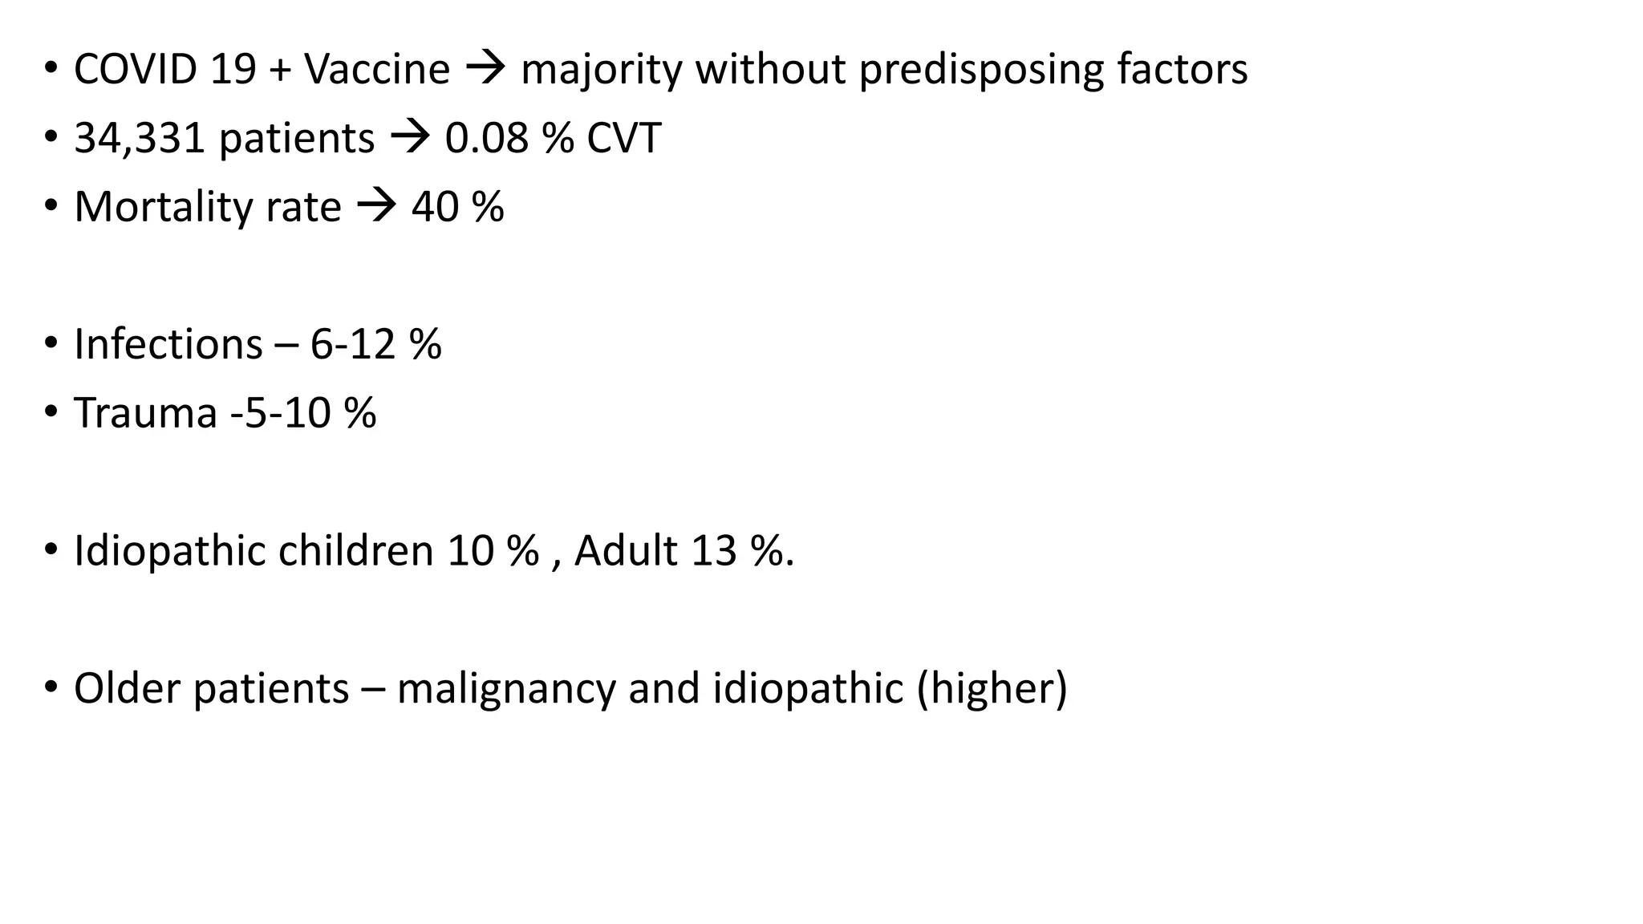

Slide 13
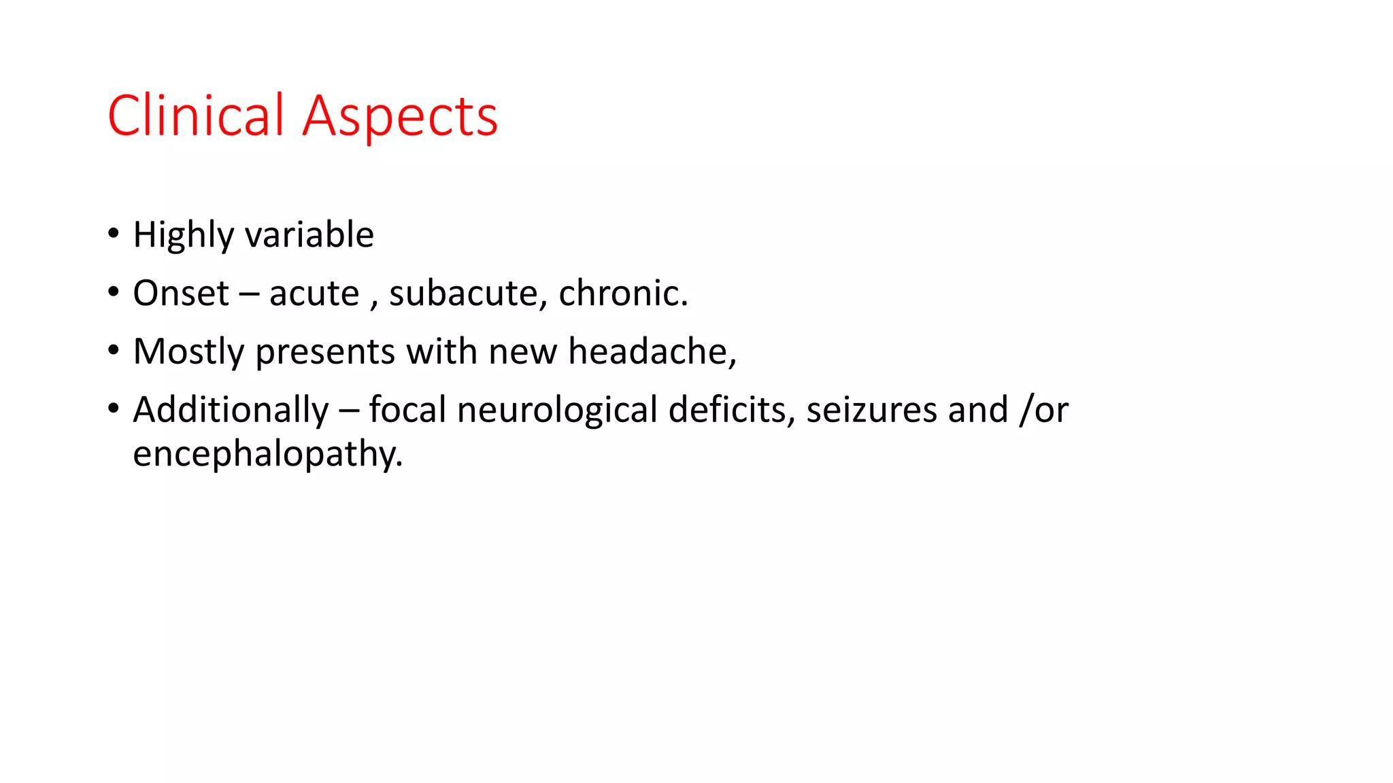

Slide 14
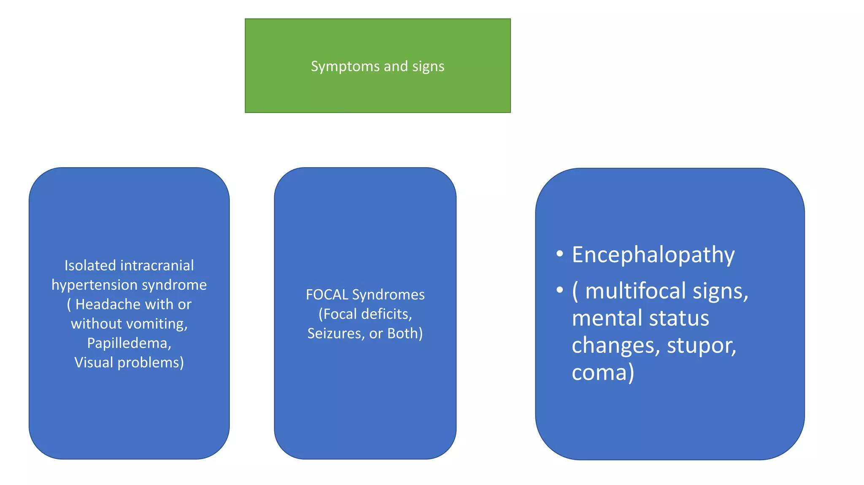

Slide 15
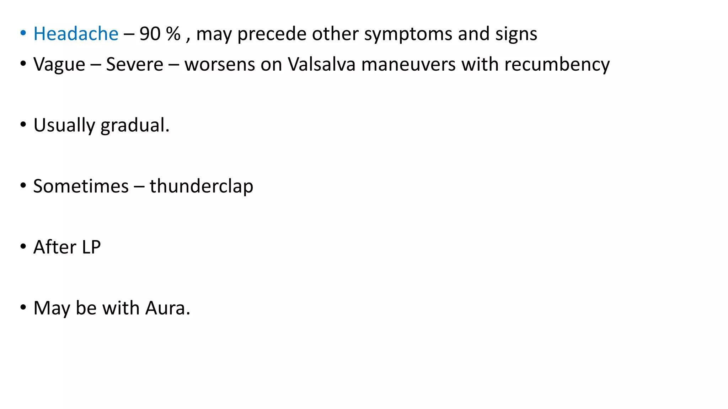

Slide 16
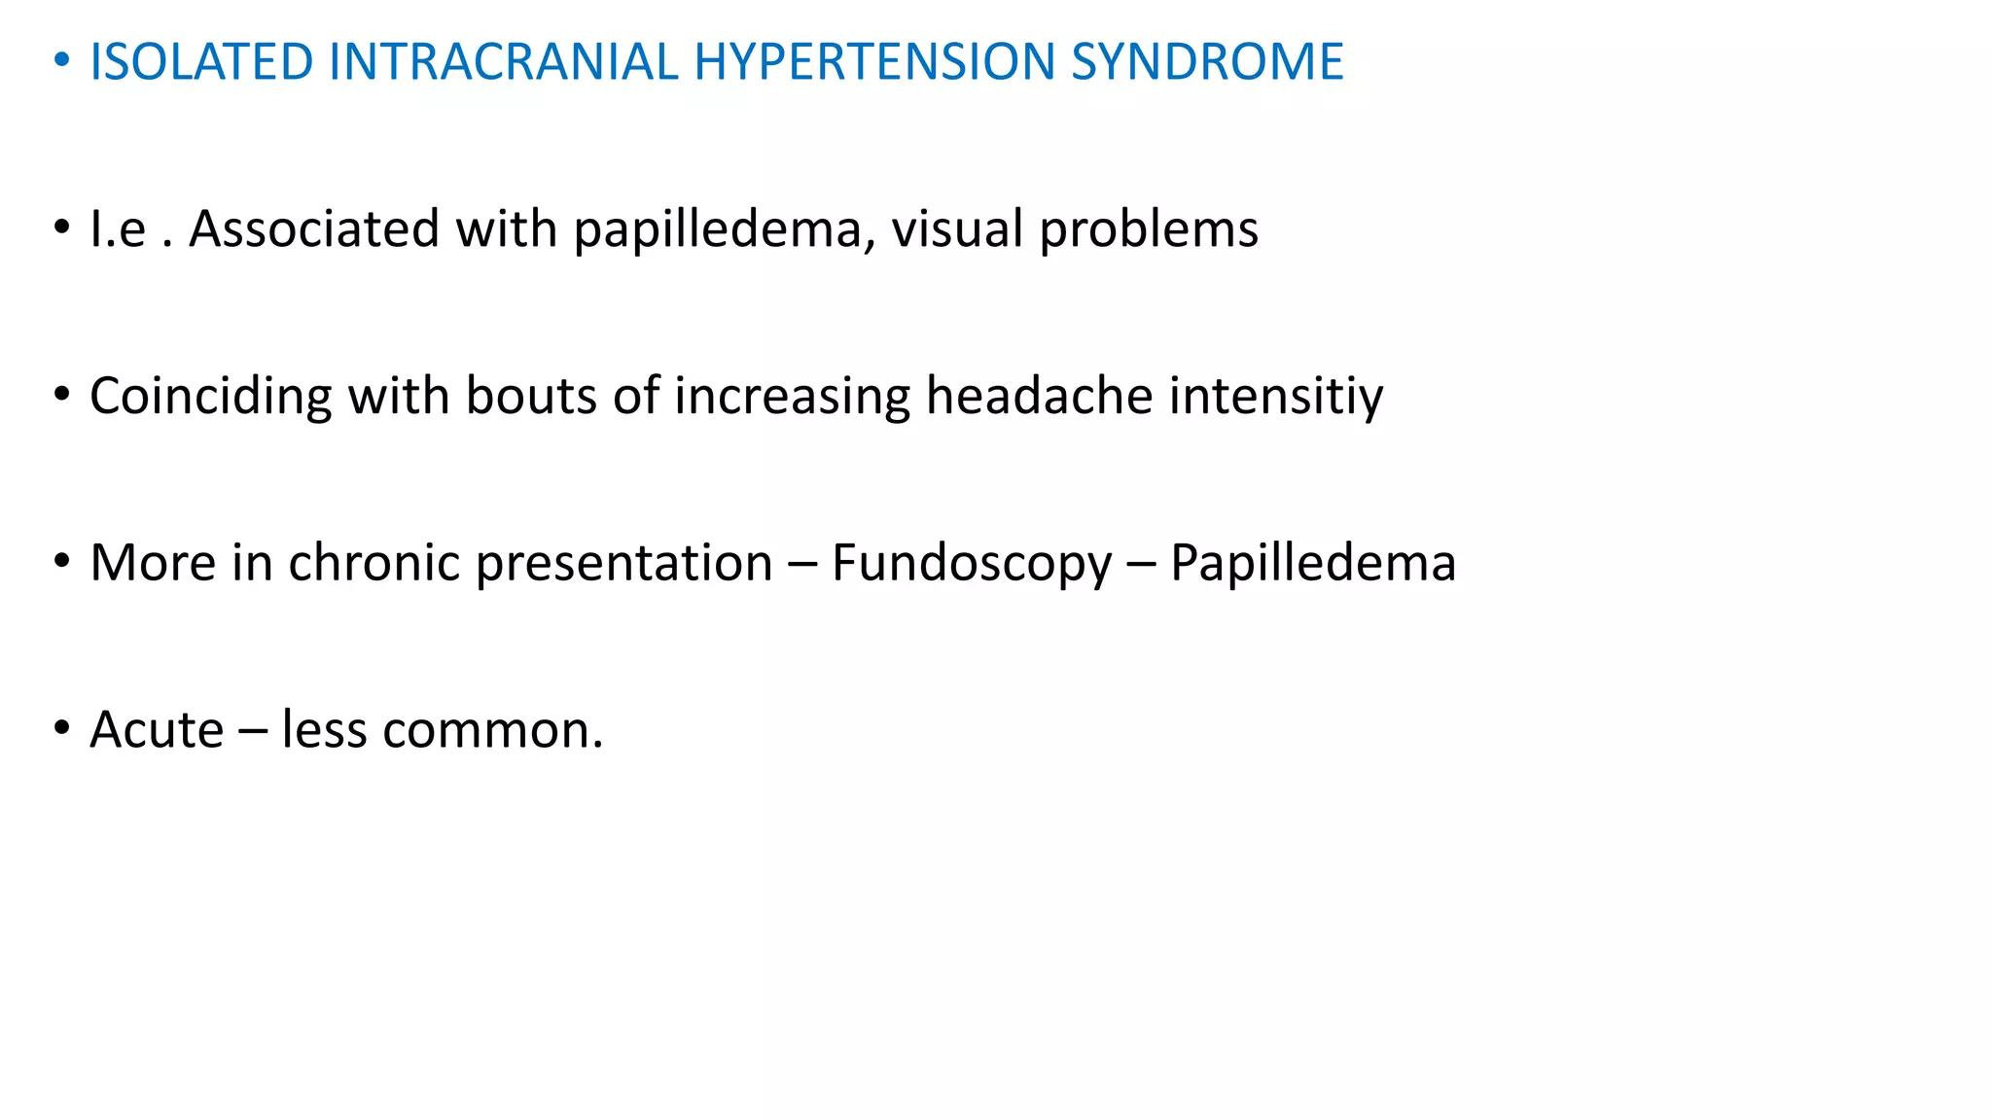

Slide 17
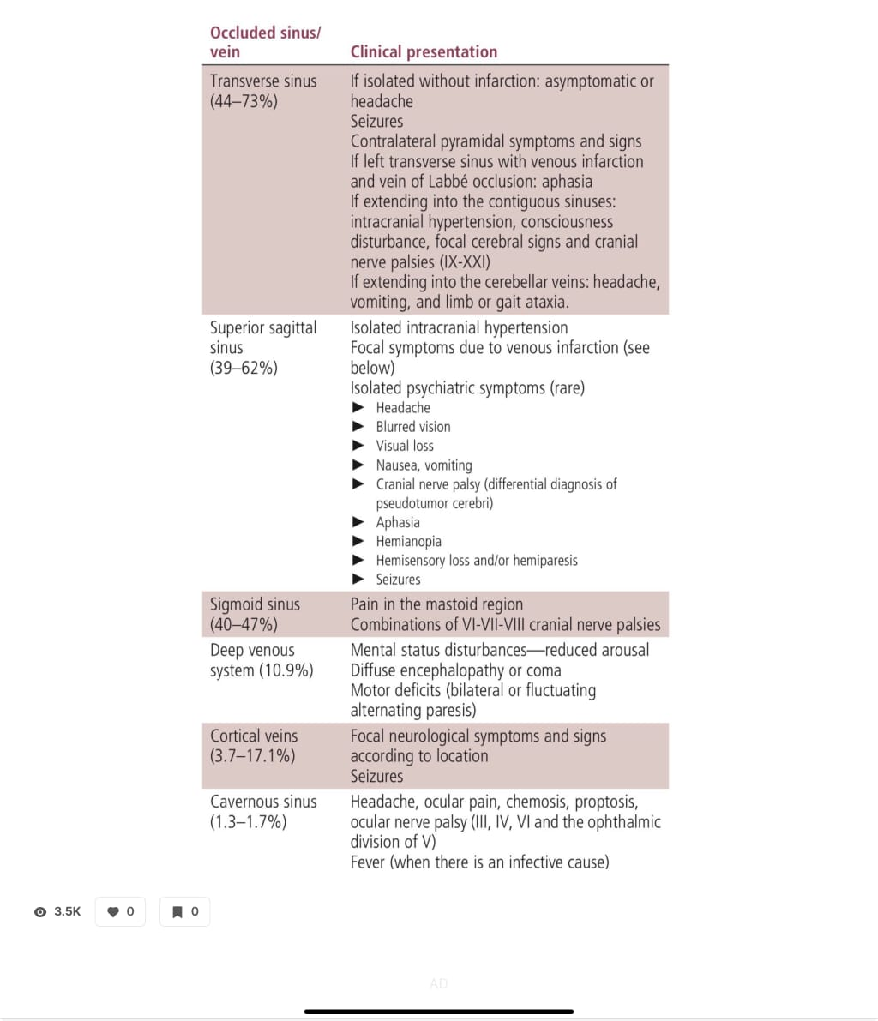

Slide 18
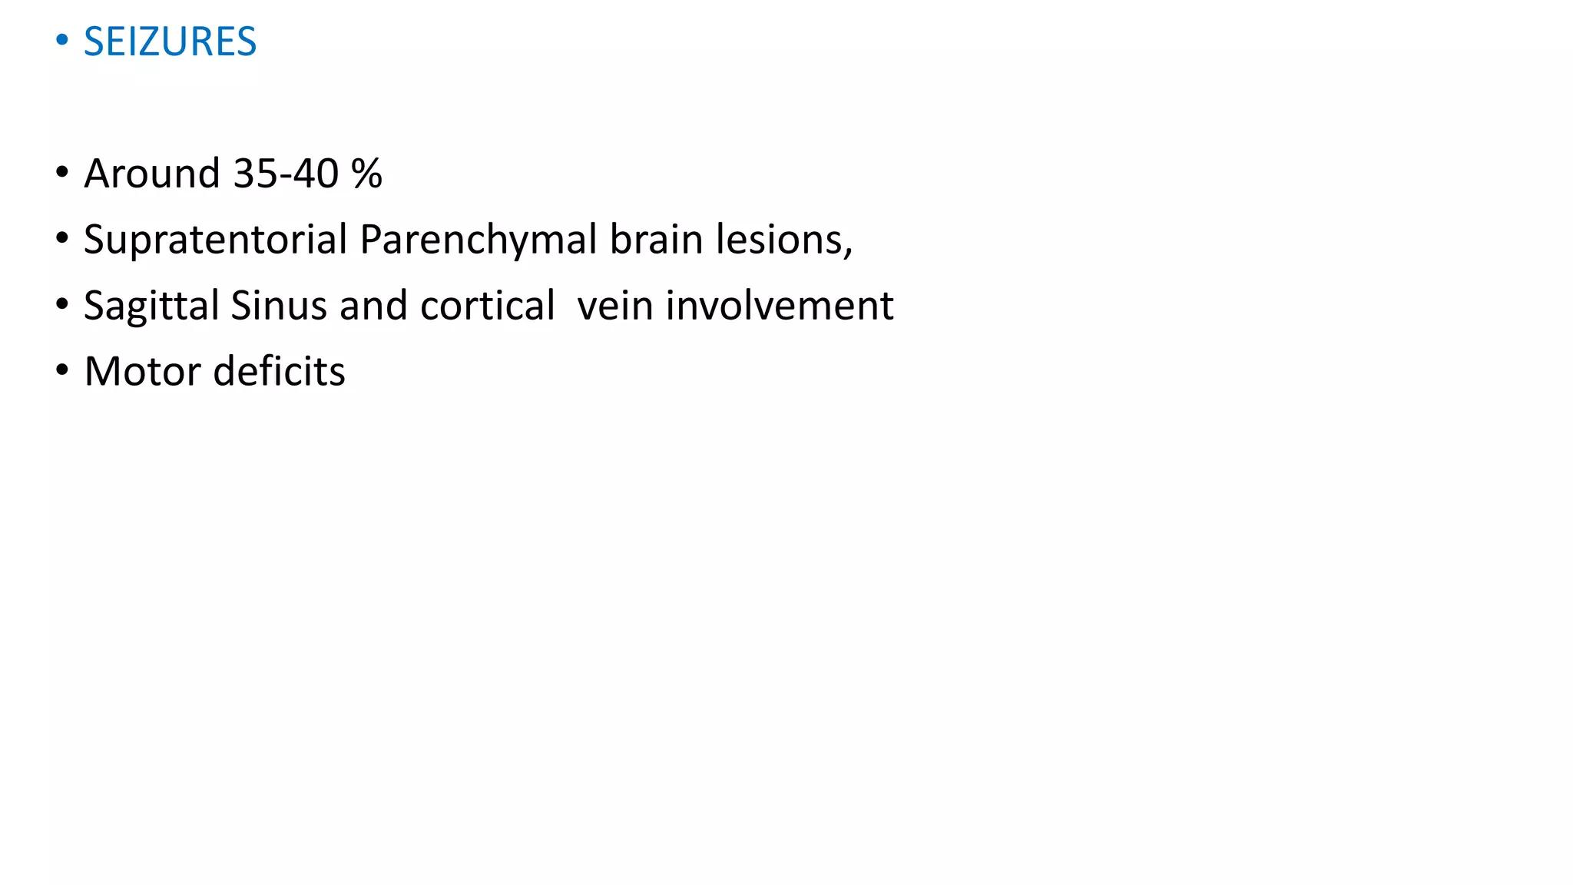

Slide 19
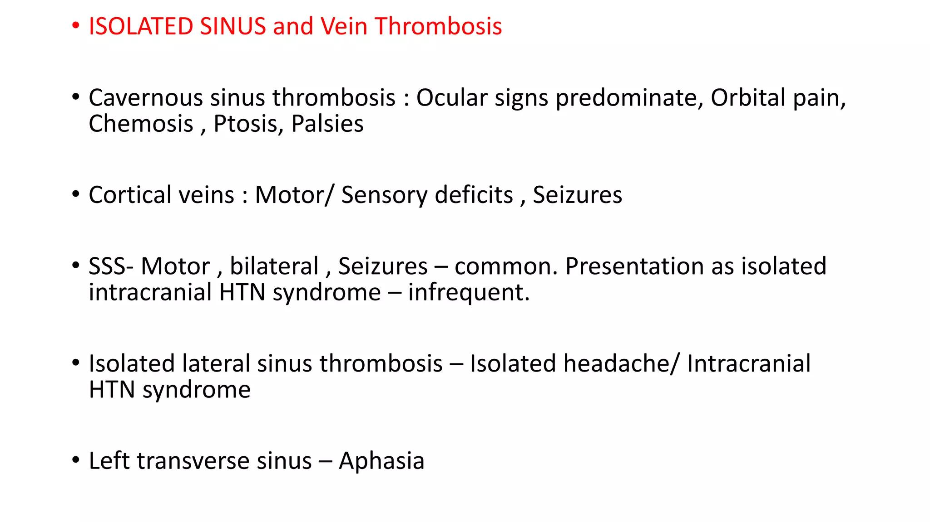

Slide 20
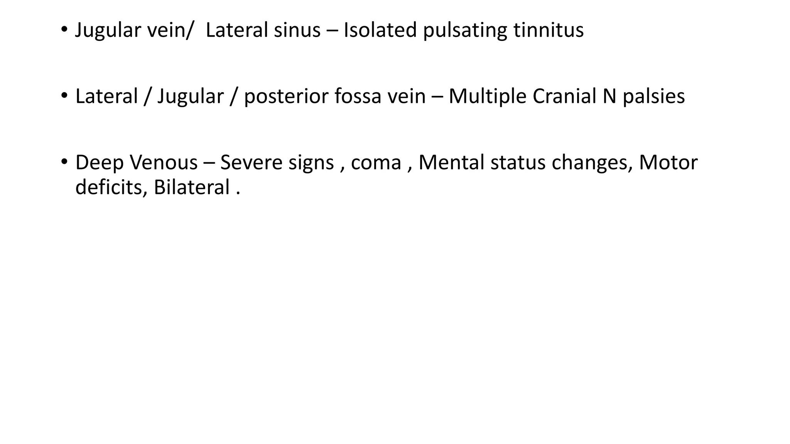

Slide 21
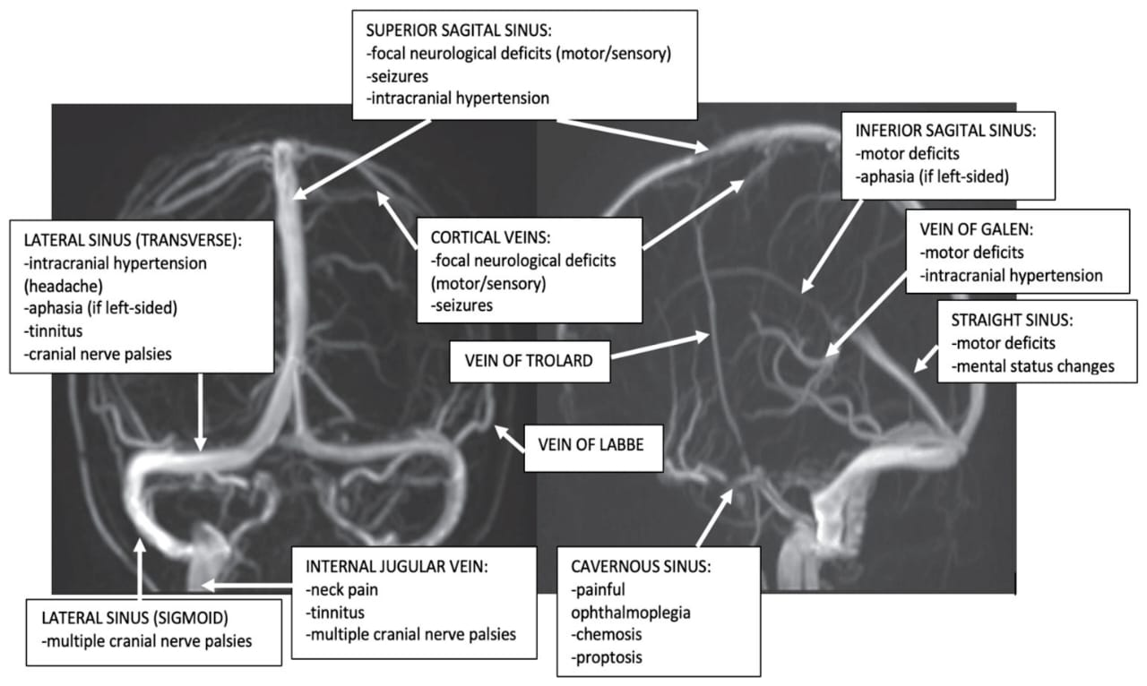

Slide 22
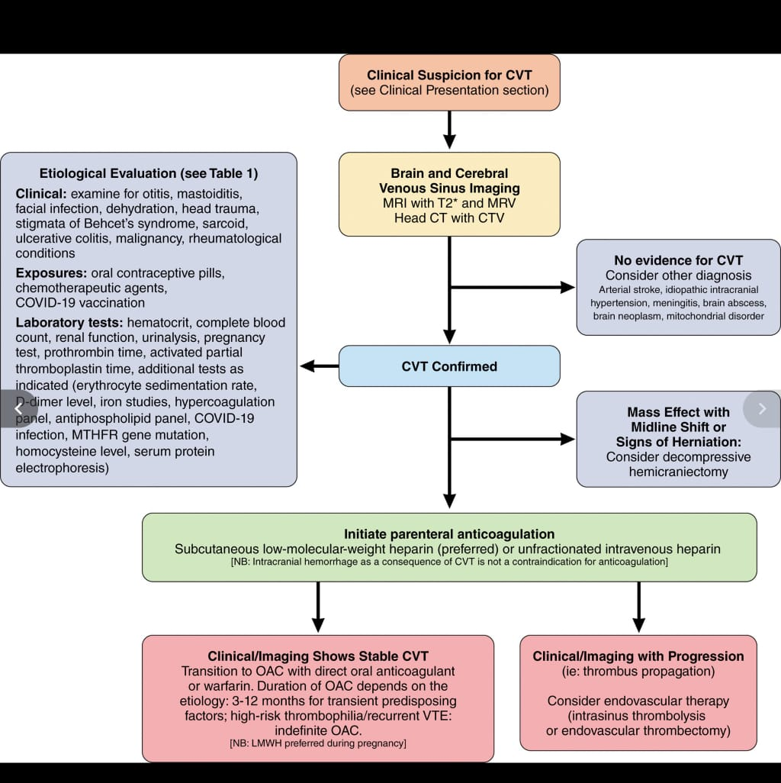

Slide 23
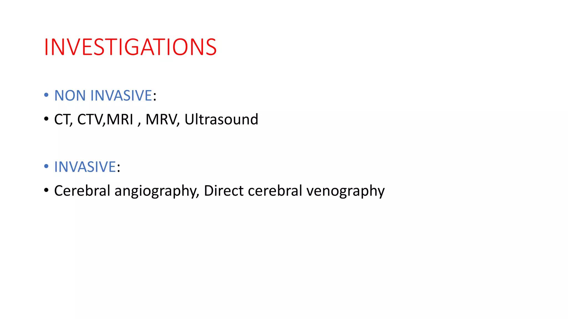

Slide 24
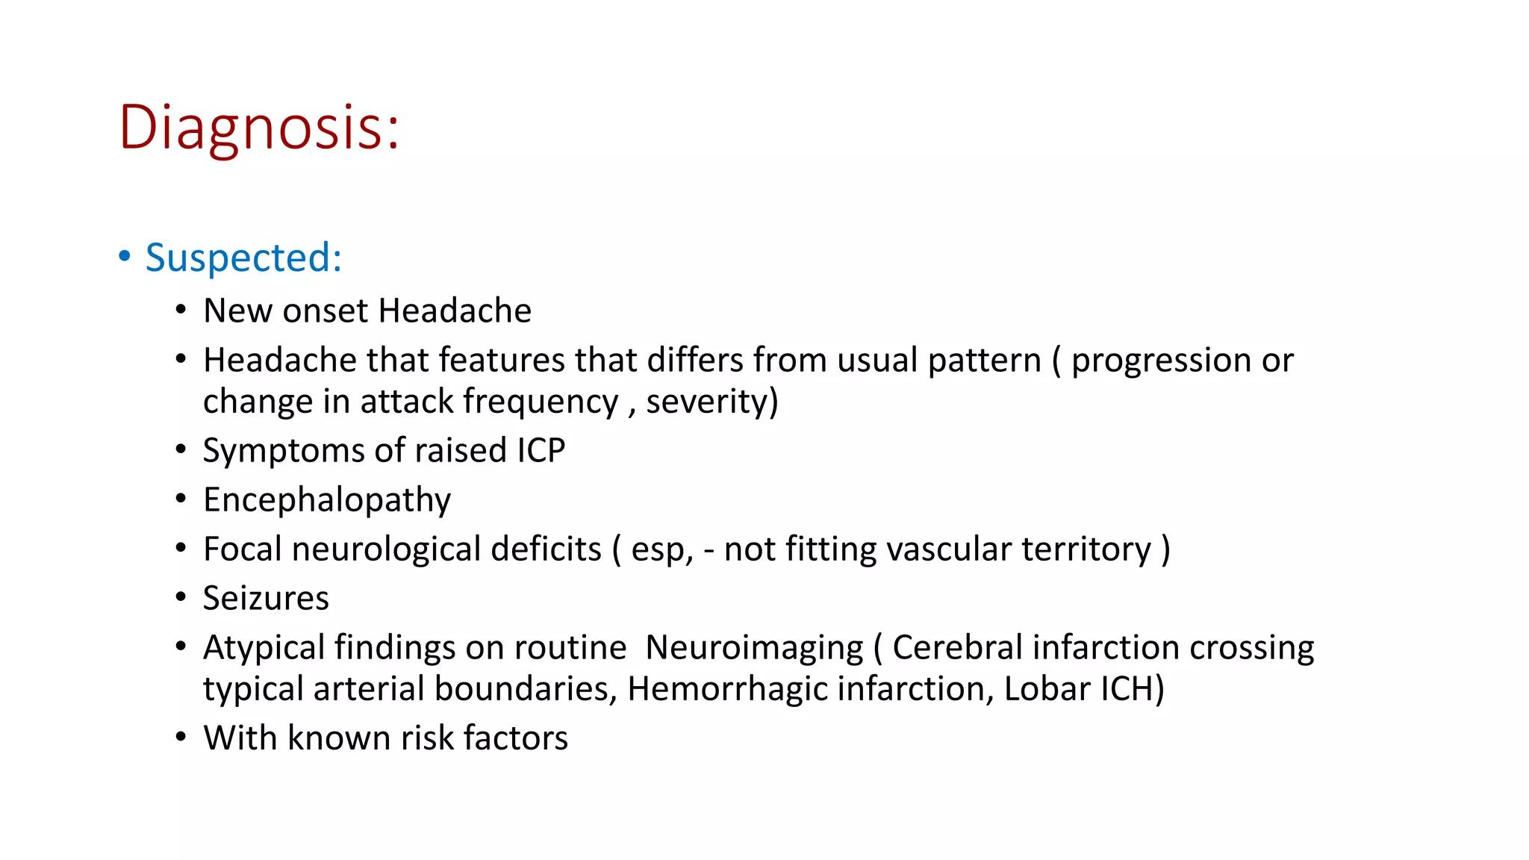

Slide 25
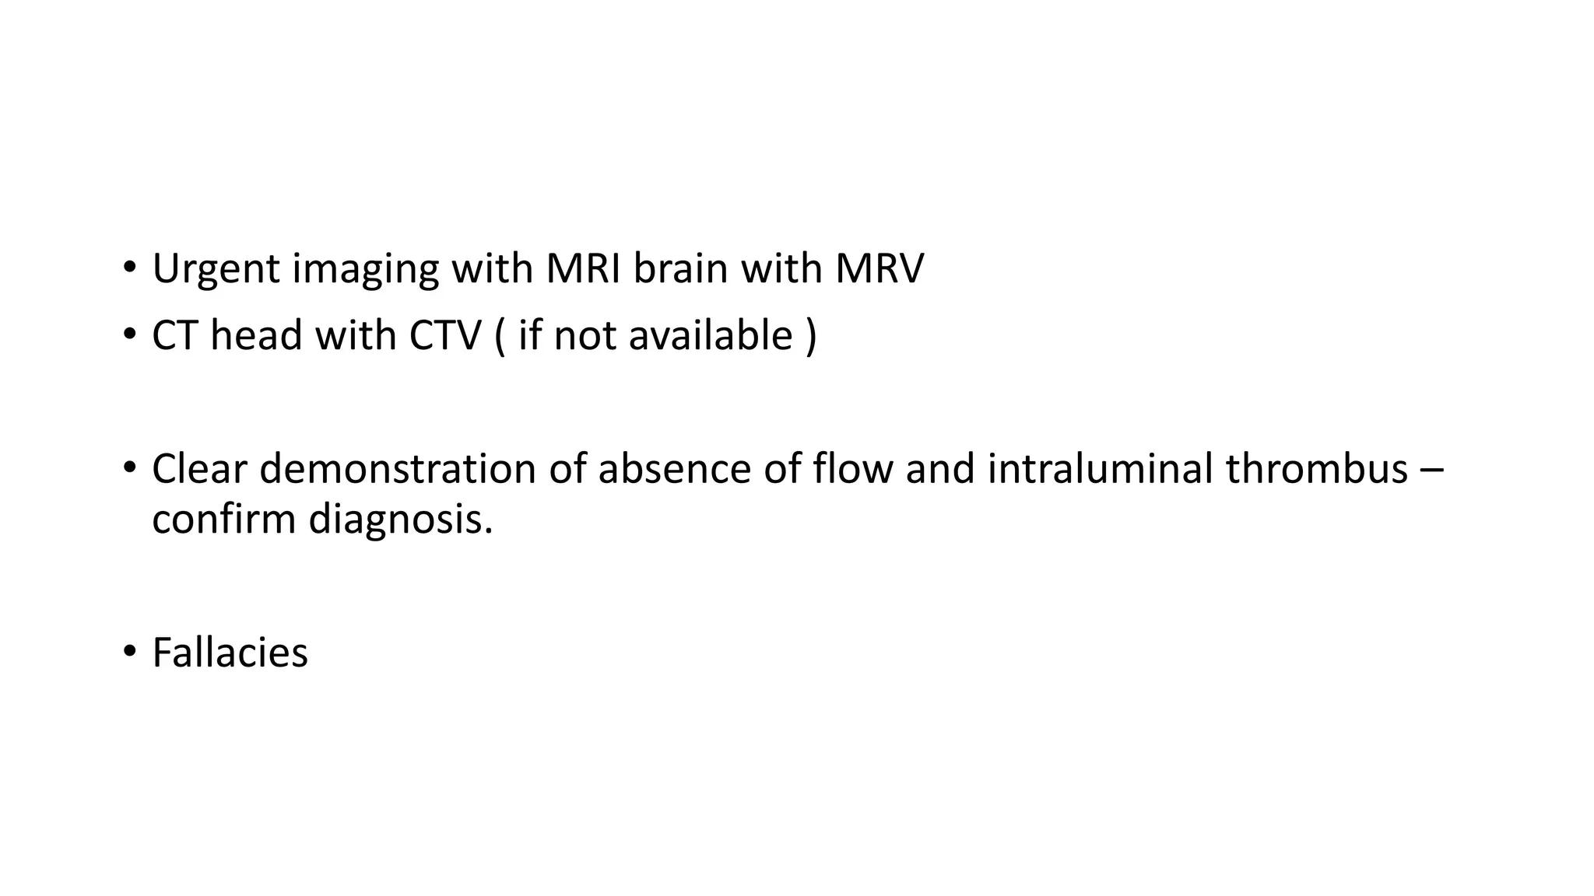

Slide 26
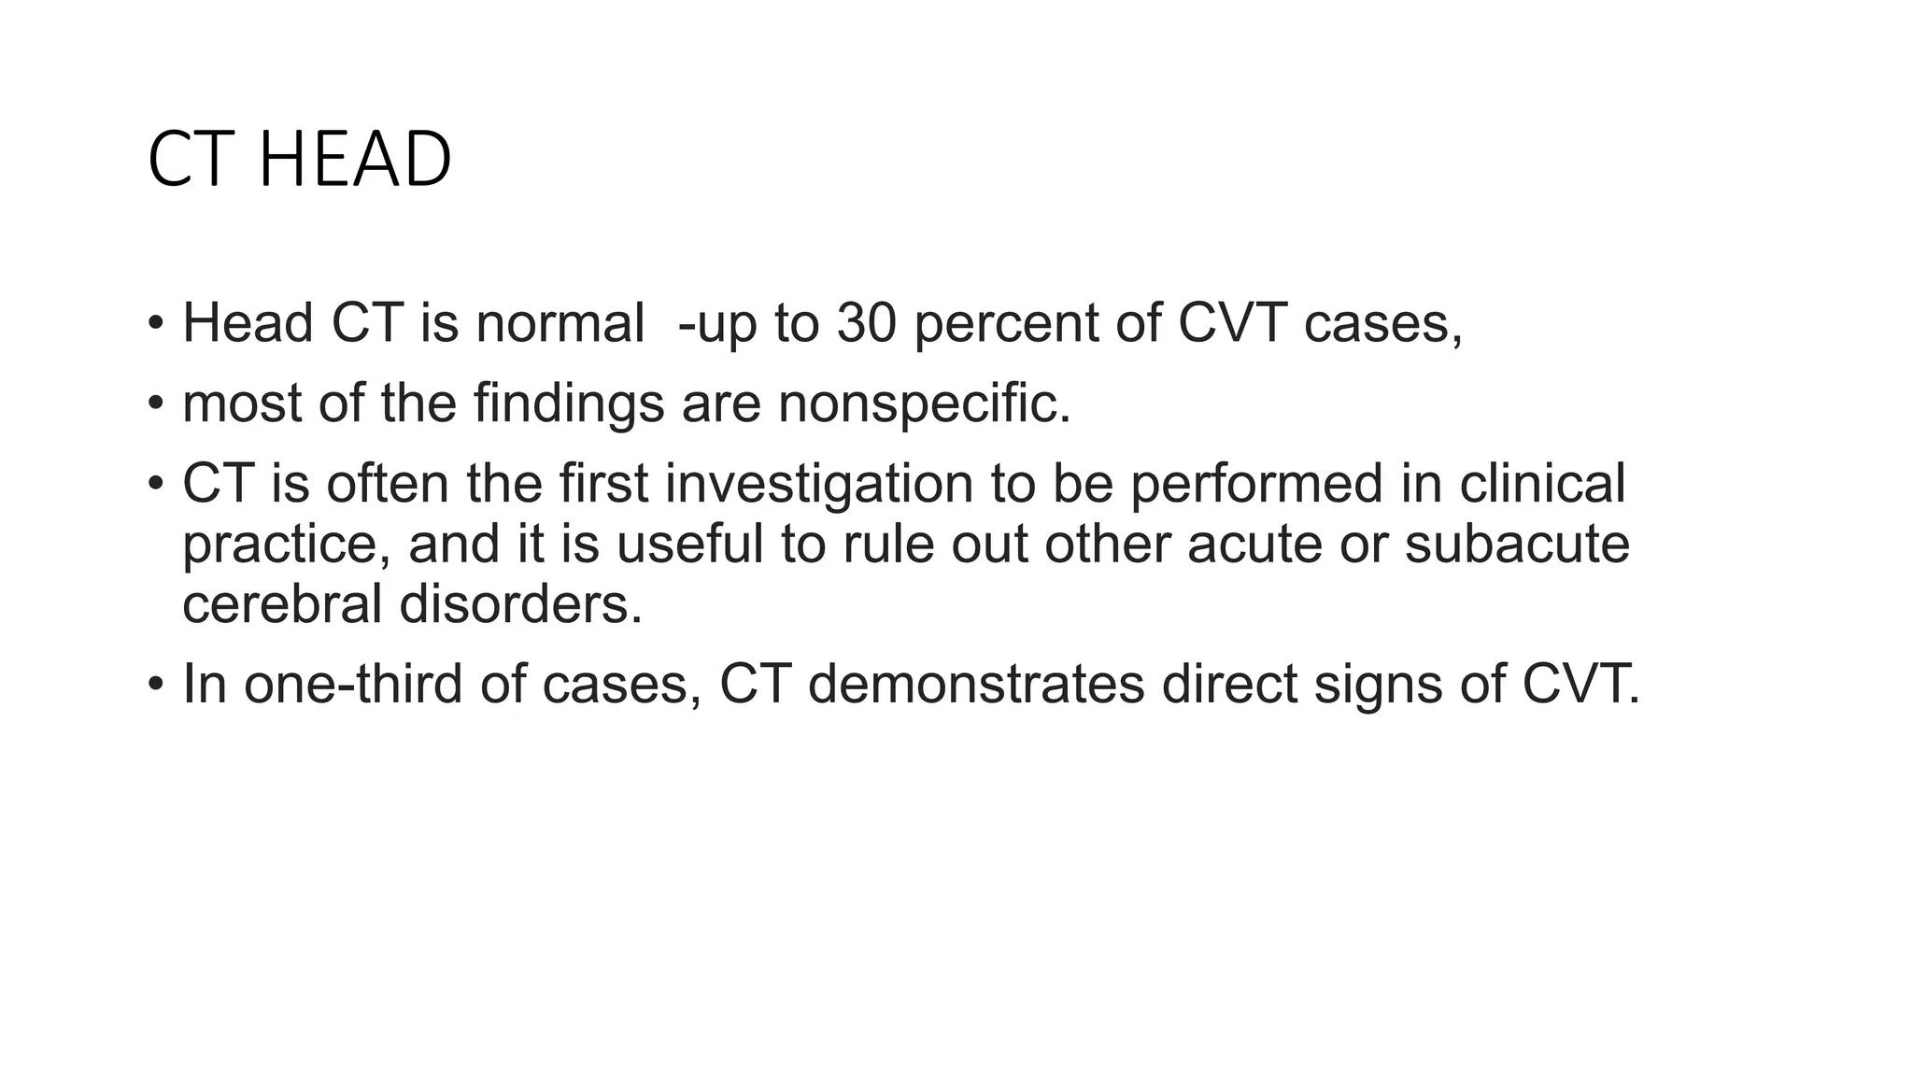

Slide 27
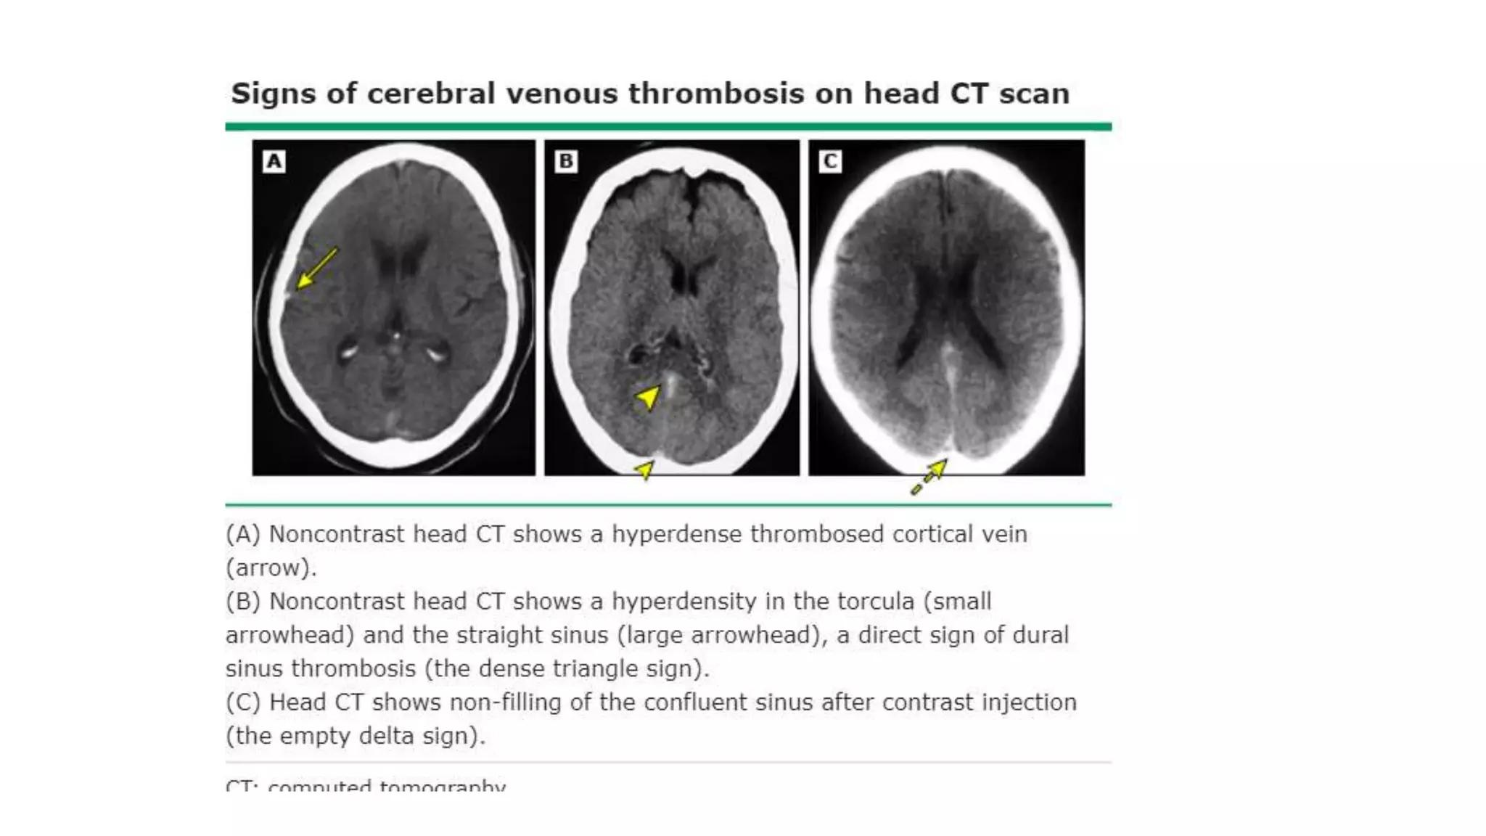

Slide 28
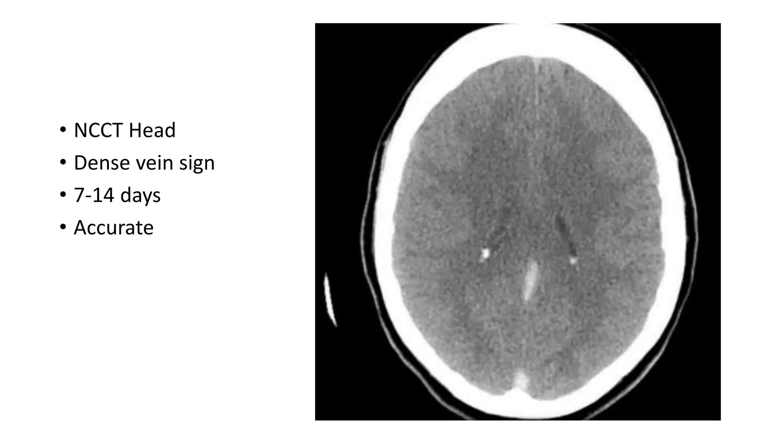

Slide 29
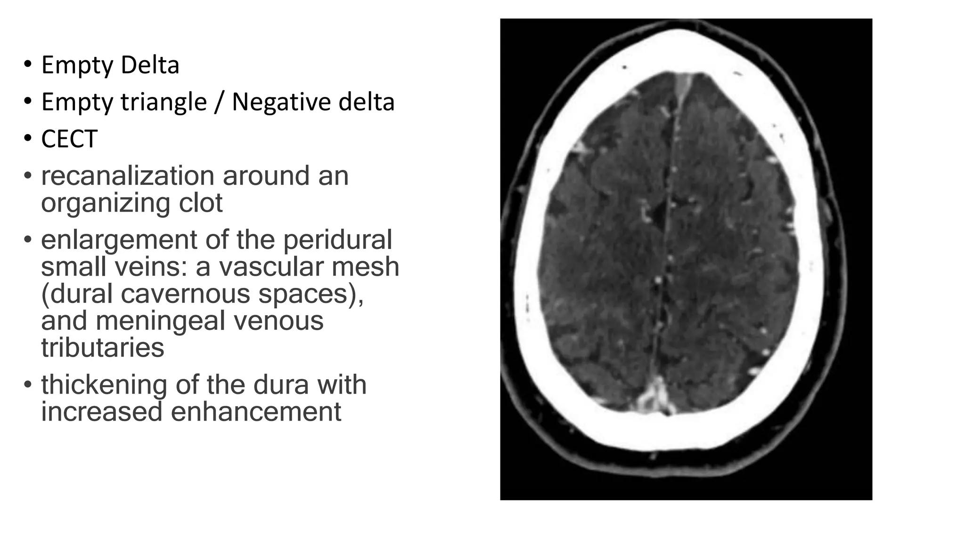

Slide 30
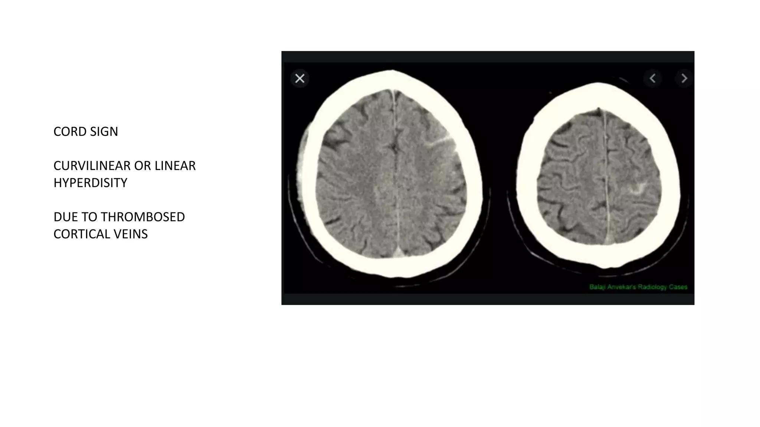

Slide 31
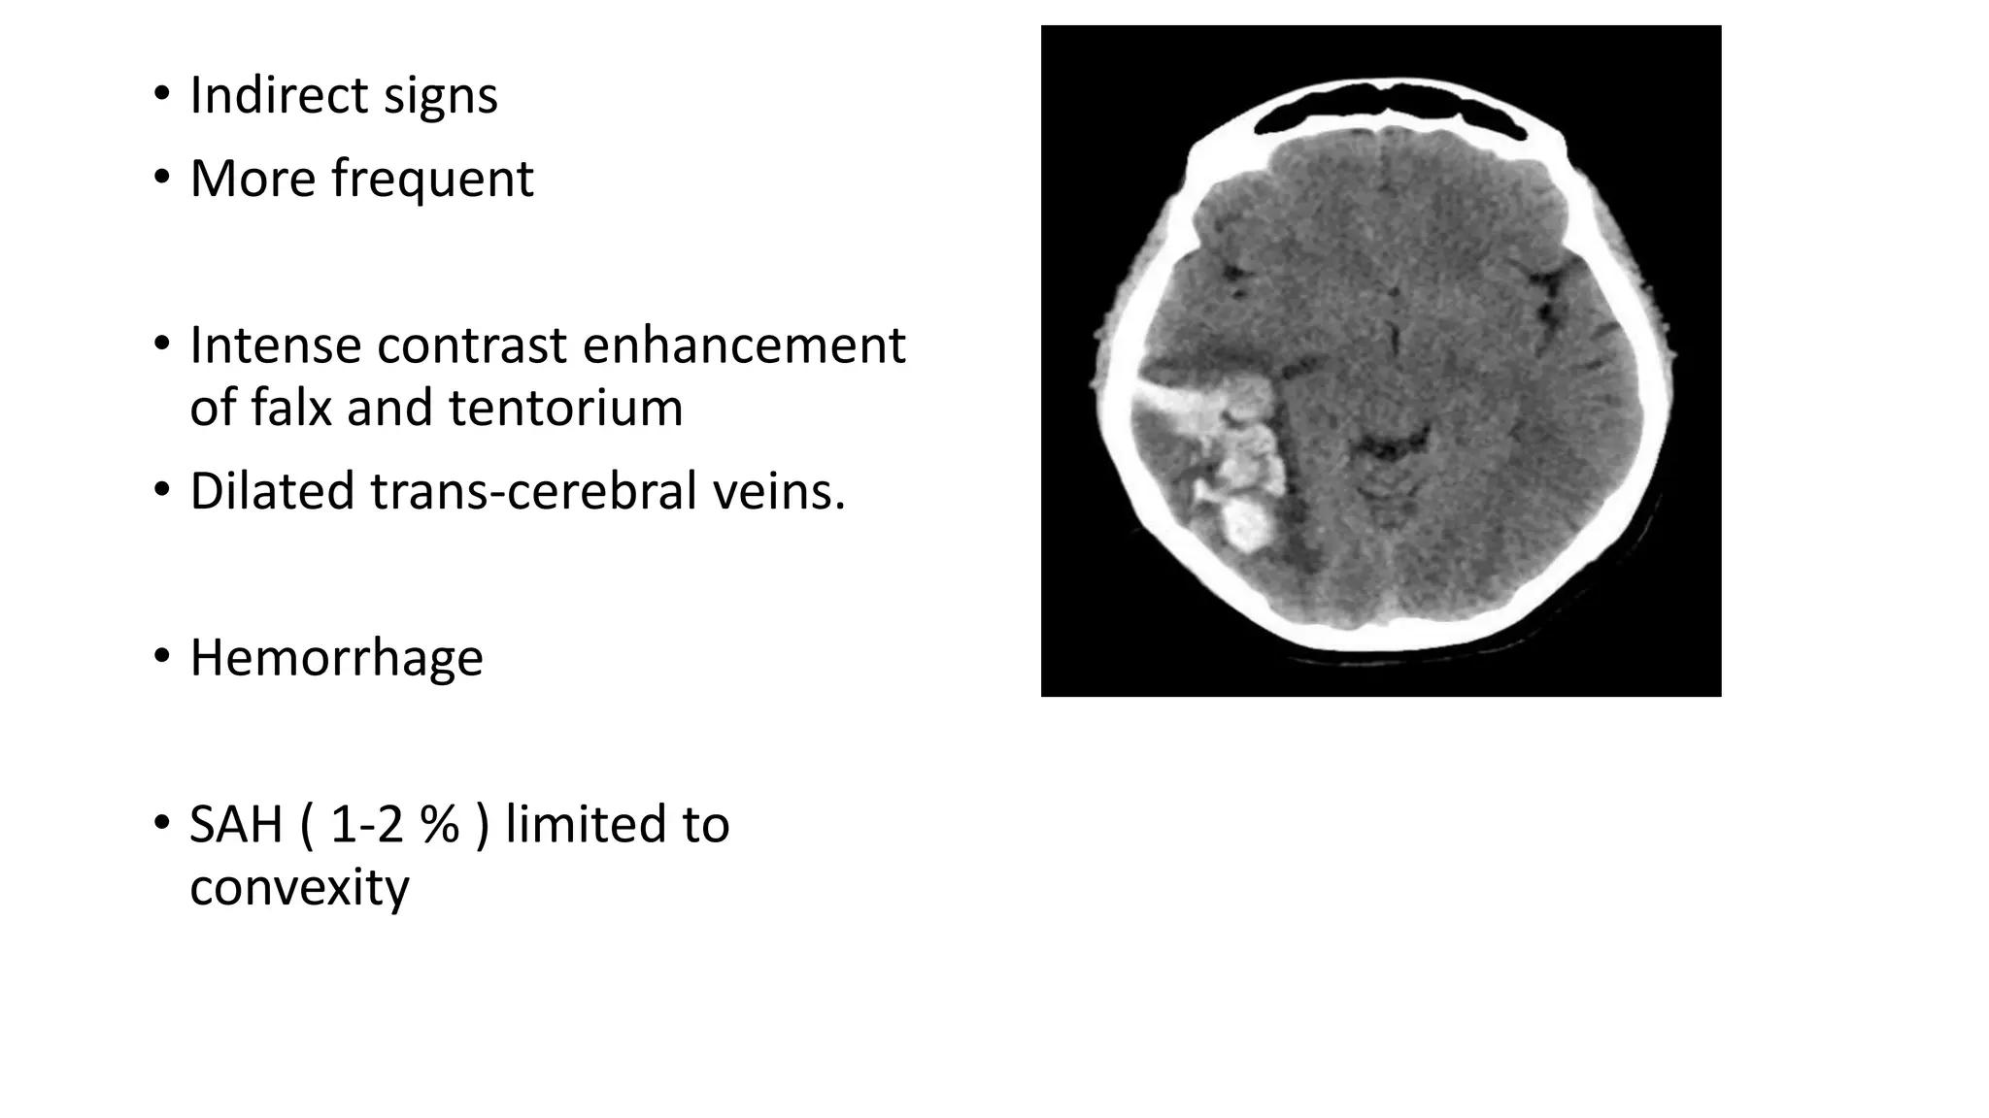

Slide 32
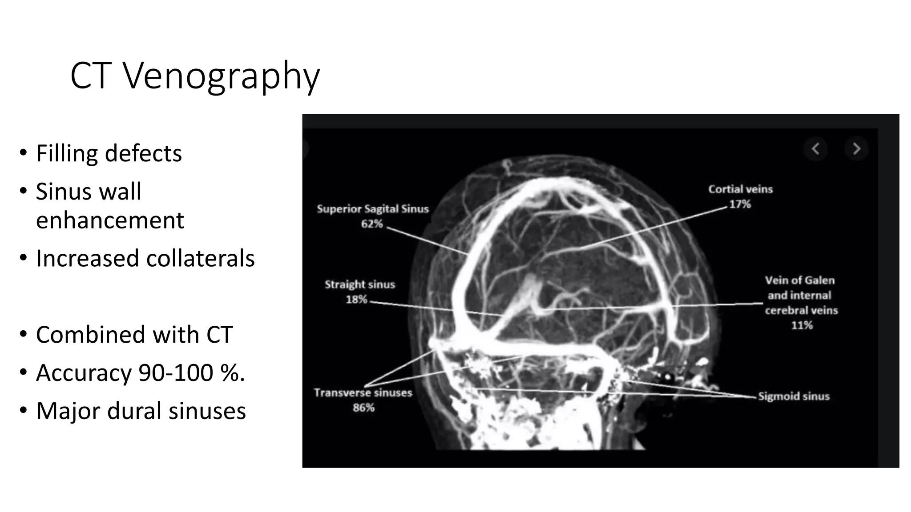

Slide 33
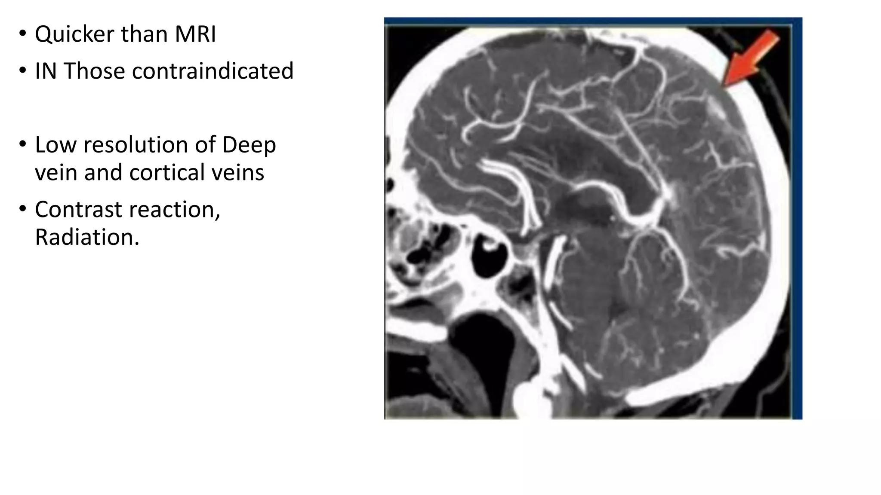

Slide 34
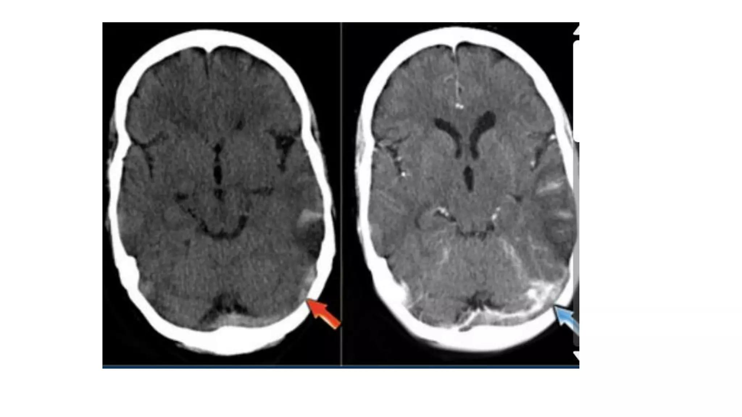

Slide 35
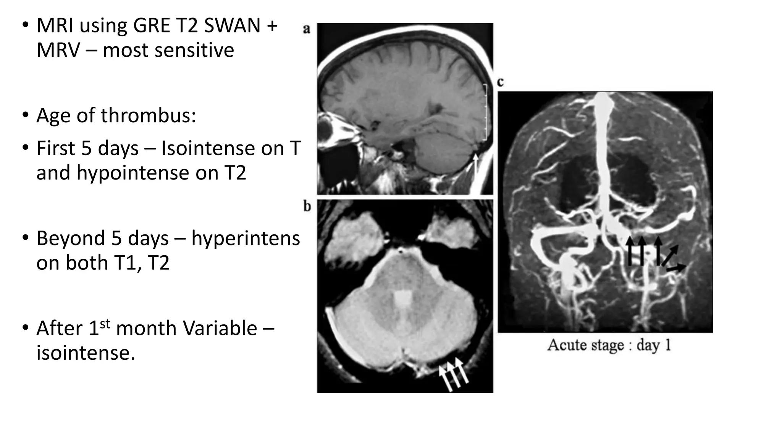

Slide 36
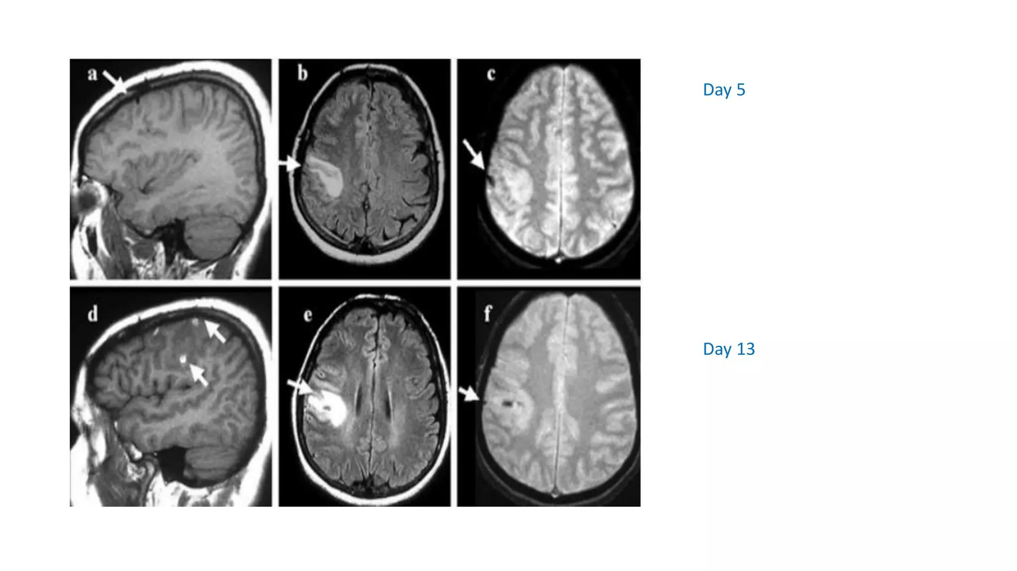

Slide 37
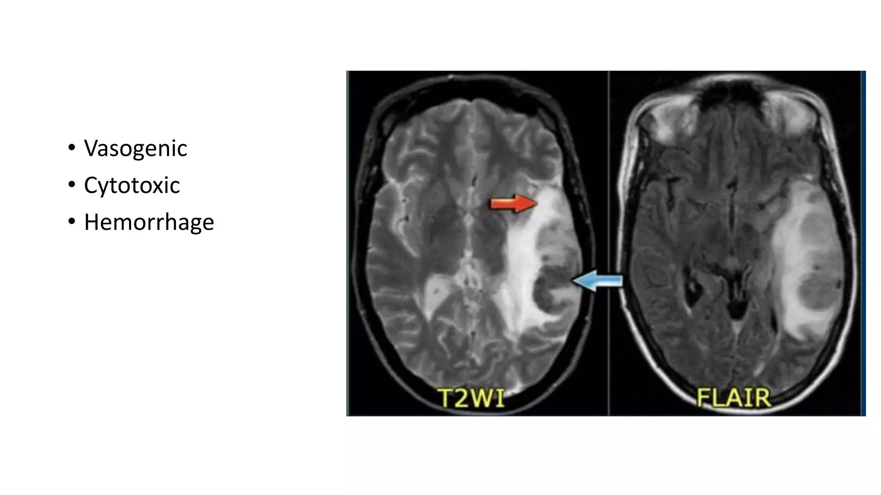

Slide 38
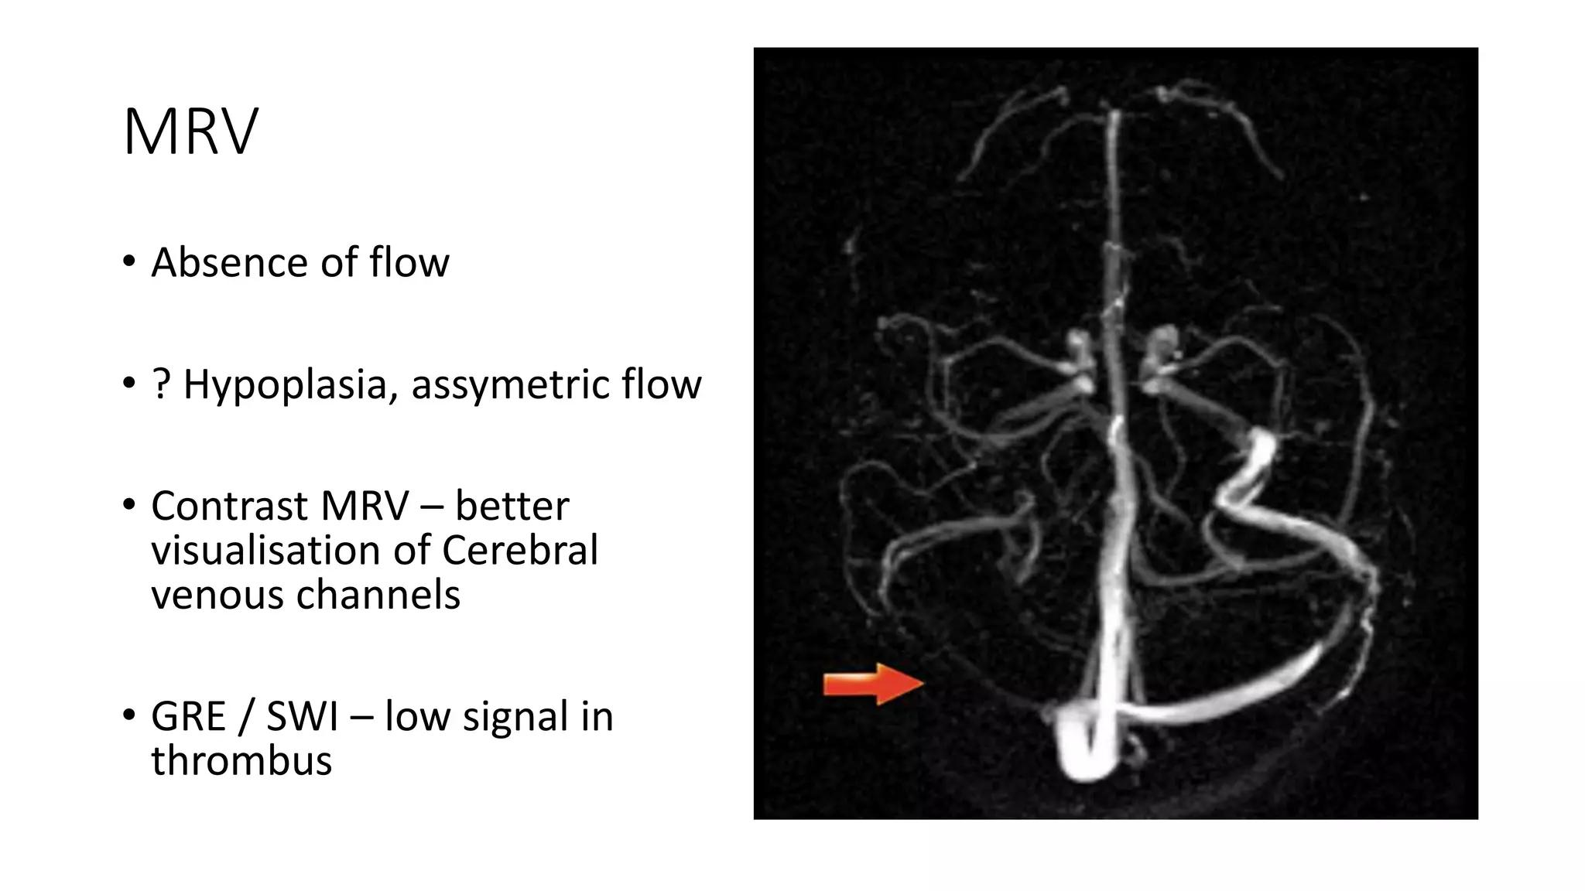

Slide 39
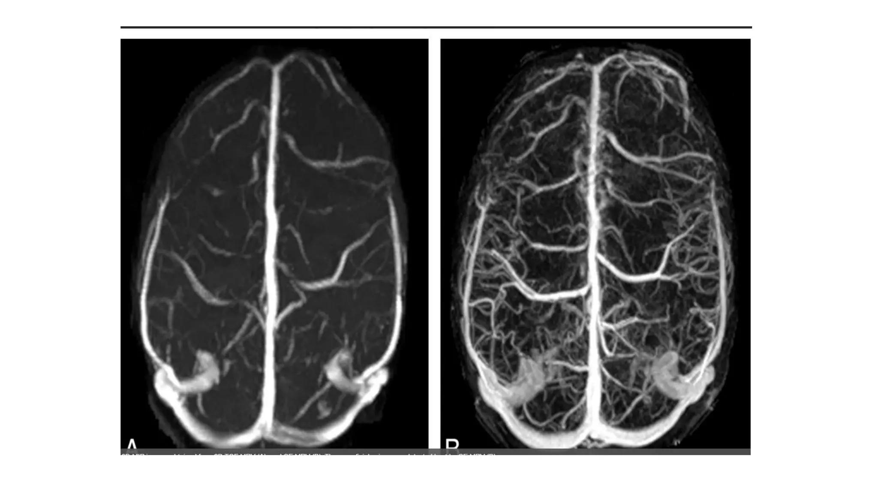

Slide 40
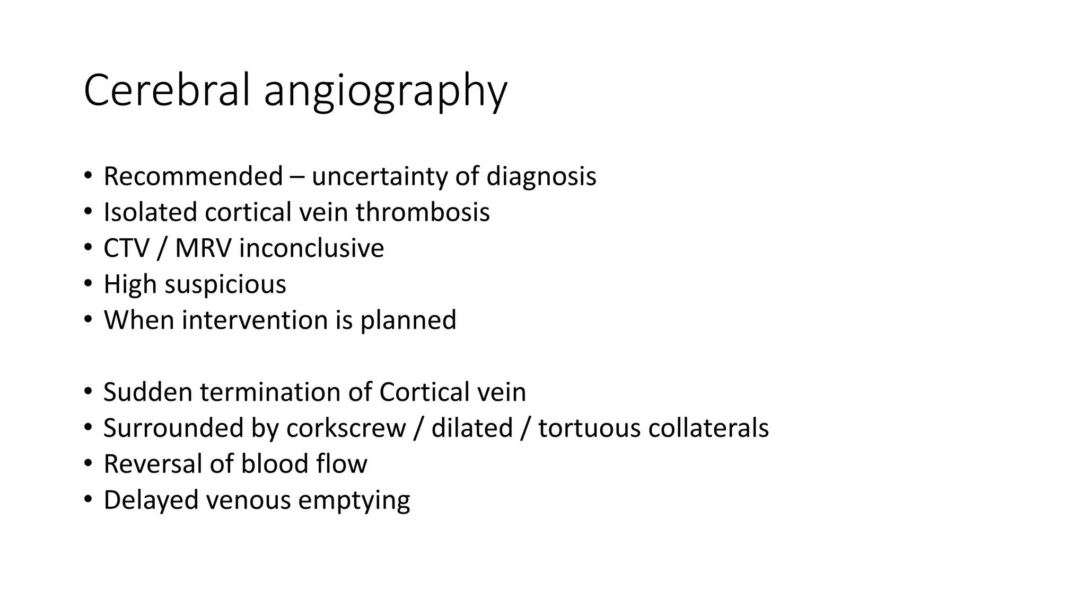

Slide 41
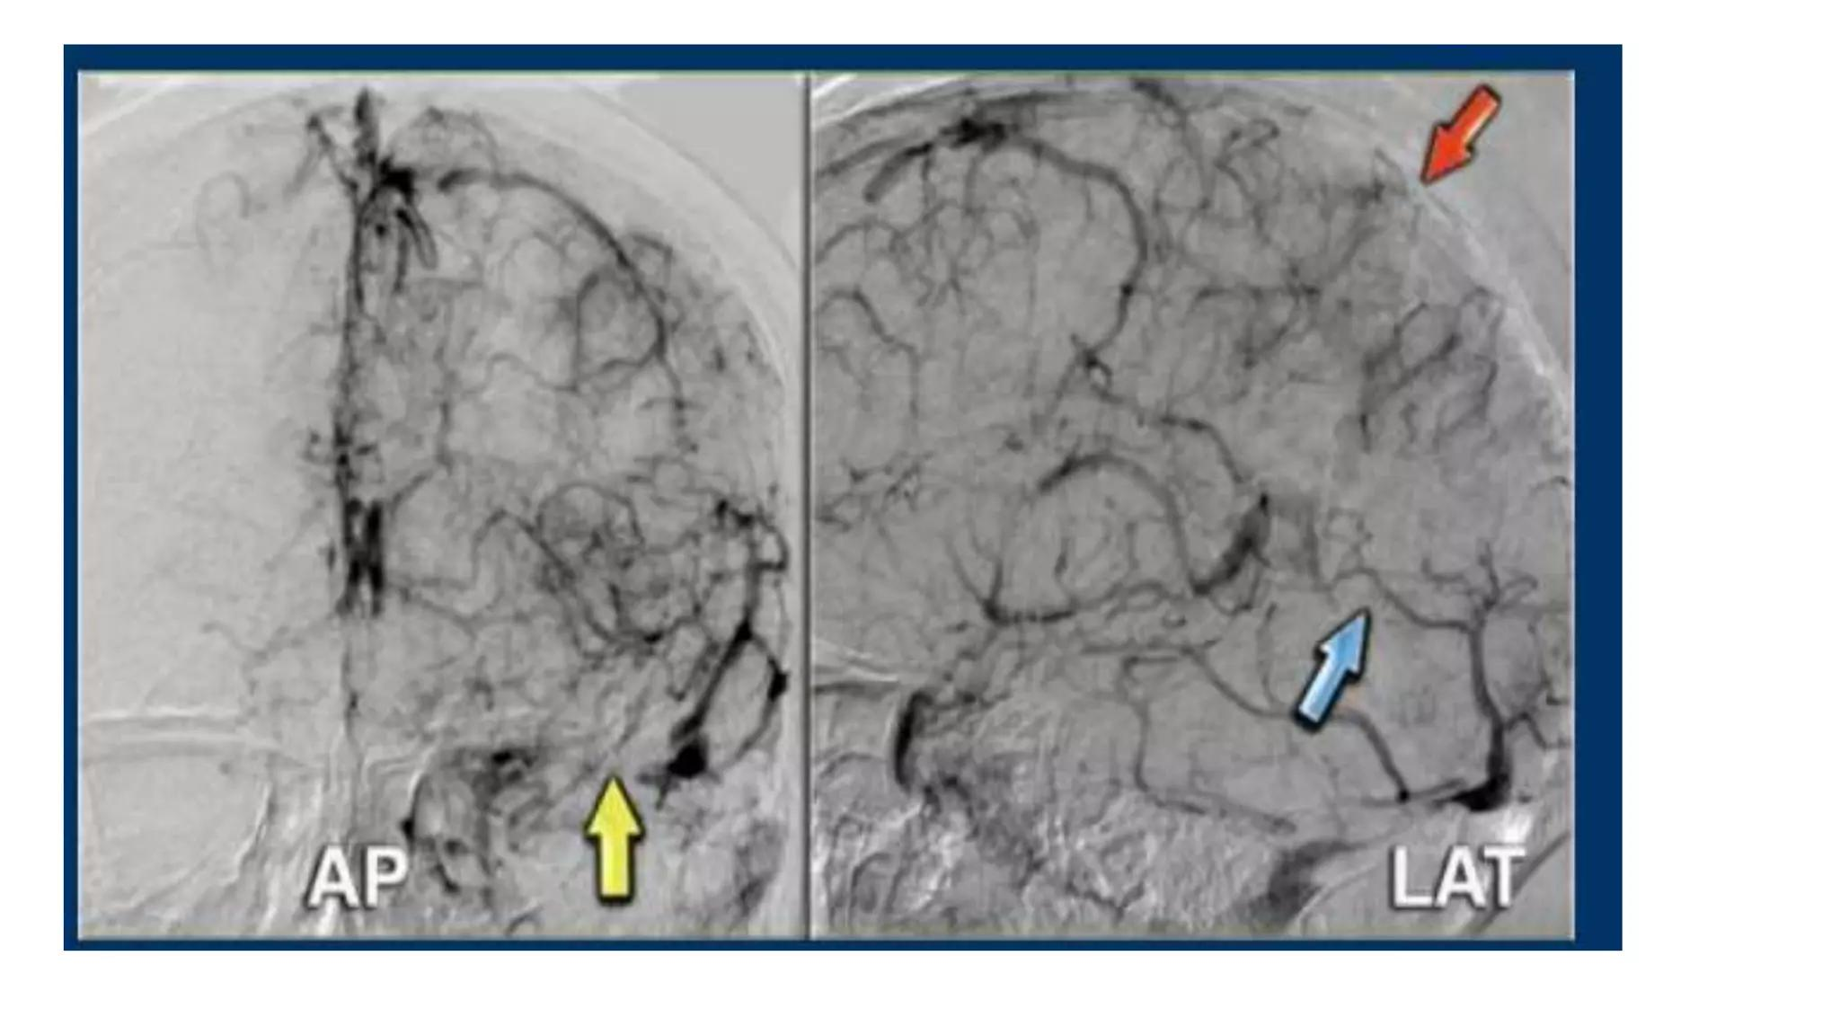

Slide 42
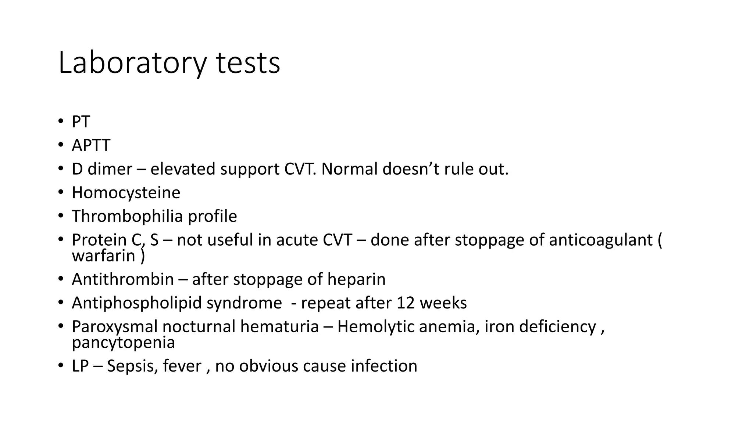

Slide 43
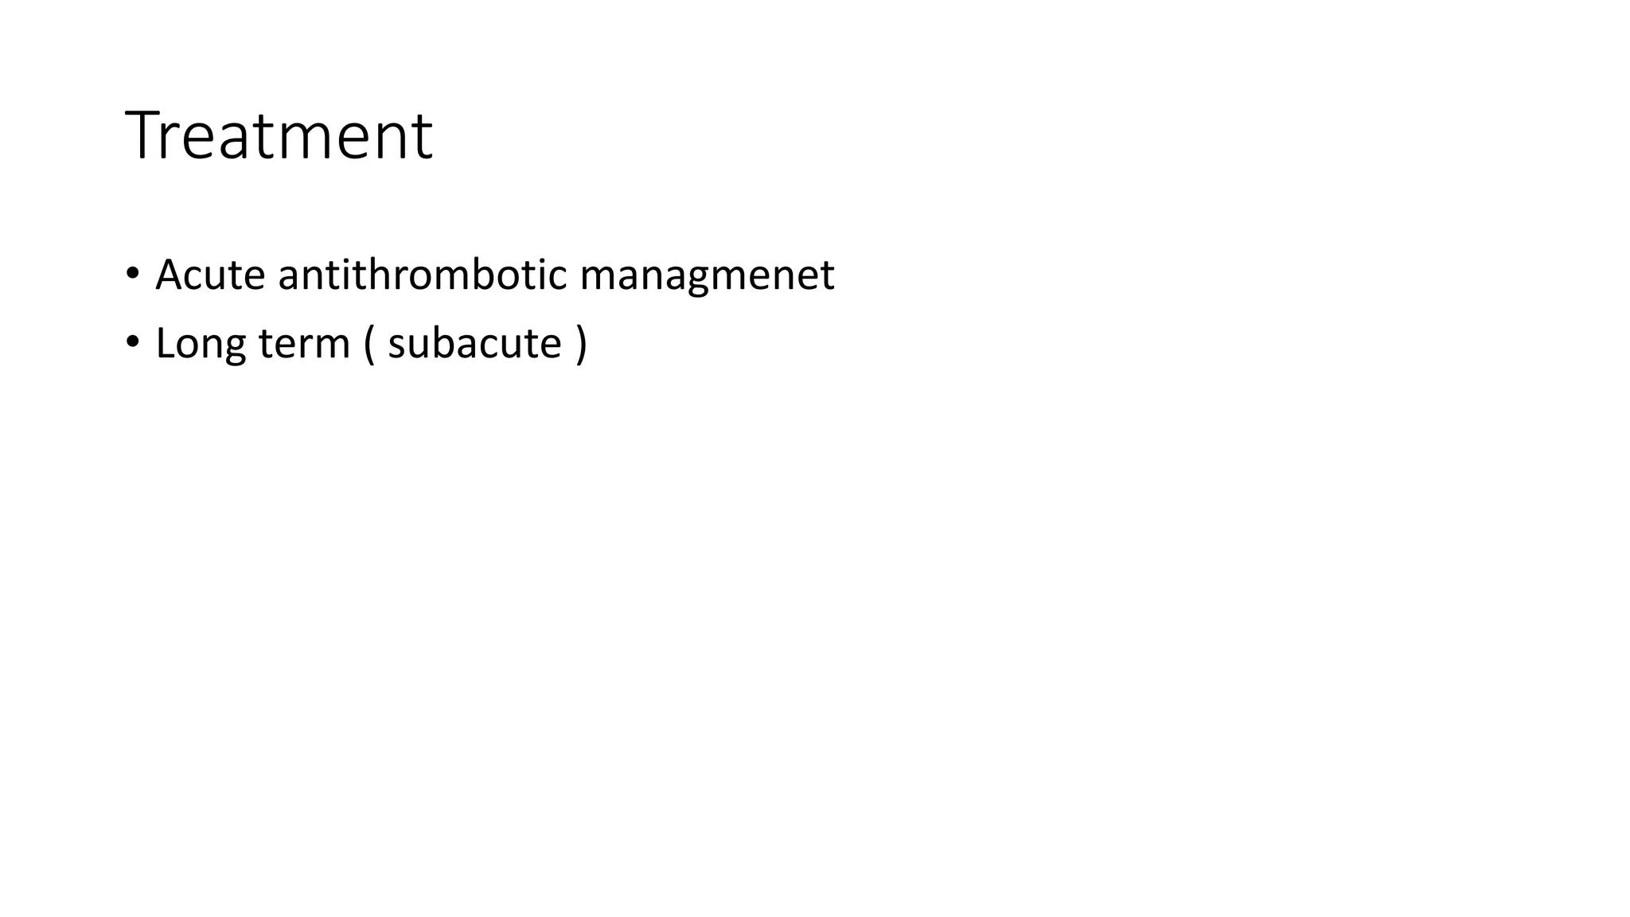

Slide 44
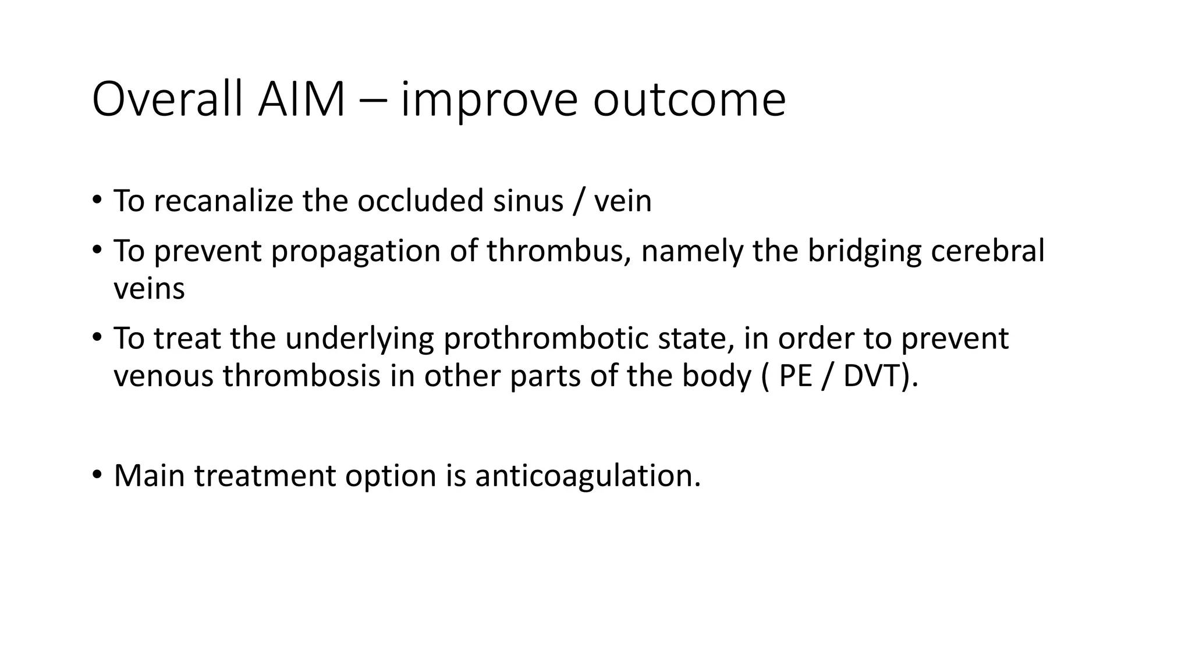

Slide 45
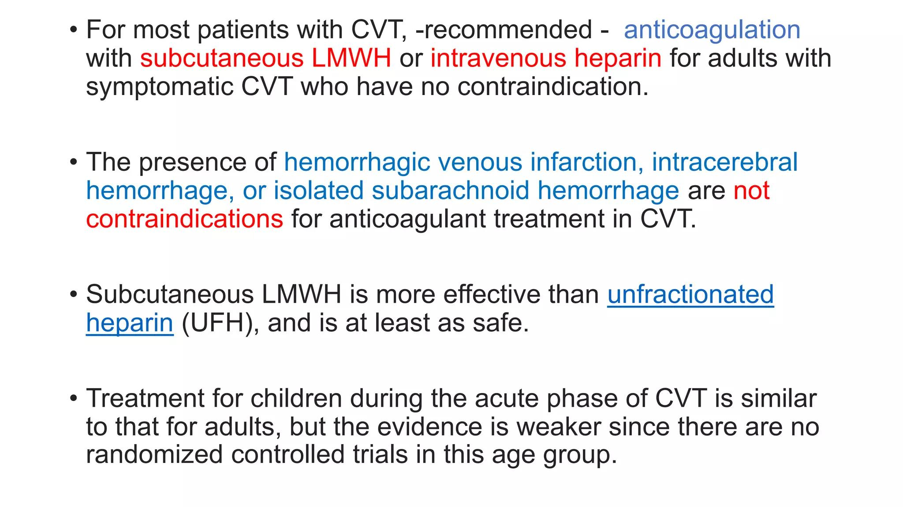

Slide 46
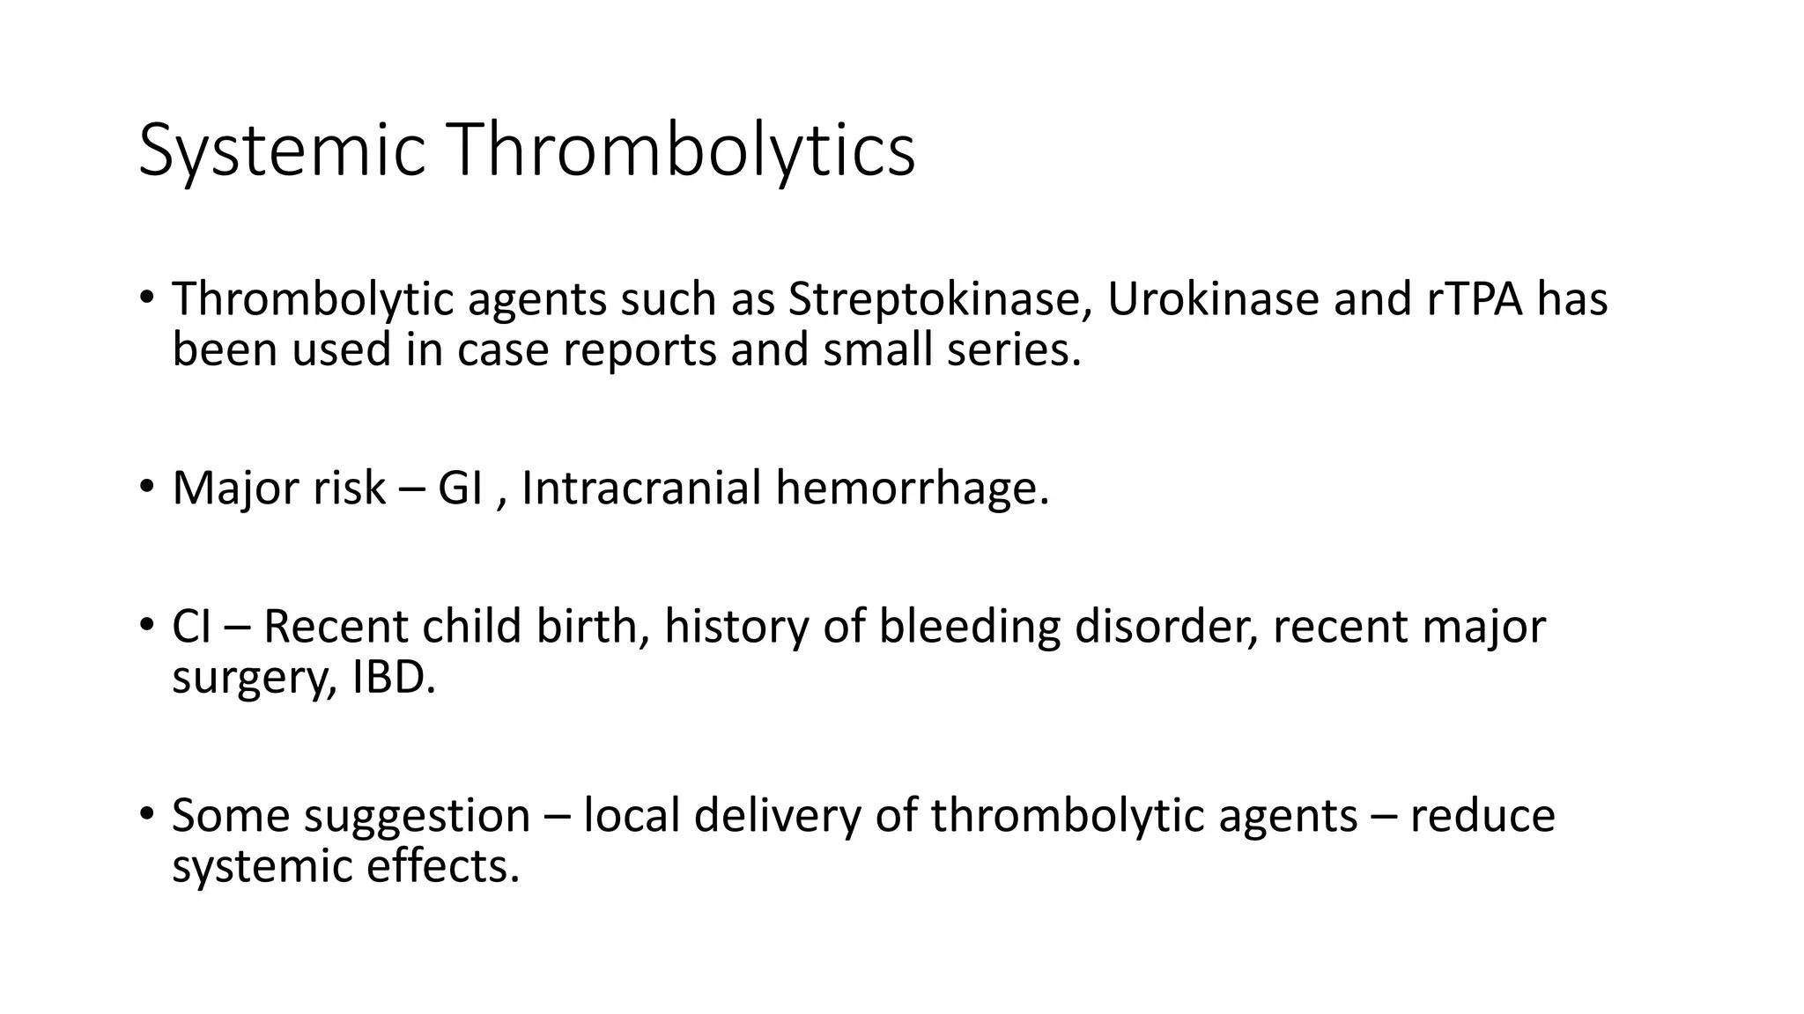

Slide 47
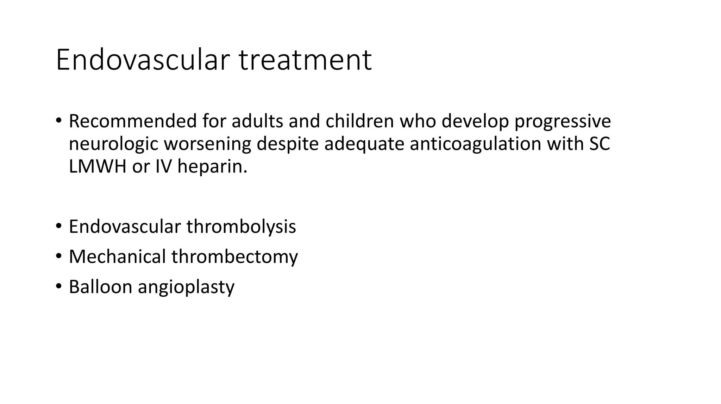

Slide 48
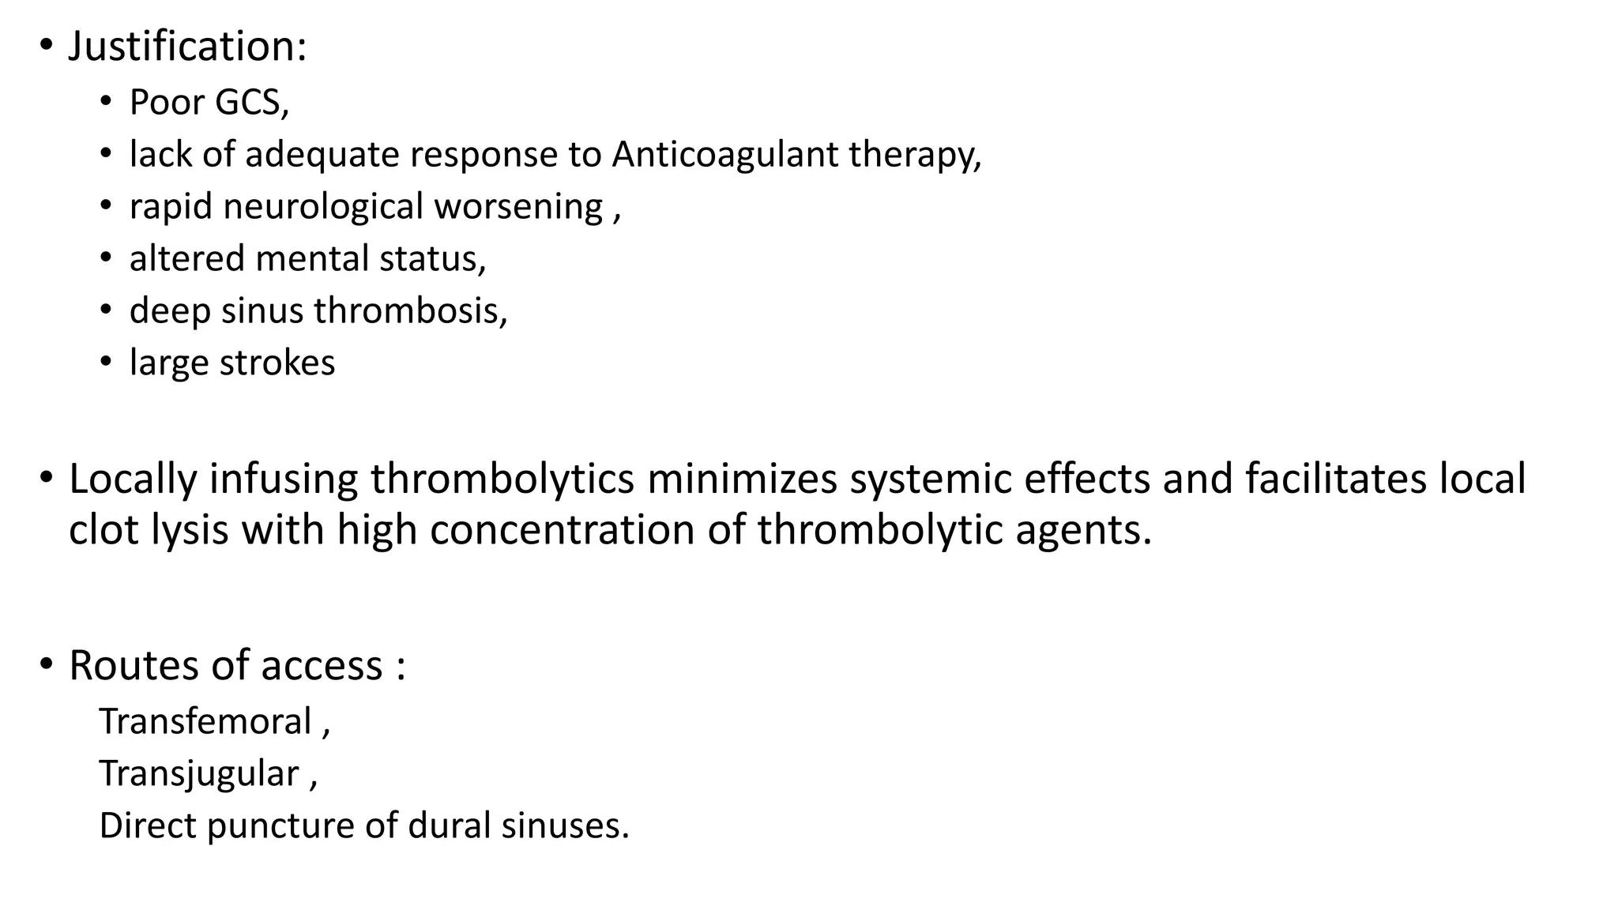

Slide 49
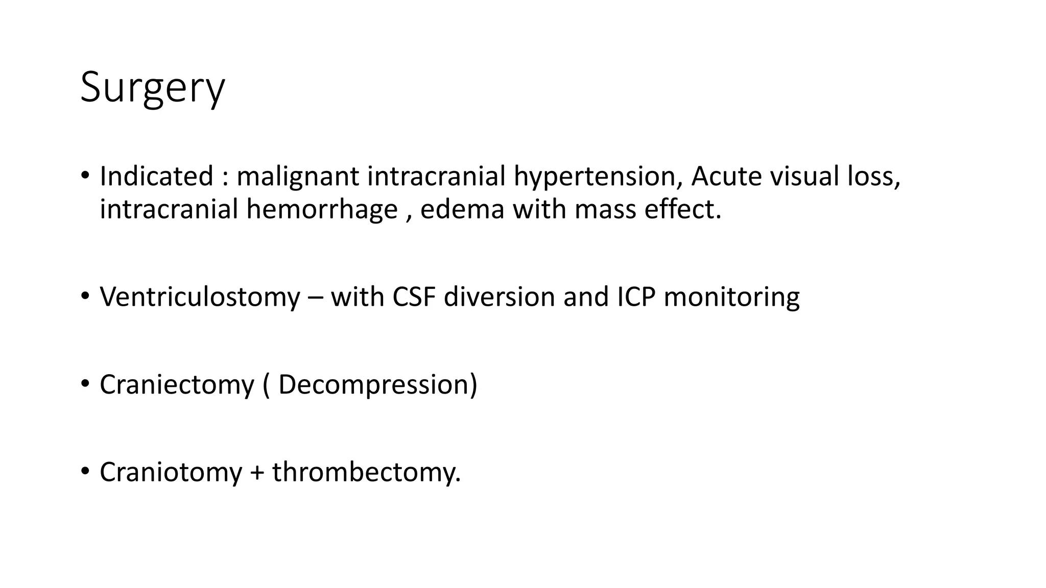

Slide 50
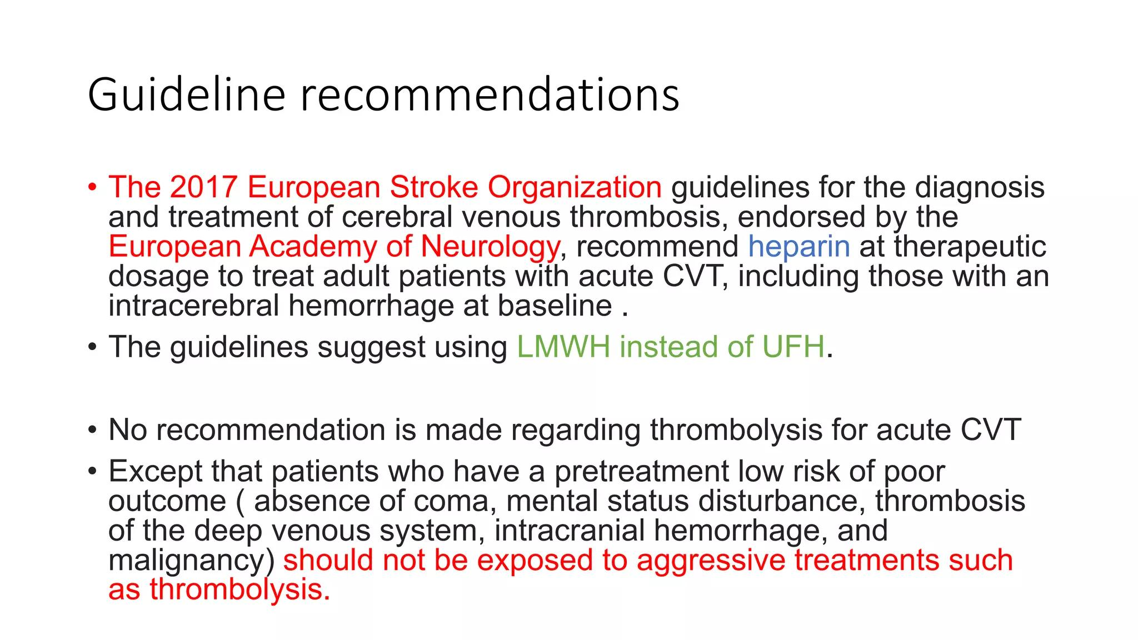

Slide 51
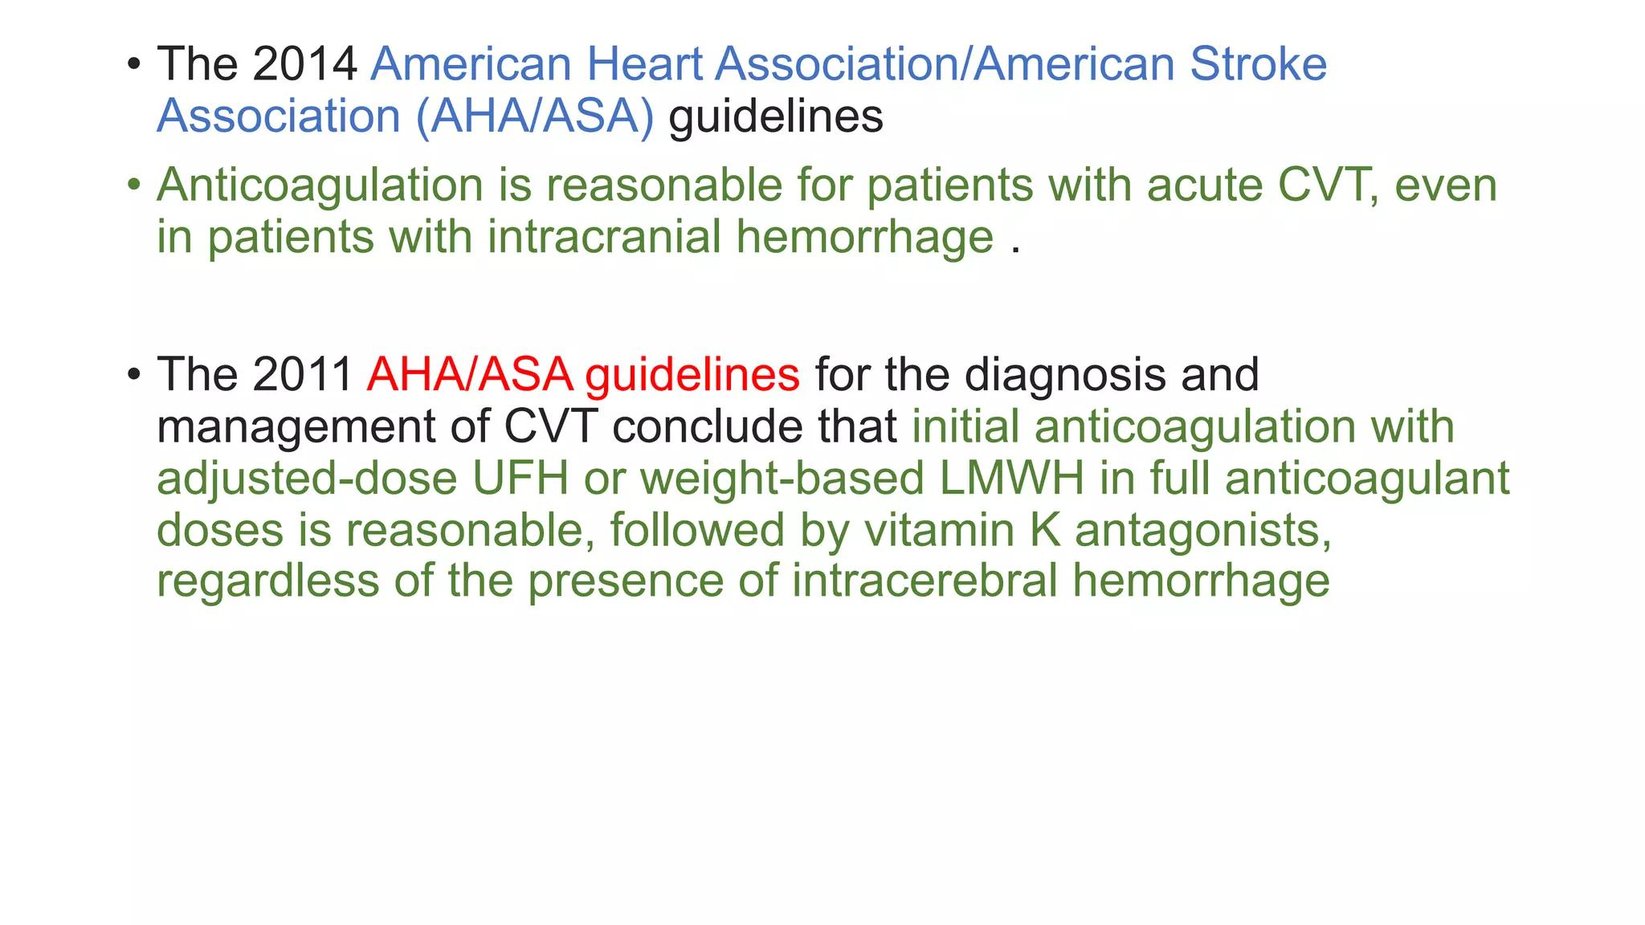

Slide 52
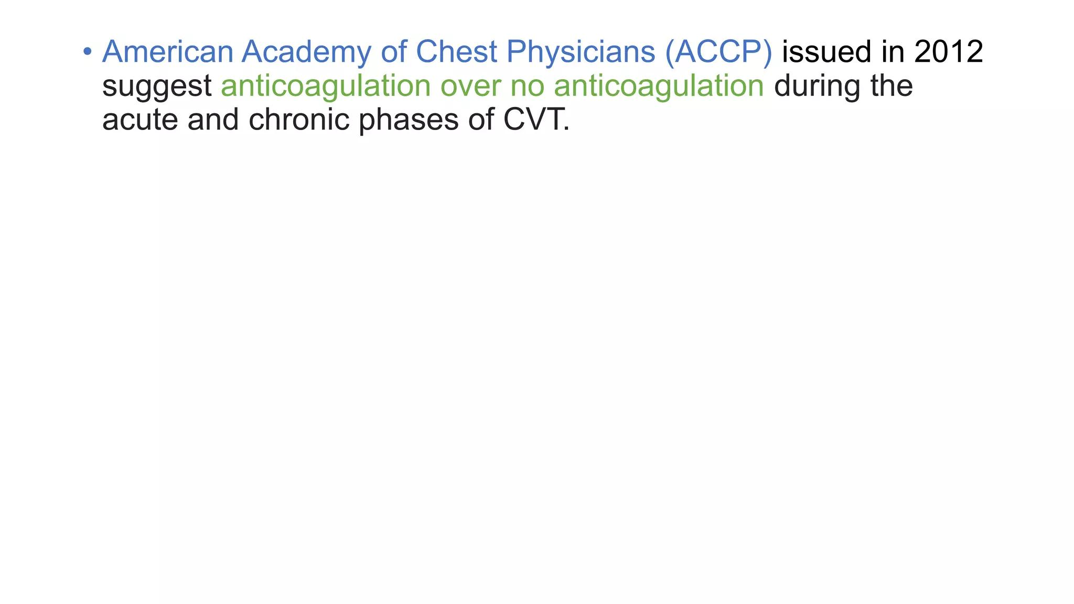

Slide 53
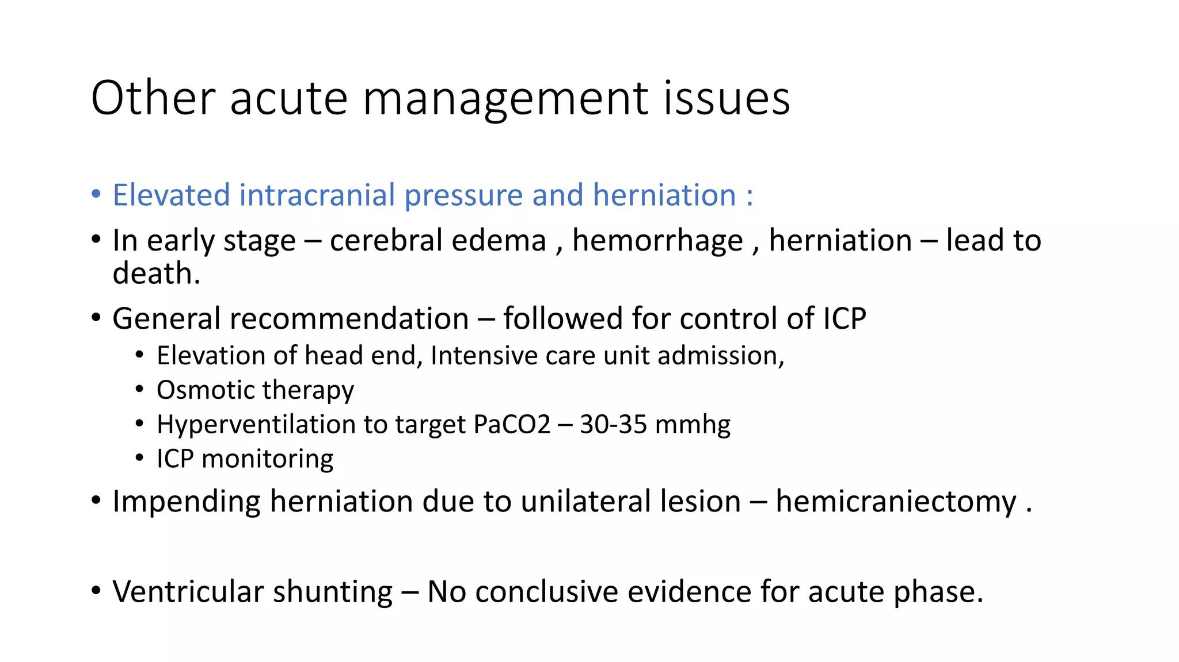

Slide 54


Slide 55


Slide 56


Slide 57


Slide 58


Slide 59


Slide 60
q. Is there any role vit.k and transamine in treatment of cvt?
Q.is there any controversial role of anticoagulants in hemorrhage in cvt background?

Slide 61


Slide 62


Slide 63


Slide 64


Slide 65


