Slide 1
Unilateral Ptosis: A Window to the Third Nerve
Differentiating Complete vs. Partial Palsy and Navigating Management
Dr Imran Abbas
Medical unit 2
Sheikh Zayed Hospital
Rahim Yar Khan

Slide 2
Learning Objectives
To review the functional anatomy of the Oculomotor Nerve (CN III) and its central nuclei.
To delineate the clinical features distinguishing complete from partial third nerve palsy.
To develop a systematic approach to the clinical examination of a patient with unilateral ptosis.
To understand the critical "Surgical vs. Medical" dichotomy in etiology.
To discuss the principles of management, monitoring, and rehabilitation for both acute and chronic phases.

Slide 3
Functional Anatomy of the Oculomotor Nerve (CN III)
Nuclei: (Midbrain)
  Somatic Motor: (Main nucleus) - LPS, Superior Rectus (SR), Medial Rectus (MR), Inferior Rectus (IR), Inferior Oblique (IO).
  Edinger-Westphal: (Parasympathetic) - Pupillary sphincter, Ciliary muscle (Accommodation).
Fascicle: Travels through red nucleus and cerebral peduncle.
Basilar: Emerges from interpeduncular fossa.
Subarachnoid: Runs between posterior cerebral and superior cerebellar arteries.
Cavernous Sinus: Occupies the superior compartment.
Superior Orbital Fissure: Divides into Superior (SR, LPS) and Inferior (MR, IR, IO) divisions.
Key Point: The parasympathetic fibers are superficially located, making them vulnerable to external compression.

Slide 4
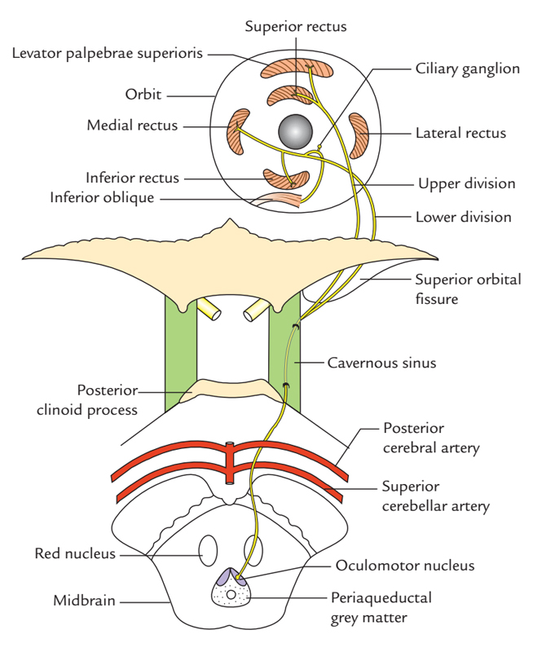

Slide 5
The Cardinal Rule: Surgical vs. Medical Palsy
This is the first and most critical diagnostic step.
"Surgical" Palsy (Compressive)
  Pupil: INVOLVED (Dilated, poorly reactive). The hallmark.
  Mechanism: Compression stretches the vulnerable superficial pupillomotor fibers.
  Etiologies: Posterior Communicating Artery (PCom) aneurysm, tumor, uncal herniation.
  Action: NEUROSURGICAL/NEURORADIOLOGICAL EMERGENCY.
"Medical" Palsy (Ischemic/Microvascular)
  Pupil: SPARED (Normal size and reactivity).
  Mechanism: Ischemia affects the central, vasa nervorum, sparing the superficial fibers.
  Etiologies: Diabetes, Hypertension, Vasculitis.
  Action: Urgent workup, but typically managed medically with expectation of spontaneous recovery.

Slide 6
Clinical Presentation: Complete Third Nerve Palsy
A classic, unmistakable presentation.
Ptosis: Complete (unable to open the eye voluntarily). Often the chief complaint.
Ocular Motility: "Down and Out" position.
  Absent Adduction (MR palsy).
  Absent Elevation (SR & IO palsy).
  Absent Depression (IR palsy).
  Preserved Abduction (LR, CN VI).
  Preserved Intorsion (SO, CN IV).
Pupil:
  If involved: Fixed and dilated.
Accommodation: Impaired if pupil involved.

Slide 7
Clinical Presentation: Partial Third Nerve Palsy
Ptosis: Incomplete/Variable. May be mild, moderate, or severe. Fluctuation can occur.
Ocular Motility: Incomplete Paresis.
  Pattern of weakness is key: e.g., MR weakness with intact IO function, or isolated IR weakness.
  May see only subtle under action of affected muscles.
  Patient may report diplopia in specific gazes.
Pupil: CRITICAL FINDING.
  Can be spared, partially involved (anisocoria >0.5mm, sluggish reaction), or fully involved.
  Any degree of pupillary involvement is highly suspicious for a compressive lesion until proven otherwise.

Slide 8
The Bedside Examination
1. Ptosis Assessment:
2. Motility & Alignment:
  Ductions & Versions (H-pattern).
3. Pupil:
  Light reaction (direct & consensual) in bright and dim light.
  Measure anisocoria. A 0.5mm difference can be significant.
  Near response.
4. Other:
  Accommodation (if patient is presbyopic, ask if near vision has suddenly worsened).
  General Neurological Exam: Cranial nerves, limbs.

Slide 9
Etiological Workup: A Targeted Approach
Step 1: Pupil Involved? -> YES
  URGENT Neuroimaging (CTA/MRA/MRI).
  High suspicion for PCom aneurysm -> Digital Subtraction Angiography (DSA) may be needed.
  If imaging negative, consider LP for inflammation (e.g., sarcoid, GCA).
Step 2: Pupil Spared? -> YES
  Assess vascular risk factors (Diabetes, HTN).
  Consider MRI brain with contrast to rule out an atypically presenting compressive lesion, especially in younger patients or without vascular risks.
  If MRI negative and vasculopathic, manage medically.
Step 3: Is it Partial and Atypical?
  High suspicion for Myasthenia: Acetylcholine receptor antibodies, Single-Fiber EMG.
  Consider inflammatory, infiltrative, or neoplastic causes.

Slide 10
Management: Acute Phase
Pupil-Involving Palsy:
  NEUROSURGICAL CONSULT.
  Immediate intervention for aneurysm (coiling/clipping).
Pupil-Sparing, Presumed Ischemic Palsy:
  Control of vascular risk factors (glucose, BP, lipids).
  Antiplatelet therapy (as per vascular risk).
  Patient Education: Counsel on high likelihood of spontaneous recovery over 3-6 months.
  Symptomatic Management:
    Ptosis: Crutch glasses or tape to improve visual field.
    Diplopia: Occlusion (patch, frosted lens).

Slide 11
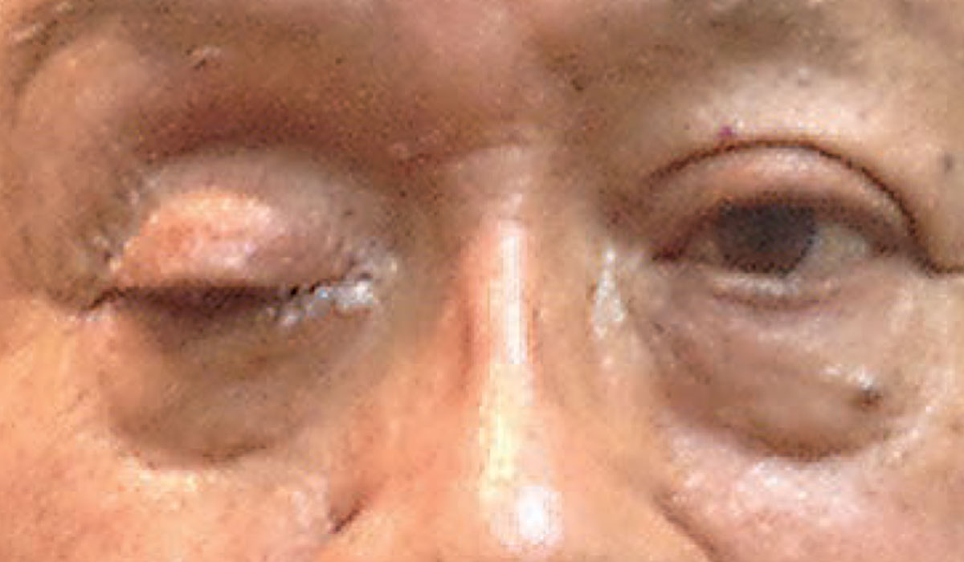

Slide 12
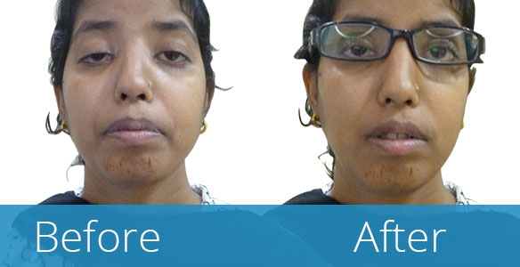

Slide 13
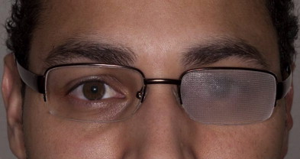
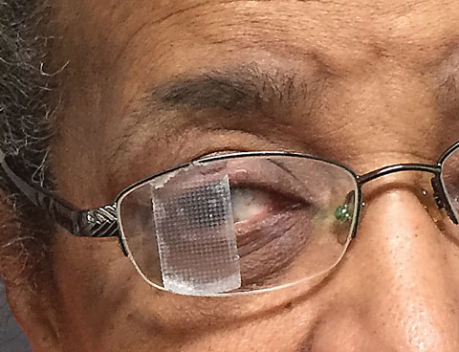

Slide 14
Management: Chronic Phase & Rehabilitation
Timing: Wait at least 6-12 months for stabilization and potential spontaneous recovery.
Goal: Restore binocular single vision in primary and reading positions, and improve cosmesis/visual field.
Surgical Strabismus Management:
  Complex. Often requires multiple muscles and adjustable sutures.
  Strategy: Weaken the overacting antagonist (e.g., LR recession) and/or resect the palsied agonist (e.g., MR resection).
  Superior Oblique Tendon Transposition (for MR weakness) is an option.
Ptosis Surgery:
  Performed AFTER strabismus surgery.
  CRITICAL: Avoid over-correction -> risk of exposure keratopathy if Bell's phenomenon is poor.
  Procedures: Frontalis sling (if levator function poor) or Muller's muscle resection.

Slide 15
Summary & Key Messages
The pupil is the prime predictor of pathology (Surgical vs. Medical).
Partial palsies are diagnostically tricky; a partially involved pupil is still a red flag.
A systematic, anatomically-guided clinical exam is paramount.
Management is a multidisciplinary effort involving Neurology, Neurosurgery, and Ophthalmology.

