Slide 1
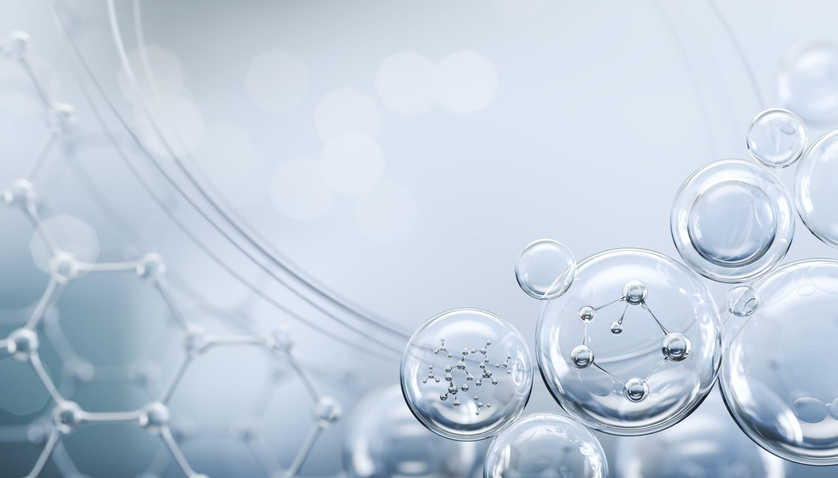
Clinico-Pathological Conference Medical unit 1
SAFWAN ALI Final year MBBS
HAIDER FAROOQ Final year MBBS

Slide 2
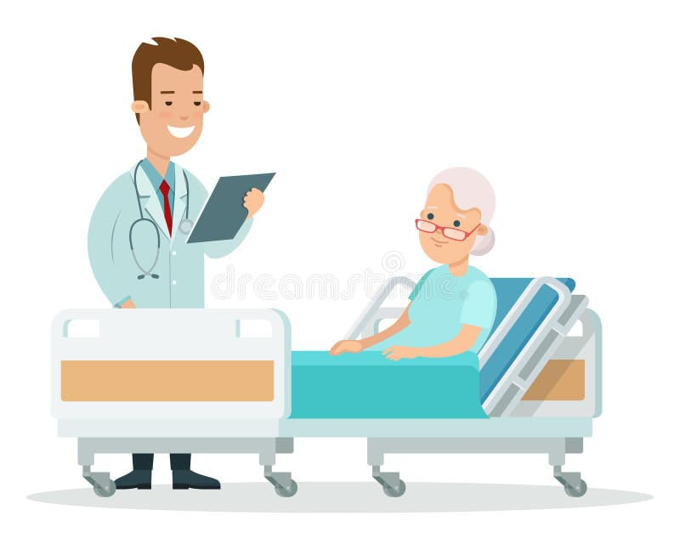
History

Slide 3
Biodata
Nasreen Bibi w/o Ghulam Rasool
53 years old woman
Married Muslim, housewife
Resident of Kot Samaba
Admitted through Emergency on 29th october 2025.

Slide 4
Presenting complain
Fever for 9 days
Shortness of breath for 7 days
gum bleed for 2 days

Slide 5
History of present illness
Patient is known case of CML diagnosed 3 years back currently on medication (imatinib),
She was in USOH 9 days back when she developed fever which was sudden in onset, high grade, intermittent with no rigors, chills and diurnal variation no aggravating factors and partially relieved by medication.
She also had shortness of breath for 7 days ,gradual in onset progressive, increase on exertion It was associated with easy fatigability but there is no hx of cough, sputum, chest pain, orthopnea or PND.

Slide 6
On her first day of admission she developed moderate gum bleeding which continued for 2 days and was relieved by medication . There was no history of nose bleed, hemoptysis,hematemesis, hematuria, melena, perviginal bleed petechiae and bruises.
There is no history of sore throat, jaundice, rash, pruritus, dark urine, feelings of lumps & bumps.

Slide 7
Systemic review
General: fatigue, weightloss (undocumented), no night sweat,anorexia
CVS: No Chest pain. Edema, Palpitation, Claudication
Respiratory: NO Cough, Sputum, Hemoptysis, Pleuritic Chest Pain, Allergic Rhinitis, Seasonal variation of cough/SOB
CNS: No Headache, loss of consciousness/Altered sensorium, Weakness, Limb, Fits. Difficulty in speech, Difficulty in swallowing, visual disturbance.
GIT: No Nausea, vomiting, dysphagia, Diarrhea, Abdominal Distension, Blood in vomitus/Stool, Yellow Discoloration of eyes Pruritus

Slide 8
Musculoskeletal: No Joint Pain, Swelling, Redness, Backache, Restriction of mobility
Genitourinary : no polyuria, dysuria and burning micturition, flank pain and post menopausal bleed.

Slide 9
Past Medical History
She is taking HTN medication for 20yrs
3years back she presented with left hypochondrium heaviness and pain for which she was evaluated and diagnosed as a case of CML on the basis of CBC with peripheral morphology and BCR-ABL gene quantification.
She is taking regular medication ( imatinib 400mg/day) and having proper regular checkup. 5 months back her dosage was increased to 600mg/day.

Slide 10
Transfusion history
14 days back she was transfused 2 pints of blood due to anemia ( Hb 6mg/dl) which was diagnosed on cbc during regular checkup
On her first day of admission she was transfused 1 pint of blood and 1 pint on 5 nov 2025
There is no past history of transfusion besides this.

Slide 11
Past surgical history
Nil

Slide 12
Family History
Hx of DM,HTN is present in family
There is NO history of blood borne disease , tb, asthma, hep B and C, IHD in family.
Personal History
Good sleep and appetite, no drug addiction and allergy.

Slide 13
Socioeconomics history
She belong to middle class family, living in cemented house, using filter water, sanitary condition was moderate

Slide 14
Summary of Hx
53 year old lady hypertensive k/c of CML present with complain of high grade fever ,SOB and gum bleed.

Slide 15
Differentials
Complication of CML ( anemia , change in state of CML)
Secondary infection.

Slide 16
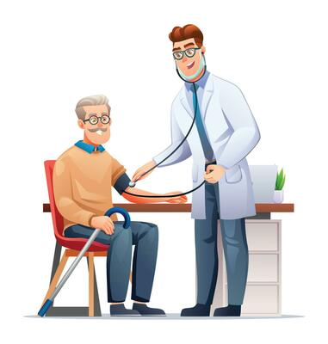
Examination

Slide 17
GPE
I have examined an old woman of usual build, conscious, cooperative and oriented during examination having Iv cannula on right hand ,she has following vitals signs
Pulse rate : 82 bpm
Blood pressure: 130/80 mmHg
Rr: 18 br/min
Temp 100F
on examination she had pallor . There is no clubbing, koilonychia, wasting of thenar and hypothenar muscles, palmar erythema, splinter hemorrhages, Heberden's and Bouchard nodes.

Slide 18
orodental hygiene was poor however there was no oral ulcers or erythema of the tonsils, there is no ear discharge jaundice, any facial swelling andthyroid was not enlarged. jvp was not raised and there was no pedal edema, purpura and rash. No lymph nodes were palpable.
Abdomen examination
Abdomen was flat with Central inverted umbilicus, there was no scar mark ,visible pulsations, striae and hernial orifice were intact . It was soft non tender there was no guarding and rigidity, liver was palpable 4 cm below the right coastal margin in the mid clavicular line total span of liver was 16cm ,nontender, firm in consistency ,surface of the liver was smooth, the left lobe of liver was not palpable.

Slide 19
Cont.
spleen and urinary bladder were not palpable, kidneys were also not bloatable. para aortic and inguinal lymph nodes were not palpable.
there was no free fluid in the form of fluid thrill and shifting dullness .
Bowel sounds were audible .Hepatic rub, splenic bruit were not audible.

Slide 20
Respiratory System Examination
The chest is bilaterally symmetrical with normal shape
No scars, dilated veins, or visible pulsations.
No intercostal retraction, use of accessory muscles, or paradoxical movement.
Trachea is central Chest expansion is equal and normal on both side
vocal fremitus is normal and equal bilaterally.
Percussion note is resonant and equal on both sides.
Breath sounds are vesicular and equal on both sides.
No added sounds such as wheeze, crackles, or pleural rub.
Vocal resonance is normal and equal bilaterally.

Slide 21
Cardiovascular system examination
Chest was symmetrical with no visible pulsations or deformities.
No scars or dilated veins over the precordium.
JVP not raised.
Apex beat palpable in the 5th intercostal space, midclavicular line, normal in character.
No parasternal heave or thrill felt.
S1 and S2 heard, regular rhythm normal intensity with No added sounds
CNS
GCS15/15
oriented to time place and person.
Cranial nerve intact
cerebellar signs were normal.

Slide 22
CASE SUMMARY
53 year old lady hypertensive k/c of CML present with complain of high grade fever SOB and gum bleed. On examination she had pallor and hepatomegaly.

Slide 23

Investigation

Slide 24
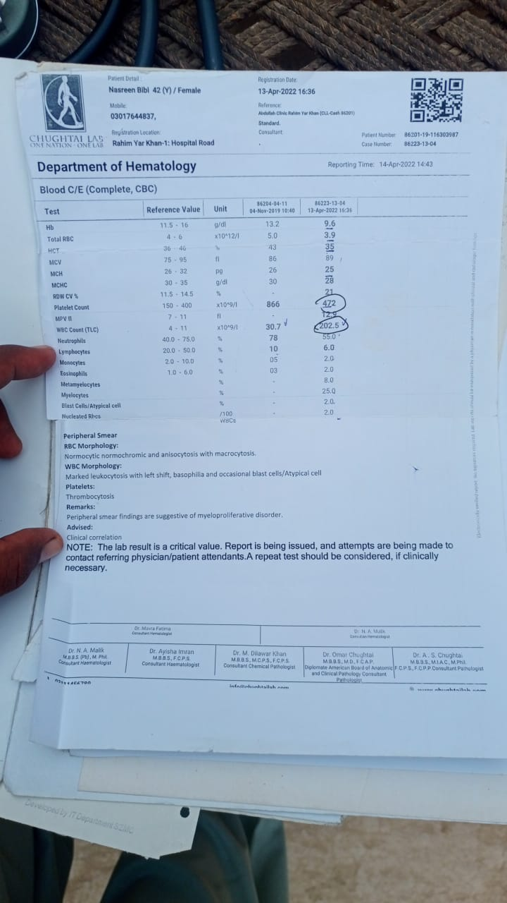
1st CBC which was suggestive for CML 2023
Hb9.6g/dl
Wbc 202x10^9/l
Plt 472x10^9/l
Marked leukocytosis with left shift, basophilia ,blast cell
Thrombocytosis
normocytic normochromic RBCs
Anisocytosis with macrocyotsis

Slide 25
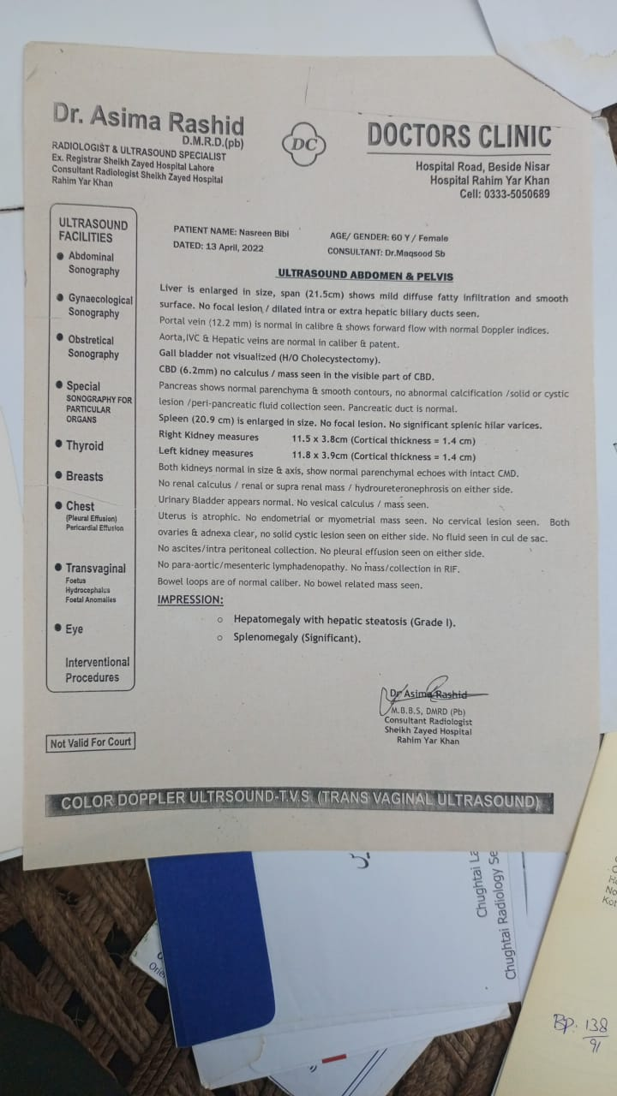
ULTRASOUND 2023
SPLENOMEGALY (20.9 CM)
Hepatomegaly

Slide 26
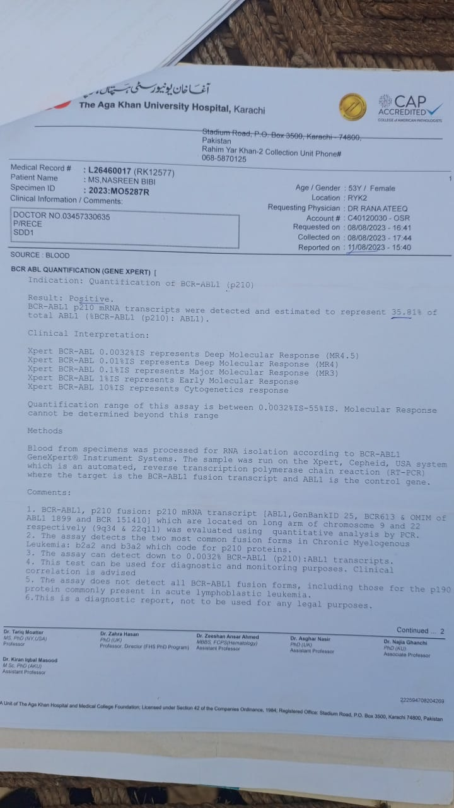
11/8/2023
Report of BCR-ABL1 ( P210) Quantification gene by which she was diagnosed .
BCR ABL1 ( P210) mRNA
35.6%

Slide 27
Treatment and follow up
Patient was started on imatinib and after she had regular checkup and response of therapy was observed in the form of BCR-ABL and cbc

Slide 28
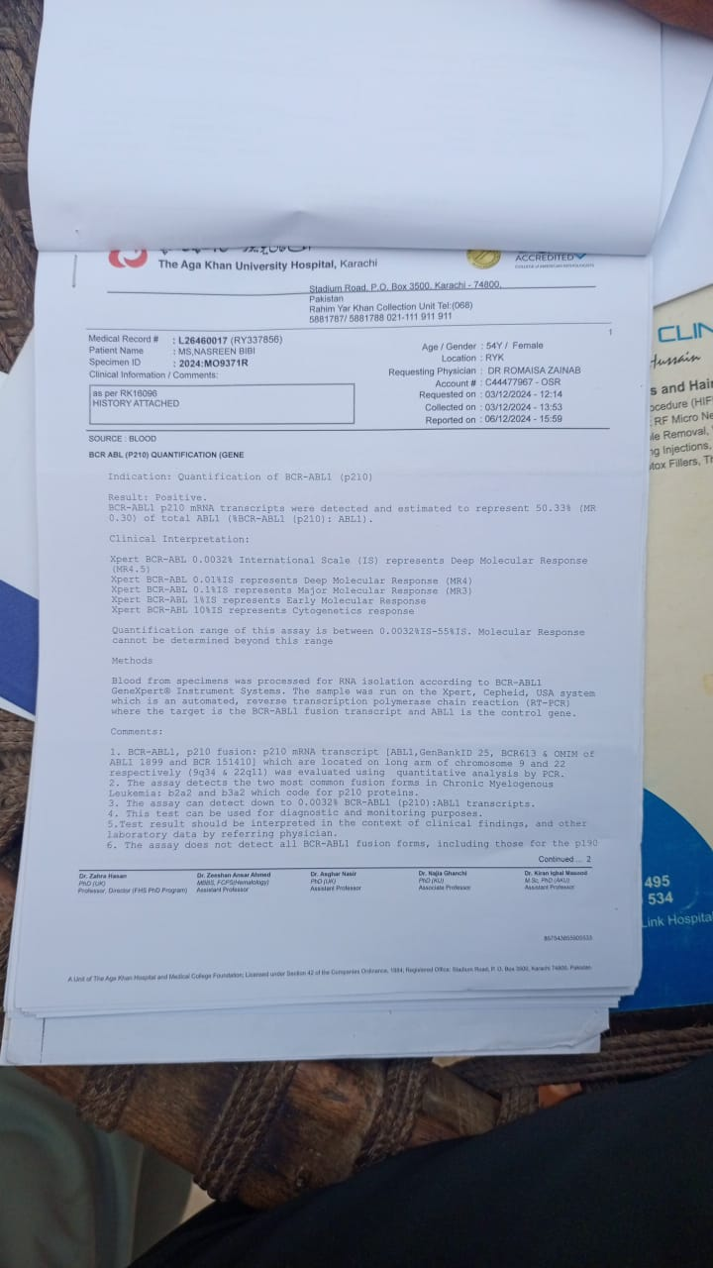
20/12/2023
BCR ABL1 ( P210) quantification gene
48%

Slide 29
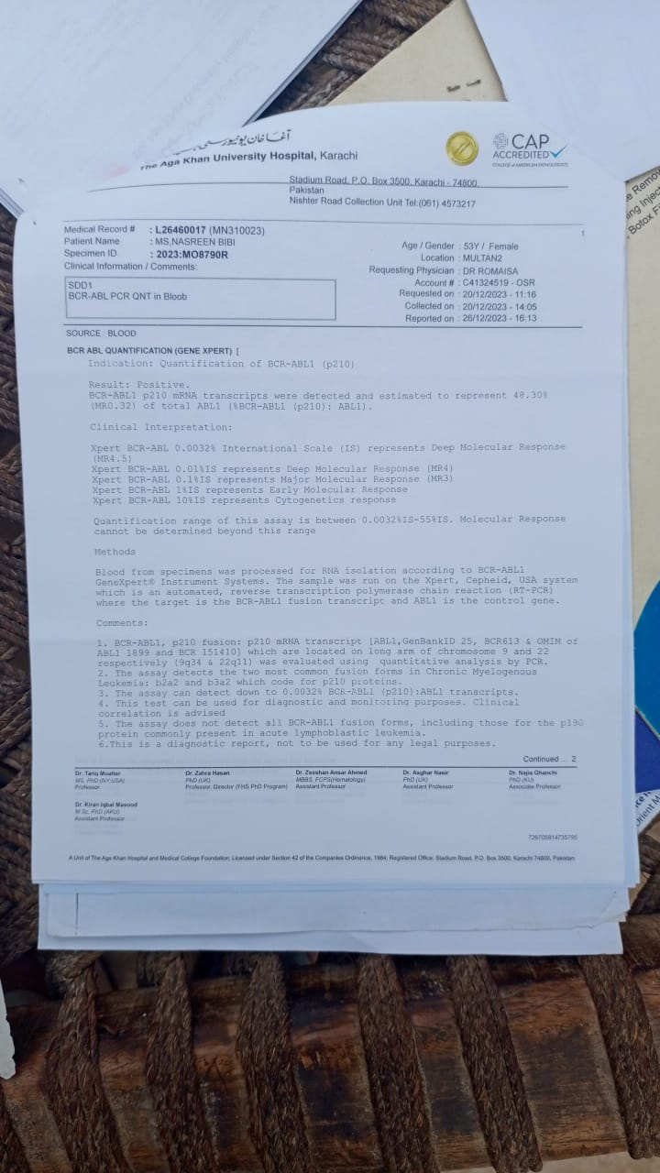
6/12/2024
BCR ABL1 ( P210) quantification gene
50.3%

Slide 30
CBC reporting
17-1-2025
18-2-2025
21-3-2025
21-4-2025
19-5-2025
WBCs 18.9,Hb 11g/dl
WBCs 29,Hb 10.8g/dl
WBCs 43.7 Hb 10.8g/dl
WBCs 38.9 Hb 10.6g/dl
Wbcs 42.9 Hb 10.5g/dl

Slide 31
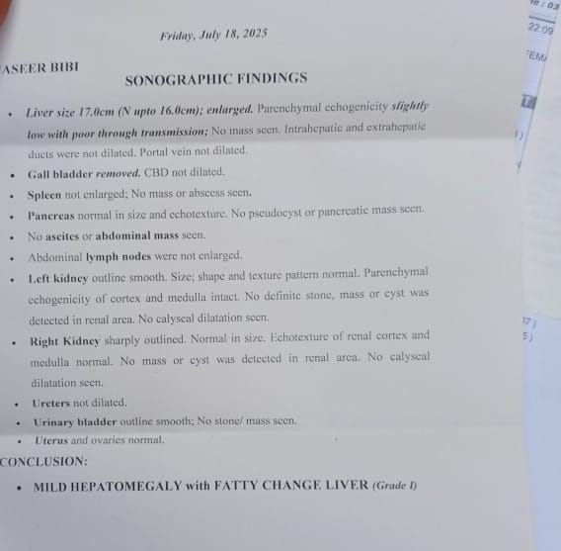
18-july-2025 USG
hepatomegaly
spleen was not enlarged

Slide 32
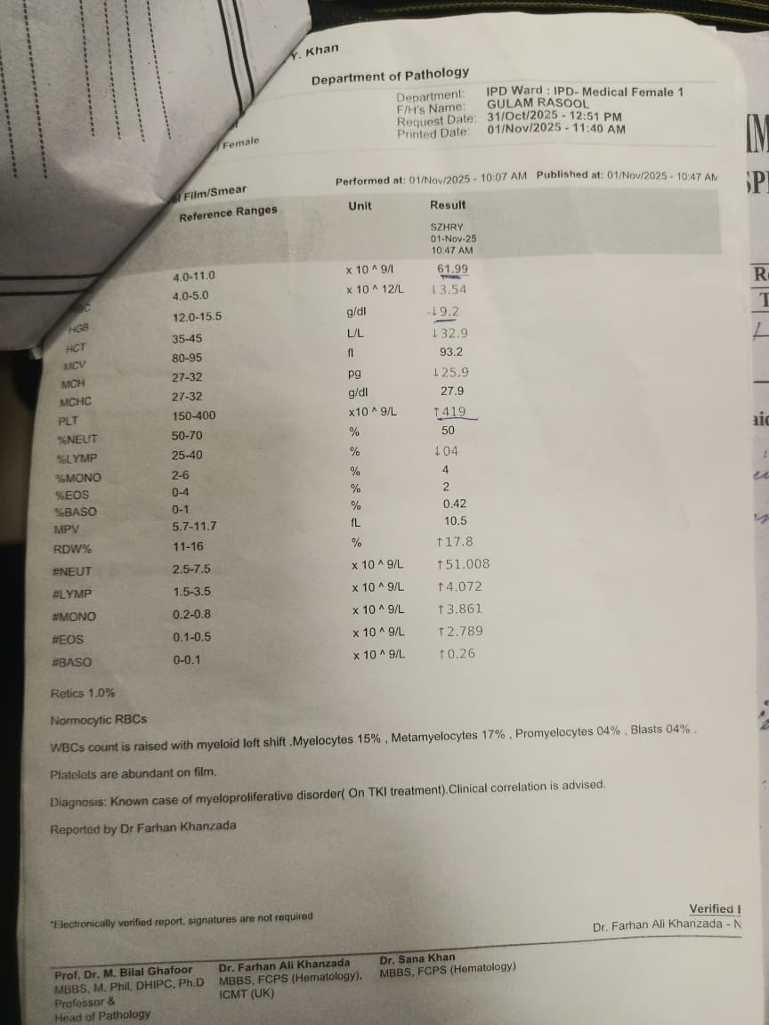
1/11/2025
CBC with peripheral morphology
Hb 9.2g/dl
Wbc 61.99x10^9/l ( 4-11)
Plt 419x10^9/l ( 150-400)
LYMP% 04 (25-40)
Neutrophils 50 ( 50-70)
normocytic RBCs
Wbc raised myloid left shift myelocyte15%,
metamyelocyte 17% promyelocyte4% blast 4%
thrombocytosis

Slide 33
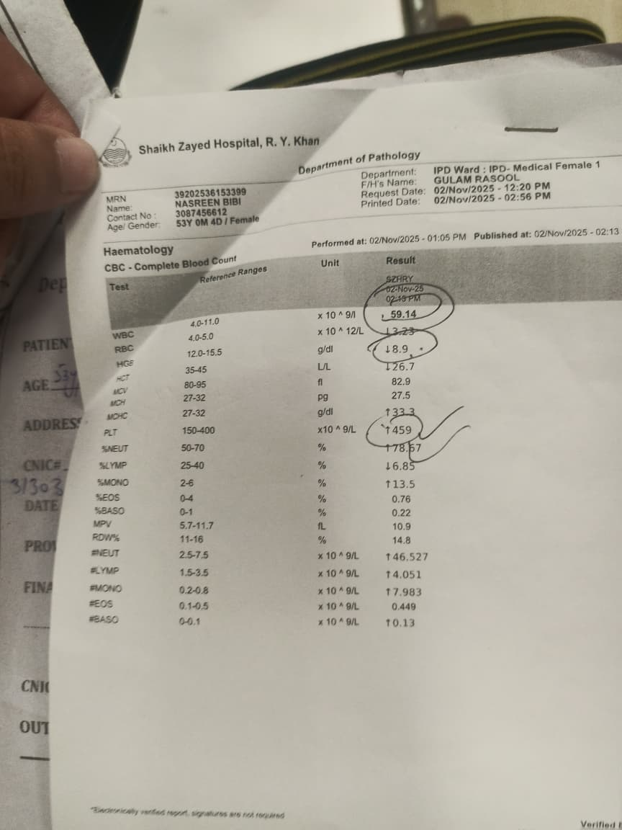
Cbc follow up
Hb 8.9g/dl
Wbc 59.14x19^9/l
Plt 459x10^9/l
MONOCYTES 13.5 % ( 2-6)
Neutrophils 78.5 ( 50-70)

Slide 34
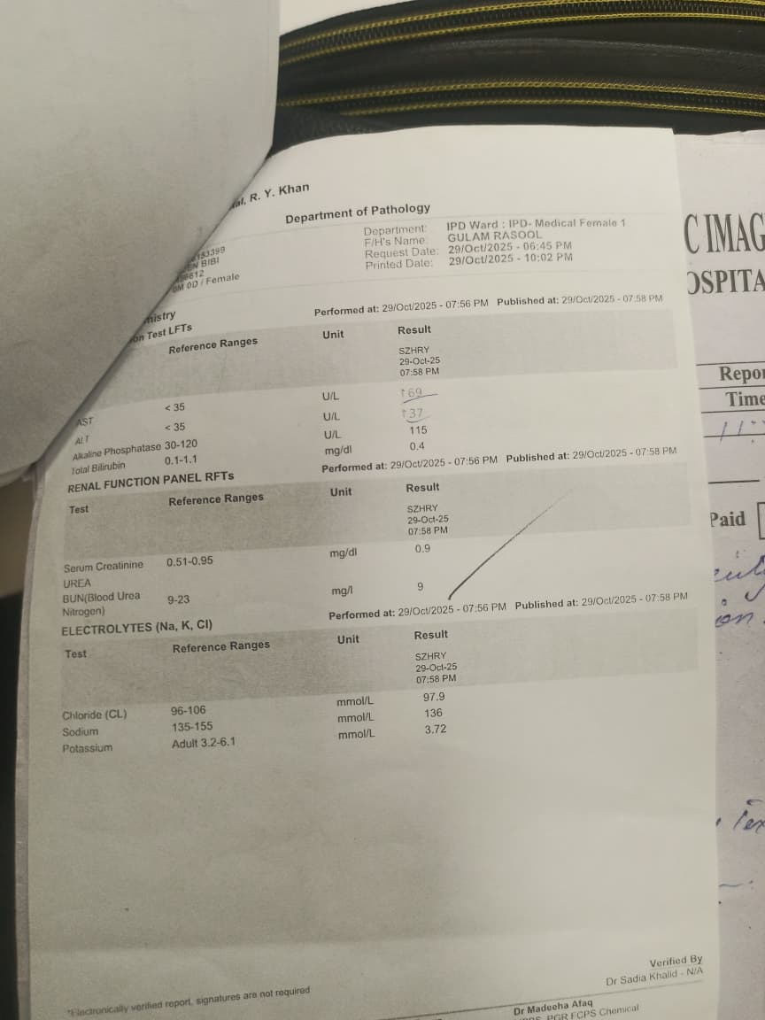
LFT and RFT and ELECTROLYTES
AST 69U/L ( <35)
ALT 37U/L ( <35)
ALP 115U/L ( 30-120)
Bilirubin 0.4 ( 0.1-1)
Serum creatine urea 0.9mg/dl (0.5-0.95)
BUN 9mg/dl ( 9-23)
CL 97.9mmol/L (N)
Sodium 136mmol/L (N)
Potassium 3.72mmol/L ( N)

Slide 35
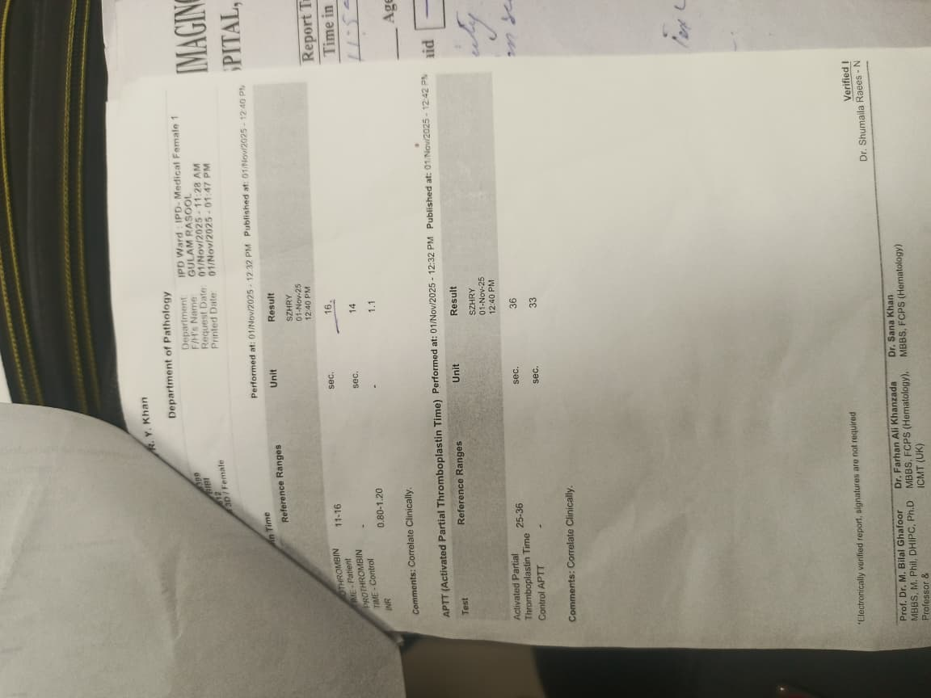
Coagulation profile
Pt 16sec ( 11-16)
Activated partial thromboplastin time (aptt) 36sec (25-36)
INR 1.1 ( 0.8-1.2)

Slide 36
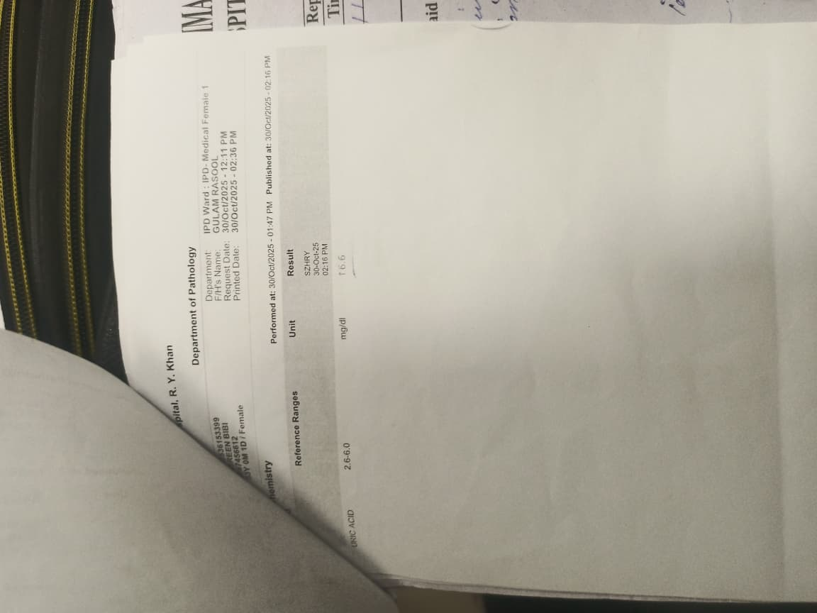
Uric acid
6.6mg/dl ( 2.6-6)

Slide 37
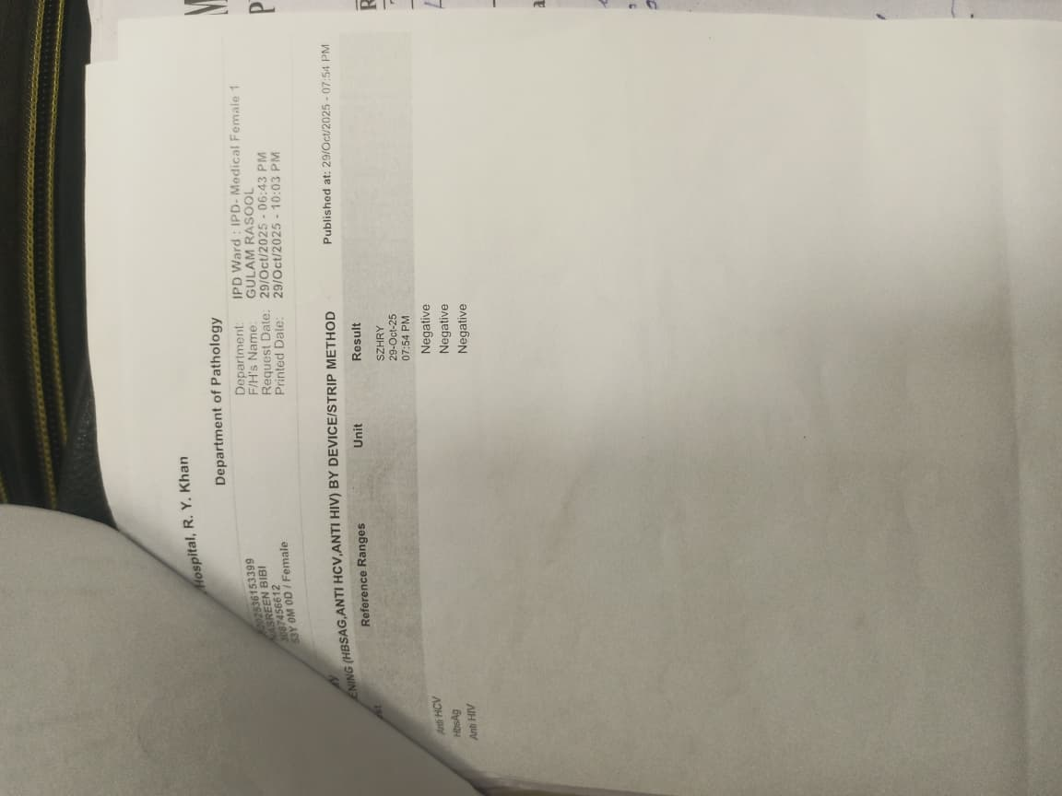
VIRAL MARKER
Hbsag negative
Anti hcv negative
Anti HIV negative

Slide 38
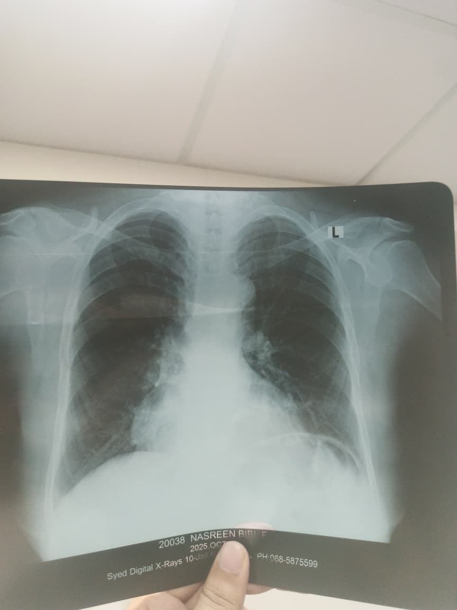
CXR
Normal

Slide 39
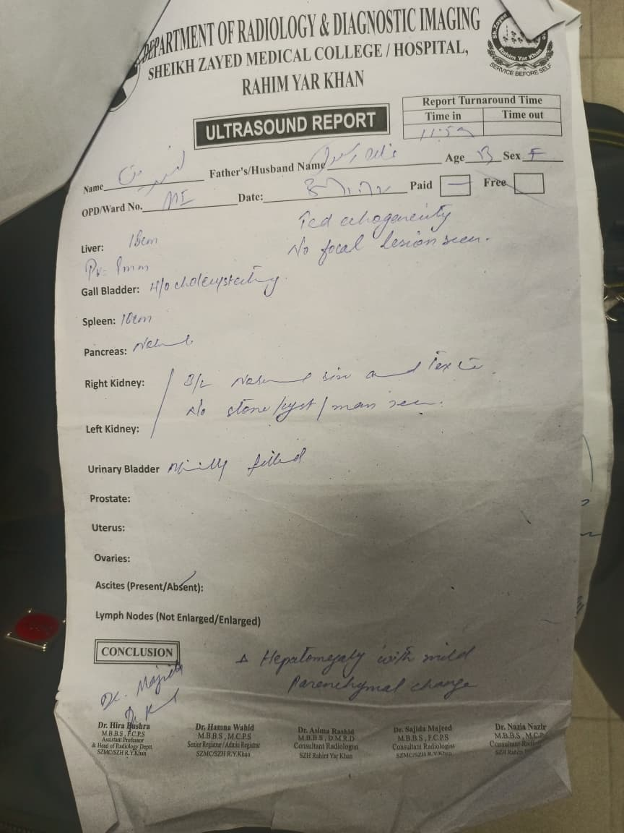
USG
spleen was not enlarged
Hepatomegaly with mild parenchymal change

Slide 40
Bone marrow biopsy is planned on monday
Treatment plan might change based on biopsy report.

Slide 41
Differentials
Infection(no cough , sputum, urinary GI symptoms no foci of fever on history crackles and clear xray, raised WBCs not neutrophillic infection)
As for gum bleed it was due to local cause and treated by putting adrenaline gauze.

Slide 42
Provisional diagnosis
Fever bone pain hepatomegaly suggesting organ involvement marked leukocytosis thrombocytosis anemia left shift , 4% blasts suggest complications including anemia lymphocytosis thrombocytosis and change in phase of CML (ACCELERATED PHASE OF CML ). However final diagnosis whether it is accelerated phase or blast phase will be made on the basis of biopsy.

Slide 43
MANAGEMENT
Patient was given:
Antipyretics
Antibiotic
Blood transfusion
Imatinib was continued as for now and biopsy is planned.
Further management will be according to bone marrow biopsy report.

Slide 44
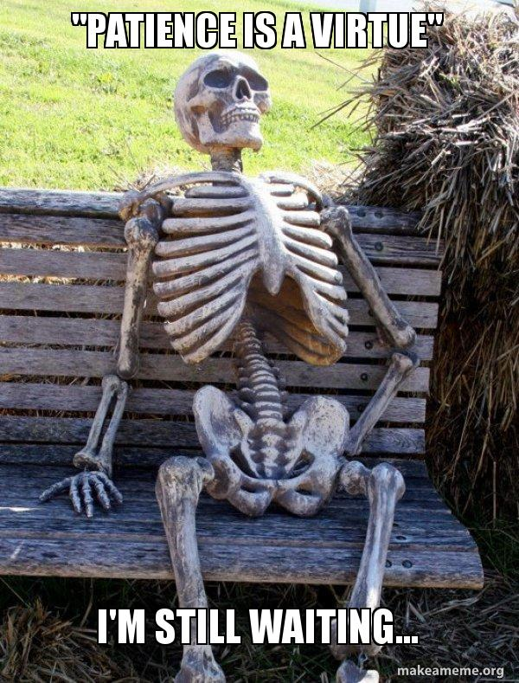

Slide 45
THANK YOU
THANK GOD

