Slide 1
Clinico-pathological conference
Medical unit II
Dr. Shehroze Malik
Dr. Jawaria Bano
Dr Fariha Hanif

Slide 2
HISTORY OF THE PATIENT

Slide 3
BIODATA
Name: Irshad Bibi
Wife of Ghulam Mustafa
Age: 55 Years
Marital Status: Married
Muslim
House wife
Address: Khanpur
MOA: OPD
DOA: 11/11/2025

Slide 4
PrESENTING COMPAINts
Headache --- 7 days
Drooping of Left Upper Eyelid --- 5 Days

Slide 5
History of presenting illness
My patient was in Usual state of health 1 week back when she developed headache in the peri-orbital region which was gradual in onset initially mild in intensity (she was able to perform routine activities) then became severe after 2 days (routine activities were hampered), pressing in character, not radiating not shifting, aggravated by noise, temporarily relieved by paracetamol, not associated with fever, neck-pain, redness of eyes & lacrimation, but associated with vomiting.

Slide 6
Continued….
Vomitting was sudden in onset multiple episodes, copious in amount, non-projectile after taking meal containing food particles, yellowish in color, not blood-tinged, not foul-smelling. It was not associated with abdominal pain, heartburn, constipation and diarrhea.

Slide 7
Continued…
Drooping of eyelid was sudden in onset, without loss of vision(For vision, she had to move her eyelid manually) associated with temporal headache not associated with jaw pain on chewing, joint pain, hemoptysis, hematuria, oral ulcer, alopecia, weakness of any limb, diplopia, facial deviation, focal deficit, tremors or fits. There is no previous history of head trauma and CVA(stroke).

Slide 8
Systemic review
CNS: No history of ALOC, difficulty in speech, vertigo, numbness and paresthesia, rigidity, tremor or gait disturbance
CVS: No chest pain, SOB, Orthopnea, PND, Palpitation, Claudication, pedal edema
GIT: No constipation, abdominal pain, melena, hematemesis, yellow discoloration of eyes.
Respiratory: No Cough, shortness of breath, wheezing, coughing up blood (hemoptysis)
Urogenital: No oliguria, dysuria, hematuria, frothy urine, burning micturition
Hematological: No fever, fatigability, bleeding from any site, lumps and bumps in the body, bone pain
Endocrine: No weight gain or loss, heat or cold intolerance, polydipsia, polyphagia, polyuria

Slide 9
Past medical and surgical history
Not significant

Slide 10
Comorbidities
She has no history of HTN previously, but upon her admission in hospital she was having raised blood pressure
No history of Diabetes Mellitus, IHD, TB, Hepatitis, Asthma, Epilepsy

Slide 11
Family History
No history of Diabetes Mellitus, HTN, IHD, TB, Asthma, Epilepsy

Slide 12
PERSONAL HISTORY
There is No history of smoking, alcohol abuse, or any other addiction, no drug allergy. Sleep and appetite is normal. There is No history of blood transfusion and bowel habits are normal.

Slide 13
Socioeconomic history
Living in non-cemented house having two rooms with ten persons living, using tap water.
Per month income is 15 Thousands

Slide 14
Menstrual and obstetric history
Menarche at 13 years of age having regular cycle with normal flow, having menopause for last 7 years.
8 pregnancies, all delivered by SVD at term with no complications

Slide 15
Differential diagnosis

Slide 16
Ischemic Midbrain Stroke
Giant cell Arteritis
Mononeuritis Uniplex
Horner’s syndrome
Migraine
Posterior communicating artery (PCom) aneurysm
SOL BRAIN

Slide 17
Examination of the patient

Slide 18
General appearance
I have examined a middle age female,of average weight and height, lying comfortably on bed, conscious, cooperative and oriented with time, place and person with obvious ptosis having IV line in place
Vital Signs:
BP: 150/ 80 mmHg on left arm and 140/80 mmHg on right arm
Pulse: 62 beats/min
RR: 18 breaths/ min
Temperature: 98F

Slide 19
General physical examination
There is no clubbing, cyanosis, koilonychias, leukonychias, splinter hemorrhage, palmar erythema, duptyren’s contracture, tremors in hands.
In eyes, there is drooping of left upper eyelid, but there was no jaundice and pallor.
Oral hygiene is satisfactory.
JVP not raised, thyroid was not enlarged
Edema was absent.
There was no lymphadenopathy.

Slide 20
CNS EXAMINATION
Cranial Nerves:
Occulomotor (Ptosis on left side. Direct and indirect light reflex are normal. Left eye was down and out. Upon examination of extra ocular movement left eye was unable to abduct and move in suprolaleral , supromedial and inferomedial direction). Fundus was also normal with no hypertensive changes
Conclusion: Pupil sparing left 3rd nerve palsy
All the remaining cranial nerves are intact.

Slide 21
Continued…
Higher mental functions: Intact
GCS: 15/15
Speech: Normal
Sensory System : Intact
Motor System: Normal bulk and tone and power is 5/5 in all the four limbs. Planters are down going bilaterally. Knee jerk is exaggerated and clonus was present at ankle
SOMI are negative

Slide 22
Cardiovascular System
Chest shape was normal, no visible pulsations or deformity.
Apex beat felt at 5th intercostal space, midclavicular line.
No thrills or heaves.
First and second Heart sounds are normal; no murmurs or extra sounds.

Slide 23
Respiratory System
Chest wall symmetrical, no deformity.
Trachea central.
Normal chest expansion bilaterally.
No use of accessory muscles of respiration.
Breath sounds vesicular, no added sounds (no wheeze, crackles, or rubs).

Slide 24
Abdominal examination
Abdomen soft, flat, and moves with respiration.
No scars, distension, or visible pulsations.
No tenderness, guarding, or rigidity.
No palpable organomegaly (liver, spleen, kidneys not palpable).
Bowel sounds normal.

Slide 25
Case summary
A 48 year female presented with left periorbital headache for 7 days and dropping of left upper eyelid for 5 days . On examination the left eye was down and out alongwith complete ptosis , pupil size and light reflexes(both direct and consensual) were normal. Visual acuity is also normal. Rest of the examination is unremarkable.

Slide 26
Investigations

Slide 27
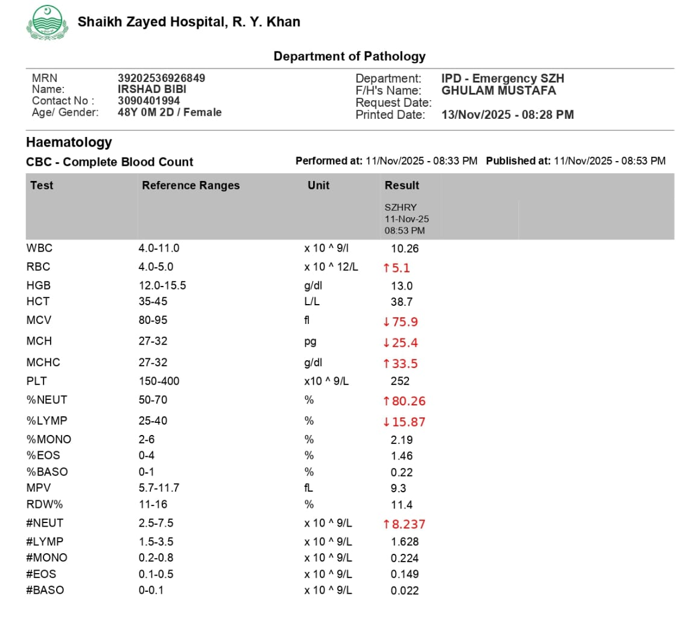
Complete Blood Count(CBC)

Slide 28
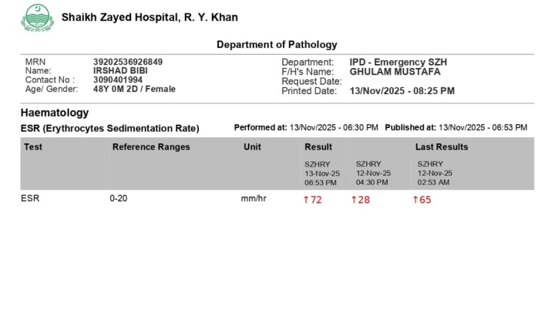
Erythrocyte Sedimentation Rate(ESR)

Slide 29
Blood Sugar Random
141mg/dL

Slide 30
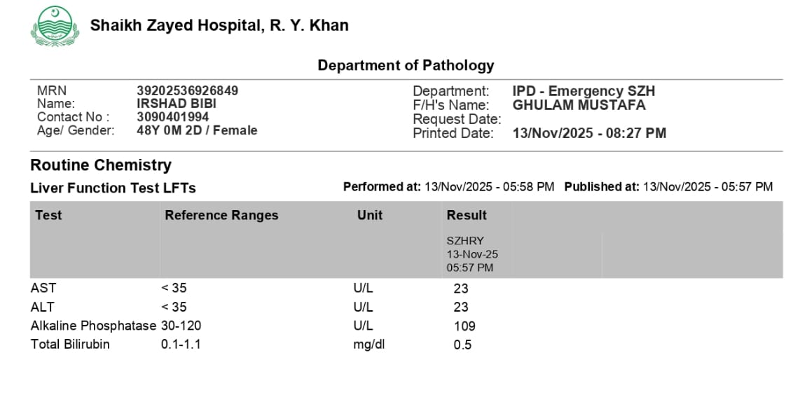
Liver Function Tests (LFTs)

Slide 31
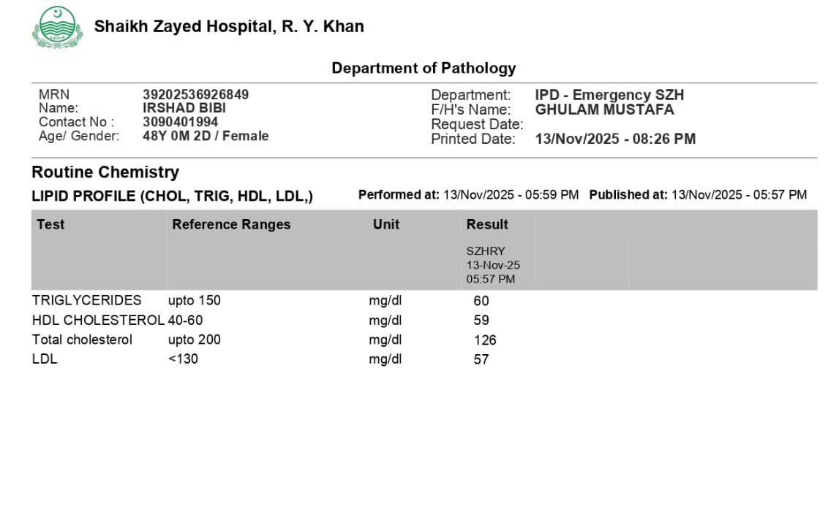
Lipid Profile

Slide 32
Renal Function Tests(RFT)
Creatinine: 0.7 mg/dl
Urea: 50 mg/dl

Slide 33
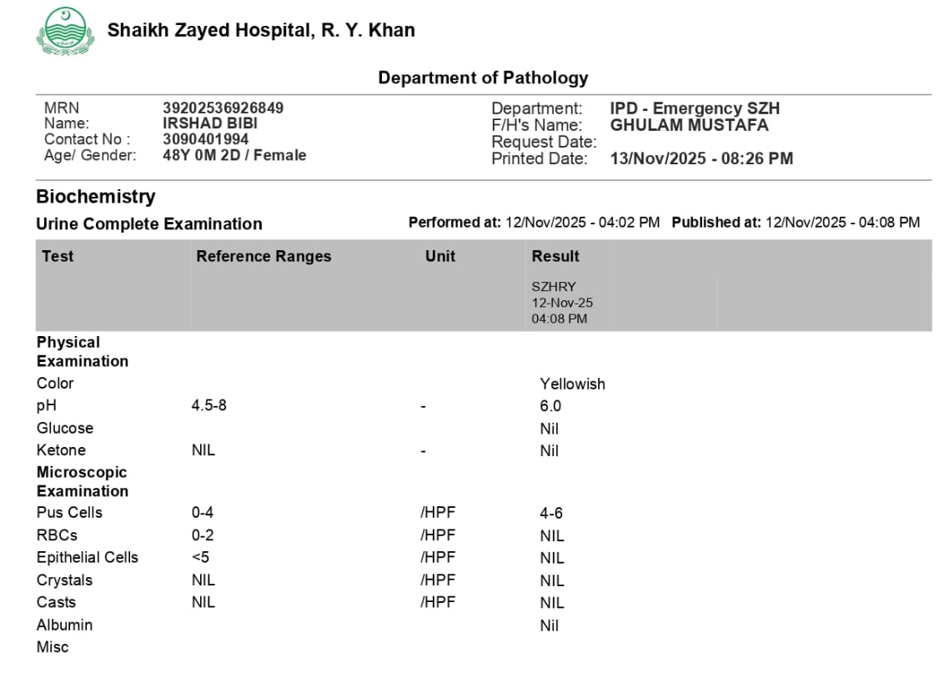
Urine Complete Examination

Slide 34
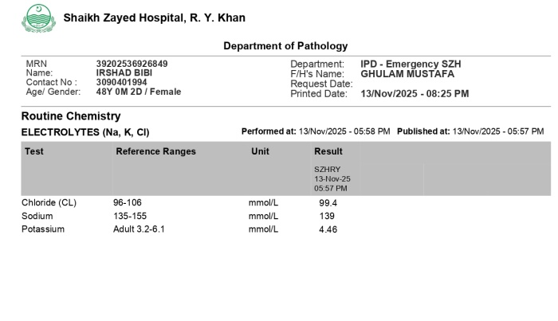
Serum Electrolytes

Slide 35
Serology
Antinuclear Antibody(ANA) Negative

Slide 36
MRI Brain
Findings:
The CSF spaces are prominent.
Normal MRI appearance of the thalami, internal and external capsules on both sides.
No Hemorrhage or Infarction seen.
No midline shift is identified.
Normal features of the cerebellar hemispheres, vermis, peduncles and brain stem with no abnormal intensities.
Normal MRI features of the cerebello-pontine angles and internal auditory canal. Normal configuration of the optic chiasma, optic nerves, extra-ocular muscles, optic disc, pituitary gland and its stalk.
CONCLUSION: CEREBRAL ATROPHY

Slide 37
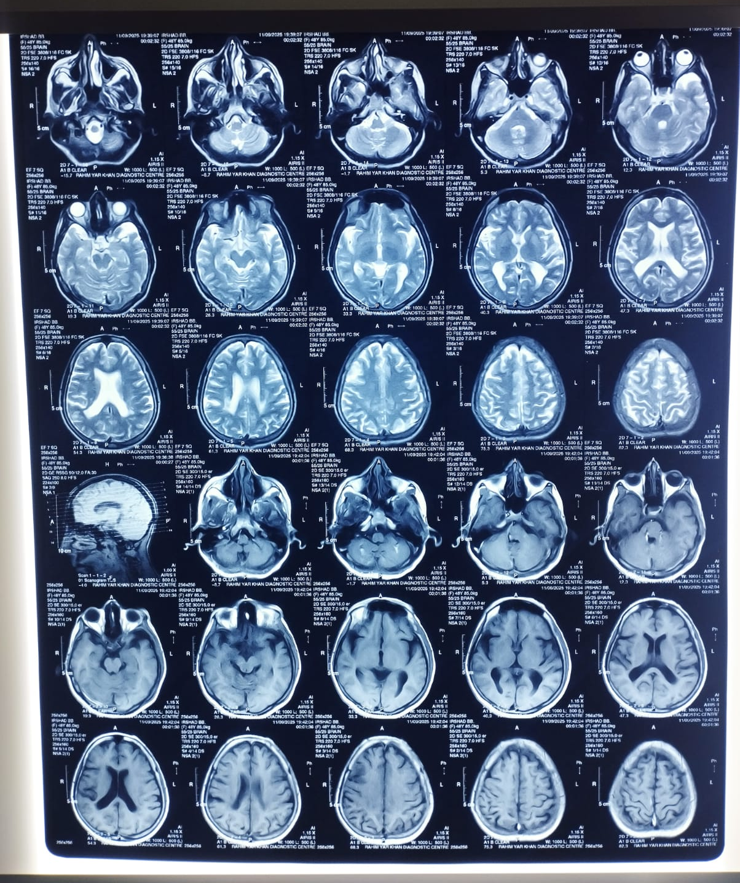

Slide 38
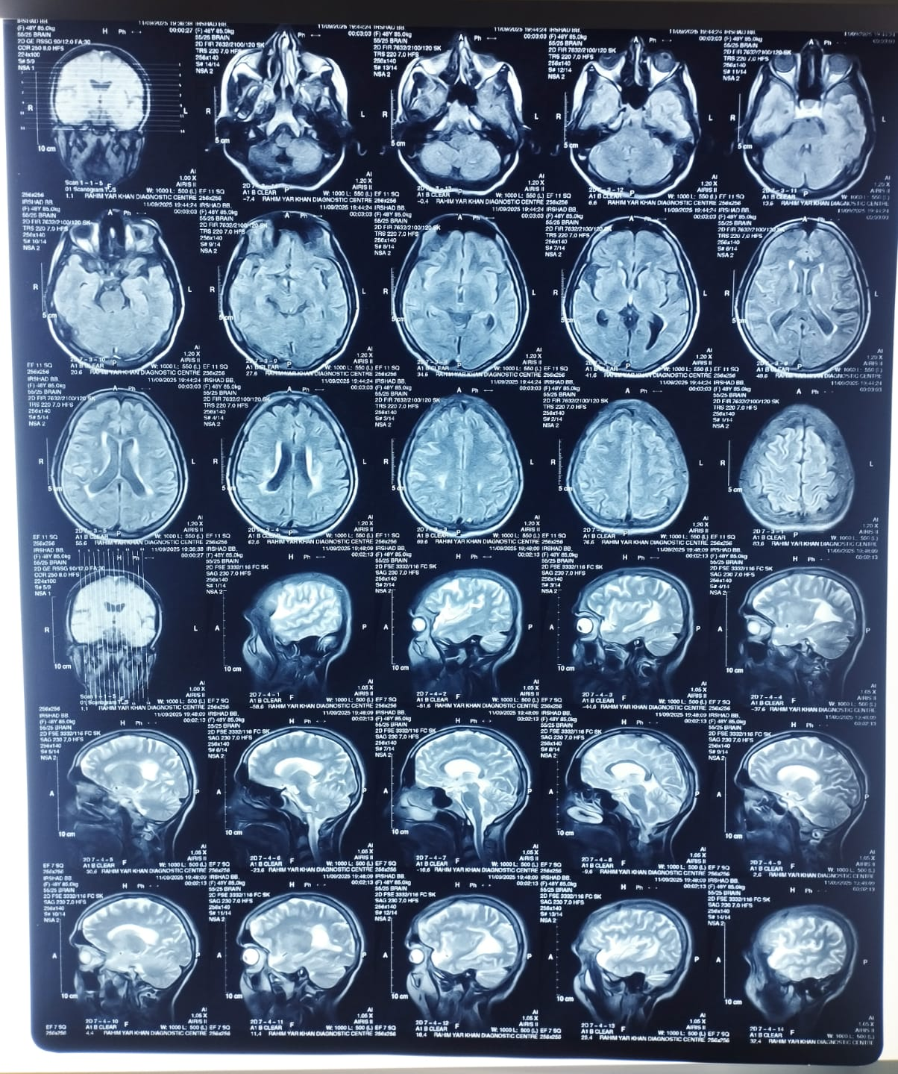

Slide 39
Mra Brain and orbit

Slide 40
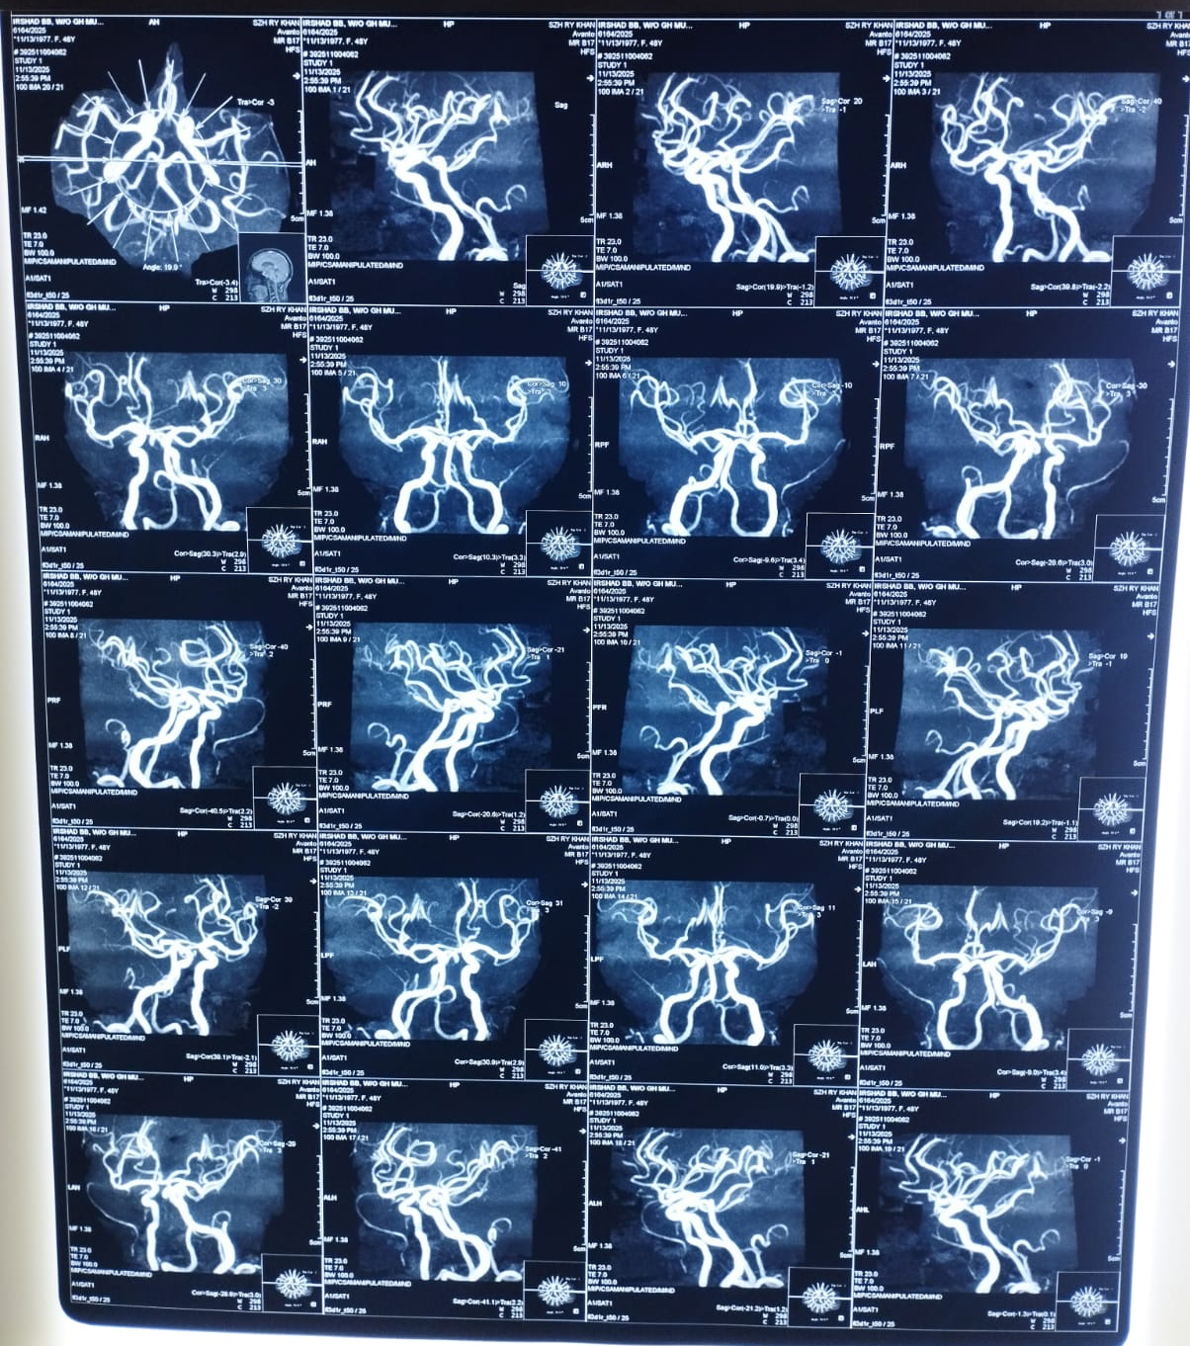

Slide 41
THANK YOU

