Slide 1


Slide 2
CHRONIC KIDNEY DISEASE
PRESENTOR: DR TANZEELA ASGHAR
(PGR NEPHROLOGY) – MEDICAL UNIT - III

Slide 3
Key points
Definition
Classification
Pathophysiology
Diabetic nephropathy
Clinical manifestations
Acute complications
Management
Goals of therapy
Workup
Treatment

Slide 4
CHRONIC KIDNEY DISEASE
Kidney function
Glomerular filtration rate (GFR) <60ml/ min/1.73m2 for > 3 months with or without kidney damage.
AND/OR
Kidney damage
with or without decreased GFR, manifested by either
Structural abnormalities ( imaging)
Histologically established disease
Markers of kidney damage i.e, proteinuria (albuminuria), urine albumin-to-creatinine ratio (uACR >30mg/g).

Slide 5
Classification of CKD
Stage | GFR (ml/min/1.73m2) | Description
1 | >90 | Normal or high
2 | 60-89 | Mild decrease
3a | 45-59 | Mild to moderate decrease
3b | 30-44 | Mod to severe decrease
4 | 16-29 | Severe decrease
5 | <15 | End stage or approaching end-stage
5D | <15 | On dialysis

Slide 6
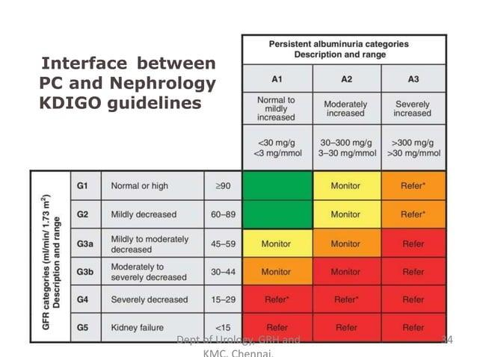

Slide 7
CKD vs. ESRD vs. Uremia
Severe form of CKD: Kidney failure (eGFR < 15)Kidneys cannot maintain homeostasis. Kidney failure is associated with fluid, electrolyte, and hormonal imbalances and metabolic abnormalities.
ESRD means the patient needs dialysis or renal transplant.
Uremia is the term used to describe the symptoms or symptom complex attributable to advanced renal failure or end-stage renal disease.

Slide 8
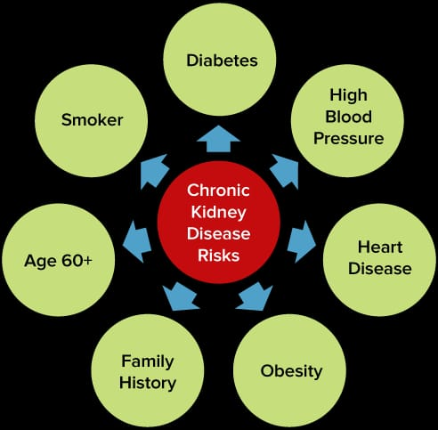
RISK FACTORS
Diabetes mellitus ( 37% )
Hypertension ( 24%)
Glomerulonephritis ( 18% )
Cystic kidney disease ( 07% )
Infective or obstructive (03% )
Miscellaneous ( 07%) – analgesic nephropathy, HIV-related, TB, AIN, trauma
Unknown (04% )

Slide 9
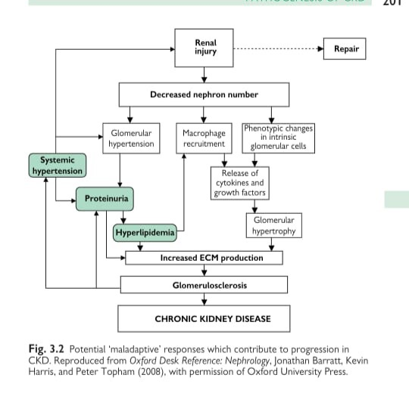
Pathophysiology

Slide 10
Diabetic nephropathy
1.Hyperglycemia → Hemodynamic Changes
Glucose ↑ → Glomerular hyperfiltration
↑ Intraglomerular pressure
Leads to early glomerular injury
2. Glomerular Structural Damage
Mesangial expansion → glomerulosclerosis
GBM thickening → albuminuria
Podocyte injury & loss → protein leakage ↑
3. Tubulointerstitial Injury
Filtered proteins → inflammation, oxidative stress
→ Tubulointerstitial fibrosis
4.Final Outcome
Progressive nephron loss
Declining GFR
CKD → ESRD

Slide 11
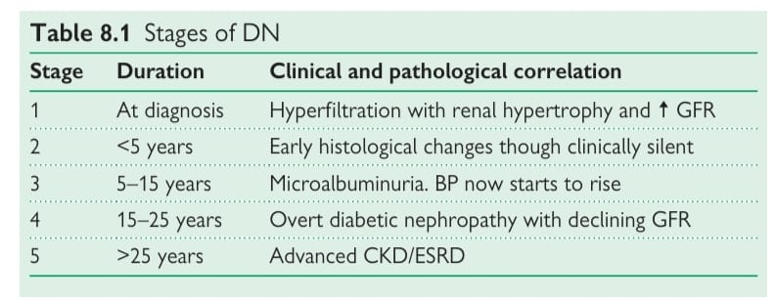
Diabetic Nephropathy

Slide 12
CLINICAL MANIFESTATIONS
(The Uremic Syndrome – System-Wise Features )
1. Water, Electrolyte & Acid–Base Balance
Breathlessness due to volume overload, and Kussmaul breathing due to acidosis.
Effects of high or low potassium

Slide 13
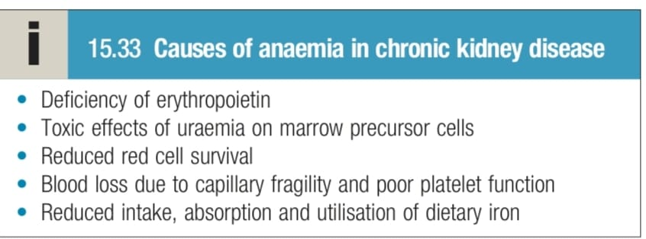
2. Haematological System
Anaemia (symptomatic).
Bleeding tendency ( uremic thrombasthenia)

Slide 14
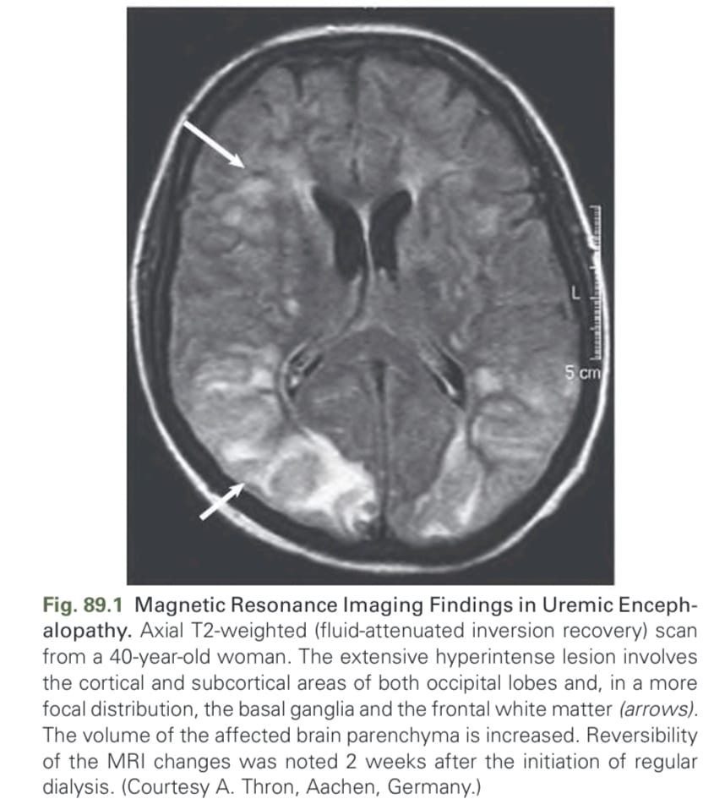
3. Cardiovascular / Respiratory
Cardiac failure (fluid overload, ↑ BP, anaemia, ↓ LV function).
Accelerated atherosclerosis → angina, stroke, PVD, vascular calcification.
Pleuritis / pleuropericarditis.
Arrhythmias secondary to electrolyte imbalance
4. Nervous System
Hypertensive stroke, encephalopathy.
Anxiety, depression, psychological disturbances.
Impaired cognition.
Peripheral + autonomic neuropathy.
Abnormal movements (restless legs).
Decreased consciousness, seizures (late)

Slide 15
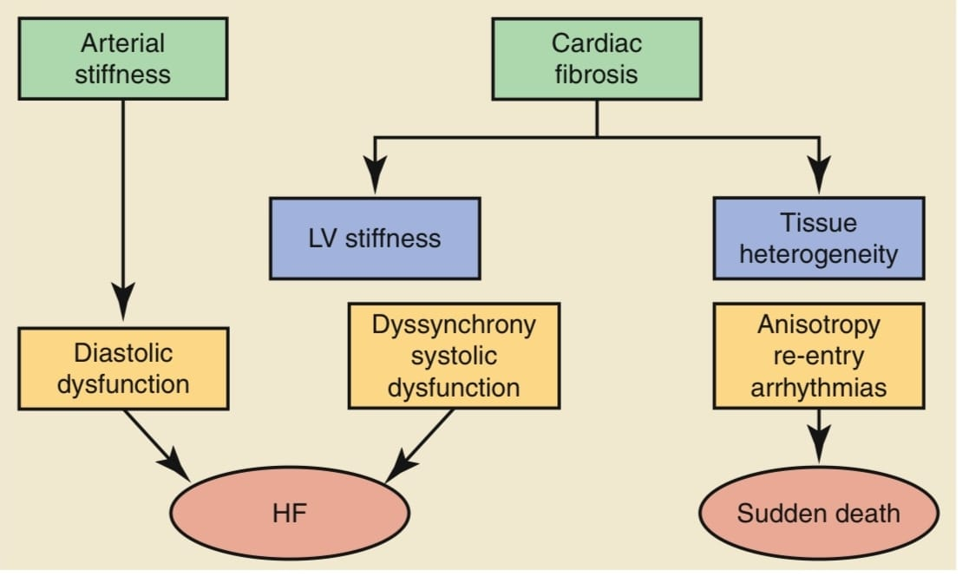

Slide 16
6. Gastrointestinal (UREMIC GASTRITIS)
Nausea, anorexia, malnutrition.
GI bleeding (ulcers, angiodysplasia).
Fetor, constipation, diarrhea (enteritis)
1.Uremic toxins :
Directly injure gastric epithelial cells
Increase oxidative stress
Alter mucosal permeability & impair mucosal healing
2. Gastrin
Dyspepsia, ulcers

Slide 17
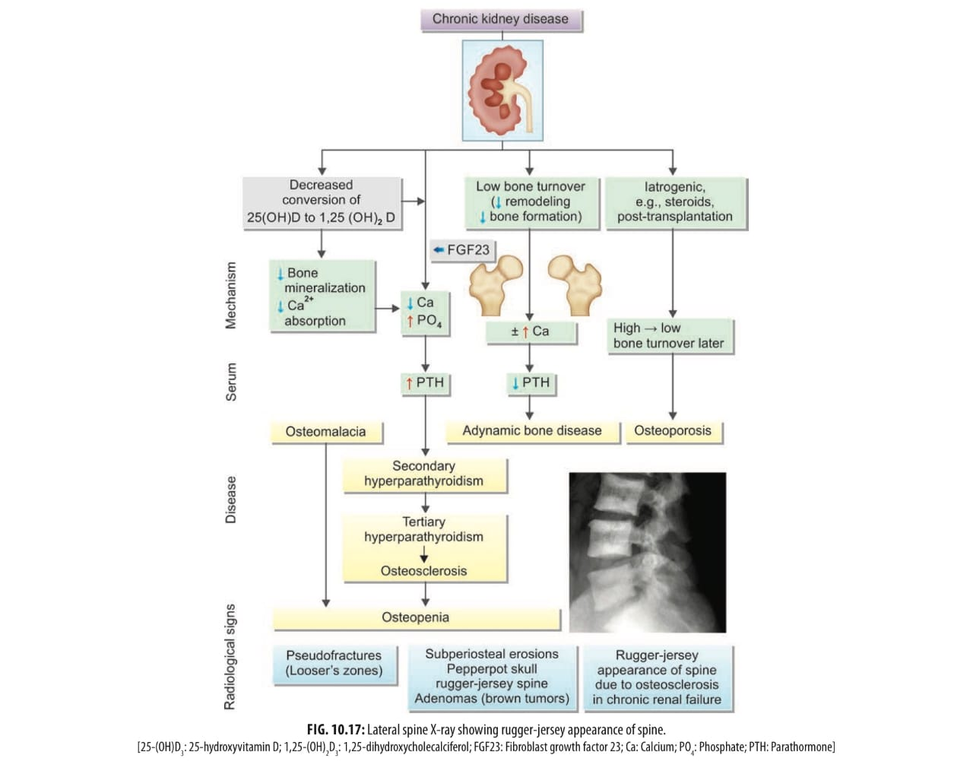
7.Bone and mineral metabolism
Abnormal vitamin D & PTH metabolism.

Slide 18
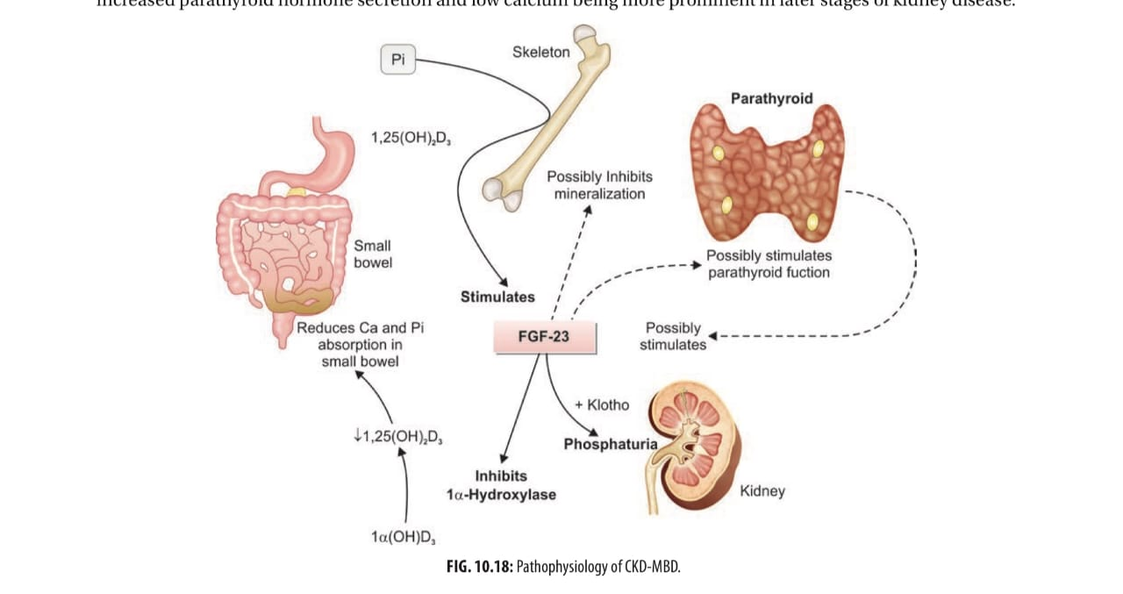
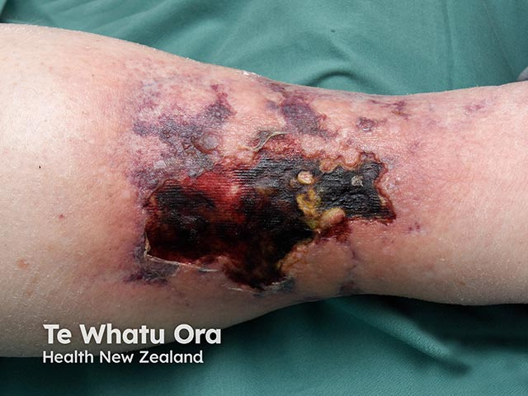
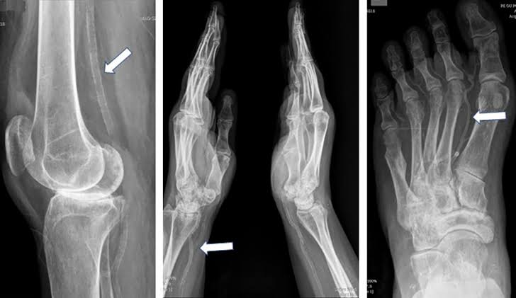

Slide 19
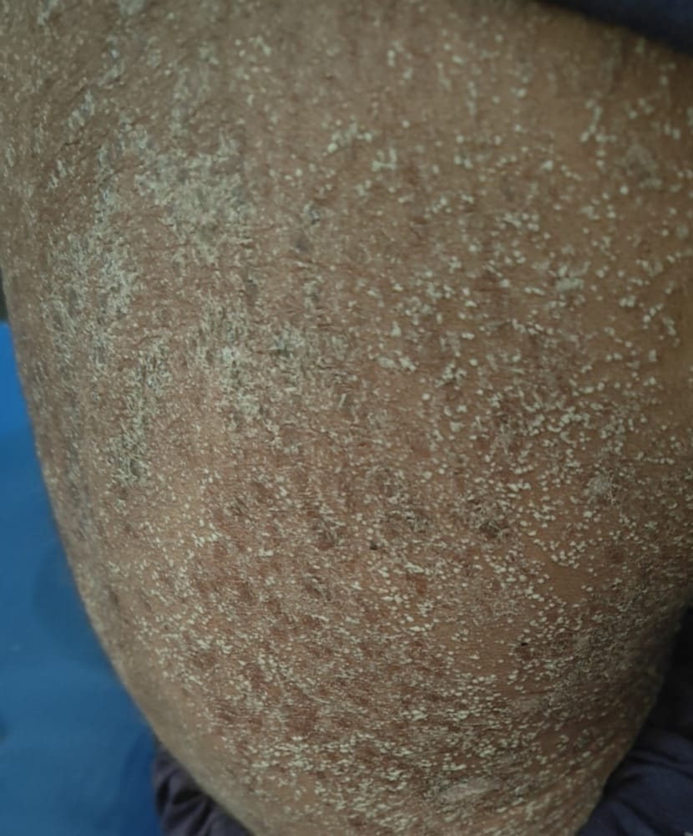
8. Skin
Dry skin, nail changes, pruritus.
Bullous eruptions.
Pallor, pigmentation.
Uraemic frost (late)

Slide 20
Acute complications
In the emergency department, chronic kidney disease (CKD) can present with several acute or life-threatening manifestations, especially during episodes of acute-on-chronic kidney injury;
Fluid overload
Hyperkalemia
Metabolic acidosis
Uremic encephalopathy (seizures)
Uremic pericarditis
Bleeding( upper gi bleed)
Notes:
Triggered by dehydration, sepsis, nephrotoxic drugs, heart failure)

Slide 21
MANAGEMENT

Slide 22
Laboratory tests
Blood tests
creatinine and urea(BUN)
Serum electrolytes & ABGs
Cbc
sr.iron and TIBC
Albumin,calcium ,phosphate, pth levels
Urinanalysis
Other tests
Imaging ( USG, CT, MRI)
Renal biopsy
Renal scan

Slide 23
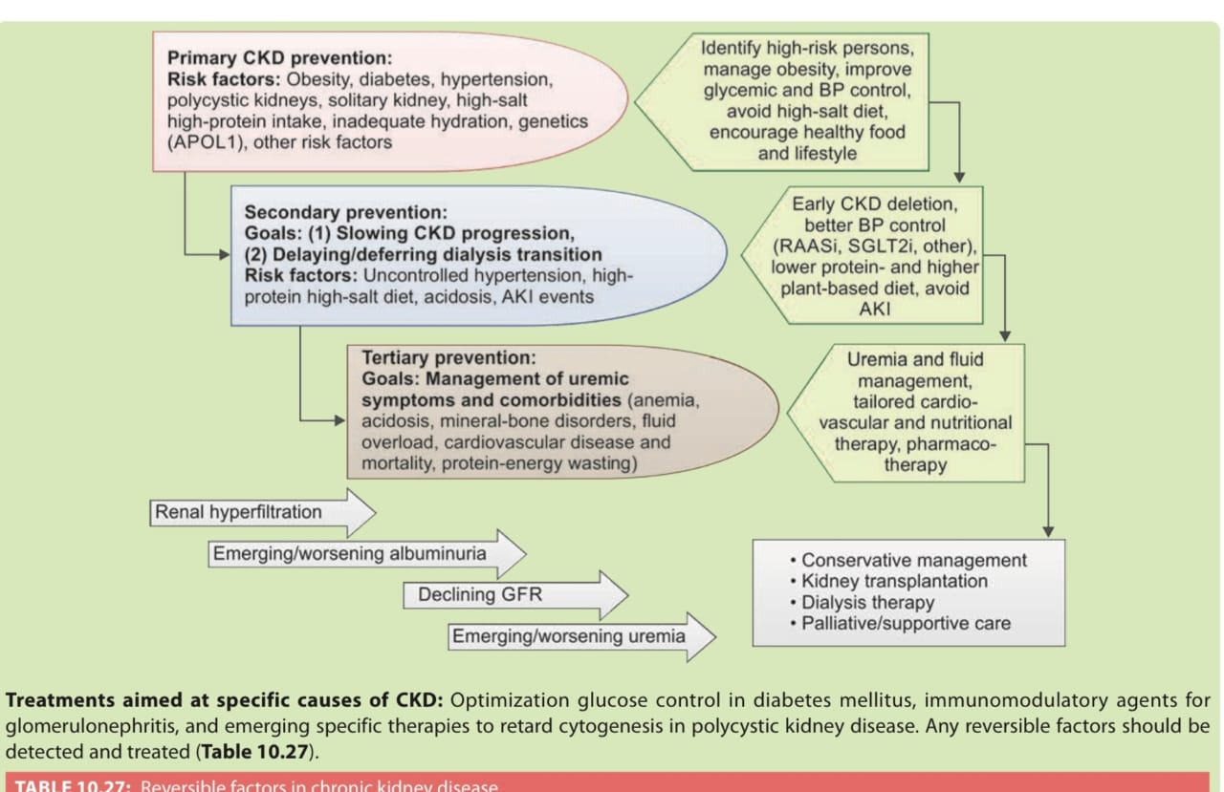
Goals of treatment
To preserve renal function
To delay the need for RRT as long as possible
Manage extra-renal manifestations
To provide good quality of life to patient
and significant others.

Slide 24
Dietary management
1.Protein: CKD 3–5 (non-dialysis): restrict to 0.6–0.8 g/kg/day
Dialysis: increase to 1.2–1.4 g/kg/day
2. Sodium : Limit to < 2 g/day (≈ 5 g salt)Avoid processed/salty foods → helps with BP & edema.
3. Potassium: Restrict if hyperkalemic or eGFR < 30.
Avoid high-K foods (bananas, oranges, tomatoes, coconut water).
4. Phosphorus: Limit dairy, nuts, beans, whole grains, colas, chocolate.
5. Fluids Restrict: If low urine output. Usual: 500–1000 mL + previous day’s urine output.

Slide 25
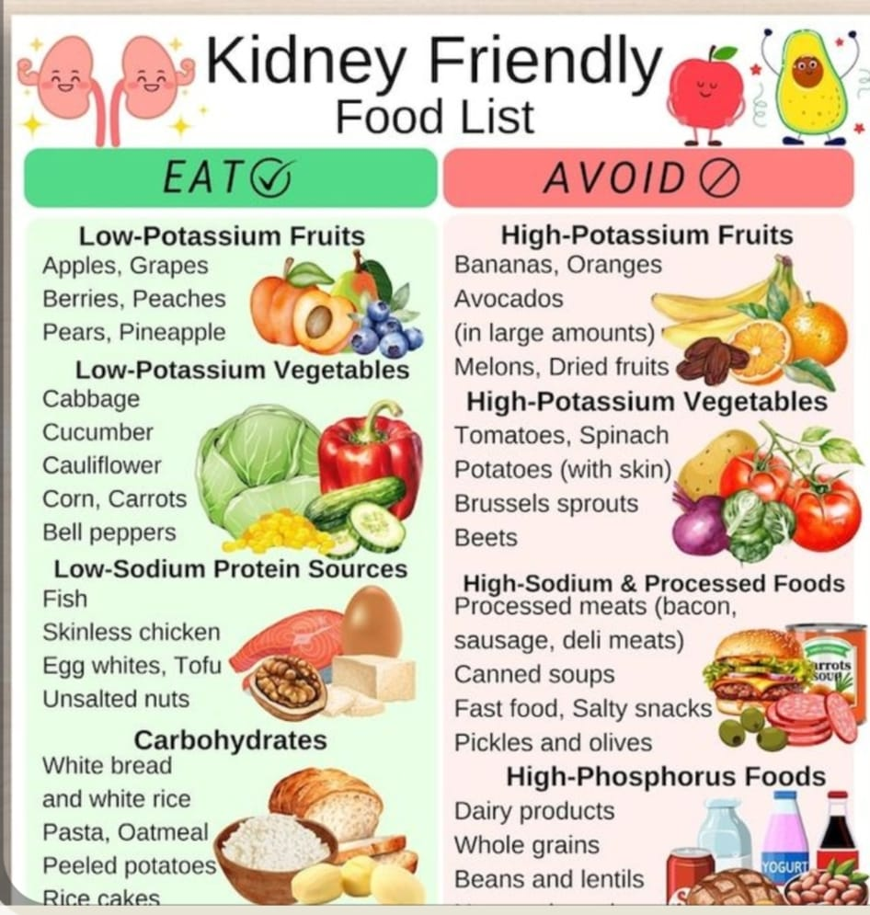

Slide 26
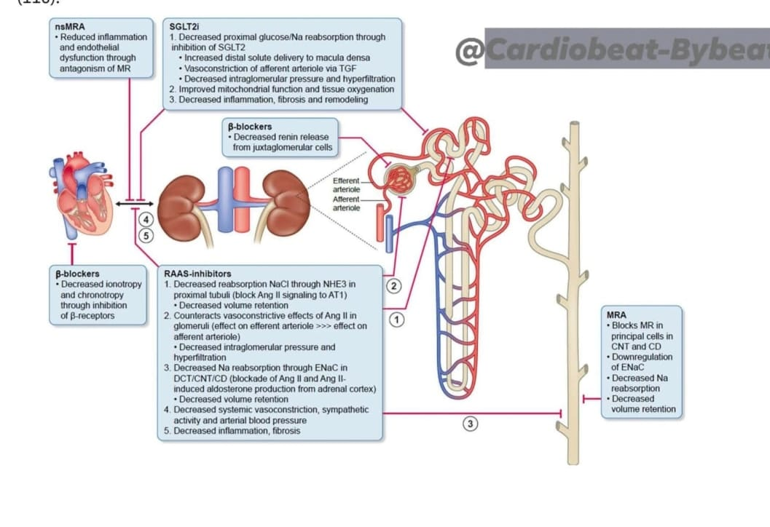
Preserve renal function
Pharmacological therapy
Anti-hypertensive therapy
Goal of therapy is to maintain bp<130/80mmHg in diabetics
and <140/90mmHg in non-proteinuric kidney
Drug of choice:
Ca-channel blockers
B-blockers
ACE/ARBs
Diuretics

Slide 27
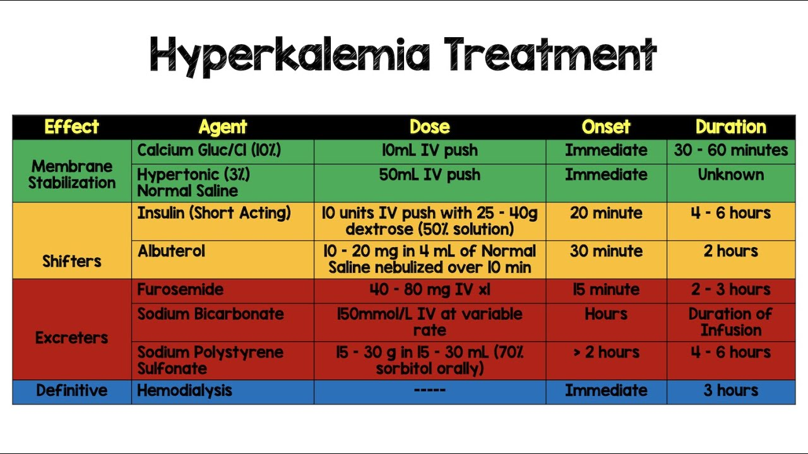
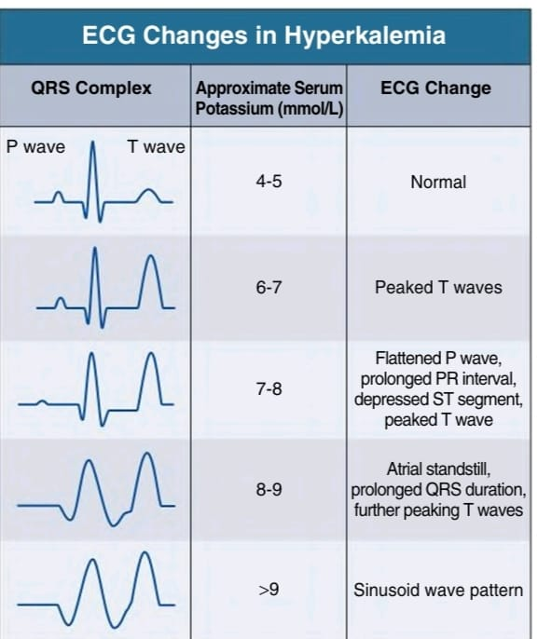
Hyperkalemia

Slide 28
Renal osteodystrophy
1. Control Serum Phosphate.
Dietary phosphate restriction: Avoid: dairy, meat, cola drinks, nuts, processed foods.
Phosphate binders Taken with meals.
Calcium-based binders Calcium carbonate, Calcium acetate→ Use if hypocalcemia (Avoid if hypercalcemia or vascular calcification.)
Non-calcium binders: Sevelamer
Iron-based binders ferrous citrate
2. Correct Vitamin D Deficiency.
3. Manage Secondary Hyperparathyroidism
Goal: PTH in target range (not normal, but 2–9× upper limit in dialysis).
4. Balance Serum Calcium
5. Dialysis adjustment:
6. Refractory Severe Hyperparathyroidism
Parathyroidectomy Indications:PTH > 800–1000 persistently Hypercalcemia + hyperphosphatemia, Bone pain, pruritus, calciphylaxis

Slide 29
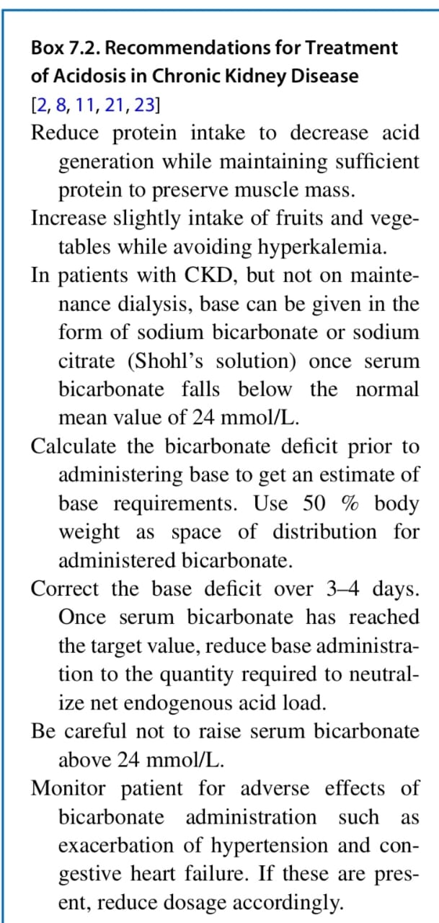
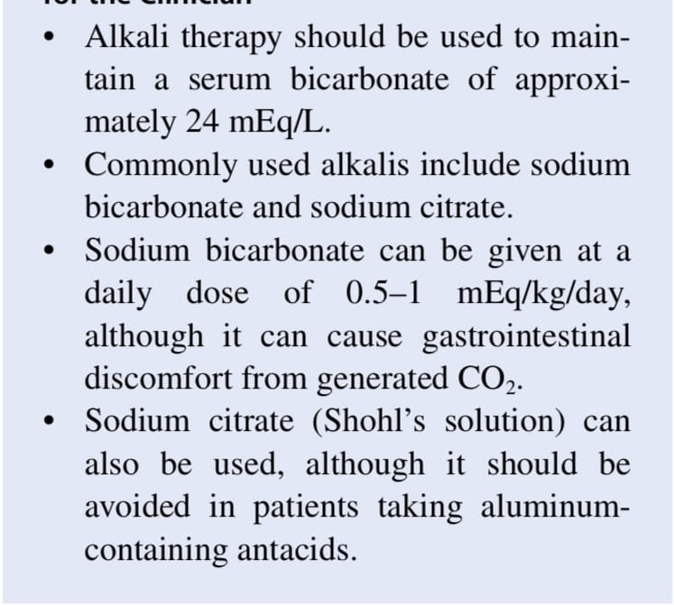
Metabolic acidosis

Slide 30
Anemia
Iron Therapy
Setting | Definition of Iron Deficiency (KDIGO) | Treatment
CKD (general) | TSAT <30%, Ferritin <500 ng/mL | Start iron first
Non-dialysis CKD | Same | Oral iron: Ferrous sulfate 200 mg TID; if intolerant → IV iron
Dialysis CKD | Same | IV iron preferred
ESA (Erythropoiesis-Stimulating Agents)
Indication | Agents & Doses | Avoid
Start when Hb <10 g/dL and iron replete | Epoetin alfa Darbepoetin | Hb >11.5–12 g/dL (↑ stroke & thrombosis risk)

Slide 31
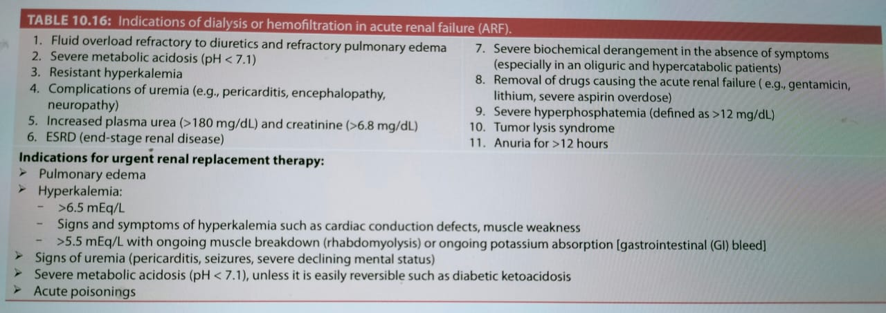
Renal Replacement Therapy

Slide 32
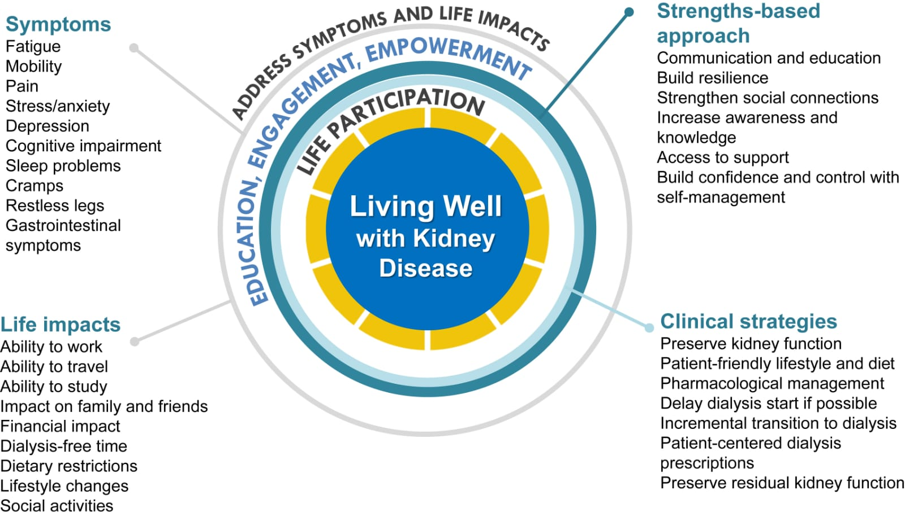
Quality of life (QOL)

Slide 33
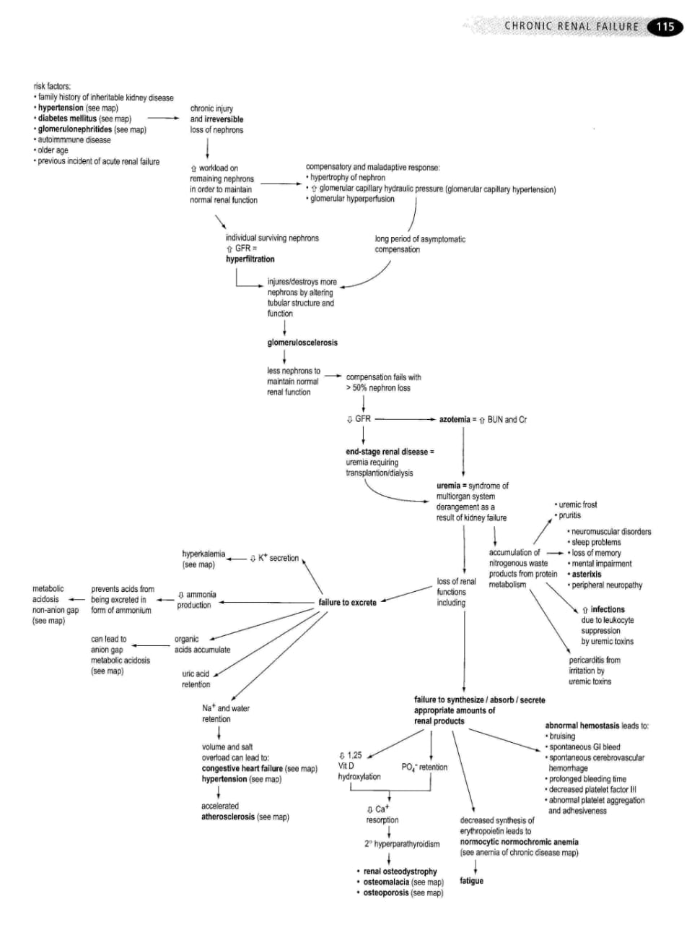

Slide 34


