Slide 1
Clinico-Pathological Conference
Medical Unit III
Dr.Farhat Aziz
Dr.Bilal Sarwar

Slide 2
HISTORY OF THE
PATIENT

Slide 3
BIODATA
Name: Ghulam Shabir
Son of Allah Dad
Age: 45 years
Marital Status : Married
Muslim
Occupation: Driver
Address : Sheikh Whan Rahim yar khan
MOA: OPD
DOA: 25-11-2025

Slide 4
PRESENTING COMPLAIN
VOMITING FOR 3 DAYS

Slide 5
HISTORY OF PRESENGTING ILLNESS
My patient is a known case of diabetes mellitus for 8 years , initially he was on oral hypoglycemic, then shifted to insulin since last 2 years . He had poor compliance and control.
He was in his usual state of health 3 days back when he developed vomiting. 2 episodes, non projectile , yellowish in color, containing food particles , not foul smelling and half cup in quantity ,no aggravating factor but relieved by antiemetics .It was not preceded by epigastric or right hypochondrial pain or retrosternal burning .

Slide 6
CONTINUED…
Vomiting was not associated with loose stools , fever ,headache , vertigo, blurring of vision, dysphagia ,hematamesis, malena, yellowish discoloration of eyes .
The patient has reduced appetite and also complains episodic flank discomfort without any radiation and colicky nature with no specific relieving and aggravating factor. He has increased urinary frequency ,frothy urine ,nocturia but no dysuria, hematuria, burning micturation.
He also experience calf pain,numbness and burning of feet, but no joint pain, redness, swelling, oral ulcer ,alopecia, photosensitivity.

Slide 7
SYSTEMIC REVIEW
CNS : No history of ALOC,difficulty in speech,rigidity, gait disturbance ,fits or limb weakness.
CVS : No chest pain, SOB, orthopnea, PND, palpitation, or pedal edema
Respiratory : No cough,SOB,wheezing,hemoptysis
Hematological : No fever , bleeding from any site of body,lupms and bumps in body or bony pain

Slide 8
PAST MEDICAL HISTORY
Patient was diagnosed to be diabetic 8 years back based on symptoms of polyuria, polydipsia and nocturia and investigations.
He was started on oral hypoglycemics that were continued for 6 years but he had poor compliance and diabetes was poorly controlled.
Due to poor control of diabetes and worsening of symptoms INSULIN 70-30 was started 2 years back.
Since last 1 year he is taking neither oral drugs nor insulin
Patient developed gradual blurring of near vision since last 5 months
But no history of MI, Stroke.

Slide 9
PAST SURGICAL HISTORY
      NOT Significant
FAMILY HISTORY
NO history of such illness in family, DM ,HTN, Asthma, epilepsy
All family members are alive and healthy.
PERSONAL HISTORY
Patient is naswar addict since last 1 year .
No smoking, alchol abuse, any drug allergy.
Sleep is normal with decreased apetite.
Bladder and bowel habits are normal.
No weight change

Slide 10
SOCIOECONOMIC HISTORY
Patient is a truck driver . His monthly income is around 25000/- with one family member dependent on him.
Lives in non cemented house in village
Uses tap water for drinking and other routine activities

Slide 11
Differential Diagnosis
Acute gastritis
Diabetic gastroparesis
CKD/DKD

Slide 12
Examination Of The Patient

Slide 13
General Appearance
I have examined a middle aged man of average height and built lying comfortably in bed well oriented with time, place and person ,having IV line in situ.
VITAL SIGNS
B.P = 170/100 mmHg
PULSE= 96 bpm
RR= 14 breaths per min
TEMP= 98F

Slide 14
GENERAL PHYSICAL EXAMINATION
The patient is obviously pale with no clubbing, cyanosis, koilonychias, leuconychia, splinter hemorrhages, palmar erythema, Dupuytren’s contracture, tremors in hands and jaundice.
Orodental hygiene is satisfactory
JVP is not raised
Thyroid was not enlarged
Edema was absent.
All proximal & distal pulses were palpable
There was no lymphadenopathy

Slide 15
ABDOMINAL EXAMINATION
Abdomen flat, moving with respiration
Umbilicus central and inverted
No scars, distension or visible pulsations
No tenderness, rigidity, guarding
No palpable visceromegaly
Upper border of liver in 5th IC space , total span 15cm
Bowel sounds normal .There was no bruit

Slide 16
RESPIRATORY SYSTEM EXAMINATION
Shape of chest is elliptical, with no visible deformity
Trachea central
Normal chest expansion bilaterally
No use of accessory muscles for respiration
Normal vesicular breathing with no added sounds

Slide 17
CVS EXAMINATION
Chest shape was normal , no visible pulsations deformity or scar mark
Apex beat felt in 5th IC space , medial to mid-clavicular line
No thrill or heave palpable
S1 and S2 audible in all respective areas with no added sounds

Slide 18
CNS EXAMINATION
Higher mental functions were intact
GCS 15/15
Speech is normal
Sensory system : All senses intact except sensation of touch which is reduced in L5 S1
Motor system : Normal bulk, tone , power 5/5 in all four limbs . All reflexes were normal except ankle jerk which was absent.
Cranial nerves intact
SOMI negative

Slide 19
INVESTIGATIONS

Slide 20
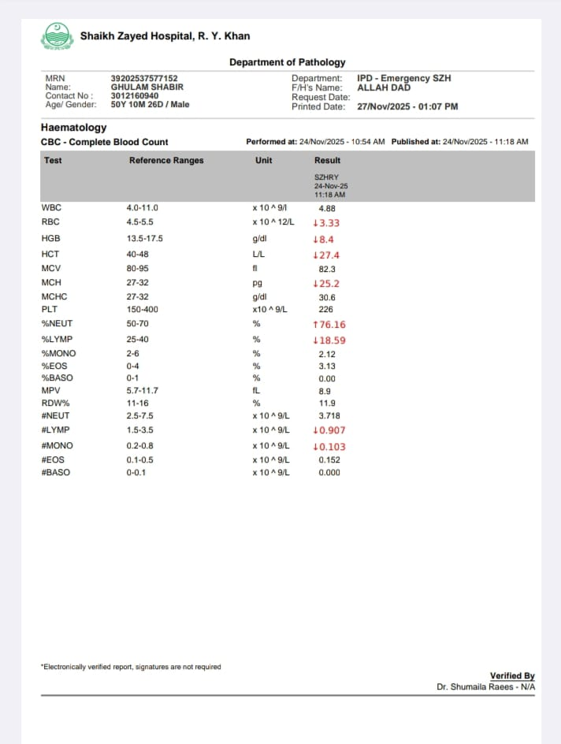

Slide 21
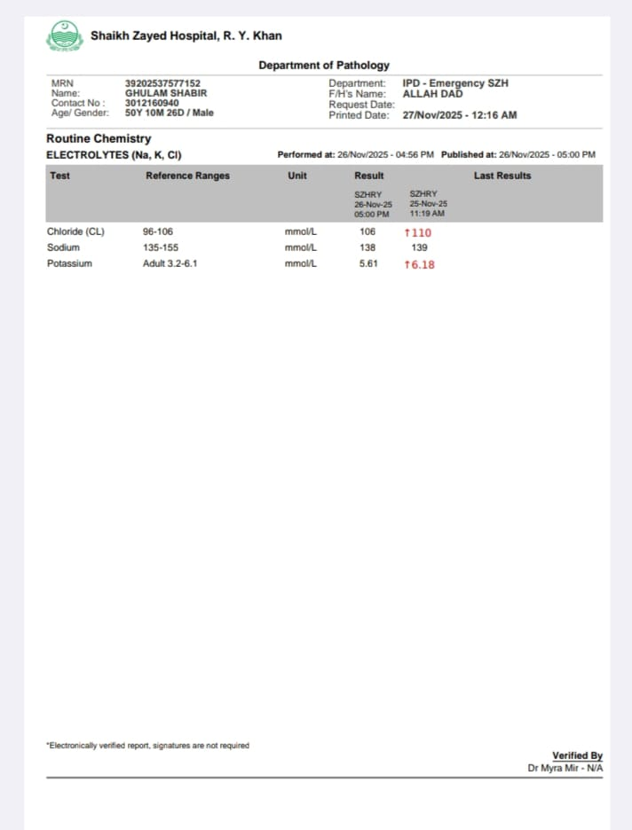

Slide 22
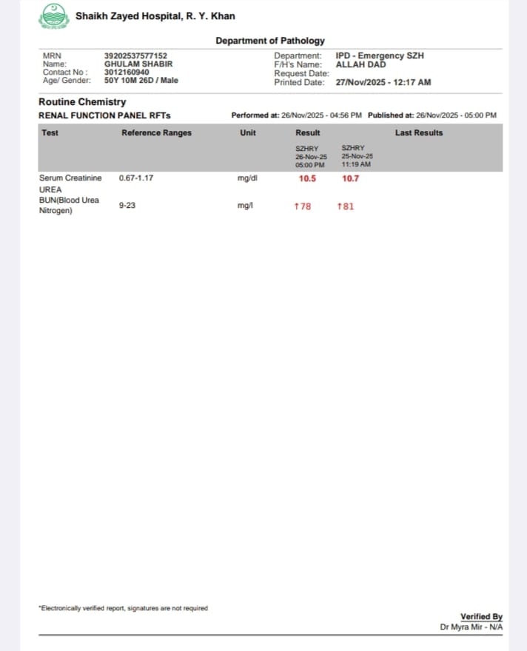

Slide 23
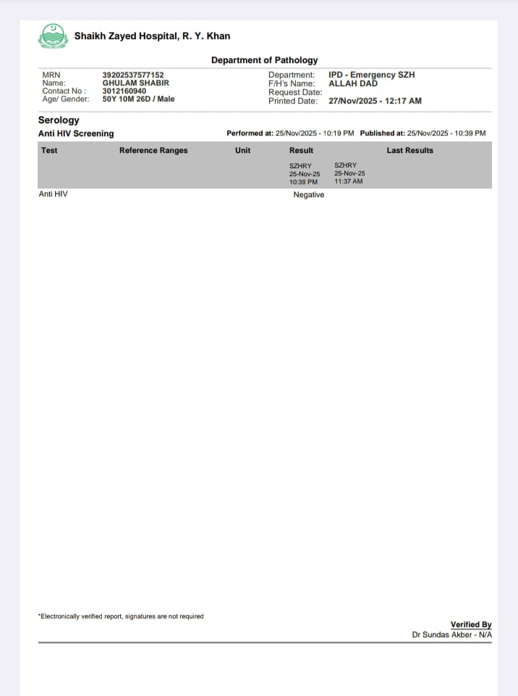

Slide 24
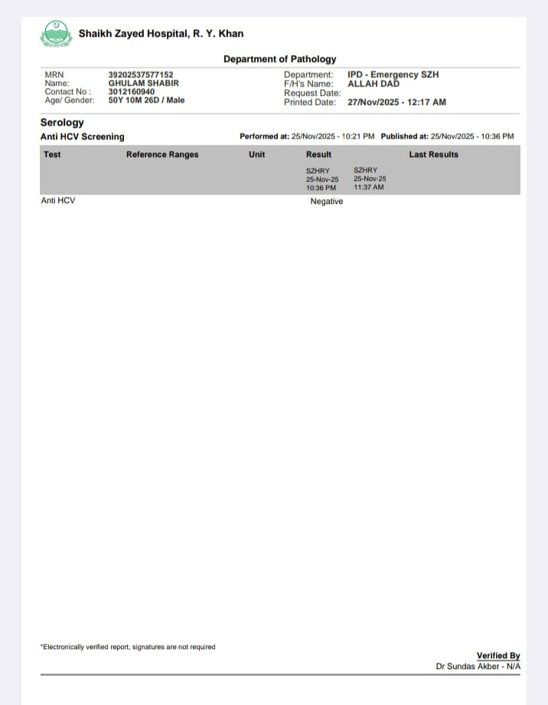

Slide 25
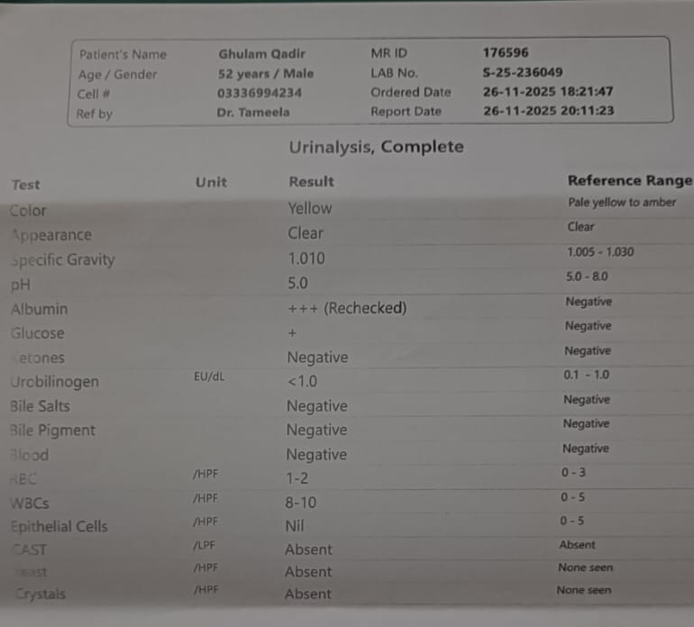

Slide 26
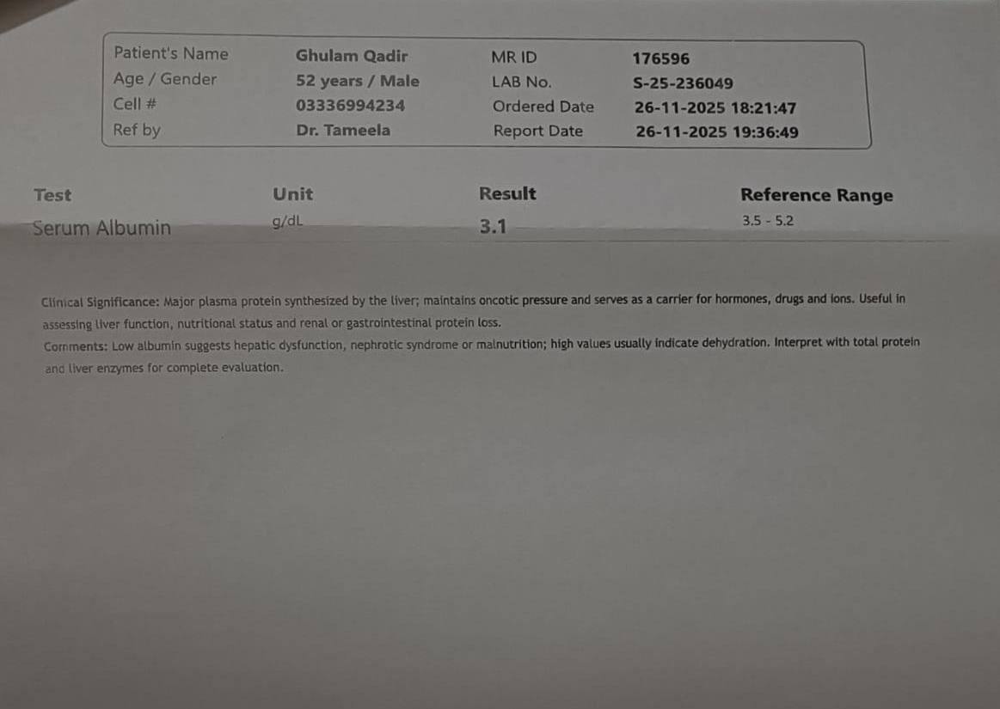

Slide 27
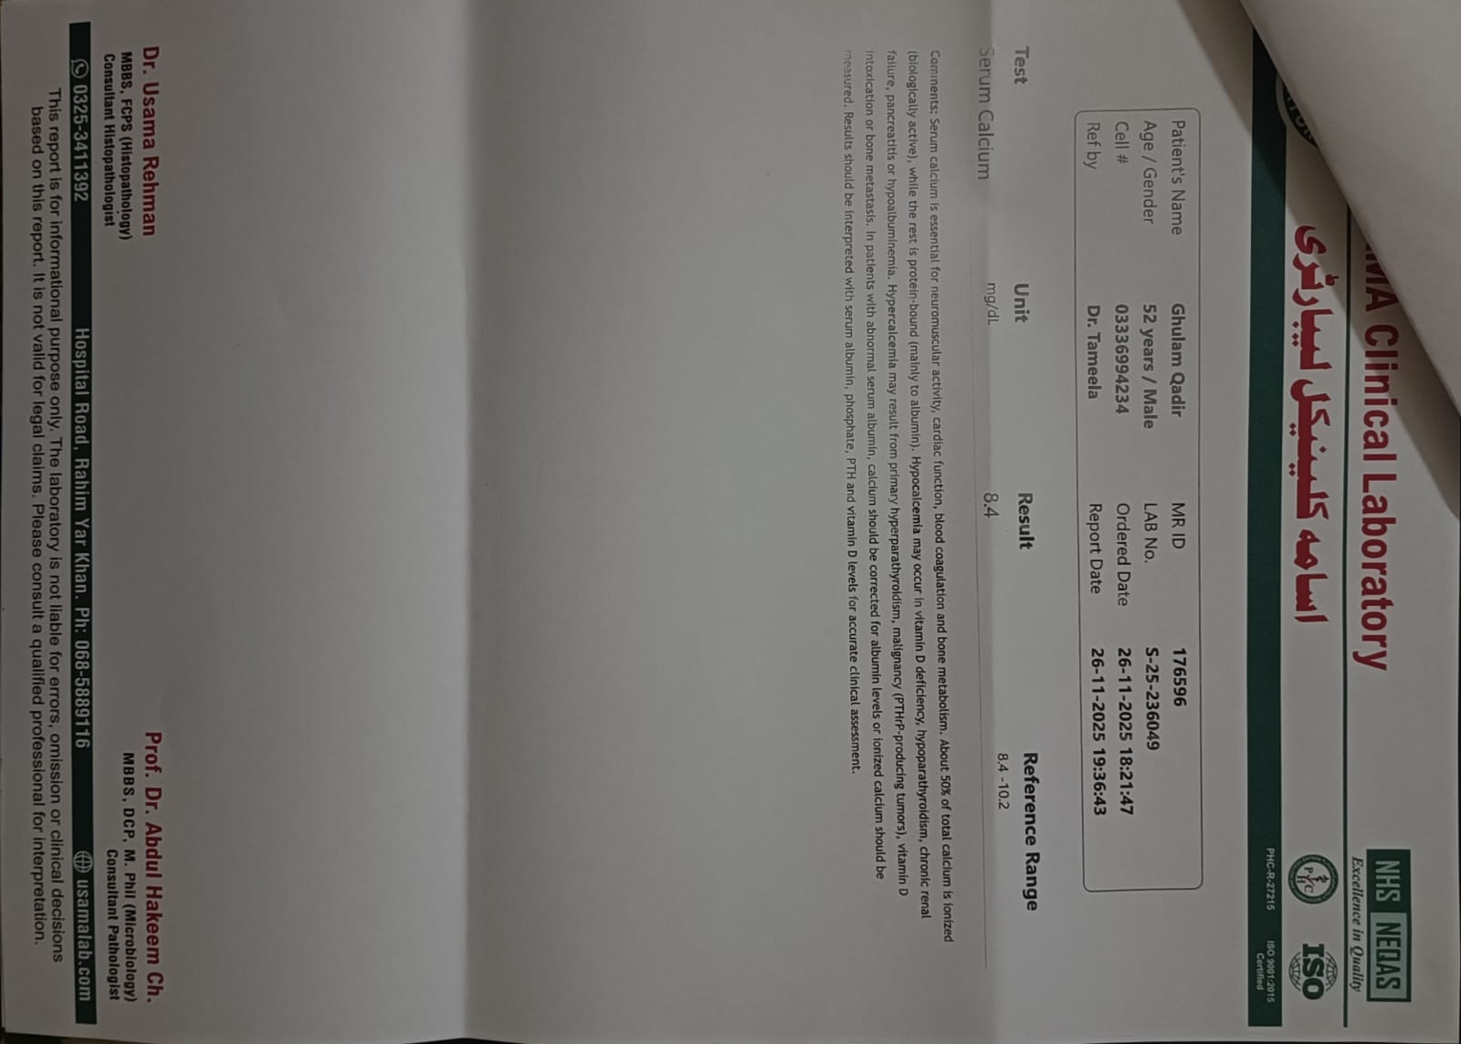
Corrected Ca=Serum Ca+0.8(4-Serum Albumin)
Corrected Ca= 9.12

Slide 28
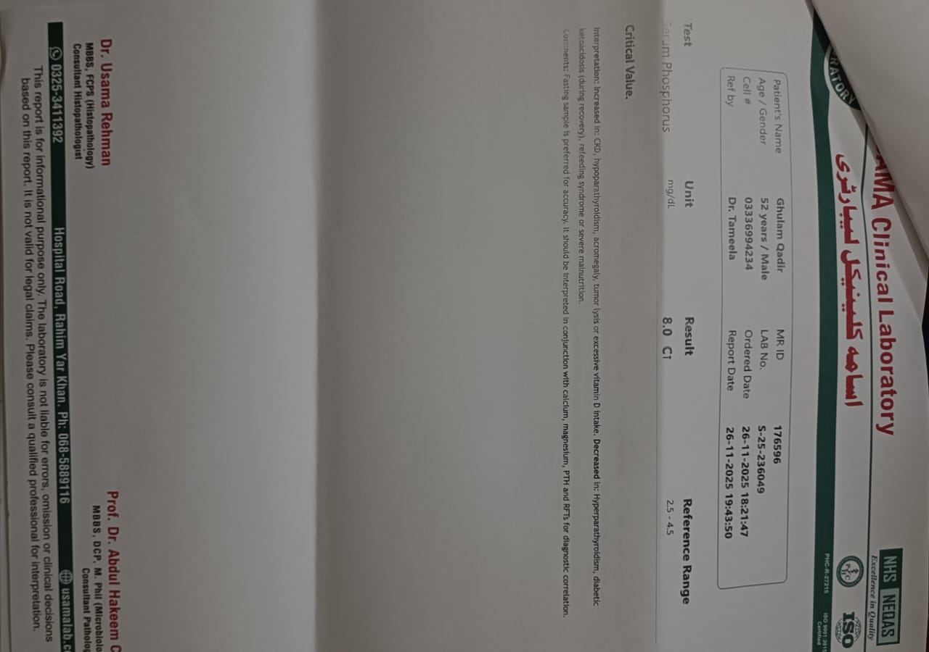

Slide 29
