Slide 1
CHRONIC MYELOID LEUKEMIA

Slide 2
Definition
Myeloproliferative neoplasm
Clonal expansion of myeloid lineage cells in the bone marrow, peripheral blood and extramedullary sites
Oncogenic fusion of gene BCR‑ABL1 on chromosome 9 and 22 forming philadelphia chromosome.

Slide 3
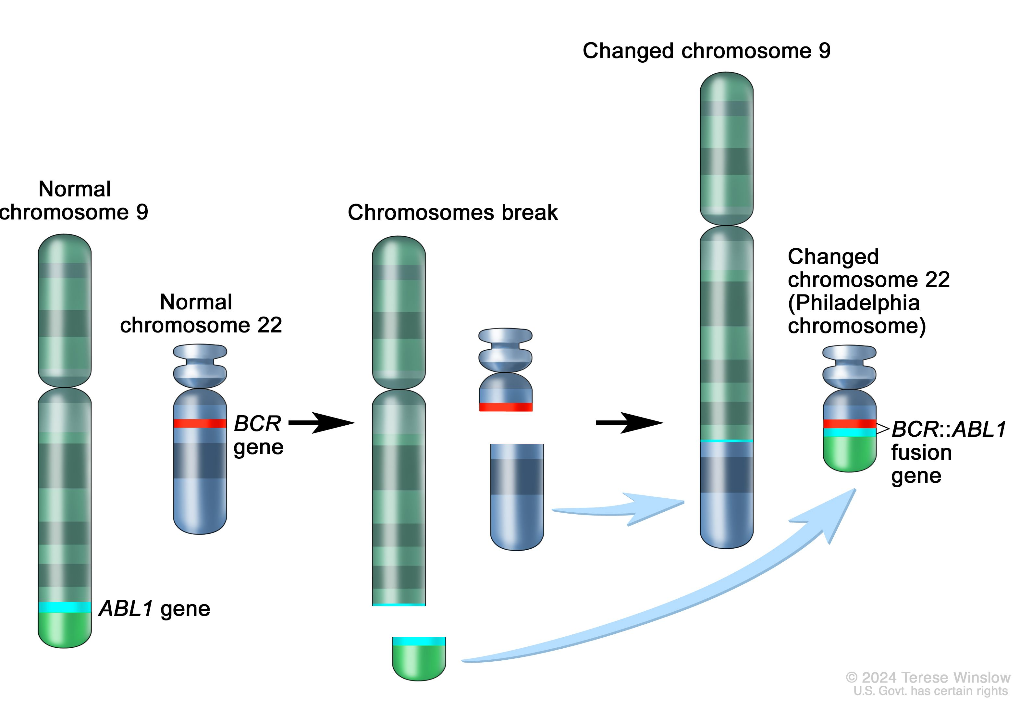
The BCR‑ABL1 fusion protein acts as a tyrosine kinase, driving multiple downstream signalling cascades (JAK/STAT, PI3K/AKT, RAS/MEK, etc) → increased proliferation and reduced apoptosis of leukemic progenitor cells.

Slide 4
Clinical Features
Median age 55–65 years.
Often asymptomatic
Common symptoms
Fever
Early satiety and left upper quadrant pain or masses (from splenomegaly).
Fatigue, malaise, weight loss, sweating
Thrombotic or hyperviscosity-related events
Myocardial infarction, venous thrombosis, visual disturbances, dyspnea and pulmonary insufficiency,
cerebrovascular accidents.
Bleeding diatheses include retinal hemorrhages,gastrointestinal bleeding, mucosal bleeding and others.
Physical Findings Splenomegaly(20-70%), hepatomegaly(5–10%), lymphadenopathy (5–10%), and extramedullary disease (skin or subcutaneous lesions).

Slide 5
Complete blood count with Peripheral Morphology and differential.
Myeloid progenitor stem cell
CFU-Erythroid
CFU-GM
CFU-MEG
Myeloblast
Myelocyte
Promyelocyte
Metamyelocyte
Band cells
Mature Neutrophills
Leukocytosis (10-500*10^ 9)
Left-shifted hematopoiesis
Blasts (usually ≤5%).
Basophilia and/or eosinophilia
Thrombocytosis
Anemia

Slide 6
Cytogenetic analysis.
karyotyping for t(9;22)(q34;q11.2) – Philadelphia chromosome
Philadelphia chromosome positive” >90% cases
Fluorescence in situ hybridization (FISH).
Reverse transcription–polymerase chain reaction (RT-PCR)
The most sensitive technique currently available
Additional: LDH, uric acid, liver/renal/TSH, viral serologies including hepatitis B, pregnancy in reproductive age, baseline comorbidities for TKI planning.

Slide 7
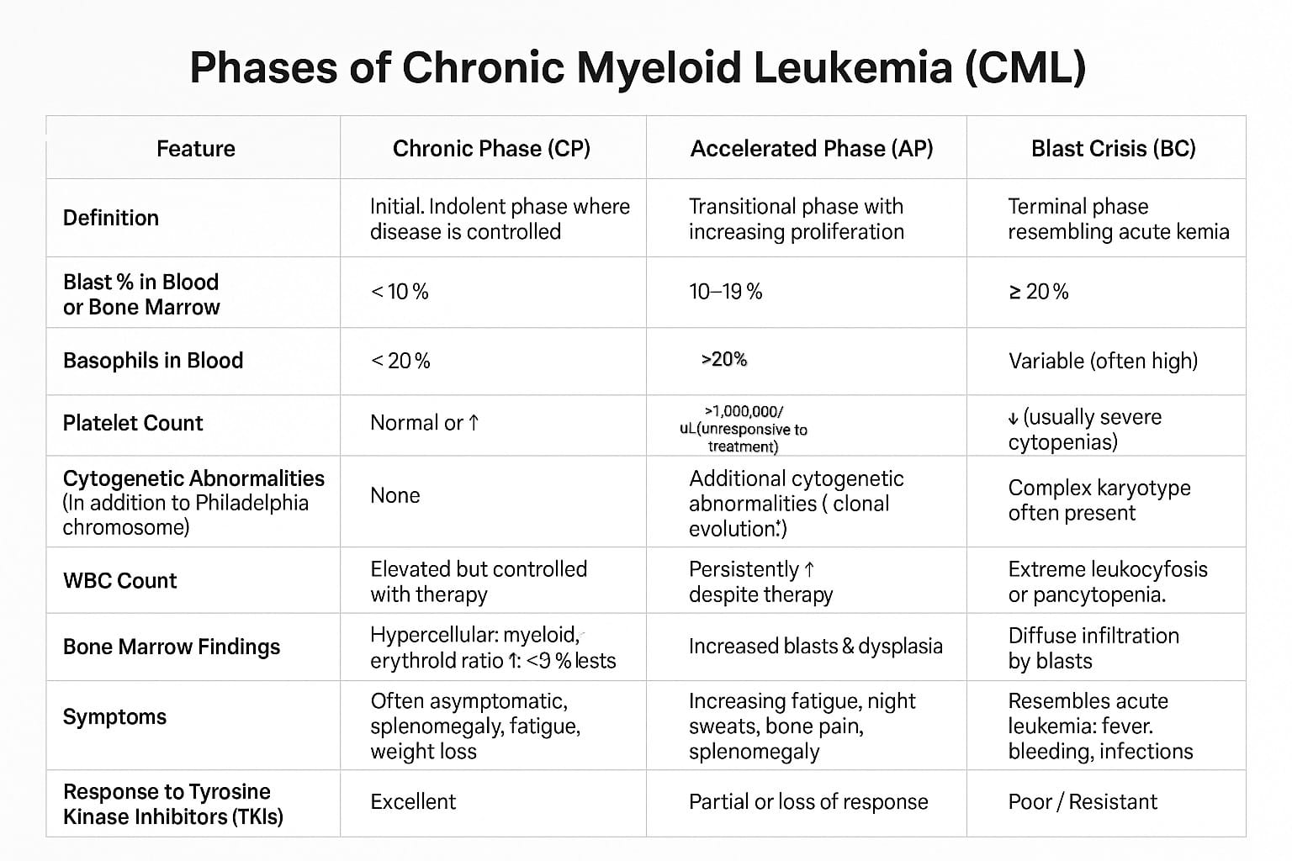

Slide 8
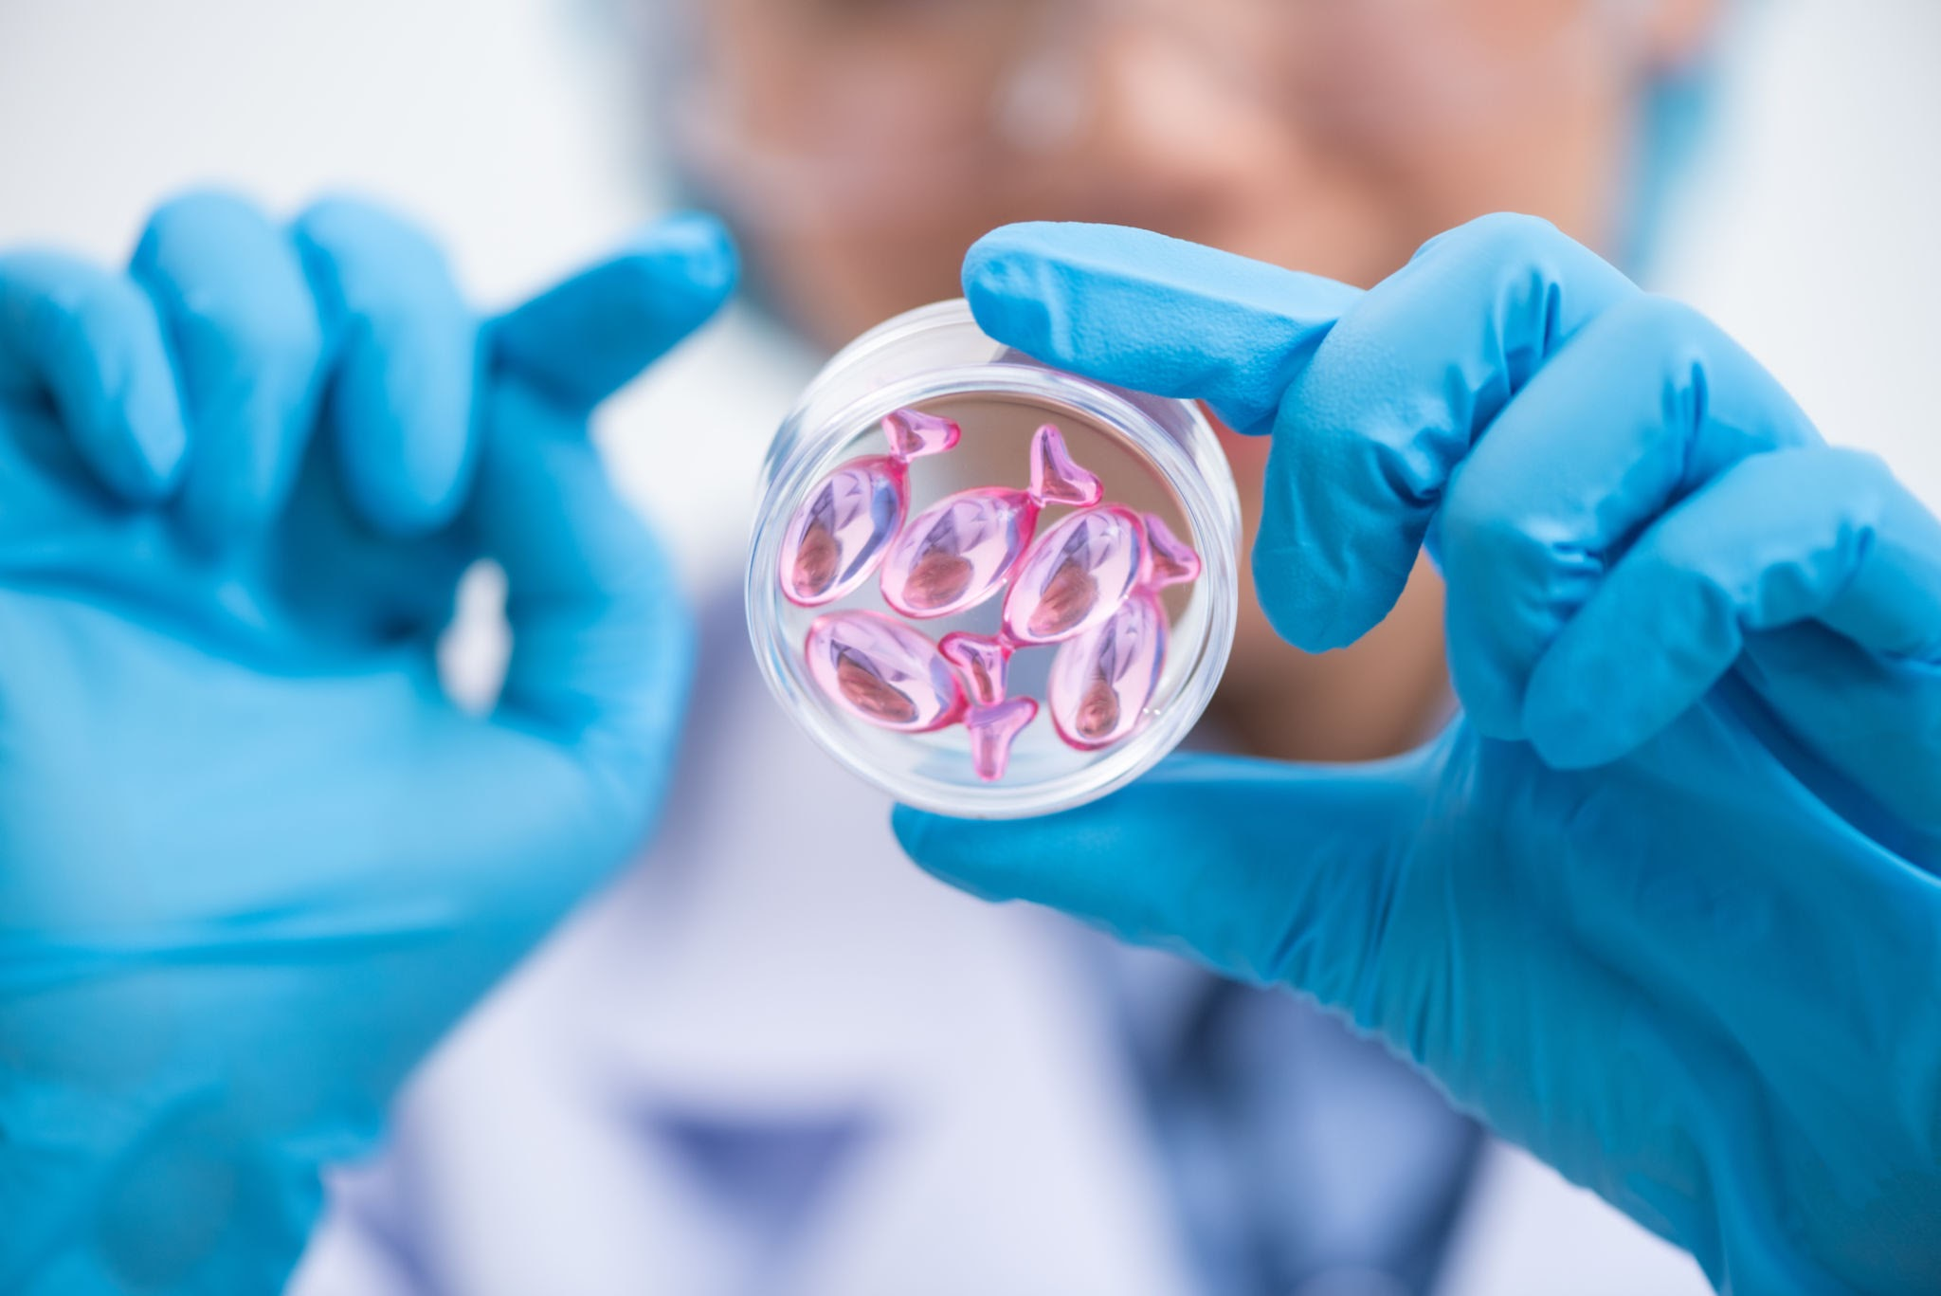
Treatment of CML

Slide 9
The goals of treatment
1. Hematologic remission (normal [CBC] and physical examination (ie, no organomegaly)
2. Cytogenetic remission (normal chromosome returns with 0% Philadelphia chromosome–positive (Ph+) cells)
3. Molecular remission (negative BCR::ABL mRNA),
which represents an attempt for cure and prolongation of patient survival

Slide 10
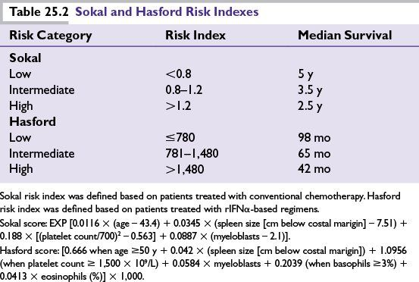

Slide 11
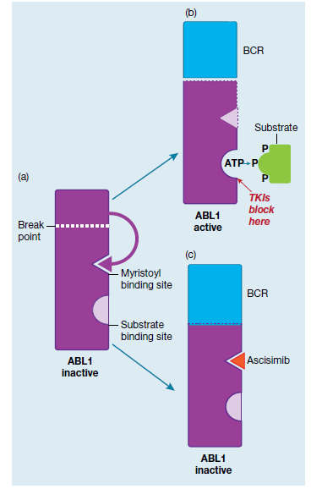
Tyrosine Kinase Inhibitors
(TKIs: imatinib, nilotinib, dasatinib,
ponatinib, bosutinib) and asciminib.

Slide 12
Treatment of Chronic Phase
For low-risk patients, any of the following may be used for first-line treatment
Imatinib, 400 mg PO daily
Nilotinib, 300 mg PO twice a day (Tasigna) or 142 mg twice a day (Danziten)
Dasatinib, 100 mg PO daily
Bosutinib 400 mg PO once daily

Slide 13
For intermediate- or high-risk patients, bosutinib, dasatinib or nilotinib is preferred over imatinib; dosages are the same as for low-risk patients.
allogeneic hematopoietic stem cell transplantation (HCT) is not recommended as first-line treatment for CP-CML.

Slide 14
For the rare patient who is intolerant to those TIKIs,
Bosutinib 400 mg PO once daily or
Ponatinib 45 mg PO once daily

Slide 15
The following options can be alternatives:
Pegylated (PEG)-interferon alfa-2a 450 mcg SC weekly or
PEG-interferon alfa-2b 6 mcg/kg SC weekly or
Hematopoietic stem cell transplantation

Slide 16
Treatment of Accelerated Phase
Higher doses or stronger agents may be needed
( nilotinib, dasatinib, bosutinib).
Allogeneic haematopoietic stem cell transplant (allo‑HSCT)if suboptimal response to TKI.
Closer monitoring, and if progression is seen, switch therapy promptly.

Slide 17
Treatment of Blast Phase
As stated above, blast phase behaves like an acute leukemia (either AML‑type or ALL‑type depending on blast lineage).
Treatment approach: combination of intensive chemotherapy (AML or ALL type) + TKI, followed by allo‑HSCT if remission achieved.
Prognosis remains guarded compared to CP; early transplant improves outcomes.

Slide 18
Monitoring response to TKI therapy
Complete hematologic response
Normalization of blood count, with white blood cell count < 10,000/μL and platelet count < 450,000/μL
Normal peripheral blood smear with no immature cells (eg, promyelocytes, myelocytes, blasts)
Absence of disease symptoms and palpable splenomegaly

Slide 19
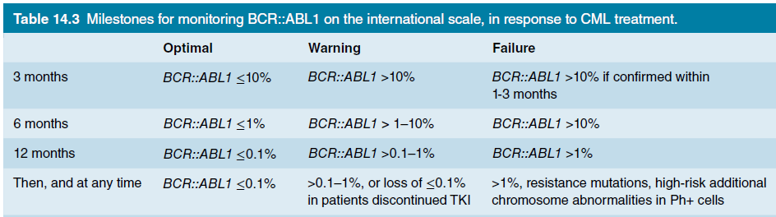
Monitoring and Follow‑Up

Slide 20
Treatment of TKI Resistance / Intolerance
If a patient fails first‑line therapy (due to resistance, intolerance or suboptimal response)
Switch to a different TKI (consider mutation profile).
For kinase‑domain mutation T315I, the 3rd generation TKI ponatinib is indicated
Emerging agents: asciminib (an allosteric inhibitor of BCR‑ABL1) for heavily pre‑treated/resistant patients.
HSCT remains a key salvage option in resistant disease.

Slide 21
Drugs | Side effects
Imatinib 400mg daily | Rash, nausea, myelosuppression, fluid retention, muscle cramps
Nilotinib 300mg daily | Myelosuppression, peripheral vascular disease, headache, nausea, prolonged QT
Dasatinib 100mg daily | Headache, pleural effusion, pulmonary hypertension, cough, prolonged QT interval
Bosutinib 400mg daily | Diarrhoea, liver test abnormalities, nausea, low platelet count. Prolonged QT interval
Ponatinib 45mg daily | Low platelets, rash, dry skin, arterial and venous thrombosis
Asciminib | Rash, gastrointestinal upset, low counts

Slide 22
Thank you

